Slide 1
143A: Principles of Operating Systems
Lecture 4: Calling conventions
Anton Burtsev
October, 2017

Slide 2
Recap from last time

Slide 3
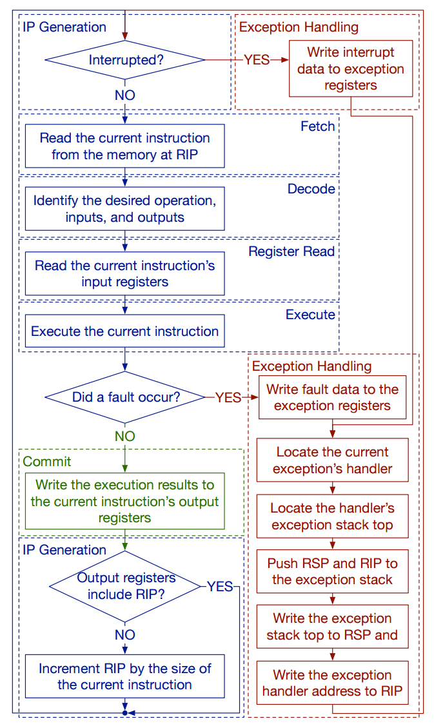
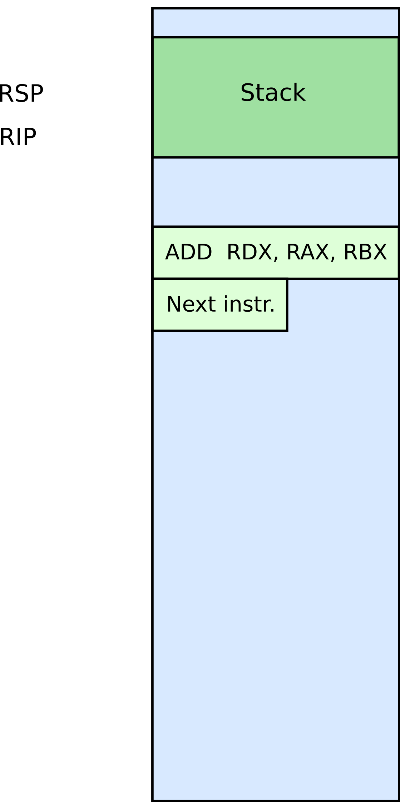

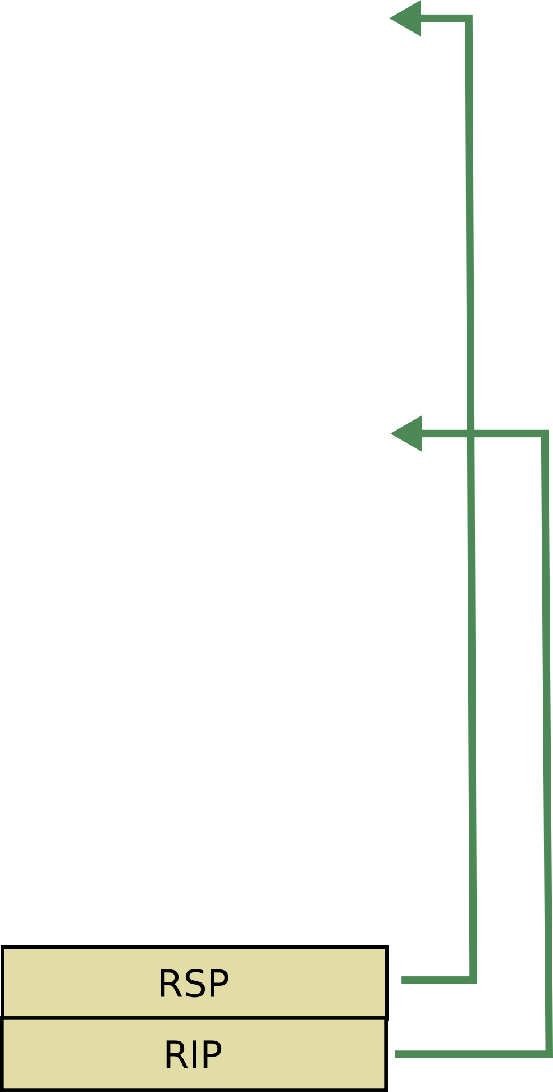




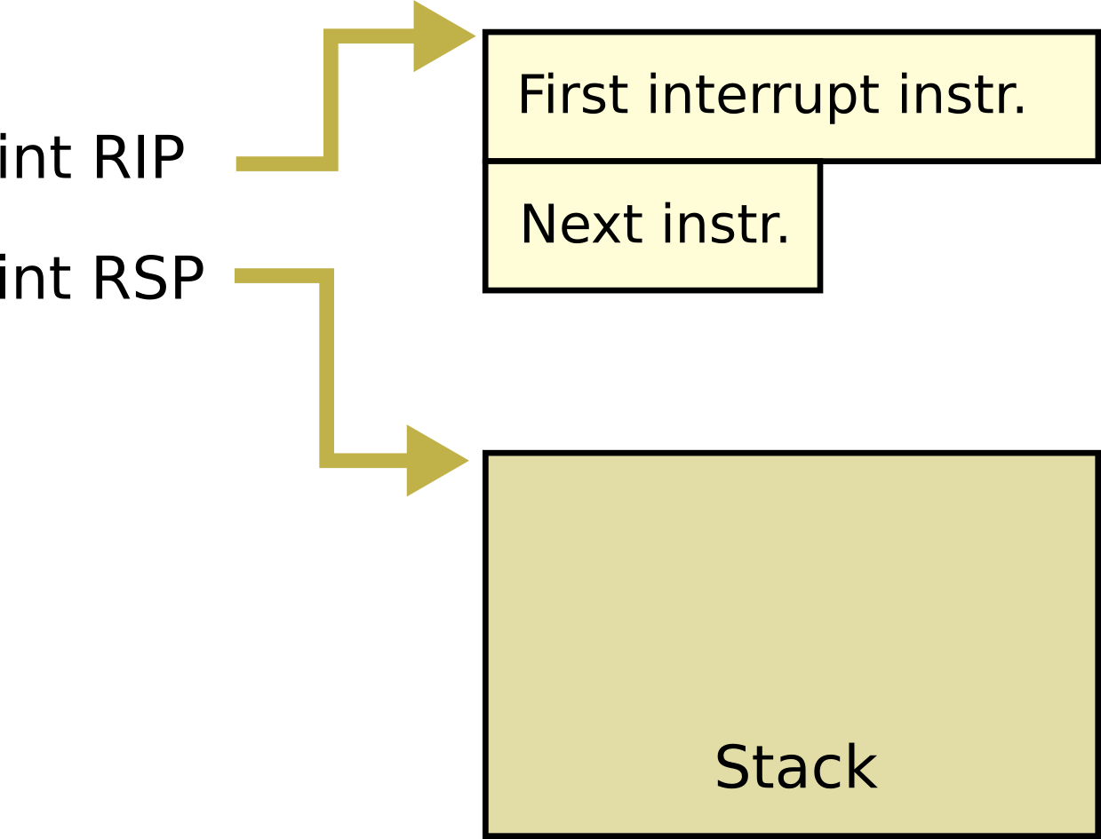

Slide 4
Stack and procedure calls

Slide 5
What is stack?

Slide 6


Stack
It's just a region of memory
  Pointed by a special register ESP
You can change ESP
  Get a new stack

Slide 7
Why do we need stack?

Slide 8
Calling functions
// some code...
foo();
// more code..
Stack contains information for how to return from a subroutine
  i.e., foo()

Slide 9





Stack
Main purpose:
  Store the return address for the current procedure
  Caller pushes return address on the stack
  Callee pops it and jumps

Slide 10
Stack
Main purpose:
  Store the return address for the current procedure
  Caller pushes return address on the stack
  Callee pops it and jumps

Slide 11
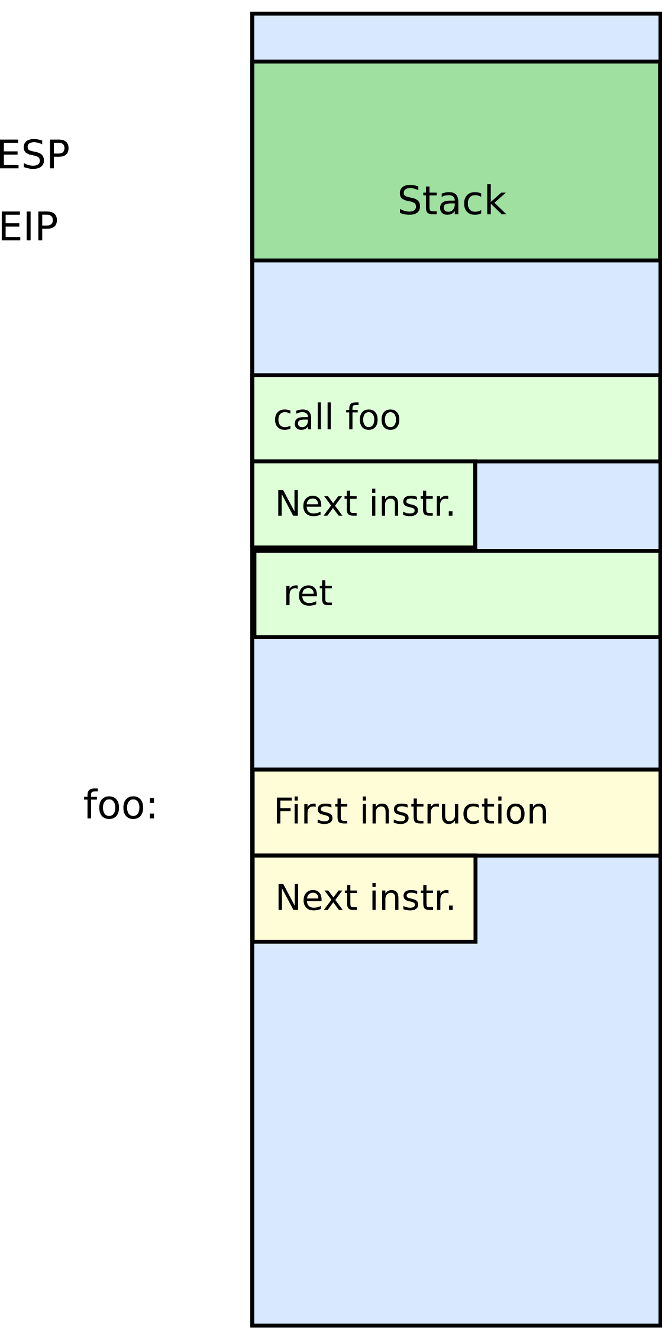
Stack
Other uses:
  Local data storage
  Parameter passing
  Evaluation stack
    Register spill

Slide 12
Call/return
CALL instruction
  Makes an unconditional jump to a subprogram and pushes the address of the next instruction on the stack
push eip + sizeof(CALL); save return
; address
jmp _my_function
RET instruction
  Pops off an address and jumps to that address

Slide 13
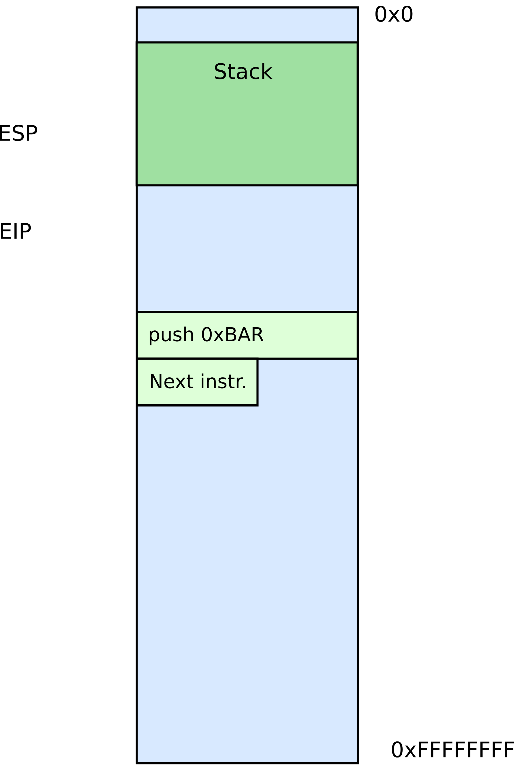


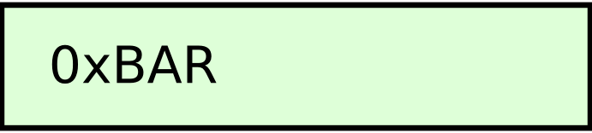
Manipulating stack
ESP register
  Contains the memory address of the topmost element in the stack
PUSH instruction
push 0xBAR
  Insert data on the stack
  Subtract 4 from ESP

Slide 14

Manipulating stack
POP instruction
pop EAX
  Removes data from the stack
  Saves in register or memory
  Adds 4 to ESP

Slide 15
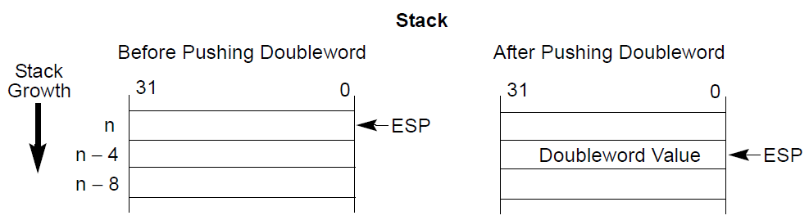
Example: PUSH

Slide 16
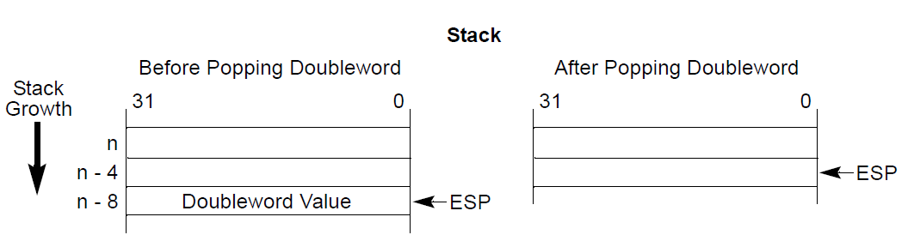
Example: POP

Slide 17
Calling conventions

Slide 18
Calling conventions
Goal: reentrant programs
  How to pass arguments
    On the stack?
    In registers?
  How to return values
    On the stack?
    In registers?
Conventions differ from compiler, optimizations, etc.

Slide 19

Stack consists of frames
Each function has a new frame
void DrawSquare(...)
{
...
DrawLine(x, y, z);
}
Use dedicated register EBP (frame pointer)
  Points to the base of the frame

Slide 20
Stack consists of frames
Each function has a new frame
void DrawSquare(...)
{
...
DrawLine(x, y, z);
}
Use dedicated register EBP (frame pointer)
  Points to the base of the frame

Slide 21
Stack consists of frames
Each function has a new frame
void DrawSquare(...)
{
...
DrawLine(x, y, z);
}
Use dedicated register EBP (frame pointer)
  Points to the base of the frame

Slide 22
Prologue/epilogue
Each function maintains the frame
  A dedicated register EBP is used to keep the frame pointer
  Each function uses prologue code (blue), and epilogue (yellow) to maintain the frame
my_function:
push ebp ; save original EBP value on stack
mov ebp, esp ; new EBP = ESP
…. ; function body
pop ebp ; restore original EBP value
ret

Slide 23
How to allocate local variables?
void my_function()
{
int a, b, c;
…
}

Slide 24
Allocating local variables
On the stack!
Each function has private instances of local variables
Can call recursively
foo(int x) {
int a, b, c;
a = x + 1;
if ( a < 100 )
foo(a);
return;
}

Slide 25
Allocating local variables
Stored right after the saved EBP value in the stack
Allocated by subtracting the number of bytes required from ESP
_my_function:
push ebp ; save original EBP value on stack
mov ebp, esp ; new EBP = ESP
sub esp, LOCAL_BYTES ; = # bytes needed by locals
… ; function body
mov esp, ebp ; deallocate locals
pop ebp ; restore original EBP value
ret

Slide 26
Example
void my_function() {
int a, b, c;
…
_my_function:
push ebp ; save the value of ebp
mov ebp, esp ; ebp = esp, set ebp to be top of the stack (esp)
sub esp, 12 ; move esp down to allocate space for the
; local variables on the stack
With frames local variables can be accessed by dereferencing EBP
mov [ebp - 4], 10 ; location of variable a
mov [ebp - 8], 5 ; location of b
mov [ebp - 12], 2 ; location of c

Slide 27
Example
void my_function() {
int a, b, c;
…
_my_function:
push ebp ; save the value of ebp
mov ebp, esp ; ebp = esp, set ebp to be top of the stack (esp)
sub esp, 12 ; move esp down to allocate space for the
; local variables on the stack
With frames local variables can be accessed by dereferencing EBP
mov [ebp - 4], 10 ; location of variable a
mov [ebp - 8], 5 ; location of b
mov [ebp - 12], 2 ; location of c

Slide 28
Example
void my_function() {
int a, b, c;
…
_my_function:
push ebp ; save the value of ebp
mov ebp, esp ; ebp = esp, set ebp to be top of the stack (esp)
sub esp, 12 ; move esp down to allocate space for the
; local variables on the stack
With frames local variables can be accessed by dereferencing EBP
mov [ebp - 4], 10 ; location of variable a
mov [ebp - 8], 5 ; location of b
mov [ebp - 12], 2 ; location of c

Slide 29
Example
void my_function() {
int a, b, c;
…
_my_function:
push ebp ; save the value of ebp
mov ebp, esp ; ebp = esp, set ebp to be top of the stack (esp)
sub esp, 12 ; move esp down to allocate space for the
; local variables on the stack
With frames local variables can be accessed by dereferencing EBP
mov [ebp - 4], 10 ; location of variable a
mov [ebp - 8], 5 ; location of b
mov [ebp - 12], 2 ; location of c

Slide 30
How to pass arguments?
Options
  Registers
  On the stack

Slide 31
How to pass arguments?
x86 32 bit
  Pass arguments on the stack
  Return value is in EAX and EDX
x86 64 bit – more registers!
  Pass first 6 arguments in registers
    RDI, RSI, RDX, RCX, R8, and R9
  The rest on the stack
  Return value is in RAX and RDX

Slide 32
x86_32: passing arguments on the stack
Example function
void my_function(int x, int y, int z)
{ … }
Example invocation
my_function(2, 5, 10);
Generated code
push 10
push 5
push 2
call _my_function

Slide 33
Example stack
: :
| 10 | [ebp + 16] (3rd function argument)
| 5 | [ebp + 12] (2nd argument)
| 2 | [ebp + 8] (1st argument)
| RA | [ebp + 4] (return address)
| FP | [ebp] (old ebp value) ← EBP points here
| | [ebp - 4] (1st local variable)
: :
: :
| | [ebp - X] (esp - the current stack pointer)

Slide 34
Example stack
: :
| 10 | [ebp + 16] (3rd function argument)
| 5 | [ebp + 12] (2nd argument)
| 2 | [ebp + 8] (1st argument)
| RA | [ebp + 4] (return address)
| FP | [ebp] (old ebp value) ← EBP points here
| | [ebp - 4] (1st local variable)
: :
: :
| | [ebp - X] (esp - the current stack pointer)

Slide 35
Example stack
: :
| 10 | [ebp + 16] (3rd function argument)
| 5 | [ebp + 12] (2nd argument)
| 2 | [ebp + 8] (1st argument)
| RA | [ebp + 4] (return address)
| FP | [ebp] (old ebp value) ← EBP points here
| | [ebp - 4] (1st local variable)
: :
: :
| | [ebp - X] (esp - the current stack pointer)

Slide 36
Example stack
: :
| 10 | [ebp + 16] (3rd function argument)
| 5 | [ebp + 12] (2nd argument)
| 2 | [ebp + 8] (1st argument)
| RA | [ebp + 4] (return address)
| FP | [ebp] (old ebp value) ← EBP points here
| | [ebp - 4] (1st local variable)
: :
: :
| | [ebp - X] (esp - the current stack pointer)

Slide 37
Example: callee side code
void my_function(int x, int y, int z)
{
int a, b, c;
…
return;
}
_my_function:
push ebp
mov ebp, esp
sub esp, 12 ; allocate local varaibles
; sizeof(a) + sizeof(b) + sizeof(c)
; x = [ebp + 8], y = [ebp + 12], z = [ebp + 16]
; a=[ebp-4]=[esp+8],
; b=[ebp-8]=[esp+4], c=[ebp-12] = [esp]
mov esp, ebp ; deallocate local variables
pop ebp
ret

Slide 38
Example: callee side code
void my_function(int x, int y, int z)
{
int a, b, c;
…
return;
}
_my_function:
push ebp
mov ebp, esp
sub esp, 12 ; allocate local varaibles
; sizeof(a) + sizeof(b) + sizeof(c)
; x = [ebp + 8], y = [ebp + 12], z = [ebp + 16]
; a=[ebp-4]=[esp+8],
; b=[ebp-8]=[esp+4], c=[ebp-12] = [esp]
mov esp, ebp ; deallocate local variables
pop ebp
ret

Slide 39
Example: callee side code
void my_function(int x, int y, int z)
{
int a, b, c;
…
return;
}
_my_function:
push ebp
mov ebp, esp ; ebp = esp
sub esp, 12 ; allocate local varaibles
; sizeof(a) + sizeof(b) + sizeof(c)
; x = [ebp + 8], y = [ebp + 12], z = [ebp + 16]
; a=[ebp-4]=[esp+8],
; b=[ebp-8]=[esp+4], c=[ebp-12] = [esp]
mov esp, ebp ;deallocate local variables (esp = ebp)
pop ebp
ret

Slide 40
Example: caller side code
caller:
; make new call frame
push ebp
mov ebp, esp
; push call arguments
push 3
push 2
push 1
; call subroutine 'callee'
call callee
; remove arguments from frame
add esp, 12
; use subroutine result
add eax, 5
; restore old call frame
pop ebp
; return
ret
int callee(int, int, int);
int caller(void)
{
int ret;
ret = callee(1, 2, 3);
ret += 5;
return ret;
}

Slide 41
Example: caller side code
caller:
; make new call frame
push ebp
mov ebp, esp
; push call arguments
push 3
push 2
push 1
; call subroutine 'callee'
call callee
; remove arguments from frame
add esp, 12
; use subroutine result
add eax, 5
; restore old call frame
pop ebp
; return
ret
int callee(int, int, int);
int caller(void)
{
int ret;
ret = callee(1, 2, 3);
ret += 5;
return ret;
}

Slide 42
Back to stack frames, so why do we need them?
… They are not strictly required
GCC compiler option -fomit-frame-pointer can disable them
Don't keep the frame pointer in a register for functions that don't need one. This avoids the instructions to save, set up and restore frame pointers; it also makes an extra register available in many functions. It also makes debugging impossible on some machines.

Slide 43


Referencing args without frames
Initially parameter is
  [ESP + 4]
Later as the function pushes things on the stack it changes, e.g.
  [ESP + 8]

Slide 44
Debugging becomes hard
  As ESP changes one has to manually keep track where local variables are relative to ESP (ESP + 4 or +8)
    Compiler can do this!
    But it's hard for a human
  It's hard to unwind the stack in case of a crash
    To print out a backtrace

Slide 45
And you only save...
A couple instructions required to maintain the stack frame
And 1 register (EBP)
  x32 has 8 registers (and one is ESP)
    So taking another one is 12.5% of register space
    Sometimes its worse it!
  x64 has 16 registers, so it doesn't really matter
That said, GCC sets -fomit-frame-pointer to “on”
  At -O, -O1, -O2 …
  Don't get surprised

Slide 46
Saving and restoring registers

Slide 47
Saving register state across invocations
Processor doesn't save registers
  General purpose, segment, flags
Again, a calling convention is needed
  Agreement on what gets saved by a callee and caller

Slide 48
Saving register state across invocations
Registers EAX, ECX, and EDX are caller-saved
  The function is free to use them
... the rest are callee-saved
  If the function uses them it has to restore them to the original values

Slide 49
In general there multiple calling conventions
  We described cdecl
  Make sure you know what you're doing
  https://en.wikipedia.org/wiki/X86_calling_conventions#List_of_x86_calling_conventions
  It's easy as long as you know how to read the table

Slide 50
Questions?

Slide 51
References
https://en.wikibooks.org/wiki/X86_Disassembly/Functions_and_Stack_Frames
https://en.wikipedia.org/wiki/Calling_convention
https://en.wikipedia.org/wiki/X86_calling_conventions
http://stackoverflow.com/questions/14666665/trying-to-understand-gcc-option-fomit-frame-pointer

