Slide 1
143A: Principles of Operating Systems
Lecture 3: PC Hardware
Anton Burtsev
October, 2017

Slide 2
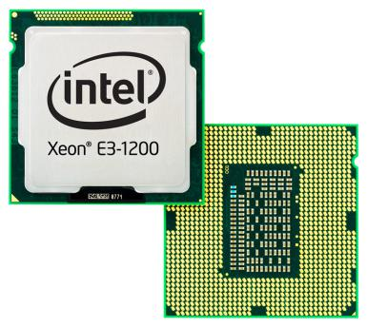
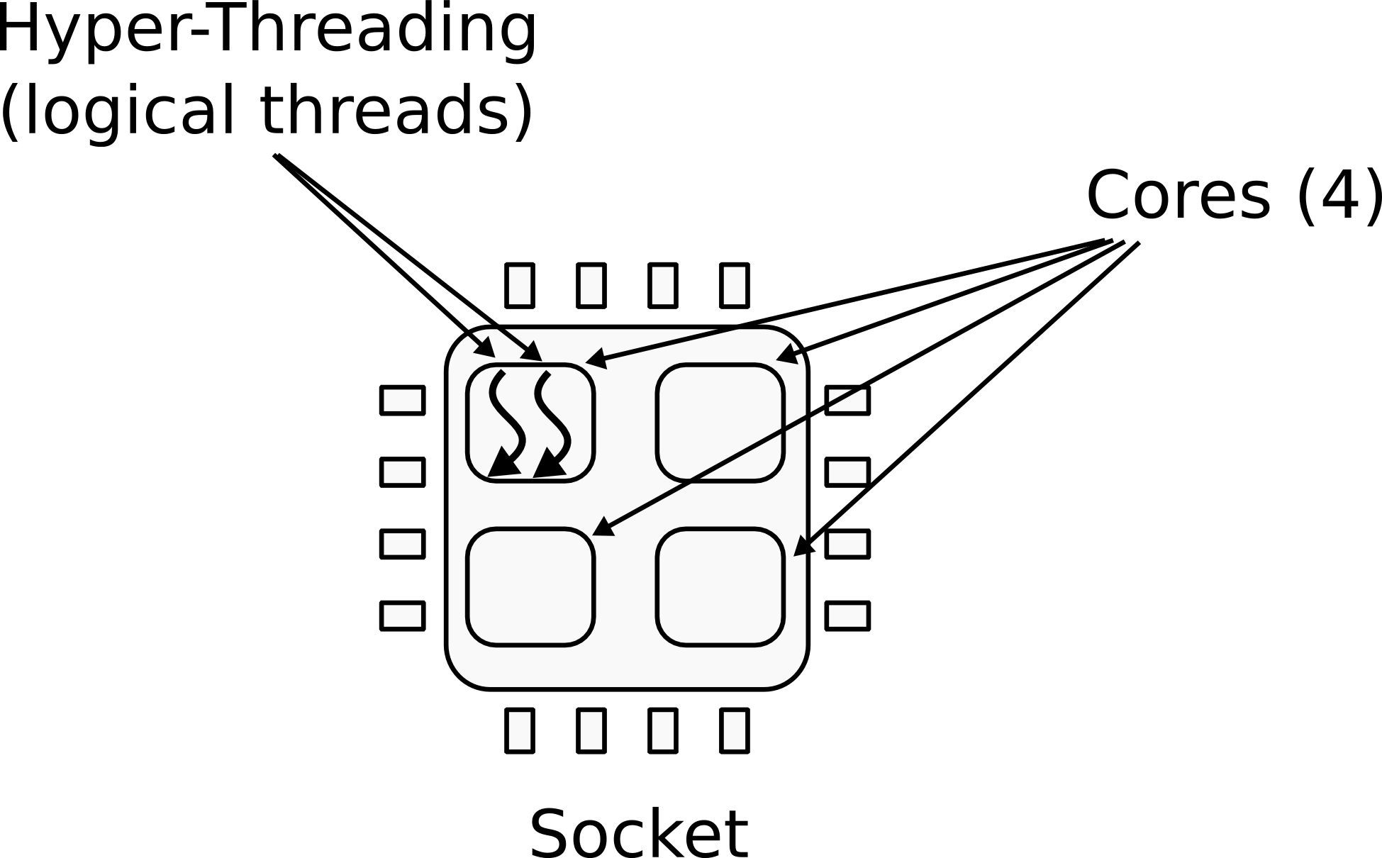
CPU
1 CPU socket
  4 cores
  2 logical (HT) threads each

Slide 3
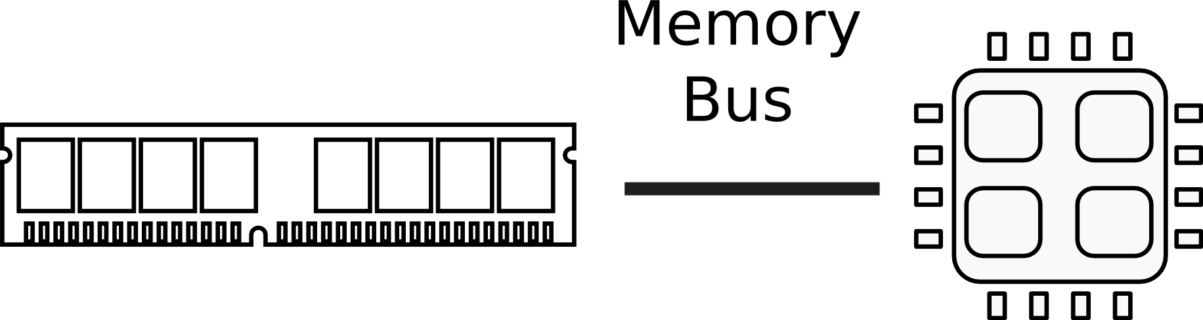
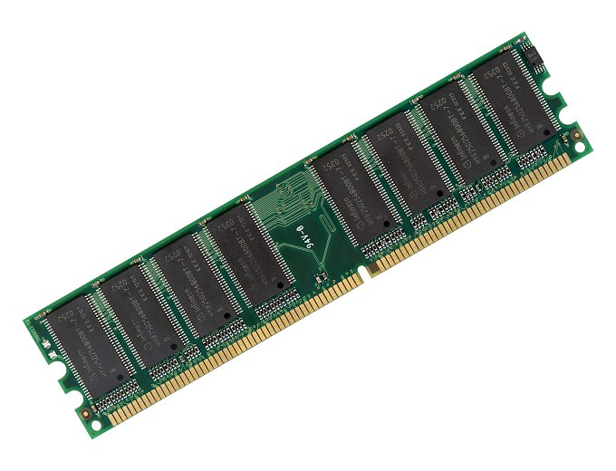
Memory

Slide 4
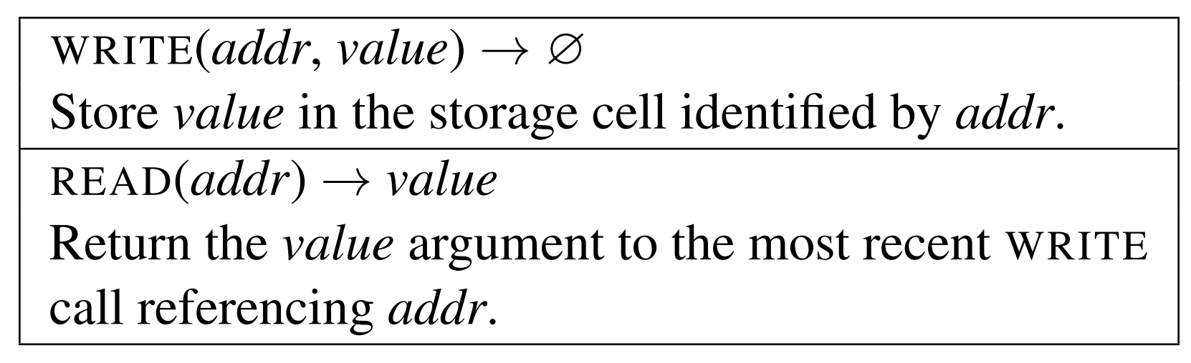
Memory abstraction
x86 assembly examples:
mov eax, [ebx] ; Move 4 bytes in memory at the address contained in EBX into EAX
mov [var], ebx ; Move the contents of EBX into the 4 bytes at memory address var.
mov eax, [esi-4] ; Move 4 bytes at memory address ESI + (-4) into EAX
mov [esi+eax], cl ; Move the contents of CL into the byte at address ESI+EAX
mov edx, [esi+4*ebx] ; Move the 4 bytes of data at address ESI+4*EBX into EDX

Slide 5
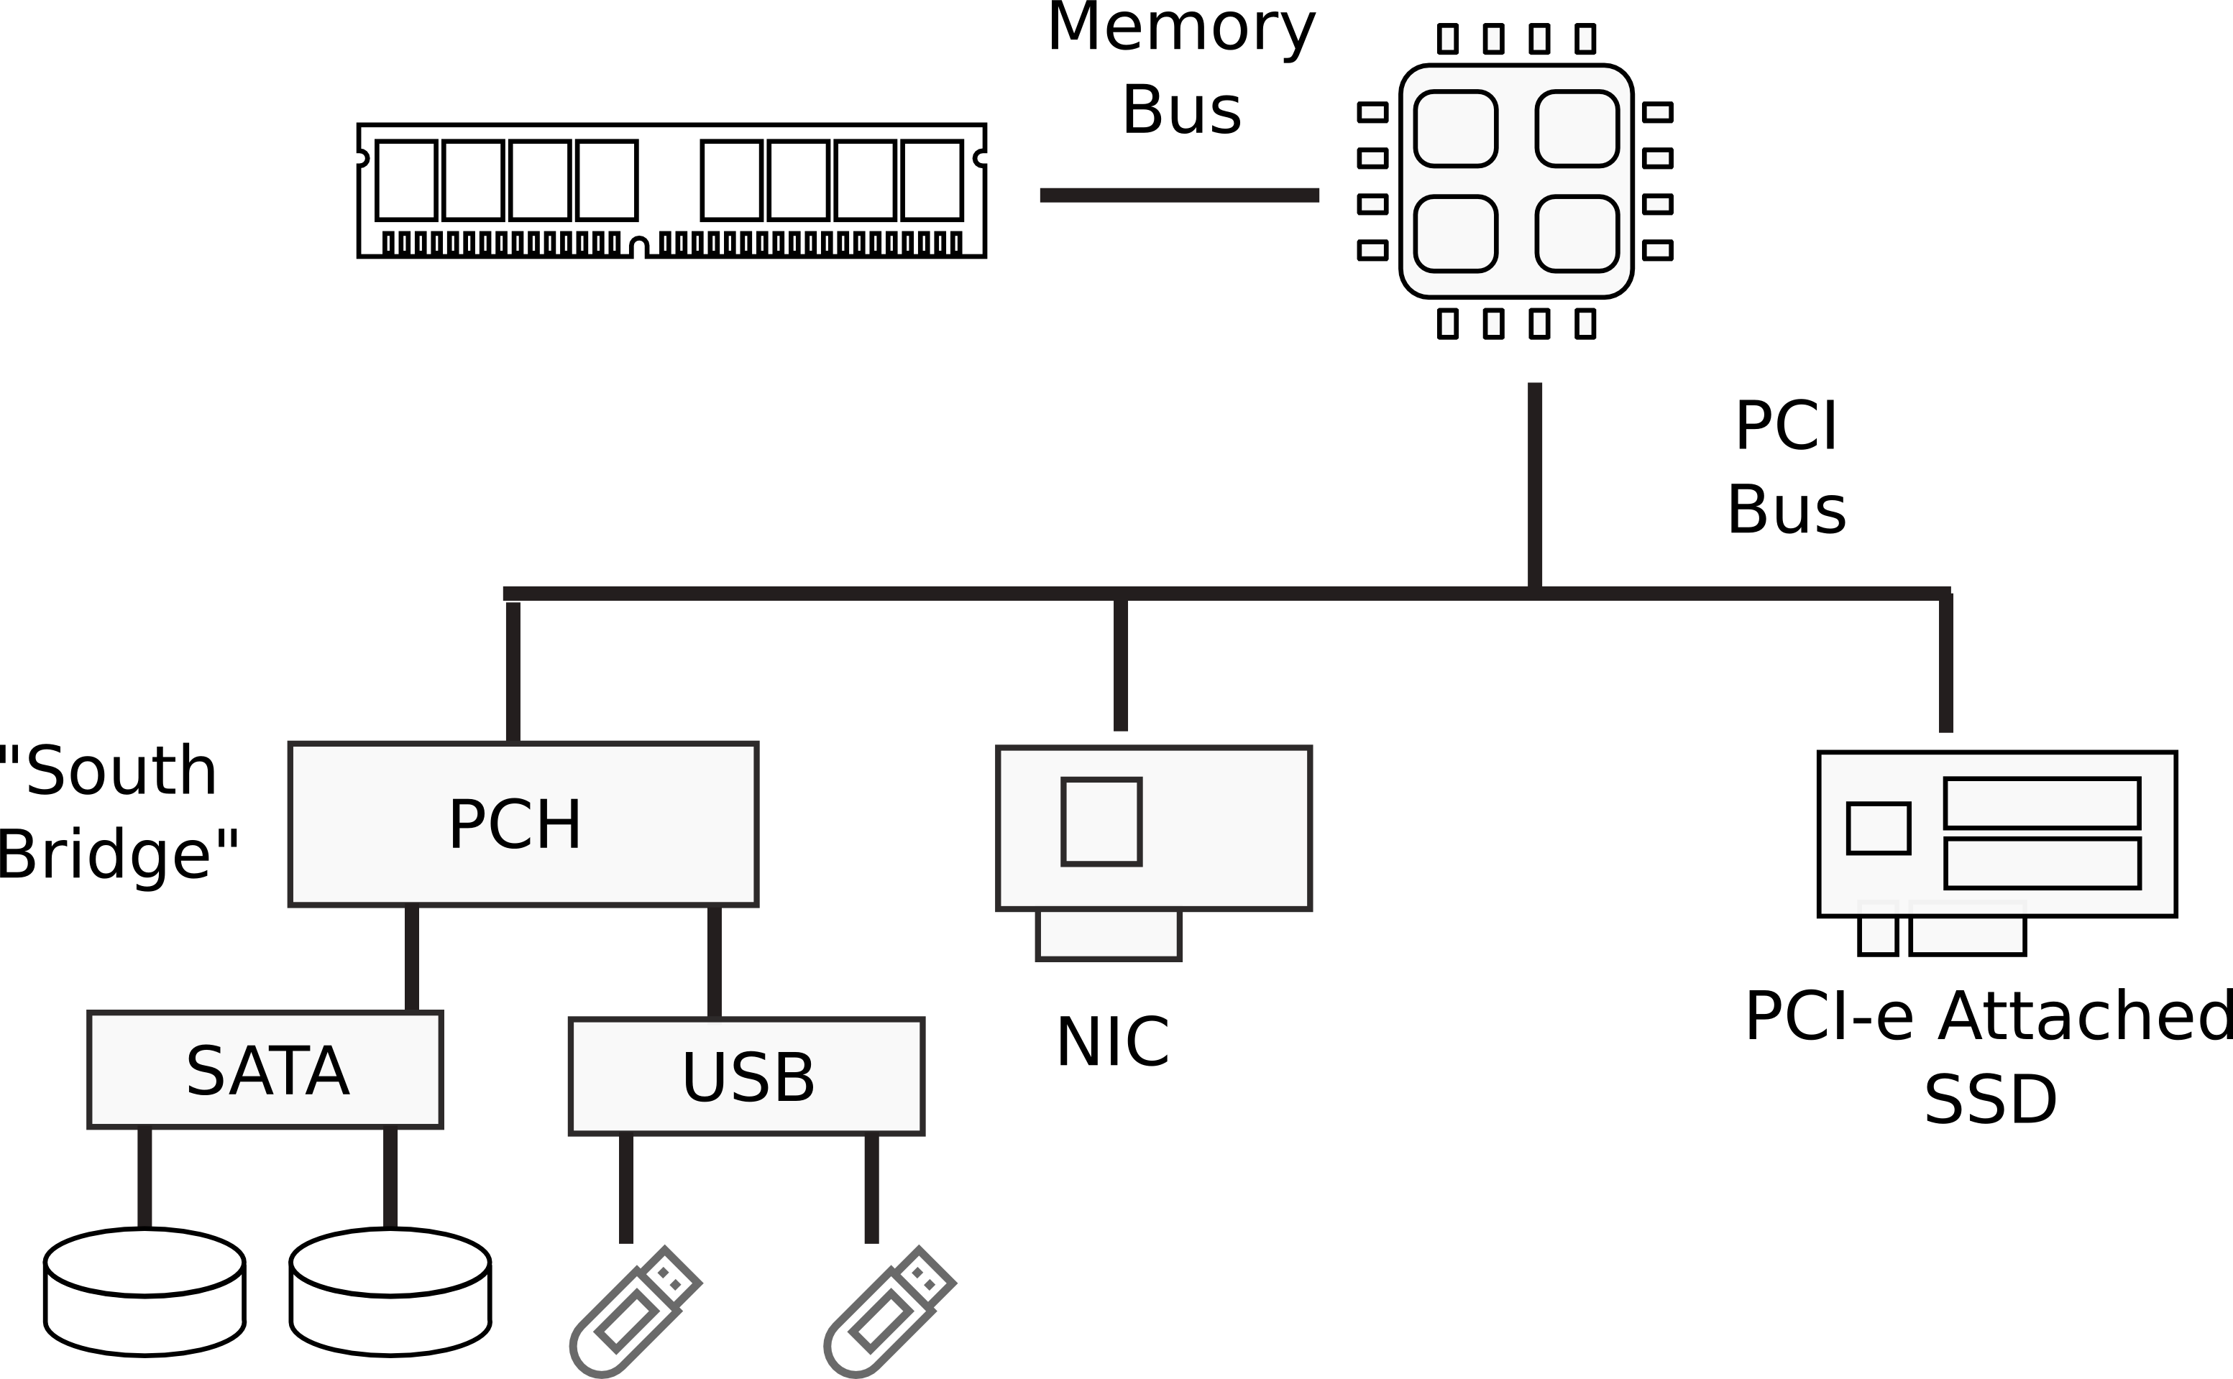
I/O Devices

Slide 6
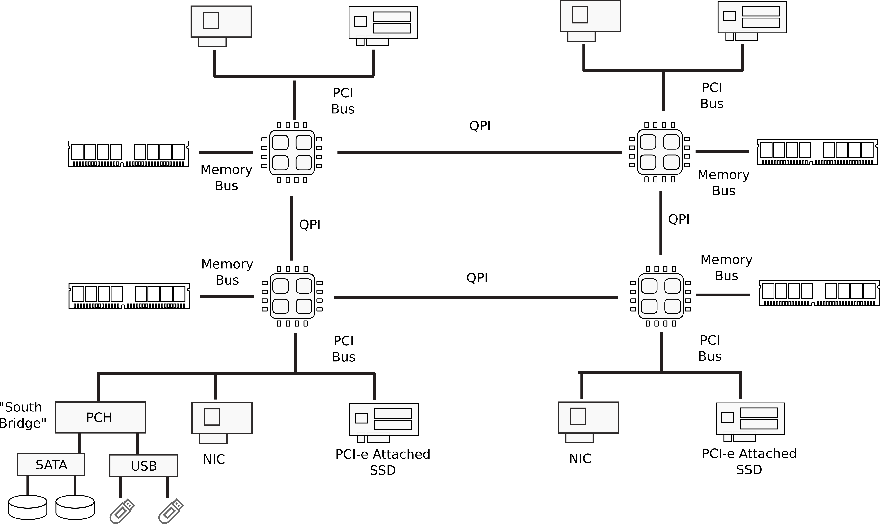
Multi-socket machines

Slide 7
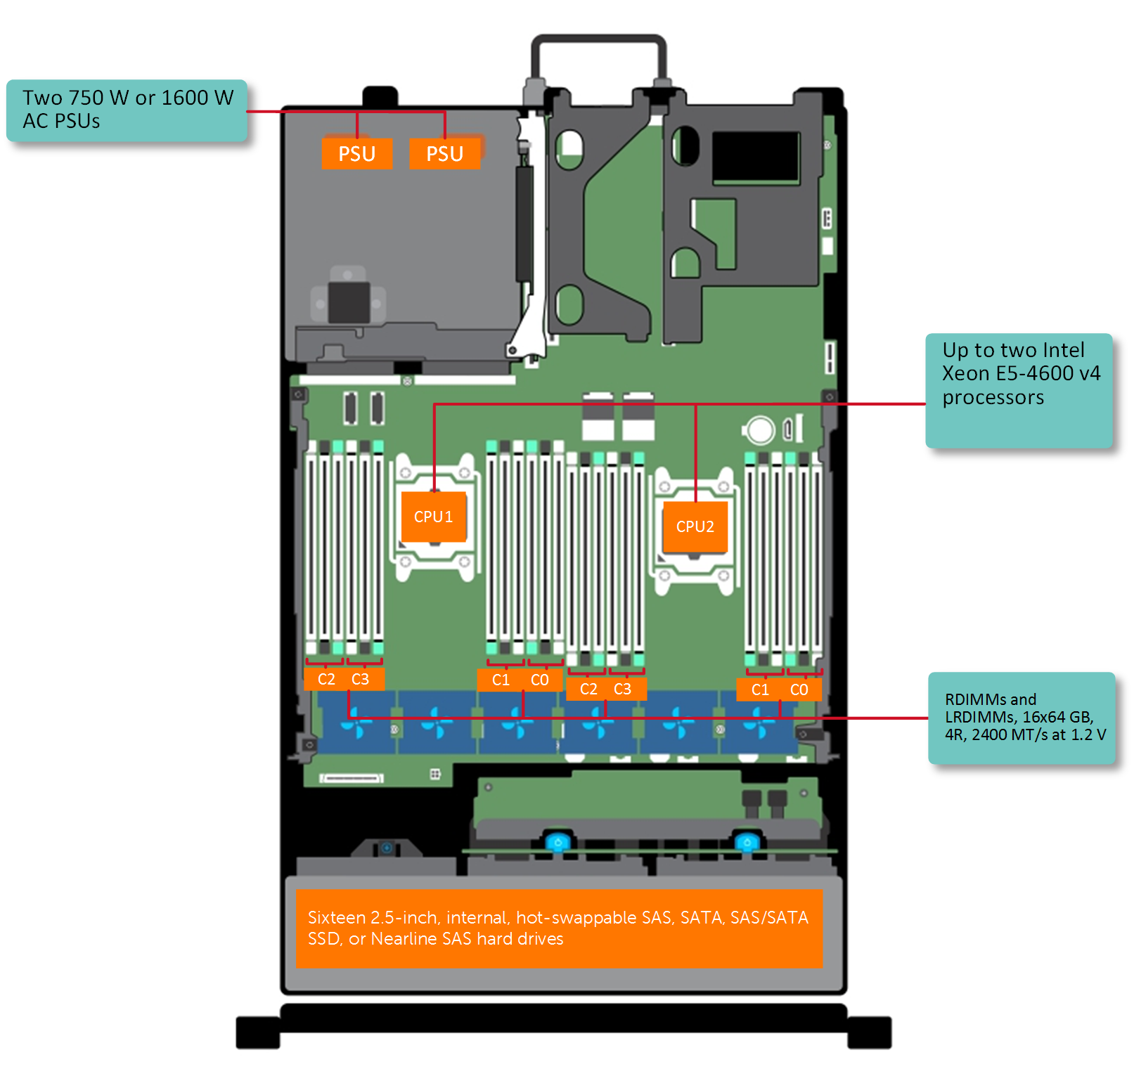
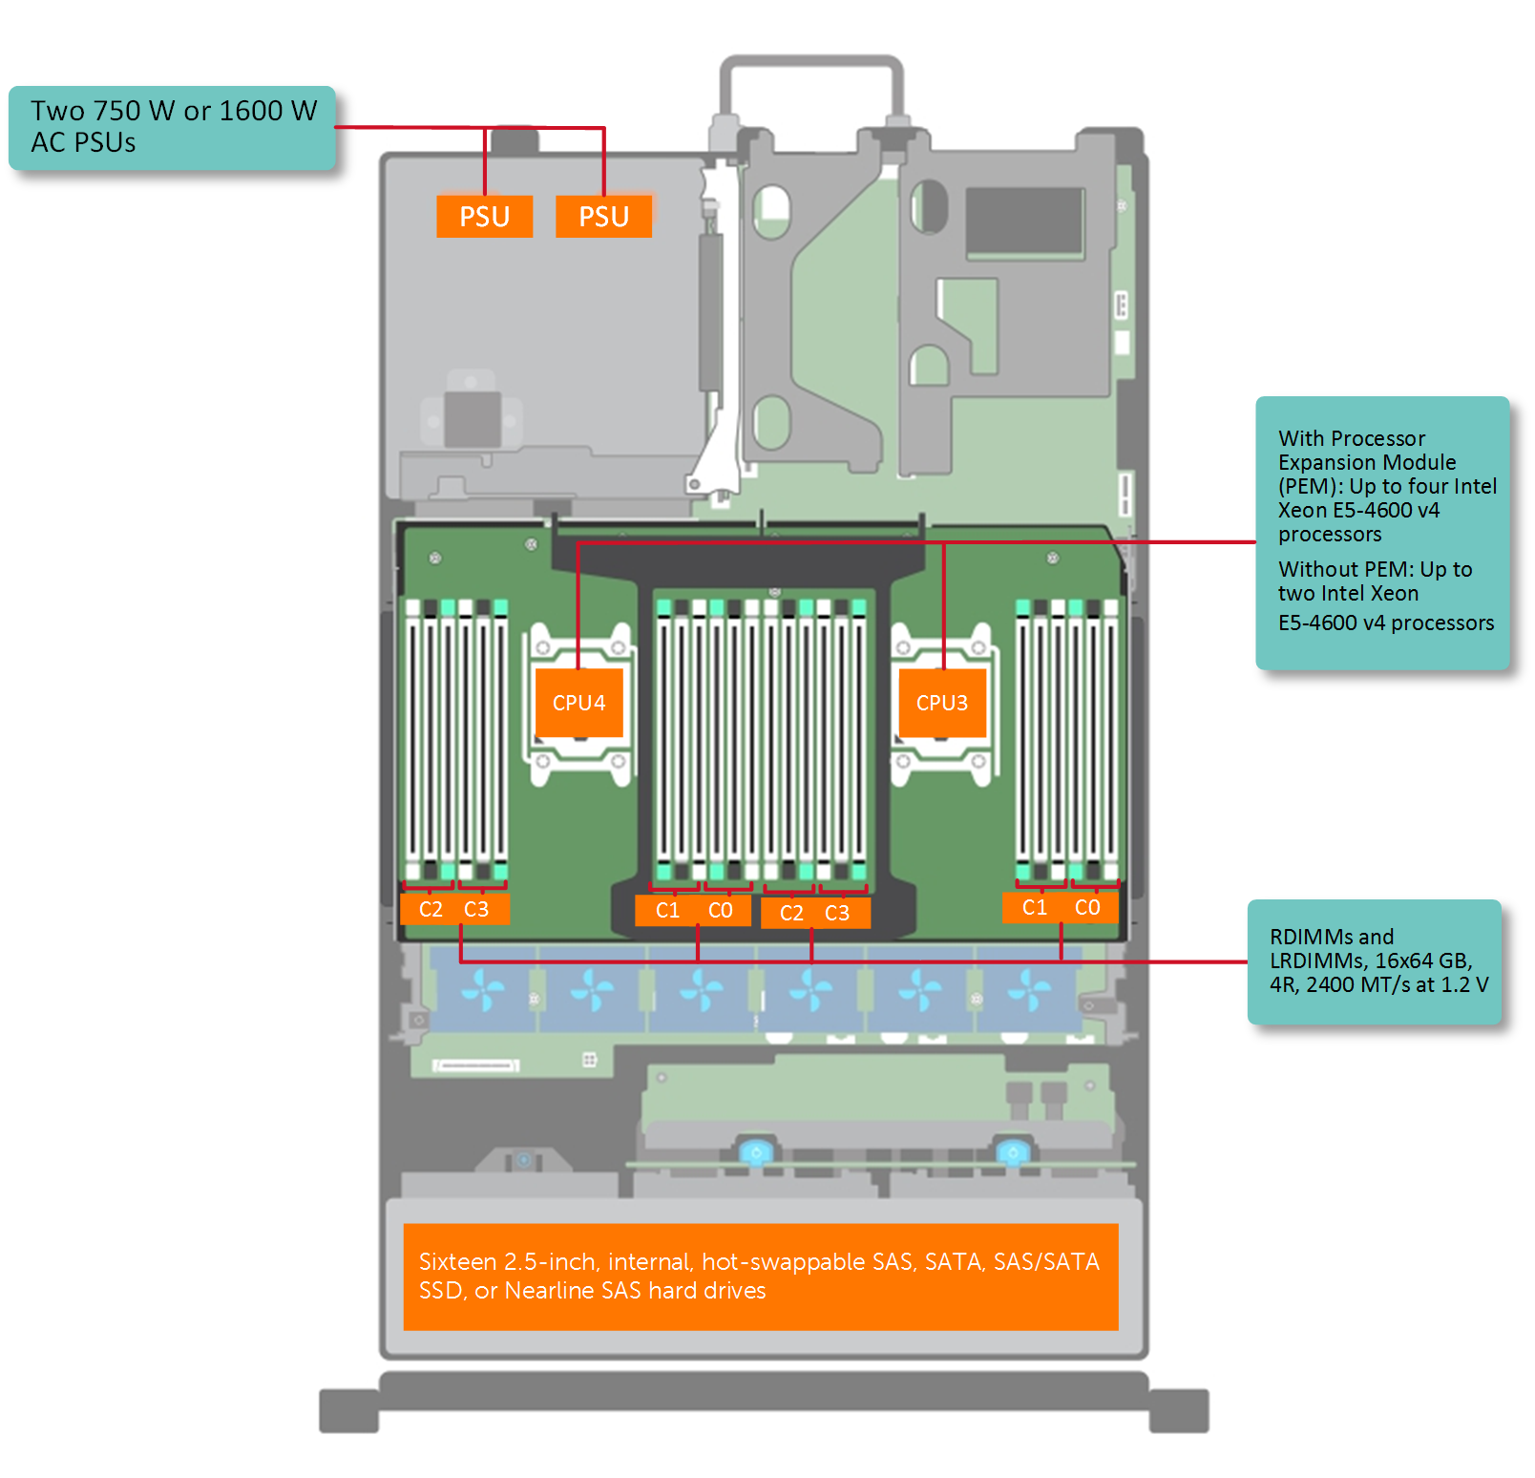
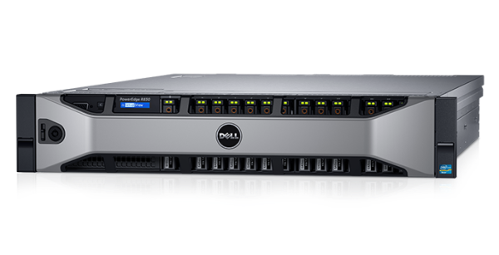
Dell R830 4-socket server
Dell Poweredge R830 System Server with 2 sockets on the main floor and 2 sockets on the expansion
http://www.dell.com/support/manuals/us/en/19/poweredge-r830/r830_om/supported-configurations-for-the-poweredge-r830-system?guid=guid-01303b2b-f884-4435-b4e2-57bec2ce225a&lang=en-us

Slide 8
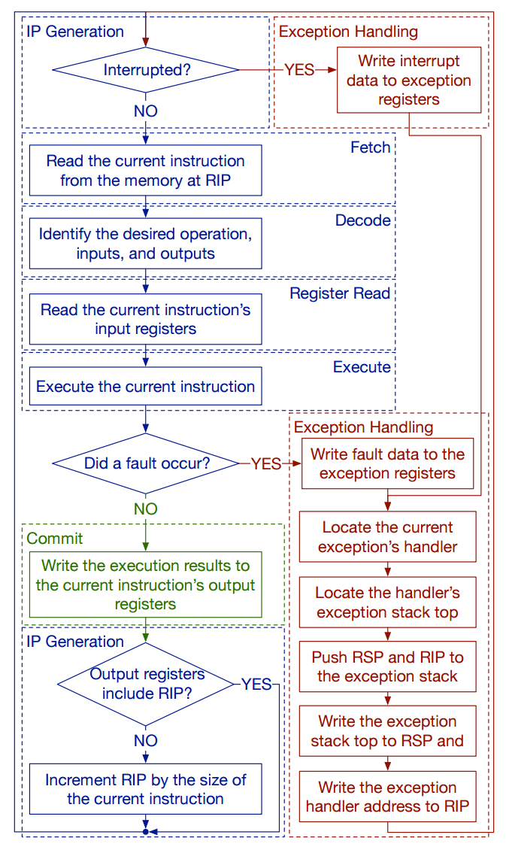
CPU execution loop
CPU repeatedly reads instructions from memory
Executes them
Example
ADD EDX, EAX, EBX
// EDX = EAX + EBX

Slide 9
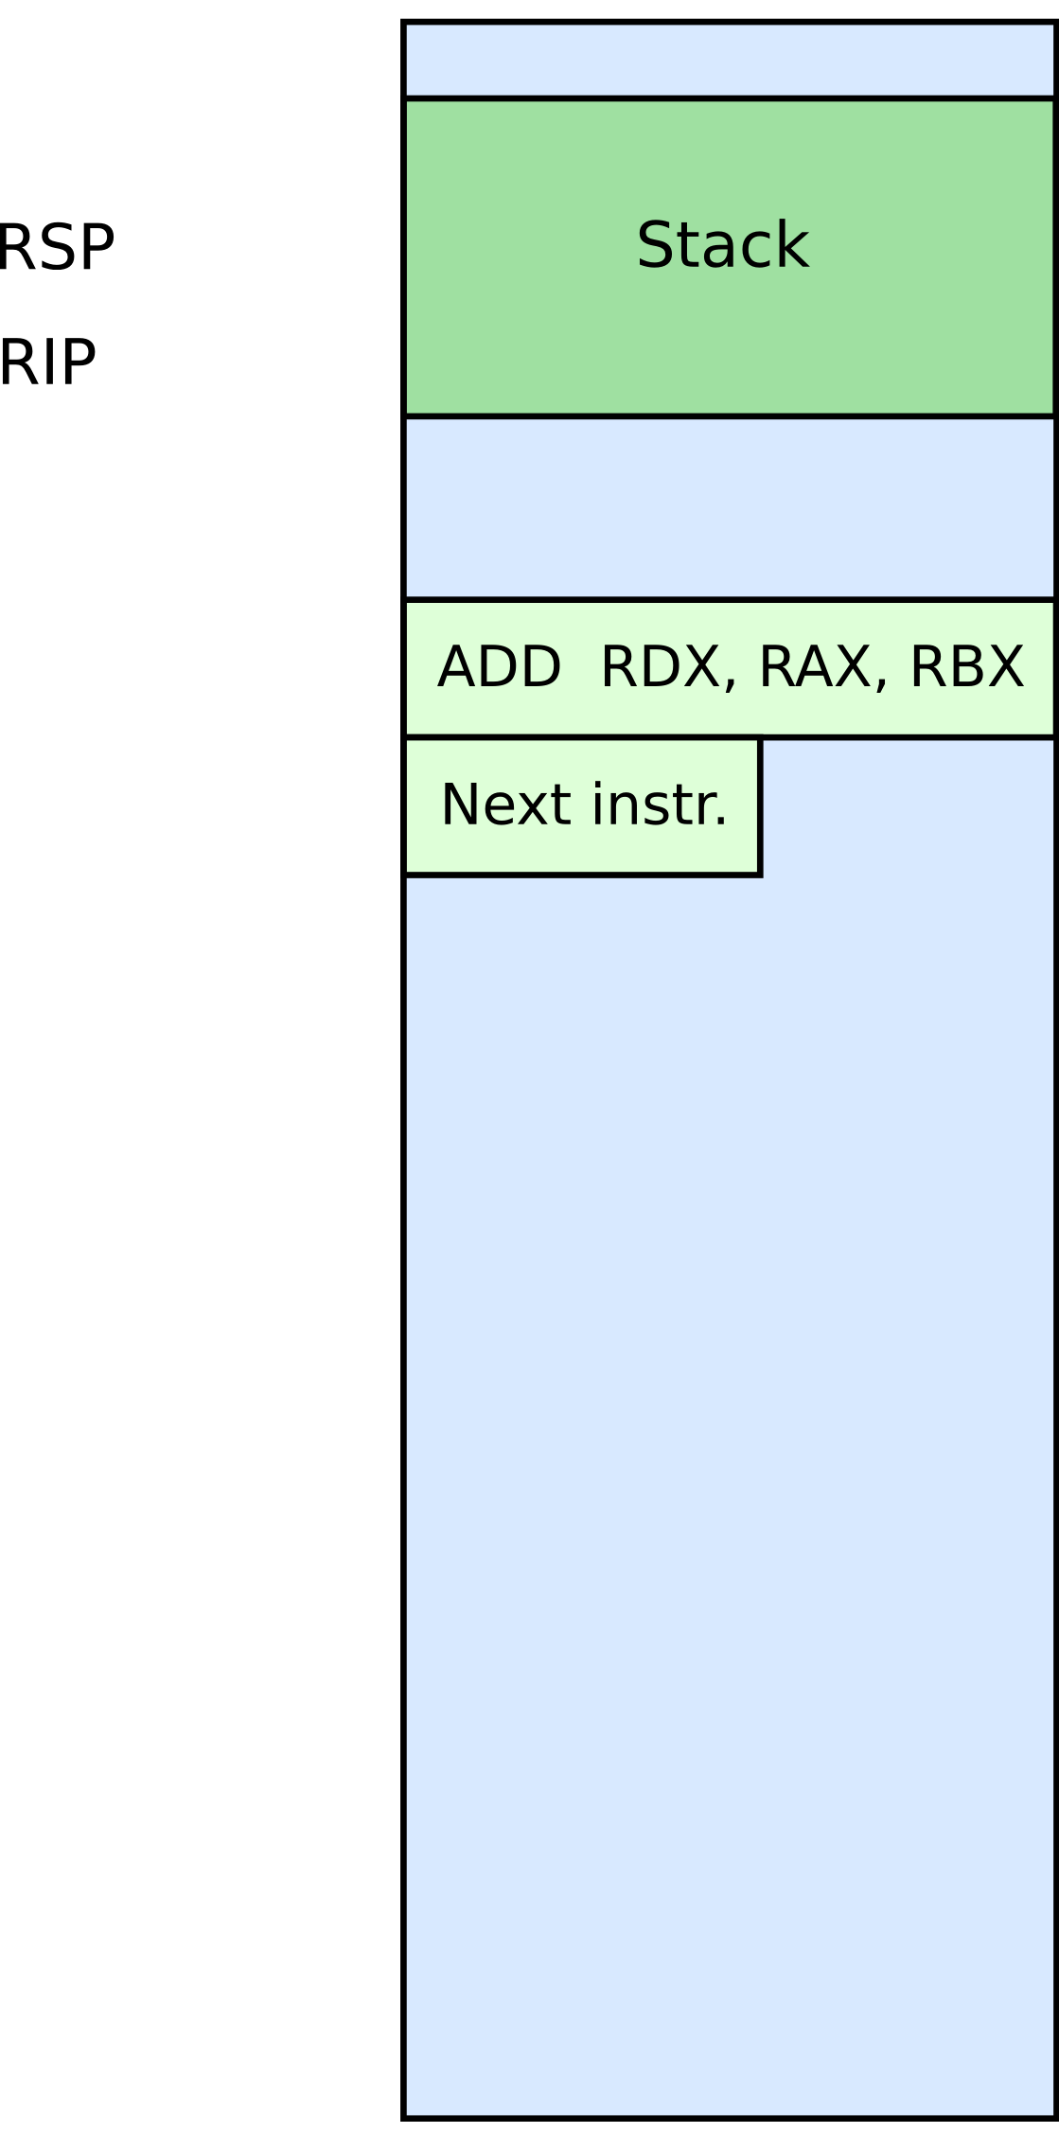

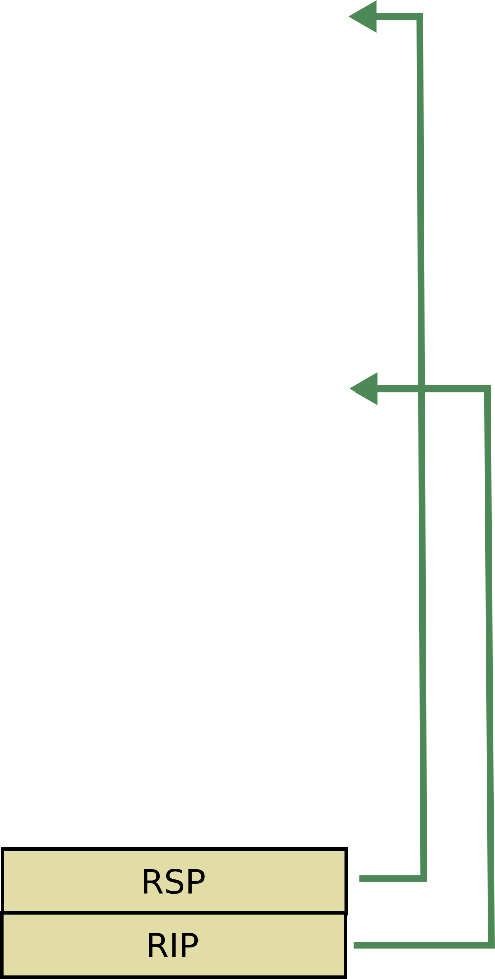




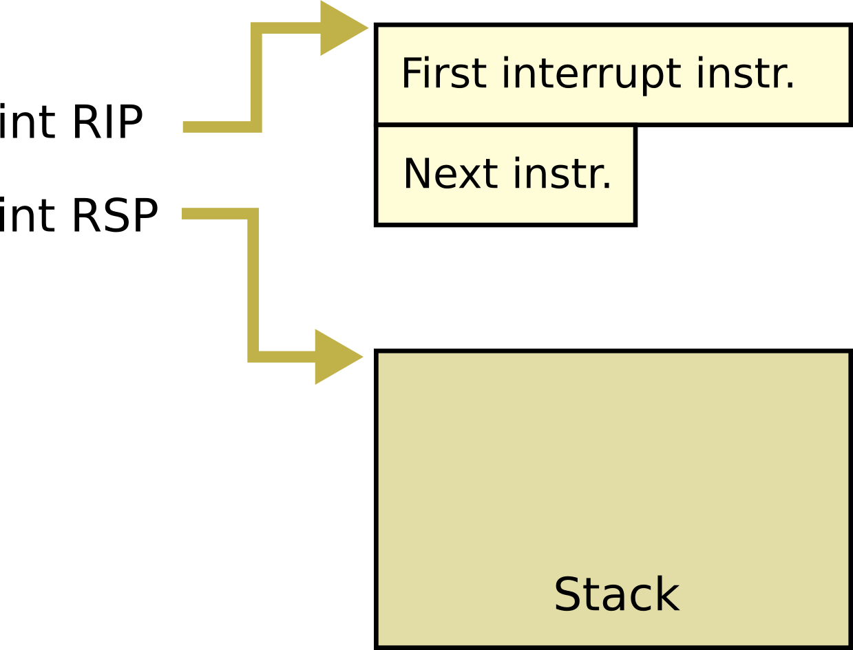

Slide 10
CPU execution loop
Fault
  Instruction's preconditions are not met
Examples
  Division by zero
  Page not mapped

Slide 11
Memory hierarchy

Slide 12
Questions?

