Slide 1
143A: Principles of Operating Systems
Lecture 7: System boot
Anton Burtsev
October, 2017

Slide 2
Outline for today
Boot operating system
Setup segments (data and code)
Switch to protected mode
  Load GDT (turn segmentation on)
Setup stack (needed to call C functions)
Load the kernel from disk into memory
Setup first page table
  2 entries [ 0 : 4MB ] and [ 2GB : (2GB + 4MB) ]
Setup high-address stack
Jump to main()
  Start executing kernel code

Slide 3
What happens when we turn on the power?
Well it's complicated
  Intel SGX Explained is a good start (Section 2.13 [1])
At a high-level a sequence of software pieces initializes the platform
  Microcode, firmware (BIOS), bootloader

Slide 4
The most important thing, the OS is not the only software running on the machine
  And not the most privileged
Today, at least two layers sit underneath the OS/hypervizor
  System Management Mode (SMM) (ring -2)
    Runs below the hypervisor/OS
  Intel Management Engine (ring -3)
    Runs on a separate CPU

Slide 5
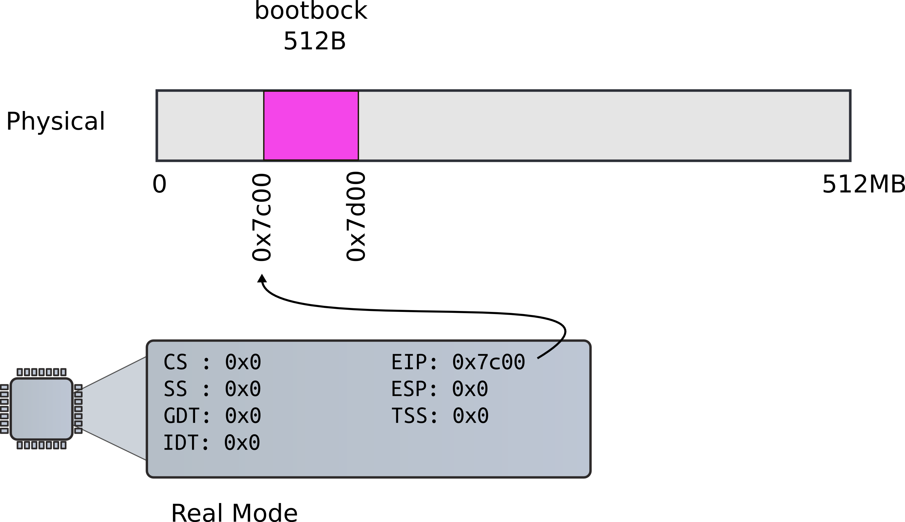
Bootloader starts

Slide 6
Bootloader starts
9111 start:
9112 cli # BIOS enabled interrupts; disable
9113
9114 # Zero data segment registers DS,ES,and
SS.
9115 xorw %ax,%ax # Set %ax to zero
9116 movw %ax,%ds # −> Data Segment
9117 movw %ax,%es # −> Extra Segment
9118 movw %ax,%ss # −> Stack Segment

Slide 7
Why start happens to be 0x7c00?
9111 start:
9112 cli # BIOS enabled interrupts; disable
9113

Slide 8
Linker are told so through the Makefile
9111 start:
9112 cli # BIOS enabled interrupts; disable
9113
bootblock: bootasm.S bootmain.c
$(CC) $(CFLAGS) -fno-pic -O -nostdinc -I. -c bootmain.c
$(CC) $(CFLAGS) -fno-pic -nostdinc -I. -c bootasm.S
$(LD) $(LDFLAGS) -N -e start -Ttext 0x7C00 -o bootblock.o bootasm.o bootmain.o
$(OBJDUMP) -S bootblock.o > bootblock.asm
$(OBJCOPY) -S -O binary -j .text bootblock.o bootblock
./sign.pl bootblock

Slide 9
Switch to protected mode
Switch from real to protected mode
  Use a bootstrap GDT that makes virtual addresses map directly to physical addresses so that the effective memory map doesn’t change during the transition.
9141 lgdt gdtdesc
9142 movl %cr0, %eax
9143 orl $CR0_PE, %eax
9144 movl %eax, %cr0

Slide 10
How GDT is defined
9180 # Bootstrap GDT
9181 .p2align 2 # force 4 byte alignment
9182 gdt:
9183 SEG_NULLASM # null seg
9184 SEG_ASM(STA_X|STA_R, 0x0, 0xffffffff) # code seg
9185 SEG_ASM(STA_W, 0x0, 0xffffffff) # data seg
9186
9187 gdtdesc:
9188 .word (gdtdesc − gdt − 1) # sizeof(gdt) − 1
9189 .long gdt

Slide 11
How GDT is defined
9180 # Bootstrap GDT
9181 .p2align 2 # force 4 byte alignment
9182 gdt:
9183 SEG_NULLASM # null seg
9184 SEG_ASM(STA_X|STA_R, 0x0, 0xffffffff) # code seg
9185 SEG_ASM(STA_W, 0x0, 0xffffffff) # data seg
9186
9187 gdtdesc:
9188 .word (gdtdesc − gdt − 1) # sizeof(gdt) − 1
9189 .long gdt

Slide 12
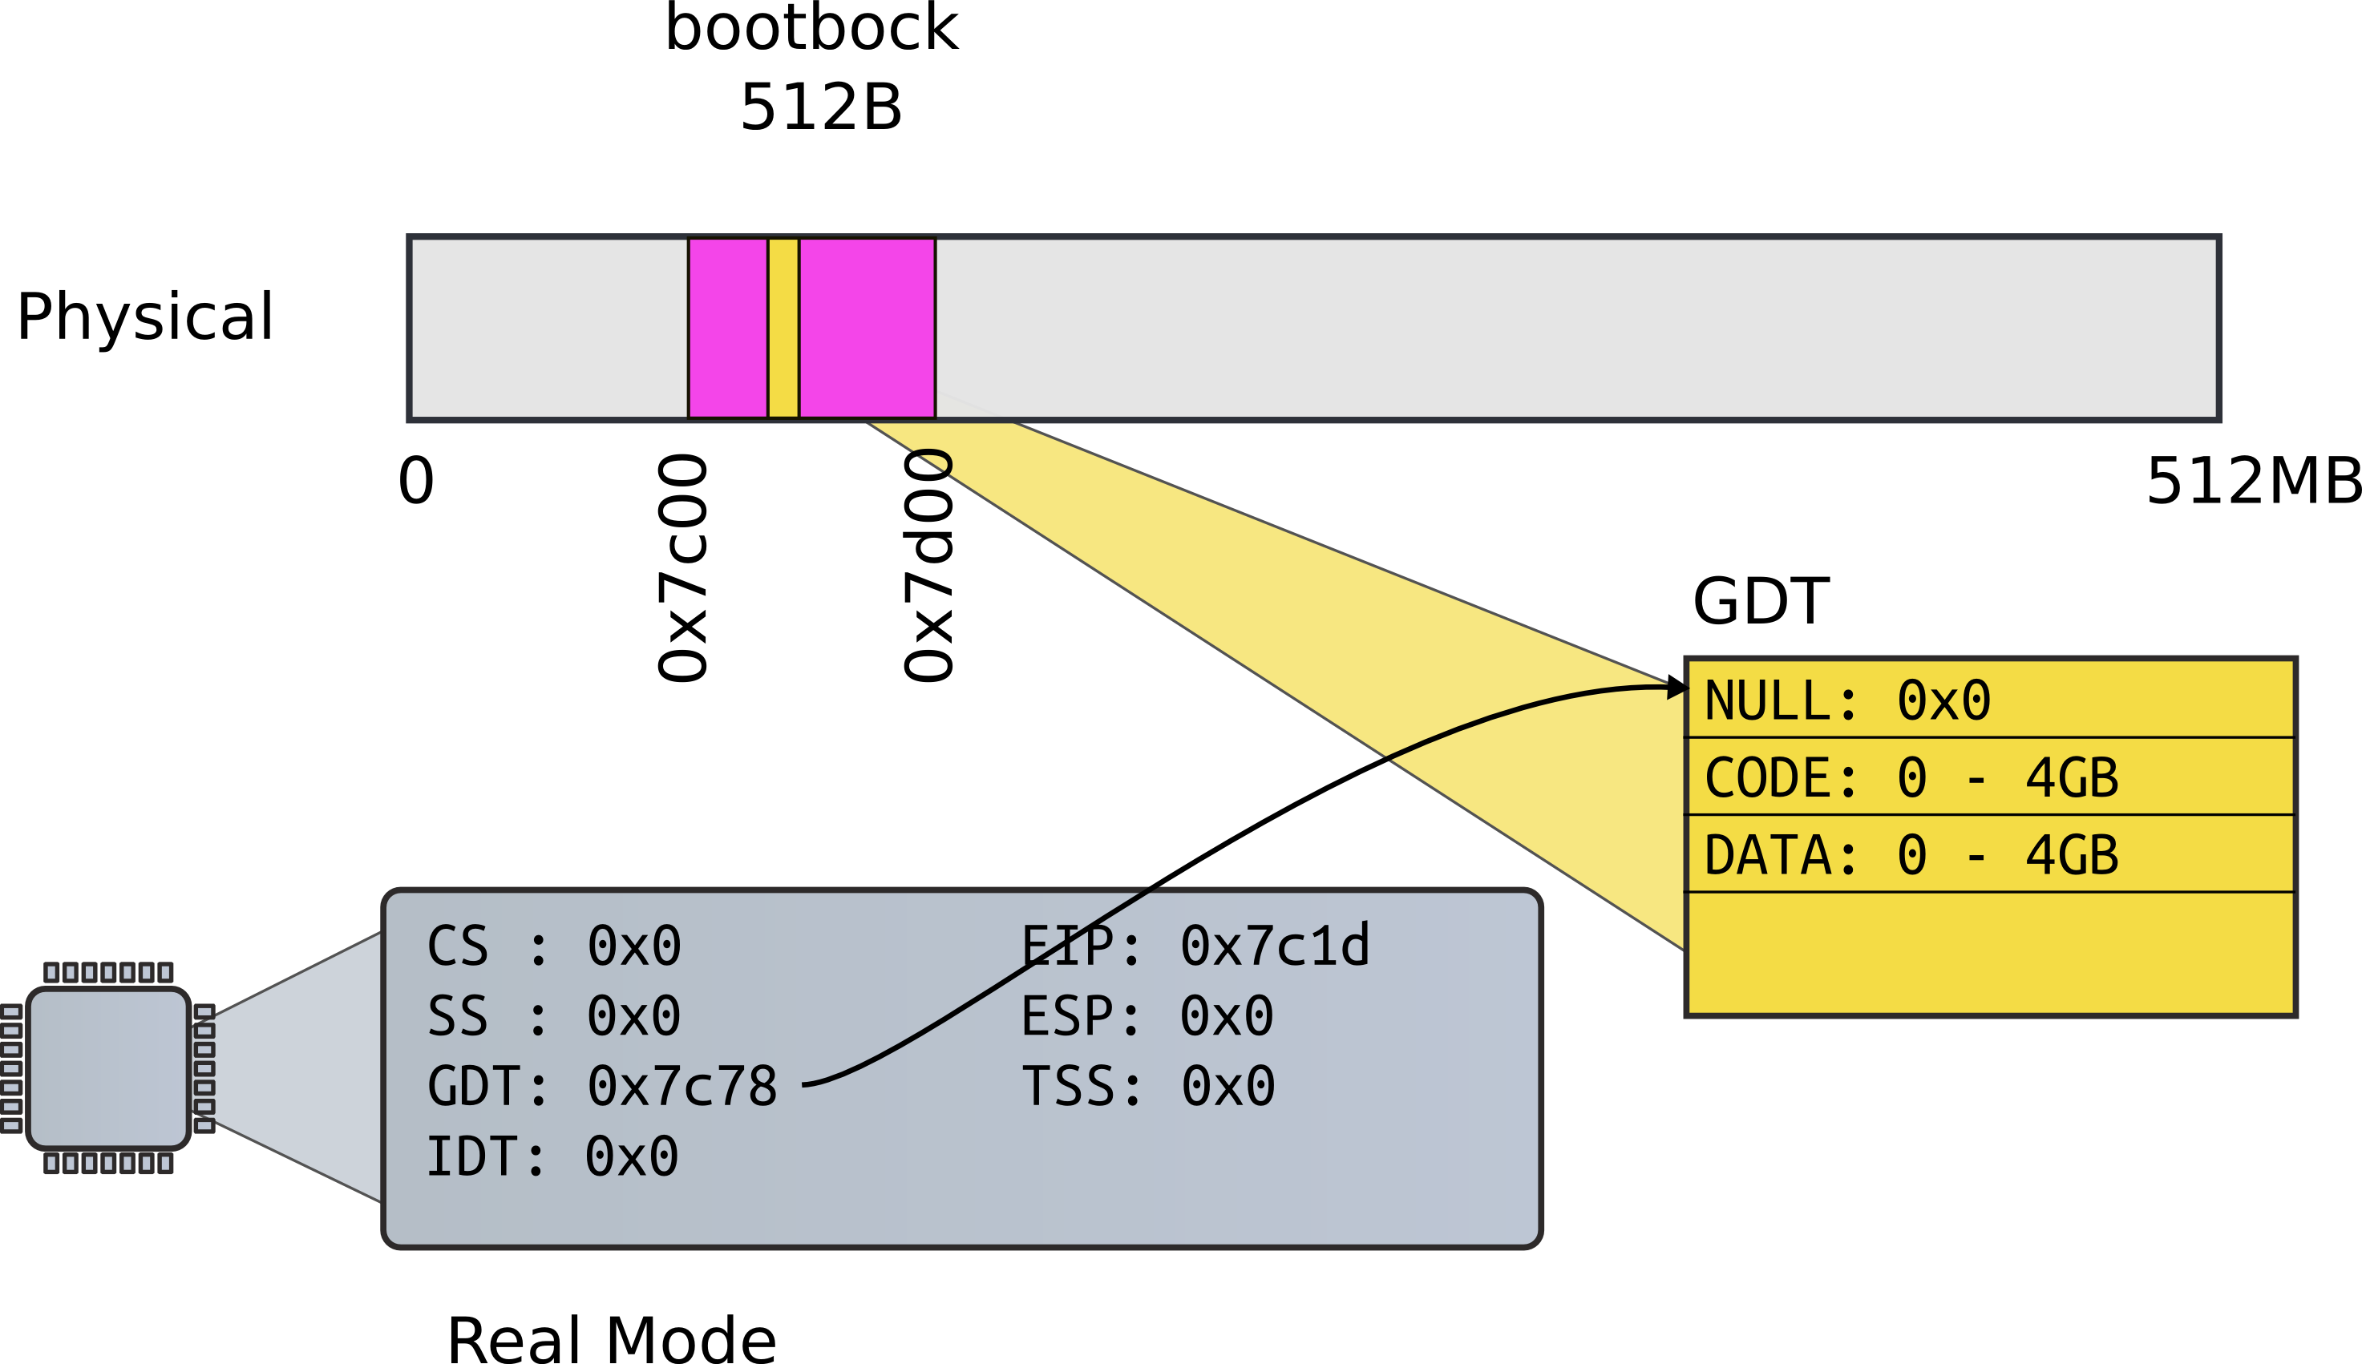
Load GDT

Slide 13
Actual switch
Use long jump to change code segment
9153 ljmp $(SEG_KCODE<<3), $start32
  Explicitly specify code segment, and address
  Segment is 0b1000 (0x8)

Slide 14
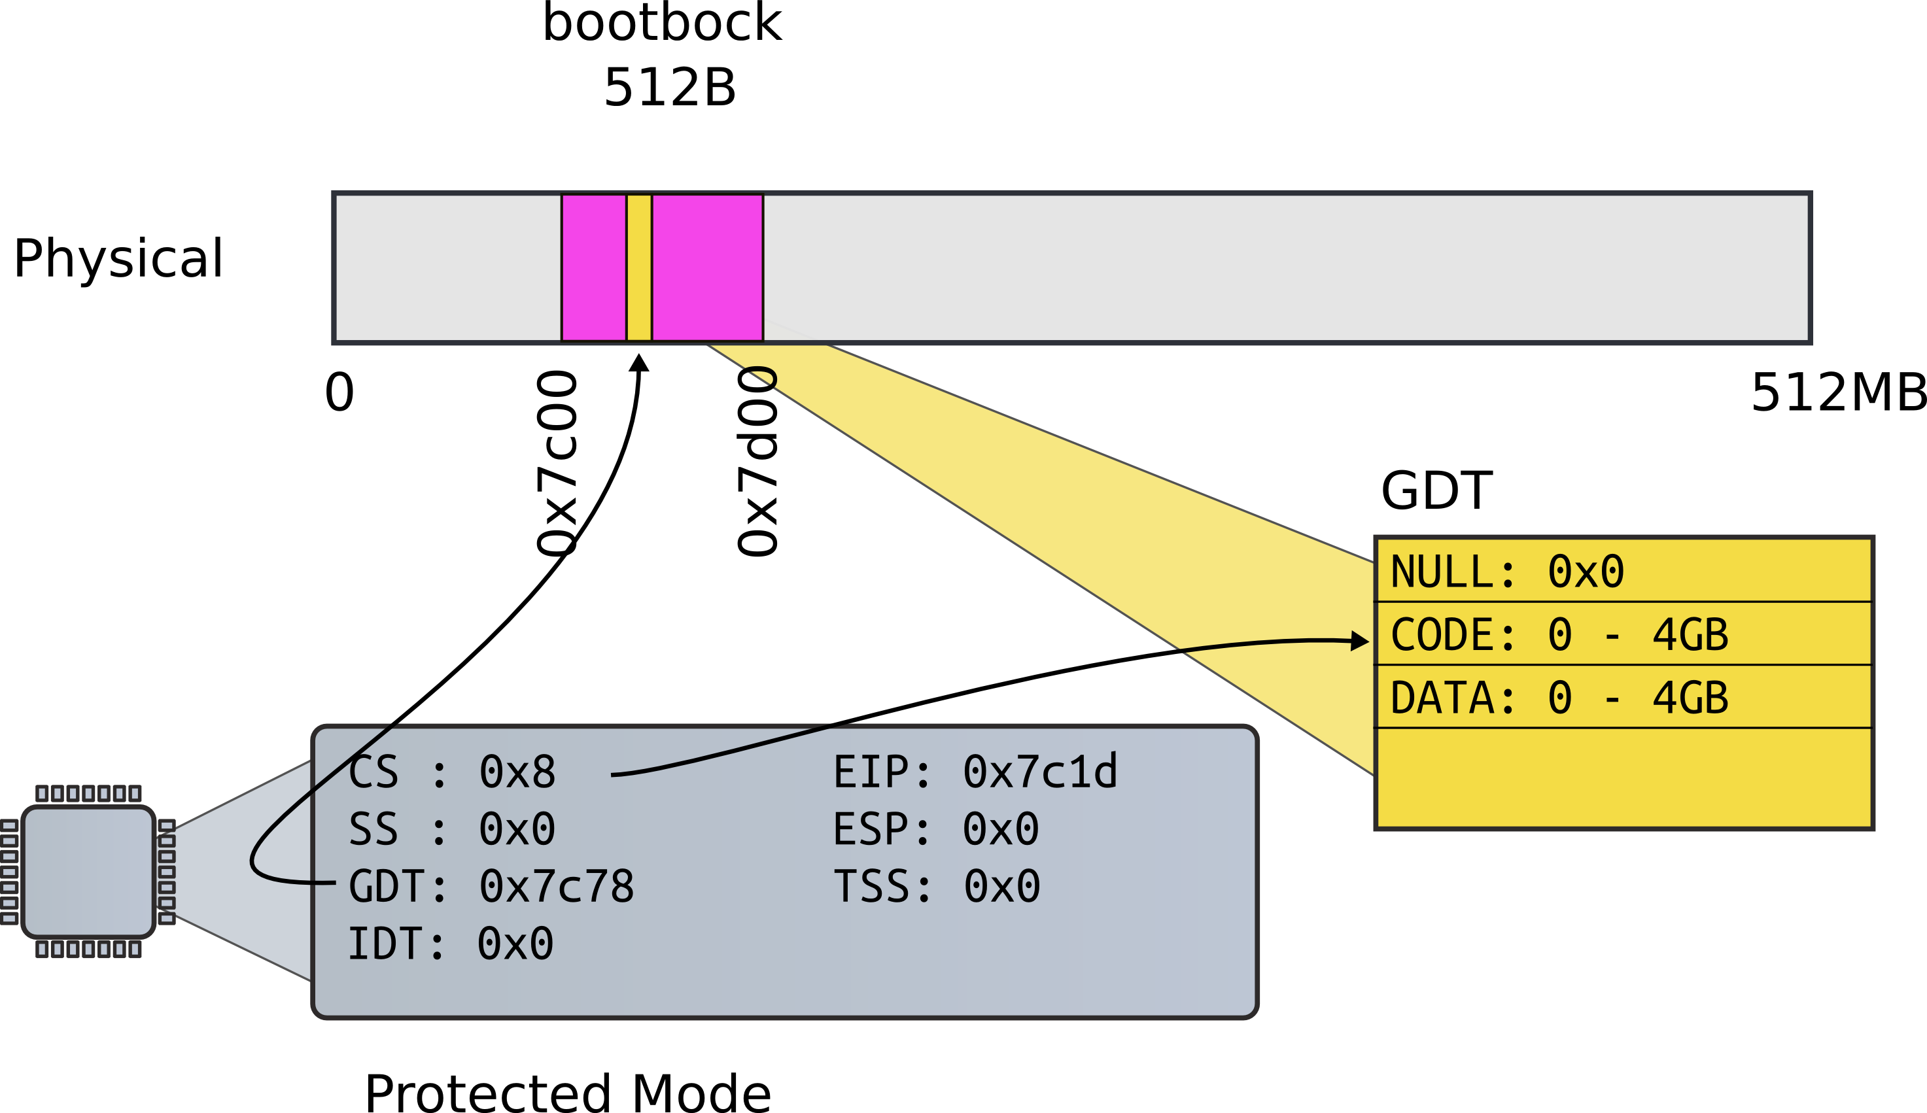
Long jump

Slide 15
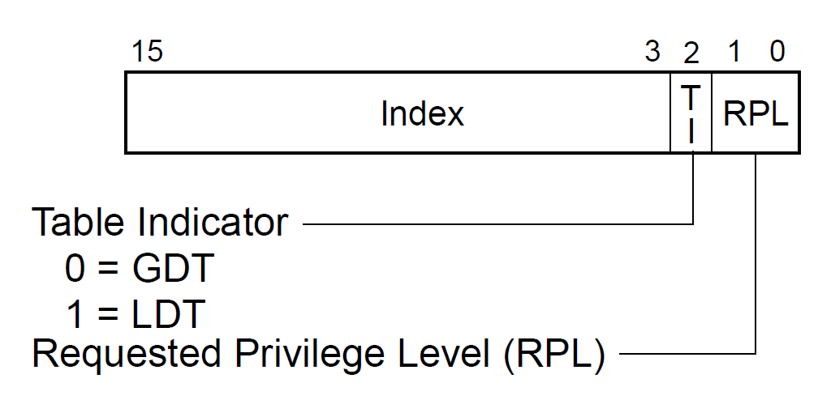
Why CS is 0x8, not 0x1?
Segment selector:

Slide 16
Segments
9155 .code32 # Tell assembler to generate 32−bit code now.
9156 start32:
9157 # Set up the protected−mode data segment registers
9158 movw $(SEG_KDATA<<3), %ax # Our data segment selector
9159 movw %ax, %ds # −> DS: Data Segment
9160 movw %ax, %es # −> ES: Extra Segment
9161 movw %ax, %ss # −> SS: Stack Segment
9162 movw $0, %ax # Zero segments not ready for use
9163 movw %ax, %fs # −> FS
9164 movw %ax, %gs # −> GS

Slide 17
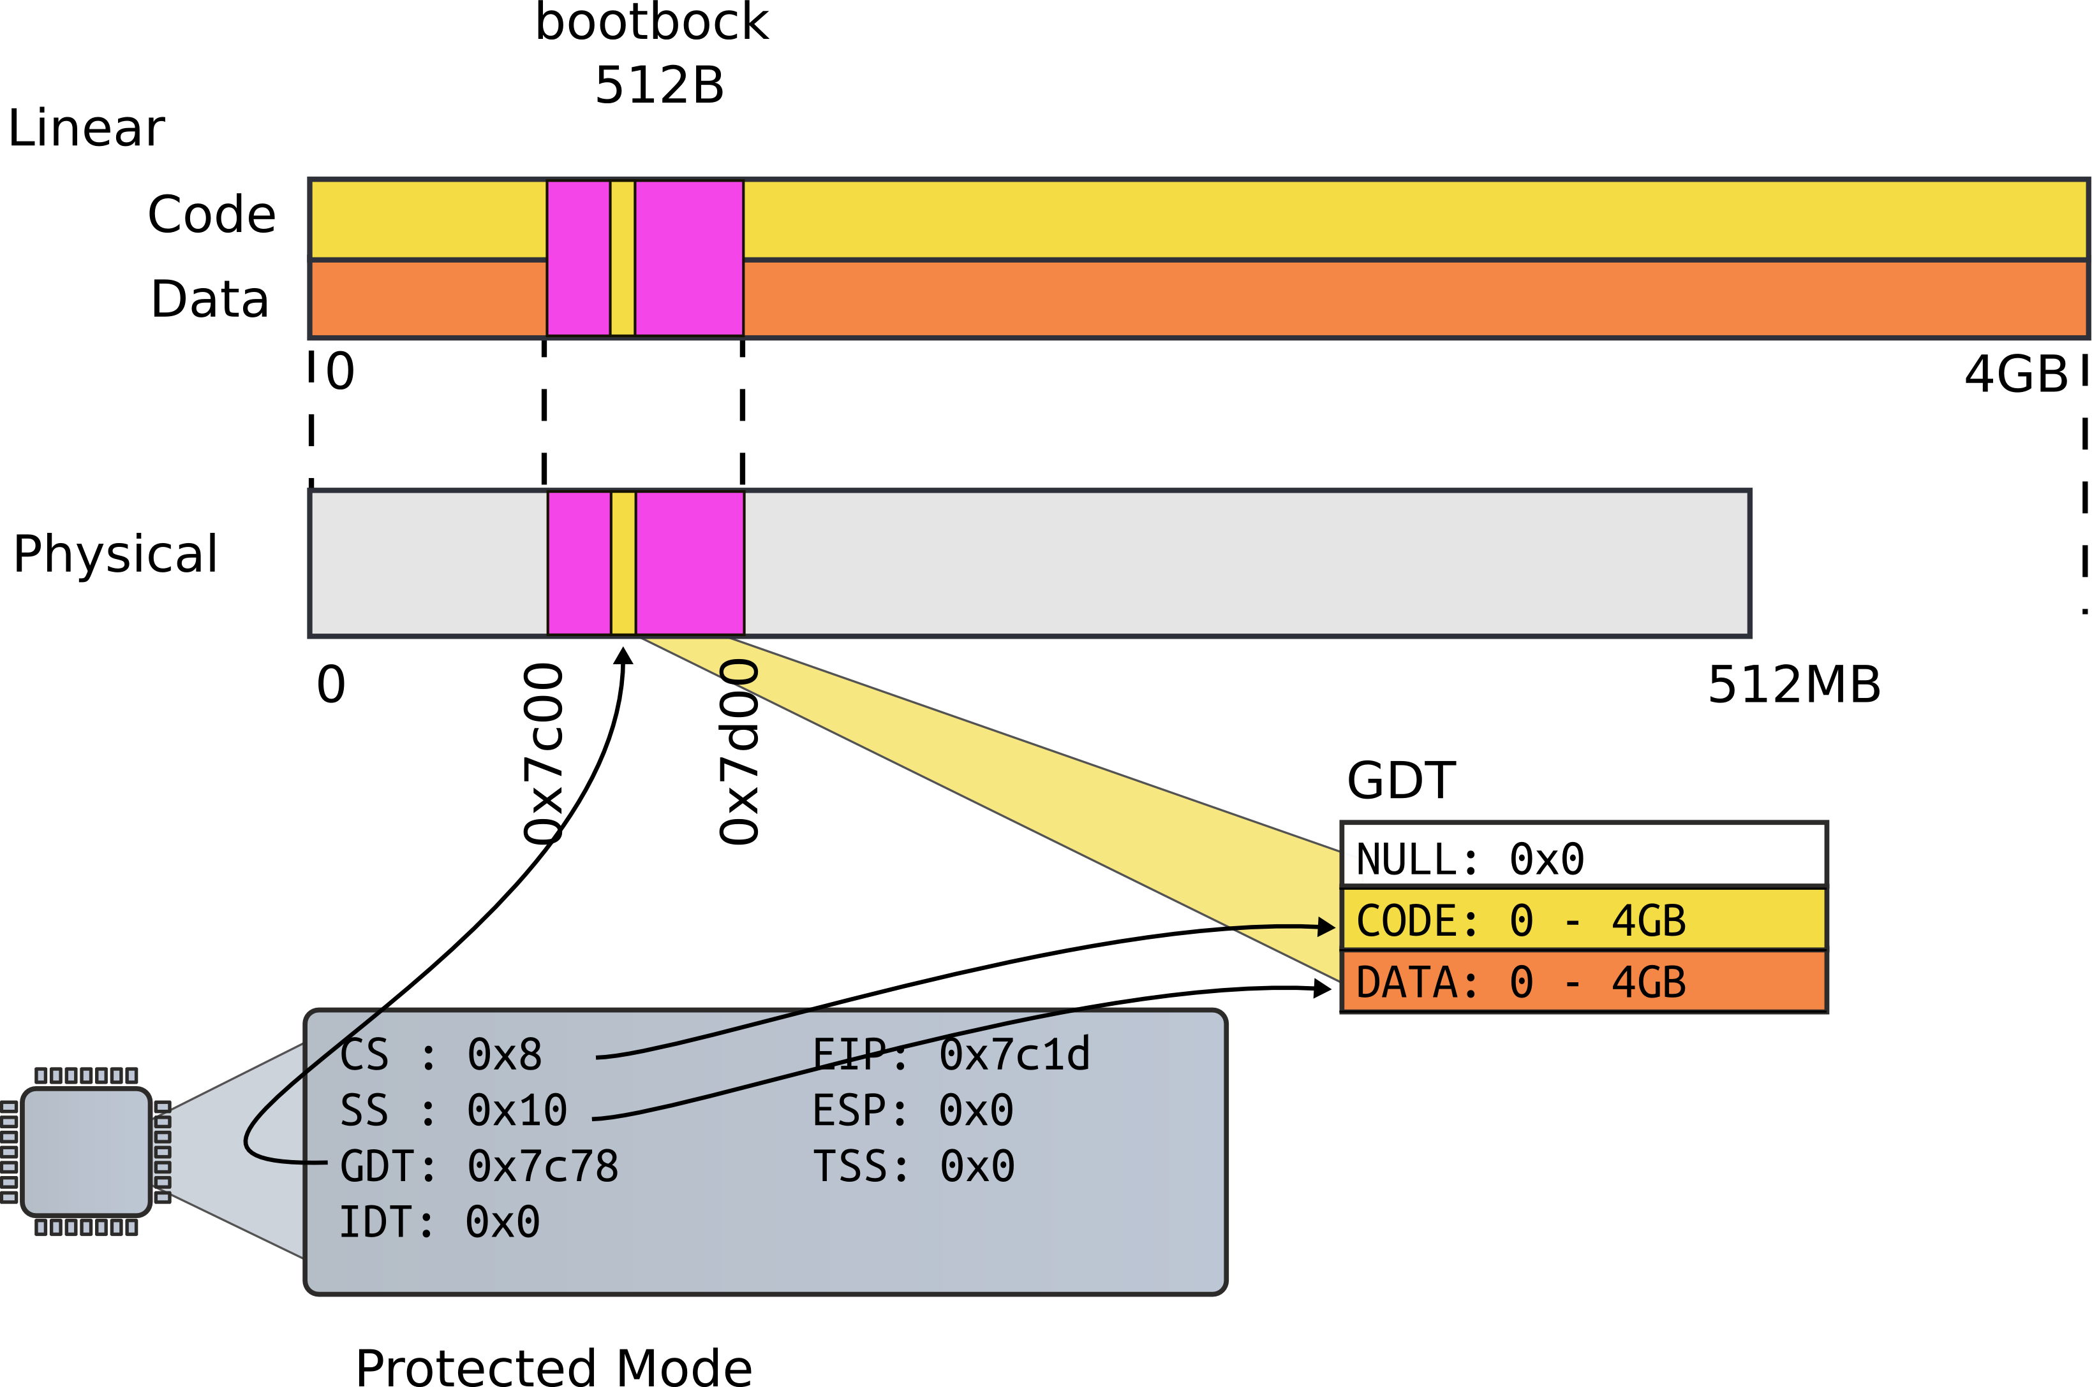
Segments

Slide 18
Setup stack
Why do we need a stack?
9166 movl $start, %esp
9167 call bootmain

Slide 19
Setup stack
Need stack to use C
  Function invocations
  Note, there were no stack instructions before that
9166 movl $start, %esp
9167 call bootmain

Slide 20

First stack

Slide 21
Invoke first C function
9166 movl $start, %esp
9167 call bootmain

Slide 22
bootmain(): read kernel from disk
9216 void
9217 bootmain(void)
9218 {
9219 struct elfhdr *elf;
9220 struct proghdr *ph, *eph;
9221 void (*entry)(void);
9222 uchar* pa;
9223
9224 elf = (struct elfhdr*)0x10000; // scratch space
9225
9226 // Read 1st page off disk
9227 readseg((uchar*)elf, 4096, 0);
9228
9229 // Is this an ELF executable?
9230 if(elf−>magic != ELF_MAGIC)
9231 return; // let bootasm.S handle error
9232

Slide 23
bootmain(): read kernel from disk
9232
9233 // Load each program segment (ignores ph flags).
9234 ph = (struct proghdr*)((uchar*)elf + elf−>phoff);
9235 eph = ph + elf−>phnum;
9236 for(; ph < eph; ph++){
9237 pa = (uchar*)ph−>paddr;
9238 readseg(pa, ph−>filesz, ph−>off);
9239 if(ph−>memsz > ph−>filesz)
9240 stosb(pa + ph−>filesz, 0, ph−>memsz − ph−>filesz);
9241 }
9242
9243 // Call the entry point from the ELF header.
9244 // Does not return!
9245 entry = (void(*)(void))(elf−>entry);
9246 entry();
9247 }

Slide 24
How do we read disk?
9257
9258 // Read a single sector at offset into dst.
9259 void
9260 readsect(void *dst, uint offset)
9261 {
9262 // Issue command.
9263 waitdisk();
9264 outb(0x1F2, 1); // count = 1
9265 outb(0x1F3, offset);
9266 outb(0x1F4, offset >> 8);
9267 outb(0x1F5, offset >> 16);
9268 outb(0x1F6, (offset >> 24) | 0xE0);
9269 outb(0x1F7, 0x20); // cmd 0x20 − read sectors
9270
9271 // Read data.
9272 waitdisk();
9273 insl(0x1F0, dst, SECTSIZE/4);
9274 }

Slide 25
How do we read disk (cont)?
9250 void
9251 waitdisk(void)
9252 {
9253 // Wait for disk ready.
9254 while((inb(0x1F7) & 0xC0) != 0x40)
9255 ;
9256 }
9257

Slide 26
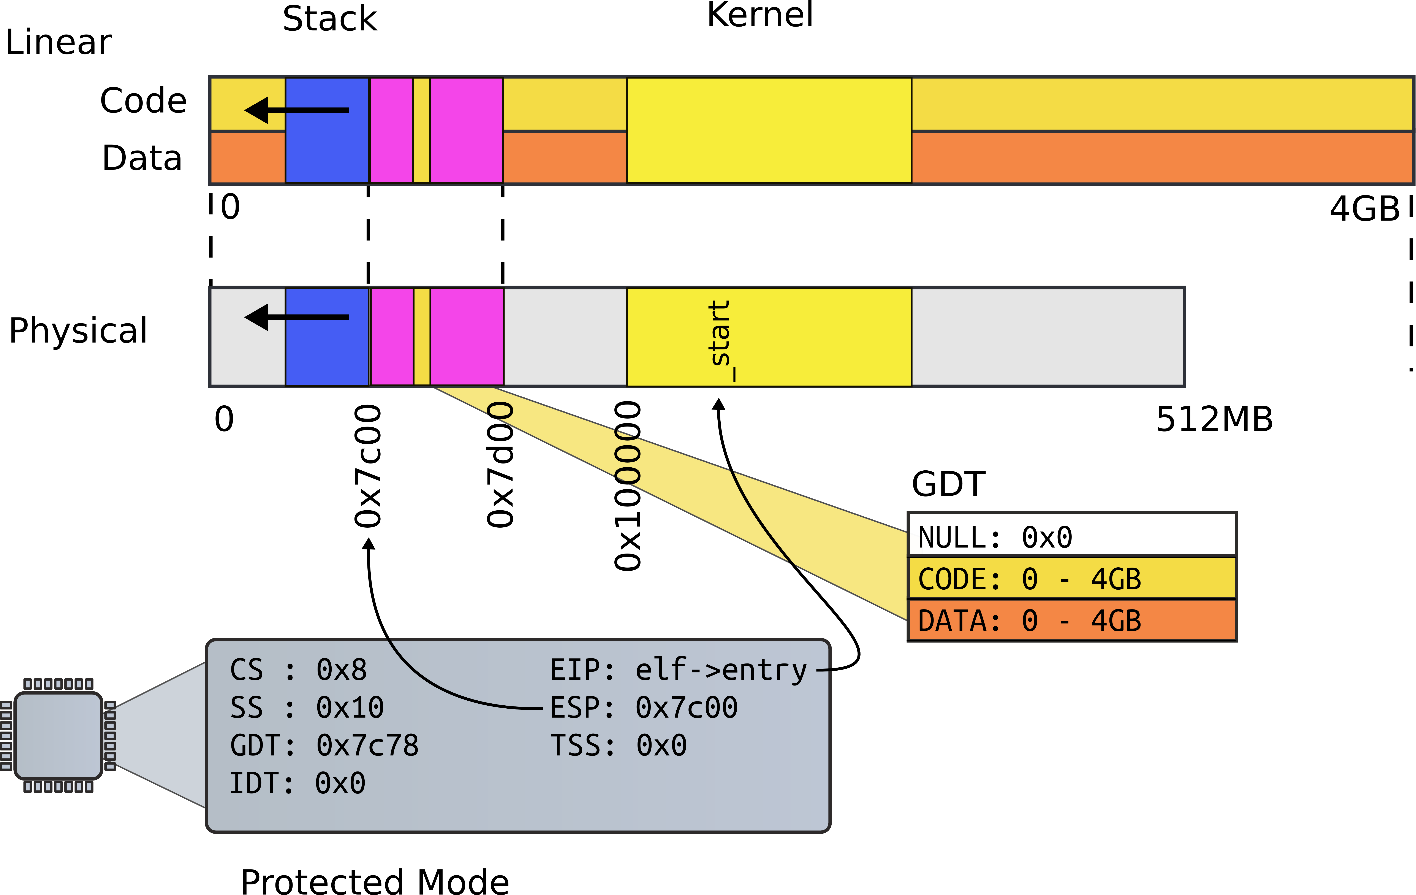
Kernel

Slide 27
entry(): kernel ELF entry
1039 .globl entry
1136 # By convention, the _start symbol specifies the ELF entry point.
1137 # Since we haven’t set up virtual memory yet, our entry point is
1138 # the physical address of ’entry’.
1139 .globl _start
1140 _start = V2P_WO(entry)
1141
1142 # Entering xv6 on boot processor, with paging off.
1143 .globl entry
1144 entry:
1145 # Turn on page size extension for 4Mbyte pages
1146 movl %cr4, %eax
1147 orl $(CR4_PSE), %eax
1148 movl %eax, %cr4

Slide 28
Set up page directory
1149 # Set page directory
1150 movl $(V2P_WO(entrypgdir)), %eax
1151 movl %eax, %cr3

Slide 29


Slide 30
First page table
Two 4MB entries (large pages)
Entry #0
  0x0 – 4MB → 0x0:0x400000
Entry #960
  0x0 – 4MB → 0x8000000:0x80400000

Slide 31
First page table
1406 // The boot page table used in entry.S and entryother.S.
1407 // Page directories (and page tables) must start on page boundaries,
1408 // hence the __aligned__ attribute.
1409 // PTE_PS in a page directory entry enables 4Mbyte pages.
1410
1411 __attribute__((__aligned__(PGSIZE)))
1412 pde_t entrypgdir[NPDENTRIES] = {
1413 // Map VA’s [0, 4MB) to PA’s [0, 4MB)
1414 [0] = (0) | PTE_P | PTE_W | PTE_PS,
1415 // Map VA’s [KERNBASE, KERNBASE+4MB) to PA’s [0, 4MB)
1416 [KERNBASE>>PDXSHIFT] = (0) | PTE_P | PTE_W | PTE_PS,
1417 };

Slide 32
First page table (cont)
0870 // Page directory and page table constants.
0871 #define NPDENTRIES 1024

Slide 33
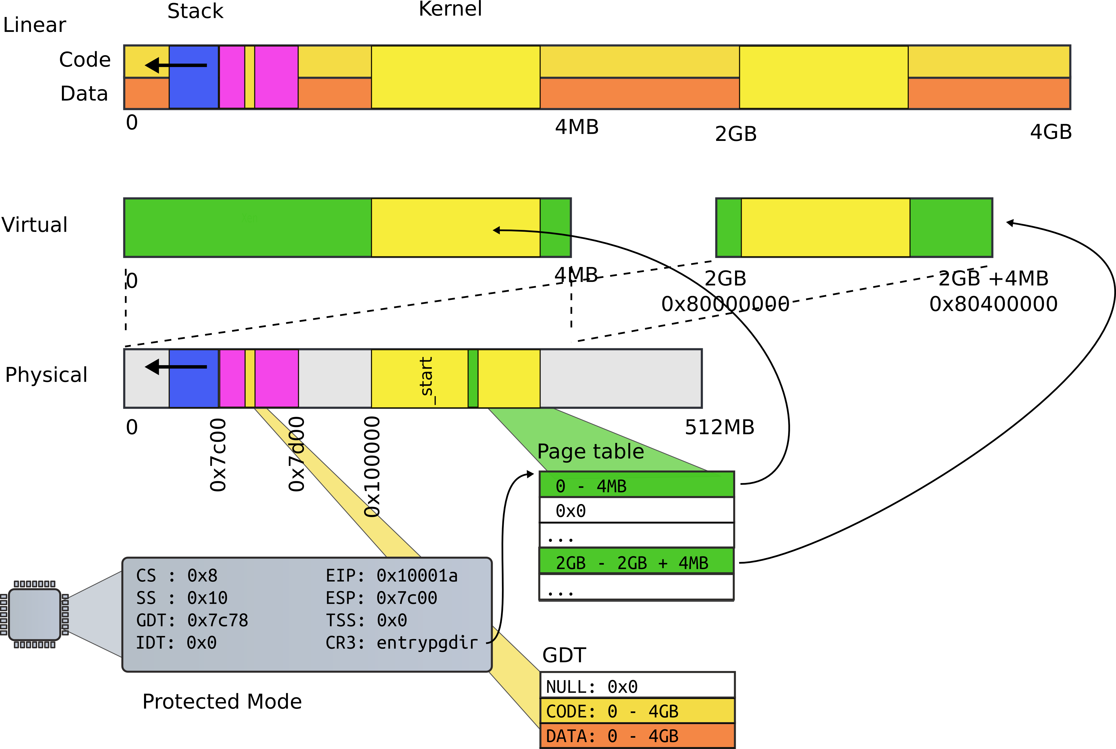
First page table

Slide 34
Turn on paging
1152 # Turn on paging.
1153 movl %cr0, %eax
1154 orl $(CR0_PG|CR0_WP), %eax
1155 movl %eax, %cr0

Slide 35
High address stack (4K)
1157 # Set up the stack pointer.
1158 movl $(stack + KSTACKSIZE), %esp
1159
...
1167 .comm stack, KSTACKSIZE
0151 #define KSTACKSIZE 4096 // size of
per−process kernel stack

Slide 36
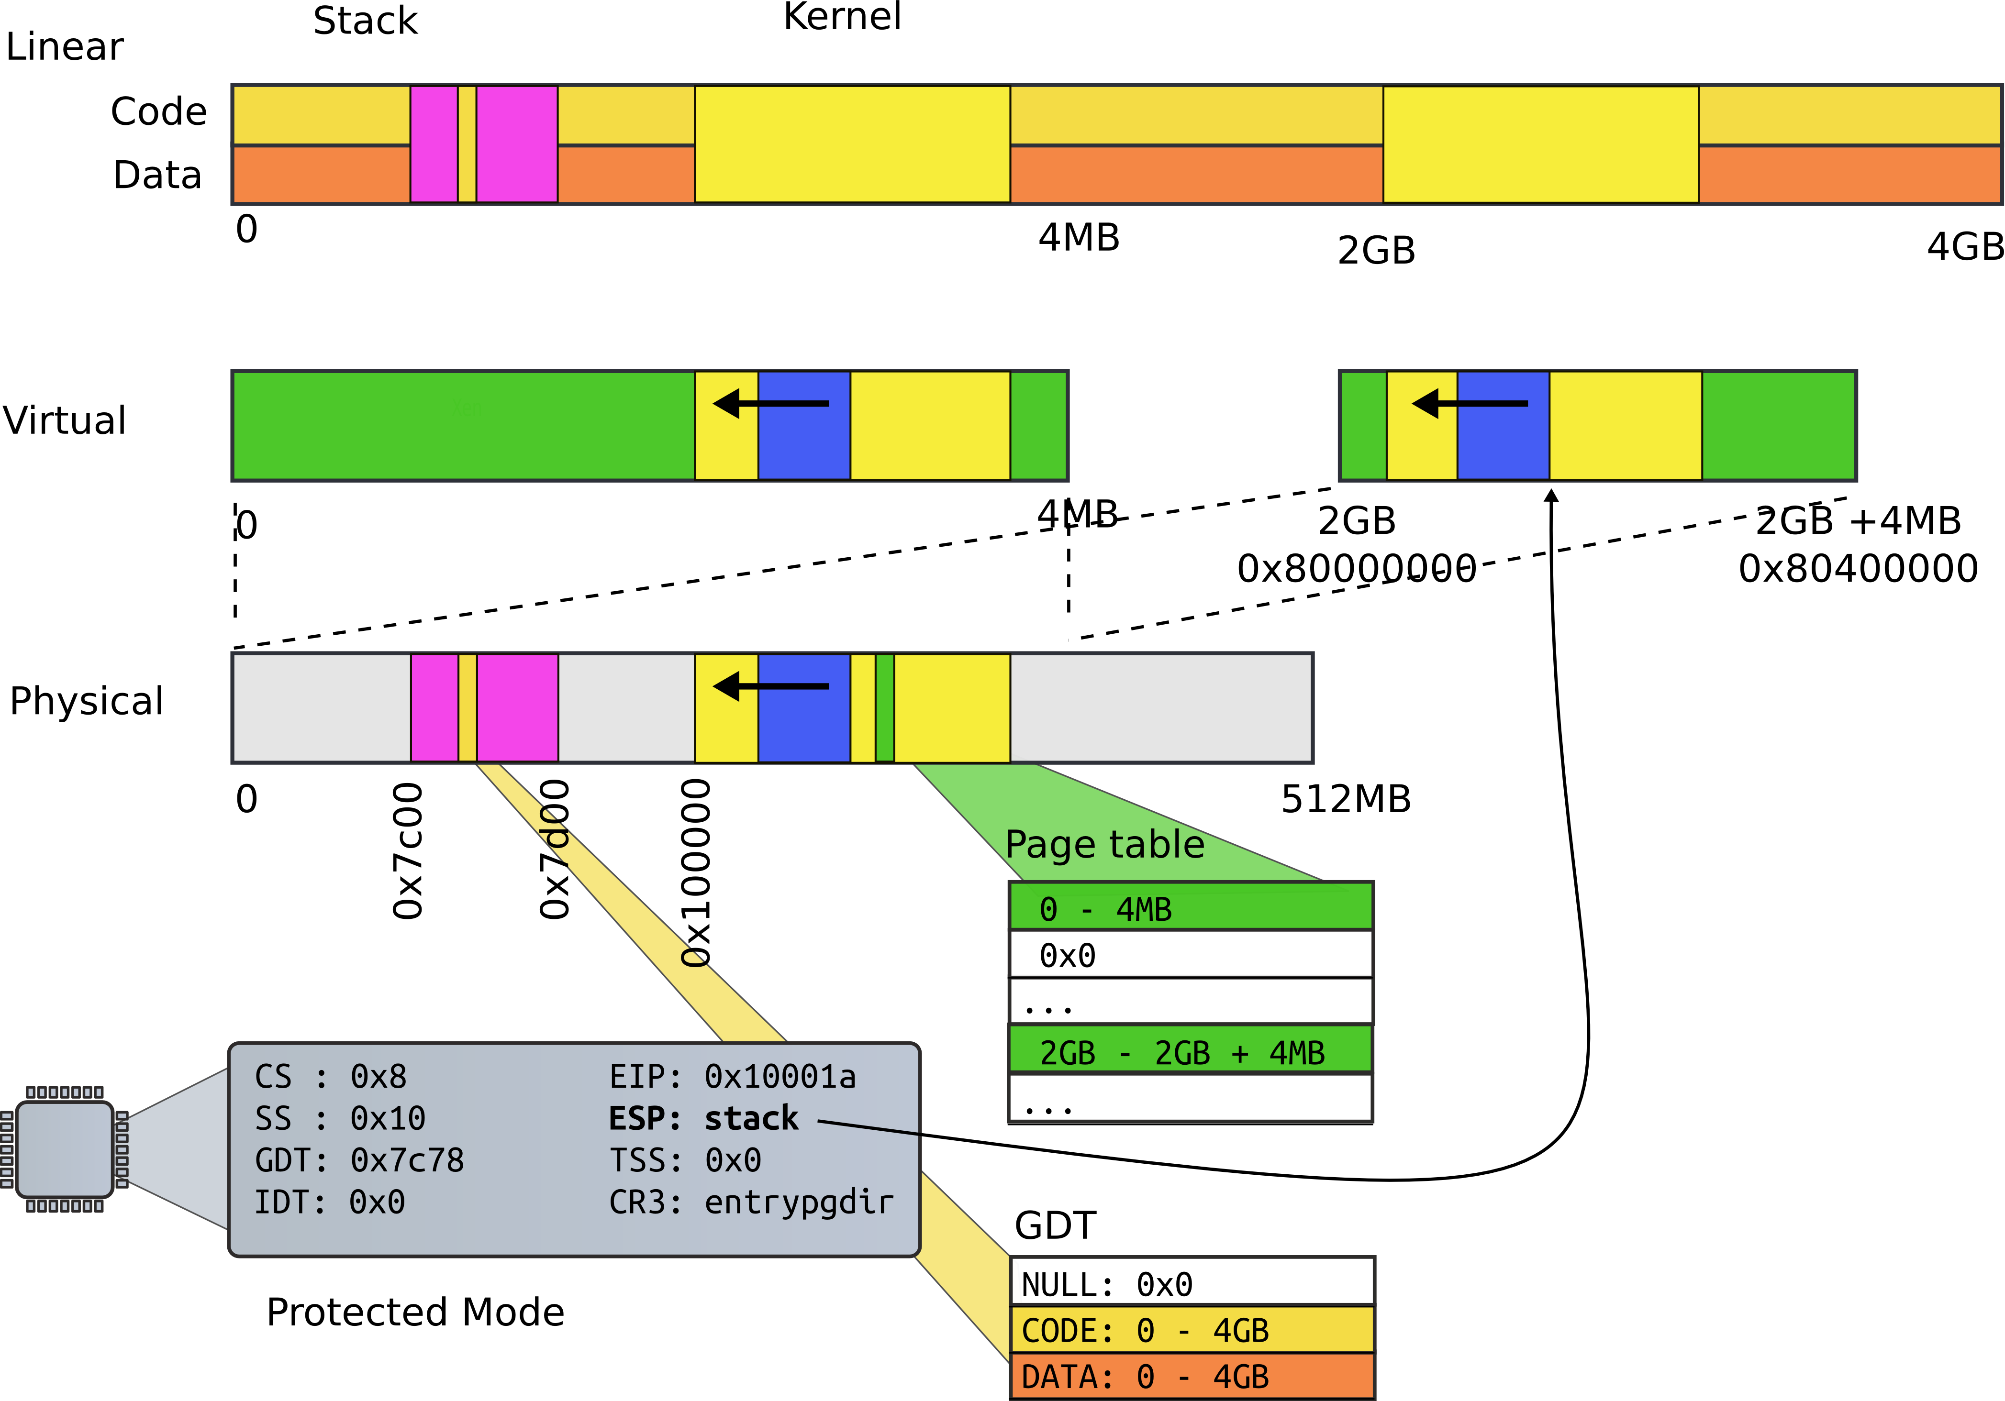
High address stack (4K)

Slide 37
Jump to main()
1160 # Jump to main(), and switch to executing at
1161 # high addresses. The indirect call is
needed because
1162 # the assembler produces a PC−relative
instruction
1163 # for a direct jump.
1164 mov $main, %eax
1165 jmp *%eax
1166

Slide 38
Running in main()
1313 // Bootstrap processor starts running C code here.
1314 // Allocate a real stack and switch to it, first
1315 // doing some setup required for memory allocator to work.
1316 int
1317 main(void)
1318 {
1319 kinit1(end, P2V(4*1024*1024)); // phys page allocator
1320 kvmalloc(); // kernel page table
1321 mpinit(); // detect other processors
1322 lapicinit(); // interrupt controller
1323 seginit(); // segment descriptors
1324 cprintf("\ncpu%d: starting xv6\n\n", cpunum());
...
1340 }

Slide 39
References
[1] Costan, Victor, and Srinivas Devadas. "Intel SGX Explained." IACR Cryptology ePrint Archive 2016 (2016): 86. https://eprint.iacr.org/2016/086.pdf

Slide 40
Questions?

