Slide 1
CS5460/6460: Operating Systems
Lecture 8: System init
Anton Burtsev
January, 2014

Slide 2
How old is the shepherd?
There are 125 sheep and 5 dogs in a flock. How old is the shepherd?

Slide 3
Recap from last time
Setup segments (data and code)
Switched to protected mode
  Loaded GDT (segmentation is on)
Setup stack (to call C functions)
Loaded kernel from disk
Setup first page table
  2 entries [ 0 : 4MB ] and [ 2GB : (2GB + 4MB) ]
Setup high-address stack
Jumped to main()

Slide 4
1157 # Set up the stack pointer.
1158 movl $(stack + KSTACKSIZE), %esp
1159
1160 # Jump to main(), and switch to executing at
1161 # high addresses. The indirect call is needed because
1162 # the assembler produces a PC−relative instruction
1163 # for a direct jump.
1164 mov $main, %eax
1165 jmp *%eax
1166
1167 .comm stack, KSTACKSIZE

Slide 5
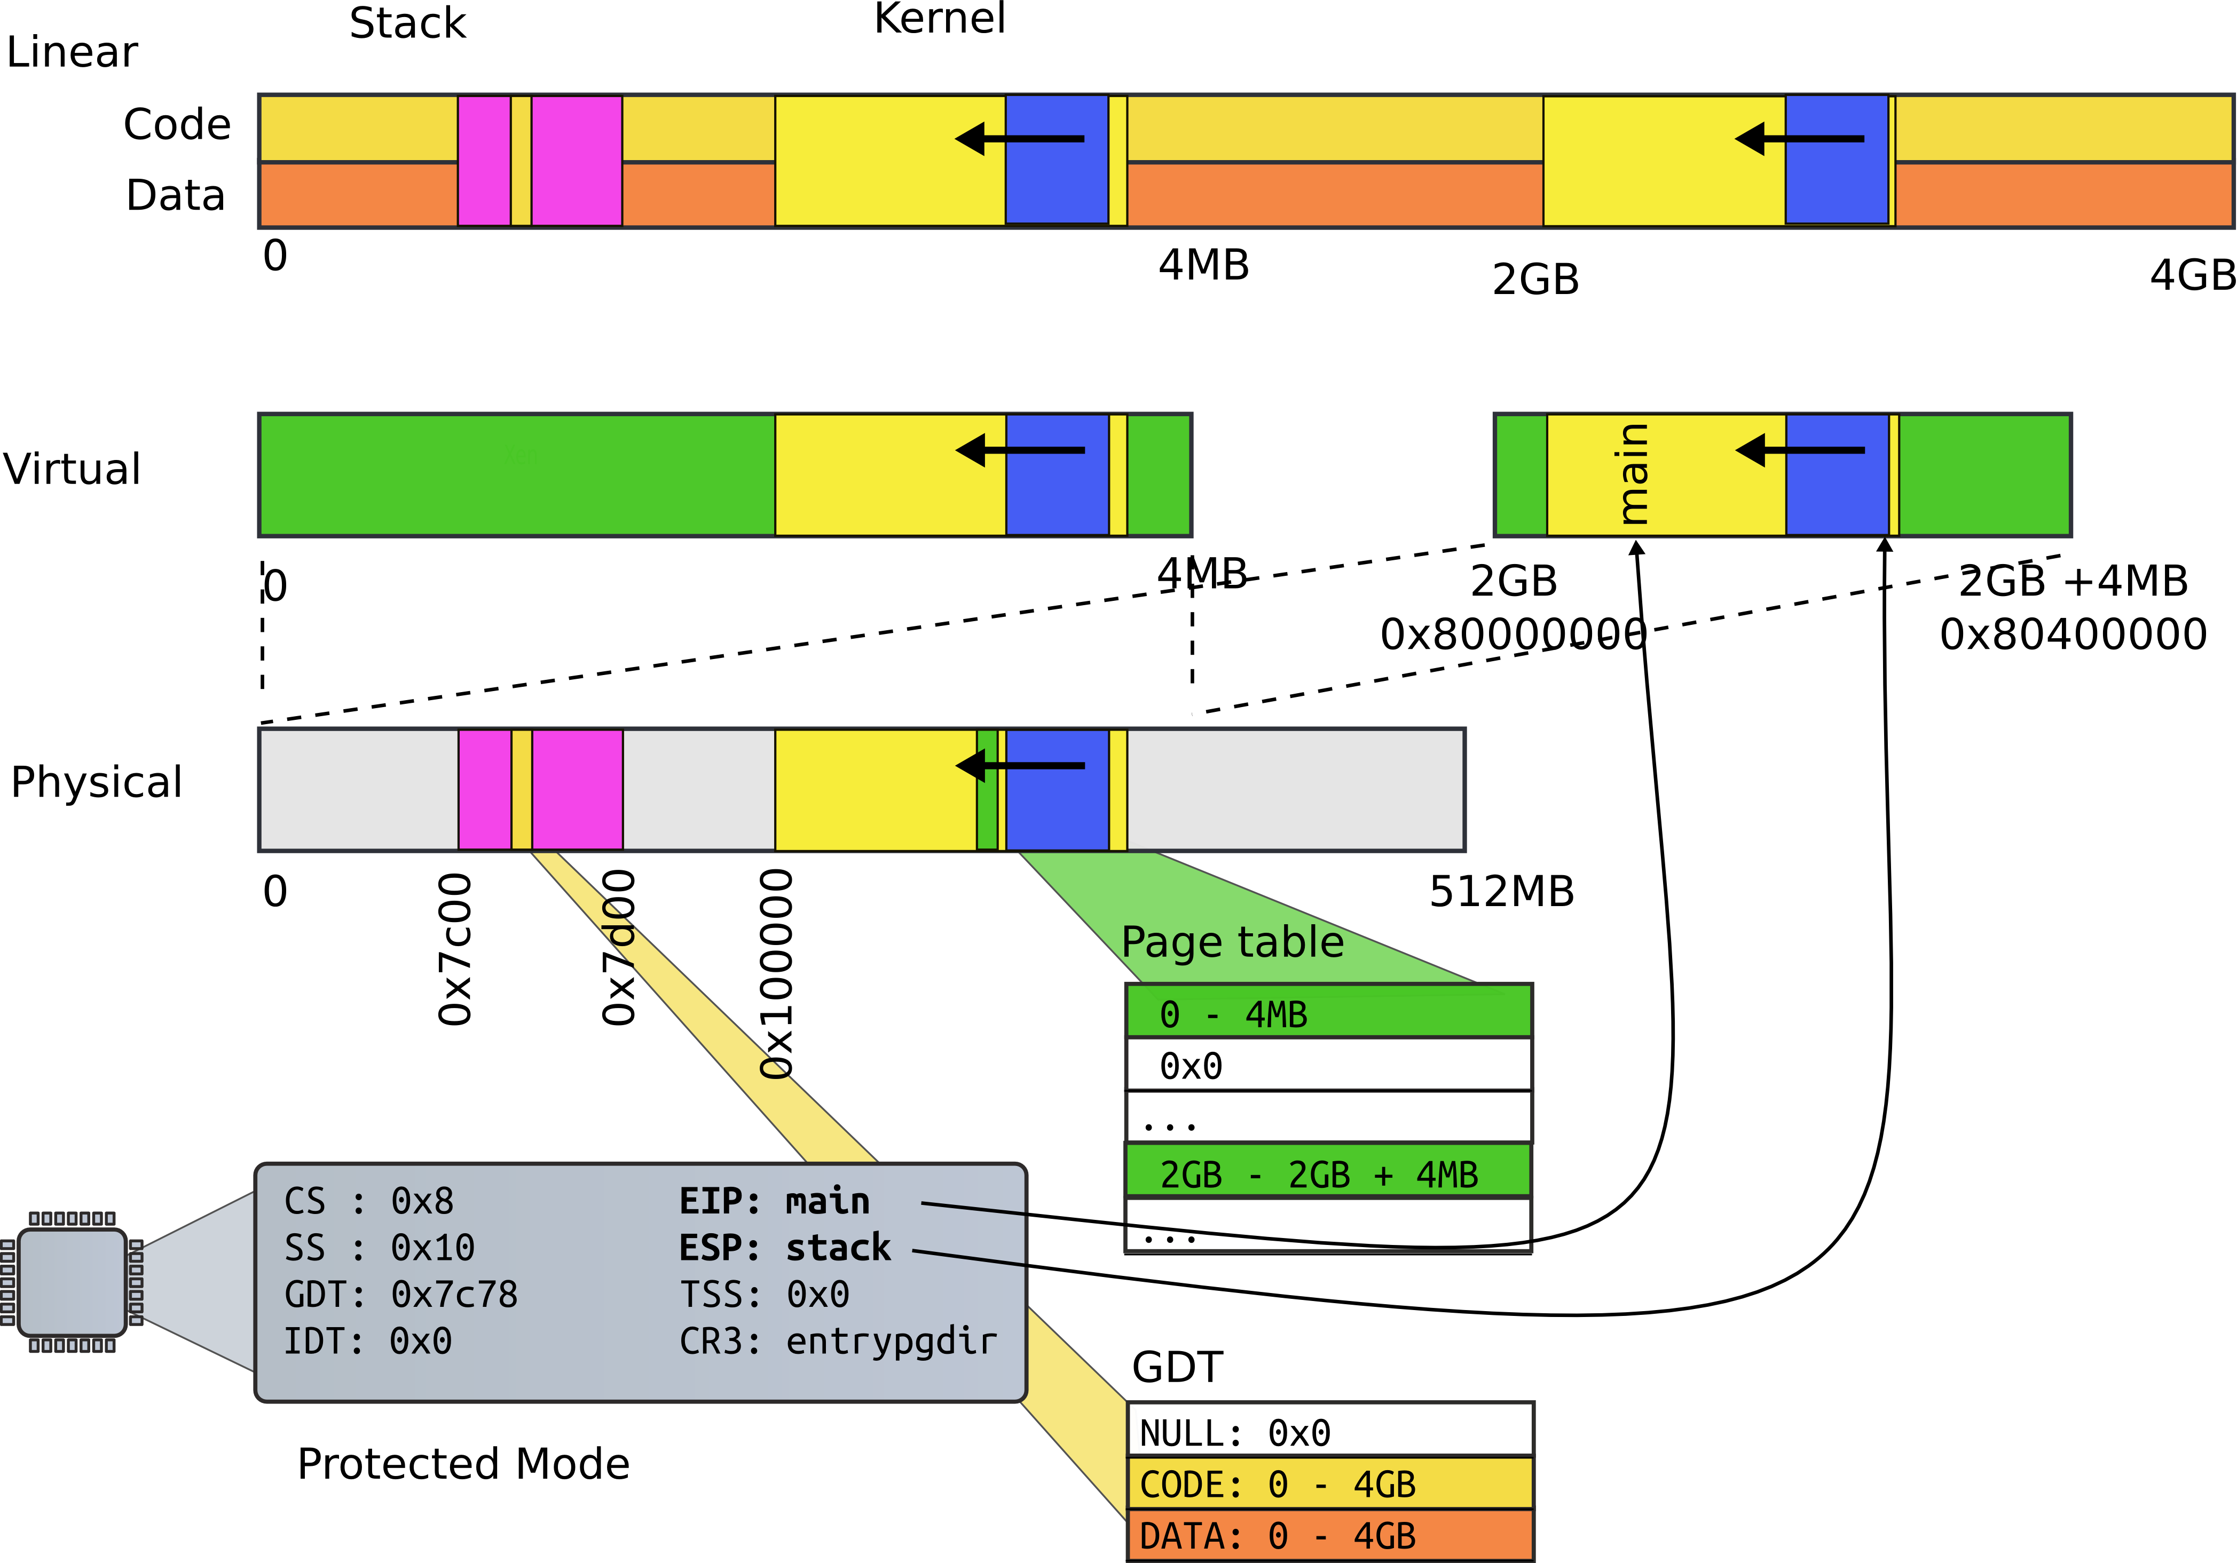
Jumped to main()

Slide 6
1316 int
1317 main(void)
1318 {
1319 kinit1(end, P2V(4*1024*1024)); // phys page allocator
1320 kvmalloc(); // kernel page table
1321 mpinit(); // detect other processors
1322 lapicinit(); // interrupt controller
1323 seginit(); // segment descriptors
1324 cprintf("\ncpu%d: starting xv6\n\n", cpunum());
1325 picinit(); // another interrupt controller
1326 ioapicinit(); // another interrupt controller
1327 consoleinit(); // console hardware
1328 uartinit(); // serial port
...
1340 }

Slide 7
Physical page allocator
Goal:
  List of free physical pages
  To allocate page tables, stacks, data structures, etc.
  Remember current page table is only 1! page
Where to get memory to keep the list itself?
  1 level, only 4MB entries
    You don't even have space to keep the second level page tables

Slide 8

Physical page allocator

Slide 9
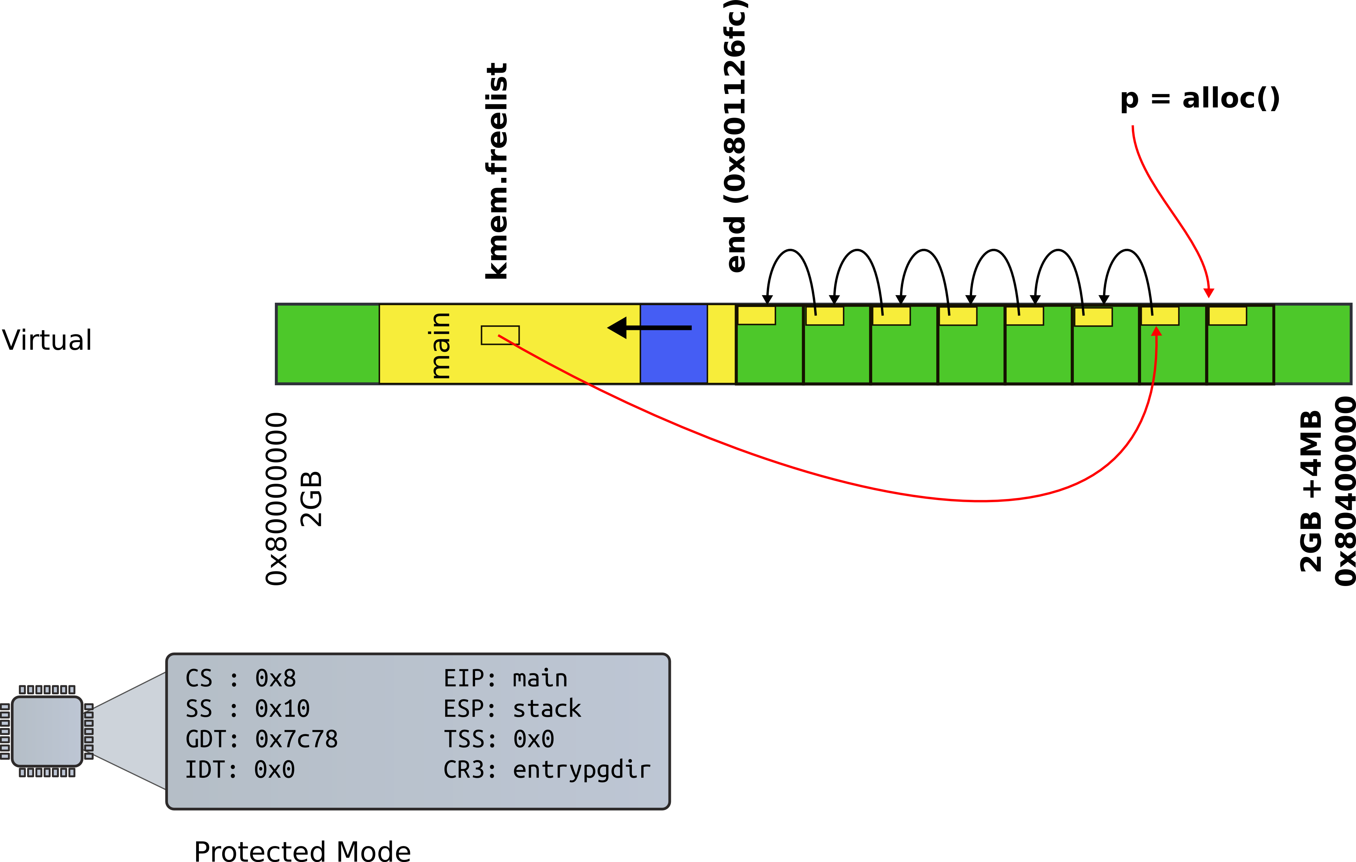
Physical page allocator

Slide 10
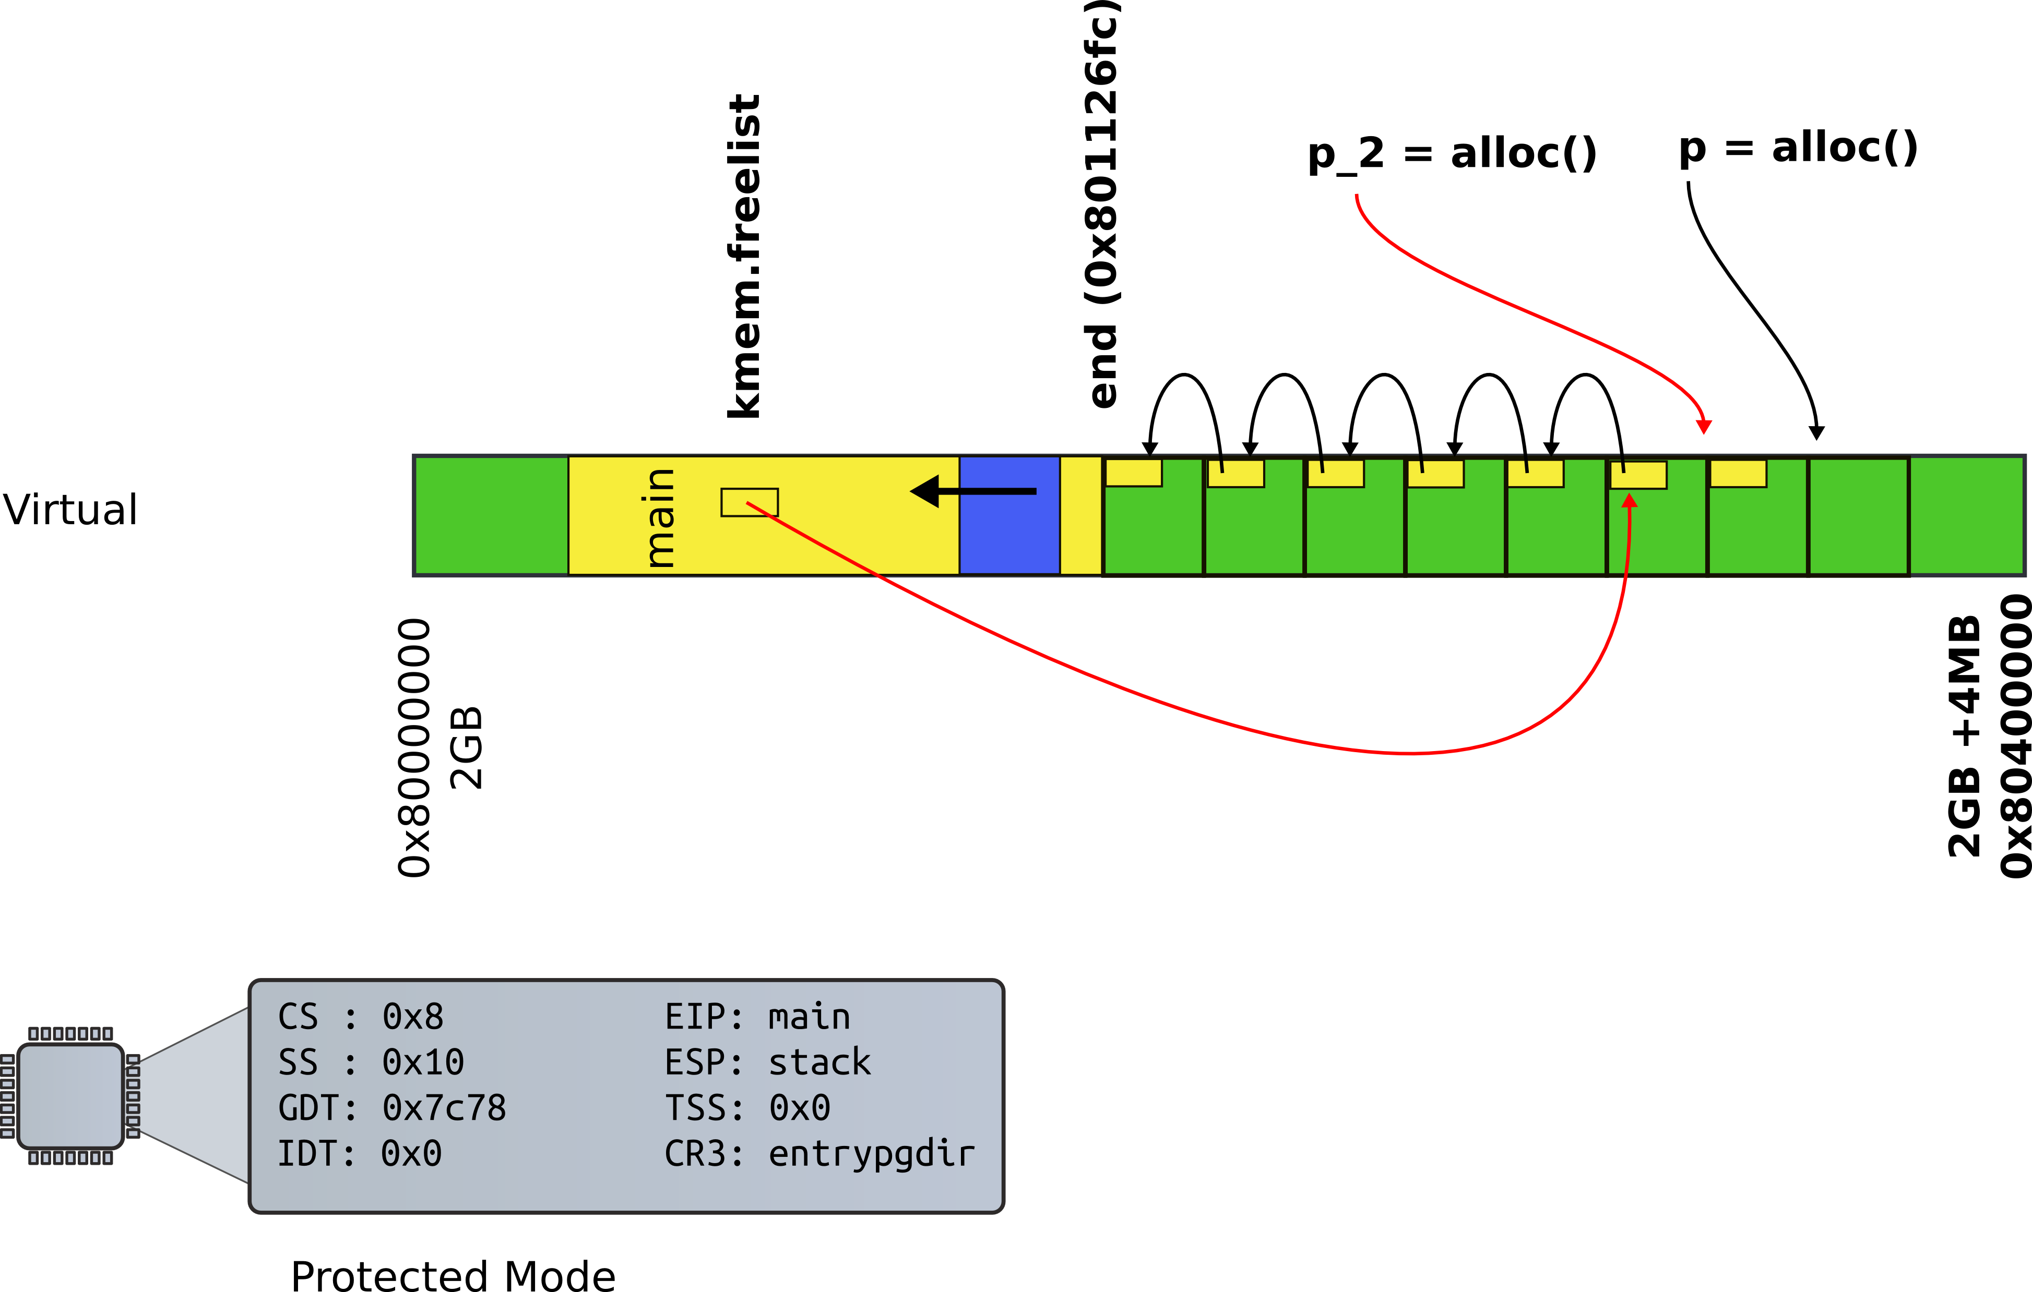
Physical page allocator

Slide 11
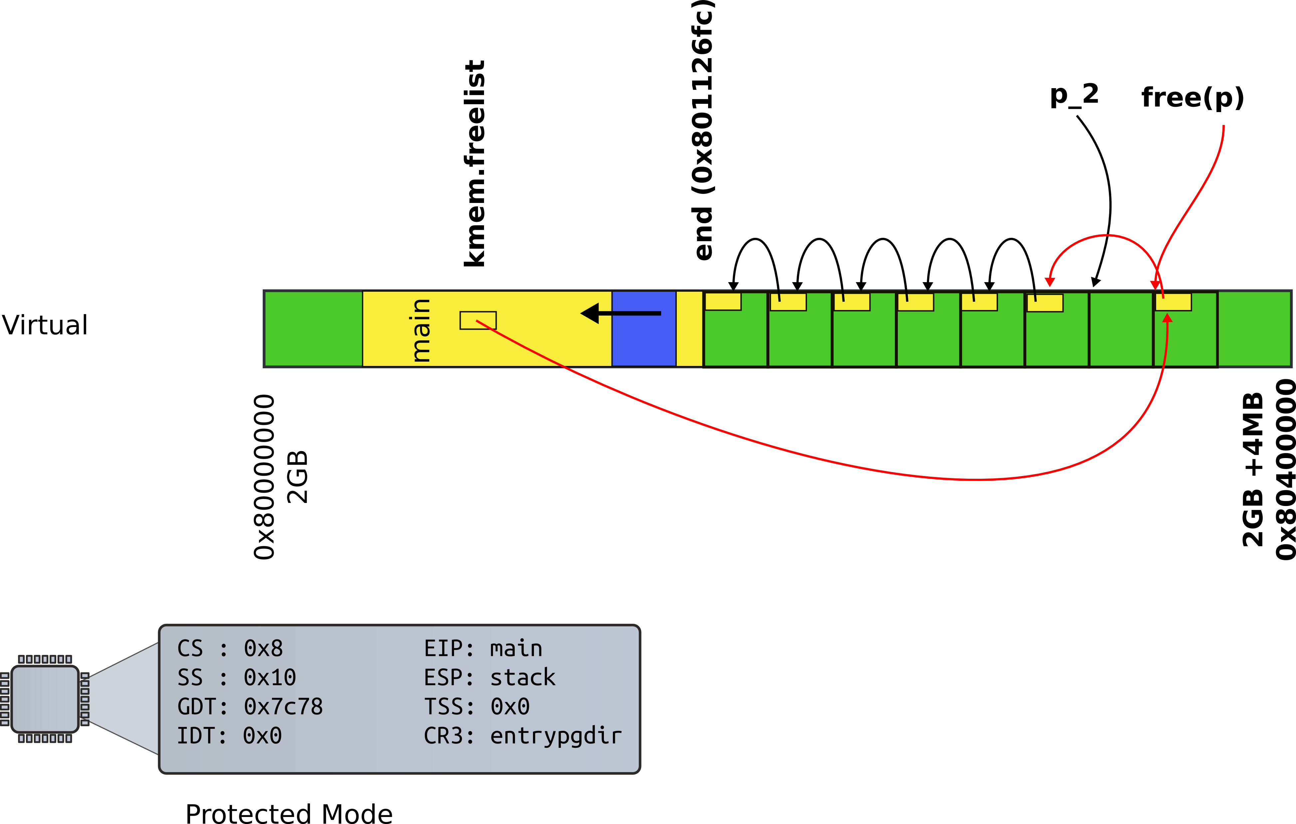
Physical page allocator

Slide 12
kalloc() - kernel allocator
3087 char*
3088 kalloc(void)
3089 {
3080 struct run *r;
...
3094 r = kmem.freelist;
3095 if(r)
3096 kmem.freelist = r−>next;
…
3099 return (char*)r;
3099 }

Slide 13
3065 kfree(char *v)
3066 {
3067 struct run *r;
...
3077 r = (struct run*)v;
3078 r−>next = kmem.freelist;
3079 kmem.freelist = r;
...
2832 }

Slide 14
Back to kinit1()
3030 kinit1(void *vstart, void *vend)
3031 {
...
3034 freerange(vstart, vend);
3035 }
3051 freerange(void *vstart, void *vend)
3052 {
3053 char *p;
3054 p = (char*)PGROUNDUP((uint)vstart);
3055 for(; p + PGSIZE <= (char*)vend; p += PGSIZE)
3056 kfree(p);
3057 }

Slide 15
Wait! Where do we start?
1316 int
1317 main(void)
1318 {
1319 kinit1(end, P2V(4*1024*1024)); // phys page allocator
1320 kvmalloc(); // kernel page table
1321 mpinit(); // detect other processors
What is this end?
1311 extern char end[];

Slide 16
Wait! Where do we start?
1316 int
1317 main(void)
1318 {
1319 kinit1(end, P2V(4*1024*1024)); // phys page allocator
1320 kvmalloc(); // kernel page table
1321 mpinit(); // detect other processors
What is this end?
1311 extern char end[]; // first address after
kernel loaded from ELF file

Slide 17
How come $main makes sense?
1157 # Set up the stack pointer.
1158 movl $(stack + KSTACKSIZE), %esp
1159
1160 # Jump to main(), and switch to executing at
1161 # high addresses. The indirect call is needed because
1162 # the assembler produces a PC−relative instruction
1163 # for a direct jump.
1164 mov $main, %eax
1165 jmp *%eax
1166
1167 .comm stack, KSTACKSIZE

Slide 18
Why is it there...0x80000000 + something?

Slide 19
Makefile
bootblock: bootasm.S bootmain.c
$(CC) $(CFLAGS) -fno-pic -O -nostdinc -I. -c bootmain.c
$(CC) $(CFLAGS) -fno-pic -nostdinc -I. -c bootasm.S
$(LD) $(LDFLAGS) -N -e start -Ttext 0x7C00 -o bootblock.o bootasm.o bootmain.o
$(OBJDUMP) -S bootblock.o > bootblock.asm
$(OBJCOPY) -S -O binary -j .text bootblock.o bootblock
kernel: $(OBJS) entry.o entryother initcode kernel.ld
$(LD) $(LDFLAGS) -T kernel.ld -o kernel entry.o $(OBJS) -b binary initcode
entryother
$(OBJDUMP) -S kernel > kernel.asm
$(OBJDUMP) -t kernel | sed '1,/SYMBOL TABLE/d; s/ .* / /; /^$$/d' > kernel.sym

Slide 20
kernel.ld: Linker script
OUTPUT_FORMAT("elf32-i386", "elf32-i386", "elf32-i386")
OUTPUT_ARCH(i386)
ENTRY(_start)
SECTIONS
{
/* Link the kernel at this address: "." means the current address */
/* Must be equal to KERNLINK */
. = 0x80100000;
….
.bss : {
*(.bss)
}
PROVIDE(end = .);
}

Slide 21
Back to main(): Kernel page table
1316 int
1317 main(void)
1318 {
1319 kinit1(end, P2V(4*1024*1024)); // phys page allocator
1320 kvmalloc(); // kernel page table
1321 mpinit(); // detect other processors
1322 lapicinit(); // interrupt controller
1323 seginit(); // segment descriptors
1324 cprintf("\ncpu%d: starting xv6\n\n", cpunum());
1325 picinit(); // another interrupt controller
1326 ioapicinit(); // another interrupt controller
1327 consoleinit(); // console hardware
1328 uartinit(); // serial port
...
1340 }

Slide 22
kvmalloc()
1857 kvmalloc(void)
1858 {
1859 kpgdir = setupkvm();
1860 switchkvm();
1861 }

Slide 23
Allocate page table directory
1836 pde_t*
1837 setupkvm(void)
1838 {
1839 pde_t *pgdir;
1840 struct kmap *k;
1841
1842 if((pgdir = (pde_t*)kalloc()) == 0)
1843 return 0;
1844 memset(pgdir, 0, PGSIZE);
...
1847 for(k = kmap; k < &kmap[NELEM(kmap)]; k++)
1848 if(mappages(pgdir, k−>virt, k−>phys_end − k−>phys_start,
1849 (uint)k−>phys_start, k−>perm) < 0)
1850 return 0;
1851 return pgdir;
1852 }

Slide 24
Remap physical pages
1836 pde_t*
1887 setupkvm(void)
1838 {
1839 pde_t *pgdir;
1840 struct kmap *k;
1841
1842 if((pgdir = (pde_t*)kalloc()) == 0)
1843 return 0;
1844 memset(pgdir, 0, PGSIZE);
...
1847 for(k = kmap; k < &kmap[NELEM(kmap)]; k++)
1848 if(mappages(pgdir, k−>virt, k−>phys_end − k−>phys_start,
1849 (uint)k−>phys_start, k−>perm) < 0)
1850 return 0;
1851 return pgdir;
1852 }

Slide 25
Kmap – kernel map
1823 static struct kmap {
1824 void *virt;
1825 uint phys_start;
1826 uint phys_end;
1827 int perm;
1828 } kmap[] = {
1829 { (void*)KERNBASE, 0, EXTMEM, PTE_W}, // I/O space
1830 { (void*)KERNLINK, V2P(KERNLINK), V2P(data), 0}, // kern text+rodata
1831 { (void*)data, V2P(data), PHYSTOP, PTE_W}, // kern data+memory
1832 { (void*)DEVSPACE, DEVSPACE, 0, PTE_W}, // more devices
1833 };

Slide 26


Slide 27
Remap physical pages
1836 pde_t*
1887 setupkvm(void)
1838 {
1839 pde_t *pgdir;
1840 struct kmap *k;
1841
1842 if((pgdir = (pde_t*)kalloc()) == 0)
1843 return 0;
1844 memset(pgdir, 0, PGSIZE);
...
1847 for(k = kmap; k < &kmap[NELEM(kmap)]; k++)
1848 if(mappages(pgdir, k−>virt, k−>phys_end − k−>phys_start,
1849 (uint)k−>phys_start, k−>perm) < 0)
1850 return 0;
1851 return pgdir;
1852 }

Slide 28
Create page table entries
1779 mappages(pde_t *pgdir, void *va, uint size, uint pa, int perm)
1780 {
1781 char *a, *last;
1782 pte_t *pte;
1783
1784 a = (char*)PGROUNDDOWN((uint)va);
1785 last = (char*)PGROUNDDOWN(((uint)va) + size − 1);
1786 for(;;){
1787 if((pte = walkpgdir(pgdir, a, 1)) == 0)
1788 return −1;
1789 if(*pte & PTE_P)
1790 panic("remap");
1791 *pte = pa | perm | PTE_P;
1792 if(a == last)
1793 break;
1794 a += PGSIZE;
1795 pa += PGSIZE;
1796 }
1797 return 0;
1798 }

Slide 29
PDX()
0805 // +−−−−−−−−10−−−−−−+−−−−−−−10−−−−−−−+−−−−−−−−−12−−−−−−−−−−+
0806 // | Page Directory | Page Table | Offset within Page |
0807 // | Index | Index | |
0808 // +−−−−−−−−−−−−−−−−+−−−−−−−−−−−−−−−−+−−−−−−−−−−−−−−−−−−−−−+
0809 // \−−− PDX(va) −−/ \−−− PTX(va) −−/
0810
0811 // page directory index
0812 #define PDX(va) (((uint)(va) >> PDXSHIFT) & 0x3FF)
...
0827 #define PDXSHIFT 22 // offset of PDX in a linear address

Slide 30
P2V and V2P
0206 // Key addresses for address space layout (see kmap in vm.c for layout)
0207 #define KERNBASE 0x80000000 // First kernel virtual address
0208 #define KERNLINK (KERNBASE+EXTMEM) // Address where kernel is linked
0209
0210 #define V2P(a) (((uint) (a)) − KERNBASE)
0211 #define P2V(a) (((void *) (a)) + KERNBASE)

Slide 31
Walk page table
1754 walkpgdir(pde_t *pgdir, const void *va, int alloc)
1755 {
1756 pde_t *pde;
1757 pte_t *pgtab;
1758
1759 pde = &pgdir[PDX(va)];
1760 if(*pde & PTE_P){
1761 pgtab = (pte_t*)P2V(PTE_ADDR(*pde));
1762 } else {
1763 if(!alloc || (pgtab = (pte_t*)kalloc()) == 0)
1764 return 0;
1765 // Make sure all those PTE_P bits are zero.
1766 memset(pgtab, 0, PGSIZE);
...
1770 *pde = V2P(pgtab) | PTE_P | PTE_W | PTE_U;
1771 }
1772 return &pgtab[PTX(va)];
1773 }

Slide 32
Walk page table
1754 walkpgdir(pde_t *pgdir, const void *va, int alloc)
1755 {
1756 pde_t *pde;
1757 pte_t *pgtab;
1758
1759 pde = &pgdir[PDX(va)];
1760 if(*pde & PTE_P){
1761 pgtab = (pte_t*)P2V(PTE_ADDR(*pde));
1762 } else {
1763 if(!alloc || (pgtab = (pte_t*)kalloc()) == 0)
1764 return 0;
1765 // Make sure all those PTE_P bits are zero.
1766 memset(pgtab, 0, PGSIZE);
...
1770 *pde = V2P(pgtab) | PTE_P | PTE_W | PTE_U;
1771 }
1772 return &pgtab[PTX(va)];
1773 }

Slide 33
Create page table entries
1779 mappages(pde_t *pgdir, void *va, uint size, uint pa, int perm)
1780 {
1781 char *a, *last;
1782 pte_t *pte;
1783
1784 a = (char*)PGROUNDDOWN((uint)va);
1785 last = (char*)PGROUNDDOWN(((uint)va) + size − 1);
1786 for(;;){
1787 if((pte = walkpgdir(pgdir, a, 1)) == 0)
1788 return −1;
1789 if(*pte & PTE_P)
1790 panic("remap");
1791 *pte = pa | perm | PTE_P;
1792 if(a == last)
1793 break;
1794 a += PGSIZE;
1795 pa += PGSIZE;
1796 }
1797 return 0;
1798 }

Slide 34
kvmalloc()
1757 kvmalloc(void)
1758 {
1759 kpgdir = setupkvm();
1760 switchkvm();
1761 }

Slide 35
Switch to the new page table
1765 void
1766 switchkvm(void)
1767 {
1768 lcr3(v2p(kpgdir));
1769 }

Slide 36
Thank you!

