Slide 1
ICS143A: Principles of Operating Systems
Final recap, sample questions
Anton Burtsev
December, 2017

Slide 2
What is operating system?

Slide 3
What is a process?

Slide 4
What mechanisms are involved into implementation of a process?

Slide 5
Describe the x86 address translation pipeline (draw figure), explain stages.

Slide 6

Address translation

Slide 7


Slide 15
What is the linear address? What address is in the registers, e.g., in %eax?

Slide 16

Logical and linear addresses
Segment selector (16 bit) + offset (32 bit)

Slide 17
What segments do the following instructions use? push, jump, mov

Slide 18
What's on the stack? Describe layout of a stack and how it changes during function invocation?

Slide 19
Example stack
: :
| 10 | [ebp + 16] (3rd function argument)
| 5 | [ebp + 12] (2nd argument)
| 2 | [ebp + 8] (1st argument)
| RA | [ebp + 4] (return address)
| FP | [ebp] (old ebp value)
| | [ebp - 4] (1st local variable)
: :
: :
| | [ebp - X] (esp - the current stack pointer)

Slide 20
Describe the steps and data structures involved into a user to kernel transition (draw diagrams)

Slide 21
Interrupt path

Slide 22
Which stack is used for execution of an interrupt handler? How does hardware find it?

Slide 23
Interrupt path

Slide 24
Describe organization of the memory allocator in xv6?

Slide 25

Physical page allocator

Slide 26
Where did free memory came from?

Slide 27
How do we switch between processes?

Slide 28
swtch()
2958 swtch:
2959 movl 4(%esp), %eax
2960 movl 8(%esp), %edx
2961
2962 # Save old callee−save registers
2963 pushl %ebp
2964 pushl %ebx
2965 pushl %esi
2966 pushl %edi
2967
2968 # Switch stacksh
2969 movl %esp, (%eax)
2970 movl %edx, %esp
2971
2972 # Load new callee−save registers
2973 popl %edi
2974 popl %esi
2975 popl %ebx
2976 popl %ebp
2977 ret
2093 struct context {
2094 uint edi;
2095 uint esi;
2096 uint ebx;
2097 uint ebp;
2098 uint eip;
2099 };

Slide 29
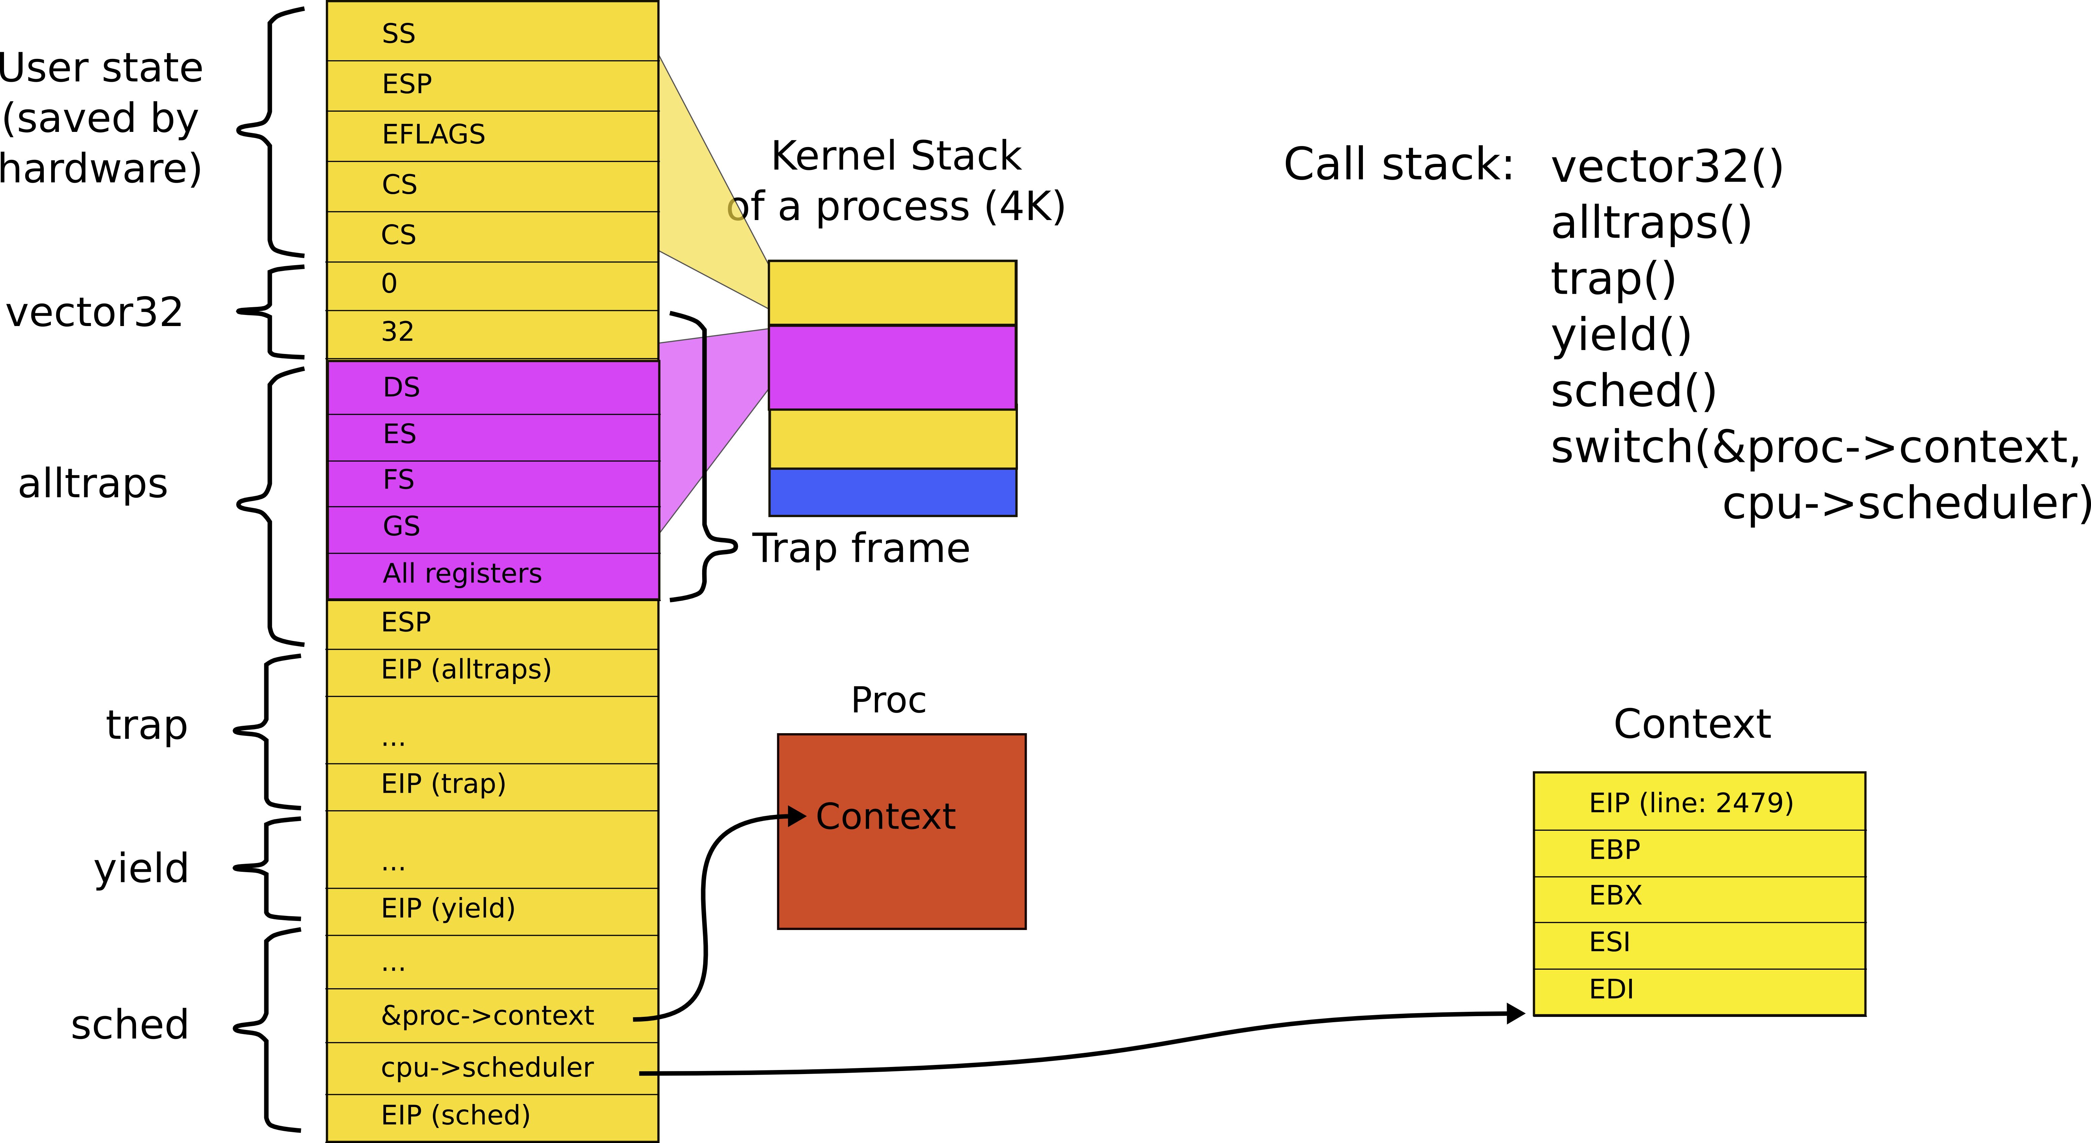
Stack inside swtch()

Slide 30
What is the interface between the kernel and user-level processes?

Slide 31
3374 void
3375 syscall(void)
3376 {
3377 int num;
3378
3379 num = proc−>tf−>eax;
3380 if(num > 0 && num < NELEM(syscalls) && syscalls[num]) {
3381 proc−>tf−>eax = syscalls[num]();
3382 } else {
3383 cprintf("%d %s: unknown sys call %d\n",
3384 proc−>pid, proc−>name, num);
3385 proc−>tf−>eax = −1;
3386 }
3387 }

Slide 32
3374 void
3375 syscall(void)
3376 {
3377 int num;
3378
3379 num = proc−>tf−>eax;
3380 if(num > 0 && num < NELEM(syscalls) && syscalls[num]) {
3381 // proc−>tf−>eax = syscalls[num]();
proc->tf->esp -= 4;
*(int*)ptoc->tf->esp = syscalls[num]();
3382 } else {
3383 cprintf("%d %s: unknown sys call %d\n",
3384 proc−>pid, proc−>name, num);
3385 // proc−>tf−>eax = −1;
proc->tf->esp -= 4;
*(int*)ptoc->tf->esp = -1;
3386 }
3387 }

Slide 33
Why do we need locks?

Slide 34

Request queue (e.g. incoming network packets)
Linked list, list is pointer to the first element

Slide 35

CPU 1 and 2 allocate new request

Slide 36

CPU 1 and 2 update next pointer

Slide 37

CPUs 1 updates head pointer

Slide 38

CPU2 updates head pointer

Slide 39

State after the race

Slide 40
List implementation with locks
9 insert(int data)
10 {
11 struct list *l;
13 l = malloc(sizeof *l);
acquire(&listlock);
14 l->data = data;
15 l->next = list;
16 list = l;
release(&listlock);
17 }
Critical section

Slide 41
Correct implementation
1573 void
1574 acquire(struct spinlock *lk)
1575 {
...
1580 // The xchg is atomic.
1581 while(xchg(&lk−>locked, 1) != 0)
1582 ;
...
1592 }

Slide 42
Xchg instruction
Swap a word in memory with a new value
  Atomic!
  Return old value

Slide 43

Deadlocks

Slide 44
Lock ordering
Locks need to be acquired in the same order

Slide 45

Locks and interrupts

Slide 46
Locks and interrupts
Never hold a lock with interrupts enabled

Slide 47
Send/receive queue
201 void*
202 send(struct q *q, void *p)
203 {
204 while(q->ptr != 0)
205 ;
206 q->ptr = p;
207 wakeup(q); /*wake recv*/
208 }
210 void*
211 recv(struct q *q)
212 {
213 void *p;
214
215 while((p = q->ptr) == 0)
216 sleep(q);
217 q->ptr = 0;
218 return p;
219 }

Slide 48

Lost wakeup problem

Slide 49
The role of file systems
Sharing
  Sharing of data across users and applications
Persistence
  Data is available after reboot

Slide 50
Architecture
On-disk and in-memory data structures represent
  The tree of named files and directories
  Record identities of disk blocks which hold data for each file
  Record which areas of the disk are free

Slide 51
Crash recovery
File systems must support crash recovery
  A power loss may interrupt a sequence of updates
  Leave file system in inconsistent state
    E.g. a block both marked free and used

Slide 52
Multiple users
Multiple users operate on a file system concurrently
  File system must maintain invariants

Slide 53
Speed
Access to a block device is several orders of magnitude slower
  Memory: 200 cycles
  Disk: 20 000 000 cycles
A file system must maintain a cache of disk blocks in memory

Slide 54

Block layer
Read and write data
  From a block device
  Into a buffer cache
Synchronize across multiple readers and writers

Slide 55
Transactions
Group multiple writes into an atomic transaction

Slide 56
Files
Unnamed files
  Represented as inodes
  Sequence of blocks holding file's data

Slide 57
Directories
Special kind of inode
  Sequence of directory entries
  Each contains name and a pointer to an unnamed inode

Slide 58
Pathnames
Hierarchical path names
  /usr/bin/sh
  Recursive lookup

Slide 59
System call
Abstract UNIX resources as files
  Files, sockets, devices, pipes, etc.
Unified programming interface

Slide 60
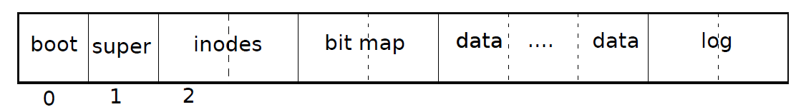
File system layout on disk
Block #0: Boot code
Block #1: Metadata about the file system
  Size (number of blocks)
  Number of data blocks
  Number of inodes
  Number of blocks in log

Slide 61
File system layout on disk
Block #2 (inode area)
Bit map area: track which blocks are in use
Data area: actual file data
Log area: maintaining consistency in case of a power outage or system crash

Slide 62
Typical use of transactions
begin_op();
...
bp = bread(...);
bp->data[...] = ...;
log_write(bp);
...
end_op();

Slide 63
Strawman scheduler (xv6)
Organize all processes as a simple list
In schedule():
  Pick first one on list to run next
  Put suspended task at the end of the list
Problem?

Slide 64
Xv6 scheduler
2458 scheduler(void)
2459 {
2462 for(;;){
2468 for(p = ptable.proc; p < &ptable.proc[NPROC]; p++){
2469 if(p−>state != RUNNABLE)
2470 continue;
2475 proc = p;
2476 switchuvm(p);
2477 p−>state = RUNNING;
2478 swtch(&cpu−>scheduler, proc−>context);
2479 switchkvm();
2483 proc = 0;
2484 }
2487 }
2488 }

Slide 65
Strawman scheduler (xv6)
Organize all processes as a simple list
In schedule():
  Pick first one on list to run next
  Put suspended task at the end of the list
Problem?

Slide 66
Strawman scheduler
Organize all processes as a simple list
In schedule():
  Pick first one on list to run next
  Put suspended task at the end of the list
Problem?
  Only allows round-robin scheduling
  Can’t prioritize tasks

Slide 67
Priority based scheduling
Higher-priority processes run first
Processes within the same priority are round-robin

Slide 68
O(1) scheduler (Linux 2.6 – 2.6.22)
Priority based scheduling
Goal: decide who to run next, independent of number of processes in system
  Still maintain ability to prioritize tasks, handle partially unused quanta, etc

Slide 69
O(1) data structures
runqueue: a list of runnable processes
  Blocked processes are not on any runqueue
  A runqueue belongs to a specific CPU
  Each task is on exactly one runqueue
  Task only scheduled on runqueue’s CPU unless migrated
2 *40 * #CPUs runqueues
  40 dynamic priority levels (more later)
  2 sets of runqueues – one active and one expired

Slide 70
O(1) data structures (contd)
Active
Expired
139
139
138
138
137
137
.
.
.
.
.
.
101
101
100
100

Slide 71
O(1) intuition
Take the first task off the lowest-numbered runqueue on active set
  Confusingly: a lower priority value means higher priority
When done, put it on appropriate runqueue on expired set
Once active is completely empty, swap which set of runqueues is active and expired
Constant time, since fixed number of queues to check; only take first item from non-empty queue

Slide 72
O(1) example
Active
Expired
139
139
138
138
137
Pick first, highest
priority task to run
137
Pick first, highest
priority task to run
Move to the
expired queue
.
.
.
.
.
.
101
101
100
100

Slide 73
What now?
Active
Expired
Flip active and
expired queues
139
139
138
138
137
137
.
.
.
.
.
.
101
101
100
100

Slide 74
Blocked tasks
What if a program blocks on I/O, say for the disk?
  It still has part of its quantum left
  Not runnable, so don’t waste time putting it on the active or expired runqueues
We need a “wait queue” associated with each blockable event
  Disk, lock, pipe, network socket, etc.

Slide 75
Blocking example
Disk
Active
Expired
139
139
138
138
137
137
.
.
.
.
.
.
Process goes on
disk wait queue
101
101
100
100

Slide 76
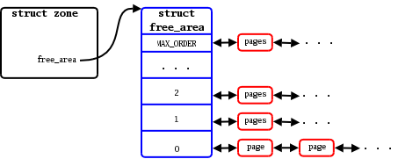
Buddy memory allocator

Slide 77
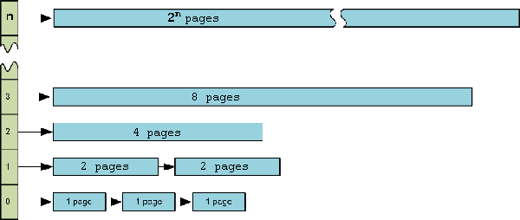
Buddy allocator

Slide 78
What's wrong with buddy?

Slide 79
What's wrong with buddy?
Buddy allocator is ok for large allocations
  E.g. 1 page or more
But what about small allocations?
  Buddy uses the whole page for a 4 bytes allocation
    Wasteful
  Buddy is still slow for short-lived objects

Slide 80
Slab:
Allocator for object of a fixed size

Slide 81
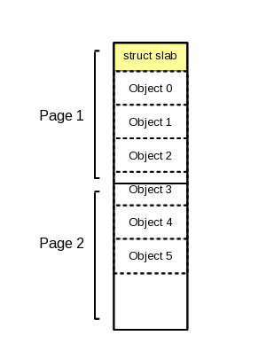
Slab
A 2 page slab with 6 objects

Slide 82
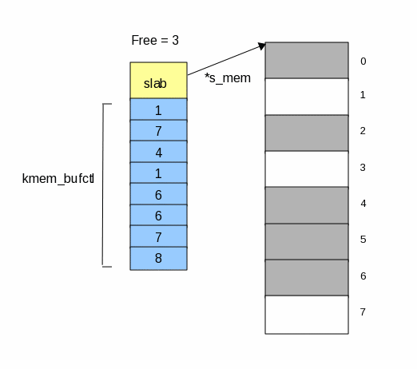
Keeping track of free objects
kmem_bufctl array is effectively a linked list
  First free object: 3
  Next free object: 1

Slide 83
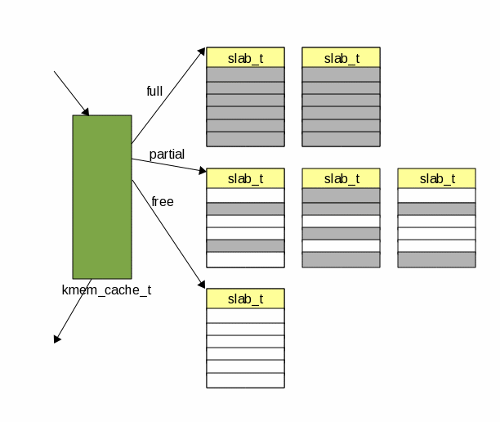
A cache is formed out of slabs

Slide 84
Slab is fine, but what's wrong?

Slide 85
Slab is fine, but what's wrong?
We can only allocate objects of one size

Slide 86
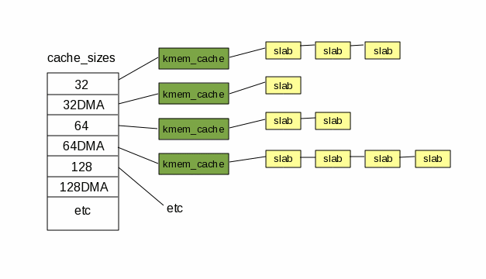
Kmalloc(): variable size objects
A table of caches
  Size: 32, 64, 128, etc.

Slide 87
Thank you!

