Slide 1
143A: Principles of Operating Systems
Lecture 6: Address translation
(Paging)
Anton Burtsev
October, 2017

Slide 2
Paging

Slide 3

Pages

Slide 4

Pages

Slide 5
Paging idea
Break up memory into 4096-byte chunks called pages
  Modern hardware supports 2MB, 4MB, and 1GB pages
Independently control mapping for each page of linear address space
Compare with segmentation (single base + limit)
  many more degrees of freedom

Slide 6
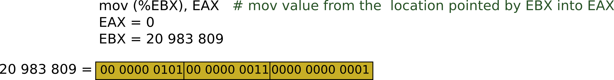
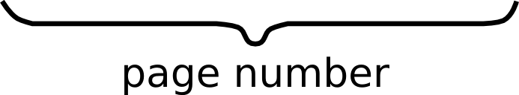





Slide 7



Slide 8





Slide 9

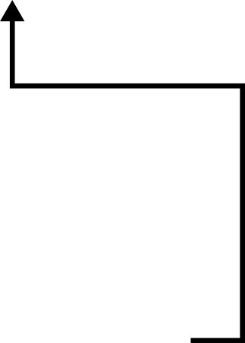


Slide 10



Slide 11
Result:
  EAX = 55

Slide 12

Page translation

Slide 13
Page translation

Slide 14
Page directory entry (PDE)
20 bit address of the page table

Slide 15
Page directory entry (PDE)
20 bit address of the page table
Wait... 20 bit address, but we need 32 bits

Slide 16
Page directory entry (PDE)
20 bit address of the page table
Wait... 20 bit address, but we need 32 bits
  Pages 4KB each, we need 1M to cover 4GB

Slide 17
Page directory entry (PDE)
20 bit address of the page table
  Pages 4KB each, we need 1M to cover 4GB
Bit #1: R/W – writes allowed?
  But allowed where?

Slide 18
Page directory entry (PDE)
20 bit address of the page table
  Pages 4KB each, we need 1M to cover 4GB
Bit #1: R/W – writes allowed?
  But allowed where?
  One page directory entry controls 1024 Level 2 page tables
    Each Level 2 maps 4KB page
  So it's a region of 4KB x 1024 = 4MB

Slide 19
Page directory entry (PDE)
20 bit address of the page table
  Pages 4KB each, we need 1M to cover 4GB
Bit #1: R/W – writes allowed?
  To a 4MB region controlled by this entry
Bit #2: U/S – user/supervisor
  If 0 – user-mode access is not allowed
A – accessed

Slide 20
Page directory entry (PDE)
20 bit address of the page table
  Pages 4KB each, we need 1M to cover 4GB
Bit #1: R/W – writes allowed?
  To a 4MB region controlled by this entry
Bit #2: U/S – user/supervisor
  If 0 – user-mode access is not allowed
  Allows protecting kernel memory from user-level applications

Slide 21
Page directory entry (PDE)
20 bit address of the page table
  Pages 4KB each, we need 1M to cover 4GB
Bit #1: R/W – writes allowed?
  To a 4MB region controlled by this entry
Bit #2: U/S – user/supervisor
  If 0 – user-mode access is not allowed
  Allows protecting kernel memory from user-level applications
Bit #5: A – accessed

Slide 22
Page translation

Slide 23
Page table entry (PTE)
20 bit address of the 4KB page
  Pages 4KB each, we need 1M to cover 4GB
Bit #1: R/W – writes allowed?
  To a 4KB page
Bit #2: U/S – user/supervisor
  If 0 user-mode access is not allowed
Bit #5: A – accessed
Bit #6: D – dirty – software has written to this page

Slide 24
Page translation

Slide 25
Back of the envelope
If a page is 4K and an entry is 4 bytes, how many entries per page?
  1k
How large of an address space can 1 page represent?
  1k entries * 1page/entry * 4K/page = 4MB
How large can we get with a second level of translation?
  1k tables/dir * 1k entries/table * 4k/page = 4 GB
  Nice that it works out that way!

Slide 26
Why do we need paging?
Compared to segments pages provide fine-grained control over memory layout
  No need to relocate/swap the entire segment
    One page is enough
You're trading flexibility (granularity) for overhead of data structures required for translation

Slide 27
Example 1: Ultimate flexibility
Each byte can be relocated anywhere in physical memory
What's the overhead of page tables?
  Imagine we use array instead of page tables (for simplicity)

Slide 28
Example 1: Ultimate flexibility
Each byte can be relocated anywhere in physical memory
What's the overhead of page tables?
  Imagine we use array instead of page tables (for simplicity)
  We need 4 bytes to relocate each other byte
    4 bytes describe 32bit address
  Therefore, we need array of 4 bytes x 4B entries
    16GBs

Slide 29
Example 2: Reasonable flexibility
Each 4K bytes (a page) can be relocated anywhere in physical memory
What's the overhead of page tables?
  Again, imagine we use array instead of page tables (for simplicity)

Slide 30
Example 2: Reasonable flexibility
Each 4K bytes (a page) can be relocated anywhere in physical memory
What's the overhead of page tables?
  Again, imagine we use array instead of page tables (for simplicity)
  We need 4 bytes to relocate each 4KB page
    4 bytes describe 32bit address
  Therefore, we need array of 4 bytes x 1M entries
    If we split 4GB address space, into 4GB pages, we need 1M pages
  We need 4MB array

Slide 31
Example 3: Less flexibility
Each 1M bytes (a 1MB page) can be relocated anywhere in physical memory
What's the overhead of page tables?
  Again, imagine we use array instead of page tables (for simplicity)
  We need 4 bytes to relocate each 1MB page
    4 bytes describe 32bit address
  Therefore, we need array of 4 bytes x 4K entries
    If we split 4GB address space, into 1MB pages, we need 4K pages
  We need 16KB array
    Wow! That's much less than 4MB required for 4KB pages

Slide 32
But why do we need page tables
Instead of arrays?

Slide 33
But why do we need page tables
… Instead of arrays?
Page tables represent sparse address space more efficiently
  An entire array has to be allocated upfront
  But if the address space uses a handful of pages
  Only page tables (Level 1 and 2 need to be allocated to describe translation)
On a dense address space this benefit goes away
  I'll assign a homework!

Slide 34

But what about isolation?
Two programs, one memory?

Slide 35
But what about isolation?
Two programs, one memory?
Each process has its own page table
  OS switches between them

Slide 36
Compared to segments pages allow ...
Emulate large virtual address space on a smaller physical memory
  In our example we had only 12 physical pages
  But the program can access all 1M pages in its 4GB address space
  The OS will move other pages to disk

Slide 37
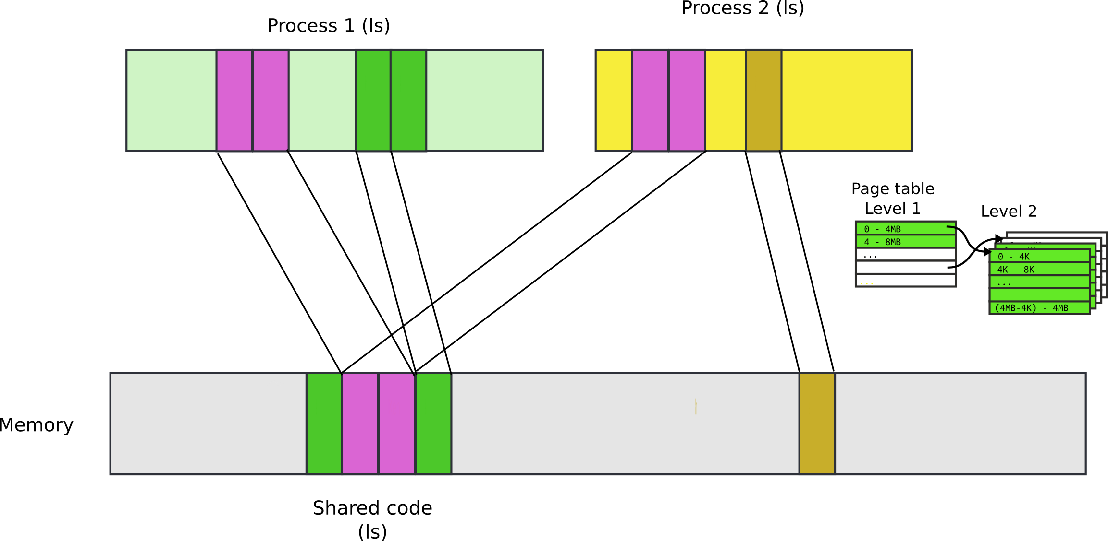
Compared to segments pages allow ...
Share a region of memory across multiple programs
  Communication (shared buffer of messages)
  Shared libraries

Slide 38
More paging tricks
Protect parts of the program
  E.g., map code as read-only
    Disable code modification attacks
    Remember R/W bit in PTD/PTE entries!
  E.g., map stack as non-executable
    Protects from stack smashing attacks
    Non-executable bit

Slide 39

Address translation

Slide 40


Slide 48
Questions?

Slide 49
References

Slide 50
More paging tricks
Determine a working set of a program?

Slide 51
More paging tricks
Determine a working set of a program?
  Use “accessed” bit

Slide 52
More paging tricks
Determine a working set of a program?
  Use “accessed” bit
Iterative copy of a working set?
  Used for virtual machine migration

Slide 53
More paging tricks
Determine a working set of a program?
  Use “accessed” bit
Iterative copy of a working set?
  Used for virtual machine migration
  Use “dirty” bit

Slide 54
More paging tricks
Determine a working set of a program?
  Use “accessed” bit
Iterative copy of a working set?
  Used for virtual machine migration
  Use “dirty” bit
Copy-on-write memory, e.g. lightweigh fork()?

Slide 55
More paging tricks
Determine a working set of a program?
  Use “accessed” bit
Iterative copy of a working set?
  Used for virtual machine migration
  Use “dirty” bit
Copy-on-write memory, e.g. lightweight fork()?
  Map page as read/only

Slide 56
When would you disable paging?

Slide 57
When would you disable paging?
Imagine you're running a memcached
  Key/value cache
You serve 1024 byte values (typical) on 10Gbps connection
  1024 byte packets can leave every 835ns, or 1670 cycles (2GHz machine)
  This is your target budget per packet

Slide 58
When would you disable paging?
Now, to cover 32GB RAM with 4K pages
  You need 64MB space
  64bit architecture, 3-level page tables
Page tables do not fit in L3 cache
  Modern servers come with 32MB cache
Every cache miss results in up to 3 cache misses due to page walk (remember 3-level page tables)
  Each cache miss is 200 cycles
Solution: 1GB pages

Slide 59

Page translation for 4MB pages

Slide 60
Segmentation

Slide 64

Descriptor table

Slide 65
Descriptor table

