Slide 1
ICS143A: Principles of Operating Systems
Lecture 12: Interrupts and Exceptions (part 2)
Anton Burtsev
November, 2017

Slide 2
Privilege levels again

Slide 3
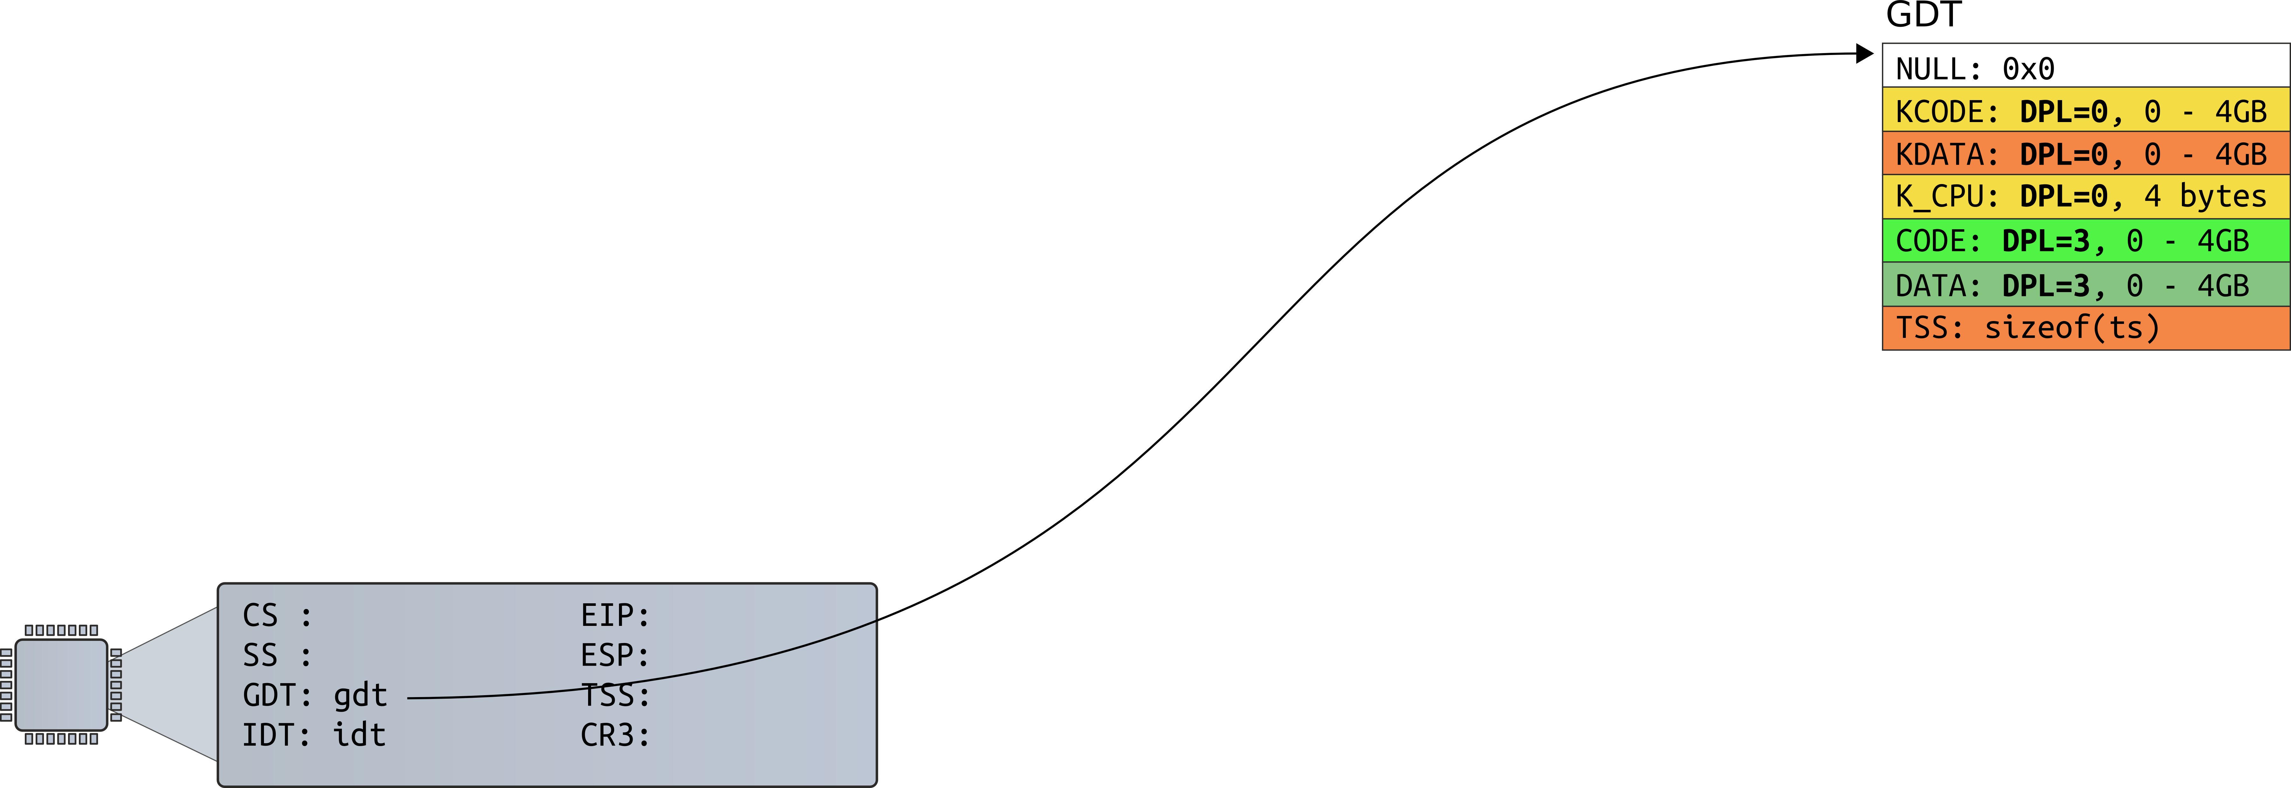
Started boot: no CPL yet

Slide 4
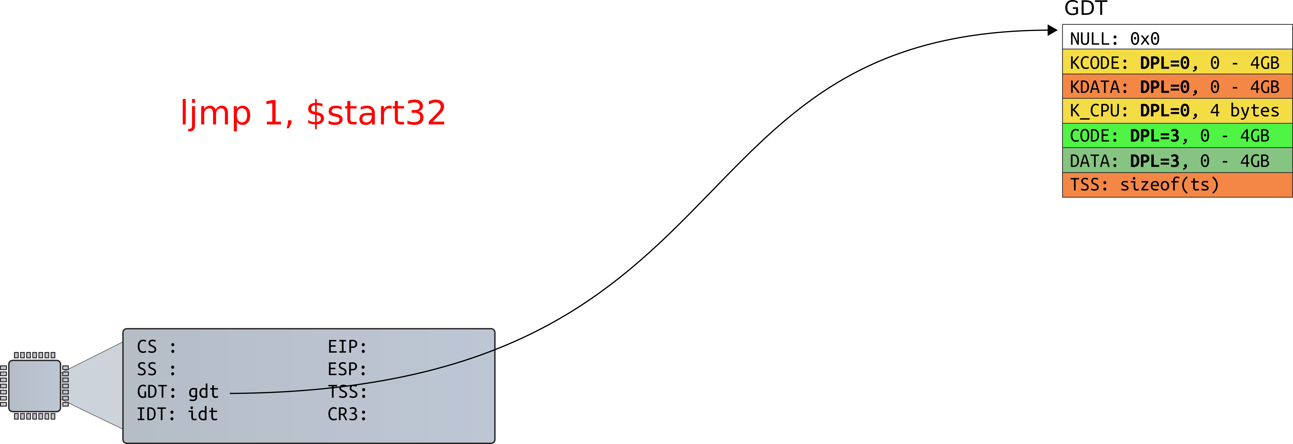
Prepare to load GDT entry #1

Slide 5
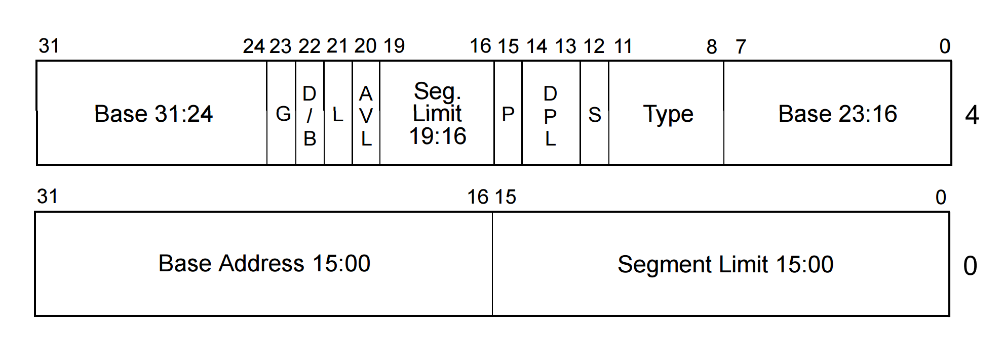
Privilege levels
Each segment has a privilege level
  DPL (descriptor privilege level)
  4 privilege levels ranging 0-3

Slide 6
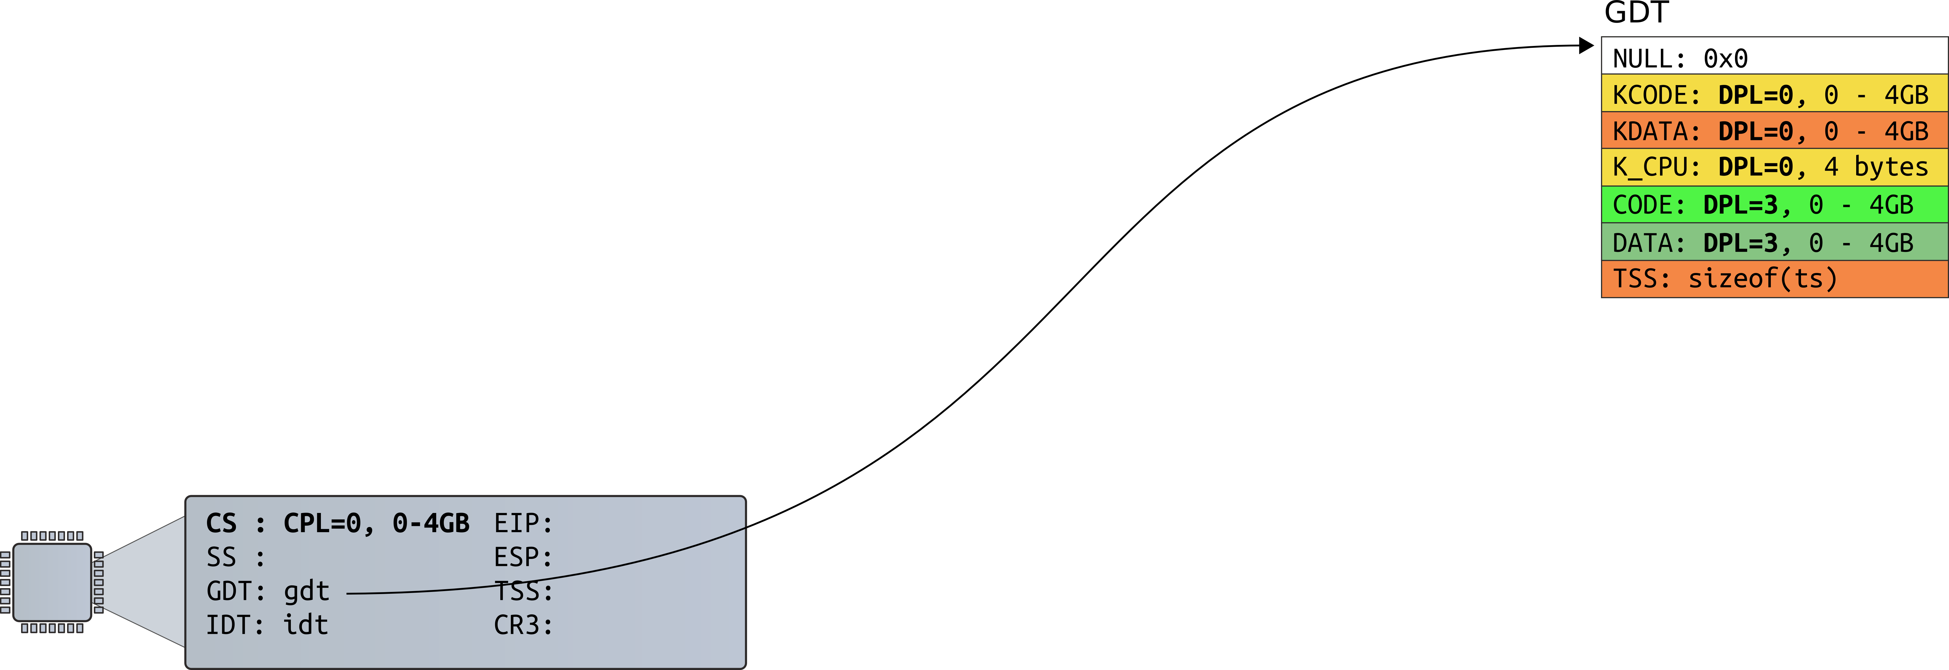
Now CPL=0. We run in the kernel

Slide 7
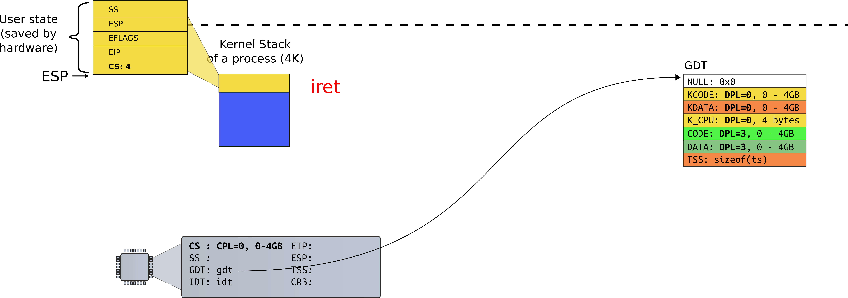
iret: return to user, load GDT #4

Slide 8
Run in user, CPL=3

Slide 9
Privilege levels
Currently running code also has a privilege level
  “Current privilege level” (CPL): 0-3
  It is saved in the %cs register

Slide 10
Privilege level transitions
CPL can access only less privileged segments
    E.g., 0 can access 1, 2, 3
Some instructions are “privileged”
  Can only be invoked at CPL = 0
  Examples:
    Load GDT
    MOV <control register>
      E.g. reload a page table by changing CR3

Slide 11
Real world
Only two privilege levels are used in modern OSes:
  OS kernel runs at 0
  User code runs at 3
This is called “flat” segment model
  Segments for both 0 and 3 cover entire address space
But then... how the kernel is protected?

Slide 12
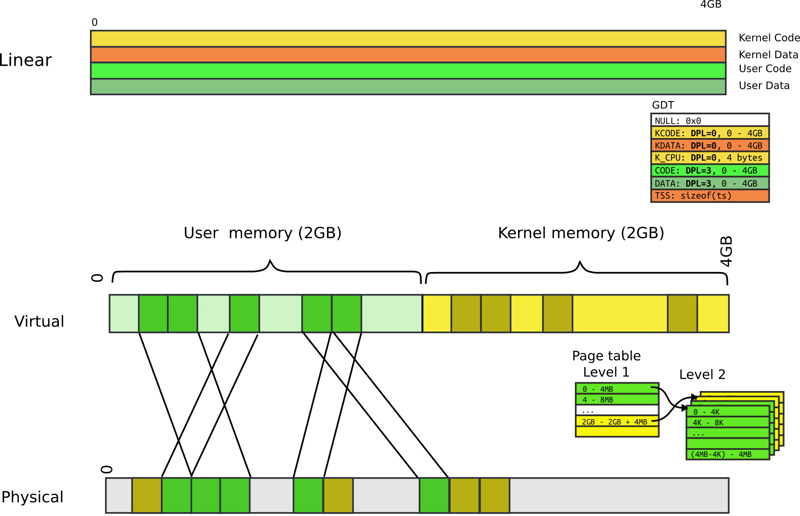

Slide 13
Page table: user bit
Each entry (both Level 1 and Level 2) has a bit
  If set, code at privilege level 3 can access
  If not, only levels 0-2 can access
Note, only 2 levels, not 4 like with segments
All kernel code is mapped with the user bit clear
  This protects user-level code from accessing the kernel

Slide 14
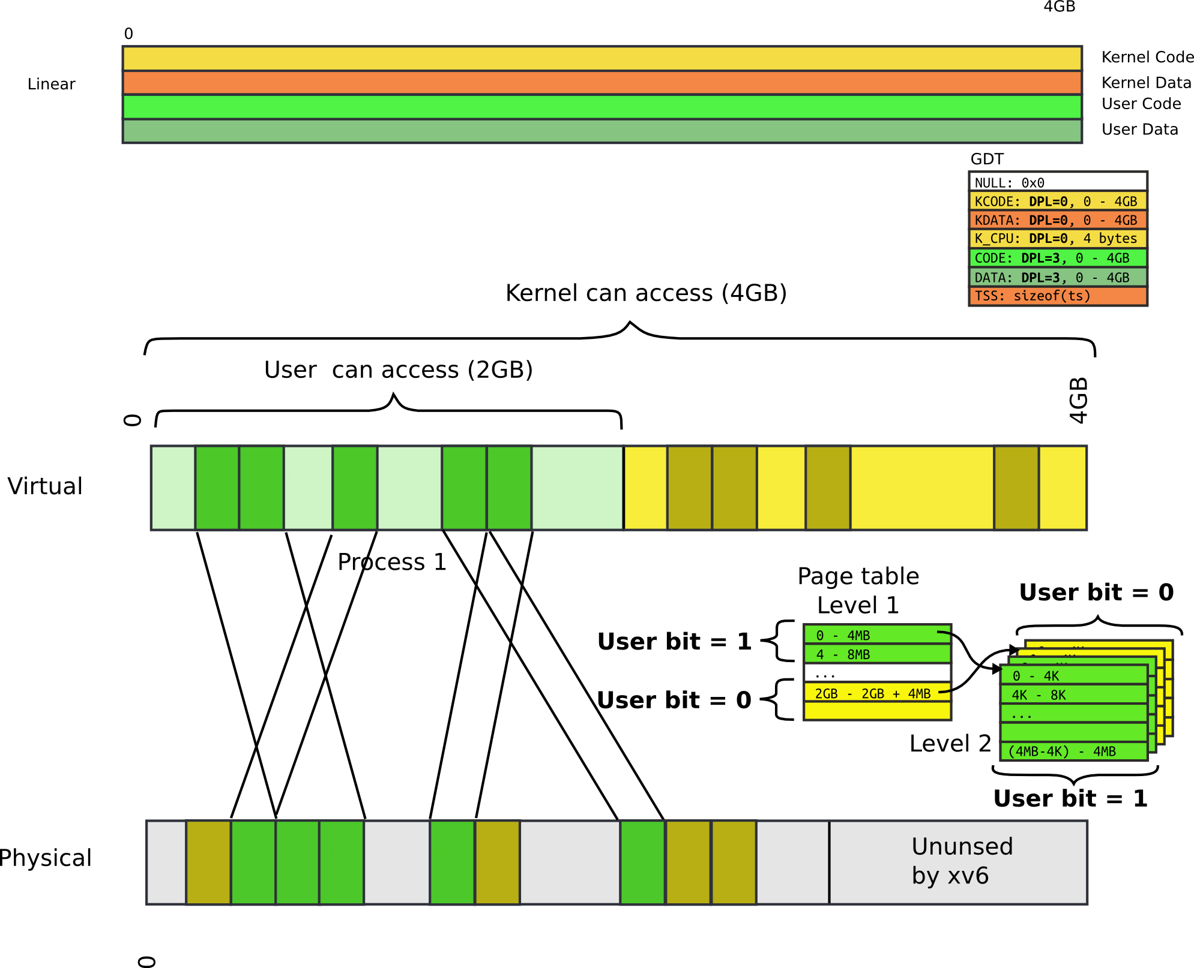

Slide 15
Back to interrupts

Slide 16
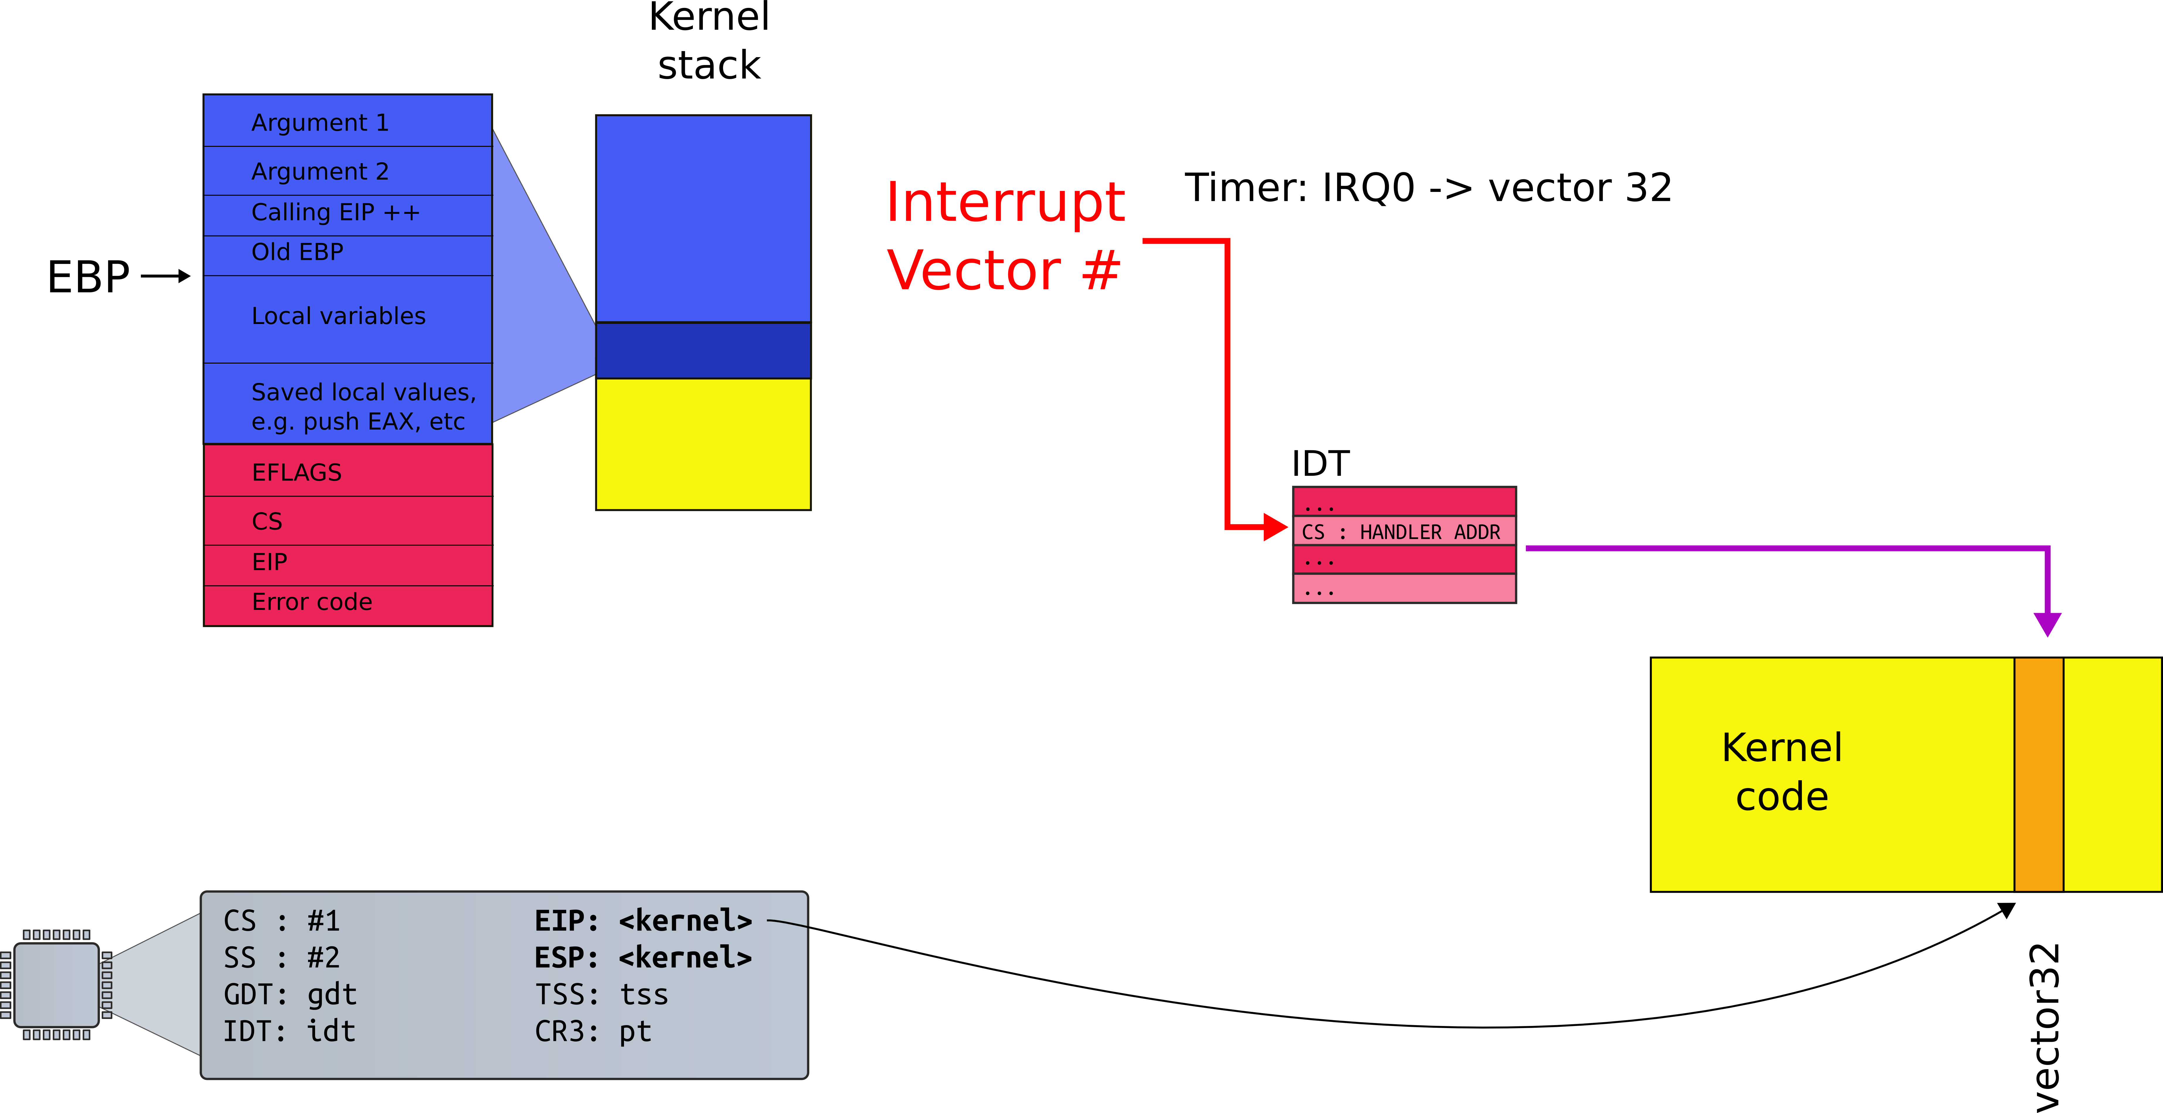
Recap: interrupt path, no PL change

Slide 17
Processing of interrupt (cross PL)
Assume we're at CPL =3 (user)

Slide 18
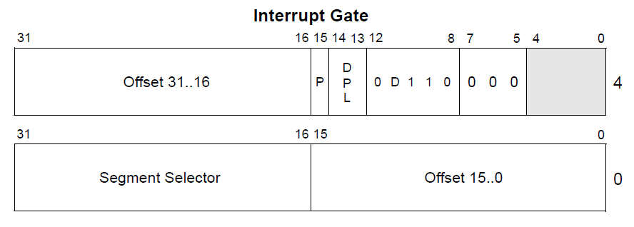
Interrupt descriptor
Interrupt is allowed
  If current privilege level (CPL) is less or equal to descriptor privilege level (DPL)
  The kernel protects device interrupts from user

Slide 19
Interrupt descriptor
Note that this new segment can be more privileged
  E.g., CPL = 3, DPL = 3, new segment can be PL = 0
  This is how user-code (PL=3) transitions into kernel (PL=0)

Slide 20
Interrupt path

Slide 21
Stack
Can we continue on the same stack?

Slide 22
Stack
But how hardware knows where it is?

Slide 23
TSS: Task State Segment (yet another table)

Slide 24
Task State Segment
Another magic control block
  Pointed to by special task register (TR)
Lots of fields for rarely-used features
A feature we care about in a modern OS:
  Location of kernel stack (fields SS/ESP)
    Stack segment selector
    Location of the stack in that segment

Slide 25
Processing of interrupt (cross PL)
Save ESP and SS in a CPU-internal register
Load SS and ESP from TSS
Push user SS, user ESP, user EFLAGS, user CS, user EIP onto new stack (kernel stack)
Set CS and EIP from IDT descriptor's segment selector and offset
If the call is through an interrupt gate clear some EFLAGS bits
Begin execution of a handler

Slide 26
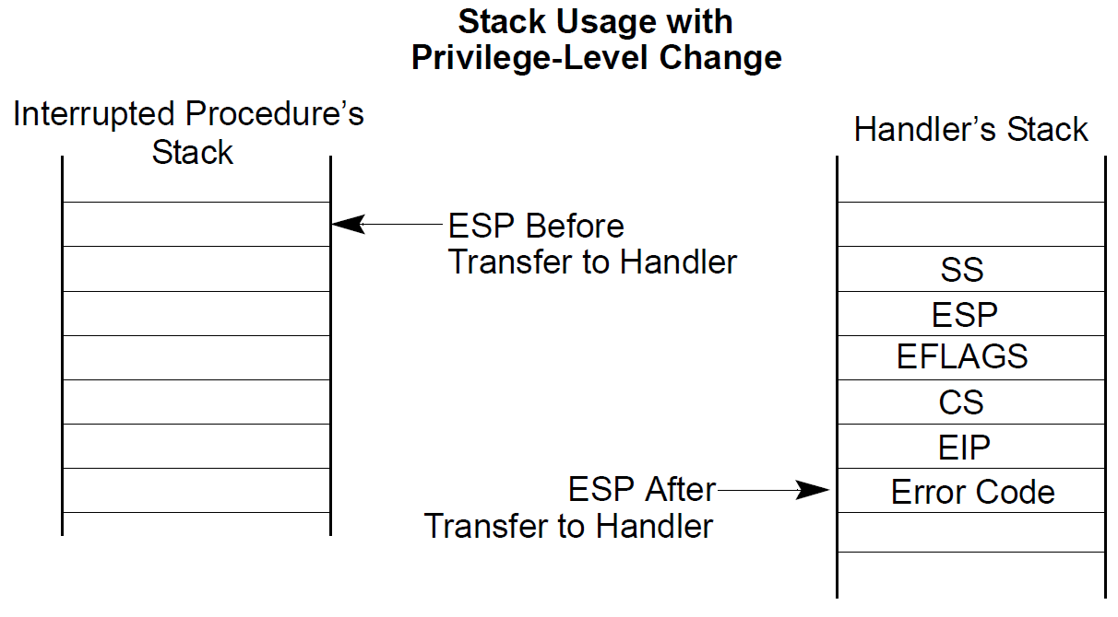

Slide 27
Complete interrupt path

Slide 28
Return from an interrupt
Starts with IRET
  Restore the CS and EIP registers to their values prior to the interrupt or exception
  Restore EFLAGS
  Restore SS and ESP to their values prior to interrupt
    This results in a stack switch
  Resume execution of interrupted procedure

Slide 29
x86 interrupt table
Device IRQs
…
…
…
0
31
47
255
Reserved for
the CPU
Software Configurable

Slide 30
Interrupts
Each type of interrupt is assigned an index from 0—255.
  0—31 are for processor interrupts fixed by Intel
  E.g., 14 is always for page faults
32—255 are software configured
  32—47 are often for device interrupts (IRQs)
  Most device’s IRQ line can be configured
  Look up APICs for more info (Ch 4 of Bovet and Cesati)
  0x80 issues system call in Linux (more on this later)

Slide 31
Sources
Interrupts
  External
    From a device
    Through CPU pins connected to APIC
  Software generated with INT n instruction
Exceptions
  Processor generated, when CPU detects an error in the program
    Fault, trap, abort
  Software generated with INTO, INT 3, BOUND

Slide 32
Software interrupts
The INT n instruction allows software to raise an interrupt
  0x80 is just a Linux convention
  You could change it to use 0x81!
There are a lot of spare indexes
OS sets ring level required to raise an interrupt
  Generally, user programs can’t issue an int 14 (page fault manually)
  An unauthorized int instruction causes a general protection fault
    Interrupt 13

Slide 33
Disabling interrupts
Delivery of maskable interrupts can be disabled with IF (interrupt flag) in EFLAGS register
Exceptions
  Non-maskable interrupts (see next slide)
  INT n – cannot be masked as it is synchronous

Slide 34
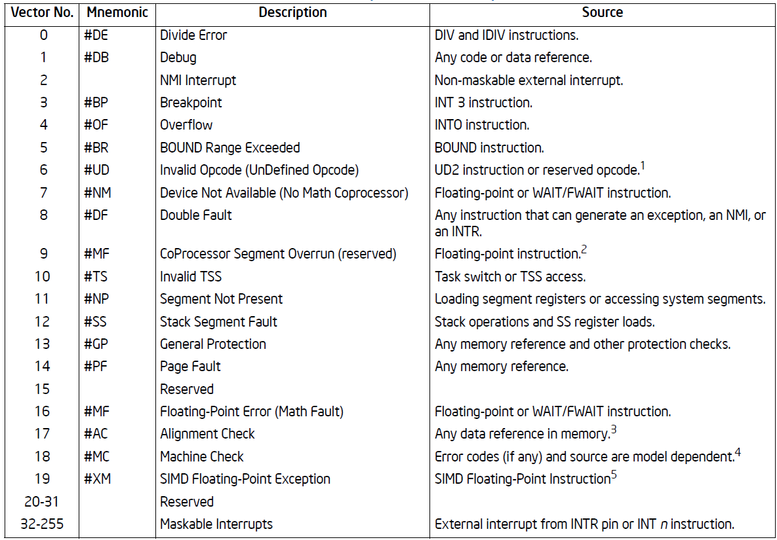

Slide 36
Nonmaskable interrupts (NMI)
Delivered even if IF is clear, e.g. interrupts disabled
  CPU blocks subsequent NMI interrupts until IRET
Sources
  External hardware asserts the NMI pin
  Processor receives a message on the system bus, or the APIC serial bus with NMI delivery mode
Delivered via vector #2

Slide 38
Thank you.

