Slide 1
ICS143A: Principles of Operating Systems
Lecture 12: Interrupts and Exceptions
Anton Burtsev
October, 2017

Slide 2
Why do we need interrupts?
Remember:
hardware interface is designed to help OS

Slide 3
Why do we need interrupts?
Fix an abnormal condition
  Page not mapped in memory
Notifications from external devices
  Network packet received
Preemptive scheduling
  Timer interrupt
Secure interface between OS and applications
  System calls

Slide 4
Two types:
synchronous and asynchronous

Slide 5
Synchronous
Exceptions – react to an abnormal condition
  E.g., page mapping (virtual address) is not present in the page table
    Bring the swapped page back to memory (copy from disk)
    Fix the page-table entry
  Invoke a system call
    Transition from user-level to kernel (more later)
  Intel distinguishes 3 types: faults, traps, aborts
Asynchronous
Interrupts – preempt normal execution
  Notify that something has happened
    New packet from the network, disk I/O completed, timer tick, notification from another CPU)

Slide 6
Handling interrupts and exceptions
Same procedure
  Stop execution of the current program
  Start execution of a handler
  Processor accesses the handler through an entry in the Interrupt Descriptor Table (IDT)
Each interrupt is defined by a number
  E.g., 14 is pagefault, 3 debug
  This number is an index into the interrupt table (IDT)

Slide 7
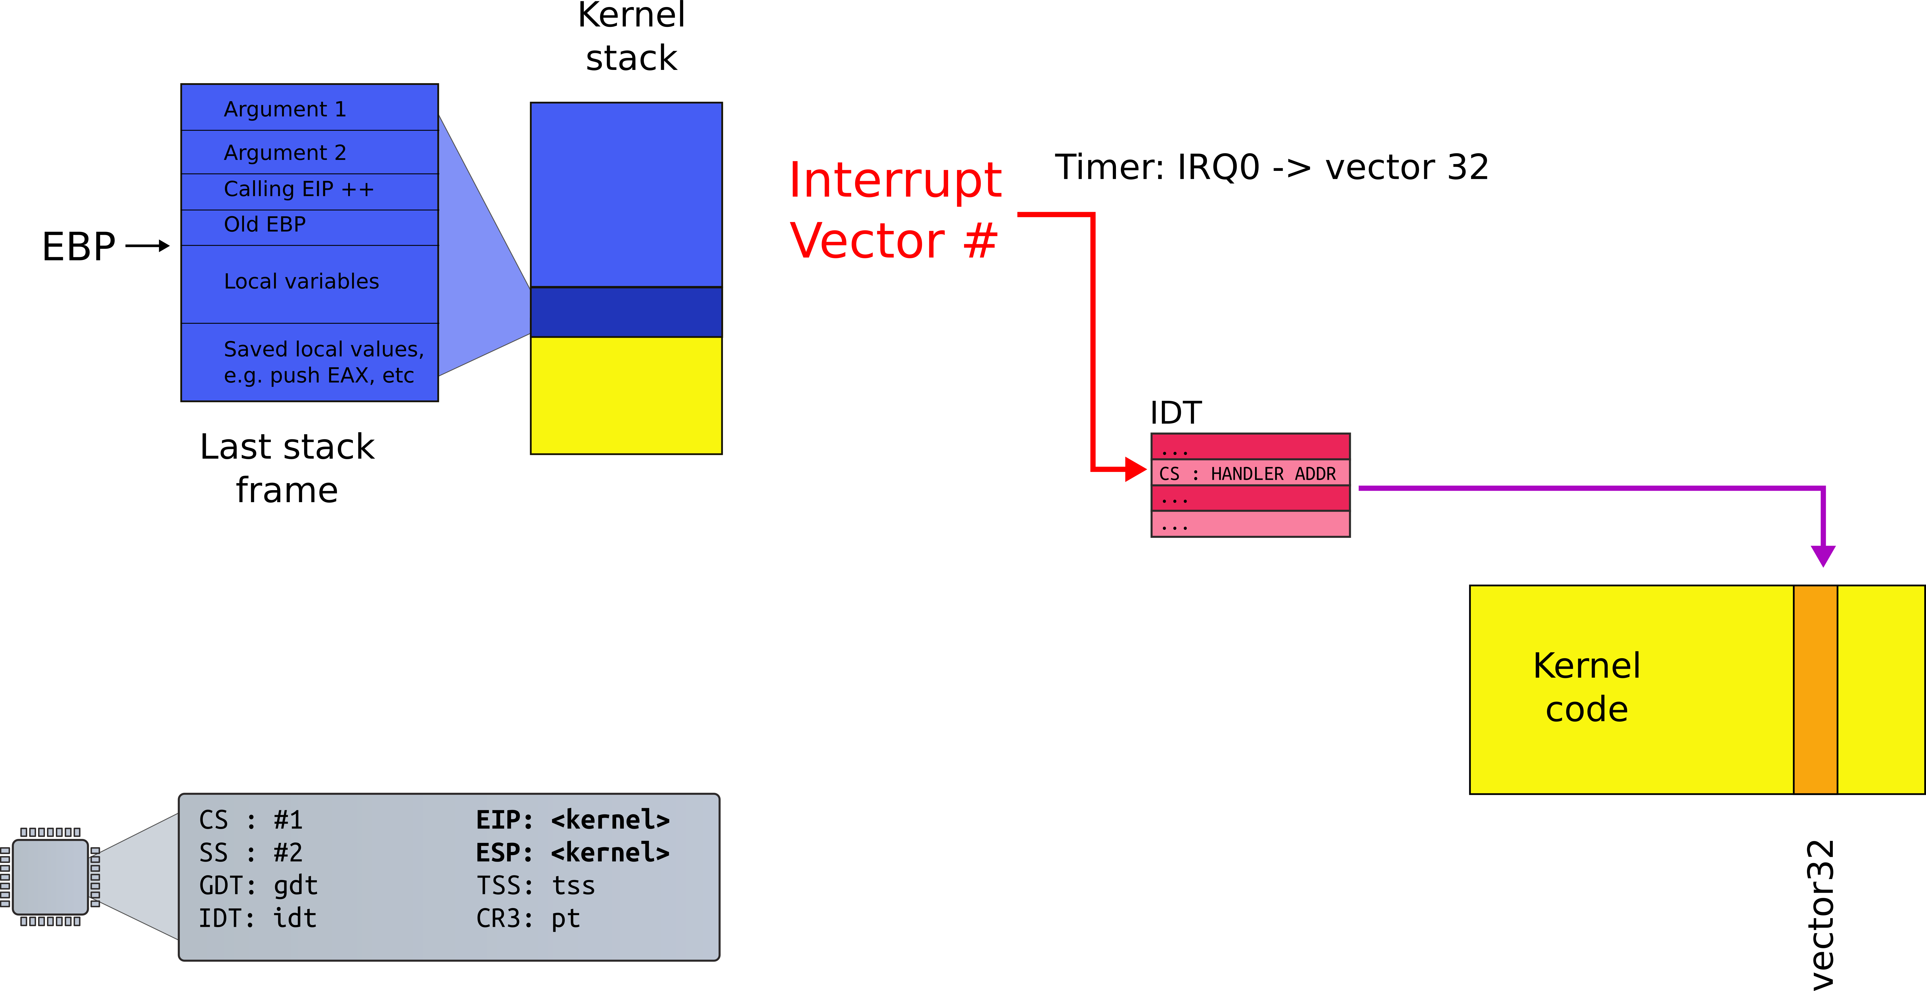
Interrupt path
no change in privilege level
e.g., we're already running in the kernel

Slide 8
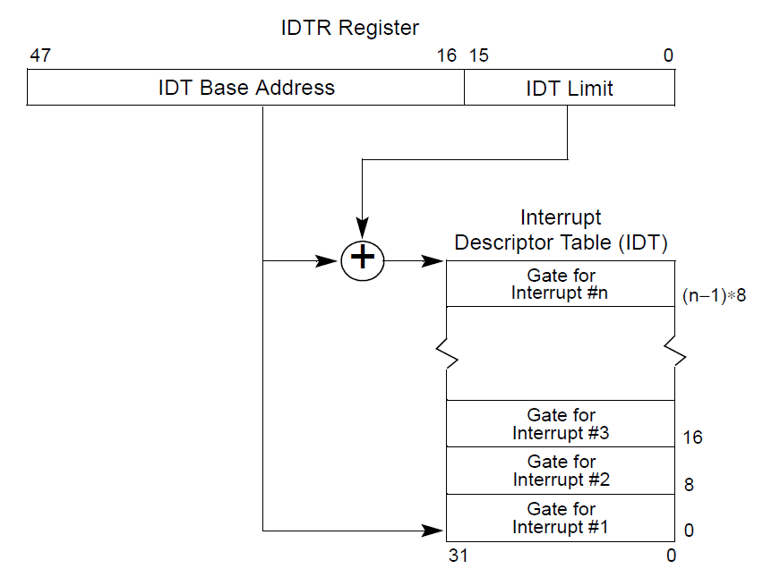

Slide 9
CPU
CPU
Memory

Slide 10
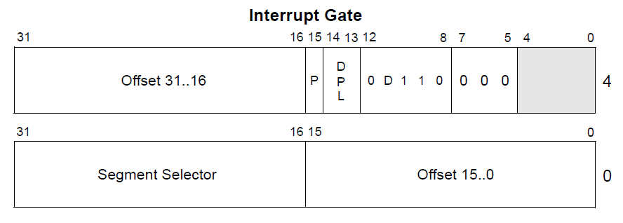
Interrupt descriptor

Slide 11
Interrupt descriptor

Slide 12
Interrupt handlers
Just plain old code in the kernel
The IDT stores a pointer to the right handler routine

Slide 13
Interrupt path

Slide 14
Processing of interrupt (same PL)
Push the current contents of the EFLAGS, CS, and EIP registers (in that order) on the stack
Push an error code (if appropriate) on the stack
Load the segment selector for the new code segment and the new instruction pointer (from the interrupt gate or trap gate) into the CS and EIP registers
If the call is through an interrupt gate, clear the IF flag in the EFLAGS register (disable further interrupts)
Begin execution of the handler

Slide 15
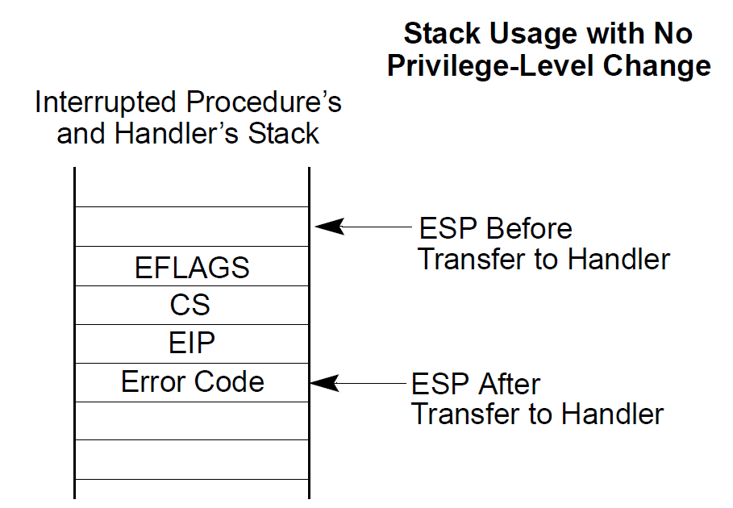

Slide 16
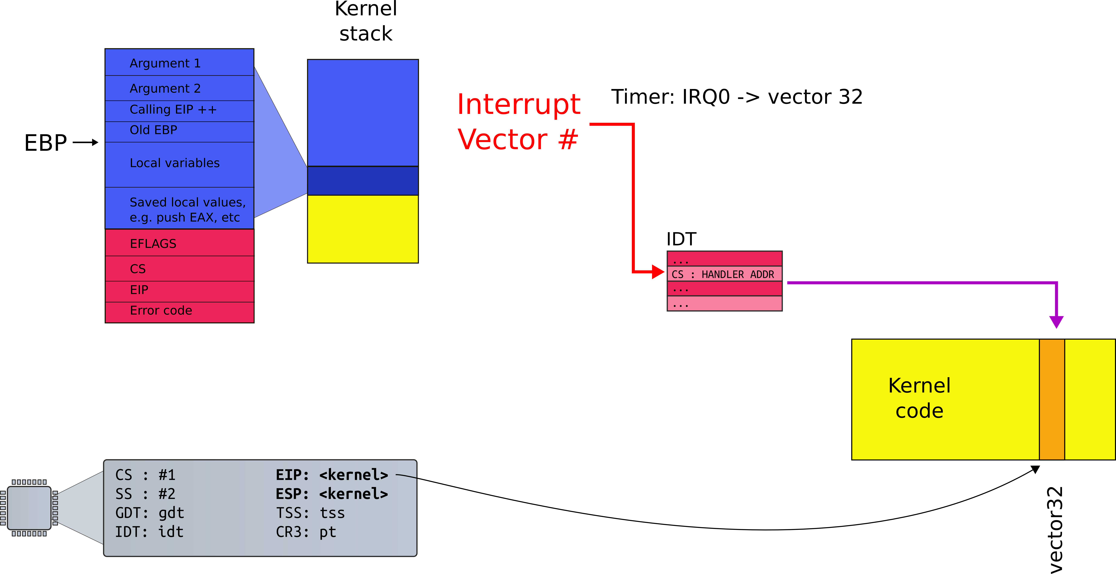
Interrupt path

Slide 17
Processing of interrupt (cross PL)
Need to change privilege level...

Slide 18
Detour:
What are those privilege levels?

Slide 19

Recap: Can a process overwrite kernel memory?

Slide 20
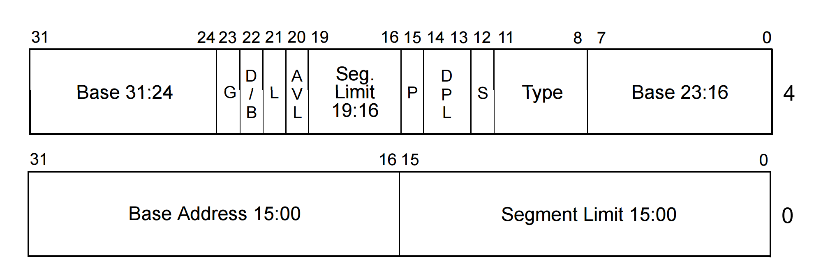
Privilege levels
Each segment has a privilege level
  DPL (descriptor privilege level)
  4 privilege levels ranging 0-3

Slide 21
Privilege levels
Currently running code also has a privilege level
  “Current privilege level” (CPL): 0-3
  It is saved in the %cs register

Slide 22
WAT!

Slide 23


Slide 27
Segmented programming (not real)
static int x = 1;
int y; // stack
if (x) {
y = 1;
printf (“Boo”);
} else
y = 0;
ds:x = 1; // data
ss:y; // stack
if (ds:x) {
ss:y = 1;
cs:printf(ds:“Boo”);
} else
ss:y = 0;

Slide 28
Actual switch
Use long jump to change code segment
9153 ljmp $(SEG_KCODE<<3), $start32
  Explicitly specify code segment, and address
  Segment is 0b1000 (0x8)

Slide 29
Privilege level transitions
CPL can access only less privileged segments
    E.g., 0 can access 1, 2, 3
Some instructions are “privileged”
  Can only be invoked at CPL = 0
  Examples:
    Load GDT
    MOV <control register>
      E.g. reload a page table by changing CR3

Slide 30
Real world
Only two privilege levels are used in modern OSes:
  OS kernel runs at 0
  User code runs at 3
This is called “flat” segment model
  Segments for both 0 and 3 cover entire address space
But then... how the kernel is protected?
  Page tables

Slide 31
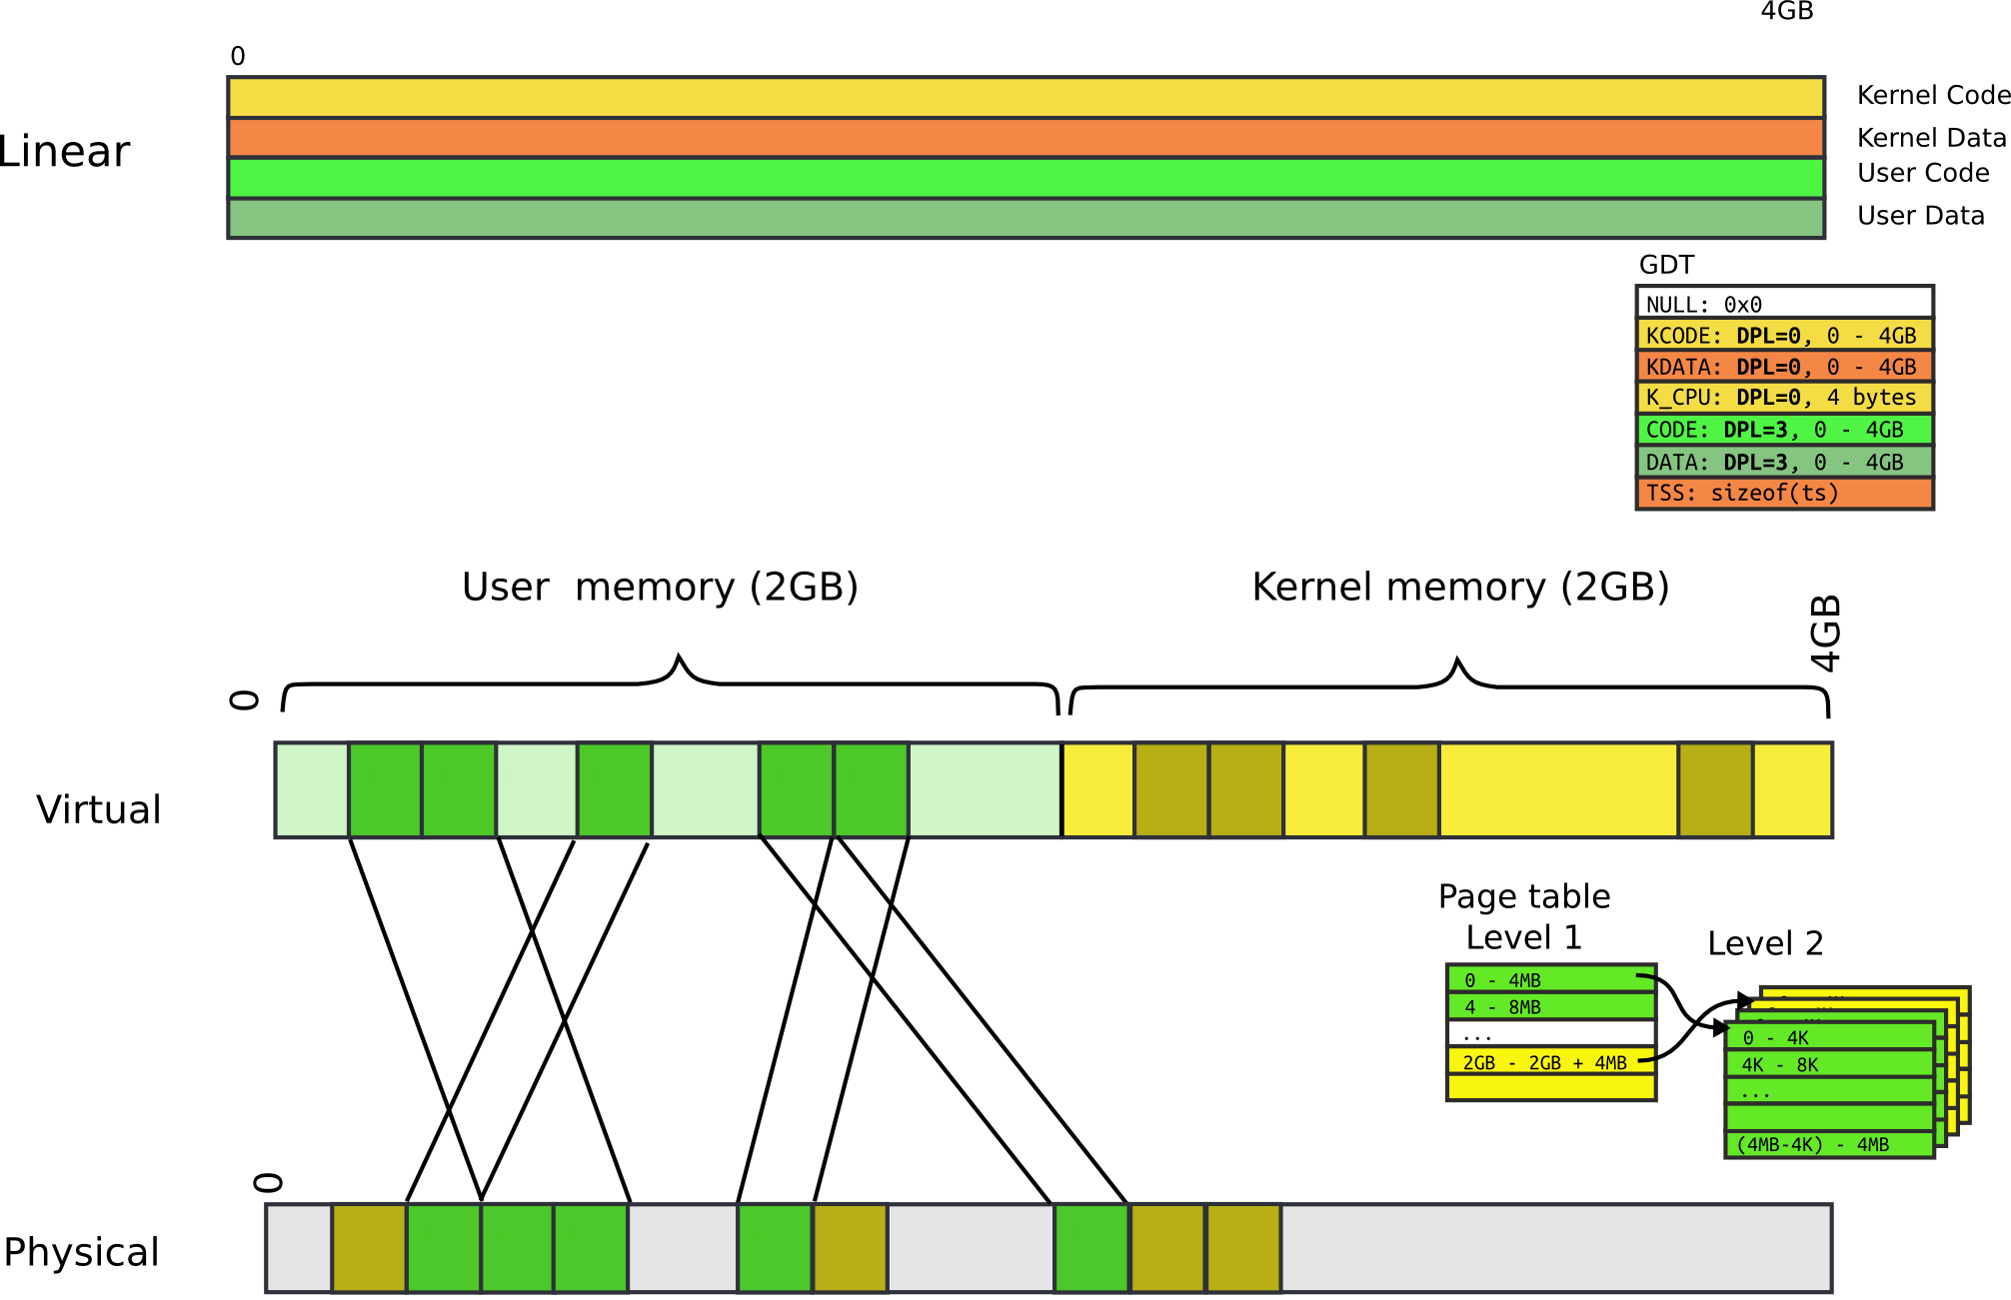

Slide 32
Page table: user bit
Each entry (both Level 1 and Level 2) has a bit
  If set, code at privilege level 3 can access
  If not, only levels 0-2 can access
Note, only 2 levels, not 4 like with segments
All kernel code is mapped with the user bit clear
  This protects user-level code from accessing the kernel

Slide 33
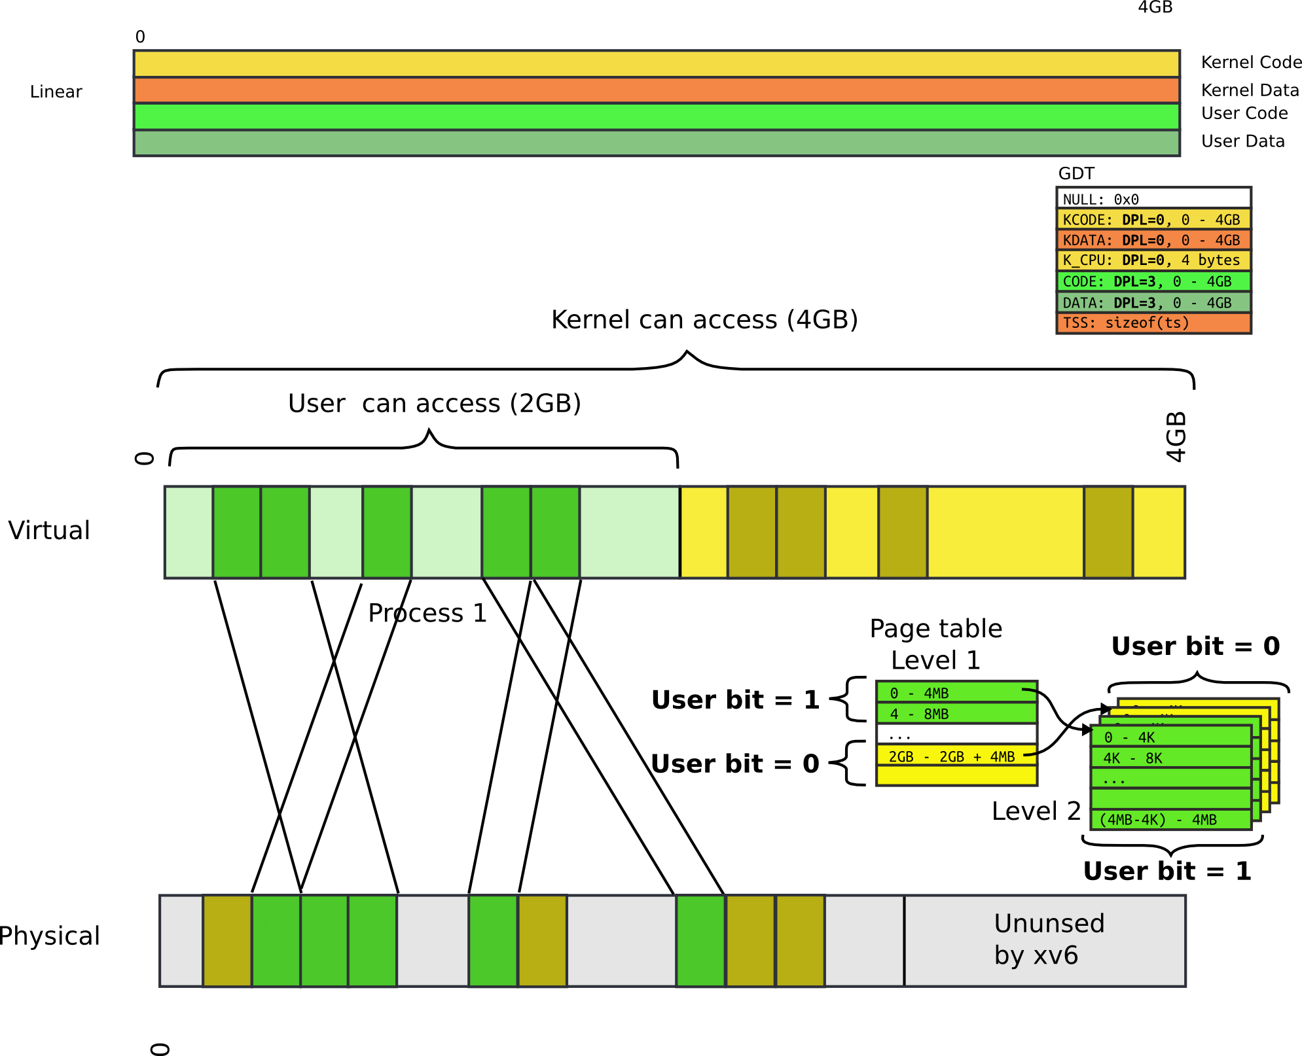

Slide 34
End of detour:
Back to handling interrupts

Slide 35
Thank you.

