Slide 1
ICS143A: Principles of Operating Systems
Lecture 12: Starting other CPUs
Anton Burtsev
February, 2017

Slide 2
Starting other CPUs

Slide 3
We're back to main()
1317 main(void)
1318 {
...
1336 startothers(); // start other
processors
1337 kinit2(P2V(4*1024*1024), P2V(PHYSTOP));
1338 userinit(); // first user process
1339 mpmain();
1340 }

Slide 4
Starting other CPUs
Copy start code in a good location
  0x7000 (remember same as the one used by boot loader)
Pass start parameters on the stack
  Stack for a high-address kernel
    Each CPU allocates a page from a physical allocator
  Entry point (mpenter())
  Two entry page table
    To do the low to high address switch

Slide 5
Start other CPUs
1374 startothers(void)
1375 {
1384 code = P2V(0x7000);
1385 memmove(code, _binary_entryother_start,
(uint)_binary_entryother_size);
1386
1387 for(c = cpus; c < cpus+ncpu; c++){
1388 if(c == cpus+cpunum()) // We’ve started already.
1389 continue;
...
1394 stack = kalloc();
1395 *(void**)(code−4) = stack + KSTACKSIZE;
1396 *(void**)(code−8) = mpenter;
1397 *(int**)(code−12) = (void *) v2p(entrypgdir);
1398
1399 lapicstartap(c−>id, v2p(code));

Slide 6
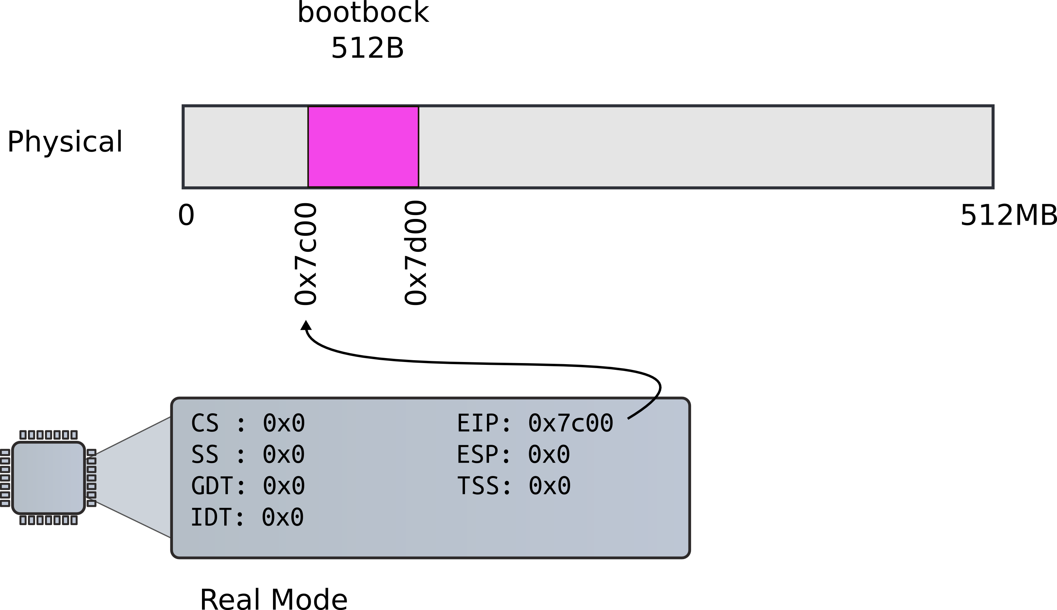
We could choose any address, but 0x7c00 is convenient

Slide 7
Start other CPUs
1374 startothers(void)
1375 {
1384 code = P2V(0x7000);
1385 memmove(code, _binary_entryother_start,
(uint)_binary_entryother_size);
1386
1387 for(c = cpus; c < cpus+ncpu; c++){
1388 if(c == cpus+cpunum()) // We’ve started already.
1389 continue;
...
1394 stack = kalloc();
1395 *(void**)(code−4) = stack + KSTACKSIZE;
1396 *(void**)(code−8) = mpenter;
1397 *(int**)(code−12) = (void *) v2p(entrypgdir);
1398
1399 lapicstartap(c−>id, v2p(code));

Slide 8

Recap(): First stack

Slide 9

Recap: kalloc() – allocate page

Slide 10
Start other CPUs
1374 startothers(void)
1375 {
1384 code = P2V(0x7000);
1385 memmove(code, _binary_entryother_start,
(uint)_binary_entryother_size);
1386
1387 for(c = cpus; c < cpus+ncpu; c++){
1388 if(c == cpus+cpunum()) // We’ve started already.
1389 continue;
...
1394 stack = kalloc();
1395 *(void**)(code−4) = stack + KSTACKSIZE;
1396 *(void**)(code−8) = mpenter;
1397 *(int**)(code−12) = (void *) v2p(entrypgdir);
1398
1399 lapicstartap(c−>id, v2p(code));

Slide 11
Start other CPUs
1374 startothers(void)
1375 {
1384 code = P2V(0x7000);
1385 memmove(code, _binary_entryother_start,
(uint)_binary_entryother_size);
1386
1387 for(c = cpus; c < cpus+ncpu; c++){
1388 if(c == cpus+cpunum()) // We’ve started already.
1389 continue;
...
1394 stack = kalloc();
1395 *(void**)(code−4) = stack + KSTACKSIZE;
1396 *(void**)(code−8) = mpenter;
1397 *(int**)(code−12) = (void *) v2p(entrypgdir);
1398
1399 lapicstartap(c−>id, v2p(code));

Slide 12
entryother.S
1123 .code16
1124 .globl start
1125 start:
1126 cli
1127
1128 xorw %ax,%ax
1129 movw %ax,%ds
1130 movw %ax,%es
1131 movw %ax,%ss
1132
Disable interrupts
Init segments with 0

Slide 13
entryother.S
1133 lgdt gdtdesc
1134 movl %cr0, %eax
1135 orl $CR0_PE, %eax
1136 movl %eax, %cr0
1150 ljmpl $(SEG_KCODE<<3), $(start32)
1151
1152 .code32
1153 start32:
1154 movw $(SEG_KDATA<<3), %ax
1155 movw %ax, %ds
1156 movw %ax, %es
1157 movw %ax, %ss
1158 movw $0, %ax
1159 movw %ax, %fs
1160 movw %ax, %gs
Load GDT
Switch to 32bit mode
  Long jump to start32
Load segments

Slide 14
entryother.S
1162 # Turn on page size extension for 4Mbyte pages
1163 movl %cr4, %eax
1164 orl $(CR4_PSE), %eax
1165 movl %eax, %cr4
1166 # Use enterpgdir as our initial page table
1167 movl (start−12), %eax
1168 movl %eax, %cr3
1169 # Turn on paging.
1170 movl %cr0, %eax
1171 orl $(CR0_PE|CR0_PG|CR0_WP), %eax
1172 movl %eax, %cr0
1173
1174 # Switch to the stack allocated by startothers()
1175 movl (start−4), %esp
1176 # Call mpenter()
1177 call *(start−8)

Slide 15
1251 static void
1252 mpenter(void)
1253 {
1254 switchkvm();
1255 seginit();
1256 lapicinit();
1257 mpmain();
1258 }

Slide 16
Init segments
1616 seginit(void)
1617 {
1618 struct cpu *c;
...
1624 c = &cpus[cpunum()];
1625 c−>gdt[SEG_KCODE] = SEG(STA_X|STA_R, 0, 0xffffffff, 0);
1626 c−>gdt[SEG_KDATA] = SEG(STA_W, 0, 0xffffffff, 0);
1627 c−>gdt[SEG_UCODE] = SEG(STA_X|STA_R, 0, 0x8000000, DPL_USER);
1628 c−>gdt[SEG_UDATA] = SEG(STA_W, 0, 0xffffffff, DPL_USER);
1629
1630 // Map cpu, and curproc
1631 c−>gdt[SEG_KCPU] = SEG(STA_W, &c−>cpu, 8, 0);
1632
1633 lgdt(c−>gdt, sizeof(c−>gdt));
1634 loadgs(SEG_KCPU << 3);
1635
1636 // Initialize cpu−local storage.
1637 cpu = c;
1638 proc = 0;
1639 }

Slide 17
Per-CPU variables
Variables private to each CPU

Slide 18
Per-CPU variables
Variables private to each CPU
  Current running process
  Kernel stack for interrupts
    Hence, TSS that stores that stack
6913 extern struct cpu cpus[NCPU];

Slide 19
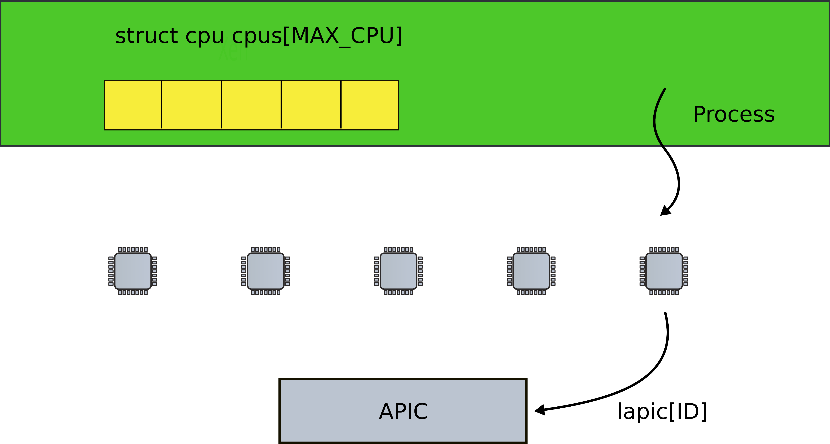
One catch: lapic[id] is slow

Slide 20
We need to save id of a CPU on each CPU
We can use a register ...

Slide 21
We need to save id of a CPU on each CPU
We can use a register …
  But it's wasteful

Slide 22
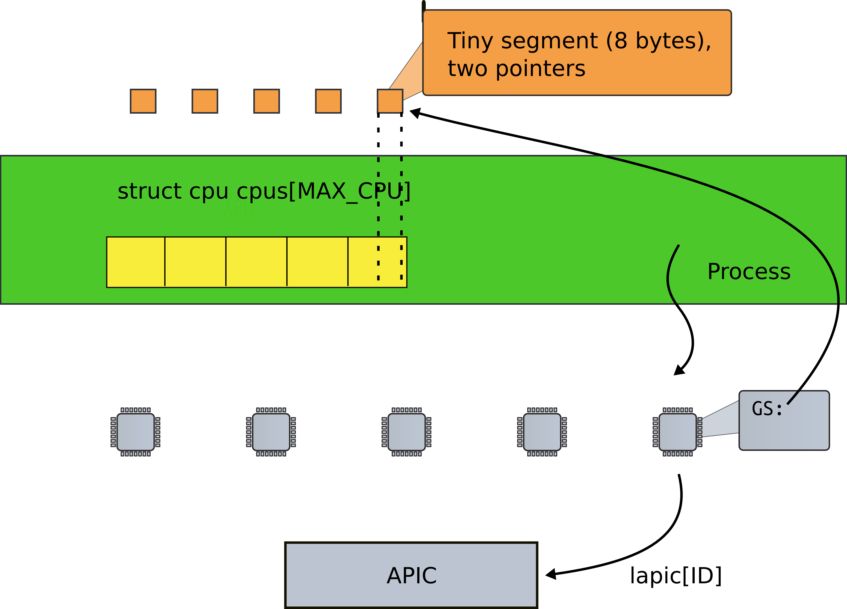

Slide 23
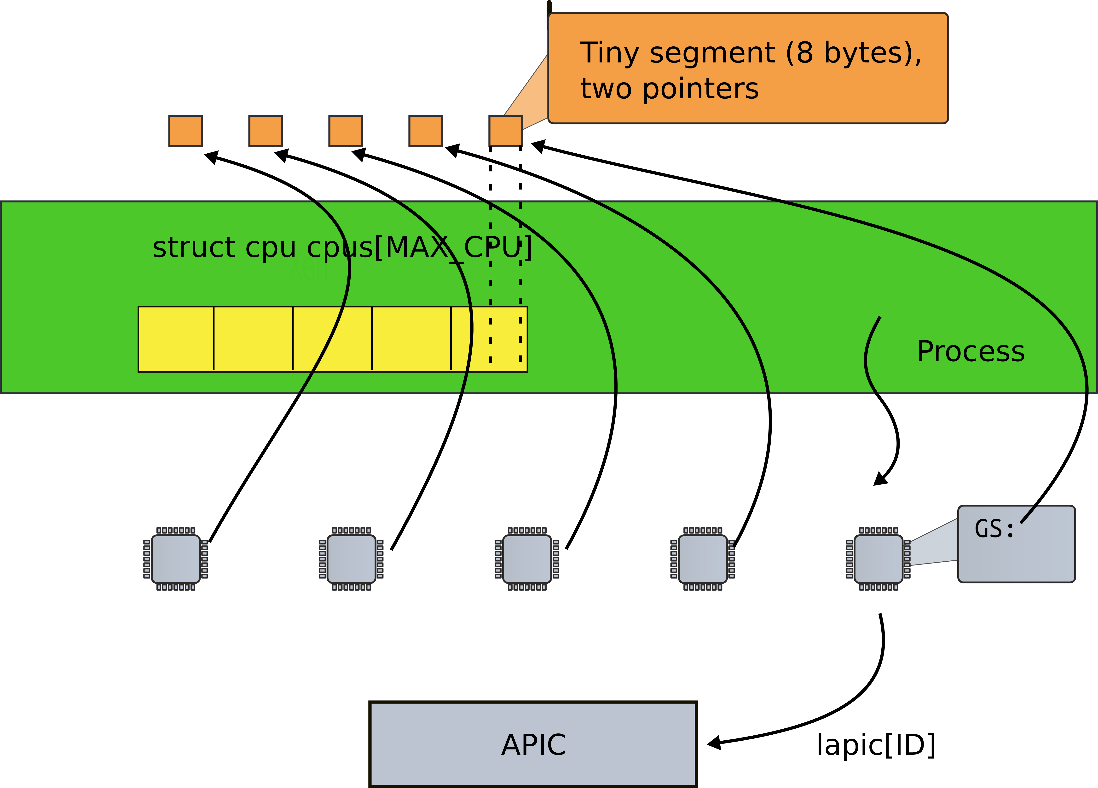

Slide 24
2300 // Per−CPU state
2301 struct cpu {
2302 uchar apicid; // Local APIC ID
2303 struct context *scheduler; // swtch() here to enter scheduler
2304 struct taskstate ts; // Used by x86 to find stack for interrupt
2305 struct segdesc gdt[NSEGS]; // x86 global descriptor table
2306 volatile uint started; // Has the CPU started?
2307 int ncli; // Depth of pushcli nesting.
2308 int intena; // Were interrupts enabled before pushcli?
2309
2310 // Cpu−local storage variables; see below
2311 struct cpu *cpu;
2312 struct proc *proc; // The currently−running process.
2313 };

Slide 25
2300 // Per−CPU state
2301 struct cpu {
2302 uchar apicid; // Local APIC ID
2303 struct context *scheduler;
2304 struct taskstate ts;
2305 struct segdesc gdt[NSEGS]; // x86 global descriptor table
...
2310 // Cpu−local storage variables; see below
2311 struct cpu *cpu;
2312 struct proc *proc; // The currently−running process.
2313 };
...
2326 extern struct cpu *cpu asm("%gs:0"); // &cpus[cpunum()]
2327 extern struct proc *proc asm("%gs:4"); // cpus[cpunum()].proc

Slide 26
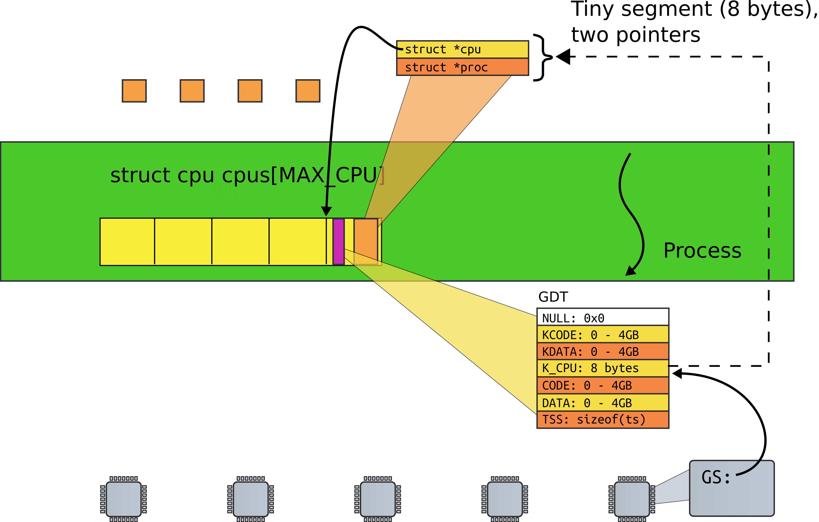

Slide 27
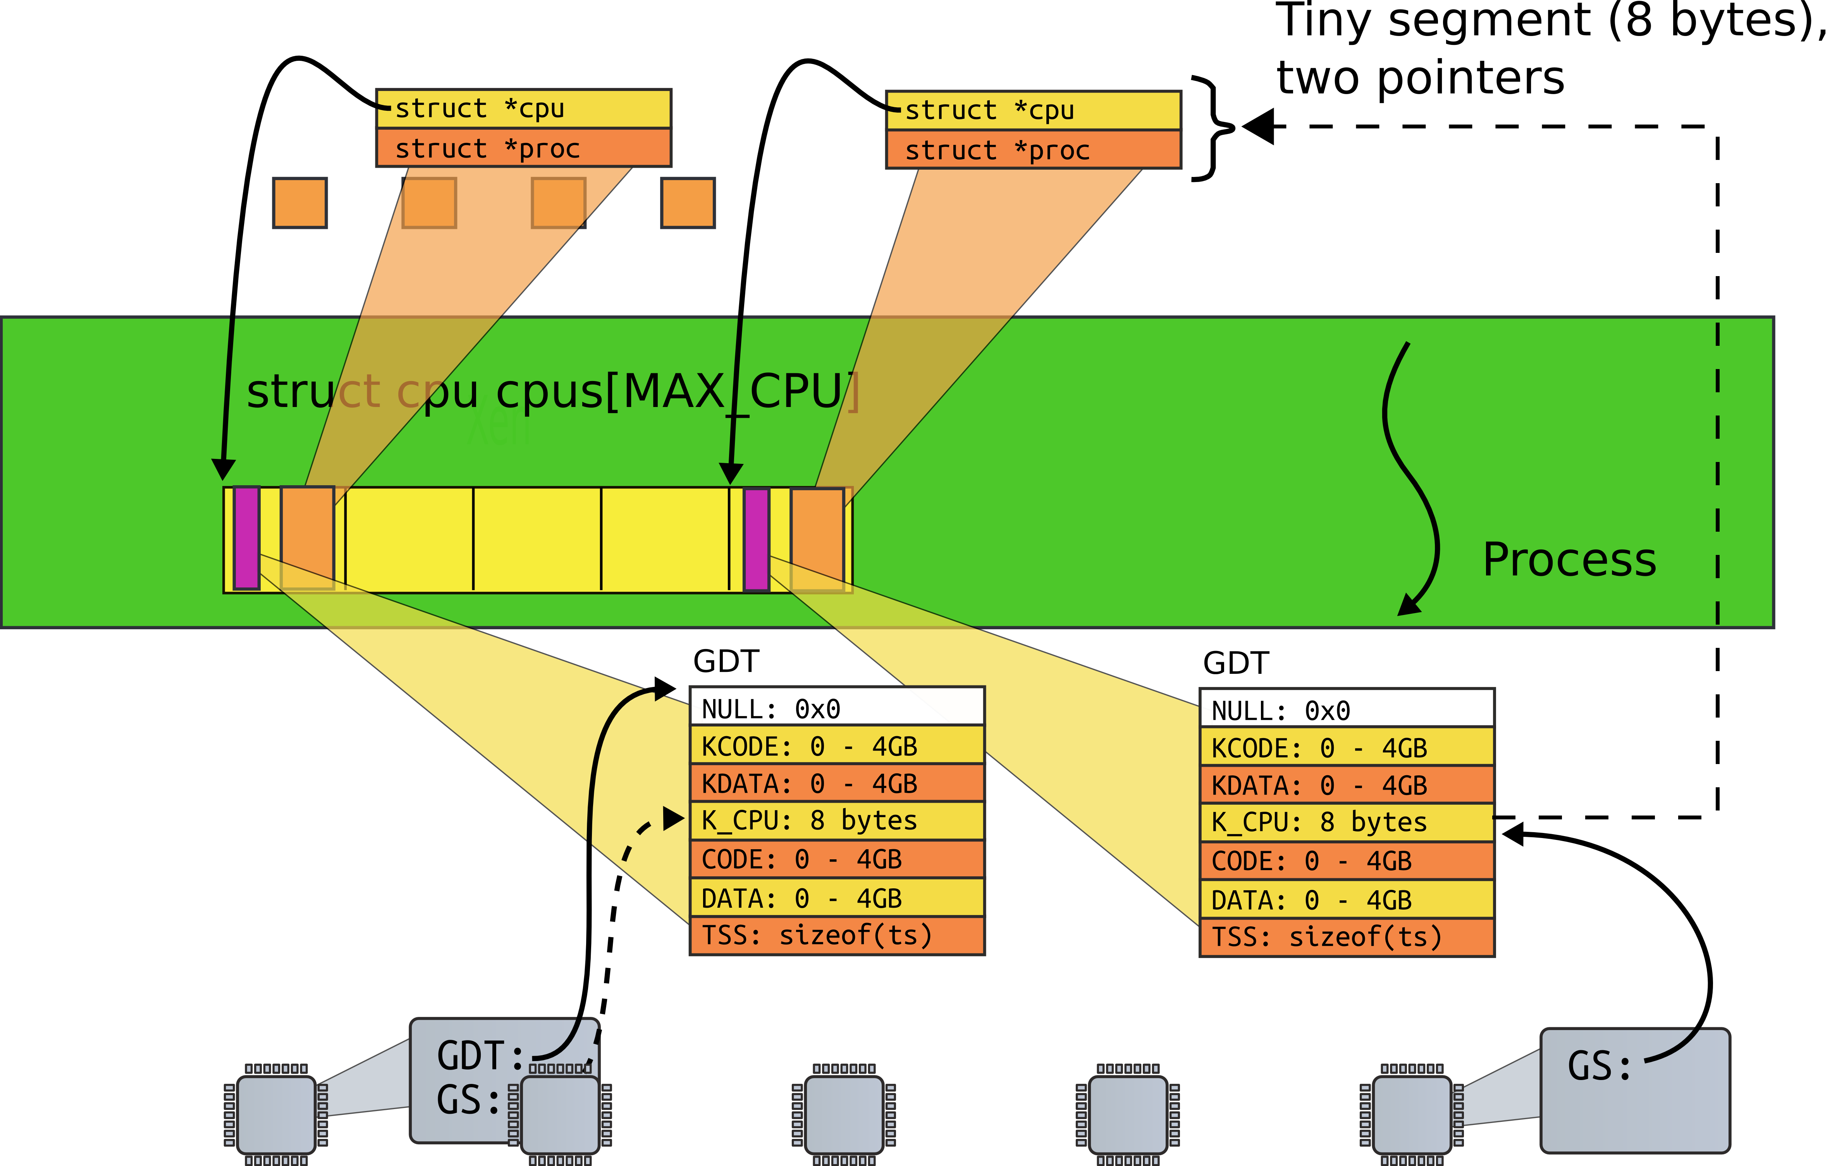

Slide 28
1251 static void
1252 mpenter(void)
1253 {
1254 switchkvm();
1255 seginit();
1256 lapicinit();
1257 mpmain();
1258 }

Slide 29
1260 // Common CPU setup code.
1261 static void
1262 mpmain(void)
1263 {
1264 cprintf("cpu%d: starting\n", cpu−>id);
1265 idtinit(); // load idt register
1266 xchg(&cpu−>started, 1);
1267 scheduler(); // start running processes
1268 }

Slide 30
Thank you

