Slide 1
ICS143A: Principles of Operating Systems
Lecture 14: System calls (part 2)
Anton Burtsev
November, 2017

Slide 2
System call path

Slide 3
Initialize IDT
3316 void
3317 tvinit(void)
3318 {
3319 int i;
3320
3321 for(i = 0; i < 256; i++)
3322 SETGATE(idt[i], 0, SEG_KCODE<<3, vectors[i], 0);
3323 SETGATE(idt[T_SYSCALL], 1, SEG_KCODE<<3,
vectors[T_SYSCALL], DPL_USER);
3324
3325 initlock(&tickslock, "time");
3326 }
tvinit() is called from main()
main()
tvinit()

Slide 4
Initialize IDT
3316 void
3317 tvinit(void)
3318 {
3319 int i;
3320
3321 for(i = 0; i < 256; i++)
3322 SETGATE(idt[i], 0, SEG_KCODE<<3, vectors[i], 0);
3323 SETGATE(idt[T_SYSCALL], 1, SEG_KCODE<<3,
vectors[T_SYSCALL], DPL_USER);
3324
3325 initlock(&tickslock, "time");
3326 }
A couple of important details
main()
tvinit()

Slide 5
Initialize IDT
3316 void
3317 tvinit(void)
3318 {
3319 int i;
3320
3321 for(i = 0; i < 256; i++)
3322 SETGATE(idt[i], 0, SEG_KCODE<<3, vectors[i], 0);
3323 SETGATE(idt[T_SYSCALL], 1, SEG_KCODE<<3,
vectors[T_SYSCALL], DPL_USER);
3324
3325 initlock(&tickslock, "time");
3326 }
Only int T_SYSCALL can be called from user-level
main()
tvinit()

Slide 6
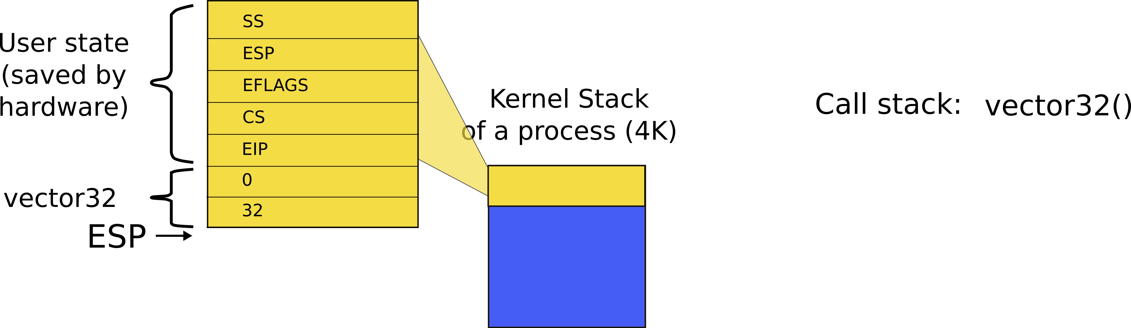
Kernel stack after interrupt
int 0x64
vector64

Slide 7
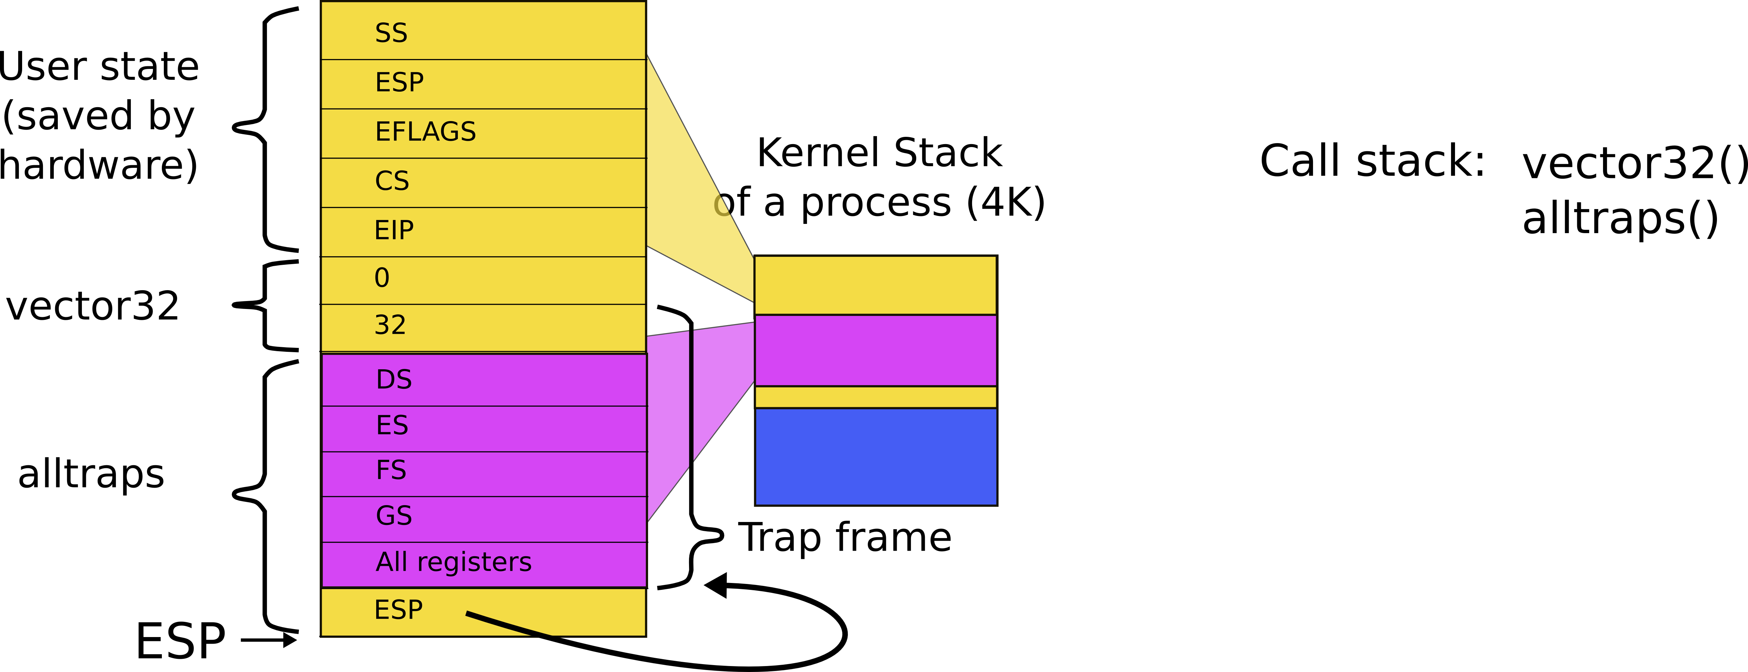
Kernel stack after interrupt
int 0x64
vector64
alltraps

Slide 8
Syscall number
System call number is passed in the %eax register
  To distinguish which syscall to invoke,
    e.g., sys_read, sys_exec, etc.
alltrap() saves it along with all other registers

Slide 9
syscall(): get the number from the trap frame
3625 syscall(void)
3626 {
3627 int num;
3628
3629 num = proc−>tf−>eax;
3630 if(num > 0 && num < NELEM(syscalls) && syscalls[num]) {
3631 proc−>tf−>eax = syscalls[num]();
3632 } else {
3633 cprintf("%d %s: unknown sys call %d\n",
3634 proc−>pid, proc−>name, num);
3635 proc−>tf−>eax = −1;
3636 }
3637 }
int 0x64
vector64
alltraps
trap(*tf)
syscall()

Slide 10
syscall(): process a syscall from the table
3625 syscall(void)
3626 {
3627 int num;
3628
3629 num = proc−>tf−>eax;
3630 if(num > 0 && num < NELEM(syscalls) && syscalls[num]) {
3631 proc−>tf−>eax = syscalls[num]();
3632 } else {
3633 cprintf("%d %s: unknown sys call %d\n",
3634 proc−>pid, proc−>name, num);
3635 proc−>tf−>eax = −1;
3636 }
3637 }

Slide 11
System call table
3600 static int (*syscalls[])(void) = {
3601 [SYS_fork] sys_fork,
3602 [SYS_exit] sys_exit,
3603 [SYS_wait] sys_wait,
3604 [SYS_pipe] sys_pipe,
3605 [SYS_read] sys_read,
3606 [SYS_kill] sys_kill,
3607 [SYS_exec] sys_exec,
3608 [SYS_fstat] sys_fstat,
3609 [SYS_chdir] sys_chdir,
3610 [SYS_dup] sys_dup,
3611 [SYS_getpid] sys_getpid,
3612 [SYS_sbrk] sys_sbrk,
3613 [SYS_sleep] sys_sleep,
3614 [SYS_uptime] sys_uptime,
3615 [SYS_open] sys_open,
3616 [SYS_write] sys_write,
3617 [SYS_mknod] sys_mknod,
3618 [SYS_unlink] sys_unlink,
3619 [SYS_link] sys_link,
3620 [SYS_mkdir] sys_mkdir,
3621 [SYS_close] sys_close,
3622 };

Slide 12
What do you think is the first system call xv6 executes?

Slide 13
1317 main(void)
1318 {
1319 kinit1(end, P2V(4*1024*1024)); // phys page allocator
1320 kvmalloc(); // kernel page table
1321 mpinit(); // detect other processors
...
1323 seginit(); // segment descriptors
...
1330 tvinit(); // trap vectors
...
1338 userinit(); // first user process
1339 mpmain(); // finish this processor’s setup
1340 }
main()

Slide 14
2502 userinit(void)
2503 {
2504 struct proc *p;
2505 extern char _binary_initcode_start[],
_binary_initcode_size[];
...
2509 p = allocproc();
2510 initproc = p;
2511 if((p−>pgdir = setupkvm()) == 0)
2512 panic("userinit: out of memory?");
2513 inituvm(p−>pgdir, _binary_initcode_start,
(int)_binary_initcode_size);
2514 p−>sz = PGSIZE;
2515 memset(p−>tf, 0, sizeof(*p−>tf));
...
2530 }
main()
userinit()

Slide 15
8409 start:
8410 pushl $argv
8411 pushl $init
8412 pushl $0 // where caller pc would be
8413 movl $SYS_exec, %eax
8414 int $T_SYSCALL
8415
...
8422 # char init[] = "/init\0";
8423 init:
8424 .string "/init\0"
8425
8426 # char *argv[] = { init, 0 };
8427 .p2align 2
8428 argv:
8429 .long init
8430 .long 0
initcode.S: call exec(“/init”, argv);
exec(“/init”, argv) has two arguemens
Push arguments on the stack
Invoke system call with
  int $T_SYSCALL

Slide 16
How do user programs access system calls?
It would be weird to write
8410 pushl $argv
8411 pushl $init
8412 pushl $0 // where caller pc would be
8413 movl $SYS_exec, %eax
8414 int $T_SYSCALL
  … every time we want to invoke a system call

Slide 17
// system calls
int fork(void);
int exit(void) __attribute__((noreturn));
int wait(void);
int pipe(int*);
int write(int, void*, int);
int read(int, void*, int);
int close(int);
int kill(int);
int exec(char*, char**);
int open(char*, int);
int mknod(char*, short, short);
int unlink(char*);
int fstat(int fd, struct stat*);
int link(char*, char*);
...
user.h
user.h defines system call prototypes
Compiler can generate correct system call stacks
  Remember calling conventions?
  Arguments on the stack

Slide 18
Example
From cat.asm
if (write(1, buf, n) != n)
A3: 53 push ebx
a4: 68 00 0b 00 00 push 0xb00
a9: 6a 01 push 0x1
ab: e8 c2 02 00 00 call 372 <write>

Slide 19
Note, different versions of gcc
  and different optimization levels
Will generate slightly different code

Slide 20
Example
From cat.asm
if (write(1, buf, n) != n)
a0: 89 5c 24 08 mov %ebx,0x8(%esp)
a4: c7 44 24 04 00 0b 00 movl $0xb00,0x4(%esp)
ab: 00
ac: c7 04 24 01 00 00 00 movl $0x1,(%esp)
b3: e8 aa 02 00 00 call 362 <write>

Slide 21
Example
From cat.asm
if (write(1, buf, n) != n)
a0: 89 5c 24 08 mov %ebx,0x8(%esp)
a4: c7 44 24 04 00 0b 00 movl $0xb00,0x4(%esp)
ab: 00
ac: c7 04 24 01 00 00 00 movl $0x1,(%esp)
b3: e8 aa 02 00 00 call 362 <write>

Slide 22
Example
From cat.asm
if (write(1, buf, n) != n)
a0: 89 5c 24 08 mov %ebx,0x8(%esp)
a4: c7 44 24 04 00 0b 00 movl $0xb00,0x4(%esp)
ab: 00
ac: c7 04 24 01 00 00 00 movl $0x1,(%esp)
b3: e8 aa 02 00 00 call 362 <write>

Slide 23
Still not clear...
  The header file allows compiler to generate a call side invocation,
    e.g., push arguments on the stack
  But where is the system call invocation itself
    e.g., int $T_SYSCALL

Slide 24
8450 #include "syscall.h"
8451 #include "traps.h"
8452
8453 #define SYSCALL(name) \
8454 .globl name; \
8455 name: \
8456 movl $SYS_ ## name, %eax; \
8457 int $T_SYSCALL; \
8458 ret
8459
8460 SYSCALL(fork)
8461 SYSCALL(exit)
8462 SYSCALL(wait)
8463 SYSCALL(pipe)
8464 SYSCALL(read)
usys.S
Xv6 uses a SYSCALL macro to define a function for each system call invocation
  E.g., fork() to invoke the “fork” system call

Slide 25
Example
Write system call from cat.asm
00000362 <write>:
SYSCALL(write)
362: b8 10 00 00 00 mov $0x10,%eax
367: cd 40 int $0x40
369: c3 ret

Slide 26
System call arguments
Where are the system call arguments?
How does kernel access them?
  And returns results?

Slide 27
Example
Write system call
if (write(1, buf, n) != n)
5876 int
5877 sys_write(void)
5878 {
5879 struct file *f;
5880 int n;
5881 char *p;
5882
5883 if(argfd(0, 0, &f) < 0 || argint(2, &n) < 0 || argptr(1, &p, n) < 0)
5884 return −1;
5885 return filewrite(f, p, n);
5886 }

Slide 28
Example
Write system call
if (write(1, buf, n) != n)
5876 int
5877 sys_write(void)
5878 {
5879 struct file *f;
5880 int n;
5881 char *p;
5882
5883 if(argfd(0, 0, &f) < 0 || argint(2, &n) < 0 || argptr(1, &p, n) < 0)
5884 return −1;
5885 return filewrite(f, p, n);
5886 }

Slide 29
argint(int n, int *ip)
3543 // Fetch the nth 32−bit system call argument.
3544 int
3545 argint(int n, int *ip)
3546 {
3547 return fetchint(proc−>tf−>esp + 4 + 4*n, ip);
3548 }
3515 // Fetch the int at addr from the current process.
3516 int
3517 fetchint(uint addr, int *ip)
3518 {
3519 if(addr >= proc−>sz || addr+4 > proc−>sz)
3520 return −1;
3521 *ip = *(int*)(addr);
3522 return 0;
3523 }

Slide 30
argint(int n, int *ip)
3543 // Fetch the nth 32−bit system call argument.
3544 int
3545 argint(int n, int *ip)
3546 {
3547 return fetchint(proc−>tf−>esp + 4 + 4*n, ip);
3548 }
3515 // Fetch the int at addr from the current process.
3516 int
3517 fetchint(uint addr, int *ip)
3518 {
3519 if(addr >= proc−>sz || addr+4 > proc−>sz)
3520 return −1;
3521 *ip = *(int*)(addr);
3522 return 0;
3523 }

Slide 31
argint(int n, int *ip)
3543 // Fetch the nth 32−bit system call argument.
3544 int
3545 argint(int n, int *ip)
3546 {
3547 return fetchint(proc−>tf−>esp + 4 + 4*n, ip);
3548 }
3515 // Fetch the int at addr from the current process.
3516 int
3517 fetchint(uint addr, int *ip)
3518 {
3519 if(addr >= proc−>sz || addr+4 > proc−>sz)
3520 return −1;
3521 *ip = *(int*)(addr);
3522 return 0;
3523 }
Start with the address where current user stack is (esp)

Slide 32
argint(int n, int *ip)
3543 // Fetch the nth 32−bit system call argument.
3544 int
3545 argint(int n, int *ip)
3546 {
3547 return fetchint(proc−>tf−>esp + 4 + 4*n, ip);
3548 }
3515 // Fetch the int at addr from the current process.
3516 int
3517 fetchint(uint addr, int *ip)
3518 {
3519 if(addr >= proc−>sz || addr+4 > proc−>sz)
3520 return −1;
3521 *ip = *(int*)(addr);
3522 return 0;
3523 }
Skip return eip

Slide 33
argint(int n, int *ip)
3543 // Fetch the nth 32−bit system call argument.
3544 int
3545 argint(int n, int *ip)
3546 {
3547 return fetchint(proc−>tf−>esp + 4 + 4*n, ip);
3548 }
3515 // Fetch the int at addr from the current process.
3516 int
3517 fetchint(uint addr, int *ip)
3518 {
3519 if(addr >= proc−>sz || addr+4 > proc−>sz)
3520 return −1;
3521 *ip = *(int*)(addr);
3522 return 0;
3523 }
Fetch n'th argument

Slide 34
fetchint(uint addr, int *ip)
3543 // Fetch the nth 32−bit system call argument.
3544 int
3545 argint(int n, int *ip)
3546 {
3547 return fetchint(proc−>tf−>esp + 4 + 4*n, ip);
3548 }
3515 // Fetch the int at addr from the current process.
3516 int
3517 fetchint(uint addr, int *ip)
3518 {
3519 if(addr >= proc−>sz || addr+4 > proc−>sz)
3520 return −1;
3521 *ip = *(int*)(addr);
3522 return 0;
3523 }

Slide 35
fetchint(uint addr, int *ip)
3543 // Fetch the nth 32−bit system call argument.
3544 int
3545 argint(int n, int *ip)
3546 {
3547 return fetchint(proc−>tf−>esp + 4 + 4*n, ip);
3548 }
3515 // Fetch the int at addr from the current process.
3516 int
3517 fetchint(uint addr, int *ip)
3518 {
3519 if(addr >= proc−>sz || addr+4 > proc−>sz)
3520 return −1;
3521 *ip = *(int*)(addr);
3522 return 0;
3523 }

Slide 36
Any idea for what argptr() shall do?
Write system call
if (write(1, buf, n) != n)
5876 int
5877 sys_write(void)
5878 {
5879 struct file *f;
5880 int n;
5881 char *p;
5882
5883 if(argfd(0, 0, &f) < 0 || argint(2, &n) < 0 || argptr(1, &p, n) < 0)
5884 return −1;
5885 return filewrite(f, p, n);
5886 }
Remember, buf is a pointer to a region of memory
  i.e., a buffer
of size n

Slide 37
argptr(uint addr, int *ip)
3550 // Fetch the nth word−sized system call argument as a pointer
3551 // to a block of memory of size n bytes. Check that the pointer
3552 // lies within the process address space.
3553 int
3554 argptr(int n, char **pp, int size)
3555 {
3556 int i;
3557
3558 if(argint(n, &i) < 0)
3559 return −1;
3560 if((uint)i >= proc−>sz || (uint)i+size > proc−>sz)
3561 return −1;
3562 *pp = (char*)i;
3563 return 0;
3564 }
Check that the pointer to the buffer is sound

Slide 38
argptr(uint addr, int *ip)
3550 // Fetch the nth word−sized system call argument as a pointer
3551 // to a block of memory of size n bytes. Check that the pointer
3552 // lies within the process address space.
3553 int
3554 argptr(int n, char **pp, int size)
3555 {
3556 int i;
3557
3558 if(argint(n, &i) < 0)
3559 return −1;
3560 if((uint)i >= proc−>sz || (uint)i+size > proc−>sz)
3561 return −1;
3562 *pp = (char*)i;
3563 return 0;
3564 }
Check that the buffer is in user memory

Slide 39
Summary
We've learned how system calls work

Slide 40
Thank you

Slide 41
sys_exec()
6225 sys_exec(void)
6226 {
6227 char *path, *argv[MAXARG];
6228 int i;
6229 uint uargv, uarg;
6230
6231 if(argstr(0, &path) < 0 || argint(1, (int*)&uargv) < 0){
6232 return −1;
6233 }
6234 memset(argv, 0, sizeof(argv));
6235 for(i=0;; i++){
6236 if(i >= NELEM(argv))
6237 return −1;
6238 if(fetchint(uargv+4*i, (int*)&uarg) < 0)
6239 return −1;
6240 if(uarg == 0){
6241 argv[i] = 0;
6242 break;
6243 }
6244 if(fetchstr(uarg, &argv[i]) < 0)
6245 return −1;
6246 }
6247 return exec(path, argv);
6248 }

Slide 42
sys_exec()
6225 sys_exec(void)
6226 {
6227 char *path, *argv[MAXARG];
6228 int i;
6229 uint uargv, uarg;
6230
6231 if(argstr(0, &path) < 0
|| argint(1, (int*)&uargv) < 0){
6232 return −1;
6233 }
...
6247 return exec(path, argv);
6248 }

