Slide 1
ICS143A: Principles of Operating Systems
Lecture 21: Program linking and loading
Anton Burtsev
March, 2017

Slide 2
Linking and loading
Linking
  Combining multiple code modules into a single executable
  E.g., use standard libraries in your own code
Loading
  Process of getting an executable running on the machine

Slide 3


Slide 4
Input: object files (code modules)
Each object file contains
  A set of segments
    Code
    Data
  A symbol table
    Imported & exported symbols
Output: executable file, library, etc.

Slide 5


Slide 6
Why linking?
Modularity
  Program can be written as a collection of modules
  Can build libraries of common functions
Efficiency
  Code compilation
    Change one source file, recompile it, and re-link the executable
  Space efficiency
    Share common code across executables
    On disk and in memory

Slide 7
Two path process
Path 1: scan input files
  Identify boundaries of each segment
  Collect all defined and undefined symbol information
  Determine sizes and locations of each segment
Path 2
  Adjust memory addresses in code and data to reflect relocated segment addresses

Slide 8
Example
Save a into b, e.g., b = a
mov a, %eax
mov %eax, b
Generated code
  a is defined in the same file at 0x1234, b is imported
  Each instruction is 1 byte opcode + 4 bytes address
A1 34 12 00 00 mov a, %eax
A3 00 00 00 00 mov %eax, b
Assume that a is relocated by 0x10000 bytes, and b is found at 0x9a12
A1 34 12 01 00 mov a,%eax
A3 12 9A 00 00 mov %eax,b

Slide 9
More realistic example
Source file m.c
extern void a(char *);
int main(int ac, char **av)
{
static char string[] = "Hello, world!\n";
a(string);
}
Source file a.c
#include <unistd.h>
#include <string.h>
void a(char *s)
{
write(1, s, strlen(s));
}

Slide 10
More realistic example
Sections:
Idx Name Size VMA LMA File off Algn
0 .text 00000010 00000000 00000000 00000020 2**3
1 .data 00000010 00000010 00000010 00000030 2**3
Disassembly of section .text:
00000000 <_main>:
0: 55 pushl %ebp
1: 89 e5 movl %esp,%ebp
3: 68 10 00 00 00 pushl $0x10
4: 32 .data
8: e8 f3 ff ff ff call 0
9: DISP32 _a
d: c9 leave
e: c3 ret
...

Slide 11
More realistic example
Two sections:
  Text (0x10 – 16 bytes)
  Data ( 16 bytes)
Sections:
Idx Name Size VMA LMA File off Algn
0 .text 00000010 00000000 00000000 00000020 2**3
1 .data 00000010 00000010 00000010 00000030 2**3
Disassembly of section .text:
00000000 <_main>:
0: 55 pushl %ebp
1: 89 e5 movl %esp,%ebp
3: 68 10 00 00 00 pushl $0x10
4: 32 .data
8: e8 f3 ff ff ff call 0
9: DISP32 _a
d: c9 leave
e: c3 ret
...

Slide 12
More realistic example
Sections:
Idx Name Size VMA LMA File off Algn
0 .text 00000010 00000000 00000000 00000020 2**3
1 .data 00000010 00000010 00000010 00000030 2**3
Disassembly of section .text:
00000000 <_main>:
0: 55 pushl %ebp
1: 89 e5 movl %esp,%ebp
3: 68 10 00 00 00 pushl $0x10
4: 32 .data
8: e8 f3 ff ff ff call 0
9: DISP32 _a
d: c9 leave
e: c3 ret
...
Code starts at 0x0

Slide 13
More realistic example
Sections:
Idx Name Size VMA LMA File off Algn
0 .text 00000010 00000000 00000000 00000020 2**3
1 .data 00000010 00000010 00000010 00000030 2**3
Disassembly of section .text:
00000000 <_main>:
0: 55 pushl %ebp
1: 89 e5 movl %esp,%ebp
3: 68 10 00 00 00 pushl $0x10
4: 32 .data
8: e8 f3 ff ff ff call 0
9: DISP32 _a
d: c9 leave
e: c3 ret
...
First relocation entry
  Marks pushl 0x10
  0x10 is beginning of the data
  section
  and address of the string

Slide 14
More realistic example
Sections:
Idx Name Size VMA LMA File off Algn
0 .text 00000010 00000000 00000000 00000020 2**3
1 .data 00000010 00000010 00000010 00000030 2**3
Disassembly of section .text:
00000000 <_main>:
0: 55 pushl %ebp
1: 89 e5 movl %esp,%ebp
3: 68 10 00 00 00 pushl $0x10
4: 32 .data
8: e8 f3 ff ff ff call 0
9: DISP32 _a
d: c9 leave
e: c3 ret
...
Second relocation entry
  Marks call
  0x0 – address is unknown

Slide 15
More realistic example
Sections:
Idx Name Size VMA LMA File off Algn
0 .text 0000001c 00000000 00000000 00000020 2**2
CONTENTS, ALLOC, LOAD, RELOC, CODE
1 .data 00000000 0000001c 0000001c 0000003c 2**2
CONTENTS, ALLOC, LOAD, DATA
Disassembly of section .text:
00000000 <_a>:
0: 55 pushl %ebp
1: 89 e5 movl %esp,%ebp
3: 53 pushl %ebx
4: 8b 5d 08 movl 0x8(%ebp),%ebx
7: 53 pushl %ebx
8: e8 f3 ff ff ff call 0
9: DISP32 _strlen
d: 50 pushl %eax
e: 53 pushl %ebx
f: 6a 01 pushl $0x1
11: e8 ea ff ff ff call 0
12: DISP32 _write
16: 8d 65 fc leal -4(%ebp),%esp
19: 5b popl %ebx
1a: c9 leave
1b: c3 ret
Two sections:
  Text (0 bytes)
  Data (28 bytes)

Slide 16
More realistic example
Sections:
Idx Name Size VMA LMA File off Algn
0 .text 0000001c 00000000 00000000 00000020 2**2
CONTENTS, ALLOC, LOAD, RELOC, CODE
1 .data 00000000 0000001c 0000001c 0000003c 2**2
CONTENTS, ALLOC, LOAD, DATA
Disassembly of section .text:
00000000 <_a>:
0: 55 pushl %ebp
1: 89 e5 movl %esp,%ebp
3: 53 pushl %ebx
4: 8b 5d 08 movl 0x8(%ebp),%ebx
7: 53 pushl %ebx
8: e8 f3 ff ff ff call 0
9: DISP32 _strlen
d: 50 pushl %eax
e: 53 pushl %ebx
f: 6a 01 pushl $0x1
11: e8 ea ff ff ff call 0
12: DISP32 _write
16: 8d 65 fc leal -4(%ebp),%esp
19: 5b popl %ebx
1a: c9 leave
1b: c3 ret
Two relocation entries:
  strlen()
  write()

Slide 17
Producing an executable
Combine corresponding segments from each object file
  Combined text segment
  Combined data segment
Pad each segment to 4KB to match the page size

Slide 18

Multiple object files

Slide 19

Merging segments

Slide 20
Linked executable
Sections:
Idx Name Size VMA LMA File off Algn
0 .text 00000fe0 00001020 00001020 00000020 2**3
1 .data 00001000 00002000 00002000 00001000 2**3
2 .bss 00000000 00003000 00003000 00000000 2**3
Disassembly of section .text:
00001020 <start-c>:
...
1092: e8 0d 00 00 00 call 10a4 <_main>
...
000010a4 <_main>:
10a7: 68 24 20 00 00 pushl $0x2024
10ac: e8 03 00 00 00 call 10b4 <_a>
...
000010b4 <_a>:
10bc: e8 37 00 00 00 call 10f8 <_strlen>
...
10c3: 6a 01 pushl $0x1
10c5: e8 a2 00 00 00 call 116c <_write>
...
000010f8 <_strlen>:
...
0000116c <_write>:
...

Slide 21
Tasks involved
Program loading
  Copy a program from disk to memory so it is ready to run
    Allocation of memory
    Setting protection bits (e.g. read only)
Relocation
  Assign load address to each object file
  Adjust the code
Symbol resolution
  Resolve symbols imported from other object files

Slide 22
Object files

Slide 23
Object files
Conceptually: five kinds of information
  Header: code size, name of the source file, creation date
  Object code: binary instruction and data generated by the compiler
  Relocation information: list of places in the object code that need to be patched
  Symbols: global symbols defined by this module
    Symbols to be imported from other modules
  Debugging information: source file and file number information, local symbols, data structure description

Slide 24

Example: UNIX A.OUT
Small header
Text section
  Executable code
Data section
  Initial values for static data

Slide 25
A.OUT header
int a_magic; // magic number
int a_text; // text segment size
int a_data; // initialized data size
int a_bss; // uninitialized data size
int a_syms; // symbol table size
int a_entry; // entry point
int a_trsize; // text relocation size
int a_drsize; // data relocation size

Slide 26

A.OUT loading

Slide 27
A.OUT loading
Read the header to get segment sizes
Check if there is a shareable code segment for this file
    If not, create one,
    Map into the address space,
    Read segment from a file into the address space
Create a private data segment
    Large enough for data and BSS
    Read data segment, zero out the BSS segment
Create and map stack segment
    Place arguments from the command line on the stack
Jump to the entry point

Slide 28
Interaction with virtual memory
Virtual memory unifies paging and file I/O
  Memory mapped files
    Memory pages are backed up by files
  Loading a segment is just mapping it into memory
Linker must provide some support
  Sections are page aligned

Slide 29
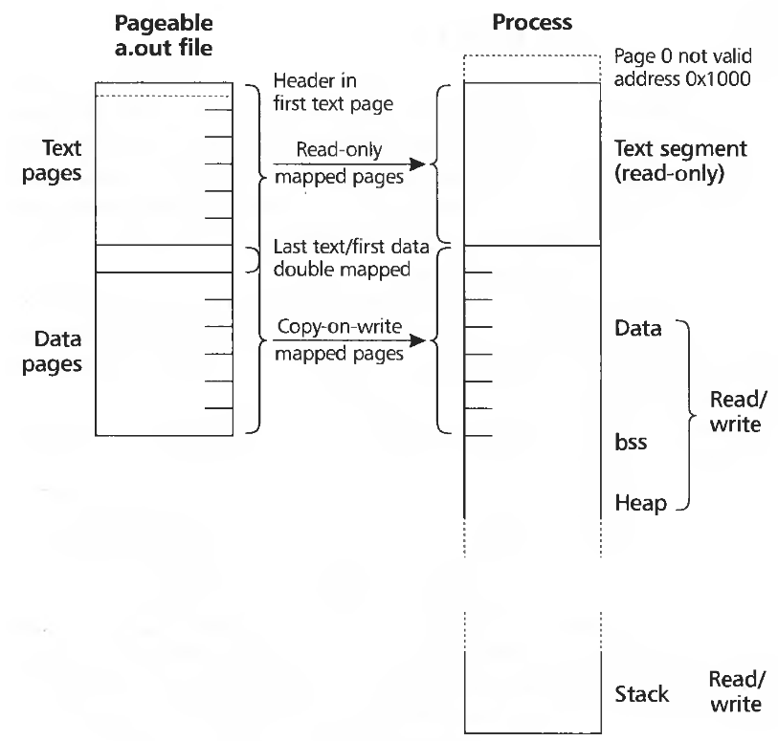
Mapping a.out

Slide 30
Relocation

Slide 31
Relocation, why?
Each program gets its own private space, why relocate?
  Linkers combine multiple libraries into a single executable
  Each library assumes private address space
    E.g., starts at 0x0
Is it possible to go away with segments?
  Each library gets a private segment (starts at 0x0)
  All cross-library references are patched to use segment numbers
Possible!
  But slow.
  Segment lookups are slow

Slide 32
Relocation
Each relocatable object file contains a relocation table
  List of places in each segment that need to be relocated
  Example:
    Pointer in the text segment points to offset 200 in the data segment
    Input file: text starts at 0, data starts at 2000, stored pointer has value 2200
    Output file: Data segment starts at 15000
      Linker adds relocated base of the data segment 13000 (DR)
    Output file: will have pointer value of 15200
  All jumps are relative on x86
    No need to relocate
    Unless its a cross-segment jump, e.g. text segment to data segment

Slide 33
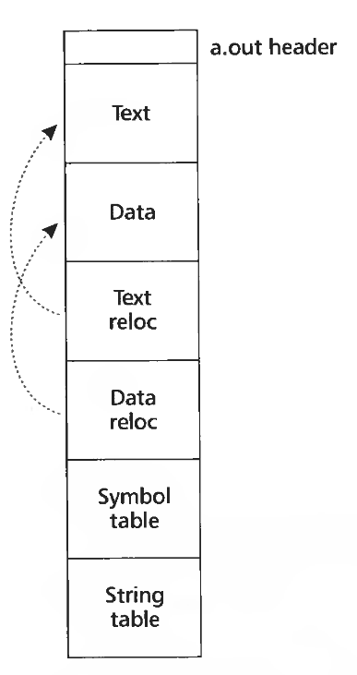
Relocatable A.OUT
Add relocation information for each section

Slide 34
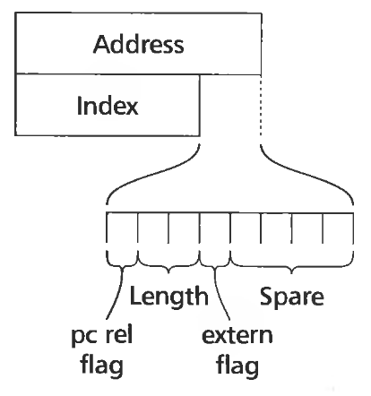
Relocation entries
Address relative to the segment
Length
  1, 2, 4, 8 bytes
Extern
  Local or extern symbol
Index
  Segment number if local
  Index in the symbol table

Slide 35
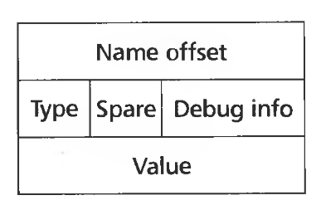
Symbol table
Name offset
  Offset into the string table
  UNIX supports symbols of any length
    Null terminated strings
Type
  Whether it is visible to other modules

Slide 36
We ran out of time here

Slide 37
Types of object files
Relocatable object files (.o)
Static libraries (.a)
Shared libraries (.so)
Executable files
We looked at A.OUT, but Unix has a general format capable to hold any of these files

Slide 38

ELF

Slide 39

ELF (continued)

Slide 40
Xv6: exec()
6310 exec(char *path, char **argv)
6311 {
...
6320 begin_op();
6321 if((ip = namei(path)) == 0){
6322 end_op();
6323 return −1;
6324 }
6325 ilock(ip);
6326 pgdir = 0;
6327
6328 // Check ELF header
6329 if(readi(ip, (char*)&elf, 0, sizeof(elf)) < sizeof(elf))
6330 goto bad;
6331 if(elf.magic != ELF_MAGIC)
6332 goto bad;
6333
...
6337 // Load program into memory.
6338 sz = 0;
6339 for(i=0, off=elf.phoff; i<elf.phnum; i++, off+=sizeof(ph)){
6340 if(readi(ip, (char*)&ph, off, sizeof(ph)) != sizeof(ph))
6341 goto bad;
6342 ...
Two sections:
  Text (0 bytes)
  Data (28 bytes)

Slide 41
Static libraries

Slide 42
Libraries
Conceptually a library is
  Collection of object files
UNIX uses an archive format
    Remember the ar tool
  Can support collections of any objects
  Rarely used for anything instead of libraries

Slide 43

Creating a static library

Slide 44
Searching libraries
First linker path needs resolve symbol names into function locations
To improve the search library formats add a directory
  Map names to member positions

Slide 45
Shared libraries

Slide 46
Motivation
1000 programs in a typical UNIX system
1000 copies of printf
How big is printf actually?

Slide 47
Motivation
1000 programs in a typical UNIX system
1000 copies of printf
  Printf is a large function
  Handles conversion of multiple types to strings
  5-10K
This means 5-10MB of disk is wasted on printf
Runtime memory costs are
  10K x number of running programs

Slide 48
Position independent code

Slide 49
Position independent code
Motivation
  Share code of a library across all processes
    E.g. libc is linked by all processes in the system
  Code section should remain identical
    To be shared read-only
  What if library is loaded at different addresses?
    Remember it needs to be relocated

Slide 50
Position independent code (PIC)
Main idea:
  Generate code in such a way that it can work no matter where it is located in the address space
  Share code across all address spaces

Slide 51
What needs to be changed?
Can stay untouched
  Local jumps and calls are relative
  Stack data is relative to the stack
Needs to be modified
  Global variables
  Imported functions

Slide 52
Example
000010a4 <_main>:
10a4: 55 pushl %ebp
10a5: 89 e5 movl %esp,%ebp
10a7: 68 10 00 00 00 pushl $0x10
10a8: 32 .data
10ac: e8 03 00 00 00 call 10b4 <_a>
...
000010b4 <_a>:
10bc: e8 37 00 00 00 call 10f8 <_strlen>
...
10c3: 6a 01 pushl $0x1
10c5: e8 a2 00 00 00 call 116c <_write>
...
Reference to a data section
  Code and data sections can be
  moved around

Slide 53
Example
000010a4 <_main>:
10a4: 55 pushl %ebp
10a5: 89 e5 movl %esp,%ebp
10a7: 68 10 00 00 00 pushl $0x10
10a8: 32 .data
10ac: e8 03 00 00 00 call 10b4 <_a>
...
000010b4 <_a>:
10bc: e8 37 00 00 00 call 10f8 <_strlen>
...
10c3: 6a 01 pushl $0x1
10c5: e8 a2 00 00 00 call 116c <_write>
...
Local function invocations
use relative addresses
  No need to relocate

Slide 54
Position independent code
How would you build it?

Slide 55
Position independent code
Main insight
  Code sections are followed by data sections
  The distance between code and data remains constant even if code is relocated
    Linker knows the distance
    Even if it combines multiple code sections together

Slide 56

Insight 1: Constant offset between text and data sections

Slide 57

Global offset table (GOT)
Insight #2:
  Instead of referring to a variable by its absolute address
  Refer through GOT

Slide 58
Global offset table (GOT)
GOT
  Table of addresses
  Each entry contains absolute address of a variable
  GOT is patched by the linker at relocation time

Slide 59
How to find position of the code in memory at run time?

Slide 60
How to find position of the code in memory at run time?
Is there an x86 instruction that does this?
  i.e., give me my current code address

Slide 61
How to find position of the code in memory at run time?
Simple trick
call L2
L2: popl %ebx
Call next instruction
  Saves EIP on the stack
  EIP holds current position of the code
  Use popl to fetch EIP into a register

Slide 62


Slide 63
PIC: Advantages and disadvantages
Any ideas?

Slide 64
PIC: Advantages and disadvantages
Bad
  Code gets slower
    One register is wasted to keep GOT pointer
      x86 has 6 registers, loosing one of them is bad
    One more memory dereference
      GOT can be large (lots of global variables)
      Extra memory dereferences can have a high cost due to cache misses
    One more call to find GOT
Good
  Share memory of common libraries
  Address space randomization

Slide 65
Back to shared libraries

Slide 66
Loading a dynamically linked ELF program
Map ELF sections into memory
Note the interpreter section
  Usually ld.so
Map ld.so into memory
  Start ld.so instead of the program
Linker (ld.so) intializes itself
Finds the names of shared libraries required by the program
  DT_NEEDED entries

Slide 67
Finding libraries in the file system
DT_RPATH symbol
  Can be linked into a file by a normal linker at link time
LD_LIBRARY_PATH
Library cache file
  /etc/ld.so.conf
  This is the most normal way to resolve library paths
Default library path
  /usr/lib

Slide 68
Loading more libraries
When the library is found it is loaded into memory
  Linker adds its symbol table to the linked list of symbol tables
  Recursively searches if the library depends on other libraries
    Loads them if needed

Slide 69
Shared library initialization
Remember PIC needs relocation in the data segment and GOT
  ld.so linker performs this relocation

Slide 70
Late binding
When a shared library refers to some function, the real address of that function is not known until load time
  Resolving this address is called binding
But really how can we build this?

Slide 71
Late binding
When a shared library refers to some function, the real address of that function is not known until load time
  Resolving this address is called binding
But really how can we build this?
  Can we use GOT?

Slide 72
Lazy procedure binding
GOT will work, but
  Binding is not trivial
    Lookup the symbol
    ELF uses hash tables to optimize symbol lookup
In large libraries many routines are never called
  Libc has over 600
  It's ok to bind all routines when the program is statically linked
    Binding is done offline, no runtime costst
  But with dynamic linking run-time overhead is too high
    Lazy approach, i.e., linking only when used, works better

Slide 73
Procedure linkage table (PLT)
PLT is part of the executable text section
  A set of entries
    A special first entry
    One for each external function
Each PLT entry
  Is a short chunk of executable code
  Has a corresponding entry in the GOT
    Contains an actual offset to the function
    Only after it is resolved by the dynamic loader

Slide 74
Each PLT entry but the first consists of these parts:
  A jump to a location which is specified in a corresponding GOT entry
  Preparation of arguments for a "resolver" routine
  Call to the resolver routine, which resides in the first entry of the PLT

Slide 75

PLT

Slide 76
Before function is resolved
Nth GOT entry points to after the jump

Slide 77

PLT after the function is resolved
Nth GOT entry points to the actual function

Slide 78
Conclusion
Program loading
  Storage allocation
Relocation
  Assign load address to each object file
  Patch the code
Symbol resolution
  Resolve symbols imported from other object files

Slide 79
Thank you!

Slide 80
Initializers and finalizers
C++ needs a segment for invoking constructors for static variables
  List of pointers to startup routines
    Startup code in every module is put into an anonymous startup routine
    Put into a segment called .init
Problem
  Order matters
  Ideally you should track dependencies
    This is not done
  Simple hack
    System libraries go first (.init), then user (.ctor)

Slide 81
Conclusion
Program loading
  Storage allocation
Relocation
  Assign load address to each object file
  Patch the code
Symbol resolution
  Resolve symbols imported from other object files

Slide 82
Next time
Static and shared libraries
Dynamic linking and loading
Position independent code
OS management of user space

Slide 83
Thank you!

Slide 84
Weak vs strong symbols
Virtually every program uses printf
  Printf can convert floating-point numbers to strings
    Printf uses fcvt()
  Does this mean that every program needs to link against floating-point libraries?
Weak symbols allow symbols to be undefined
  If program uses floating numbers, it links against the floating-point libraries
    fcvt() is defined an everything is fine
  If program doesn't use floating-point libraries
    fcvt() remains NULL but is never called

Slide 85
Simplest object file: DOS .com
Only binary code
  Loaded at 0x100 offset
  0x00 – 0xFF is reserved for program prefix
    Command line arguments
Set EIP to 0x100
Set ESP to the top of the segment
Run!

