Slide 1
Operating System
Course Project
CSL 3030
Task Manager for LINUX
By-
Pratul Singh (B20CS095)
Shashwat Singh (B20CS066)
Jayant Sorte (B20CS022)

Slide 2
PROBLEM STATEMENT
It often happens that user forgets to close the app and it ends up draining unnecessary battery, consuming more RAM, and the processors are used unnecessarily.
In such cases, the user wants to check for the resources, the processes are consuming and to end some unresponsive process. To eliminate these type of problems, the user requires an interface to terminate applications and processes, add some mischievous process to blocklist as needed for best performance.

Slide 3
OUR METHODOLOGY
Initially we learned to use psutil library and tried to extract processes and make a dummy resource monitor on terminal.
After making it on terminal, we learned the basics of tkinter in order to make the GUI of the manager and to add some basic functions of it.
We initially implemented the resource monitoring display on tkinter and later added the processes information,
We also added features like END TASK and ADD TO BLOCKLIST to give user more options to manage the processes.
Many bugs were also found during the making which were fixed.

Slide 4
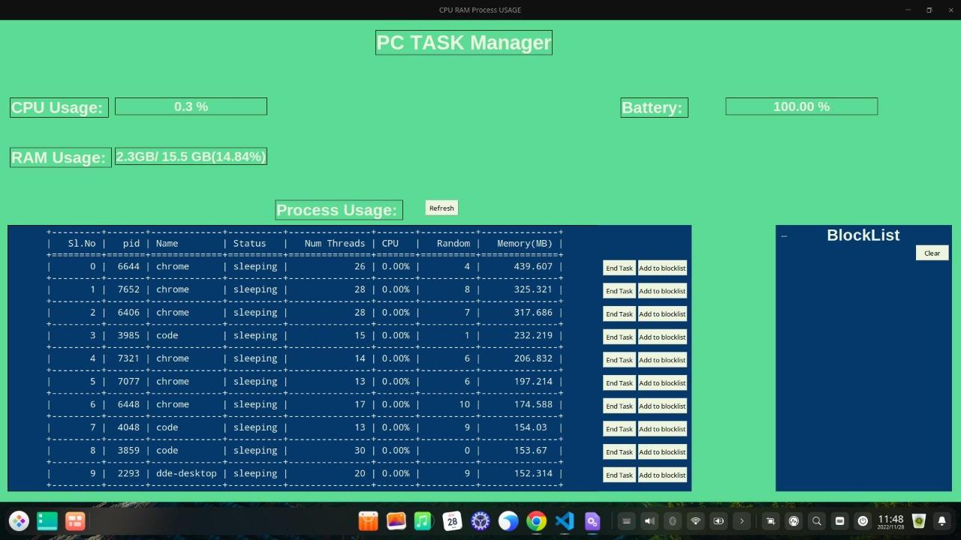
FINAL OUTPUT
We have been able to build a task manager that allows user to monitor live basic resources like RAM,CPU and battery.
It also allows users to kill an application.
It also has a feature of adding processes to blocklist, which will prevent them from starting in the future unless they are removed from the blocklist

Slide 5
Future ADD-ONS
Since it is a basic task manager right now, we hope to add more visual representation of the data like by using graphs, charts to make it more appealing.
We also hope to implement the feature of setting priorities to different processes, and also to add information about the active user.
We hope to implement the feature of adding buttons to open frequently-used applications.

Slide 6
LESSONS LEARNED
We learned to use psutil library in order to get processes informations.
We learned to use tkinter library to make simple GUI of applications with very less coding.
We learned to find alternative solutions to some problems that we encountered during the making of the project.

Slide 7
THANK YOU

