Slide 1
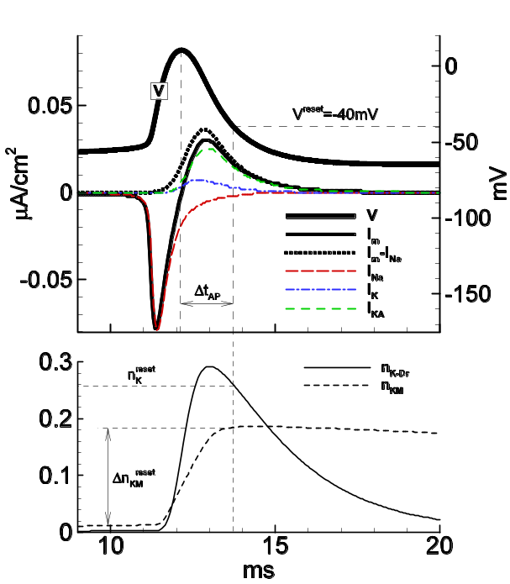
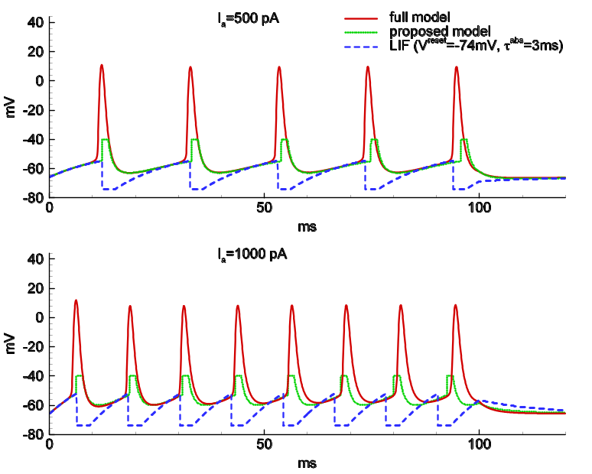
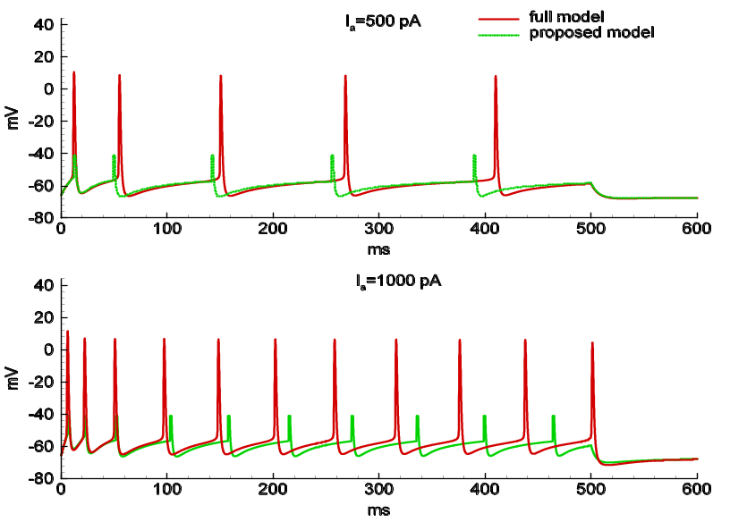
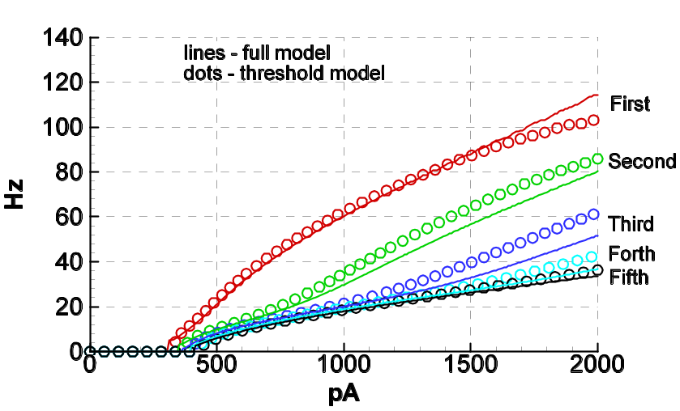
Full and Threshold Single-Neuron Model
Spike trains for a neuron with I_{Na} , I_{K-Dr} , I_{KA}
Single spike
Spike trains for a neuron with I_{Na} , I_{K-Dr} , I_{KA} , I_{KM} , I_{AHP}
Spike adaptation

Slide 2
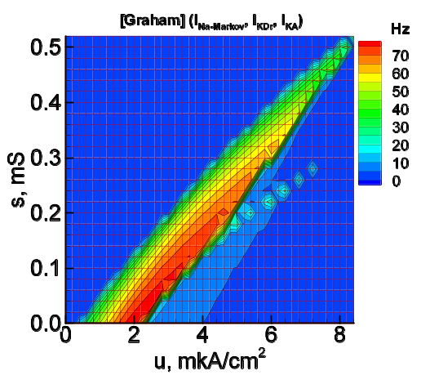
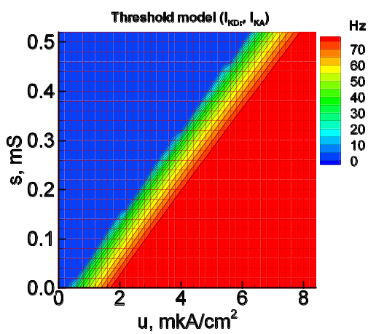
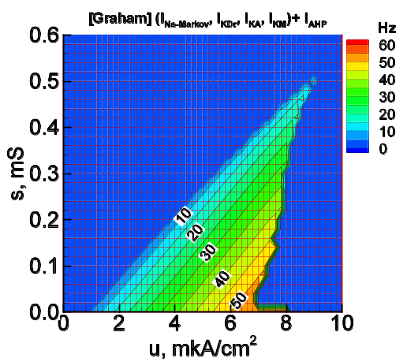
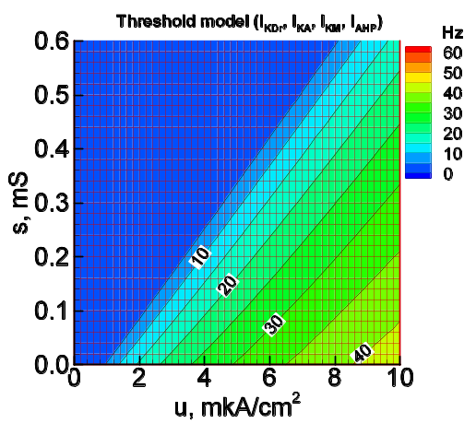
Steady-state firing rate

