Slide 1
Sales predictions
Item sales prediction in various stores

Slide 2
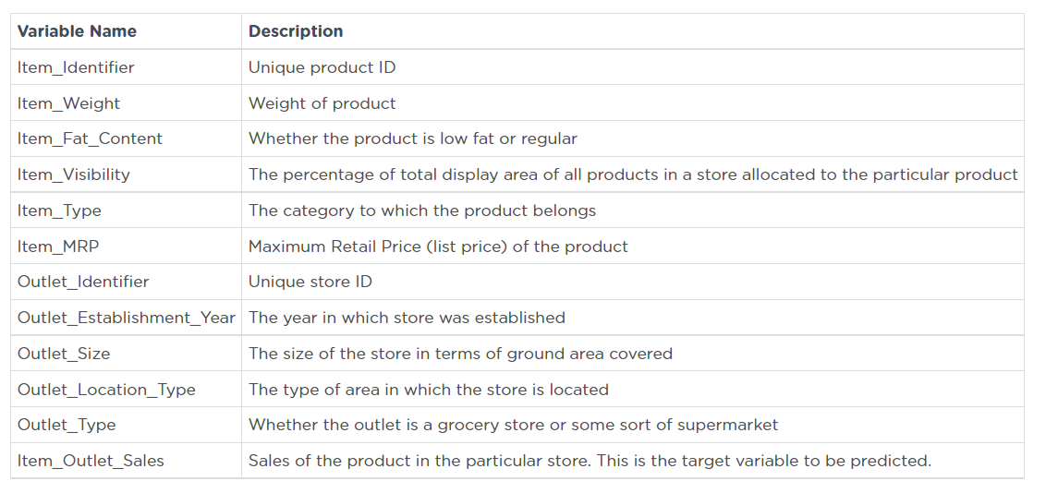
This project contains data analysis and item sales prediction in various stores. This should help the retailer understand the properties of products and outlets that play crucial roles in increasing sales. Here is the dictionary for the dataset:

Slide 3
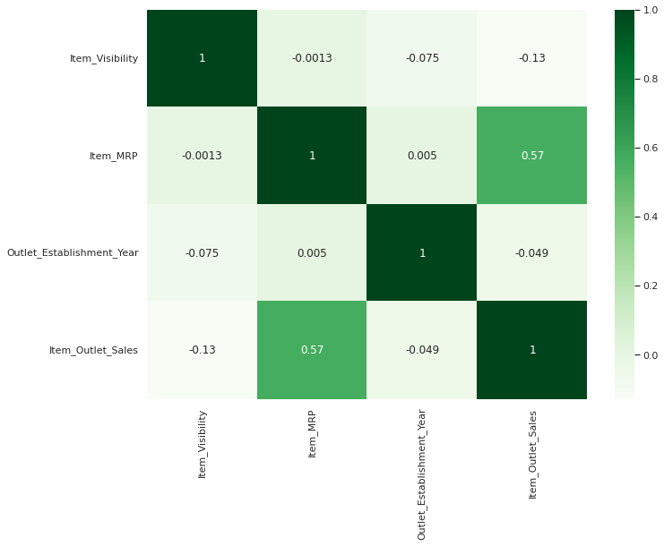
On the first visualization we can see a correlation in data, that shows what features have the most impact on sales.
Visualization above shows that Item Max Retail Price has high impact on Outlet Sales.

Slide 4
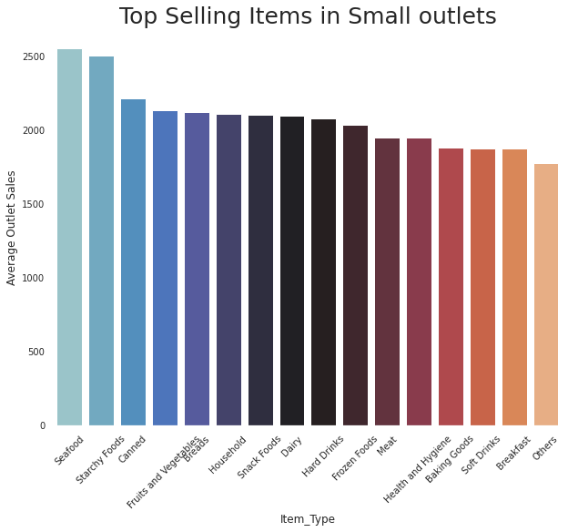

Slide 5
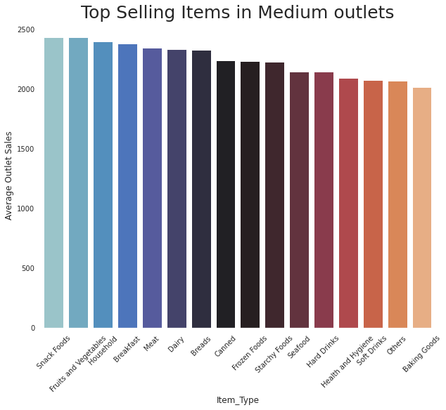

Slide 6
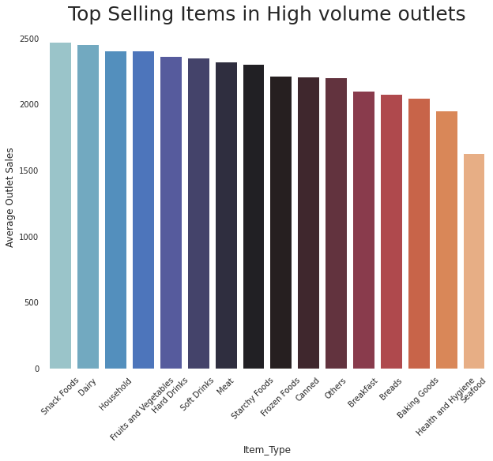

Slide 7
Small outlets are doing way better in selling seafood and starchy foods while high volume outlets are selling much less seafood, but doing much better in selling dairy and soft drinks. Medium outlets are pretty balanced, average sales numbers here are in the medium to high values.

Slide 8
Using different types of Machine Learning models on this data set gives the ability to determine which model does the best job on predictions. Based on my observations using Linear regression model will be best suited for this dataset.

