Slide 1


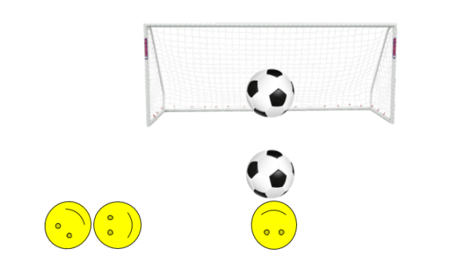
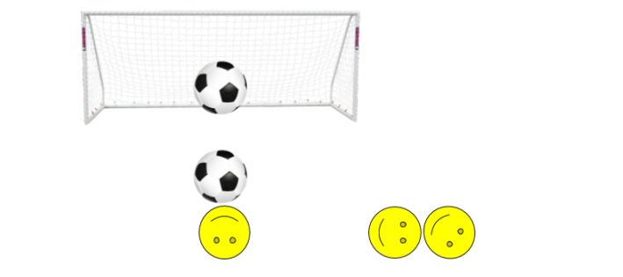
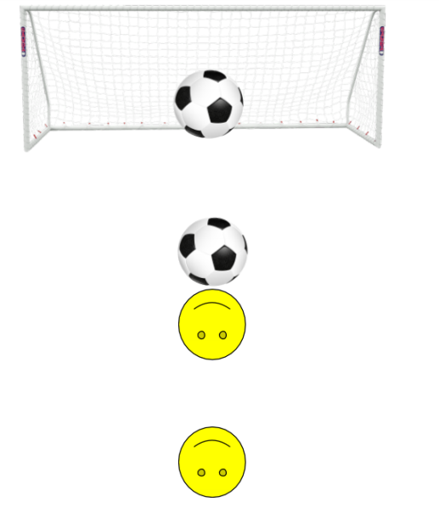
SoccerBot by MakeBlock Robot
Antone Evans and Zach Goins
Faculty Mentor(s): Dr. Sun
University of Central Arkansas
Department of Computer Science
ABSTRACT
Section II (Hitting Ball from Left)
Section III (Hitting Ball from Right)
Section IV (Result)
In this technical report, we use the mBot starter/orion board as a model for our Multimedia project. Firstly, we constructed the robot then we created a simple program where the robot turns and drives to ensure it worked. Next, we checked our ultrasonic senor and wrote a simple program to ensure the robot was working correctly. Our bot is call the SoccerBot because it's goal is the hit three soccer balls into the goal without the help of anything other than the program. The program is written in arduino mode using the mBlock IDE.
We first check if the ultrasonic distance is greater than 40 and less than 49. If this case it true, this part of the code will run and the robot will hit the ball from a left angel otherwise it will check a next case. The left motor is set to 50 and the right motor is set to 0 this will allow the soccerBot to turn left. There is a 1.5 second wait to allow the robot to turn. The bot then sets both wheels to 50 for 5 seconds to allow the robot to get to the middle of the field where the goal is. The robot then turns forward to face the goal. The the left motor is turn off and right motor is left at 50 this will allow the robot to turn forward. The robot then goes forward for 2 seconds at full speed. The soccerBot is then turned off.
We first check if the ultrasonic distance is greater than 30 and less than 39. If this case it true, this part of the code will run and the robot will hit the ball from a right angel otherwise it will check a next case. The right motor is set to 50 and the left motor is set to 0 this will allow the soccerBot to turn right. There is a 1.5 second wait to allow the robot to turn. The bot then sets both wheels to 50 for 5 seconds to allow the robot to get to the middle of the field where the goal is. The robot then turns forward to face the goal. The the right motor is turn off and right motor is right at 50 this will allow the robot to turn forward. The robot then goes forward for 2 seconds at full speed. The soccerBot is then turned off.
Our final result however, does not reflect this work. Our initial goal was to write a single program that would be able to handle all three cases; however, do to hardware problems. Our final project could not handle all three cases. The ultrasonic sensor suddenly stopped working. It continued to read the same number for instance it would not change from 30cm no matter how close or far you would move it from an object. Therefore, from our code above you notice that our ultrasonic sensor handles the three if else cases; therefore, without it the soccerBot would be clueless on which angle to hit the ball. However, all three cases would work if the ultrasonic sensor was functional.
Section V (Solution)
Our solution to this program was to write the code separately on three different workspaces - straight, from the left angle and from the right angle. We then eliminated the ultrasonic senor if statement and allowed the program to run. This way is more hard coded and not dynamic at all; however, to show what we were attempting to do this would work. However, for demoing the robot and time limits, we made a simple program and would change the speed of the robot.
Figured 1.1: Hitting Ball from Left
Figured 1.2: Hitting Ball from Right
Section I (Hitting Ball Straight On)
We first check if the ultrasonic distance is greater than 50. If this case it true, this part of the code will run and the robot will hit the ball from a straight angel otherwise it will check a next case. The motor is the set to full speed of 255. As you can tell we have to set both motors, motor 9 is the right and motor 10 is the left. There is then a delay or wait for three seconds to allow the soccorBot to take the ball to the net. The motors are then set to 0 which stops the robot.
ACKNOWLEDGEMENTS
This research was supported by the University of Central Arkansas Multimedia Class in “Robotics” which gave us a greater understanding of how hardware works. Thank you to Dr. Sun for helping direct us with our bi-weekly schedule report, our labs sign in sheet and the honesty when accounting for our contribution. Many thanks to makerBlock and his industrial design team for the mBlock. The documentation and videos provided by your documentation has been a source of endless help during this process. A special thank you to my teammate for being a great source of help. We worked together like a well oil machine and faced every obstacle together. We helped to uplift each others ideas and it was a great time working.
Figured 1.3: Hitting Ball Straight On

