Slide 1
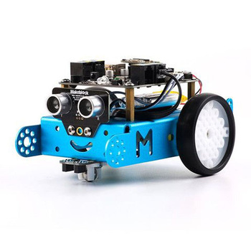

SoccerBot by MakeBlock Robot
Antone Evans and Zach Goins

Slide 2
Objective
To create a soccerBot that will be able to hit a soccer ball no matter the angle.
The soccerBot should use its ultrasonic sensor along with the written code to accomplish this task.

Slide 3
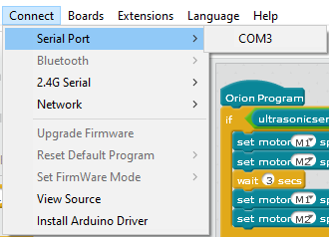
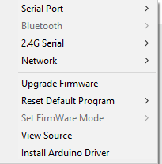
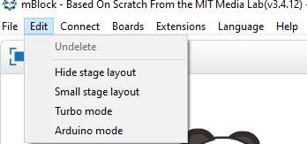
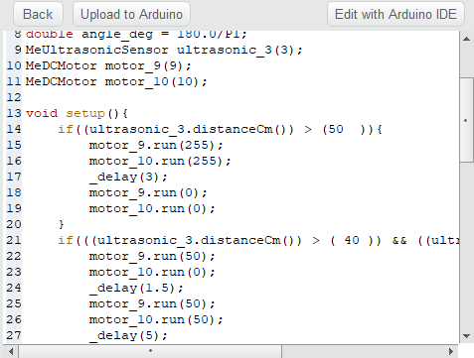
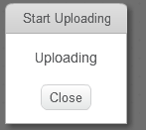
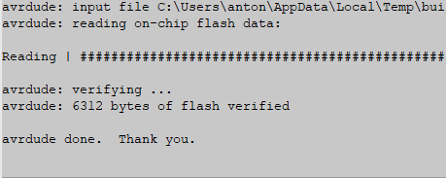
Set Up

Slide 4
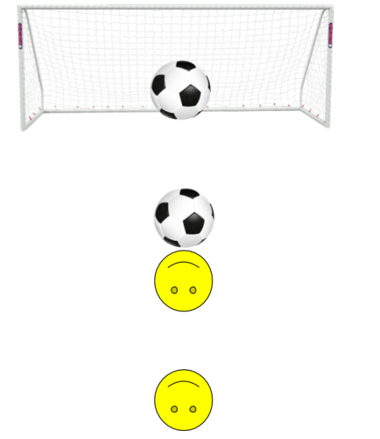
Hitting Ball Straight On

Slide 5
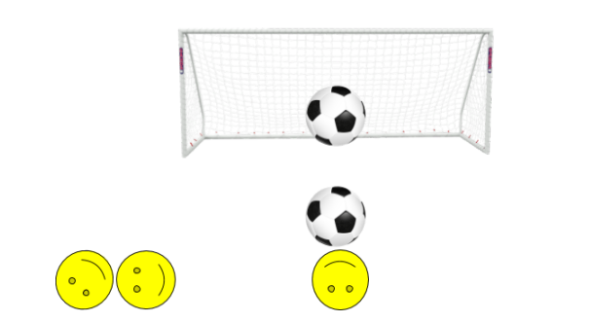
Hitting Ball from Left

Slide 6
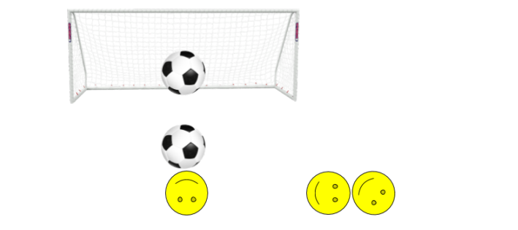
Hitting Ball from Right

Slide 7
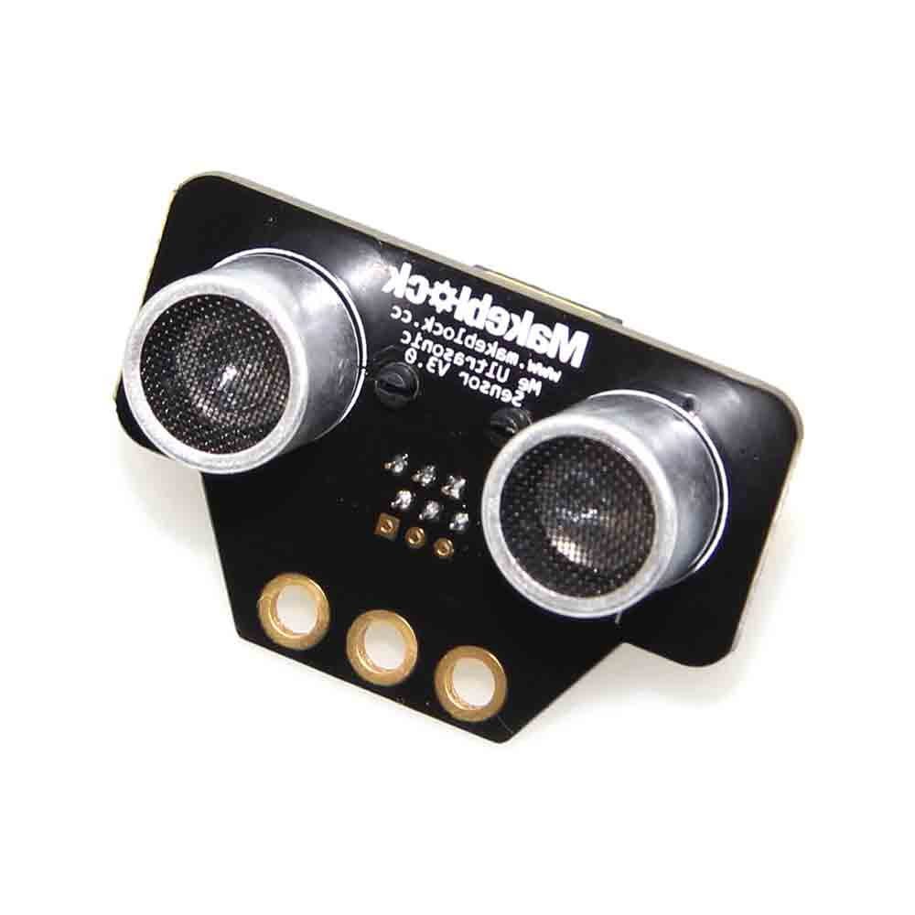
Expected End Result
Based on the balls distance from the robot the robot would make the logical choice to hit the ball either straight on or from a right or left angel.
This was unable to work because of the ultrasonic sensor not being able to work.

Slide 8
Actual End Result
For demoing in class purposes we will run the code that hits the ball straight on.
Our demo video shows the ball being hit from all three angels.
This was possible because we uploaded each segment of the code and made the decision for the soccerBot.

Slide 9
Demo

Slide 10
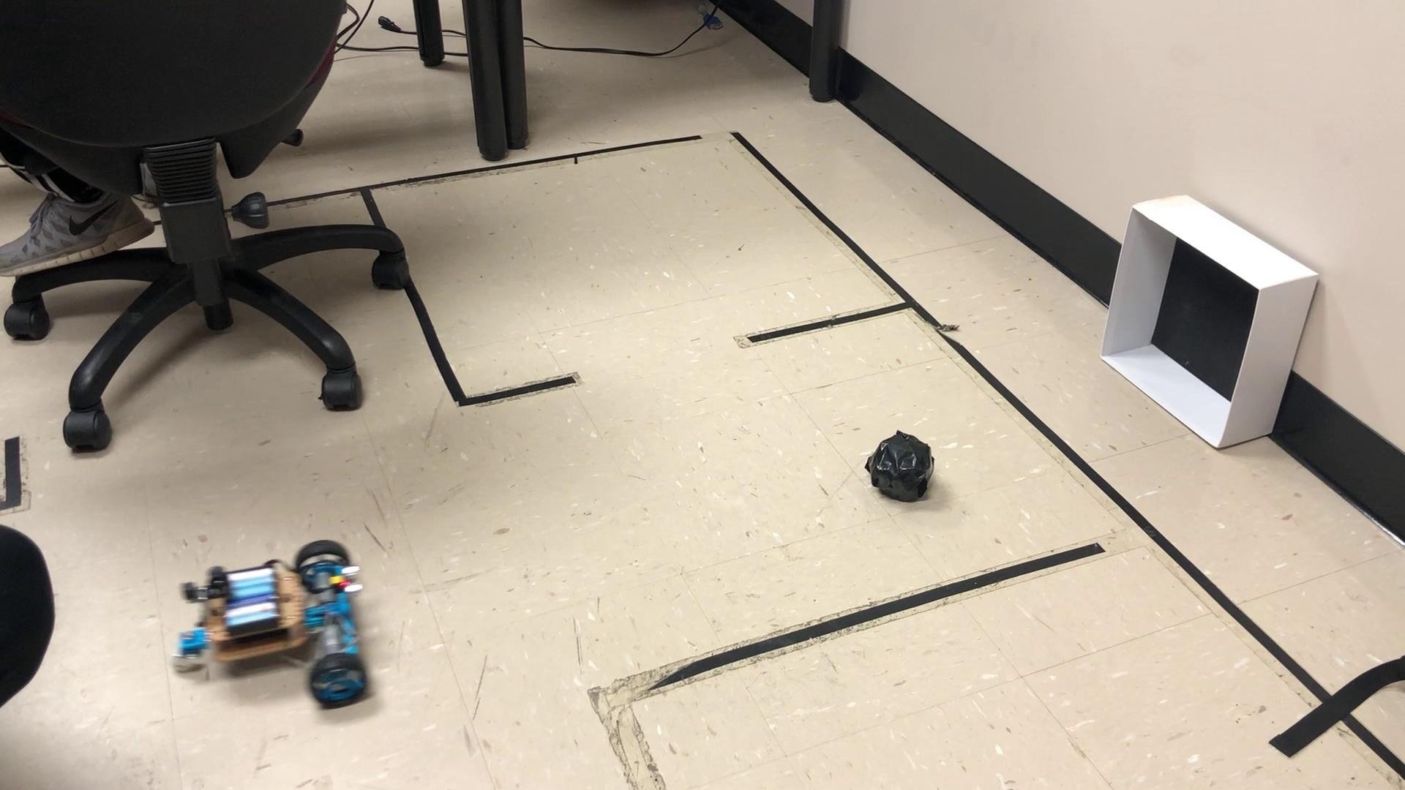
Hitting Ball Straight On

Slide 11
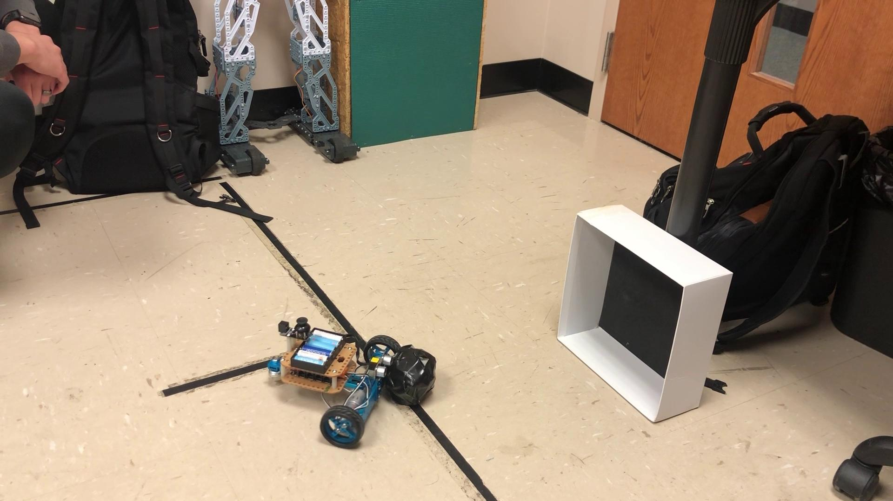
Hitting Ball from Left

Slide 12
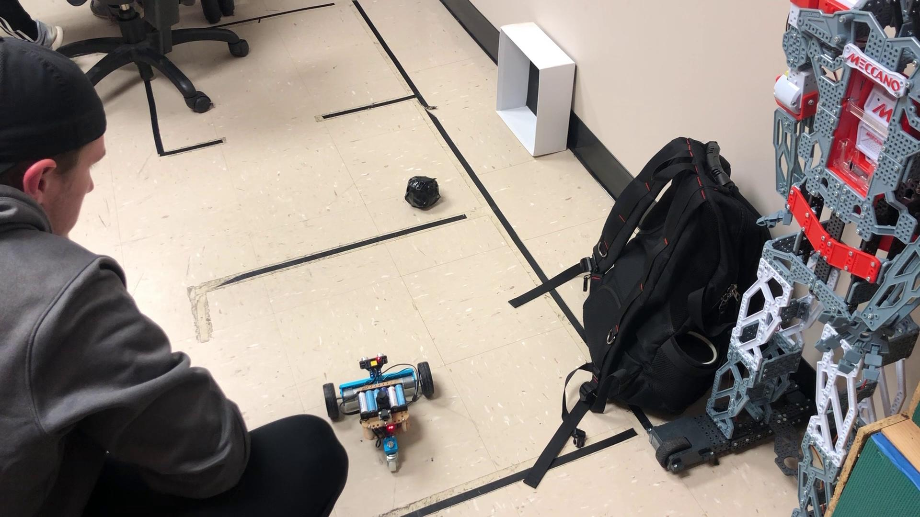
Hitting Ball from Right

