Slide 1
R and R Studio
2019
Antonello Salis
Forestry Officer
antonellosalis@gmail.com
Antonello.salis@fao.org

Slide 2
R & RStudio
https://cran.r-project.org/
https://www.r-project.org/
License: GNU General Public License
Pricing: Free
https://www.rstudio.com/
License: AGPL v3
Pricing : Free

Slide 3
R training Roadmap
1 day (1 hour) [file: R_training_A1.R]
Install R & Rstudio;
Overview;
First steps with Rstudio:
    Data types;
    Vectors;
    Plots.

Slide 4
R training Roadmap
Before start please click on “Clone or Download” green button in https://github.com/antonellosalis/R_training;
Save and unzip the content on your computer.

Slide 5
Yes No
data handling and storage: numeric, textual
matrix algebra
hash tables and regular expressions
high-level data analytic and statistical functions
graphics
programming language: loops, branching, subroutines
is not a database, but connects to DBMSs
no professional / commercial support

Slide 6
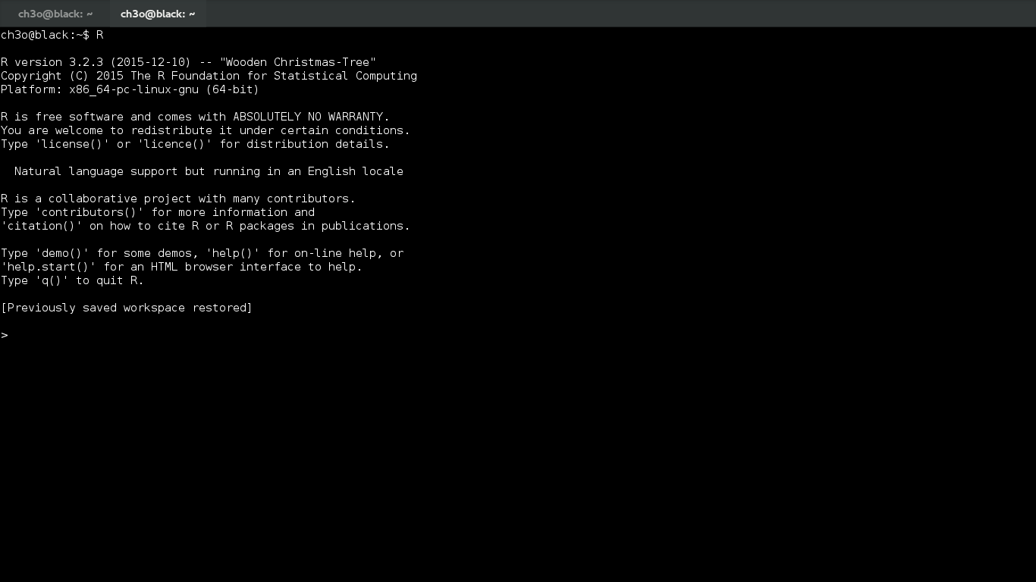

Slide 7
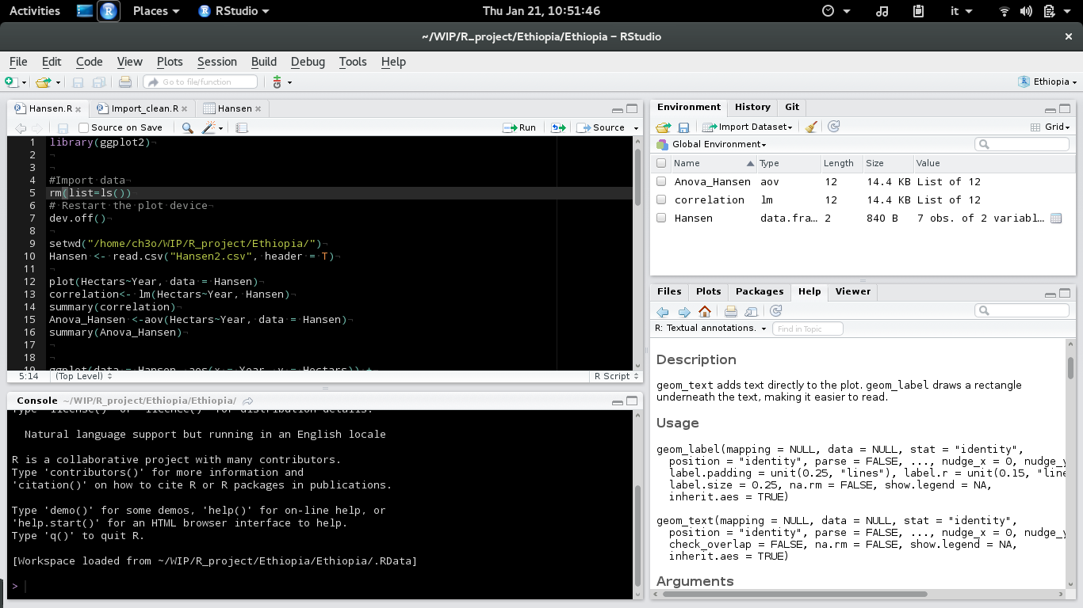

Slide 8
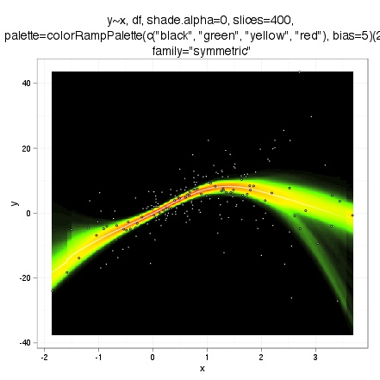

Slide 9

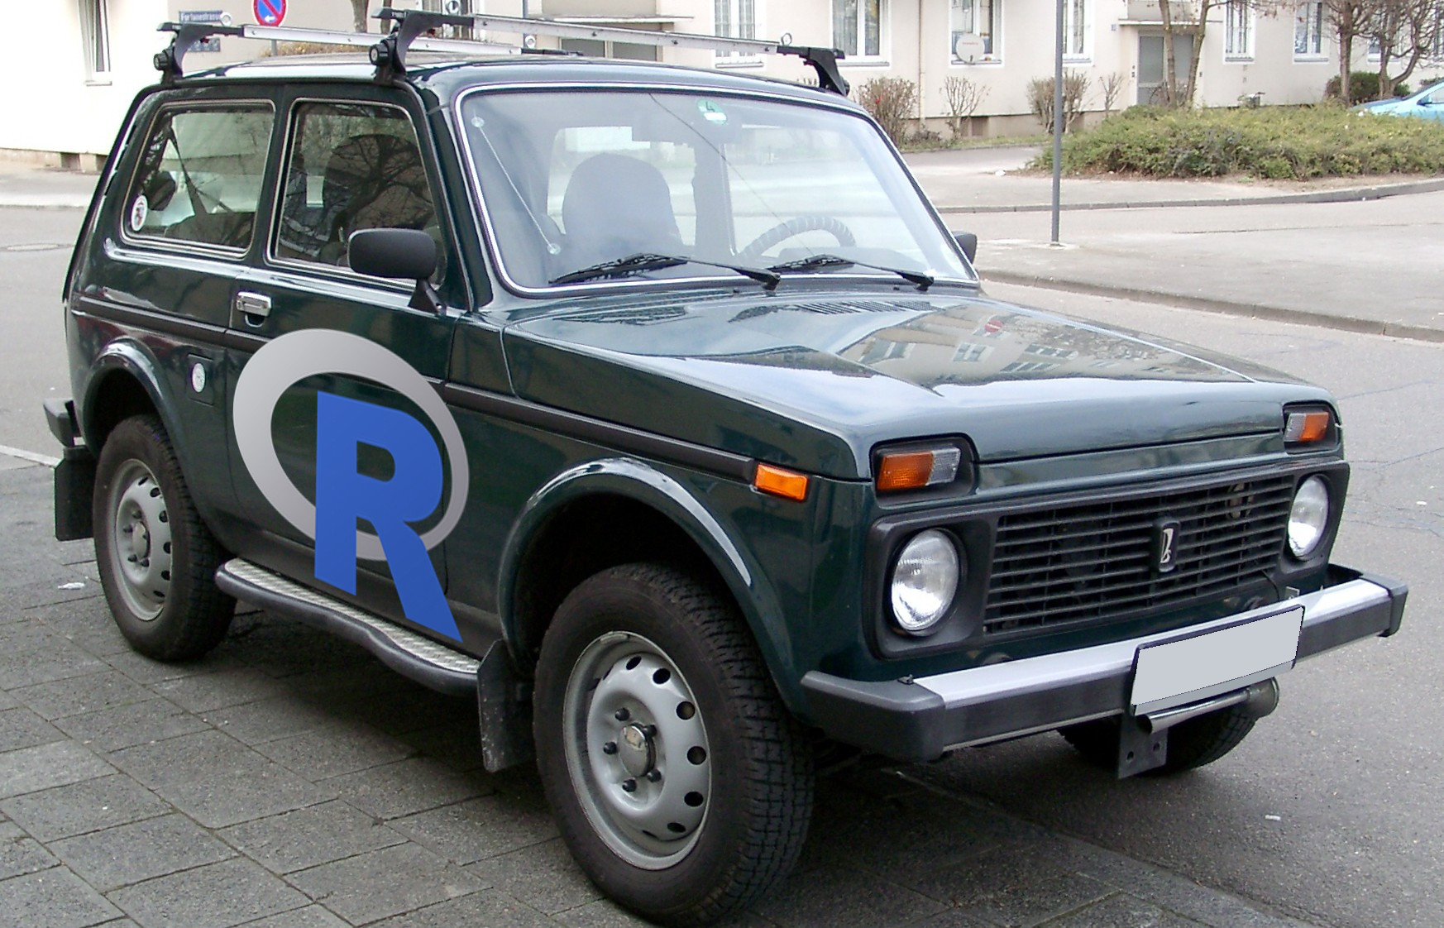
Over 10.000 Packages!
ggplot2
bayess
gdal
reshape
animation
Mass

Slide 10
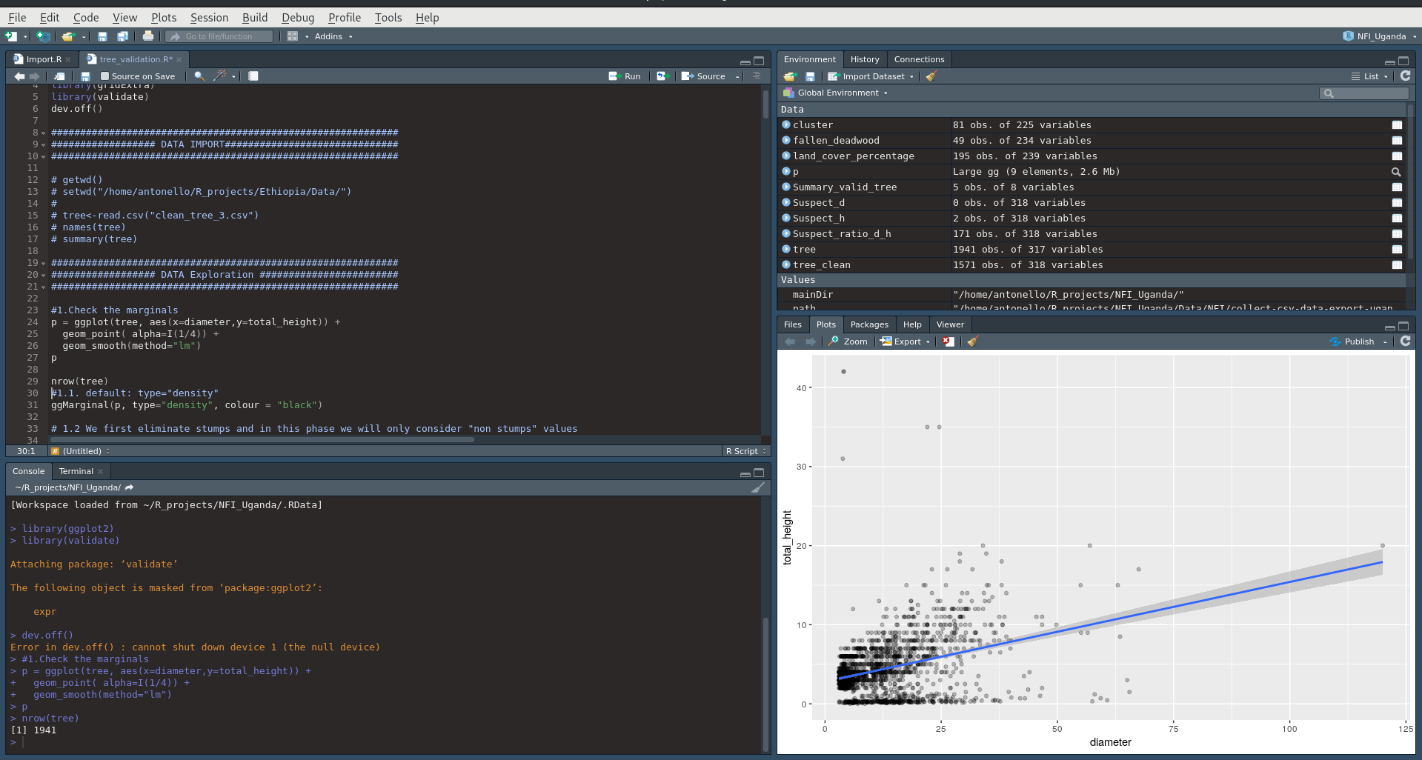
RStudio structure

