Slide 1

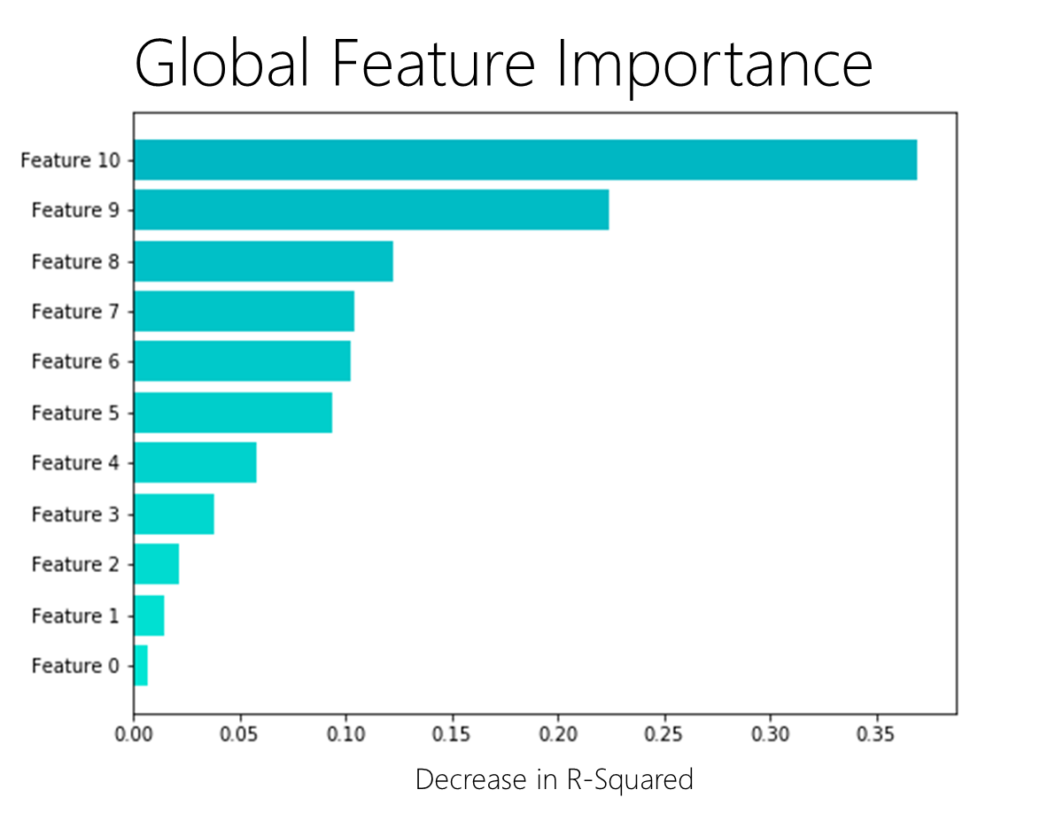
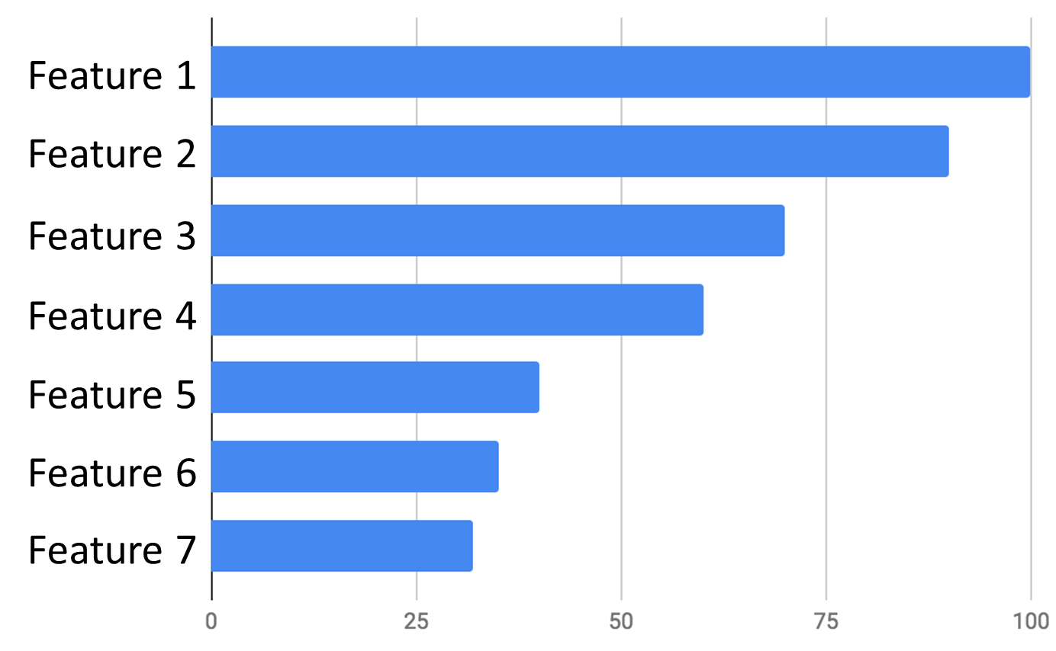

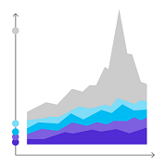

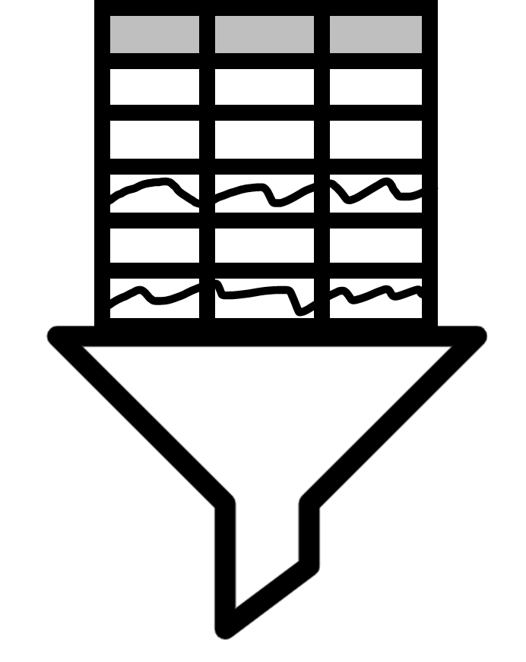




Stateful
Recommendations

Slide 2



Cache

Slide 3
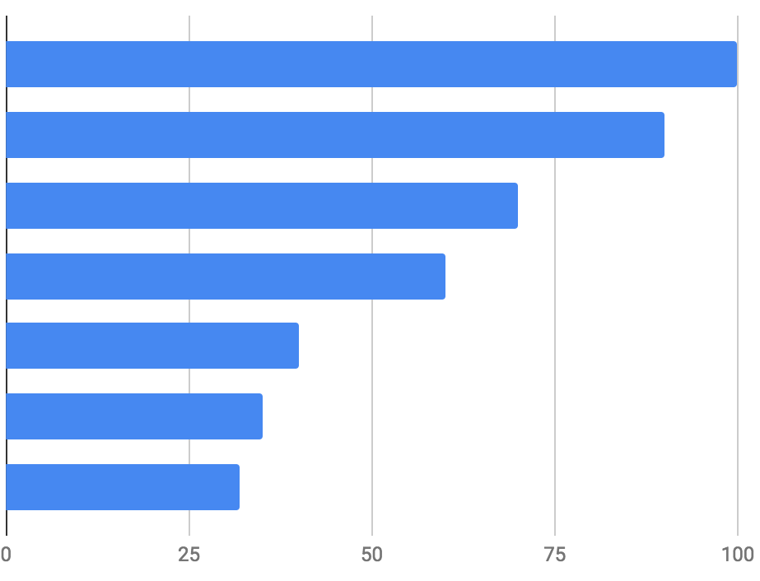
Feature 1
Feature 2
Feature 3
Feature 4
Feature 5
Feature 6
Feature 7
Notes:
Feature 1

Slide 4



ML.NET pipeline
Recommendations
Anomaly Detection
Recommendations

Slide 5
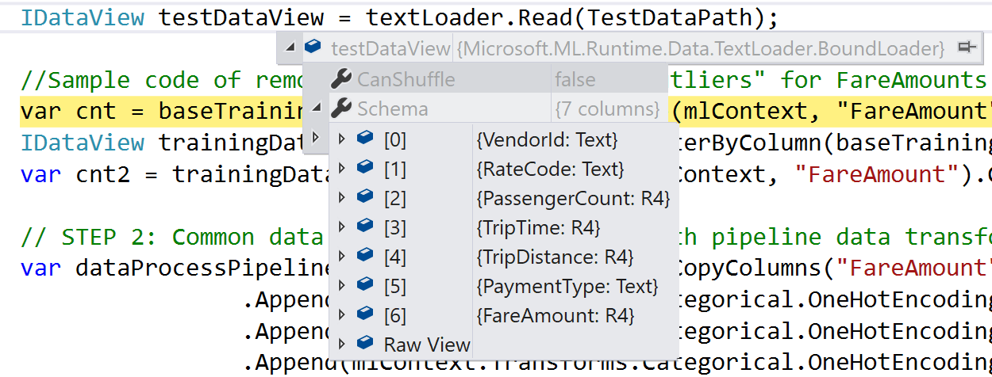
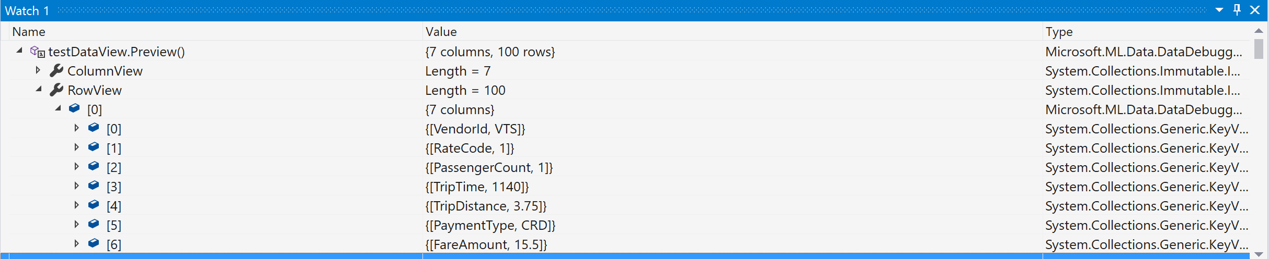
Row’s
Data

Slide 6
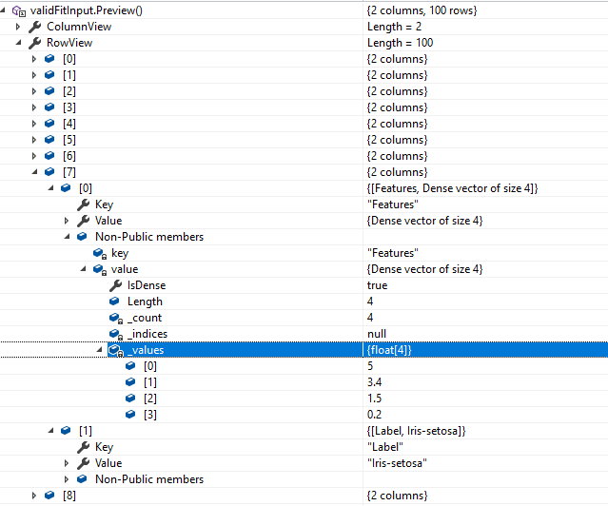

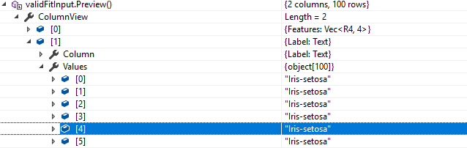
In the case that your dataview you will encounter following message by calling Preview function:
All you need to do is to click on that
icon and Visual studio will execute function in multithreaded environment and produce you object which you can inspect.

Slide 7
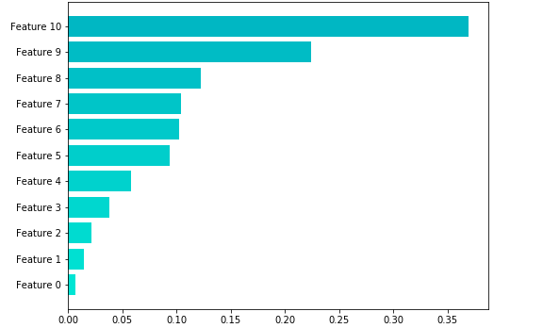
Global Feature Importance
Decrease in R-Squared

Slide 8
