Slide 1


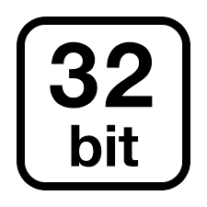


ML.NET pipeline
Recommendations
Anomaly Detection
Recommendations

