Slide 1


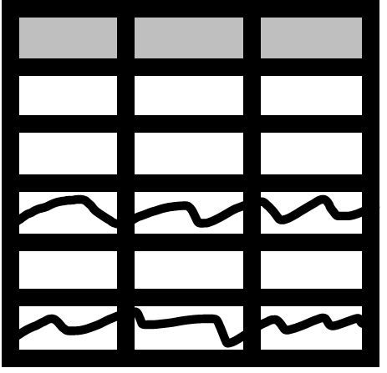


IDataView interoperability in the .NET ecosystem
IDataView
Data Prep
libraries
Plotting
libraries

Slide 2


Slide 3
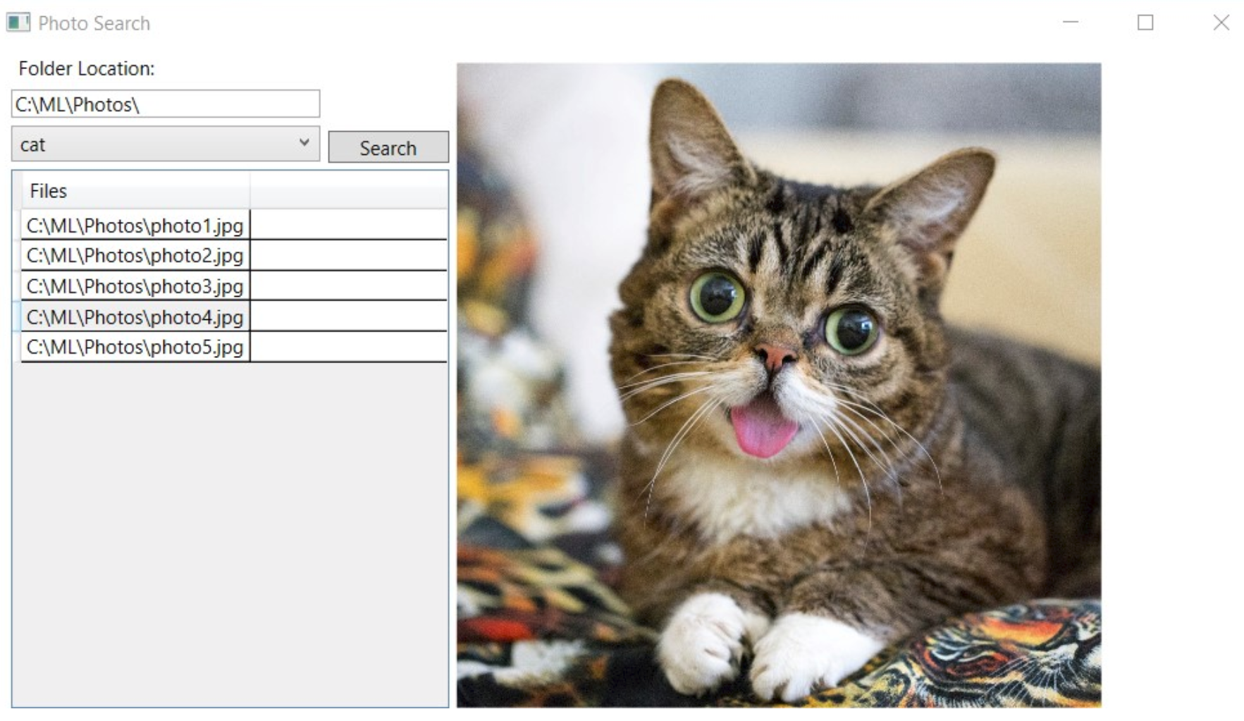
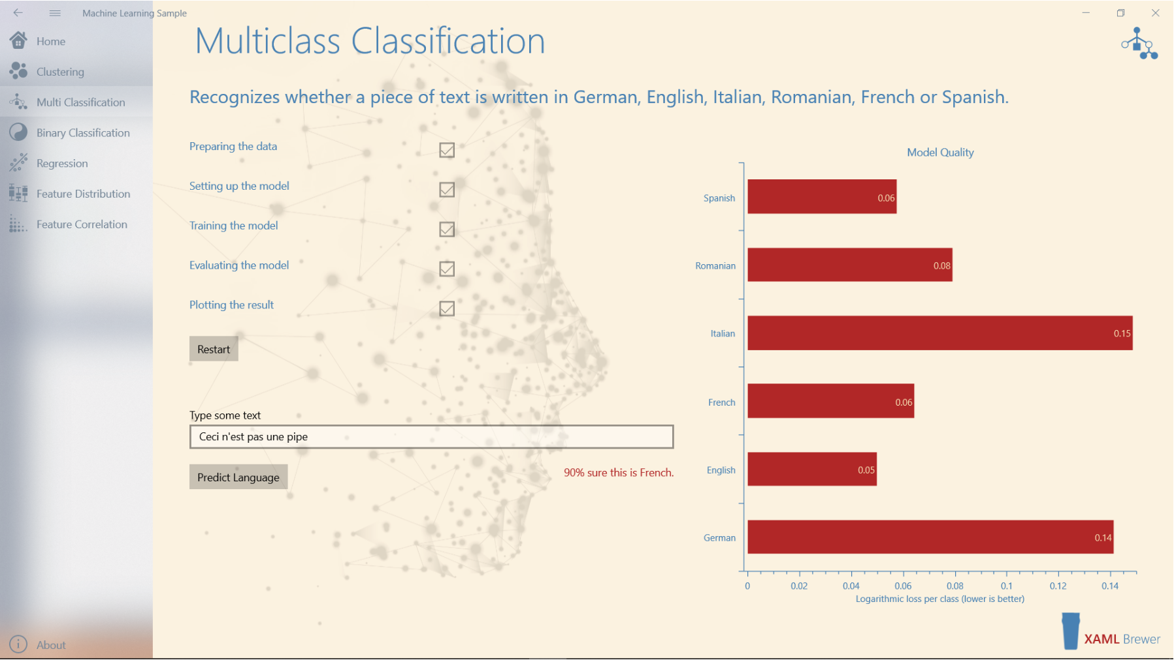



Slide 4


Developer-friendly ML APIs to:
nuget
Transforms
Trainers
Misc.
Extensions
Text
Linear
ML Data framework
Schema
Boosted Trees
Evaluators
Missing values
Svm
Calibrators
Categorical
K-Means
Data loaders
Normalization
Feature Selection

Slide 5

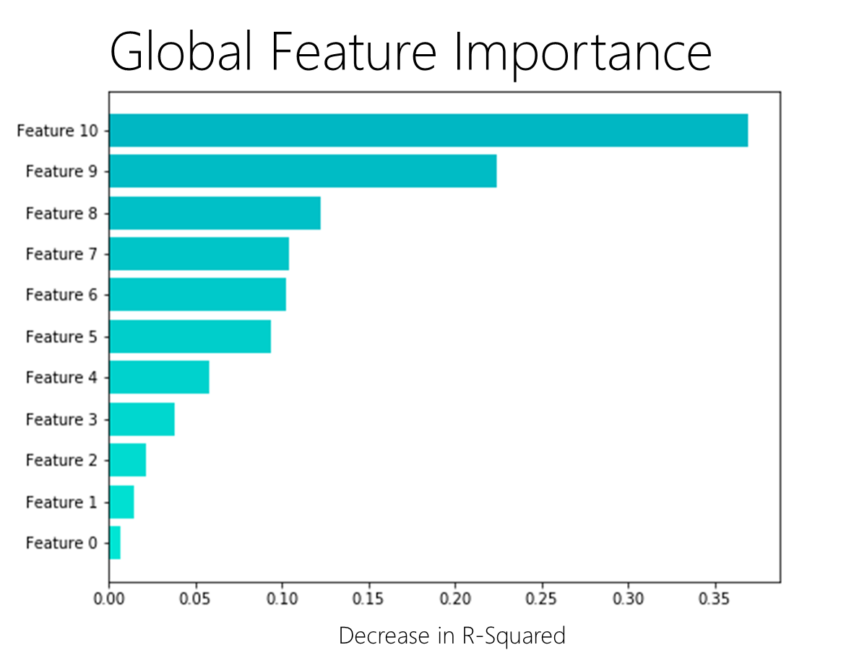
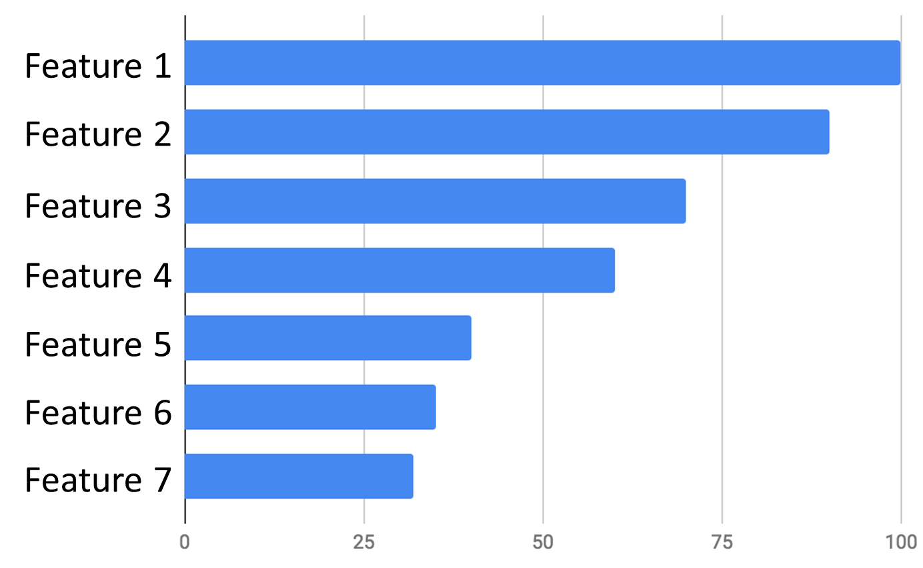

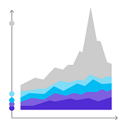





Stateful
Recommendations

Slide 6



Cache

Slide 7
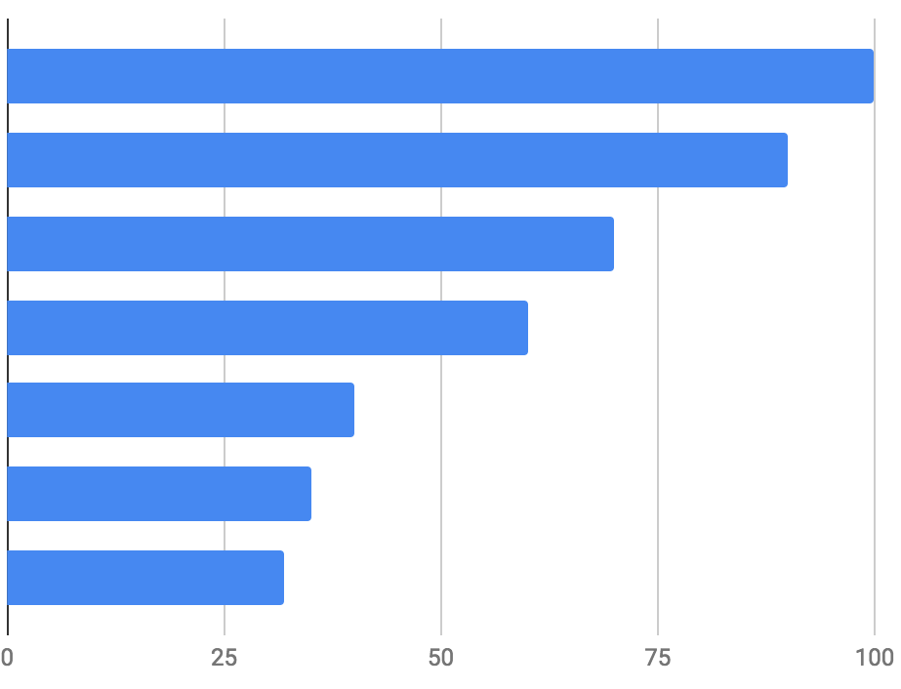
Feature 1
Feature 2
Feature 3
Feature 4
Feature 5
Feature 6
Feature 7
Notes:
Feature 1

Slide 8



ML.NET pipeline
Recommendations
Anomaly Detection
Recommendations

Slide 9
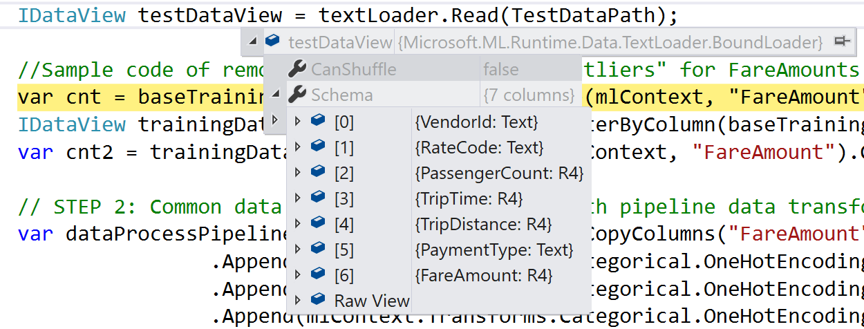
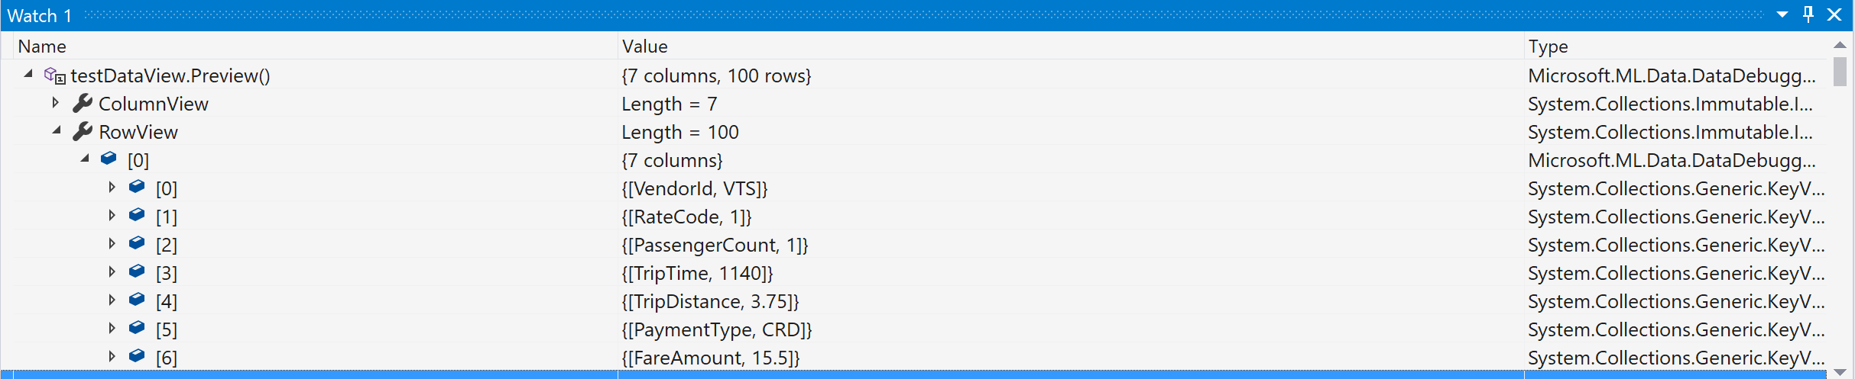
Row’s
Data

Slide 10
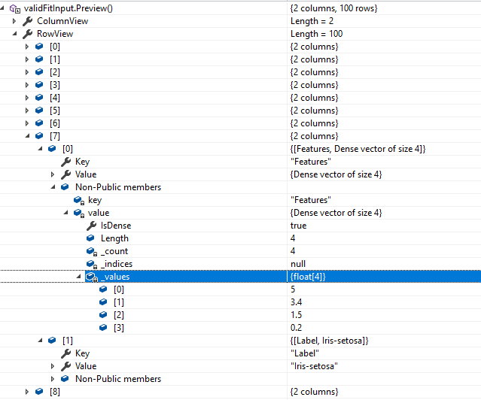

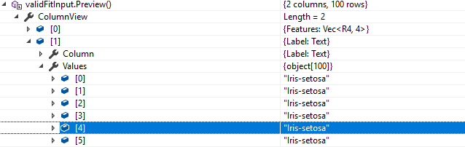
In the case that your dataview you will encounter following message by calling Preview function:
All you need to do is to click on that
icon and Visual studio will execute function in multithreaded environment and produce you object which you can inspect.

Slide 11
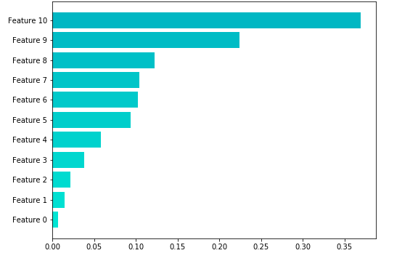
Global Feature Importance
Decrease in R-Squared

Slide 12
