Slide 1


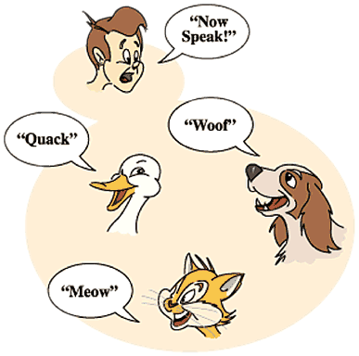

Polymorphism
Abstract Classes, Abstract Methods, Override Methods
C# OOP
Basics
SoftUni Team
Technical Trainers
Software University
http://softuni.bg

Slide 2

Table of Contents
Polymorphism
Definition
Types
Override Methods
Overload Methods
Abstraction
Classes
Methods

Slide 3
Questions
sli.do #CSharp-Fund

Slide 4

Polymorphism

Slide 5
What is Polimorphism?
From the Greek
Polys
(many)
Morphe
(shape/forms)
Polymorphos
This is something similar to a word having several different meanings depending on the context
Notes:
Polymorphism is the ability of an object to take on many forms. The most common use of polymorphism in OOP occurs when a parent class reference is used to refer to a child class object.

Slide 6
Polymorphism in OOP
Ability of an object to take on many forms
public interface IAnimal {}
public abstract class Mammal {}
public class Person : Mammal, IAnimal {}
Person IS-A Person
Person IS-AN Animal
Person IS-A Mammal
Person IS-AN Object

Slide 7
Reference Type and Object Type
public class Person : Mammal, Animal {}
Animal person = new Person();
Mammal personOne = new Person();
Person personTwo = new Person();
Reference Type
Object Type
Variables are saved in reference type
You can use only reference methods
If you need object method you need to cast it or override it

Slide 8
Keyword - is
Check if object is an instance of а specific class
public class Person : Mammal, Animal {}
Animal person = new Person();
Mammal personOne = new Person();
Person personTwo = new Person();
if (person is Person)
{
((Person) person).getSalary();
}
Check object type of person
Cast to object type and use its methods

Slide 9
Keyword - is (2)
Anytime you find yourself writing code of the form "if the object is of type T1, then do something, but if it's of type T2, then do something else", slap yourself.
From Effective C++, by Scott Meyers

Slide 10
Types of Polymorphism
Runtime polymorphism
Compile time polymorphism
public class Shape {}
public class Circle : Shape {}
public static void Main()
{
Shape shape = new Circle()
}
Method overriding
public static void Main()
{
int Sum(int a, int b, int c)
double Sum(Double a, Double b)
}
Method overloading

Slide 11
Compile Time Polymorphism
Also known as Static Polymorphism
Argument lists could differ in:
Number of parameters.
Data type of parameters.
Order of parameters.
public static void Main()
{
static int MyMethod(int a, int b) {}
static double MyMethod(double a, double b) {}
}
Method overloading

Slide 12
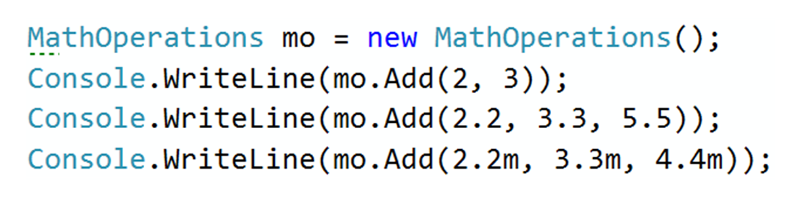
Problem: MathOperation
MathOperation
+Add(int, int): int
+Add(double, double, double): double
+Add(decimal, decimal, decimal): decimal
Notes:
Extensibility / Polymorphism: New functionality may be easily plugged in without changing existing classes as long the new plug-in classes extend given base classes.
Reusability: For a set of similar applications a framework can be defined using a core set of classes that are to be extended by classes that fill in the application-dependent part.
Information Hiding: If a more general class using a simpler contract is sufficient, details from extending classes may be hidden to some of the client classes. This allows them to be more independent from possible changes and diminishes the load of contracts that must be understood by a reader of these client classes.
(c) 2006 National Academy for Software Development - http://academy.devbg.org*
12##

Slide 13
Solution: MathOperation
public int Add(int a, int b)
{
return a + b;
}
public double Add(double a, double b, double c)
{
return a + b + c;
}
public decimal Add(decimal a, decimal b, decimal c)
{
return a + b + c;
}
Notes:
Extensibility / Polymorphism: New functionality may be easily plugged in without changing existing classes as long the new plug-in classes extend given base classes.
Reusability: For a set of similar applications a framework can be defined using a core set of classes that are to be extended by classes that fill in the application-dependent part.
Information Hiding: If a more general class using a simpler contract is sufficient, details from extending classes may be hidden to some of the client classes. This allows them to be more independent from possible changes and diminishes the load of contracts that must be understood by a reader of these client classes.
(c) 2006 National Academy for Software Development - http://academy.devbg.org*
13##

Slide 14
Rules for Overloading a Method
Method signature should be different
Number of arguments
Type of arguments
Order of arguments
Method’s return type isn’t part of it’s signature
Overloading can take place in the same class or in it’s sub-classes
Constructors can be overloaded
Notes:
To pass more specific object to method

Slide 15
Runtime Polymorphism
Also known as Dynamic Polymorphism
public class Rectangle {
public virtual double Area() {
return this.a * this.b;
}
}
public class Square : Rectangle {
public override double Area() { return this.a * this.a;
}
}
Method overriding
Notes:
Demo (look at View -> Notes Page)
public static void main(String[] args) {
Vegetarian babyDeer = new Deer();
Vegetarian babyElephant = new Elephant();
List<Vegetarian> vegetarianAnimals = new ArrayList<>();
vegetarianAnimals.add(babyDeer);
vegetarianAnimals.add(babyElephant);
}

Slide 16
Runtime Polymorphism (2)
Usage of override method
public static void Main()
{
Rectangle rect = new Rectangle(3.0, 4.0);
Rectangle square = new Square(4.0);
Console.WriteLine(rect.Area());
Console.WriteLine(square.Area());
}
Method overriding

Slide 17
Problem: Animals
Animal
string Name
string FavouriteFood
+ExplainSelf():string
Cat
Dog
+ ExplainSelf():string
+ ExplainSelf():string
Notes:
Extensibility / Polymorphism: New functionality may be easily plugged in without changing existing classes as long the new plug-in classes extend given base classes.
Reusability: For a set of similar applications a framework can be defined using a core set of classes that are to be extended by classes that fill in the application-dependent part.
Information Hiding: If a more general class using a simpler contract is sufficient, details from extending classes may be hidden to some of the client classes. This allows them to be more independent from possible changes and diminishes the load of contracts that must be understood by a reader of these client classes.
(c) 2006 National Academy for Software Development - http://academy.devbg.org*
17##

Slide 18
Solution: Animals
public abstract class Animal
{
public string Name { get; protected set; }
public string FavouriteFood { get; private set; }
public virtual string ExplainSelf()
{
return string.Format(
"I am {0} and my favourite food is {1}",
this.Name,
this.FavouriteFood";
}
}
Notes:
Extensibility / Polymorphism: New functionality may be easily plugged in without changing existing classes as long the new plug-in classes extend given base classes.
Reusability: For a set of similar applications a framework can be defined using a core set of classes that are to be extended by classes that fill in the application-dependent part.
Information Hiding: If a more general class using a simpler contract is sufficient, details from extending classes may be hidden to some of the client classes. This allows them to be more independent from possible changes and diminishes the load of contracts that must be understood by a reader of these client classes.
(c) 2006 National Academy for Software Development - http://academy.devbg.org*
18##

Slide 19
Solution: Animals (2)
public class Dog : Animal
{
public Dog(string name, string favouriteFood)
: base(name, favouriteFood)
{
}
public override string ExplainSelf()
{
return base.ExplainSelf() + Environment.NewLine +
"DJAAF";
}
}
Notes:
Extensibility / Polymorphism: New functionality may be easily plugged in without changing existing classes as long the new plug-in classes extend given base classes.
Reusability: For a set of similar applications a framework can be defined using a core set of classes that are to be extended by classes that fill in the application-dependent part.
Information Hiding: If a more general class using a simpler contract is sufficient, details from extending classes may be hidden to some of the client classes. This allows them to be more independent from possible changes and diminishes the load of contracts that must be understood by a reader of these client classes.
(c) 2006 National Academy for Software Development - http://academy.devbg.org*
19##

Slide 20
Rules for Overriding Method
Overriding must take place in any sub-classes
The overriding method and the base must have same return type and same signature
Base method must have the virtual keyword
Overriding method must have the abstract or override keyword
Private and static methods cannot be overriden
Notes:
To pass more specific object to method

Slide 21
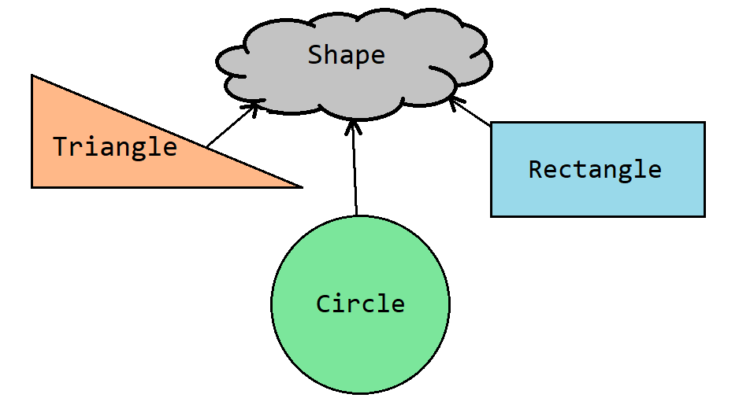
Abstract Classes

Slide 22
Abstract Classes
Abstract class can NOT be instantiated
An abstract class may or may not include abstract methods.
If it has at least one abstract method, it must be declared abstract
To use abstract class, you need to inherit it
public abstract class Shape {}
public class Circle : Shape {}
Shape shape = new Shape(); // Compile time error
Shape circle = new Circle(); // Polymorphism

Slide 23
Abstract Classes Elements
Can have fields
public abstract class Shape
{
private Point startPoint;
protected Shape(Point startPoint)
{
this.startPoint = startPoint;
}
public Point StartPoint() => this.startPoint;
public abstract void Draw();
}
Can have constructor too
Can have methods
Implemented by child classes
Notes:
But they can be subclassed.

Slide 24
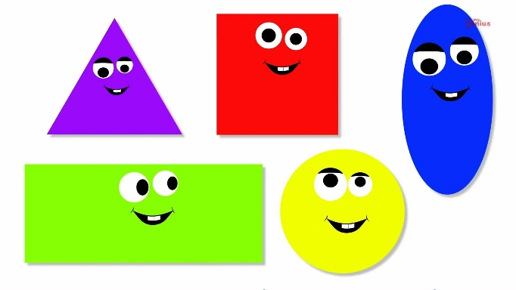
Problem: Shapes
Shape
-double Perimeter
-double Area
+CalculatePerimeter
+CalculateArea
Rectangle
Circle
-double Height
-double Width
-double Height
-double Width
+CalculatePerimeter
+CalculateArea
+CalculatePerimeter
+CalculateArea
Notes:
Extensibility / Polymorphism: New functionality may be easily plugged in without changing existing classes as long the new plug-in classes extend given base classes.
Reusability: For a set of similar applications a framework can be defined using a core set of classes that are to be extended by classes that fill in the application-dependent part.
Information Hiding: If a more general class using a simpler contract is sufficient, details from extending classes may be hidden to some of the client classes. This allows them to be more independent from possible changes and diminishes the load of contracts that must be understood by a reader of these client classes.
(c) 2006 National Academy for Software Development - http://academy.devbg.org*
24##

Slide 25
Solution: Shapes
public abstract class Shape
{
public abstract double CalculatePerimeter();
public abstract double CalculateArea();
public virtual string Draw()
{
return "Drawing ";
}
}
Notes:
Extensibility / Polymorphism: New functionality may be easily plugged in without changing existing classes as long the new plug-in classes extend given base classes.
Reusability: For a set of similar applications a framework can be defined using a core set of classes that are to be extended by classes that fill in the application-dependent part.
Information Hiding: If a more general class using a simpler contract is sufficient, details from extending classes may be hidden to some of the client classes. This allows them to be more independent from possible changes and diminishes the load of contracts that must be understood by a reader of these client classes.
(c) 2006 National Academy for Software Development - http://academy.devbg.org*
25##

Slide 26
Solution: Shapes (2)
public class Rectangle : Shape
{
//TODO: Add fields and constructor
public override double CalculatePerimeter()
{ return this.sideA * 2 + this.sideB * 2; }
public override double CalculateArea()
{ return this.sideA * this.sideB; }
public sealed override string Draw()
{ return base.Draw() + "Rectangle"; }
}
Notes:
Extensibility / Polymorphism: New functionality may be easily plugged in without changing existing classes as long the new plug-in classes extend given base classes.
Reusability: For a set of similar applications a framework can be defined using a core set of classes that are to be extended by classes that fill in the application-dependent part.
Information Hiding: If a more general class using a simpler contract is sufficient, details from extending classes may be hidden to some of the client classes. This allows them to be more independent from possible changes and diminishes the load of contracts that must be understood by a reader of these client classes.
(c) 2006 National Academy for Software Development - http://academy.devbg.org*
26##

Slide 27
Solution: Shapes (3)
public class Circle : Shape
{
//TODO: Add fields and constructor
public override double CalculatePerimeter()
{ return 2 * Math.PI * this.radius; }
public override double CalculateArea()
{ return Math.PI * this.radius * this.radius; }
public sealed override string Draw()
{ return base.Draw() + "Circle"; }
}
Notes:
Extensibility / Polymorphism: New functionality may be easily plugged in without changing existing classes as long the new plug-in classes extend given base classes.
Reusability: For a set of similar applications a framework can be defined using a core set of classes that are to be extended by classes that fill in the application-dependent part.
Information Hiding: If a more general class using a simpler contract is sufficient, details from extending classes may be hidden to some of the client classes. This allows them to be more independent from possible changes and diminishes the load of contracts that must be understood by a reader of these client classes.
(c) 2006 National Academy for Software Development - http://academy.devbg.org*
27##

Slide 28


Keyword - sealed
Modifier prevents other classes from inheriting from it
public abstract class Shape {}
public sealed class Rectangle : Shape {}
public class Sqaure : Rectangle {} //Compile time error

Slide 29
Keyword - sealed
Allow classes to derive from your class and prevent them from overriding specific virtual methods or properties.
public class Rectangle : Shape
{
public sealed override double GetArea() {}
}
public class Square : Rectangle
{
public override double GetArea() {}
//Compile time error
}

Slide 30


Association
Static
Non-Static
With a type
(class)
With instances
(objects)

Slide 31


Initialization
Static
Non-Static
Just before the
first time usage
When the constructor
is called

Slide 32


Memory Clearance
Static
Non-Static
On program exit
By the garbage collector

Slide 33
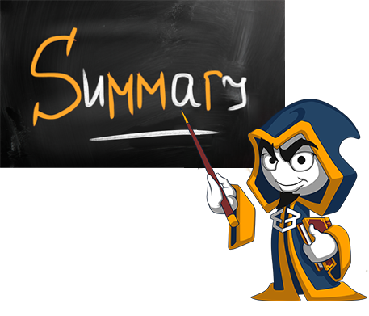
Summary
Polymorphism
Definition
Types
Override Methods
Overload Methods
Abstraction
Classes
Methods

Slide 34







Polymorphism
https://softuni.bg/courses/csharp-oop-basics

Slide 35
License
This course (slides, examples, demos, videos, homework, etc.) is licensed under the "Creative Commons Attribution-NonCommercial-ShareAlike 4.0 International" license
Attribution: this work may contain portions from
"Fundamentals of Computer Programming with C#" book by Svetlin Nakov & Co. under CC-BY-SA license
"C# Part I" course by Telerik Academy under CC-BY-NC-SA license
"C# Part II" course by Telerik Academy under CC-BY-NC-SA license

Slide 36





Trainings @ Software University (SoftUni)
Software University – High-Quality Education, Profession and Job for Software Developers
softuni.bg
Software University Foundation
http://softuni.foundation/
Software University @ Facebook
facebook.com/SoftwareUniversity
Software University Forums
forum.softuni.bg

