Slide 1


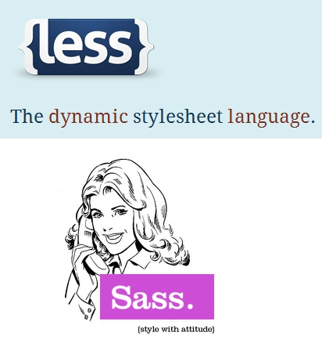

SASS & LESS
Syntactically Awesome StyleSheets
Dynamic StyleSheet Language
SASS LESS
SoftUni Team
Technical Trainers
Software University
http://softuni.bg

Slide 2


Table of Contents
SASS Overview
Working with SASS
Installing SASS
SASS Features
Nesting
Variables
Mixins
Selector Inheritance
LESS Overview

Slide 3
Have a Question?
sli.do #front-end

Slide 4
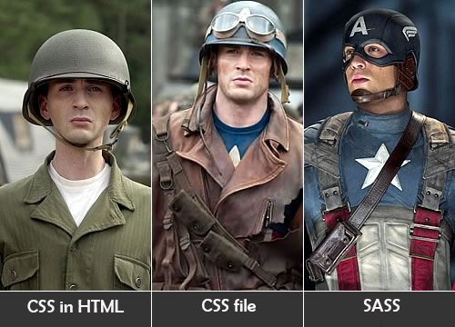
SASS Overview

Slide 5

SASS
Syntactically Awesome Stylesheets (SASS)
Extension of CSS
Makes CSS coding much easier and organized
Translates to pure CSS (server-side)
No slowdown at the client
SASS powers the CSS coding through
Variables (define once, use at many places)
Mixins (reusable functions with parameters)

Slide 6

SASS Tools
SASS has many implementations
Usually available directly in your IDE as a plugin
Originally SASS was a Ruby-based tool
Install Ruby (e.g. from http://rubyinstaller.org)
Install the "SASS" gem module (gem install sass)
SASS is natively supported in Visual Studio and WebStorm
Web Compiler for Visual Studio

Slide 7

Sass Installation

Slide 8

SASS Features

Slide 9
SASS Selector Nesting
body {
font: normal 16px arial;
color: #fff;
background-color: #011b63;
div {
font-size: 2.3em;
font-weight: bold;
ul li {
list-style-type:none;
a {
text-decoration:none;
color:white;
}
}
}
}
body {
font: normal 16px arial;
color: #fff;
background-color: #011b63;
}
body div {
font-size: 2.3em;
font-weight: bold;
}
body div ul li {
list-style-type: none;
}
body div ul li a {
text-decoration: none;
color: white;
}
SASS
Compile

Slide 10
SASS Selector Nesting
Selectors can also reference themselves by the & symbol:
body {
font: normal 16px arial;
color: #fff;
background-color: #011b63;
a {
text-decoration:none;
color:white;
&:hover {
text-decoration:underline;
color:tomato;
}
}
}
body {
font: normal 16px arial;
color: #fff;
background-color: #011b63;
}
body a {
text-decoration: none;
color: white;
}
body a:hover {
text-decoration: underline;
color: tomato;
}
SASS
Compile

Slide 11
SASS Variables
SASS supports variables
Using the $ (dollar) symbol
E.g. $text-color, $font-size
Variables have name and hold value
Can be defined outside the selector, always up!
Can be used to store colors, size, etc…
Usable to set one element many times (“code reuse”)
$text-color: tomato;

Slide 12
SASS Variables – Example
$color-non-visited: black;
$color-visited: tomato;
body {
a {
color: $color-non-visited;
&:visited {
color: $color-visited;
}
}
}
body a {
color: black;
}
body a:visited {
color: tomato;
}
SASS
Compile

Slide 13
SASS Variables-Interpolation
SASS variables can be inserted as CSS properties
Using #{$variable}
$border-side: top;
$border-color: tomato;
$border-style: ridge;
$border-width: 15px;
li {
border-#{$border-side}:
$border-width $border-style $border-color;
}
border-top: 15px ridge tomato;

Slide 14


Slide 15

Mixins: Reusable Blocks of SASS Code
Mixins are kind of developer-defined functions
Allow reusing blocks of code several times
Two kind of mixins
Parameterless
Render the same styles every time
With parameters
Render styles based on some input parameters
E.g. gradients, borders, etc…

Slide 16
Defining and Using Mixins
Defining a mixin (without parameters):
Using (including) a mixin:
@mixin default-element-border {
border: 1px solid black;
background: tomato;
border-radius: 10px;
}
ul li {
@include default-element-border;
}

Slide 17
Mixins with Parameters
Mixins can also be defined with parameters
Defined like in C# / Java / JS and can have default value
@mixin opacity-maker($value) {
opacity: $value;
filter: alpha(opacity=($value*100));
zoom: 1;
}
@mixin box-initialize($border:none,$background:rgba(0,0,0,0.7),$size:200px) {
width: $size;
height: $size;
border: $border;
background: $background;
padding: 15px;
}

Slide 18
SASS Selector Inheritance
We can inherit selectors in SASS with @extend
.default-border {
border: 3px solid black;
background: tomato;
border-radius: 8px;
}
.dotted-border {
@extend .default-border;
border-style: dotted;
}
.default-border, .dotted-border {
border: 3px solid black;
background: tomato;
border-radius: 8px;
}
.dotted-border {
border-style: dotted;
}
SASS
Compile

Slide 19
Importing SASS Files
SASS files can be imported in other SASS files
Like CSS files can be imported in CSS files
Use the @import directive
SASS defines partials
i.e. SASS files that are meant to be imported
Just use prefix _ (underscope)
@import '_gradients.scss'
// and can use the items from _gradients.scss

Slide 20
LESS

Slide 21
LESS
LESS is CSS preprocessor, similar to SASS
http://lesscss.org
Can be compiled both in the browser at the server
Using a LESS parser written in JavaScript
LESS features include
Nesting selectors
Variables
Mixins
Color editing functions

Slide 22
LESS – Example
@base-color: green;
@base: 5%;
@filler: @base * 2;
@other: @base + @filler;
.example {
color: #888 / 4;
background-color: @base-color + #111;
height: 100% / 2 + @filler;
}
.example {
color: #222222;
background-color: #119111;
height: 60%;
}
LESS
Compile

Slide 23

Summary
SASS
Simplifies the CSS development + enables code reuse
SASS support in Visual Studio
Use VS 2013U2 (or later) or WebStrom
SASS features
Nesting, variables, mixins, inheritance
LESS
Similar to SASS, can be processed client-side

Slide 24







SASS & LESS
https://softuni.bg/courses/csharp-web-development-basics

Slide 25

License
This course (slides, examples, demos, videos, homework, etc.) is licensed under the "Creative Commons Attribution-NonCommercial-ShareAlike 4.0 International" license

Slide 26





Trainings @ Software University (SoftUni)
Software University – High-Quality Education, Profession and Job for Software Developers
softuni.bg
Software University Foundation
http://softuni.foundation/
Software University @ Facebook
facebook.com/SoftwareUniversity
Software University Forums
forum.softuni.bg

