Slide 1

Inheritance and Prototypes
Class Inheritance, Prototypes, Prototype Chain, Code Reuse
SoftUni Team
Technical Trainers
Software University
http://softuni.bg

Slide 2
Table of Content
Simple Inheritance
Accessing Parent Members
Prototype Chains
Abstract Classes and Class Hierarchies

Slide 3
Have a Question?
sli.do
#JSCORE

Slide 4
Person
name
email
Teacher
subject
Simple Class Inheritance
Inheriting Data and Methods

Slide 5
Class Inheritance
Classes can inherit (extend) other classes
Child class inherits data + methods from its parent
Child class can:
Add properties (data)
Add / replace methods
Add / replace accessor properties
Base (parent, super) class
Person
name
email
Teacher
Child (derived) class
subject

Slide 6
Class Inheritance – Example
class Person {
constructor(name, email) {
this.name = name; this.email = email;
}
}
Person
name
class Teacher inherits Person
email
class Teacher extends Person {
constructor(name, email, subject) {
super(name, email);
this.subject = subject;
}
}
Invoke the parent constructor
Teacher
subject

Slide 7
Class Inheritance – Example (2)
let p = new Person("Maria", "maria@gmail.com");
console.log("Person: " +
p.name + ' (' + p.email + ')');
// Person: Maria (maria@gmail.com)
let t = new Teacher("Ivan", "iv@yahoo.com", "PHP");
console.log("Teacher: " + t.name +
' (' + t.email + '), teaches ' + t.subject);
// Teacher: Ivan (iv@yahoo.com), teaches PHP

Slide 8
Submitting Classes in the Judge
SoftUni Judge (https://judge.softuni.bg) submissions should consist of a single function / arrow function / class definition
Submit multiple classes as function returning JS object:
function personAndTeacherClasses() {
class Person { … }
class Teacher extends Person { … }
return { Person, Teacher };
}
Check your solution here: https://judge.softuni.bg/Contests/339

Slide 9
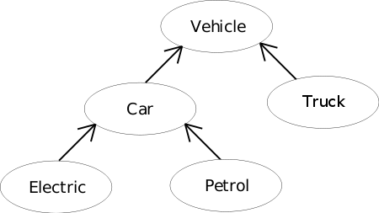
Accessing Parent Members
Invoking Parent Methods

Slide 10
Inheriting and Replacing toString()
class Person {
constructor(name, email) {
this.name = name;
this.email = email;
}
toString() {
let className = this.constructor.name;
return `${className} (name: ${this.name}, email: ${this.email})`;
}
}

Slide 11
Inheriting and Replacing toString() – Teacher
class Teacher extends Person {
constructor(name, email, subject) {
super(name, email);
this.subject = subject;
}
toString() {
let baseStr = super.toString().slice(0, -1);
return baseStr + `, subject: ${this.subject})`;
}
}
Invoke toString() from the base (parent) class

Slide 12
Inheriting and Replacing toString() – Student
class Student extends Person {
constructor(name, email, course) {
super(name, email);
this.course = course;
}
toString() {
let baseStr = super.toString().slice(0, -1);
return baseStr + `, course: ${this.course})`;
}
}
Invoke toString() from the base (parent) class

Slide 13
Inheriting and Replacing toString() – Usage
let p = new Person("Maria", "maria@gmail.com");
console.log('' + p);
// Person (name: Maria, email: maria@gmail.com)
let t = new Teacher("Ivan", "iv@yahoo.com", "PHP");
console.log('' + t);
// Teacher (name: Ivan, email: iv@yahoo.com, subject: PHP)
let s = new Student("Ana", "ana@mail.ru", 3);
console.log('' + s);
// Student (name: Ana, email: ana@mail.ru, course: 3)
Check your solution here: https://judge.softuni.bg/Contests/339

Slide 14
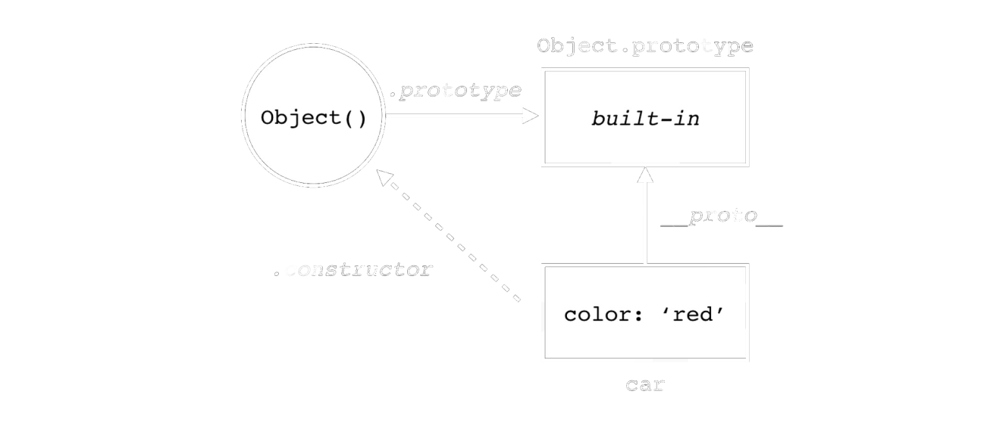
The Prototype Chain
How Does It Work?

Slide 15
Prototypes in JavaScript
Every object in JS has a prototype (template)
Internally called __proto__ in browsers and NodeJS
Properties not found in the object are looked up in the prototype
Can be obtained using Object.getPrototypeOf(obj)
Using __proto__ directly is deprecated → should be avoided!

Slide 16
The Prototype Chain for JS Classes
Teacher
subject
Object{…}
Person
toString()
name
__proto__
email
Function. __proto__
toString()
Student
__proto__
course
__proto__
toString()
__proto__

Slide 17
Prototype Chain (for Classes)
Classes have a prototype (a parent function)
Prototypes form a prototype chain
Object.getPrototypeOf(Teacher) == Person
// true (class prototype holds the parent class)
Teacher.__proto__ == Person; // true
// The same as the above (unofficial property)
Object.getPrototypeOf(Person) == Function.prototype; // true

Slide 18
Prototypes in Classes and Objects
Prototypes in classes / functions
Classes use their __proto__ to resolve methods / properties
__proto__ holds the parent class / function
Classes have also prototype object used to create nеw objects
Assigned to __proto__ of each new object
Prototypes in objects
Objects use their __proto__ to resolve methods / properties
Objects do not have prototype object

Slide 19
Object Instantiation (Create New Object)
Function. __proto__
Person
Teacher
name
subject
__proto__
email
toString()
toString()
Object{…}
__proto__
__proto__
Teacher (instance)
'Ivan'
'ivan@email.cx'
'Biology'
__proto__

Slide 20
Object Instantiation (Create New Object)
Function. __proto__
Person
Teacher
name
subject
__proto__
email
toString()
toString()
Object{…}
__proto__
__proto__
Teacher (instance)
'Ivan'
'ivan@email.cx'
'Biology'
__proto__

Slide 21
Prototype Chain for JS Objects
Teacher (instance)
Person.prototype
Teacher.prototype
name
toString()
toString()
email
__proto__
__proto__
subject
__proto__
Property lookup

Slide 22
Problem: Extending Prototype
Extend a passed class's prototype with a property species and method toSpeciesString():
Person.prototype.species – holds a string value "Human"
Person.prototype.toSpeciesString() – returns "I am a {species}. {class.toString()}"
new Person("Maria", "maria@gmail.com").toSpeciesString()
// "I am a Human. Person (name: Maria, email: maria@gmail.com)"
new Student("Ana", "ana@mail.ru", 3).toSpeciesString()
// "I am a Human. Student (name: Ana, email: ana@mail.ru, course: 3)"

Slide 23
Solution: Extending Prototype
function extendPrototype(Class) {
Class.prototype.species = "Human";
Class.prototype.toSpeciesString = function () {
return `I am a ${this.species}. ${this.toString()}`;
}
}
extendPrototype(Person);
Person
Student
species
inherit
species
toSpeciesString()
toSpeciesString()

Slide 24
Vehicle
Car
Truck
Bus
Abstract Classes and Mixins
Inheriting Pieces of Functionality

Slide 25
What is Abstract Class?
Abstract classes are abstractions → cannot be instantiated
Check new.target in the constructor
class Abstract {
constructor() {
if (new.target === Abstract)
throw new TypeError("Cannot construct Abstract instances directly");
}
}

Slide 26
What is a Mixin?
Mixins are bits of functionality that can be added to objects of different classes
Allow extending existing classes without modifying them directly
The code becomes more portable
function Mixin() {
this.extensionFunc = function() { // New functionality …};
return this;
}

Slide 27
What is a Mixin?
function asCircle() {
this.area = function() {
return Math.PI * this.radius * this.radius;
};return this;
}
class Circle {constructor(r) { this.radius = r; } }
asCircle.call(Circle.prototype);
let circle = new Circle(5);
circle.area();
asCircle
area()
area()
Circle
radius

Slide 28
Checking the Object Type
Checking object type using constructor.name
Check if object belongs to a certain class (or its descendant):
let p = new Person("Pesho","pesho@hit.bg");
console.log(p.constructor.name);
// Person
let t = new Teacher("Pesho","pp@hit.bg","PHP");
console.log(t instanceof Person)
// true

Slide 29
Problem: Class Hierarchy
Define the following class hierarchy:
Figure
Abstract class, defines toString() and get area()
Circle
Еxtends Figure, adds radius
Rectangle
Еxtends Figure, adds width + height
Figure
toString()
get area()
Circle
Rectangle
radius
width
height

Slide 30
Solution: Class Hierarchy
function classHierarchy() {
class Figure {
constructor() {
if (new.target === Figure)
throw new Error("Cannot instantiate an abstract class.");
}
get area() { return undefined; }
toString() { let type = this.constructor.name; return type;
}
}
abstract method → will be implemented in child classes

Slide 31
Solution: Class Hierarchy (2)
class Circle extends Figure {
constructor(radius) {
super();
this.radius = radius;
}
get area() { return Math.PI * this.radius * this.radius; }
toString() {
return super.toString() + ` - radius: ${this.radius}`;
}
}

Slide 32
Solution: Class Hierarchy (3)
class Rectangle extends Figure {
constructor(width, height) {
super(); [this.width, this.height] = [width, height];
}
get area() { return this.width * this.height; }
toString() {
return super.toString() + ` - width: ${this.width}, height: ${this.height}`;
}
} return { Figure, Circle, Rectangle };
}
Check your solution here: https://judge.softuni.bg/Contests/339

Slide 33

Live Exercises

Slide 34

Summary
…
…
…
Inheritance allows extending existing classes
Objects in JS have prototypes
Objects look for properties in their prototype chains
Prototypes form a hierarchical chain

Slide 35
https://softuni.bg/trainings/2081/js-advanced-october-2018

Slide 36













SoftUni Diamond Partners

Slide 37





SoftUni Organizational Partners

Slide 38




Trainings @ Software University (SoftUni)
Software University – High-Quality Education and Employment Opportunities
softuni.bg
Software University Foundation
http://softuni.foundation/
Software University @ Facebook
facebook.com/SoftwareUniversity
Software University Forums
forum.softuni.bg

Slide 39

License
This course (slides, examples, demos, videos, homework, etc.) is licensed under the "Creative Commons Attribution-NonCommercial-ShareAlike 4.0 International" license

