Slide 1


Spotify
Analysis
Antonia Sunseri
Manith Kumarapeli

Slide 2

Introduction
Introduction
Problem Statement
Are top-hit songs becoming shorter over time, and how do musical features transcend into a track's popularity?
Project Motivation
Streaming platforms influence consumption and production of music.
Artists could target popularity through algorithms
Identify how music is produced and consumed
Dataset
Source: Top Hits Spotify from 2000–2019 (Kaggle)
Contains song metadata for Spotify Top Hits from 2000 to 2019 for 2,000 songs.
Methodology
Hypotheses
Analysis Strategy
Project Goals
Problems Faced

Slide 3


Introduction
Methodology
Methodology
Hypotheses
Analysis Strategy
Project Goals
Problems Faced
Data Wrangling:
Missing Values
Outlier Detection
Duplicate Removal
Correction of Data Types
Data Analysis:
Distribution Visualizations
Summary Statistics
Correlation Analysis
Predictive Modeling

Slide 4
Data Wrangling
Introduction
Methodology
No missing values were found in the dataset with 2,000 observations
59 duplicated columns were identified and removed.
All data types in the data frame matched as they do in their respective columns.
Hypotheses
Analysis Strategy
Project Goals
Problems Faced

Slide 5
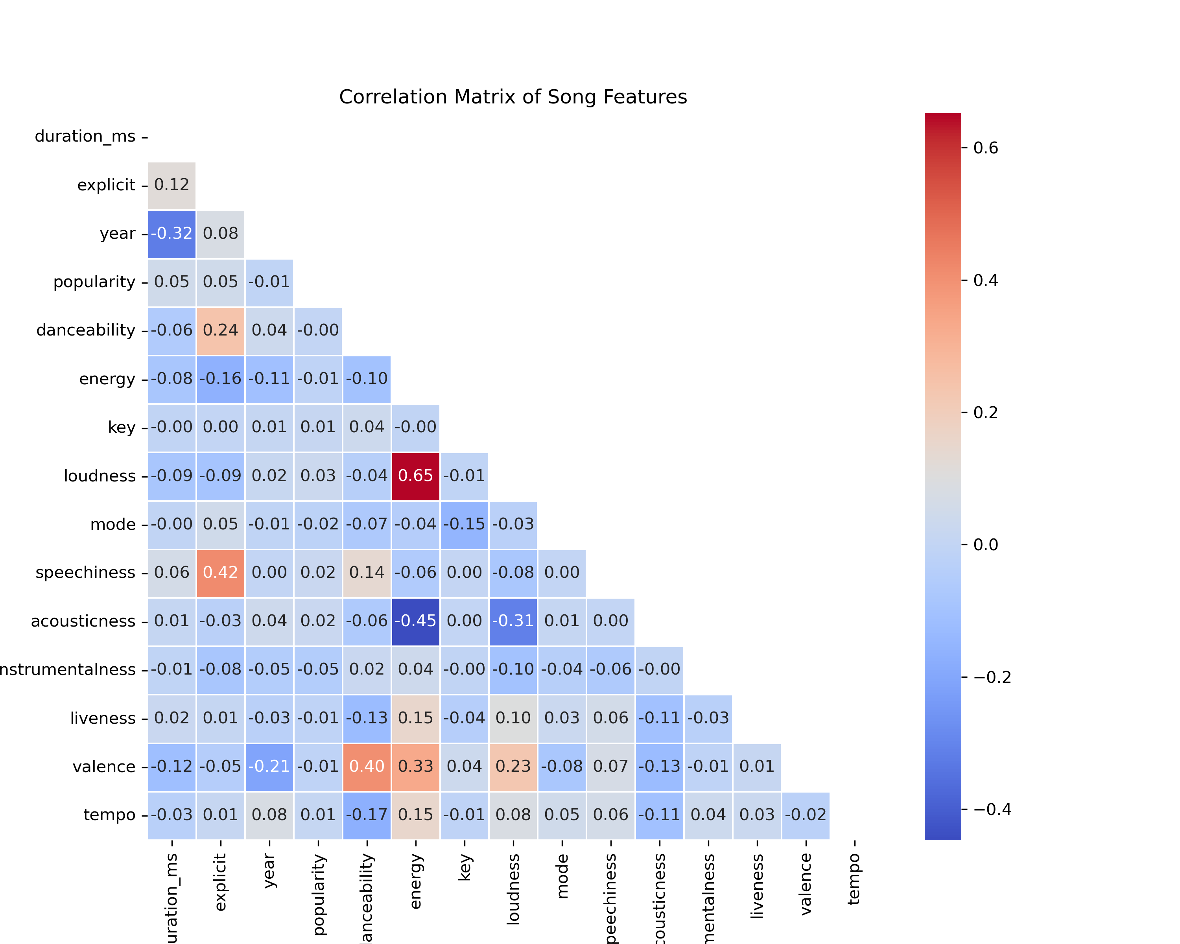
Data Analysis
Introduction
Methodology
Summary Statistics
Feature Distributions
Exploratory Data Analysis
Hypotheses
Analysis Strategy
Project Goals
Problems Faced

Slide 6
Hypotheses
Introduction
Methodology
01
The average duration of top-hit songs has decreased between 2000 to 2019, due to the influence of streaming platforms and shorter listener attention spans
Hypotheses
Analysis Strategy
Project Goals
Problems Faced
02
Tracks that have one or more featured artist will have a higher popularity score compared to those without, due to increased exposure
03
Explicit songs have higher popularity scores, especially in more recent years, reflecting cultural changes

Slide 7

Analysis/Modelling
Strategy
Introduction
Methodology
Hypotheses
Analysis Strategy
Project Goals
Cleaning and Preprocessing
Correlation Analysis – Correlation Matrix
Feature Engineering – Extracting Artists
Predictive Modelling
Problems Faced

Slide 8
Project Goals
Introduction
Methodology
01
02
Conduct EDA to uncover feature distributions and summary statistics
Clean and preprocess "Top Hits Spotify (2000-2019)" data set for analysis
Hypotheses
Analysis Strategy
Project Goals
Problems Faced
03
Explore the relationship between musical audio features and track popularity
04
Identify cultural and/or economic factors that may explain shifts in music trends

Slide 9
Problems Faced
Introduction
Methodology
Hypotheses
Analysis Strategy
Identifying collaborating artists is problematic
Artist popularity is subjective worldwide
No clear description of popularity
Could longer songs have silent gaps?
What are explicit songs?
Project Goals
Problems Faced

Slide 10


Thank You!
Any Question?
Despacito
Luis Fonsi, Daddy Yankee
0:23
-3:25

