Slide 1



The curse of knowing: What happens when ML-algorithms can no longer rely on missingness patterns to make accurate predictions when deployed?
a simulation study
Antonia Tsvetanova
3rd Year PhD Student EPSRC iCASE award with Microsoft Research, UK
Centre for Health Informatics, The University of Manchester
@AntoniaTsv
antonia.tsvetanova@manchester.ac.uk
Microsoft Visit PhD Research Project
May – September, 2022

Slide 2
Presentation overview
Introduction
Completed and current projects
MSR study
Future work
Notes:
So, what are CPMs?
CPMs are statistical tools which are able to use patient information and clinical measurements to produce a risk estimate of a particular health outcome of interest. (QRISK is a clinically-established CPM to assess our risk of having a heart attack or stroke over the next 10 years)

Slide 3
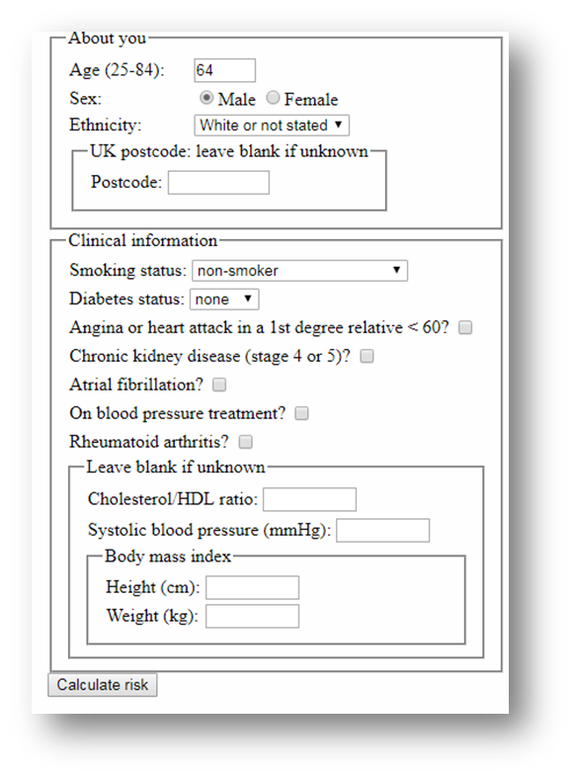

What are CPMs?
QRISK3 for Cardiovascular Disease
Notes:
So, what are CPMs?
CPMs are statistical tools which are able to use patient information and clinical measurements to produce a risk estimate of a particular health outcome of interest. (QRISK is a clinically-established CPM to assess our risk of having a heart attack or stroke over the next 10 years)

Slide 4
CPM pipeline: Statistical models
The CPM Pipeline
Development + Internal
validation
(External)
Validation
Implementation
(Deployment)
Notes:
Dev: Data is fitted/algorithm is trained into a model
Val: Could be internal/external. Newly developed model is tested on a similar or independent, separate dataset
Implementation: CPM is implemented into the workflow of patients, clinicians, medical staff

Slide 5
CPM pipeline: ML models
The CPM Pipeline
Test
(Deployment)
Train +
Internal
validation
Notes:
Dev: Data is fitted/algorithm is trained into a model
Val: Could be internal/external. Newly developed model is tested on a similar or independent, separate dataset
Implementation: CPM is implemented into the workflow of patients, clinicians, medical staff

Slide 6
Electronic Health Records
Biased towards sicker patients
Cost-effective
Electronic
Health
Records
Pros
Cons
Longitudinal data collected over many years
Contain missing data

Slide 7
What do we mean by missing data?
Missing data are observations/records which were:
Never collected (either by design or not)
Lost accidentally
Wrongly collected and so deleted
Missing values can be in the outcome of interest or in explanatory variables / features
Notes:
Missing data generally raise three direct concerns.

Slide 8
Missing data: Issues
Missing data generally raise three direct concerns:
Difficulty with performing the intended analysis
Loss of power & loss of precision
Bias
Therefore, it’s important to carefully consider why data may be missing..
Notes:
Missing data generally raise three direct concerns.
1.Analysis require untestable assumptions
2. Missing values irreversibly lose power
3. Biased estimates – eg. Means, percentages, percentiles, ratios, regression parameters; biased SE - eg. Resulting in incorrect p-values and CI
4. Inefficiency (loss of information from the available data)

Slide 9
Missing data: Mechanisms
MCAR
Missing Completely At Random
MAR
Missing At Random
MNAR
Missing Not At Random
The probability P that the data are missing (M) does NOT depend on the values of observed or missing data.
P(Y|X) = P(Y)
Eg: Blood pressure measurements may be MCAR because of breakdown of an equipment.
The probability P that data are missing depends on the values of the observed data, but does NOT depend on the missing values.
P(Y|X) = P(Y|X_{obs})
Eg: Blood pressure measurements may be MAR if younger individuals are more likely to have their blood pressure missing.
The probability P that data are missing depends on the values of the missing data.
P(Y|X) = P(Y|X_{obs}, X_{mis})
Eg: Selective non-response to certain questions: income, BMI.
observed
data
observed
data
observed
data
M
M
M
missing
data
missing
data
missing
data

Slide 10
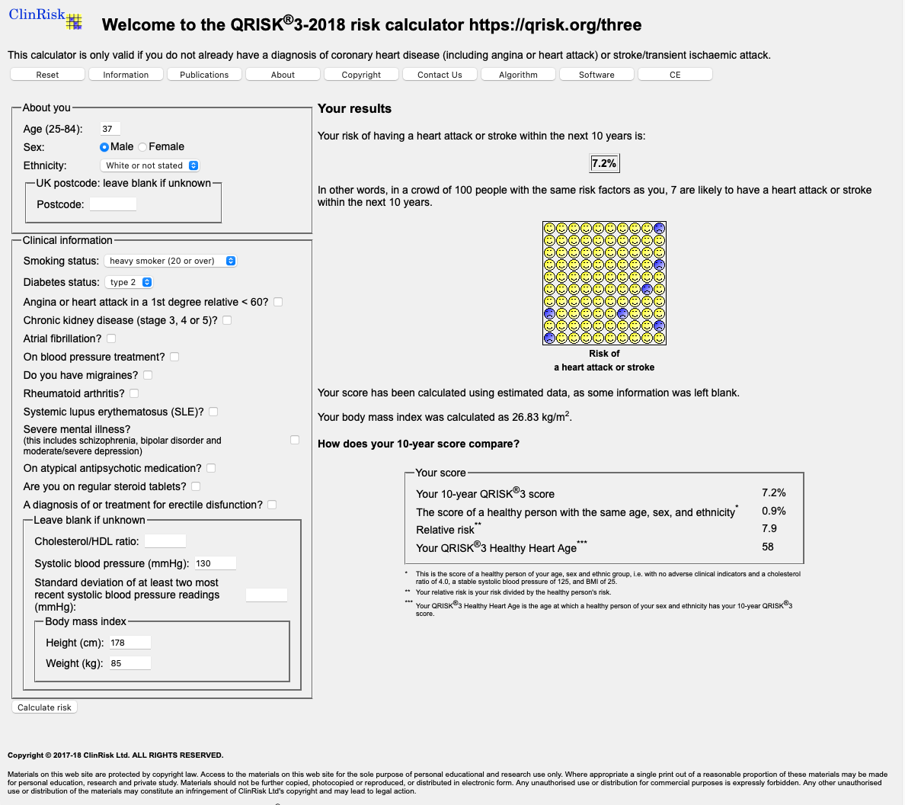

Patient Joe
The model will either do mean imputation for continuous variables or assume that the value is negative for binary when deployed
Notes:
Now, it’s important to mention the way those risks are used in clinical practice. Essentially, if your risk if under 10% the doctor might give you some lifestyle advice, eg start exercising more, stop smoking, eat healthy etc. However, if your risk is above 10%, the clinician may decide to prescribe you statins which are blood pressure treatment medicines in order to lower your future risk of CVD.
It is also important to mention that when this model was developed, the inclusion criteria stated that patients should have not been treated for CVD before entering.

Slide 11

Patient Joe
What would happen to Joe's cardiovascular risk?
Suppose Joe was on a blood pressure treatment all along..
..but this information was not collected as the doctor assumed he wouldn’t be on it, since he’s in his 30s, i.e. the data is MAR

Slide 12
Patient Joe
Increase by 6%

Slide 13
Why did Joe’s risk go up?
The treatment itself isn't increasing Joe’s risk but is acting as a marker for the fact that his underlying risk is already higher
This 6% difference in his CVD risk might dictate the care Joe receives afterwards..

Slide 14
Missing data: Assumptions
We can tell from the data at hand whether the missing observations are MCAR or not
We cannot tell from the data at hand whether the missing observations are MAR or MNAR
In the MNAR setting, it is very rare to know the appropriate model for the missing data mechanism
MAR can be made more likely by collecting more explanatory variables which may explain missing values (e.g. age in blood pressure example, collection of repeated measures)
Notes:
Missing data generally raise three direct concerns.

Slide 15
Presentation overview
Introduction
Completed and current projects
MSR study
Future work
Notes:
So, what are CPMs?
CPMs are statistical tools which are able to use patient information and clinical measurements to produce a risk estimate of a particular health outcome of interest. (QRISK is a clinically-established CPM to assess our risk of having a heart attack or stroke over the next 10 years)

Slide 16
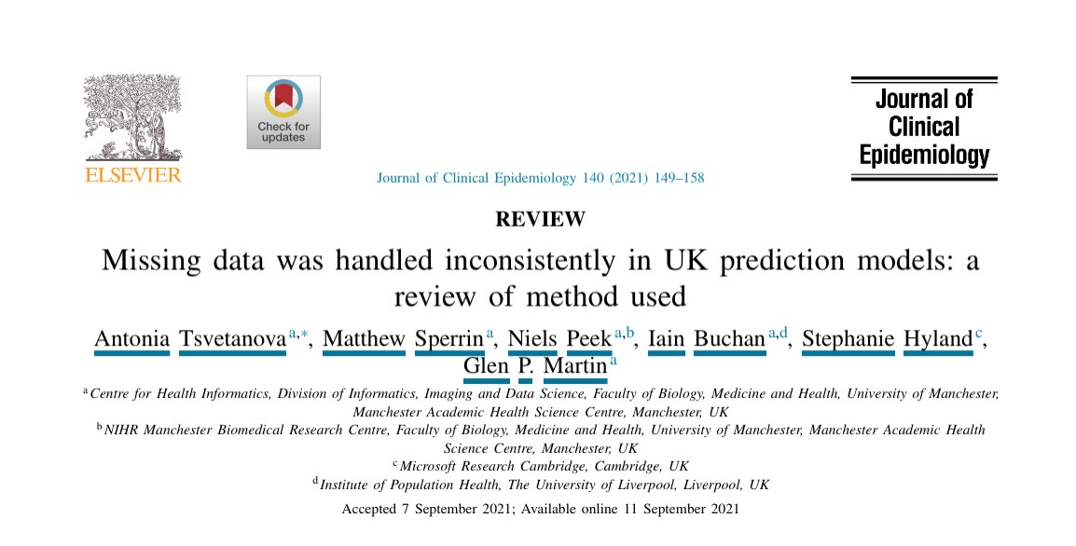
Paper 1

Slide 17
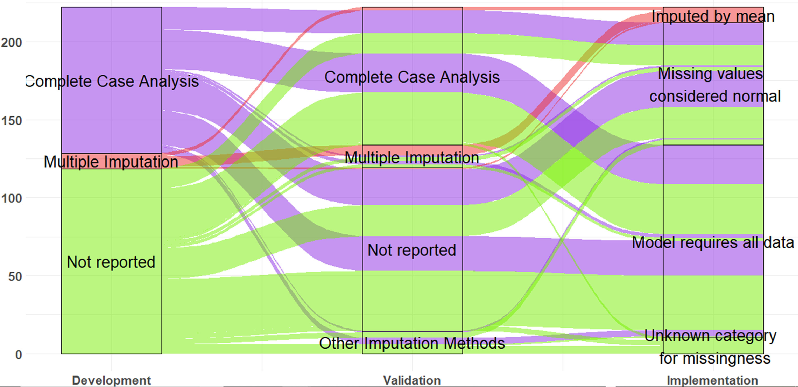
Missing data: Handling methods
Missing data handling strategies are generally inconsistent across the pipeline of CPMs. We don’t know whether this has (if any) effect on the predictive performance of CPMs.

Slide 18
Paper 2
”Quantifying the problem of inconsistent missing data handling across the pipeline of CPMs: A simulation study”
Aim:
To determine whether the performance of a CPM as estimated in a validation study sufficiently represents the performance one would see in implementation under different combinations of imputation strategies across these phases
Objectives:
First, identify which approaches are compatible under which mechanisms
Second, when not compatible, we will determine how much bias is introduced in assessment of model performance
Through this study, we assume that the missingness mechanism stays the same across validation and implementation stages…

Slide 19
Presentation overview
Introduction
Completed and current projects
MSR study
Future work
Notes:
So, what are CPMs?
CPMs are statistical tools which are able to use patient information and clinical measurements to produce a risk estimate of a particular health outcome of interest. (QRISK is a clinically-established CPM to assess our risk of having a heart attack or stroke over the next 10 years)

Slide 20
Paper 3: Microsoft project
Rationale:
Informative observation means models can exploit missingness (e.g. via missingness indicators, or subtly in some other way). However, it has not yet been explored what happens when these missingness patterns are eliminated, i.e., the model can no longer rely on this to make accurate predictions.
Hypothesis:
Therefore, we hypothesise that, if there is any change in the relationship between observation and the outcomes, such as, observation becomes uninformative, the model performance might shift.

Slide 21
Key Questions:
Do models ‘break’ when the mechanism of missingness changes across their pipeline?
If so, which ML models suffer the most?
By how much?

Slide 22
Aims and Objectives
Aim:
To simulate the potential impacts of the specific type of dataset shift induced by observation processes, on ML-algorithms used in health settings, as a result of changes in clinicians’ observation, recording and coding practices
Objectives:
First, we emulate different measurement processes in train and test datasets
Then, we determine how the estimated predictive performance changes when the missingness mechanism shifts across the pipeline of CPMs.

Slide 23
Notation
We focus on a latent variable model developed for a binary outcome:
Z_{1,1} , Z_{1,2} and Z_{2,2} are observable predictors and could be fully or partially observed
X₁ and X₂ are latent variables, where X₁ is never observed
R₁ is a missingness indicator, where R₁ = 1 when Z_{1,1} , Z_{1,2} are observed and R₁ = 0 when the two variables are set to missing
Z_{1,1}* , Z_{1,2}* are the observable parts of Z_{1,1} , Z_{1,2}
Y is a binary outcome and it is always observed
U is an unmeasured variable, which potentially induces a relationship between R₁ and Y , and it is used to mimic MNAR scenario

Slide 24
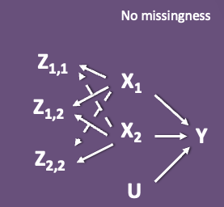
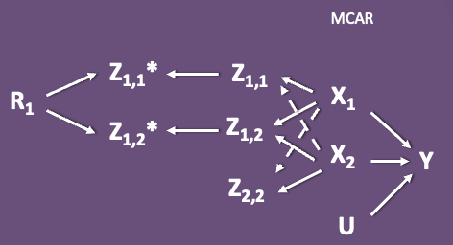
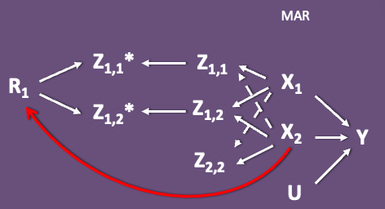
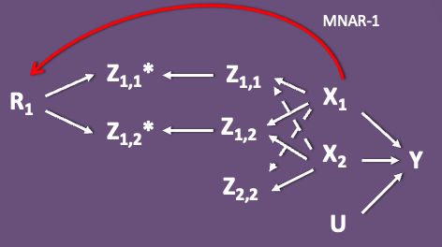
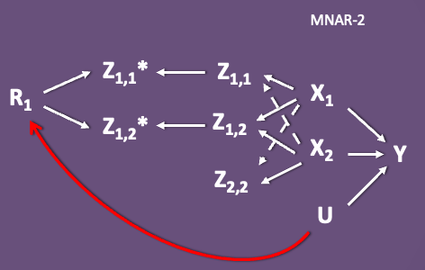
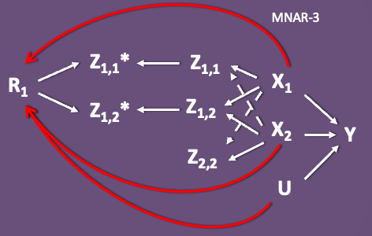
Simulation Setup

Slide 25
Simulation Setup: Test data generation
No missingness
Z_{1,1}
X₁
Z_{1,2}
X₂
Y
Z_{2,2}
U

Slide 26
Simulation Setup: Train data generation
MCAR
Z_{1,1}*
Z_{1,1}
R₁
X₁
Z_{1,2}*
Z_{1,2}
X₂
Y
Z_{2,2}
U

Slide 27
Simulation Setup: Train data generation
MAR
Z_{1,1}*
Z_{1,1}
R₁
X₁
Z_{1,2}*
Z_{1,2}
X₂
Y
Z_{2,2}
U

Slide 28
Simulation Setup: Train data generation
MNAR-1
Z_{1,1}*
Z_{1,1}
R₁
X₁
Z_{1,2}*
Z_{1,2}
X₂
Y
Z_{2,2}
U

Slide 29
Simulation Setup: Train data generation
MNAR-2
Z_{1,1}*
Z_{1,1}
R₁
X₁
Z_{1,2}*
Z_{1,2}
X₂
Y
Z_{2,2}
U

Slide 30
Simulation Setup: Train data generation
MNAR-3
Z_{1,1}*
Z_{1,1}
R₁
X₁
Z_{1,2}*
Z_{1,2}
X₂
Y
Z_{2,2}
U

Slide 31
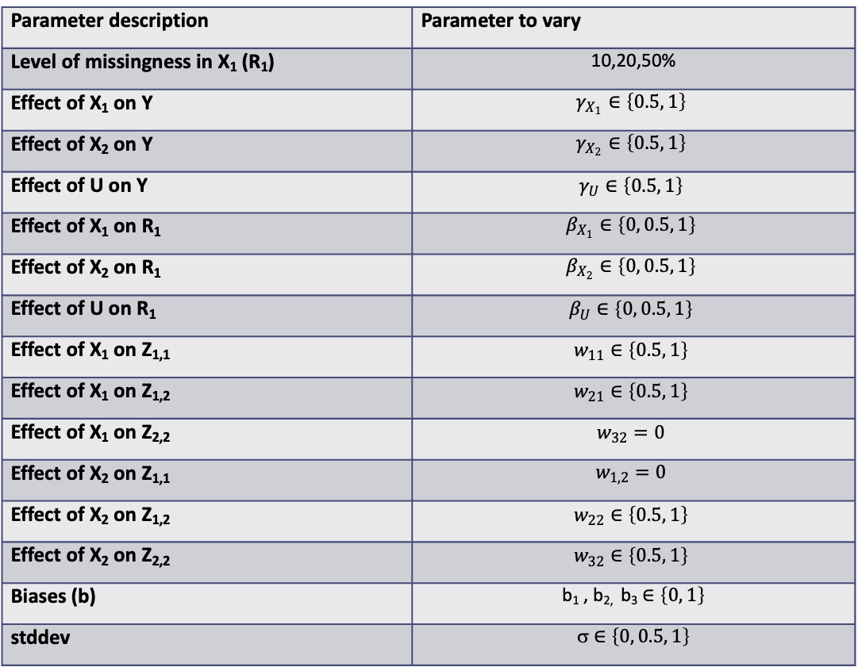
Simulation parameter choices
Parameter description | Parameter to vary
Level of missingness in X₁ (R₁) | 10,20,50%
Effect of X₁ on Y | $$γ_{X_{1}}∈\left\{0.5, 1\right\}$$
Effect of X₂ on Y | $$γ_{X_{2}}∈\left\{0.5, 1\right\}$$
Effect of U on Y | $$γ_{U}∈\left\{0.5, 1\right\}$$
Effect of X₁ on R₁ | $$β_{X_{1}}∈\left\{0, 0.5, 1\right\}$$
Effect of X₂ on R₁ | $$β_{X_{2}}∈\left\{0, 0.5, 1\right\}$$
Effect of U on R₁ | $$β_{U}∈\left\{0, 0.5, 1\right\}$$
Effect of X₁ on Z_{1,1} | $$w_{11}∈\left\{0.5, 1\right\}$$
Effect of X₁ on Z_{1,2} | $$w_{21}∈\left\{0.5, 1\right\}$$
Effect of X₁ on Z_{2,2} | $$w_{32}=0$$
Effect of X₂ on Z_{1,1} | $$w_{1,2}=0$$
Effect of X₂ on Z_{1,2} | $$w_{22}∈\left\{0.5, 1\right\}$$
Effect of X₂ on Z_{2,2} | $$w_{32}∈\left\{0.5, 1\right\}$$
Biases (b) | b₁ , b_{2,} b₃ $∈\left\{0, 1\right\}$
stddev | σ $∈\left\{0, 0.5, 1\right\}$

Slide 32
Missing data handling
We plan to pick a ‘native’ missing data strategy for each model (if the model requires data to be imputed in advance) and fix it.
e.g.
Trees that ‘natively’ handle missing data
Indicator variables for some RNNs
Multiple imputation by chained equations for Logistic Regression

Slide 33
Model selection
We will be applying ML and logistic regression models to all datasets train, validation and test.
The ML models will include:
‘Classic suite’ of models (the import sklearn approach)
logistic regression
random forests
boosting trees
A suite of classic ‘deep learning’ methods (the import pytorch approach)
fully connected neural networks

Slide 34
Estimands/Targets of analysis
Mean Square Error (MSE)
Calibration in the large
O:E ratio
Brier Score

Slide 35
Performance measures
Our key target is the predictive accuracy of the CPMs, therefore we are interested in estimating the SE, coverage of the CI and the bias of the estimands mentioned earlier.

Slide 36
What’s next?
Train and test a NN using PyTorch approach
Run the simulation for n_iter = 200
Analyse results & publish the study!
Come back to Microsoft next summer for an internship ☺

Slide 37

Acknowledgements
Stephanie Hyland Microsoft Research, Cambridge, UK
Glen Martin Division of Informatics, Imaging and Data Science, Faculty of Biology, Medicine and Health, University of Manchester, Manchester Academic Health Science Centre, Manchester, UK.
Matt Sperrin Division of Informatics, Imaging and Data Science, Faculty of Biology, Medicine and Health, University of Manchester, Manchester Academic Health Science Centre, Manchester, UK.
Niels Peek NIHR Manchester Biomedical Research Centre, Faculty of Biology, Medicine and Health, University of Manchester, Manchester Academic Health Science Centre & Christabel Pankhurst Institute for Health Technology Research and Innovation, Manchester, UK
Iain Buchan Institute of population health, The University of Liverpool. UK
This work was supported by Engineering and Physical Sciences Research Council (EPSRC) Industrial Cooperative Awards in Science & Technology (iCASE) award and Microsoft Research through its PhD Scholarship Programme.

Slide 38
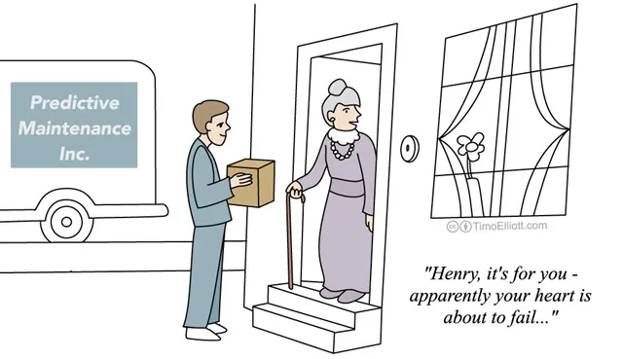
Thank you. Any Questions?

