Slide 1
{Software Architecture: as code}
Diagrams & Qualities as code

Slide 2
About me
Short bio
I am a technical team lead at Luxoft a DXC Technology Company.
As core value I am a lifelong learner with focus on progress (not on perfection) and following the split-apply-combine strategy approach.
I have more than 18 years of experience in Java Enterprise complex projects. I started with an ERP project then I have gone through e-governments projects for 10 years and for the last 7 years I have been here at Luxoft working on banking projects.
As part of my work, I often put on the solution architect hat and dive into architectural thinking, working with team members and peers on frameworks, design patterns, best practices in order to build the bridge between the business change/request and the technology solution and outline each of the phases and requirements required to make that solution work.

Slide 3
Software Architecture
Some thoughts
(un)fortunately, there is no consensus about the definition, so I may share some thoughts
“Architecture is about the important stuff. Whatever that is.” –Ralph Johnson
Architecture is a way of thinking, it is a mindset, to solve something, to tell in a simple way an intricate story, to build up a model, to make it easy to transmit to the others what we are intending/proposing in order to solve our problem. Software architecture deals with abstraction, with decomposition and composition, with relationships & interoperability, with style.

Slide 4
Software diagrams as code
As software engineers, when addressing software architecture, we all have to create architecture diagrams to convey our ideas with other fellow engineers and stakeholders.
These days we use everything as code approach for documentation, infrastructure provisioning, CI/CD templates, and many other things.
Creating architecture diagrams has now the support for 'as code' approach.

Slide 5
Software diagrams as code
Use case
Diagram as Code allows us to track the architecture diagram changes in any version control system.
PlantUML is used to draw UML diagrams, using a simple and human readable text description.
We can use this tool for visual documentation purposes as it has in-built support to a class, object, sequence, activity, and use case diagrams. It helps us to create a visual representation of the abstract ideas/concepts of the system’s design.
The PlantUML is compatible with all java-based IDEs: IntelliJ, Eclipse
The beauty of this approach is that it enables software engineers to use the same tools as for software development thus benefiting also of version control for clear and easy tracing architecture design changes over time.

Slide 6
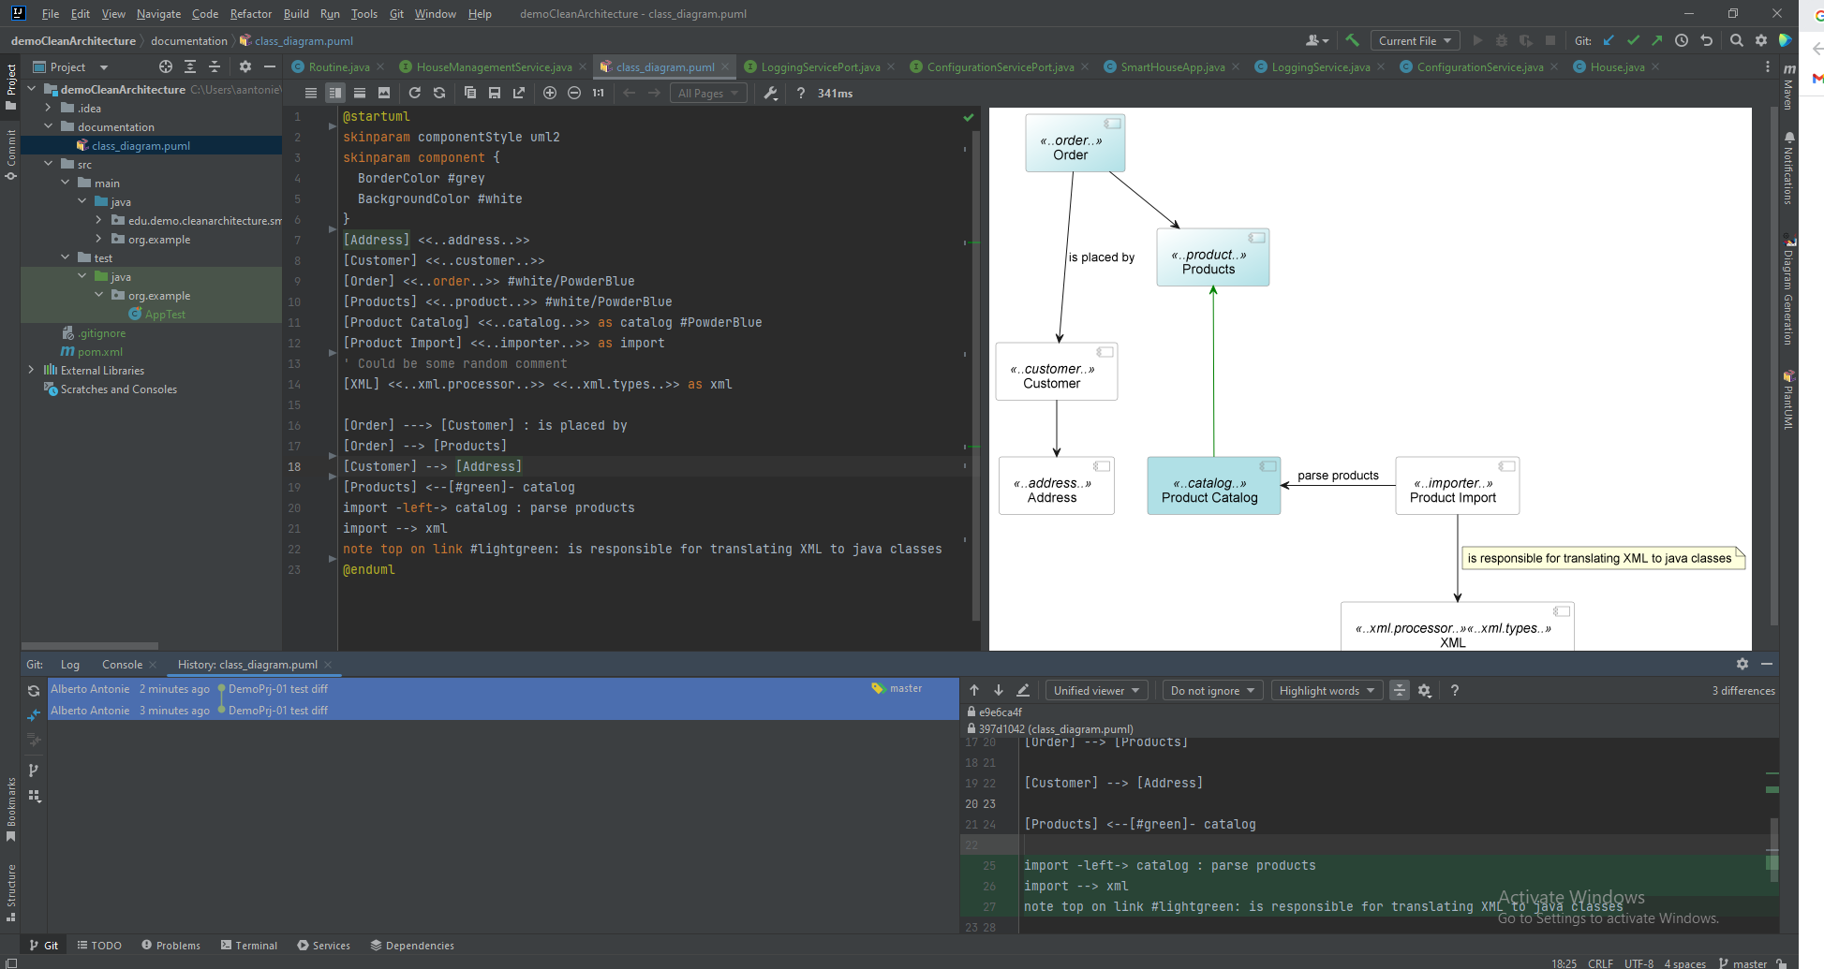
Software diagrams as code

Slide 7
Software Architecture as code
“Truth can only be found in one place: the code.” –Robert C. Martin, Clean Code: A Handbook of Agile Software Craftsmanship
Nowadays software architecture is not only a professional specialization anymore but increasingly it is more of a function in software engineering.
One of the perils of any software solution is the software degradation/software entropy, understood as insufficient care in maintaining the coherence with product design and established design principle.
Software architecture can and must enforce architecture fitness test which validates architecture design over time and provides continuous feedback for architectural conformance and informs the development process as it happens rather than after the fact. Archunit framework offers the capabilities for software architecture fitness testing.
“ArchUnit is a free, simple and extensible library for checking the architecture of your Java code using any plain Java unit test framework. That is, ArchUnit can check dependencies between packages and classes, layers and slices, check for cyclic dependencies and more.” - https://www.archunit.org/

Slide 8
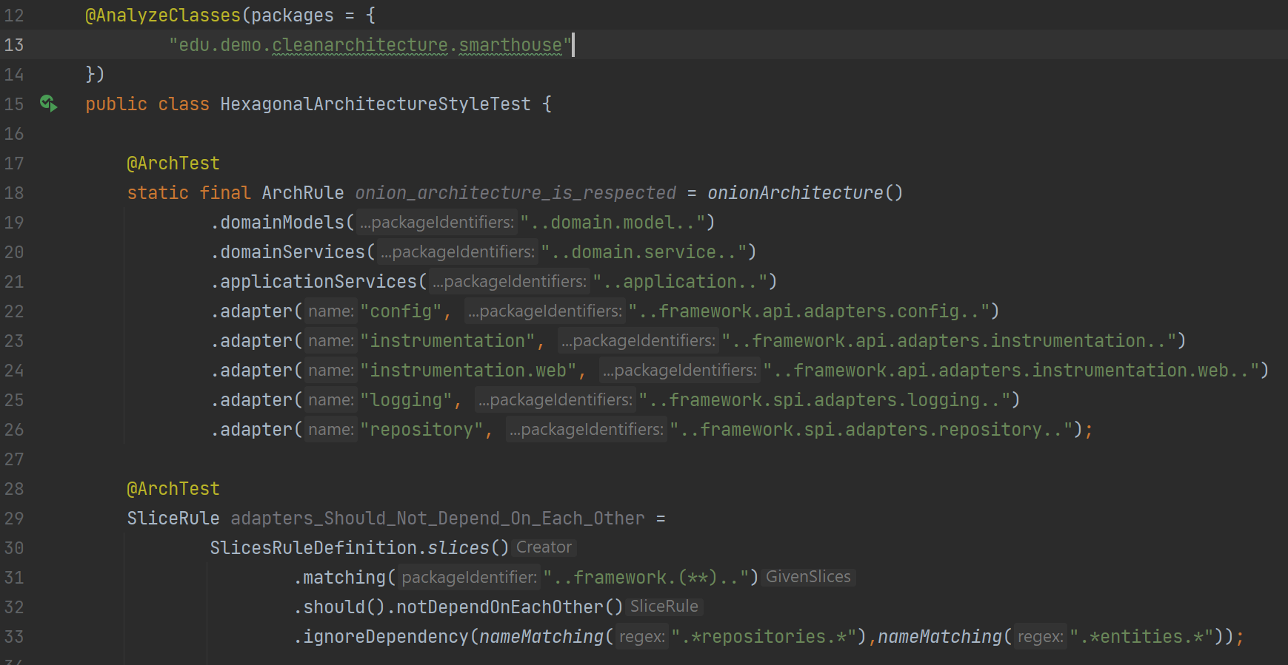
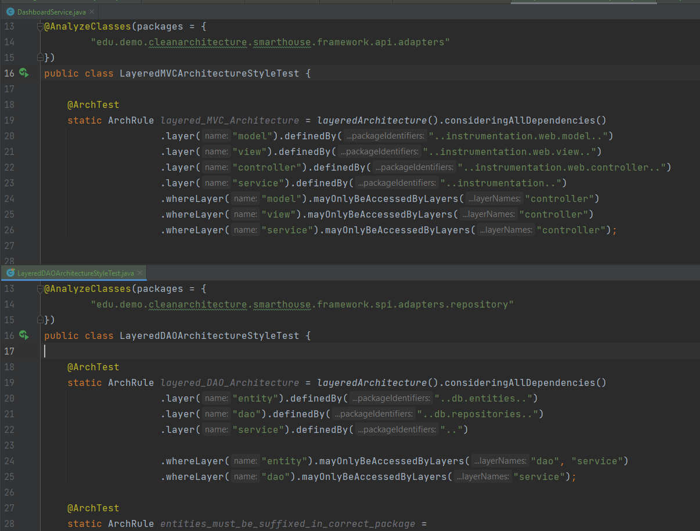
Software Architecture as code
Architectural style conformity test
Hexagonal architectural style
Layered architectural style

Slide 9
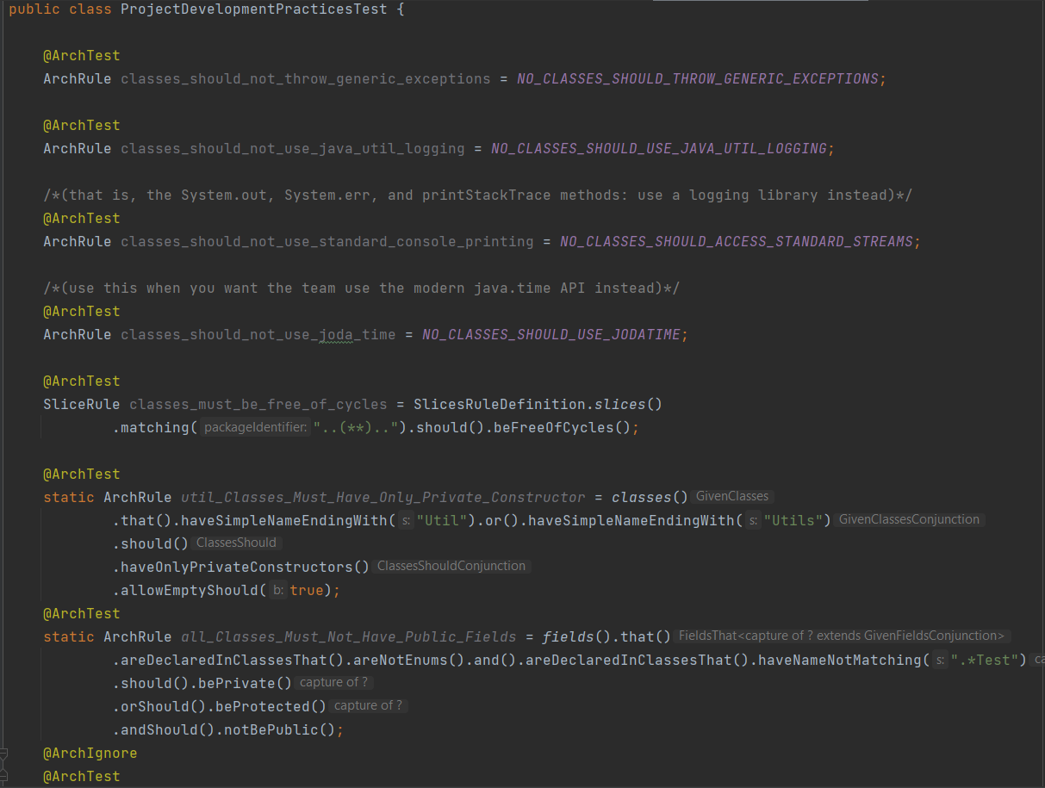
Software Architecture as code
Project development practices compliance test

Slide 10
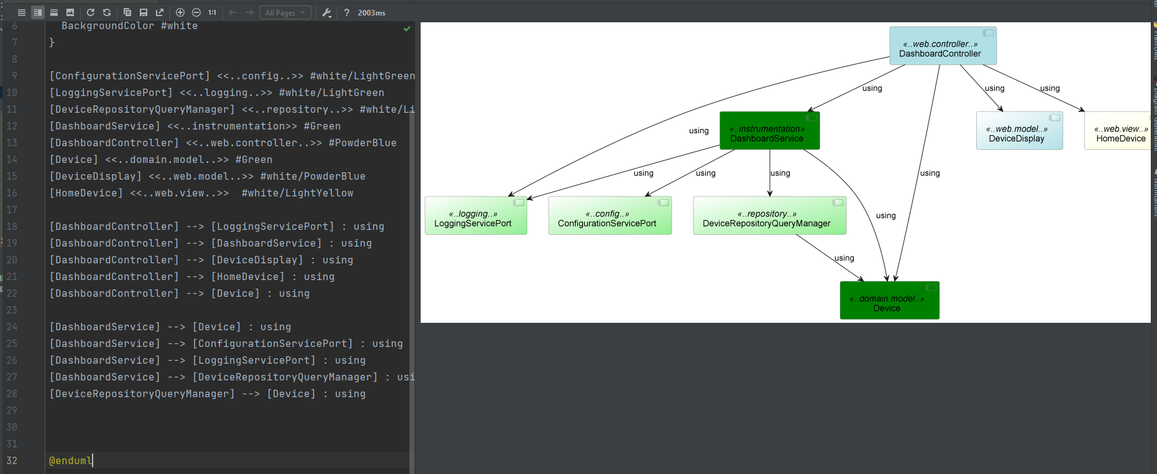
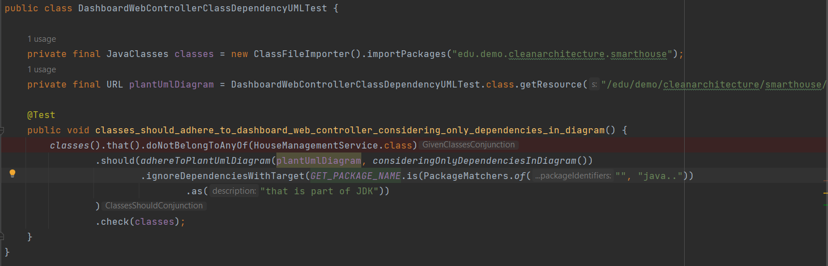
Software Architecture as code
PlantUML diagram class dependencies test

Slide 11
Software Architecture as code
Closing thoughts
Having software architecture models created using code so using the same tools as for software development, they are also versionable alongside your codebase
This kind of tooling enables what I would call Mob design, diagrams can be automatically generated and refreshed as you type. Using Plantuml and a large shared screen, it is very convenient for a team to brainstorm and create/visualize several architecture scenarios
The diagrams and documentation as code provides support for a more accurate, up-to-date, even daring to living software architecture diagrams that actually reflect the code
ArchUnit as software architecture fitness testing provides active capabilities for verifying predefined application architecture characteristics and architectural constraints as it is written and runs as a unit test that gives developers and application architects fast feedback on their work.
It also allows a team to define its own best practices and architecture rules and having architectural decisions documented with a reason as code in repository
The presented tools can address the Model-code gap concern providing the support to guard/keep code and model in synch through the architecture-fitness tests and feedback to diagrams compliance

Slide 12
Software Architecture as code
Resources
https://github.com/antoniealberto/demoCleanArchitecture
https://www.archunit.org
https://plantuml.com/
https://github.com/TNG/ArchUnit-Examples
https://beza1e1.tuxen.de/definitions_software_architecture.html
https://resources.sei.cmu.edu/asset_files/Presentation/2015_017_101_438772.pdf
https://blogs.oracle.com/javamagazine/post/unit-test-your-architecture-with-archunit
https://medium.com/ing-blog/architecture-and-design-unit-testing-using-archunit-f3ba6b5ae03b

Slide 13
Thank you!

Slide 14
Q&A

