Slide 1
Task 2 report
Human-Computer Interaction
Antoni Forzpańczyk a2019156557
Jędrzej Szor a2019156557

Slide 2

Introduction
Following report presents our opinion about chosen groups of guidelines. We selected five topics with five sections each from given assignment instruction. We provide justifications to our opinion with selected rating. Our work is referred to Heuristic Evaluation rules which provides usability inspection method for computer software that helps to identify usability problems in the user interface (UI) design.

Slide 3

Object of studies
Our work subject is website https://overflow.io/ – User flow diagramming tool. That site was awarded by Awwwards with “Site of the Day (3/20/2018)” and “Best Website Gallery” prize. https://www.awwwards.com/

Slide 4

List of Topics
The Homepage
Page Layout
Navigation
Text Appearance
Content Organization

Slide 5

The Homepage
The homepage is different from all other subpages among the Web site. Its responsibility is to provide first good impression to everyone who visits the site. It is very important to include all features expected and be sure that this site looks like home one, like initial and welcoming place for all incomers.
Sections:
Enable Access to the Homepage
Show All Major Options on the Homepage
Create a Positive First Impression of Your site
Limit Prose Text on the Homepage
Ensure the Homepage Looks like a Home Page

Slide 6


No. 6-HE-1.1 Easy Access to the Homepage
No. 6-HE-1.1 | Good aspect
Name: Easy Access to the Homepage
Evidence: Heuristic: User control and freedom Interface aspect: Return to Home Page button is big and noticeable. It is a service logo. After one click user is moved to relevant site section which is the Home Page

Slide 7
No. 6-HE-1.1 Easy Access to the Homepage
Explanation: Heuristic is met due to the site giving user control, providing him an easy access to Home Page from everywhere within the site. The Home Screen button is intuitive. In addition while hovering the cursor on the logo, cursor changes which diagnosis of a link to click.
Benefit: Rating: 4 – Usability catastrophe Justification: Frequency: It is very common on websites since it is very important and a lot of user of all kinds use it often. Impact: It has a huge impact making the website to use and navigate. Persistence: It repeatedly helpful when using the website.
Possible solution and/or Trade-offs: This solution has become the standard and it is the most popular and efficient way of navigating to the Home Page. Due to that we cannot think of any useful trade-off.
Relationships: No. 6-HE-5.5

Slide 8
No. 6-HE-1.2 All major options are shown
No. 6-HE-1.2 | Good aspect
Name: All major options are shown on the Homepage
Evidence: Heuristic: Aesthetic and minimalist design Interface aspect: The homepage consists only of few buttons and a video.

Slide 9
No. 6-HE-1.2 All major options are shown
Explanation: Heuristic is met due to the homepage being very simple, consisting only of few most useful buttons and an introductory video. The homepage is very transparent and gives the user only few possibilities making it easier to navigate.
Benefit: Rating: 3 - Major usability importance Justification: Frequency: It is not that common solution, though very important one. It is particularly important for new users who visit the website for the first time. Succinct and transparent homepage helps finding the purpose of the website and the most important functions. Impact: It makes usage of the site way easier. Having everything on the homepage certainly makes the website more clear and comfortable to use. Persistence: It is very helpful during almost every usage of the website. Having a hub on a webpage makes navigating through the webpage much easier. Weights: This benefit has a big impact on the user’s ease of website navigation and is used almost every time the user enters the site. Due to that we rated it as a major importance.
Possible Trade-offs: Another possible solution is just lack of the options in the homepage. It is possible to use a site without that solution, although it is much more difficult and less transparent.
Relationships: No. 6-HE-2.2, No. 6-HE-5.5, No. 6-HE- 5.3

Slide 10
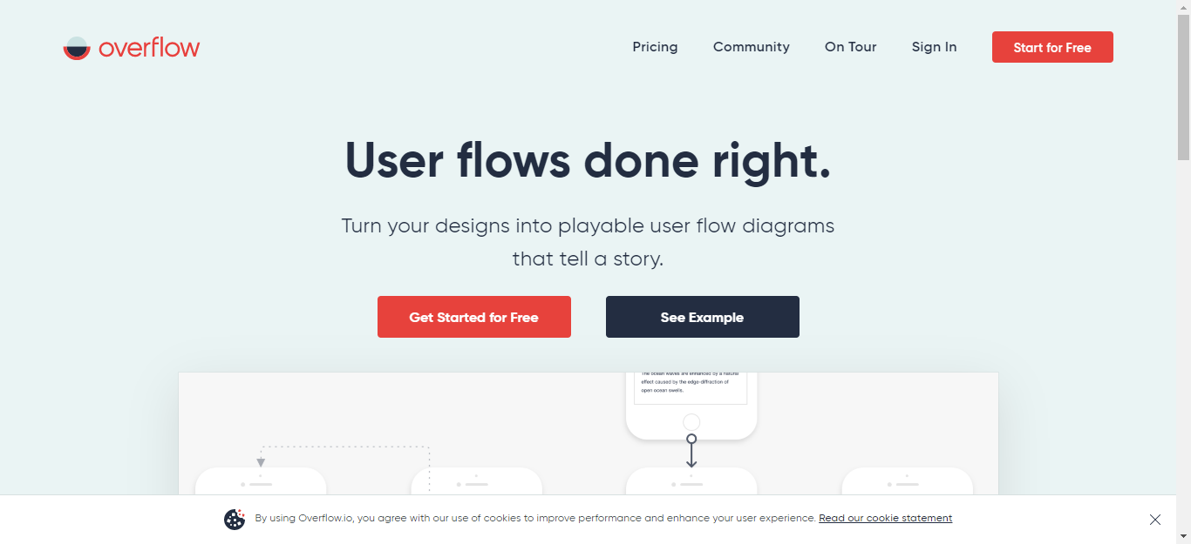
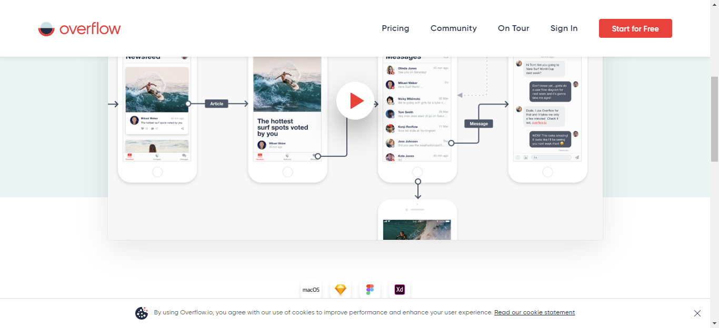
No. 6-HE-1.3 Good first impression of the site
No. 6-HE-1.3 | Good aspect
Name: Good first impression of the site
Evidence: Heuristic: Aesthetic and minimalist design Interface aspect: The homepage consists of few buttons and a video. Minimum content.

Slide 11
No. 6-HE-1.3 Good first impression of the site
Explanation: Heuristic is met due to the homepage being minimalist. Only the most important content is present and nothing more. It creates a great first impression of a site that is transparent, easy to navigate, succinct and user-friendly.
Benefit: Rating: 2 - Minor usability importance Justification: Frequency: It is becoming more and more popular. Every kind of user will surely notice it. Impact: It is very important, users are bound to make their opinion about the company or organisation basing on the first impression of the website. Persistence: First impression is the most important the first time user enters the website but is not without impact later on. Website with good first impression is comfortable to use and user-friendly. Weights: We rated this as a minor importance due to the first impression being really important mostly the first time and it is not crucial for usability.
Possible Trade-offs: First impression cannot be traded for anything else. It is quite abstract and it either is or is not.
Relationships: No. 6-HE-1.4

Slide 12

No. 6-HE-1.4 Limited Prose Text on the Homepage
No. 6-HE-1.4 | Good aspect
Name: Limited Prose Text on the Homepage
Evidence: Heuristic: Aesthetic and minimalist design Interface aspect: The Homepage lacks of huge amount of prose text. Page consists of only a few necessary sentences which describe providing product. Despite the amount, user has clear idea what page is about and can identify its purpose

Slide 13
No. 6-HE-1.4 Limited Prose Text on the Homepage
Explanation: Heuristic is met considering only a few lines of prose text. Everything is clear and understandable. At homepage user is not flooded with huge amount of text which improves the first impression and clarity.
Benefit: Rating: 3 - Major usability importance Justification: Frequency: Clarity on the homepage is generally present among websites. Most of users value lack of prose text at the very first page. Impact: The only necessary and limited text on the homepage attracts more than huge amount of detailed data. User does not want to deep into complex information at the very first moment of usage. Persistence: Huge amount of text at the beginning might repeatedly bother the user. It may be discouraging to struggle through the prose text without any segmentation or grouping in tabs in lower levers of the website. Weights: We weighted this issue as major importance because of importance the very first moments of website usage. This huge amount of prose text may just put user off using the website.
Possible Trade-offs: To access the detailed text with complex information website should provide button “Learn more” or reveal information gradually.
Relationships: No. 6-HE-5.5, No. 6-HE-5.1

Slide 14
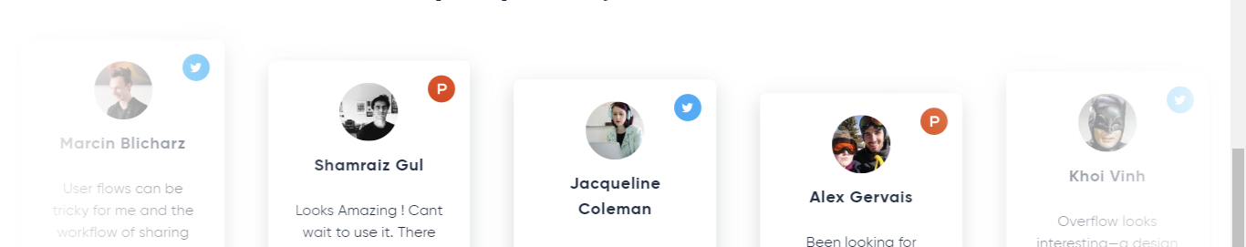
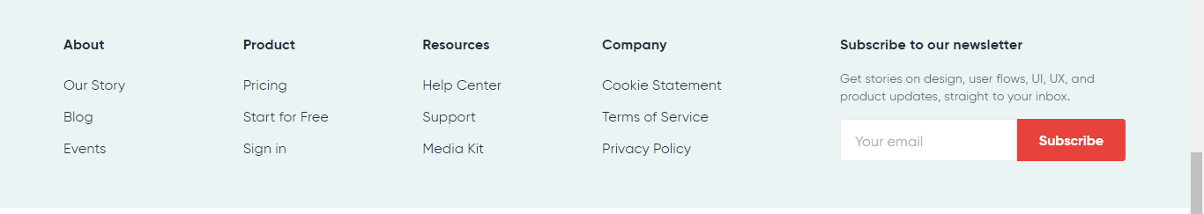
No. 6-HE-1.5 Homepage looks like a Home Page
No. 6-HE-1.5 | Good aspect
Name: Homepage looks like a Home Page
Evidence: Heuristic: Aesthetic and minimalist design Interface aspect: Provided Home Page on Overflow.io satisfies all major key factors. It has promise, call to action, contact details, visual branding, link to video showing example and trust elements. All of these wrapped in well-designed layout which attracts user to search through the website.
Trust elements
Promise
Contact
video
Call to action

Slide 15
No. 6-HE-1.5 Homepage looks like a Home Page
Explanation: Heuristic is met by the general layout of the page which truly identifies itself as a homepage. Whole information presented are relevant to that very first moment of user’s website usage.
Benefit: Rating: 4 - Catastrophic usability importance Justification: Frequency: Most of first pages of websites or products look like home pages. Repeatedly designed sites with common layout and content have driven the standard of website creation. Impact: It is strongly important to show the user that first page he or she entered is the home one. In other case user might get lost and does not know where and how search appropriate information. Persistence: This issue might be repeatedly frustrating that there is no clear structure of the site. Weights: We rated this as a catastrophic importance because despite the visual design much more important is content and layout design. If user cannot locate himself where he is, when homepage does not look like the place where you start search the information, user might be just put off using that site.
Possible Trade-offs: We cannot find better trade-off. This is standard and users require that.
Relationships: No. 6-HE-1.3, No. 6-HE-2.2, No. 6-HE-5.5, No. 6-HE-5.1

Slide 16

Page layout
All Web pages should be structured for ease of comprehension. This includes putting items on the page in an order that reflects their relative importance. Designers should place important items consistently, usually toward the top and center of the page.
Sections:
Avoid Cluttered Displays
Place Important Items at Top Centre
Structure for Easy Comparison
Align Items on a Page
Use Fluid Layouts

Slide 17
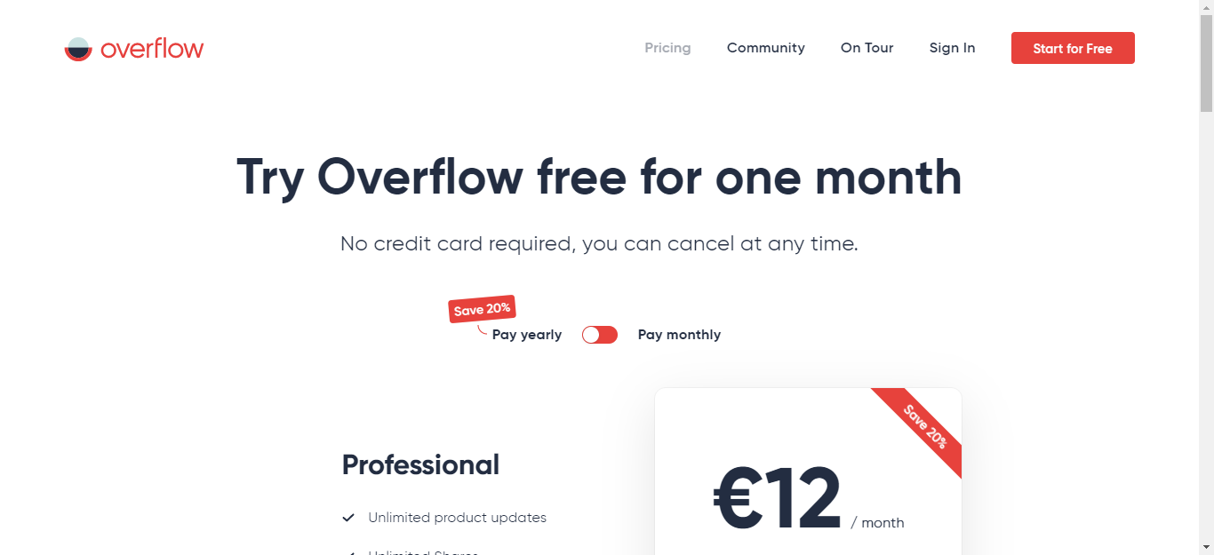
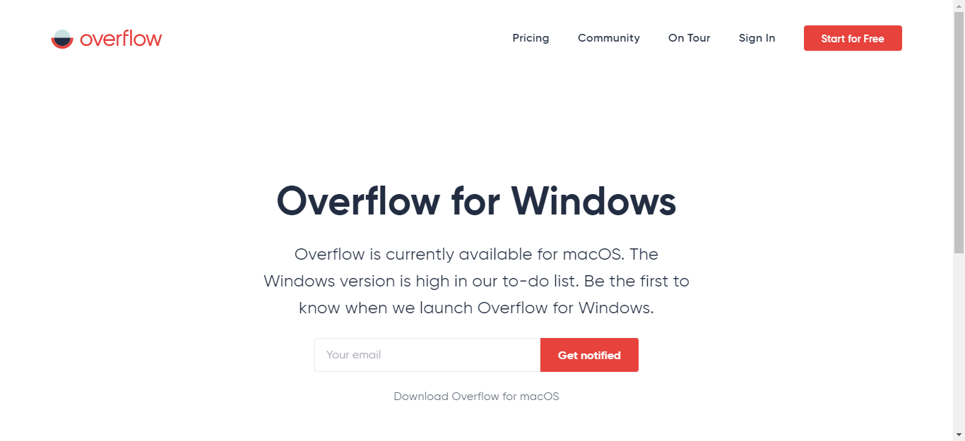
No. 6-HE-2.1 No cluttered displays
No. 6-HE-2.1 | Good aspect
Name: No cluttered displays
Evidence: Heuristic: Aesthetic and minimalist design Interface aspect: The website is succinct and has only few widgets in the view.

Slide 18
No. 6-HE-2.1 No cluttered displays
Explanation: Heuristic is met due to the website being transparent and minimalist. Only the most important information and widgets are shown which is likely to make user find what he is looking for much easier.
Benefit: Rating: 3 - Major usability importance Justification: Frequency: It is not very popular to find websites without cluttered displays. All of the users are bound to get lost in the clutter of buttons, text fields and pictures. Impact: It is very important, users are much more likely to find what they are looking for if there are only few most important buttons. Persistence: It is most important the first time a user visits the website. Transparent layout with only the most important options helps comprehend the content of the site much easier and faster. Weights: We rated this as a major importance due to the not cluttered displays being really important for the first impression and ease of navigation. Even though it is the most important during the first usage of website, it is really important during every other usage as well and makes the website more user-friendly.
Possible Trade-offs: Not cluttered display cannot really be traded for anything else. Other possibility would be to use a lot of links and put the redundant widgets there, but it still creates clutter.
Relationships: No. 6-HE-5.3, No. 6-HE-5.5, No. 6-HE-2.4

Slide 19
No. 6-HE-2.2 Most important information placed in top center
No. 6-HE-2.2 | Good aspect
Name: Most important information placed in top center
Evidence: Heuristic: Aesthetic and minimalist design Interface aspect: Every tab has information and few buttons in top center.

Slide 20
No. 6-HE-2.2 Most important information placed in top center
Explanation: Heuristic is met due to every tab having a sentence explaining its purpose and the most important buttons in the top center. It saves time and helps a lot when navigating through the website
Benefit: Rating: 2 - Minor usability importance Justification: Frequency: Placing most important information in top center is becoming and more popular. All users benefit from that wasting less time on wandering through the website looking for the information. Impact: It is important for clarity purpose and helps a lot when looking for something particular on the site. Persistence: It is most important the first time a user visits the website, although it is not without meaning during other usages of the website. Once the user gets familiar with the website, navigating gets easier. Weights: We rated this as a minor importance due to the case being important mostly during the first usage of the website and it is not crucial for the usability.
Possible Trade-offs: Placing most important information in the top center can be traded for placing the important information somewhere else but without clutter of redundant information. If it is isolated, it fulfills its purpose.
Relationships: No. 6-HE-2.1, No. 6-HE-2.4, No. 6-HE-5.1

Slide 21
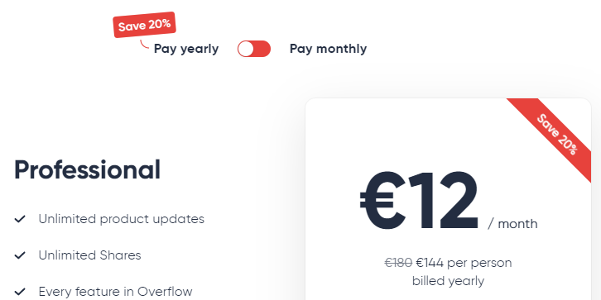
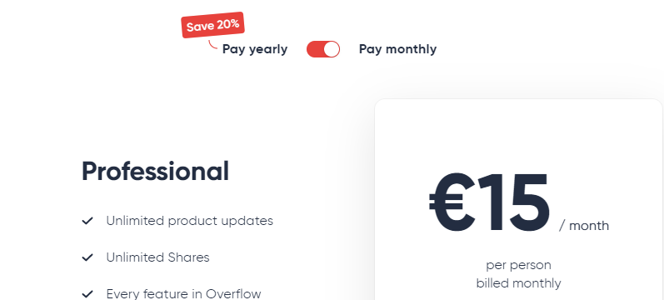
No. 6-HE-2.3 Lack of a structure for easy comparison
No. 6-HE-2.3 | Problem
Name: Lack of a structure for easy comparison
Evidence: Heuristic: Recognition rather than recall Interface aspect: On the pricing section we have two option of payment for the Pro version of the product. User can decide whether pay monthly or yearly. To display price and additional information about the discounts and exact prices needs to switch using the button.
Change by clicking on the switch

Slide 22
No. 6-HE-2.3 Lack of a structure for easy comparison
Explanation: Heuristic is not met because of necessity to double checking and remembering the prices for monthly and yearly way of payment. There is no clear comparison between. User is forced to click the switch couple times to decide which option is suitable.
Benefit: Rating: 2 - Cosmetic problem Justification: Frequency: A lot of pages have problem with displaying data in pleasant and useful way. User are forced to click to switch, have double windows opened. Impact: This situation is easy to overcome yet is irritating because it required form the user additional actions done. Persistence: That situation might be annoying all the time user wants to compare data, choose suitable option. However, it is not done regularly, when best option is found there is no need to compare prices any more. Weights: We noted that as cosmetic problem because it is not the minor issue which disqualify website. When product is desired, the way how information is displayed might be only disturbing.
Possible Trade-offs: The best trade-off it just provide two columns with visible two options at one glance to ensure a clarity of comparison.
Relationships: No. 6-HE-5.4, No. 6-HE-5.2, No. 6-HE-5.5, No. 6-HE-2.4

Slide 23
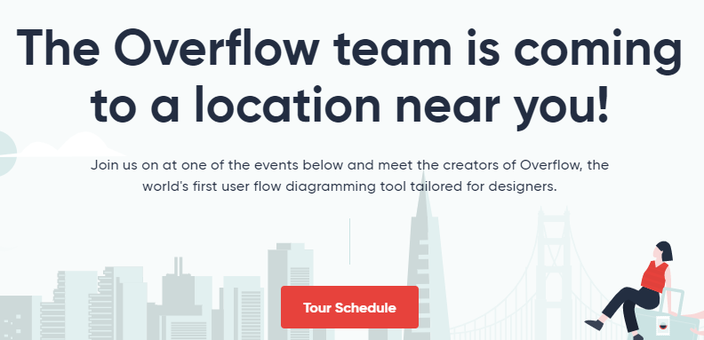
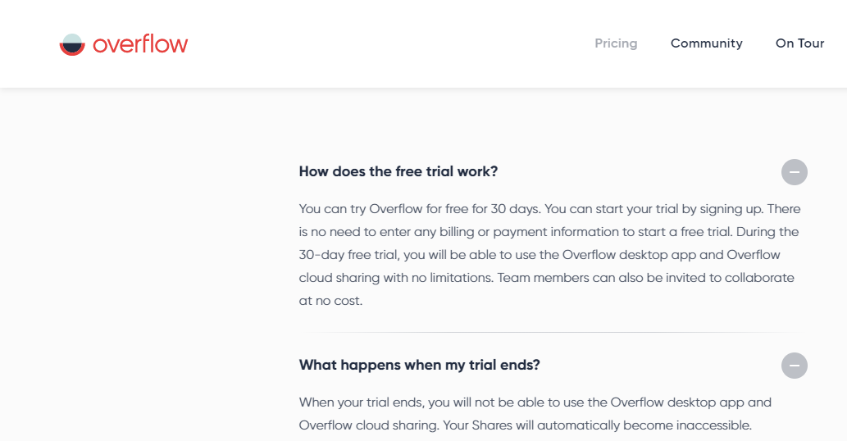
No. 6-HE-2.4 Items on a page well aligned
No. 6-HE-2.4 | Good aspect
Name: Items on a page well aligned
Evidence: Heuristic: Aesthetic and minimalist design Interface aspect: All widgets are placed in one line vertically or horizontally

Slide 24
No. 6-HE-2.4 Items on a page well aligned
Explanation: Heuristic is met due to all items being well aligned. It very looks aesthetic and makes the website look tidy.
Benefit: Rating: 1 - Cosmetic importance Justification: Frequency: Aligning items on websites is a standard and it can be encountered almost everywhere. All kinds of users are bound to notice lack of it. Impact: It is not very important in the matter of usability. Persistence: It creates a good impression every time a user enters the website. Weights: We rated this as a cosmetic importance due to aligning items on the page not being of importance to the usability of the website but rather visual effect that makes the page tidy.
Possible Trade-offs: Aligning items on the page has no trade-offs, the items can be either aligned or not.
Relationships: No. 6-HE-2.5, No. 6-HE-5.3

Slide 25
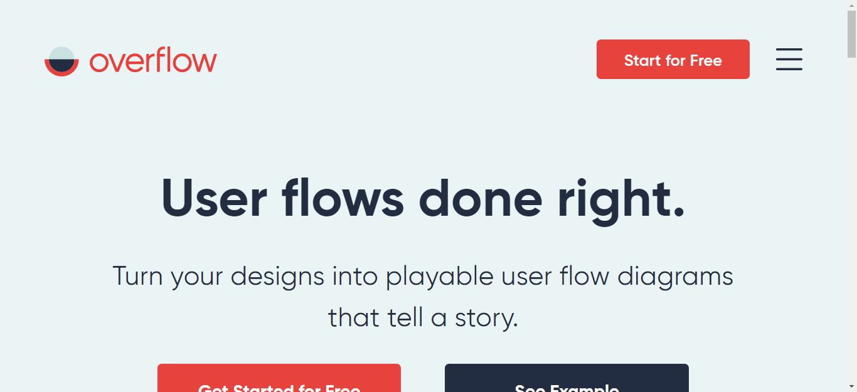
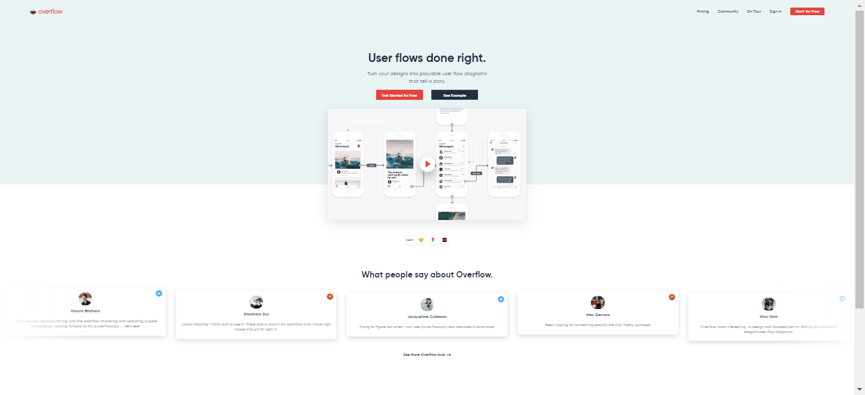
No. 6-HE-2.5 Fluid layouts used
No. 6-HE-2.5 | Good aspect
Name: Fluid layouts used
Evidence: Heuristic: Aesthetic and minimalist design Interface aspect: Website content adjusts itself to higher resolution screens
175% of resolution scale
33% of resolution scale

Slide 26
No. 6-HE-2.5 Fluid layouts used
Explanation: Heuristic is met due to the aesthetics considering the web page layout. Areas maintain the size and location despite to the screen resolution changes. Website keeps its layout with the text respectively scaled to the bigger size of the screen. Fluid layout maintains clarity of displayed information apart from different screen resolutions.
Benefit: Rating: 3 - Major usability importance Justification: Frequency: Nowadays websites are built with focus on different resolutions of the screens. However these old ones are not scalable well. They have fixed pixel values set which disarrange proper layout of the site. Impact: This issue might discourage from using the website because messed layout of the website makes it unusable. Persistence: This situation for sure is repeatedly annoying because website is not adjusted to resources that user have. Weights: We rated this aspect as a major usability importance because that might be discouraging and disqualifying for the user, but nowadays websites are built to be as adaptive to users resources as it is possible.
Possible Trade-offs: There is no any possible trade-off. Websites must be flexible to users’ screens resolution.
Relationships: No. 6-HE-2.1, No. 6-HE-3.5

Slide 27

Navigation
Navigation refers to the method used to find information within a Web site. A navigation page is used primarily to help users locate and link to destination pages. A Web site’s navigation scheme should allow users to find and access information effectively.
Sections:
Provide Navigational Options
Differentiate and Group Navigation Elements
Use a Clickable 'List of Contents' on Long Pages
Provide Feedback on User's Location
Use Appropriate Menu Types

Slide 28



No. 6-HE-3.1 Navigational options are provided
No. 6-HE-3.1 | Good aspect
Name: Navigational options are provided
Evidence: Heuristic: User control and freedom Interface aspect: Navigation bar is present.
Go to Home Page button
Menu Bar
Call to action buttons

Slide 29
No. 6-HE-3.1 Navigational options are provided
Explanation: Heuristic is met due to the navigation bar being present and allowing ease access to all of the tabs from any place on the website.
Benefit: Rating: 4 - Critical importance Justification: Frequency: Navigational options are a necessary standard and can be encountered everywhere. Every user uses that since it is the easiest way of travelling through the site. Impact: It is a must have, since lack of it is almost impossible for regular user to overcome and makes the website completely unusable. Persistence: Navigation bar enables moving through the website during every usage, it is a key functionality. Weights: We rated this as a critical importance due to navigational options being crucial functionality on the website and allowing users to go back and forth the tabs with ease and comfort.
Possible Trade-offs: It is a necessary standard and we cannot think of any usable trade-off.
Relationships: No. 6-HE-1.1, No. 6-HE-3.2, No. 6-HE-5.4

Slide 30
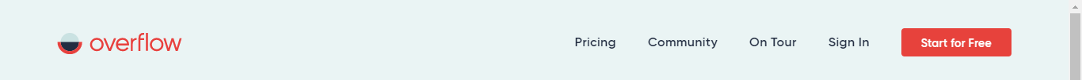
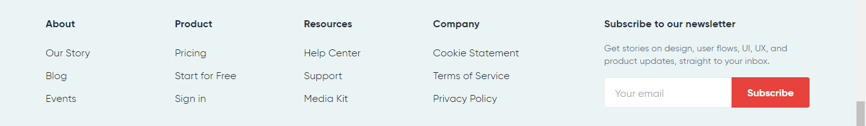
No. 6-HE-3.2 Differentiated and grouped navigation elements
No. 6-HE-3.2 | Good aspect
Name: Differentiated and grouped navigation elements
Evidence: Heuristic: Consistency and standards Interface aspect: Menu bar is present, scalable and all navigation buttons and options are grouped in one place. They are distinguishable among the rest of the page content.
Menu bar
Footer

Slide 31
No. 6-HE-3.2 Differentiated and grouped navigation elements
Explanation: Heuristic is met because of menu bar being visible and accessible. User knows where to find navigation options even though buttons do not have different shape nor colour. All of them are aligned together at the top of the page. If website is shrunk menu bar becomes a dropdown marked by three stripes icon.
Benefit: Rating: 3 - Critical importance Justification: Frequency: Grouped navigation options in one place is common feature of most of the websites. There are only particular ones with spread navigation options due to the huge variety of content and necessity to include it on the website. Impact: Spread navigation options all over the site are barely to overcome. User might be both confused and irritated with no ability to navigate himself along the web content. Persistence: Grouped navigation options are repeatedly helpful and even desired by the user. Weights: We rated this as critical importance because of the ease we need to provide the user to move along the site. This feature is almost fundamental. Obviously, user can somehow overcome that issue yet it might be so annoying with long term usage.
Possible Trade-offs: Menu bar should be more distinctive.
Relationships: No. 6-HE-3.1, No. 6-HE-3.5

Slide 32

No. 6-HE-3.3 Lack of list of contents on long pages
No. 6-HE-3.3 | Problem
Name: Lack of list of contents on long pages
Evidence: Heuristic: User control and freedom Interface aspect: There are no lists of contents
No photo
evidence

Slide 33
No. 6-HE-3.3 Lack of list of contents on long pages
Explanation: Heuristic is violated due to the lack of lists of contents which would make navigation through long pages easier and more transparent.
Severity: Rating: 2 - Minor usability problem Justification: Frequency: Lack of list of contents on long pages is a rather common problem. Every user is bound to feel the pain of it when looking for something in particular on a long page. Impact: Overcoming this problem is dull and annoying. User is probable to waste a lot of time when searching for something on a long page. Persistence: This problem is repetitive and users are bound to encounter it every time they search for something on the page Weights: We rated this as minor problem due to the case being not that difficult to overcome but rather dull. This problem is going to be the most difficult in specific conditions when user is not reading the whole page but looking for one part in particular.
Possible solution: The most reasonable solution would be to use the lacking clickable list of contents which would allow user to quickly and easily navigate through long pages of content.
Relationships: No. 6-HE-5.1

Slide 34
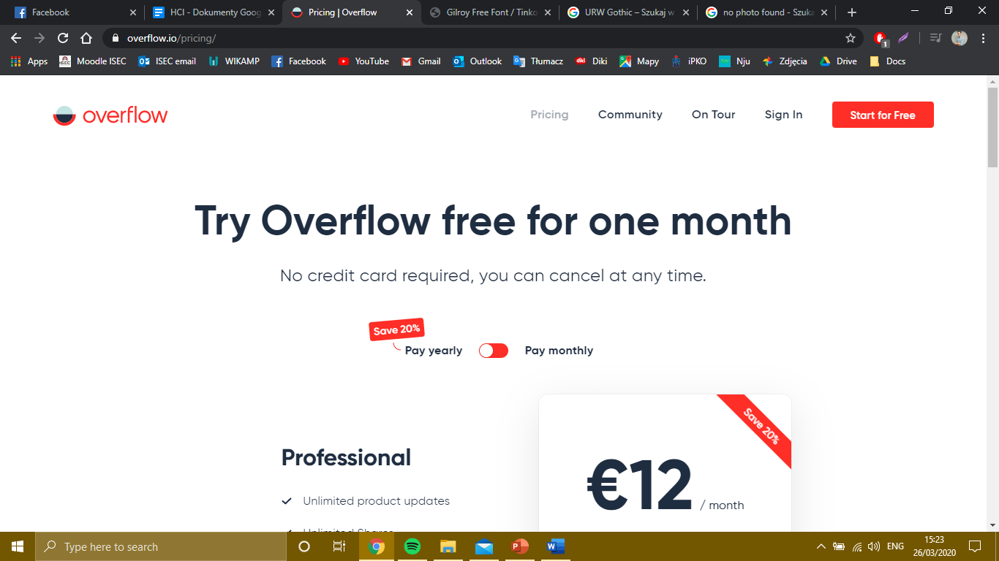

No. 6-HE-3.4 Feedback on user's location not provided
No. 6-HE-3.4 | Problem
Name: Feedback on user's location provided
Evidence: Heuristic: User control and freedom Interface aspect: Website’s content is divided into subpages and user location is labelled in menu by changing color intensity on current clicked button, however there is no label or headline provided..

Slide 35
No. 6-HE-3.4 Feedback on user's location not provided
Explanation: Heuristic is slightly met due to provided position labelling on menu bar buttons. Nevertheless, lack of a clear information to the user where is he right now is noticeable. Despite the content of the subpage slightly noticeable changed color intensity of the button and the URL user is not precisely informed about his location.
Severity: Rating: 3 - Major importance Justification: Frequency: Lack of subpage title is a common problem. The reason is that headlines might mess the design of the page or designers think that only a content will be enough to point users’ location. Impact: It is very difficult to overcome such situation when user cannot find himself on the webpage. It forces to start navigation from the beginning - homepage to once again find something desired. In complex websites it might be just irritating and putting user off using the website, Persistence: For new users this issue may be repeatedly annoying and disturbing. For experienced and old ones who know the structure of the site is bearable. Weights: We rated this as a major importance because clear notification which subpage is used is necessary especially on complexed webpages. For new users in might confuse and force to repeat whole way along the web structure once again. To avoid that, simple labels could be used.
Possible Trade-offs: Placing the headline or text somewhere in the corner with the label of the subpage coherent with menu content.
Relationships: No. 6-HE-3.1, No. 6-HE-4.3

Slide 36

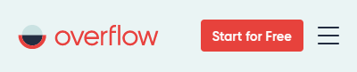

No. 6-HE-3.5 Appropriate menu types
No. 6-HE-3.5 | Good aspect
Name: Appropriate menu types
Evidence: Heuristic: User control and freedom Interface aspect: Desktop version and mobile version have different menus accordingly.
Mobile version
PC version

Slide 37
No. 6-HE-3.5 Appropriate menu types
Explanation: Heuristic is met due to the usage of black text on plain background. It ensures clarity of provided information.
Benefit: Rating: 4 – Catastrophic usability problem Justification: Frequency: Dark font color on high-contrast background is on almost every website. Impact: There is nothing so frustrating on website than unreadable text composed in colourful or not plain background. Most of users cannot stand struggling to read text on the website. Persistence: This problem repeatedly annoys customers. Weights: We weighted that issue as catastrophic because the lack of clarity on the website, providing confusion declassifies the website entirely in behalf of the user.
Possible trade-offs: Considering this website we cannot find better trade-off than using clear black text on plain background.
Relationships: No. 6-HE-3.1, No. 6-HE-3.2, No. 6-HE-3.4, No. 6-HE-5.1, No. 6-HE-2.1

Slide 38

Text Appearance
There are some issues related to text characteristics that can help ensure communication with users such as using 12-points of familiar font. Using black text on plain, high-contrast backgrounds and background colors to help users understand the grouping of related information.
Sections:
Use Black Text on Plain, High-Contrast Backgrounds
Format Common Items Consistently
Use Attention-Attracting Features when Appropriate
Use Familiar Fonts
Use at Least 12-Point Font

Slide 39
No. 6-HE-4.1 Black Text on Plain, High-Contrast Backgrounds
No. 6-HE-4.1 | Good aspect
Name: Black Text on Plain, High-Contrast Backgrounds
Evidence: Heuristic: Aesthetic and minimalist design Interface aspect: Website consists of high-contrast font on plain, white background.

Slide 40
No. 6-HE-4.1 Black Text on Plain, High-Contrast Backgrounds
Explanation: Heuristic is met due to the usage of black text on plain background. It ensures clarity of provided information.
Benefit: Rating: 4 – Catastrophic usability problem Justification: Frequency: Dark font color on high-contrast background is on almost every website. Impact: There is nothing so frustrating on website than unreadable text composed in colourful or not plain background. Most of users cannot stand struggling to read text on the website. Persistence: This problem repeatedly annoys customers. Weights: We weighted that issue as catastrophic because the lack of clarity on the website, providing confusion declassifies the website entirely in behalf of the user.
Possible trade-offs: Considering this website we cannot find better trade-off than using clear black text on plain background.
Relationships: No. 6-HE-5.1, No. 6-HE-4.2

Slide 41
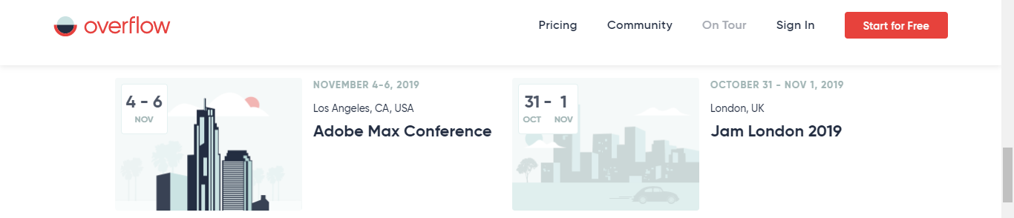
No. 6-HE-4.2 Common items formatted consistently
No. 6-HE-4.2 | Good aspect
Name: Common items formatted consistently
Evidence: Heuristic: Consistency and standards Interface aspect: All items are formatted in the same way
Menu bar
Tour info

Slide 42
No. 6-HE-4.2 Common items formatted consistently
Explanation: Heuristic is met due to all items being formatted in the same way. Such consistency enables users to recognize patterns and find particular information and buttons much easier. Formatting everything in the same way creates an impression of tidiness.
Benefit: Rating: 3 - Major usability importance Justification: Frequency: It is a standard, almost all websites are consistent in the way of formatting. Lack of that would affect all users. Impact: It is very important since consistency allows users to recognize standards. Lack of that would end up in confusion and waste of time. Persistence: Consistency makes every usage of the website easier and much more effective and time saving. Weights: We rated this as a major importance due to the consistency being crucial in the matter of recognizing items on the website. Without consistent formatting users are bound to get lost.
Possible Trade-offs: We cannot think of any usable trade-off to consistent formatting.
Relationships: No. 6-HE-4.1, No. 6-HE-5.3

Slide 43
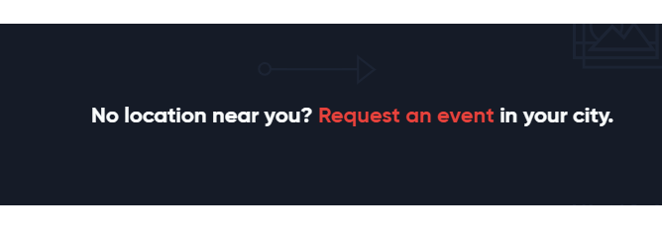
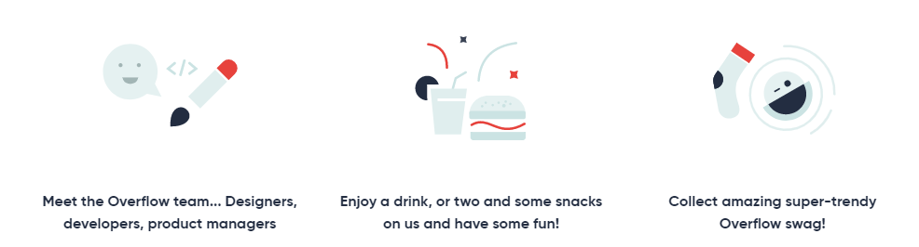
No. 6-HE-4.3 Attention attracting features are used
No. 6-HE-4.3 | Good aspect
Name: Attention attracting features are used
Evidence: Heuristic: Aesthetic and minimalist design Interface aspect: Colorful buttons on a white background are used.
Proposition to request of an event
Description of the Overflow event

Slide 44
No. 6-HE-4.3 Attention attracting features are used
Explanation: Orange and black buttons are very visible on a white background. User is bound to notice them first when he enters the website.
Benefit: Rating: 1 - Cosmetic importance Justification: Frequency: It is not very commonly used. Impact: It is not very important. It provides a tool for focusing user’s attention which allows the designers to make user see the most important buttons first. Persistence: It is mostly important during first usages of the website, once the user knows what the site has to offer, it is not very important. Weights: We rated this as a cosmetic importance due to the attention attracting features being not very important and only having meaning during first usages of the website.
Possible Trade-offs: Another possible solution would be to not use those features. This would make the website only a little bit less user-friendly and transparent.
Relationships: No. 6-HE-3.5, No. 6-HE-4.4, No. 6-HE-4.5

Slide 45
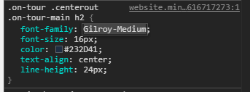
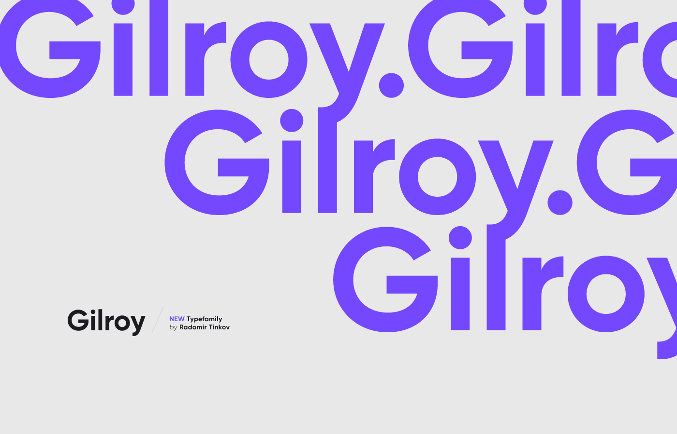
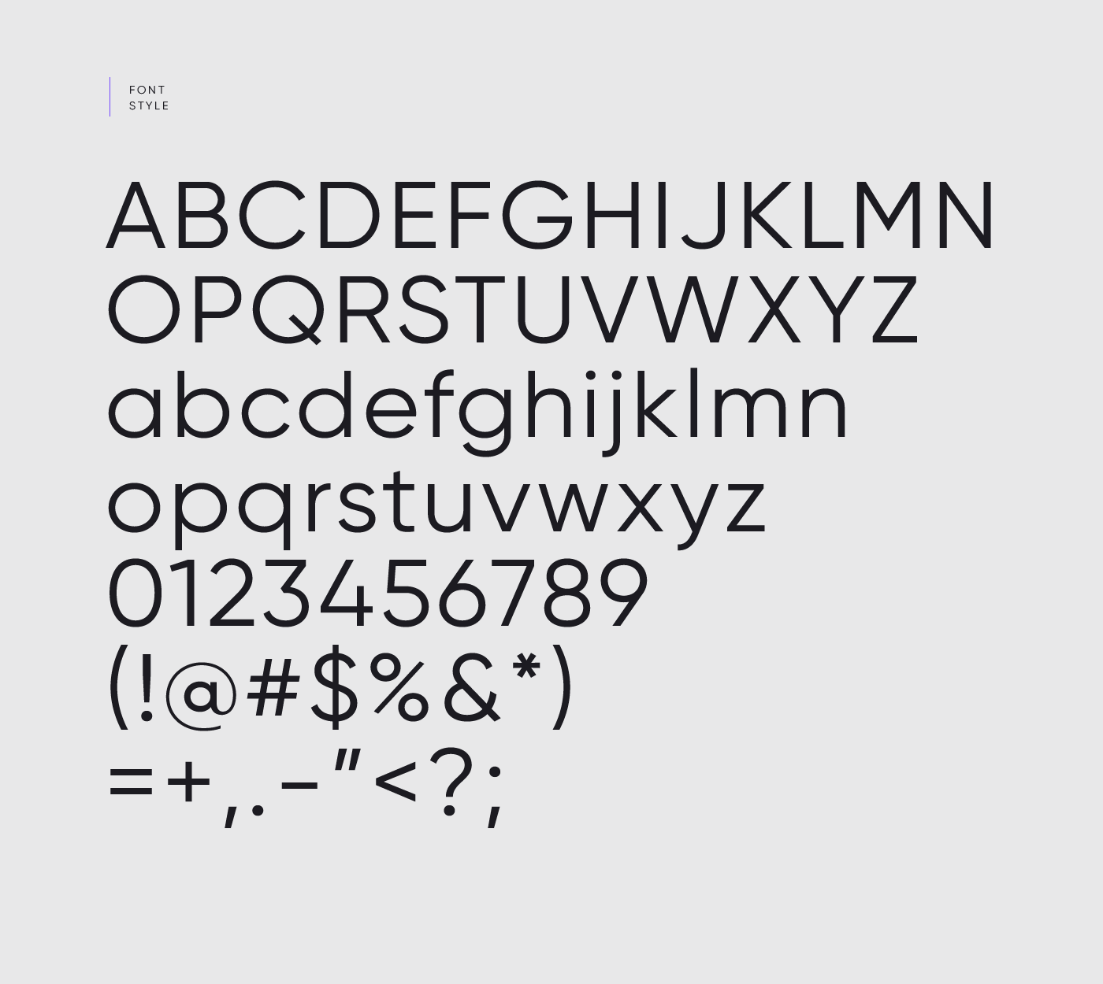
No. 6-HE-4.4 Familiar fonts are used
No. 6-HE-4.4 | Good aspect
Name: Familiar fonts are used
Evidence: Heuristic: Aesthetic and minimalist design Interface aspect: Used font is readable and similar to Gothic – Microsoft Word basic font.
https://www.tinkov.info/gilroy.html

Slide 46
No. 6-HE-4.4 Familiar fonts are used
Explanation: Used font is easy to read, looks tidy and modern. It is similar to well-known and widely used font URW Gothic.
Benefit: Rating: 1 - Cosmetic importance Justification: Frequency: It is very common to encounter familiar fonts on websites. Designers use well known and tested solutions. It is particularly helpful for new users who get easily confused and lost. Impact: It is not very important. If the font is readable it barely matters if it is familiar or not. Users save no time whatsoever. Persistence: Font is usually the same on the entire page, which makes it very persistent case. Weights: We rated this as a cosmetic importance due to the unimportance of the familiarity of font. As long as it is readable, it doesn't really matter.
Possible Trade-offs: This benefit has no usable trade-offs we’re aware of.
Relationships: No. 6-HE-4.5

Slide 47
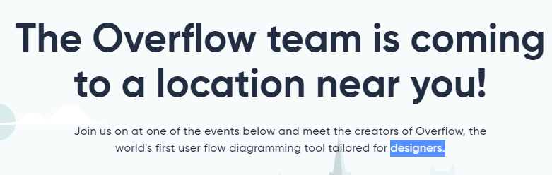
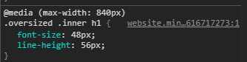
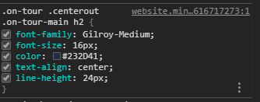
No. 6-HE-4.5 Font is bigger than 12-point
No. 6-HE-4.5 | Good aspect
Name: Font is bigger than 12-point
Evidence: Heuristic: Aesthetic and minimalist design Interface aspect: Used font is big and readable
48px
16px

Slide 48
No. 6-HE-4.5 Font is bigger than 12-point
Explanation: Used font is easy to read, big letters make it easier to read everything without a need to move closer to the screen.
Benefit: Rating: 3 - Major importance Justification: Frequency: It is a standard on almost every website. It is especially important for elderly users, or any other users with bad eyesight. Impact: It is very important, since too small letters are extremely uncomfortable and sometimes even painful to read. Persistence: Font is usually the same on the entire page, which makes it a very persistent case. Too small font will be a problem every step of the way. Weights: We rated this as a major importance due to the font size being crucial in the matter of readability and usability.
Possible Trade-offs: This benefit has no usable trade-offs we’re aware of.
Relationships: No. 6-HE-5.1, No. 6-HE-4.4

Slide 49

Content Organization
After ensuring that content is useful, well-written, and in a format that is suitable for the Web, it is important to ensure that the information is clearly organized. In some cases, the content on a site can be organized in multiple ways to accommodate multiple audiences.
Sections:
Organization Information
Clearly Ensure that Necessary Information is Displayed
Group Related Elements
Minimize the Number of Clicks or Pages
Display Only Necessary Information

Slide 50
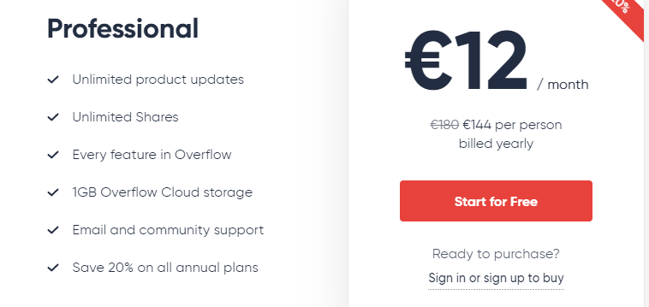
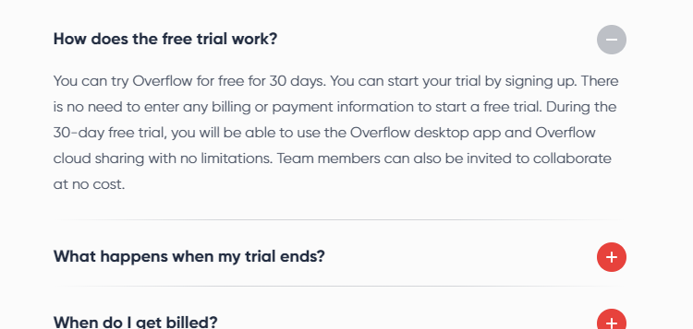
No. 6-HE-5.1 Information organized clearly
No. 6-HE- 5.1 | Good aspect
Name: Information organized clearly
Evidence: Heuristic: Aesthetic and minimalist design Interface aspect: Information provided on the website is clear?
Pricing
Frequently asked questions

Slide 51
No. 6-HE-5.1 Information organized clearly
Explanation: Heuristic is met since the information provided on the website is succinct and clear. Small amounts of text make user feel more comfortable when reading it. Text fields are aligned consistently and information concerning the same thing are grouped accordingly.
Benefit: Rating: 3 - Major importance Justification: Frequency: Clear organization of information is not very often found on the websites. Every kind of user is sure to notice well organized content Impact: It is very important since it allows user to find information easily and quickly. It makes the website more intuitive and clear. Persistence: This benefit is valuable during every usage of the website. Clearly organized information saves user’s time enabling him to find and learn much faster and easier. Weights: We rated this as a major importance as the clear organization of information is the key to the website being readable and actually helpful.
Possible Trade-offs: This benefit has no usable trade-offs we’re aware of.
Relationships: No. 6-HE-1.1, No. 6-HE-1.3, No. 6-HE-1.4, No. 6-HE-2.1, No. 6-HE-2.2, No. 6-HE-2.3, No. 6-HE-5.3

Slide 52
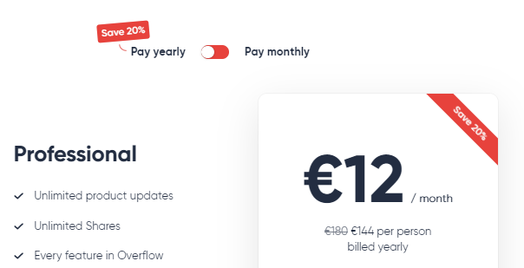
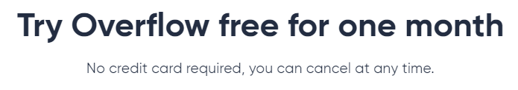
No. 6-HE-5.2 Clearly Ensure that Necessary Information is Displayed
No. 6-HE-5.2 | Good aspect
Name: Clearly Ensure that Necessary Information is Displayed
Evidence: Heuristic: Recognition rather than recall Interface aspect: All features and details of the Professional plan are displayed clearly in pricing section.
Billing option
Discount
information
Payment and cancellation
Listed content

Slide 53
No. 6-HE-5.2 Clearly Ensure that Necessary Information is Displayed
Explanation: All necessary information is grouped together in place relevant to current topic. Pricing section consists of price, features of the plan as well as the important information about credit card and cancellation option. User has everything he needs displayed in one place in neat manner.
Benefit: Rating: 3 - Major importance Justification: Frequency: It is common to group all information together on one page or provide particular links to further information. Impact: It is very important because it prevents user to be confused. It assures lack of misunderstanding. Persistence: The benefit is valuable only one time when user needs the information. Further, it loses its importance because user knows everything about the products and its pricing. Weights: We rated that case as major importance despite the weak persistence. It is very important to gather all information together and ensure that this is the data user needs right now to avoid misunderstanding and in addition complaints.
Possible Trade-offs: This benefit has no usable trade-offs we’re aware of.
Relationships: No. 6-HE-5.1, No. 6-HE-5.3

Slide 54
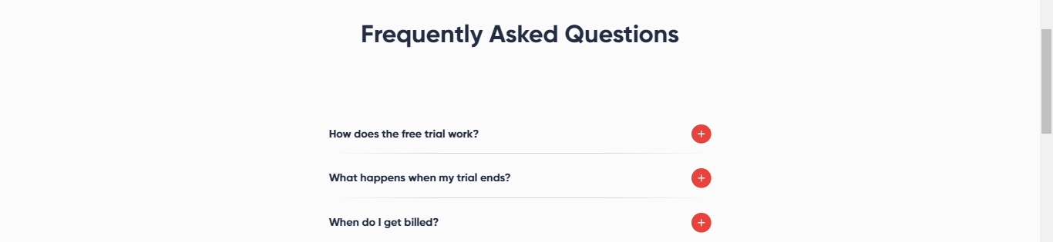
No. 6-HE-5.3 Related elements are grouped together
No. 6-HE- 5.3 | Good aspect
Name: Related elements are grouped together
Evidence: Heuristic: Recognition rather than recall Interface aspect: Related elements are presented together.

Slide 55
No. 6-HE-5.3 Related elements are grouped together
Explanation: Heuristic is met as related elements are grouped together, most of them are placed in appropriate subpages. User does not have to remember any information since it is all put together in a readable form.
Benefit: Rating: 3 - Major importance Justification: Frequency: This is rather often found on websites since it is easy to write as well as to read and makes the entire page more organized. All kinds of users are bound to benefit from it. Impact: This benefit is important, since users can find all information concerning one topic in the same place without need to search for different parts of the information around the website. Persistence: It is a persistent matter, as information grouped together helps every time the user is looking for it. Weights: We rated this as a major importance as it is a rather important and persistent case.
Possible Trade-offs: This benefit has no usable trade-offs we’re aware of.
Relationships: No. 6-HE-1.2, No. 6-HE-2.1, No. 6-HE-2.4, No. 6-HE-5.1

Slide 56
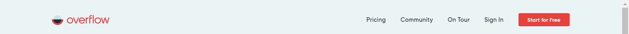
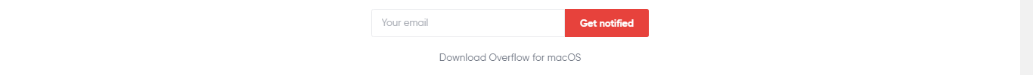
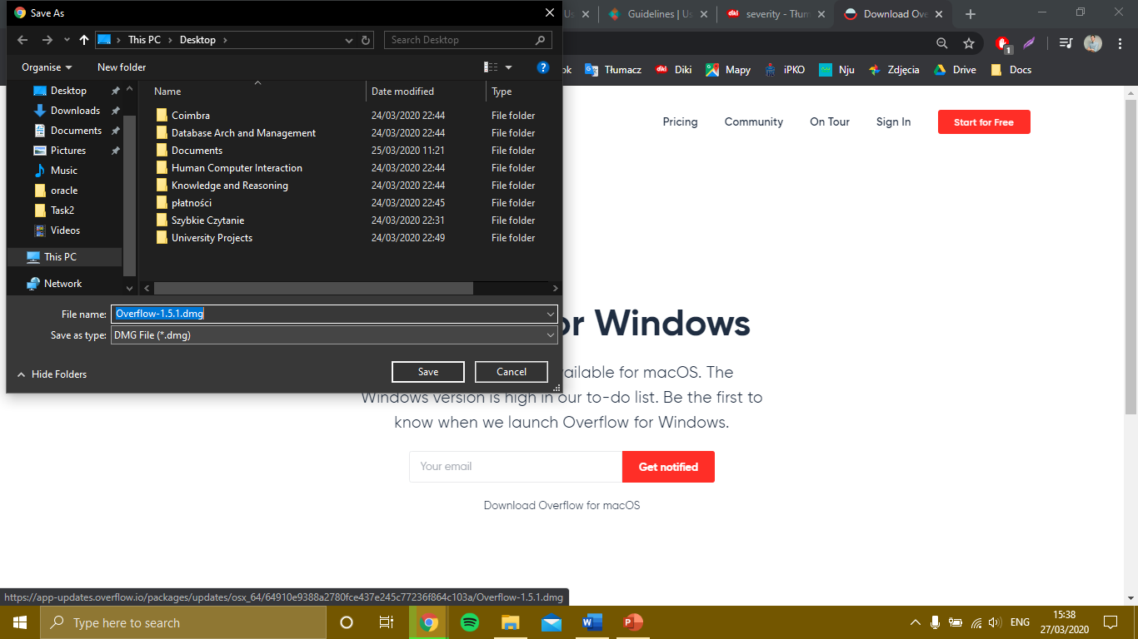
No. 6-HE-5.4 Low number of clicks and pages
No. 6-HE- 5.4 | Good aspect
Name: Low number of clicks and pages
Evidence: Heuristic: Aesthetic and minimalist design Interface aspect: The number of subpages is low and the number of buttons on each of them is also low.
Homepage
1.
“Start for free” subpage
2.
Downloaded file
3.

Slide 57
No. 6-HE-5.4 Low number of clicks and pages
Explanation: Heuristic is met as the number of subpages and the number of clicks required to navigate through the website is low. It allows users to familiarize with the website easier and see almost everything the website provides at once.
Benefit: Rating: 2 - Minor importance Justification: Frequency: This is not very often found on websites, most of them have lots of subpages. This benefit makes the website more clear and easy to follow. All kinds of users are bound to benefit from it. Impact: This benefit is not very important, since users can open different subpages in different search engine tabs and look at all the information. Persistence: This benefit is rather persistent since a clear and easily readable website is comfortable to use every time. Weights: We rated this as a minor importance as it is not very important case and very often impossible to use by designers if the website needs to have big amounts of information.
Possible Trade-offs: A possible trade-off would be to use cascading subpages which would prevent clutter in the navigation bar and guarantee a relatively small amounts of clicks necessary to access the desired information.
Relationships: No. 6-HE-3.1, No. 6-HE-2.3

Slide 58
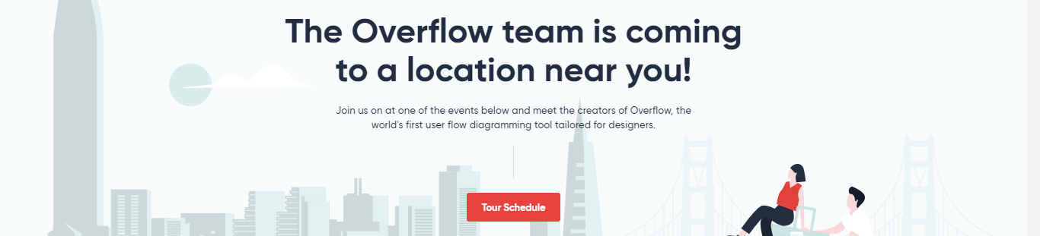
No. 6-HE-5.5 Only necessary information displayed
No. 6-HE-5.5 | Good aspect
Name: Only necessary information displayed
Evidence: Heuristic: Aesthetic and minimalist design Interface aspect: The amount of information displayed is small.

Slide 59
No. 6-HE-5.5 Only necessary information displayed
Explanation: Heuristic is met as the amount of displayed information is small and it is only the most necessary information. The website uses few “learn more” buttons and there is not much text.
Benefit: Rating: 3 - Major importance Justification: Frequency: This is not very often found on websites, most of them are packed with information that is not crucial. This benefit makes the website more readable and easy to use. Impact: This benefit is important as smaller amounts of text are easier to comprehend and read. Users are probable to get lost in the clutter of unnecessary information. Persistence: It is a persistent matter, as small amounts of only necessary information helps every time the user is looking for it. Weights: We rated this as a major importance as it is a rather important and persistent case.
Possible Trade-offs: This benefit has no usable trade-offs we’re aware of.
Relationships: No. 6-HE-1.2, No. 6-HE-1.4, No. 6-HE-5.1

