Slide 1
Gender Classification System
What is a GCS?
A GCS is a system designed to determine a person's gender, typically using biometric cues like facial features or voice (Guo, 2015).
Facial images are used to extract features and then a classifier is applied to the extracted features to learn a gender recognizer.
The gender classification result is often a binary value, e.g., 1 or 0, representing either male or female.
Gender recognition is essentially a two-class classification problem.
Although other biometric traits could also be used for gender classification, such as gait, face-based approaches are still the most popular for gender discrimination.

Slide 2




1
2
3
4
Data
ML
Train
Output

Slide 3


1
2
3
4
Input
200.000 pictures
Labeled by gender
ML
Data
Train
Output
MALE
FEMALE

Slide 4
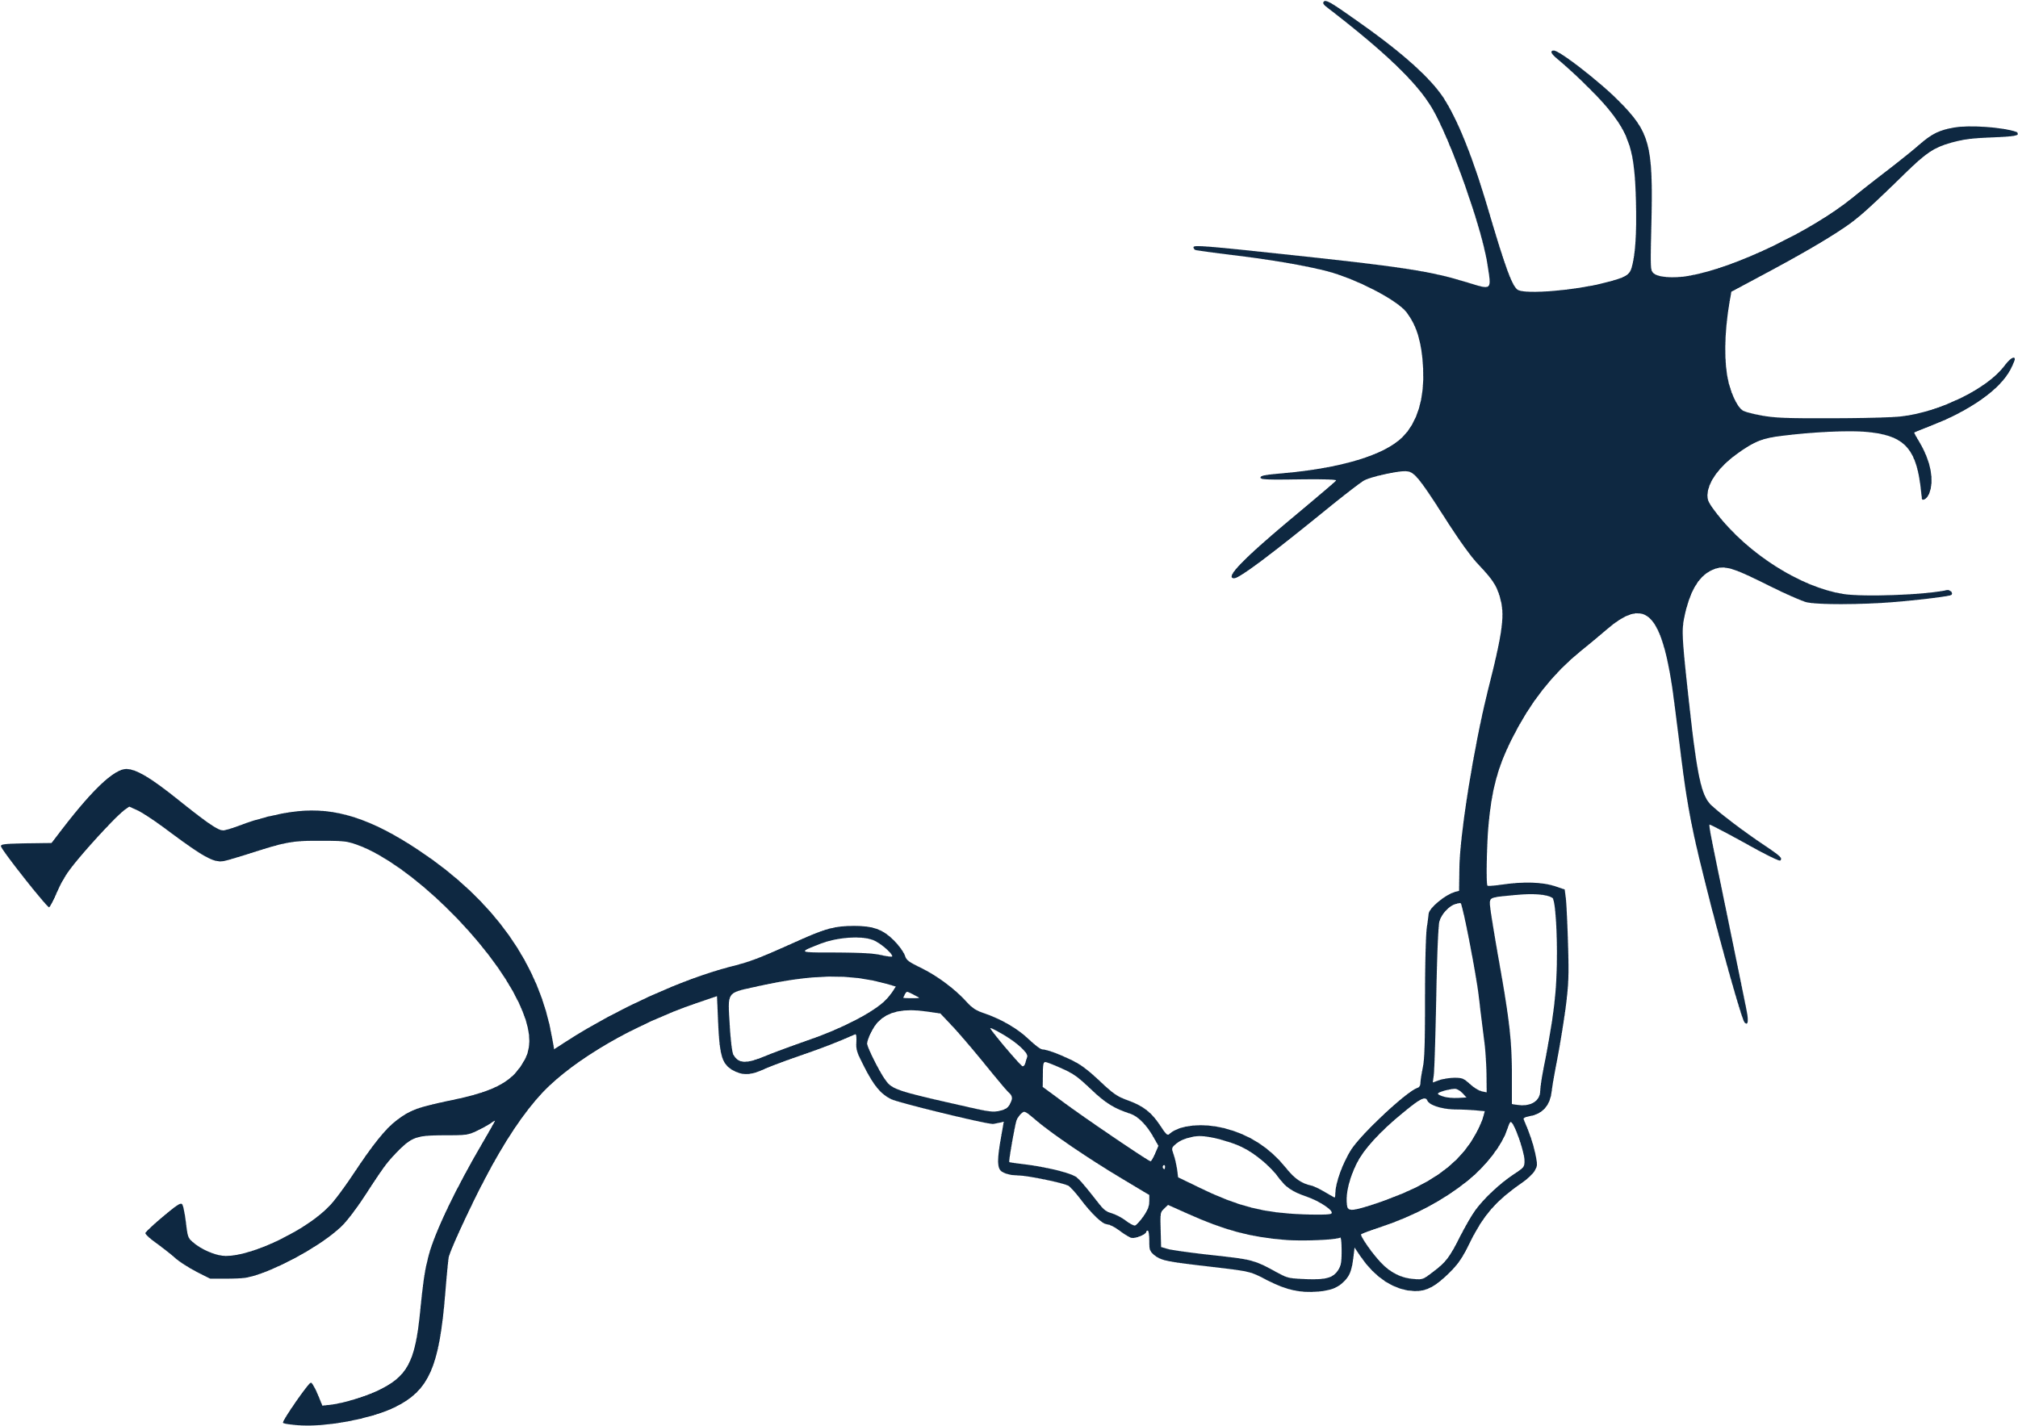
1
2
ML_{Machine Learning Algorithm}
  Supervised
  Neural network
3
4
Output
Data
ML
Train

Slide 5
1
2
3
4
Training process
  Split dataset
  Feature extraction
  Validation
  Accuracy
ML
Output
Data
Train

Slide 6
1
2
3
4
GCS_{Gender Classification System}
    The AI system is capable of classify the gender given a photo.
ML
Data
Train
Output

Slide 7
1
2
3
4
_{LET’S TAKE A LOOK!}
ML
Data
Train
Output

Slide 8
Let’s do an exercise!

Slide 9
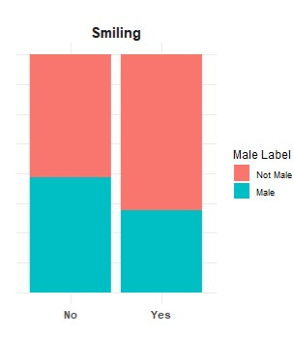
Exercise
Make groups of 5-6
Check the data used to train the algorithm
Anticipate the predicted gender and accuracy of the algorithm
Discuss the questions

Slide 10




Do you think it is possible to predict the outcome
of the AI system for the following images?
1
2
3
4

Slide 11
Why is this important?
Transparency High-Risk AI (Annex IV – Tech Docu.)
      where relevant, the data requirements in terms of datasheets describing the training methodologies and techniques and the training data sets used, including a general description of these data sets, information about their provenance, scope and main characteristics; how the data was obtained and selected; labelling procedures (e.g. for supervised learning), data cleaning methodologies (e.g. outliers detection);

Slide 12
Why is this important?
Biases (Recital 67)
      The data sets should also have the appropriate statistical properties, including as regards the persons or groups of persons in relation to whom the high-risk AI system is intended to be used, with specific attention to the mitigation of possible biases in the data sets, that are likely to affect the health and safety of persons, have a negative impact on fundamental rights or lead to discrimination prohibited under Union law, especially where data outputs influence inputs for future operations (feedback loops).
      Biases can for example be inherent in underlying data sets, especially when historical data is being used, or generated when the systems are implemented in real world settings.

Slide 13
References
Guo, G. (2015). Gender Classification. In: Li, S.Z., Jain, A.K. (eds) Encyclopedia of Biometrics. Springer, Boston, MA. https://doi.org/10.1007/978-1-4899-7488-4_9176

