Slide 1


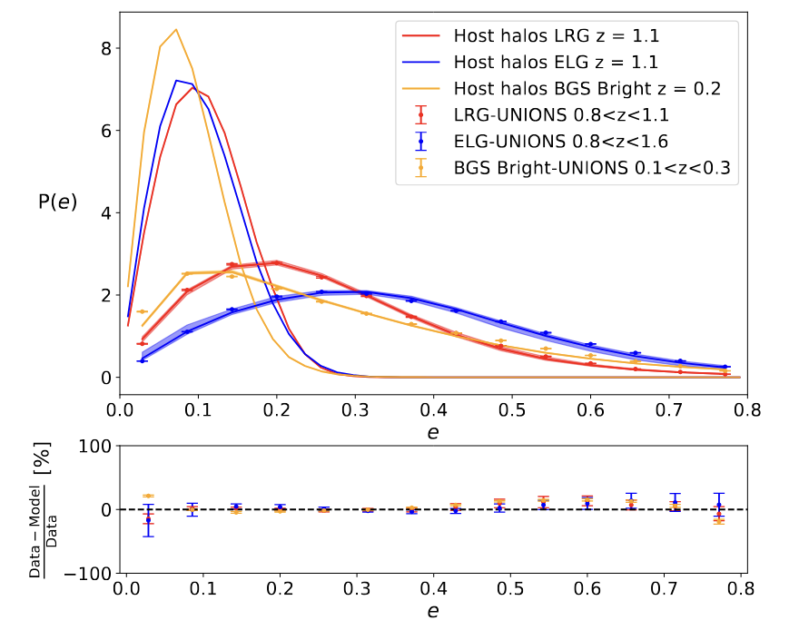
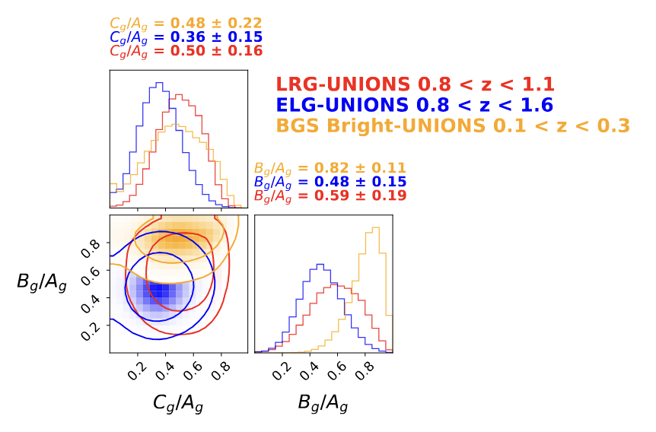
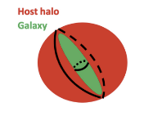
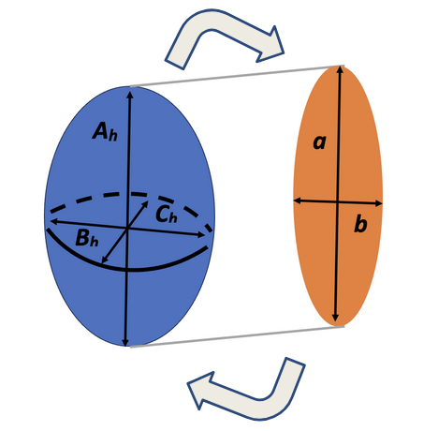
Inferring the 3D shapes of galaxies inside halos
with
Antonin Corinaldi,
CEA Paris-Saclay,
CosmoStat (France)
1
Context: galaxy-halo connection in 3D for intrinsic alignments
2
Methodology: simulation-based inference using a forward model of 3D shapes of galaxies in halos
3
Results: constraints on 3D shapes for 3 galaxy samples from the distributions of ellipticities of galaxies and halos
3
Takeaway: we can constrain the distribution of 3D shapes of galaxies from observations, using simulations.

