Slide 1
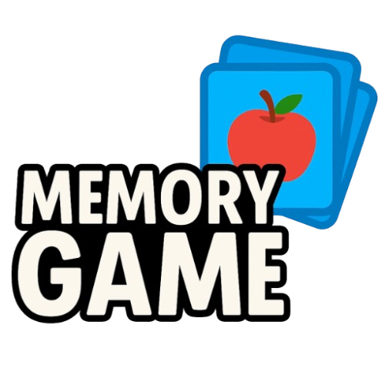

Slide 2
Have you ever dreamed of improving your memory?

Slide 3
With MemoryGame this is possible

Slide 4
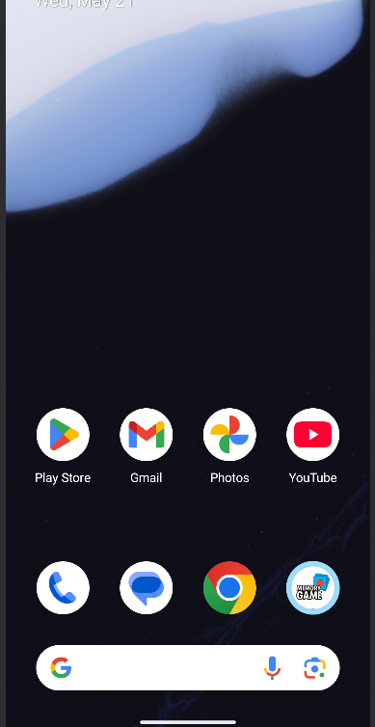

Slide 5
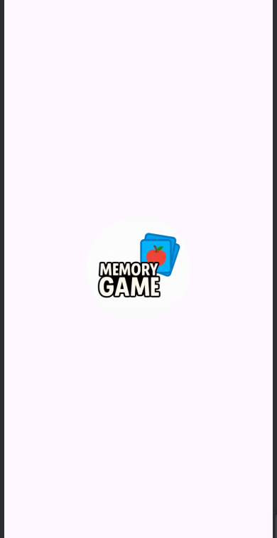

Slide 6
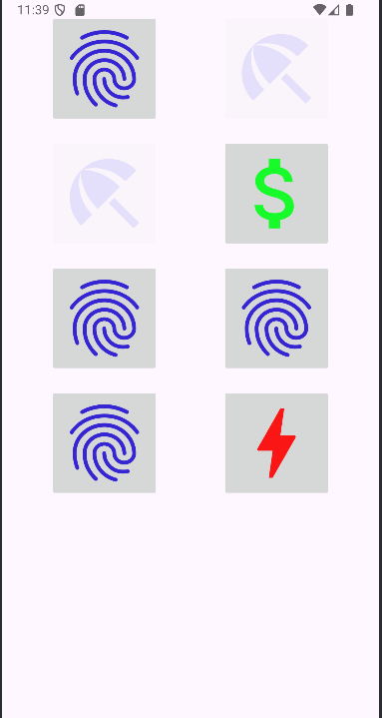

Slide 7
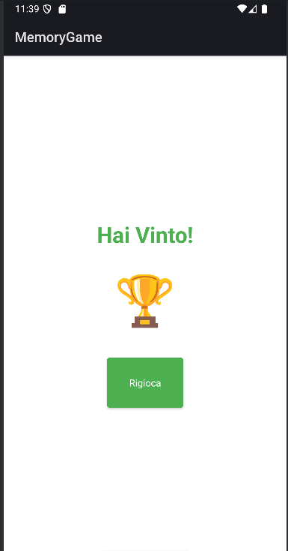

Slide 8
Future Implementations
Multiplayer Mode
More Level
Global/local ranking

Slide 9
This is

