Slide 1
POLITECNICO DI MILANO
ONLINE LEARNING PROJECT
Adaptive Budget Allocation for Online Advertising
Learning to bid under a hard budget as campaign scale and market dynamics evolve
Project team: Arbizzani Tonelli Antonio, Arisi Leonardo, Berra Claudia, Di Paolo Gaia.
A controlled study of learning, budget pacing, and adaptation
2026
Notes:
Buongiorno, presentiamo il progetto di Online Learning Applications sul budget-constrained online bidding. Un'agenzia pubblicitaria deve fare offerte in aste first-price round dopo round, imparando dal feedback delle aste e rispettando un budget limitato. La presentazione copre i quattro requisiti: per ognuno mostriamo la versione allineata ai lab, la diagnosi dei suoi limiti e un'estensione mirata, sempre a parità di ambiente e seed.

Slide 2



PROBLEM DEFINITION
Auction Model and Budget Constraint
First-price auction, each round
Utility and cost on a win
Global budget constraint
The highest competing bid for campaign i is the only uncertain quantity in the auction.
Higher bids win more often but earn less per win and spend more budget.
The initial spend rate is ρ = B/T. Effective learners must reconcile it with the remaining budget.
With multiple campaigns, the learner selects a super-action: one feasible bid per campaign subject to the conflict graph.
CONFLICT GRAPH
The investigation expands in scope:
1 to 4 campaigns
stochastic to changing markets
semi-bandit and full feedback
Notes:
Il modello è quello della consegna. A ogni round scegliamo una bid per campagna; per ogni campagna l'incertezza è riassunta dalla highest competing bid m. Se la nostra bid la supera vinciamo, otteniamo utility v meno b e paghiamo b: bid più alte vincono di più ma consumano più budget. Il vincolo di budget è globale sull'orizzonte, con rate per round rho uguale a B su T. Nei requisiti multi-campagna entra il conflict graph: campagne in conflitto non possono avere bid positive nello stesso round, quindi la scelta diventa una super-azione combinatoria.

Slide 3
EXPERIMENTAL DESIGN
Failure Diagnosis and Controlled Improvement
STEP 1
STEP 2
STEP 3
STEP 4
Reference learner
Failure diagnosis
Targeted intervention
Controlled ablation
Start from established methods: UCB, linear programs over distributions, Hedge, and online gradient descent.
Track regret, expenditure, selected bids, and policy evolution to identify the binding limitation.
Change only the component linked to the failure while keeping the environment and benchmark fixed.
Run the same environments and seeds while changing one component at a time.
Every comparison is paired. Baseline and revised learners see the same environment realizations, so the curves isolate algorithmic differences.
Notes:
Il metodo di lavoro è lo stesso per tutti e quattro i requisiti. Partiamo sempre da una versione lab-aligned, costruita con gli strumenti del corso. Poi guardiamo i risultati onestamente, non solo il numero finale ma il comportamento nel tempo, e individuiamo dove l'algoritmo è conservativo. Introduciamo quindi un'estensione mirata e minimale, dichiarando esplicitamente ogni metodo fuori corso. Infine ogni scelta è difesa con un'ablation a parità di ambiente e di seed: si cambia una cosa sola alla volta.

Slide 4
01
STAGE 1: SPARSE FEEDBACK
Single Campaign Under a Hard Budget
Two reference learners: budget-blind UCB1 and a budget-aware UCB learner whose action distribution comes from a linear program.
T = 5000
B = 125 → ρ = 0.025
v = 0.6
3 uniform competitors → P(win) = b³
discrete bid grid, b ≤ v
Stochastic clairvoyant: LP over bid distributions with true win probabilities, spend ≤ ρ. On this instance it mixes 96.6% on bid 0.4 — expected reward ≈ 0.0126 per round.
BENCHMARK
Notes:
Il requisito 1 è il caso più controllato: una sola campagna, ambiente stocastico. La highest competing bid è il massimo di tre competitor uniformi, quindi la probabilità di vincere con bid b è b al cubo: per bid basse le vittorie sono rare, e questo guiderà tutta la discussione. Budget 125 su 5000 round, quindi rho 0.025: il vincolo è attivo. Il benchmark è il clairvoyant del corso: un LP che conosce la distribuzione e mixa quasi tutto sul bid 0.4, con reward atteso circa 0.0126 per round. Il requisito chiede due algoritmi: UCB1 che ignora il budget e un'estensione UCB-like con il vincolo gestito da un LP.

Slide 5
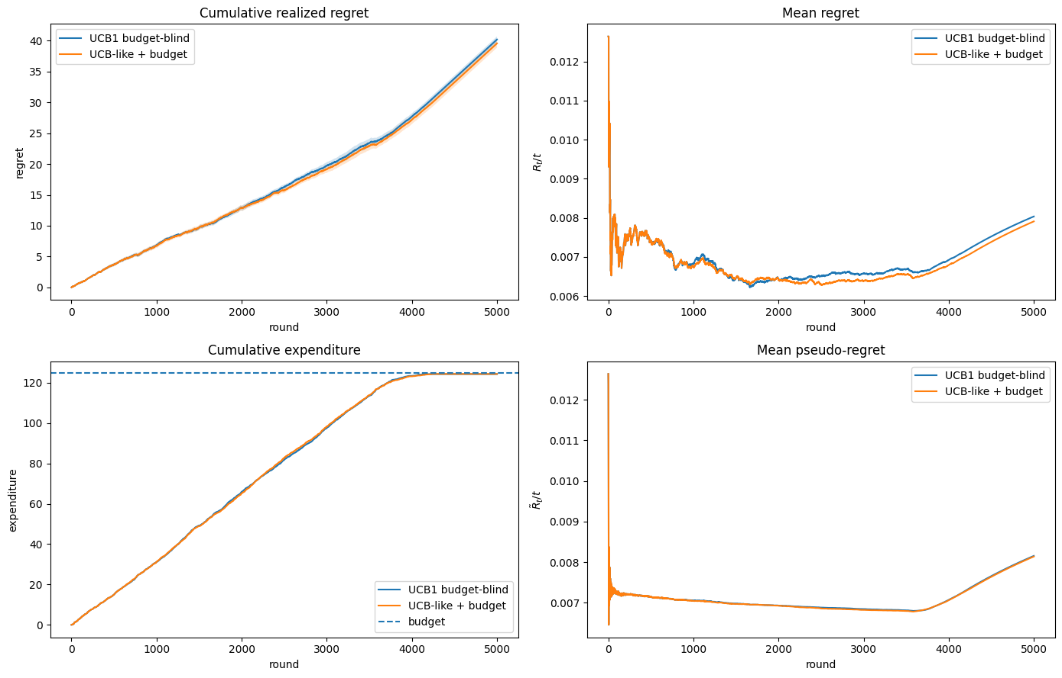
STAGE 1: FAILURE DIAGNOSIS
Wide Confidence Intervals Neutralize the Budget Constraint
40.2
39.6
final regret, UCB1 budget-blind
final regret, UCB-like + budget LP
Why the budget-aware learner behaves like UCB1
Hoeffding intervals stay wide for most of the horizon. The cost LCB often equals zero, so the LP treats many bids as nearly free.
Both learners exhaust the budget early, play the null bid in about one third of the rounds, and obtain about 36% of the clairvoyant reward.
Budget estimation is the binding limitation.
Notes:
Questo è il risultato onesto della versione base: le curve dei due learner sono quasi sovrapposte, regret finale 40.2 contro 39.6. Non è un errore: è il comportamento atteso. Gli intervalli di Hoeffding su reward e costo restano larghi per tutto l'orizzonte, e il lower bound sul costo viene troncato a zero perché i costi non possono essere negativi. Quindi il vincolo dell'LP è quasi sempre non informativo e il learner budgeted collassa su UCB1. Entrambi esauriscono il budget prima della fine, giocano bid nulla in circa un terzo dei round e chiudono al 36 percento del clairvoyant. La diagnosi: il collo di bottiglia non è la stima dei reward ma la gestione del budget.

Slide 6

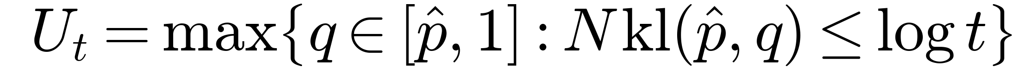

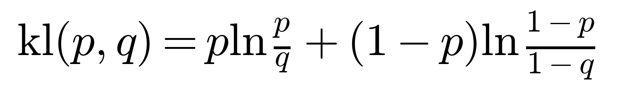
S1: INTERVENTION
A Bernoulli Model Makes Rare Wins Learnable
1 WIN PROBABILITY
2 KL CONFIDENCE BOUND
3 AFFORDABILITY FILTER
At a fixed bid, one Bernoulli outcome determines both reward and cost. We estimate its probability and derive both quantities from it.
KL bounds replace Hoeffding bounds and tighten faster when winning probabilities are small.
The LP considers a bid only when the remaining budget can pay for it. Bid 0 remains the zero-cost action.
KL measures the discrepancy between two Bernoulli rates. Its geometry yields tighter upper bounds near zero and one.
BERNOULLI KL DISTANCE
Relevant win probabilities are small: P(win) = b³ is 0.027 at b = 0.3 and 0.064 at b = 0.4. Hoeffding optimism saturates and can rank bids in the wrong order. The Bernoulli KL interval concentrates faster near zero.
WHY KL FITS THIS AUCTION
CONTROLLED VARIABLES
same LP and fixed ρ = B/T
same environments and seeds
dynamic pacing tested with no material effect
Notes:
L'estensione cambia solo il learner budgeted, in tre punti. Primo: a bid fissata, reward e costo dipendono solo dall'esito binario dell'asta, quindi stimiamo una cosa sola, la probabilità di vittoria, e ricaviamo reward e costo attesi. Il feedback è esattamente Bernoulli. Secondo: sostituiamo Hoeffding con il bound KL, che dichiariamo come metodo fuori corso. Il punto è che le probabilità rilevanti sono piccole, 0.027 a bid 0.3, e lì Hoeffding satura a uno: il reward ottimista ordina le bid al contrario. Il bound KL sfrutta la varianza Bernoulli che va a zero vicino agli estremi e si stringe proprio dove serve. Terzo: filtro di pagabilità, una bid è giocabile solo se il budget residuo la copre. Tutto il resto, LP, rho fisso, seed, è invariato. Avevamo provato anche il pacing dinamico: qui non cambia nulla e lo abbiamo tolto per tenere la modifica minima.

Slide 7
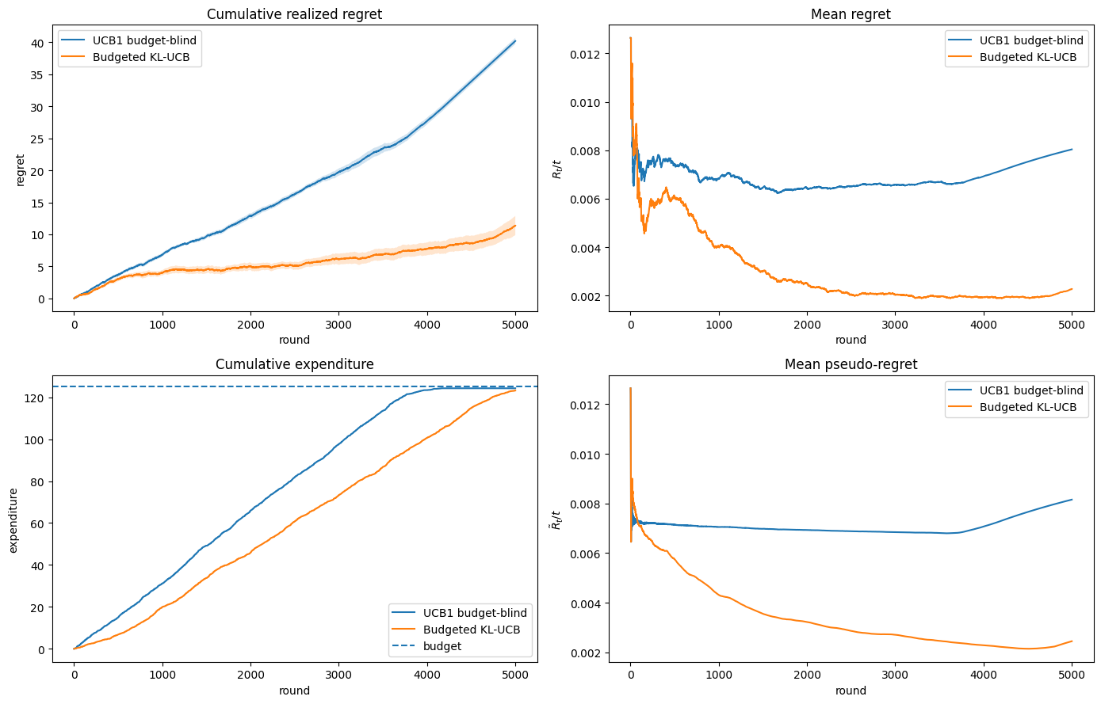
STAGE 1: EVIDENCE
KL Confidence Bounds Reduce Final Regret to 11.4
40.2
11.4
→
final regret
82%
123 / 125
of clairvoyant reward (was 36%)
budget used while preserving affordability
ABLATION WITH MATCHED SEEDS
KL: regret 11.4 and spend 123/125. Hoeffding: regret 35.7 and spend 45/125. Loose optimism keeps selecting low bids that rarely win.
Notes:
Il cambio di comportamento è netto. Il regret finale passa da 40.2 a 11.4, dal 36 all'82 percento del clairvoyant. La spesa segue il budget fino a fine orizzonte, 123 su 125, e la distribuzione delle bid si concentra attorno alla mixture del clairvoyant: bid 0.4 giocata in circa metà dei round. L'ablation risponde alla domanda naturale: il guadagno viene dal bound o dal filtro? A parità di tutto, cambiando solo il bound, KL chiude a 11.4 mentre Hoeffding a 35.7 e spende solo 45 su 125: insiste su bid troppo basse, vince poco e non riesce a spendere. Il driver è il bound KL. Il risultato è stabile ripetendo l'esperimento con T mille, tremila e cinquemila a parità di rho.

Slide 8
02
STAGE 2: COMBINATORIAL SCALE
Shared Budget Across Multiple Campaigns
Each round selects one feasible bid profile over the conflict graph. Semi-bandit feedback reveals outcomes for selected campaign-bid pairs.
4 campaigns · v = (0.95, 0.85, 0.78, 0.90)
T = 3000 · B = 700 → ρ ≈ 0.233
conflict chain 0–1–2–3
33 atomic arms · 250 super-actions
Beta marginals + 30% common factor → corr ≈ 0.3
BENCHMARK
Clairvoyant LP over feasible super-actions with true expected reward and cost under the average budget rate ρ = B/T.

Slide 9
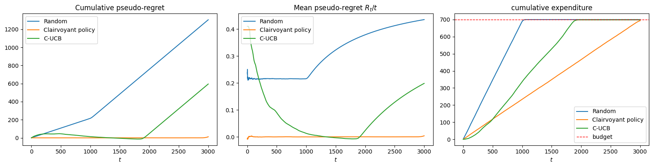
STAGE 2: FAILURE DIAGNOSIS
The Learner Finds Good Actions but Spends Too Early
MID-HORIZON
t ≈ 1900
FINAL
Pseudo-regret stays near zero. The action estimates are already accurate.
Cost lower bounds understate expenditure. The learner exhausts the budget near round 1900 and then selects only the null action.
Final pseudo-regret reaches about 595, compared with 0.435 per round for the random policy. Maximum spend remains 699/700.

Slide 10


S2: INTERVENTION
Empirical Costs Align Spending with the Horizon
1 WIN PROBABILITY PER ARM
2 KL BOUND FOR WIN PROBABILITY
One Bernoulli estimate for each campaign and bid. Semi-bandit feedback supports an independent update for every selected arm.
KL bounds improve the ranking of campaign-bid pairs with small winning probabilities.
3 EMPIRICAL COST IN THE LP
4 DYNAMIC PACING
The LP uses the unbiased empirical cost estimate. The ablation isolates its effect on early expenditure.
The spend cap becomes remaining budget divided by remaining rounds. The LP also excludes unaffordable super-actions.
The linear program remains unchanged. Only its statistical estimates and budget cap change.

Slide 11
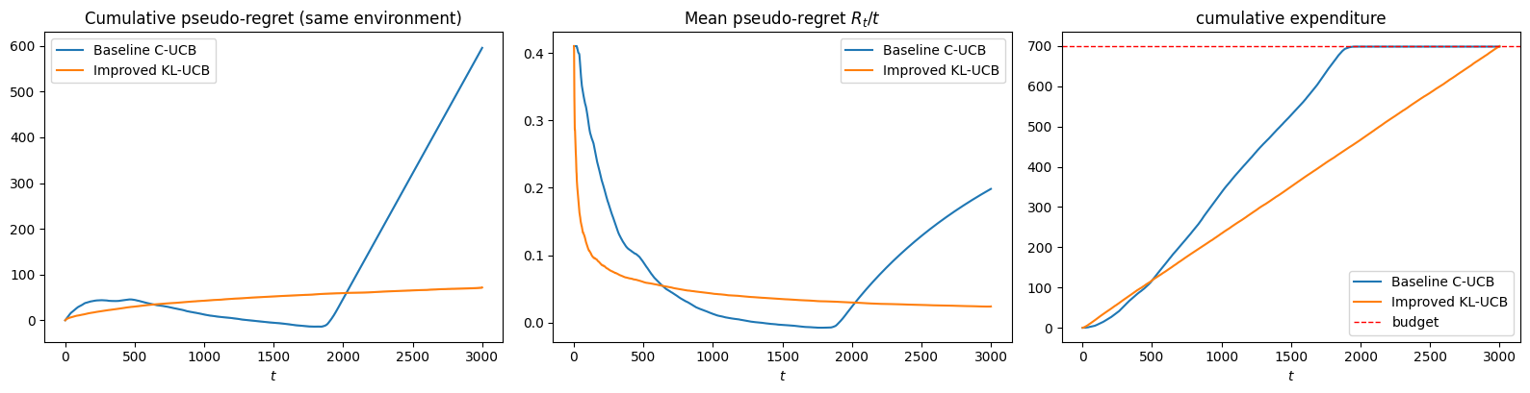
STAGE 2: EVIDENCE
Dynamic Pacing Extends Strong Performance to the Horizon
≈ 595
96%
0.024
→
≈ 72
final pseudo-regret with matched seeds
of the oracle’s expected reward
regret per round at the horizon, still decreasing

Slide 12
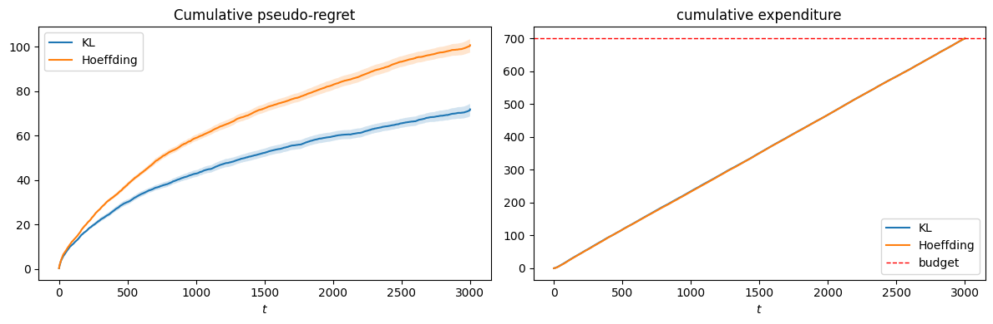
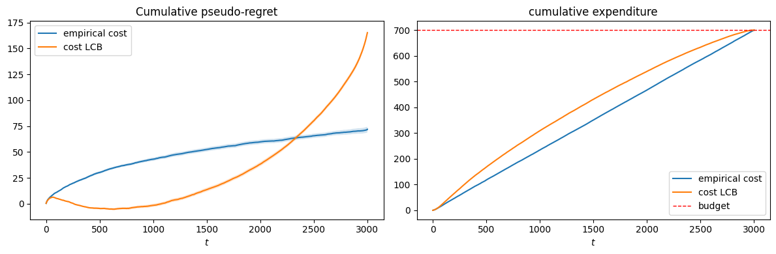
S2: ABLATION
Confidence and Cost Estimates Produce Separate Gains
72 vs 101
KL versus Hoeffding. Only the confidence bound changes, and KL ranks small-probability arms more accurately.
72 vs 165
Empirical cost versus cost LCB. The LCB spends 241 by T/4 instead of 177, and its early advantage disappears before the horizon.

Slide 13
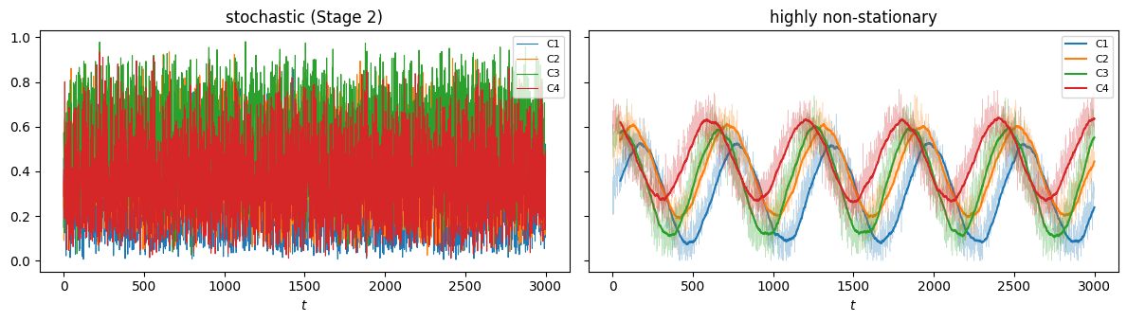
03
STAGE 3: ADAPTIVE BUDGET PRICE
Primal-Dual Budget Control
The same combinatorial bidding instance now provides full feedback. After each round, thresholds reveal reward and cost for every super-action.
Stochastic: Beta marginals + common factor
Highly non-stationary: oblivious fast sinusoids + small noise
T = 3000 · B = 700 · 250 super-actions
Hard budget enforcement
Best fixed distribution in hindsight under the expected budget constraint. We compare against full OPT, a stricter target than ρ times OPT in the adversarial guarantee.
BENCHMARK

Slide 14
STAGE 3: FAILURE DIAGNOSIS
Conservative Normalization Leaves Budget Unused
PRIMAL LEARNER: HEDGE ON 250 SUPER-ACTIONS
0.249 / 0.222
regret/T — stochastic / non-stationary (random: 0.436 / 0.391)
DUAL LEARNER: PROJECTED OGD, λ ∈ [0, 1/ρ]
569 / 558
spend out of 700 with no violations
REFERENCE LEARNING RATES
DIAGNOSIS
The learner beats the random policy in both regimes, but wide normalization makes its updates small and leaves budget unused.
Hedge needs losses in [0,1], but the Lagrangian contains a changing dual variable. Fixed worst-case normalization creates a range near 11 and reduces the effective update size.

Slide 15

S3: INTERVENTION
Calibrated Learning Rates Improve Budget Use
1 RATES CALIBRATED TO THE UPDATE RANGE
2 PER-ACTION BUDGET CHECK
Only an unaffordable sampled action is replaced with the null action. Affordable actions remain available.
Hedge updates only on the action-dependent part of the Lagrangian. Learning rates follow the theoretical bounds for the resulting Hedge and OGD ranges.
Declared asymmetry: Hedge and the dual still update on the proposed x t , while the budget decreases with the cost of the executed action.
Override frequency is ≈ 0 in both regimes.
The dual variable already prices overspending. It rises when average expenditure exceeds ρ and reduces the appeal of costly actions.
DUAL VARIABLE AS PACING
The ablation attributes the observed gain to calibrated learning rates. The per-action check provides a cleaner safety rule but has negligible empirical effect on this instance.

Slide 16
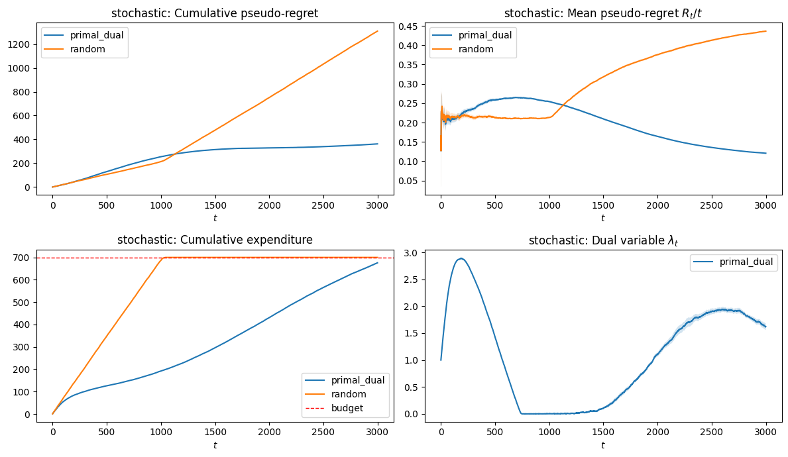
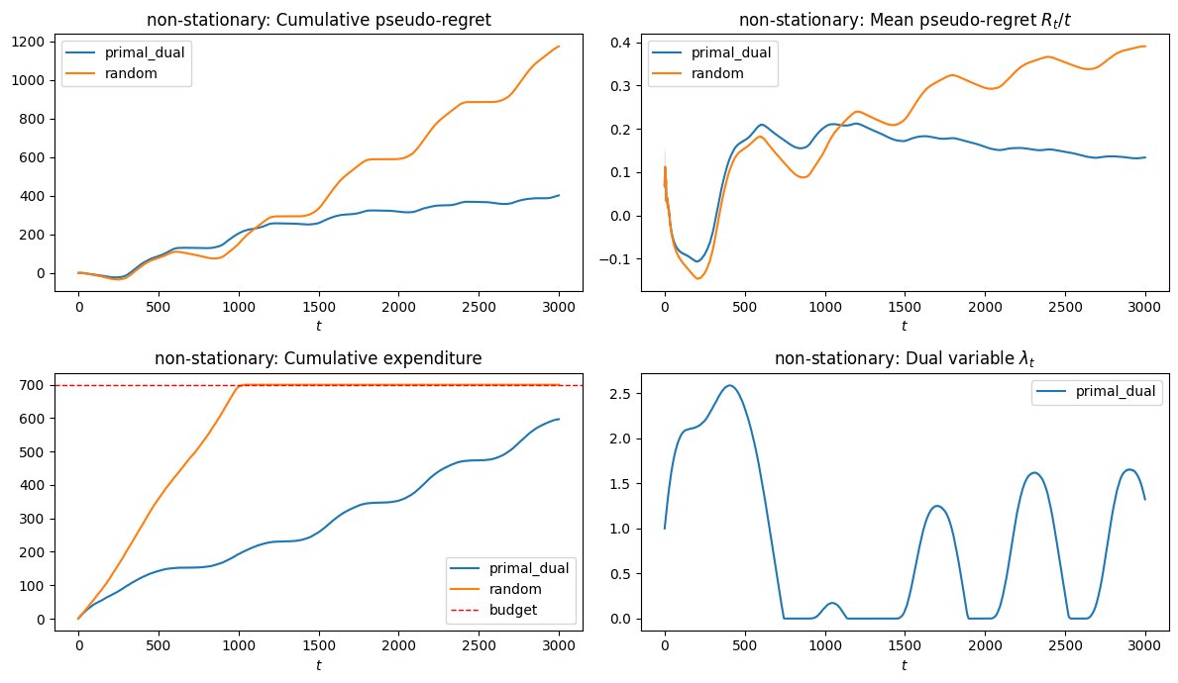
S3: EVIDENCE
Calibrated Rates Improve Both Regimes
STOCHASTIC
HIGHLY NON-STATIONARY
0.249
→
0.121
0.222
→
0.134
569→676 · 558→597
regret/T, stochastic
regret/T, non-stationary
spend out of 700 with no violation

Slide 17
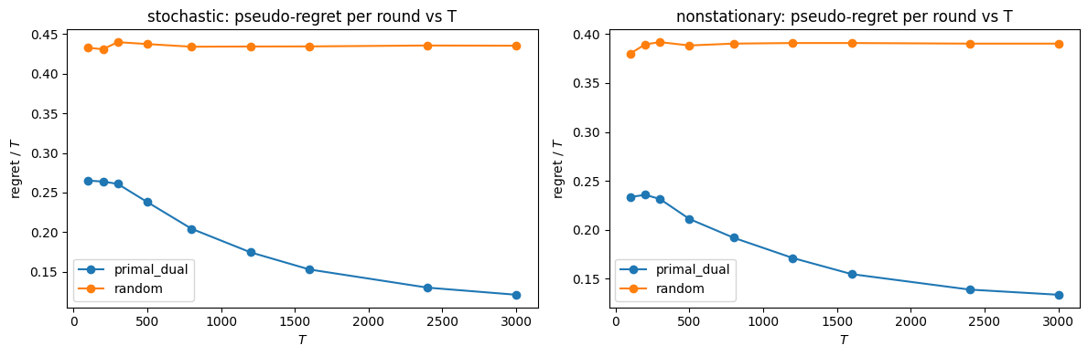
STAGE 3: ROBUSTNESS
Regret per Round Decreases with the Horizon
0.27 → 0.12
0.23 → 0.13
regret/T as T grows, stochastic — consistent with sublinear regret
regret/T as T grows, non-stationary — same algorithm, same constants
Across horizons from 100 to 3000, primal-dual regret per round decreases in both environments while the random policy stays high and nearly flat.

Slide 18
04
STAGE 4: MARKET DRIFT
Budgeted Learning in a Changing Auction Market
The combinatorial learners now face three market regimes. Sliding windows and change detection compete with the full-feedback primal-dual method as profitable campaigns change over time.
HORIZON
BUDGET
ALGORITHMS
BENCHMARK
T = 3000
B = 560
SW Combinatorial-UCB CUSUM Combinatorial-UCB Primal-dual (full feedback)
≈ 1229
3 equal segments, L = 1000, 2 known change points (Υ T = 2).
First-price auctions, 4 campaigns, ρ = B/T ≈ 0.187.
segment-local oracle: one LP per segment, same ρ per round.

Slide 19




STAGE 4: MARKET STRUCTURE
Piecewise-Stationary Market
The cheapest campaign rotates at every change point:
T = 3000 · 3 segments · B = 560
One bid per campaign each round, from a grid of 8 values , denser on low bids (step 0.10, then 0.15).
SEGMENT 1
t = 1–1000
cheapest: C1
Conflict chain C1–C2–C3–C4: adjacent campaigns cannot both bid → 168 super-actions, 27 positive arms.
SEGMENT 2
t = 1001–2000
Each campaign has a hidden threshold , fixed within a segment, new at each change point.
cheapest: C2
Win where
, pay the bid (first price): utility
, cost
.
SEGMENT 3
t = 2001–3000
All campaigns draw from a shared budget B = 560, ρ = B/T ≈ 0.187 per round.
cheapest: C3
distributions of mi · x: 0 to 1
C1
C2
C3
C4

Slide 20
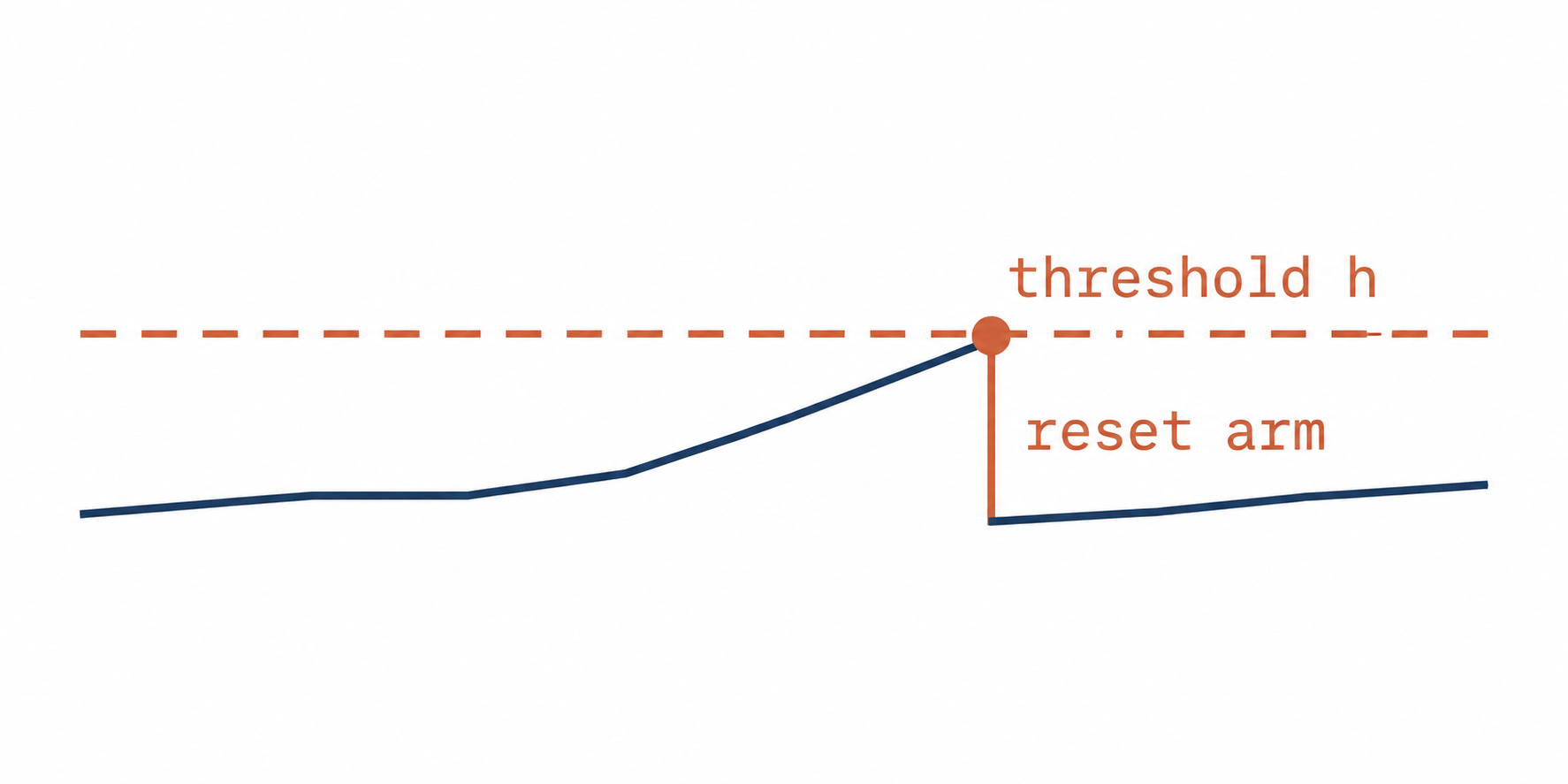
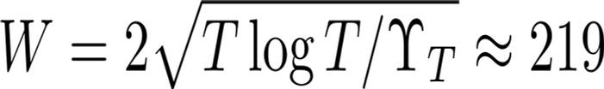
S4: ADAPTATION
Three Ways to Handle Stale Information
Hyperparameters follow analytical formulas. The number of change points is known.
FORGETS BY CONSTRUCTION
DETECTS, THEN RESETS
NEVER FORGETS
SW-UCB
CUSUM-UCB
Primal-dual
discarded
window W
· Hedge on K = 168 super-actions, full feedback
· OGD on the dual λ (budget price)
· gains normalized in [0,1], per-action budget stop
· cache of the last W rounds only
· bonus computed with log W
· arm unseen in window: one forced pull
· M reference samples per arm → mean
· statistic accumulates deviations; over h → arm reset
· α-exploration keeps arms monitored
Both UCB learners send reward UCBs and cost LCBs to an LP over feasible super-actions with a fixed cap ρ = B/T.
SHARED DECISION LAYER

Slide 21
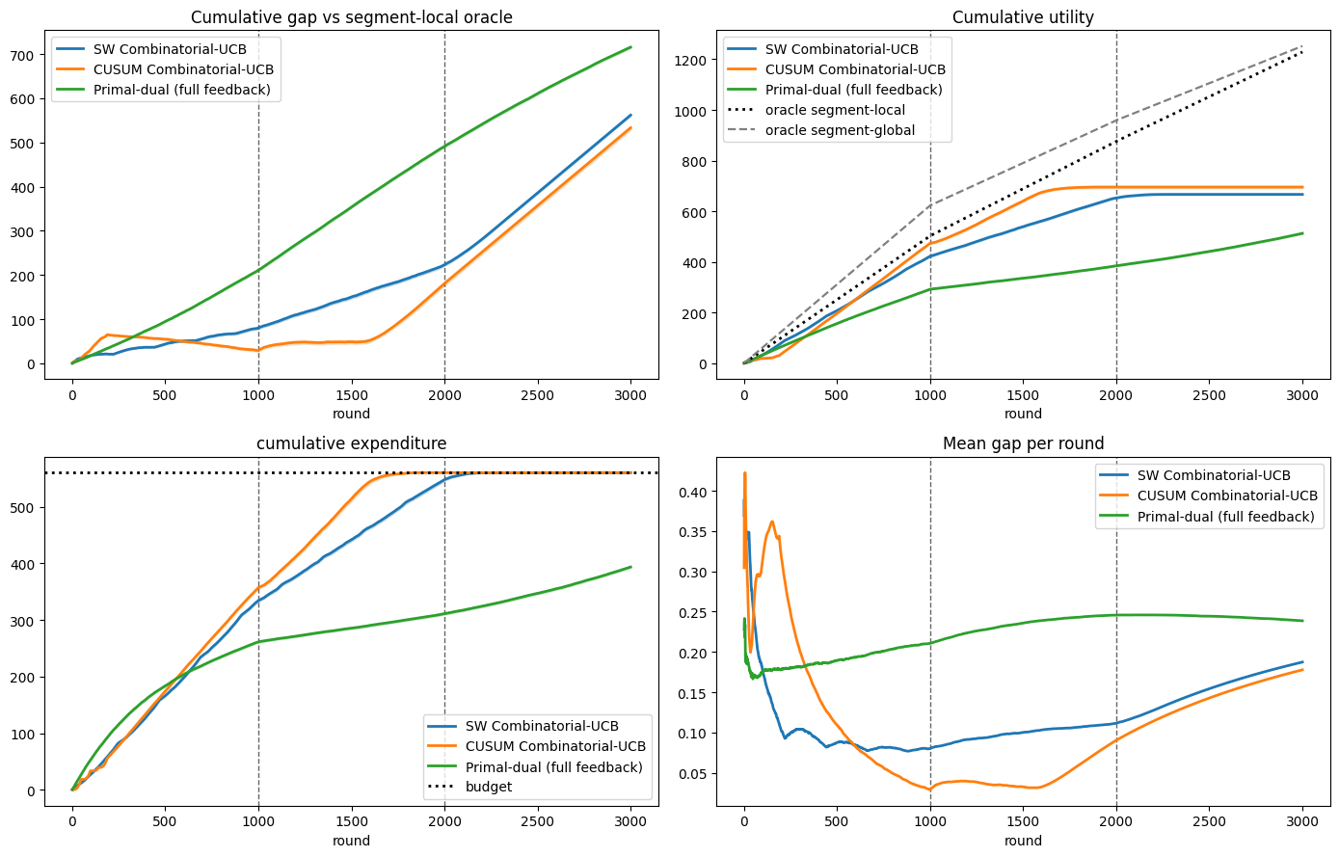
STAGE 4: FAILURE DIAGNOSIS
Early Spending Limits Relearning After Change Points
30 trials · final gap vs segment-local oracle ≈ 1229
SW-UCB
562
CUSUM-UCB
533
Primal-dual
716
PROBLEMS TO FIX
① both UCBs spend all of B, but too early : cost LCB understates costs, fixed ρ never corrects
② primal-dual leaves 167 of 560 unused : infinite memory, conservative
③ CUSUM fires ~18 resets vs 54 reference : too few samples per arm to reach h ≈ 14.6 (no hand-tuning of h)
Mean over 30 trials, shaded SEM · dashed lines: change points · dotted: oracles and budget.

Slide 22



S4: INTERVENTION
Memory and Pacing Preserve Future Capacity
Same environments, benchmarks, and seeds
01 · WIDER WINDOW
02 · EMPIRICAL COST
03 · DYNAMIC PACING
· half a segment: widest window that stays comfortably stationary
· more samples per arm in the combinatorial setting
· derived from known quantities, not tuning
· replaces the cost LCB in the LP
· fixes the early budget exhaustion
· LP cap = remaining budget / remaining rounds
· recovers spend drift around change points
ablation, 30 trials each: gap 496 → 417 vs W = 219
Supported by the multi-campaign ablation: pseudo-regret 72 versus 165
Same pacing rule as the multi-campaign stage
CUSUM DETECTOR UNCHANGED: only the decision layer changes through empirical cost and dynamic pacing.
PRIMAL-DUAL UPDATED: each method enters the comparison with its calibrated learning rates.

Slide 23
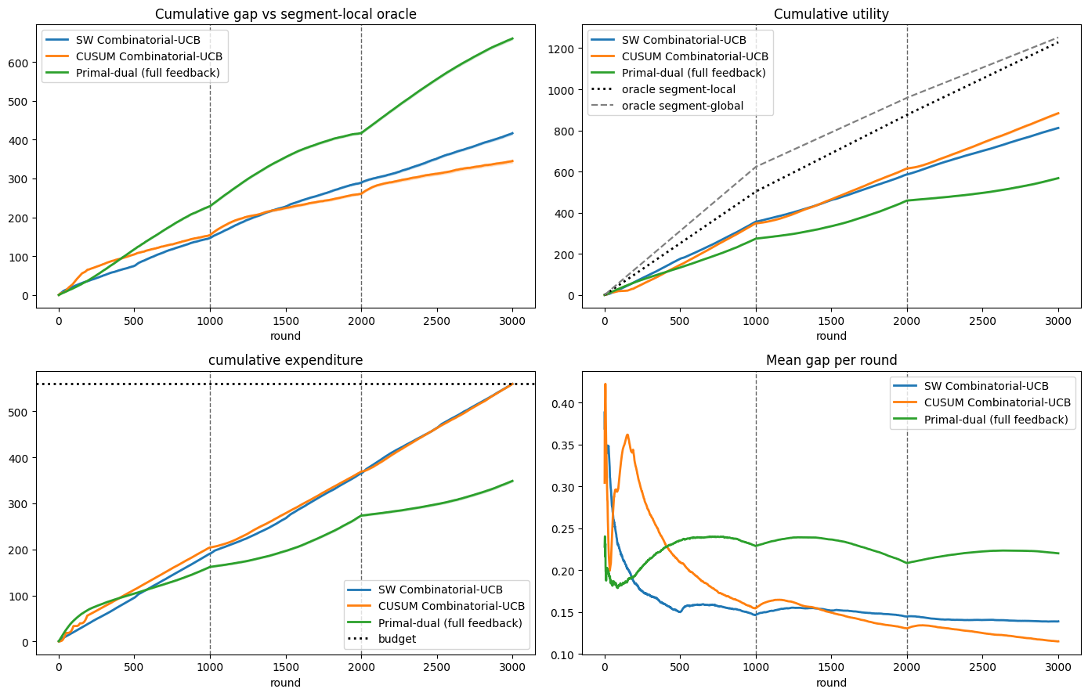
STAGE 4: EVIDENCE
CUSUM-UCB Reaches the Lowest Final Gap
30 trials with matched seeds. Every trial respects the budget.
FINAL GAP, BASELINE → IMPROVED
CUSUM-UCB
533 → 345
best method because resets concentrate near the true change points
SW-UCB
562 → 417
wider window, empirical cost, dynamic pacing
Primal-dual
716 → 660
calibrated rates, with 211 of 560 left unused
Light bar: baseline · solid bar: improved · scale up to 716.
Empirical cost and pacing extend spending to the horizon. The wider window supplies more observations per arm. CUSUM resets rise from about 18 to 32 per trial.

Slide 24
CROSS-STAGE SYNTHESIS
CUSUM-UCB Leads Under Market Drift
Average gap per round for the revised learners
0.115
0.139
0.220
CUSUM-UCB: active resets refresh statistics after each change
SW-UCB: passive forgetting pays a fixed variance cost
Primal-dual: 0.239 with the reference rates
WHAT THE COMPARISON SHOWS
LIMITATIONS
· CUSUM-UCB finishes slightly ahead of SW-UCB and clearly ahead of primal-dual.
· The primal-dual benchmark is a best fixed distribution and does not track segment-specific policies.
· Calibrated rates reduce the primal-dual gap, but 211 of 560 remain unused.
· A windowed primal-dual variant improves on full memory but still trails both UCB learners.
· CUSUM reacts slowly when observations are divided across many arms.
· A segment-global oracle can move budget across regimes, which no online learner can reproduce without future information.
· Repeated exploration after each change creates a persistent gap that grows with the number of arms.

Slide 25
POLITECNICO DI MILANO
ONLINE LEARNING PROJECT
Adaptive Budget Allocation
Arbizzani Tonelli Antonio · Arisi Leonardo · Berra Claudia · Di Paolo Gaia
github.com/antonioarbizzanitonelli

