Slide 1
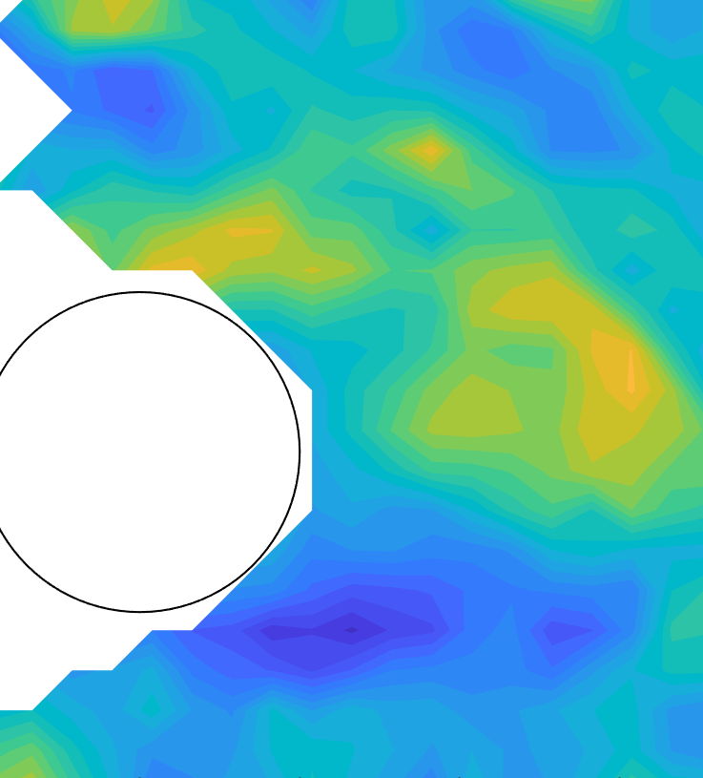
MSC MATHEMATICAL ENGINEERING · A.Y. 2025/26
Verification and validation
of fluid flows
Numerical analysis of internal flows
and experimental characterisation of a circular-cylinder wake
Antonio Arbizzani Tonelli

Slide 2
OVERVIEW
02
Project at a glance
Numerical and experimental study of two canonical flows, organised as a verification and validation chain. Every reported quantity is tied to a reference solution or measurement, and an explicit error metric.
LAMINAR PIPE · VERIFICATION
TURBULENT PIPE · VALIDATION
CYLINDER WAKE · SHEDDING
CYLINDER FORCES · UNCERTAINTY
St 0.18–0.20
1.24%
0.082%
1.50 ± 0.08
Identified independently from PSV velocity and lift force
Pressure-gradient error against Hagen–Poiseuille; profile error 3.18%
Friction-factor error of standard k– ε at Re_{b} = 75,000
Mean drag coefficient with first-order standard uncertainty
METHODS
RANS CFD (PHOENICS) · grid-sensitivity analysis · particle-shadow velocimetry · spectral analysis · load-cell calibration · uncertainty propagation · MATLAB data processing

Slide 3
OBJECTIVE
03
Research objective
Establish a traceable verification and validation chain for numerical pipe flow and experimental cylinder-wake measurements.
CASE 1 · INTERNAL FLOW
CASE 2 · SEPARATED FLOW
Pipe flow, CFD
Cylinder wake, experiment
Regimes
Laminar, Re_{b} = 193 · turbulent, Re_{b} = 75,000
Regime
Unsteady wake, Re_{D} ≈ 10⁴
Reference
Hagen–Poiseuille solution; measured profiles and friction factor
Reference
No closed-form solution: calibrated measurement chain
Test
Verification of the solver, validation of four k–ε closures
Test
Characterisation of the wake with quantified uncertainty
Compared
Velocity profile, pressure gradient, Darcy friction factor
Compared
Mean field, Strouhal number, force coefficients

Slide 4
PROBLEM
04
Verification and validation framework
NUMERICAL · PHOENICS PIPE FLOW
EXPERIMENTAL · FLUME, CIRCULAR CYLINDER
1
2
3
4
5
Grid sensitivity
Analytical verification
Model validation
Measurement calibration
Wake characterisation and uncertainty
Relative profile difference
Velocity RMSE and friction factor
Poiseuille profile and pressure gradient
Force residual
Strouhal number and force coefficients
Verification — does the solver reproduce a known solution?
Validation — does the model reproduce measurements?
Grid sensitivity — necessary, but not proof of physical accuracy.

Slide 5
PART I
Internal flow CFD
Grid sensitivity, analytical verification of laminar flow, and validation of four k–ε closures against turbulent pipe measurements.
06 Numerical setup
07 Laminar grid
08 Turbulent grid
09 Laminar development
10 Poiseuille profile
11 Pressure gradient
12 Turbulent development
13 Turbulent structure
14 Wall scaling
15 Profile validation
16 Friction factor

Slide 6
I · INTERNAL FLOW · CFD
06
Numerical setup
Parameter
Laminar
Turbulent
Grid sensitivity, successive grids
Diameter D
0.15 m
0.10 m
ε_{i,i+1} = ‖φ_{i}^{int} − φ_{i+1}‖∞ / ‖φ_{i+1}‖∞
Bulk velocity W_{b}
0.45 m/s
0.75 m/s
Developed flow
Kinematic viscosity ν
3.5·10⁻⁴ m²/s
10⁻⁶ m²/s
ε_{p}(z) = ‖W(r,z) − W_{ref}(r)‖∞ / ‖W_{ref}‖∞ ≤ 10⁻³
Re_{b} = W_{b}D/ν
192.9
75,000
Darcy friction factor
Closure
—
4 k–ε models
f = 8τ_{w} / (ρW_{b}²)
Axisymmetric pipe solved with PHOENICS. Turbulent closures: standard, RNG, realisable and low-Re k–ε . The comparison is specific to the implemented grids and wall treatments.
Profile validation
Normalised RMSE on experimental radial coordinates

Slide 7
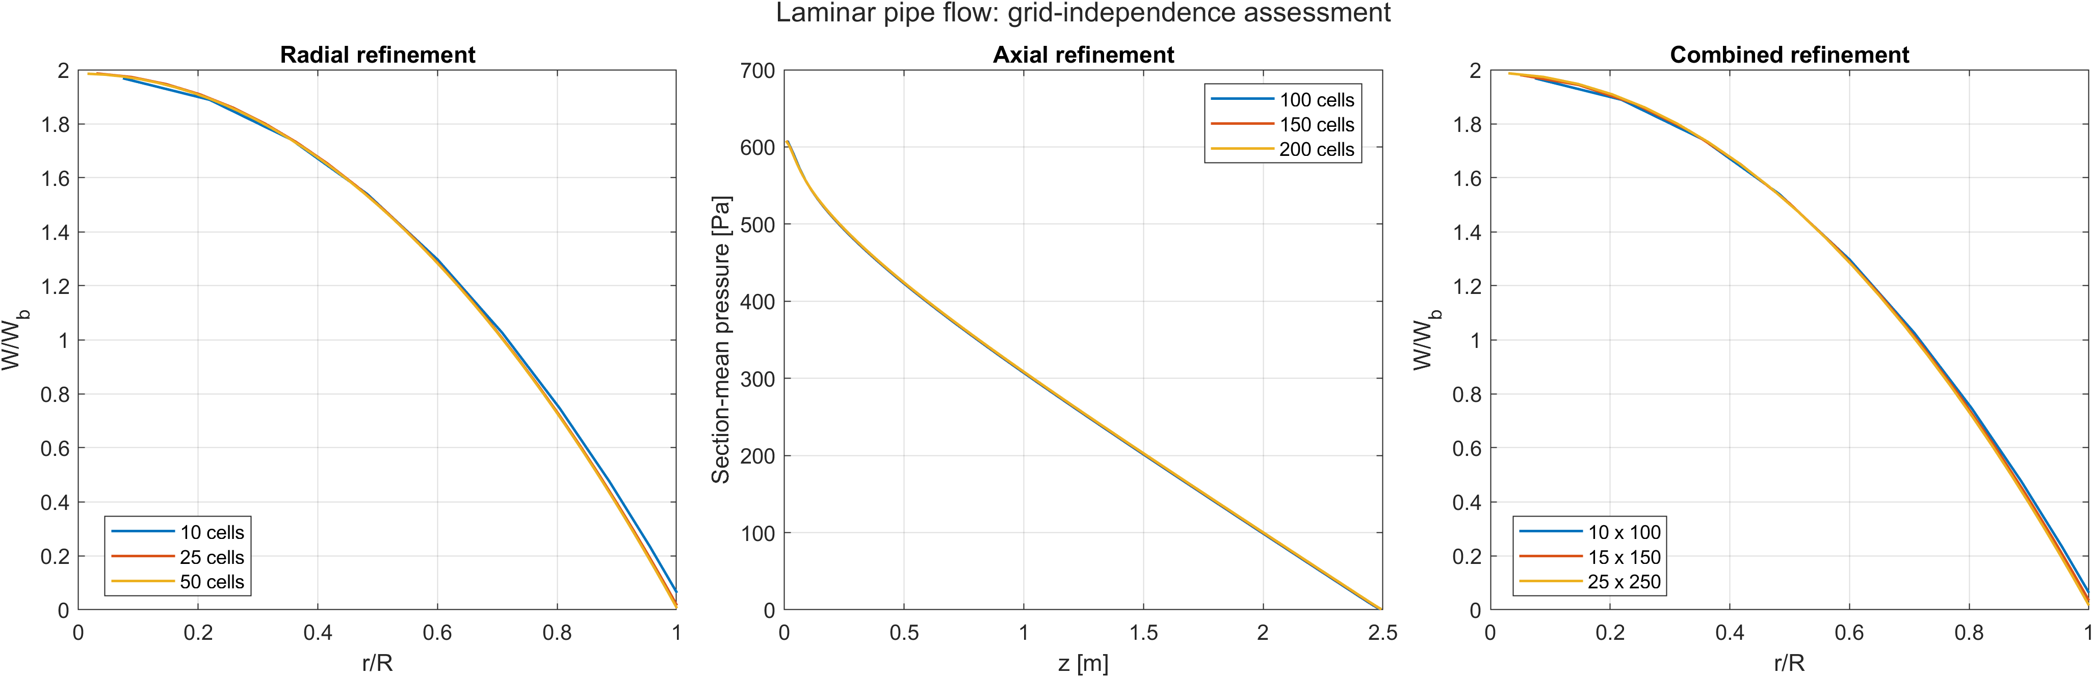
I · INTERNAL FLOW · CFD
07
Laminar grid: medium–fine differences below 1%
METHOD
OBSERVATION
IMPLICATION
Three grids per path. Radial and combined: velocity profile at z ≈ 0.8L . Axial: pressure at half radius. Coarse result interpolated onto the finer grid.
Radial 2.36 → 0.52%, axial 0.41 → 0.23%, combined 1.44 → 0.93%. No change in shape and no spurious oscillations.
The finest grid is retained. Pairwise differences, not a formal GCI: the refinement ratio is not uniform across directions.

Slide 8
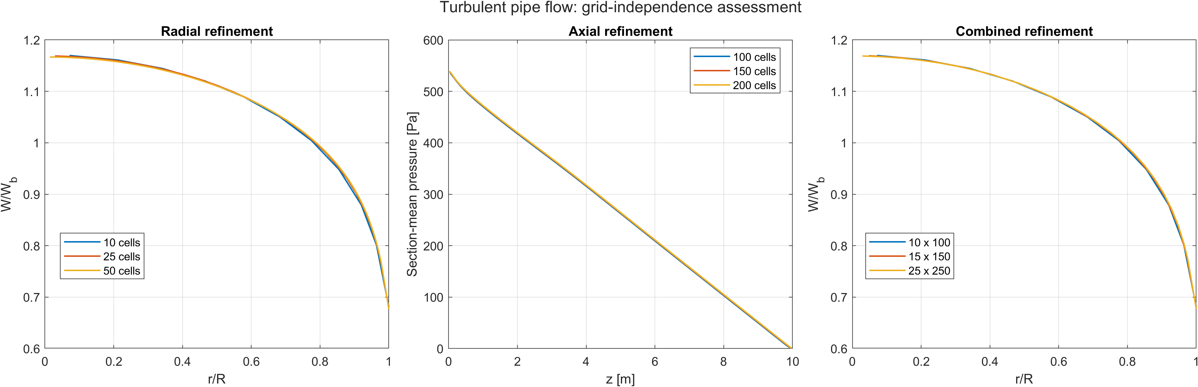
I · INTERNAL FLOW · CFD
08
Turbulent grid: lower sensitivity than the laminar case
GRIDS
OBSERVATION
IMPLICATION
Radial 10 / 25 / 50 cells, axial 100 / 150 / 200 cells, combined 10×100 → 25×250.
Medium–fine differences 0.24% radial, 0.13% axial, 0.37% combined. Residual differences concentrate near the wall.
The tested refinements produce small profile changes. Model differences are interpreted for these grids and wall treatments.

Slide 9
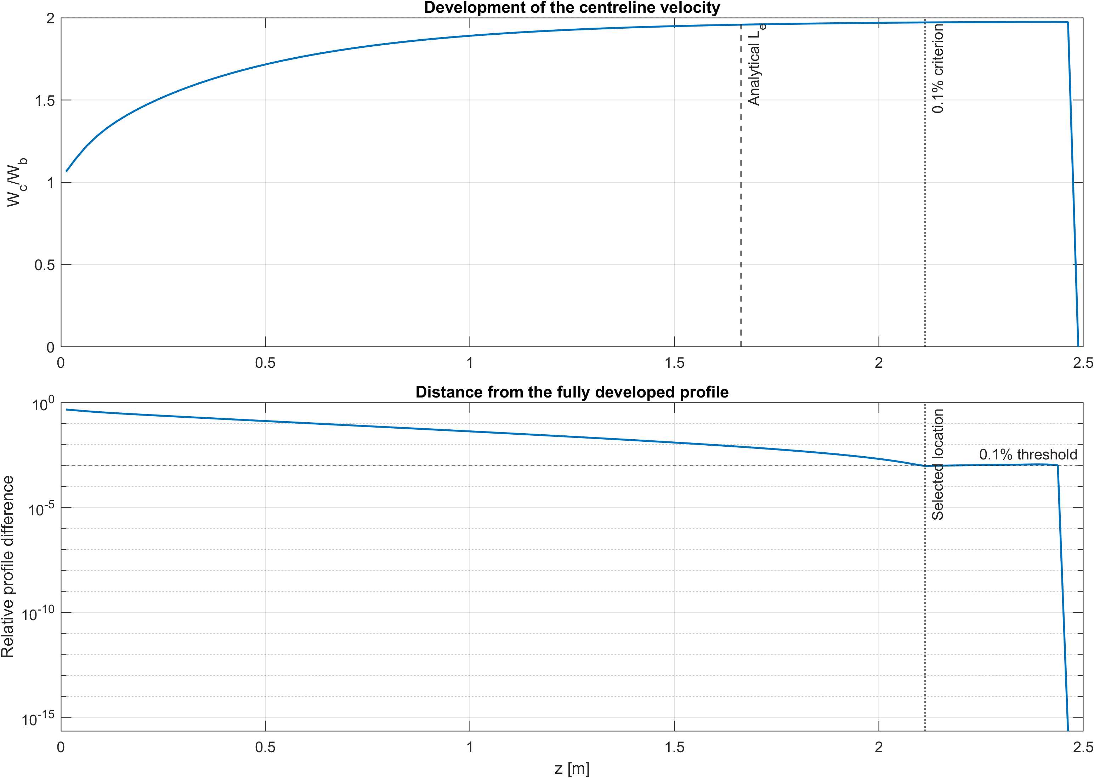
I · INTERNAL FLOW · CFD
09
Laminar entry length depends on its definition
CRITERION
First axial station where the full profile is within 0.1% of the last interior profile.
Correlation 0.0575 Re D
Numerical, 0.1% criterion
1.663 m
2.113 m
OBSERVATION
Centreline velocity tends to 2W_{b} ; the profile distance decreases monotonically.
IMPLICATION
The 27% gap reflects the strict full-profile threshold and discrete axial sampling. The asymptotic state is correct.

Slide 10
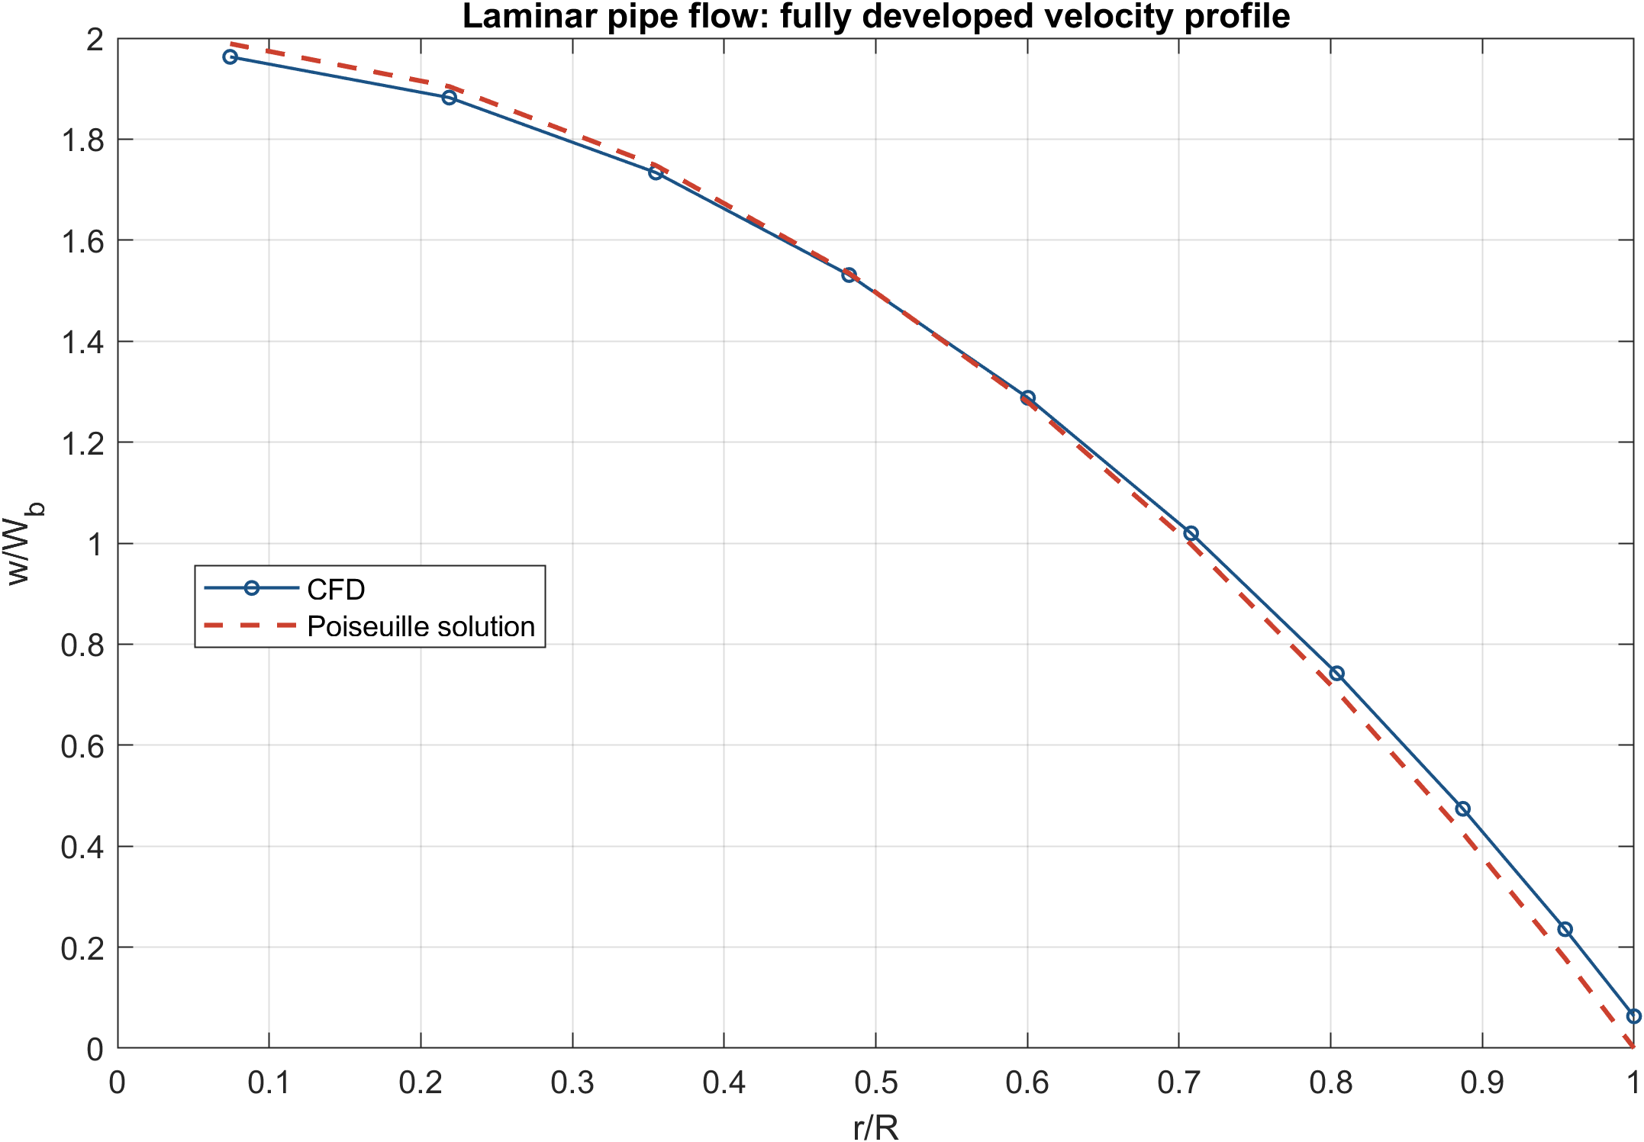
I · INTERNAL FLOW · CFD
10
Developed profile matches Poiseuille within 3.2%
REFERENCE
W/W_{b} = 2[1 − (r/R)²]
Profile L∞ error
Reconstructed W_{b}
3.18%
0.4523 m/s · 0.51%
OBSERVATION
The largest differences occur near the wall, where the computed radial profile is steep.
IMPLICATION
The computed profile agrees closely with Poiseuille flow on the tested mesh. The remaining local error has not been isolated.

Slide 11
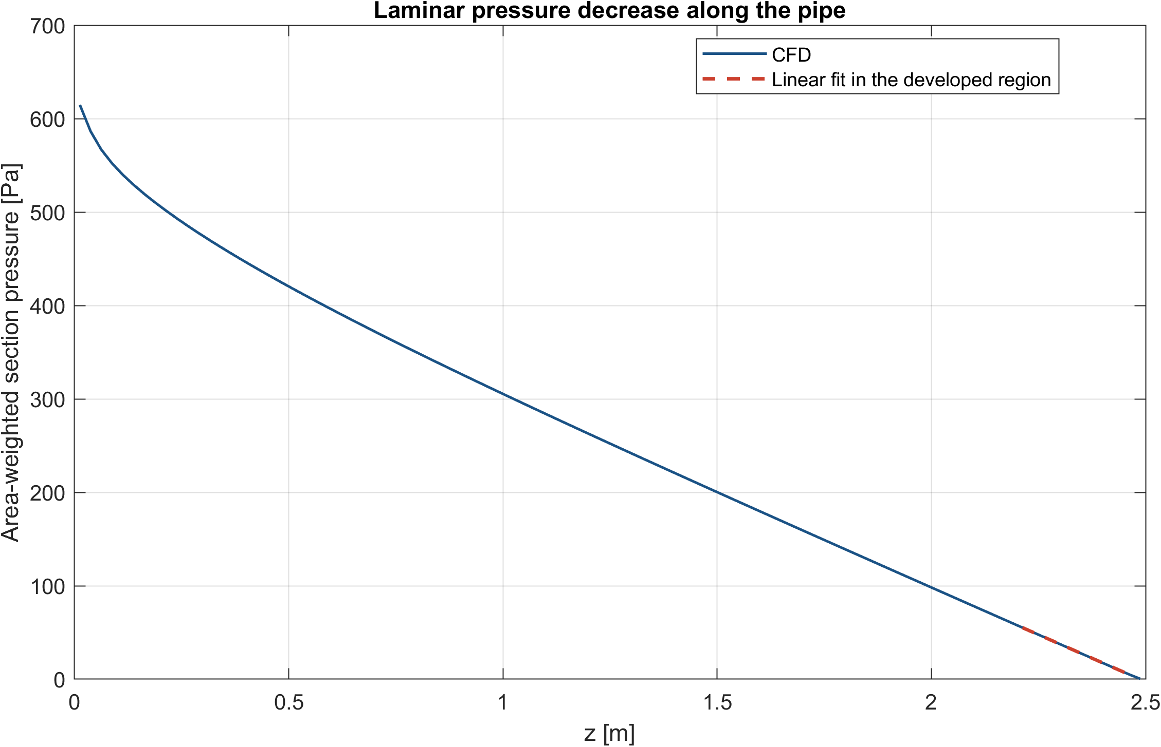
I · INTERNAL FLOW · CFD
11
Pressure gradient matches the analytical value within 1.24%
METHOD
Area-weighted pressure p̄(z) = (2/R²)∫p r dr ; least-squares slope over the developed stations. Reference −32 μW_{b}/D².
Analytical
CFD
Error
−203.84 Pa/m
−201.32 Pa/m
1.24%
OBSERVATION
Pressure becomes linear once inlet development is complete.
IMPLICATION
The integral momentum balance and the implied wall shear are verified independently of the profile.

Slide 12
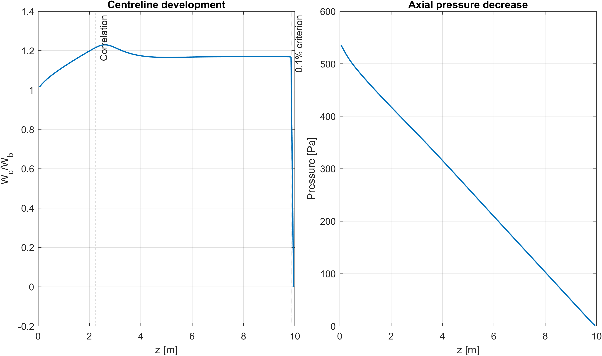
I · INTERNAL FLOW · CFD
12
Turbulent flow: the centreline converges before the profile
Correlation 1.359 D Re^{1/4}
Full-profile 0.1% criterion
2.249 m
9.85 m
OBSERVATION
Centreline velocity stabilises early; the full radial profile keeps changing weakly downstream. Pressure decreases linearly once developed.
IMPLICATION
A turbulent entry length is not unique: it depends on the observable and on the threshold used to define it.

Slide 13
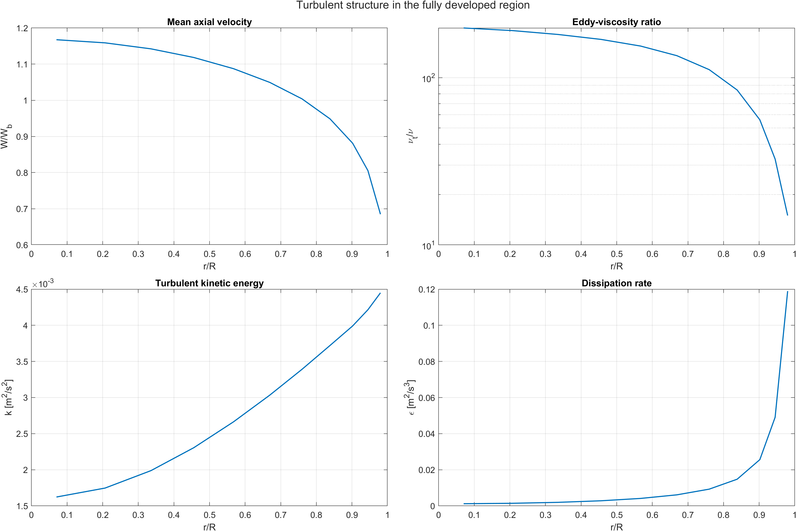
I · INTERNAL FLOW · CFD
13
Developed turbulent field: flat core, active wall region
FIELDS
Mean velocity, eddy-viscosity ratio ν_{t}/ν, turbulent kinetic energy k and dissipation ε in the developed region, standard k–ε.
OBSERVATION
The mean profile is flatter than the laminar parabola. k and ε increase towards the wall, consistent with shear production. Symmetry about the axis is preserved.
IMPLICATION
The solution is physically consistent before any comparison with measured data.

Slide 14
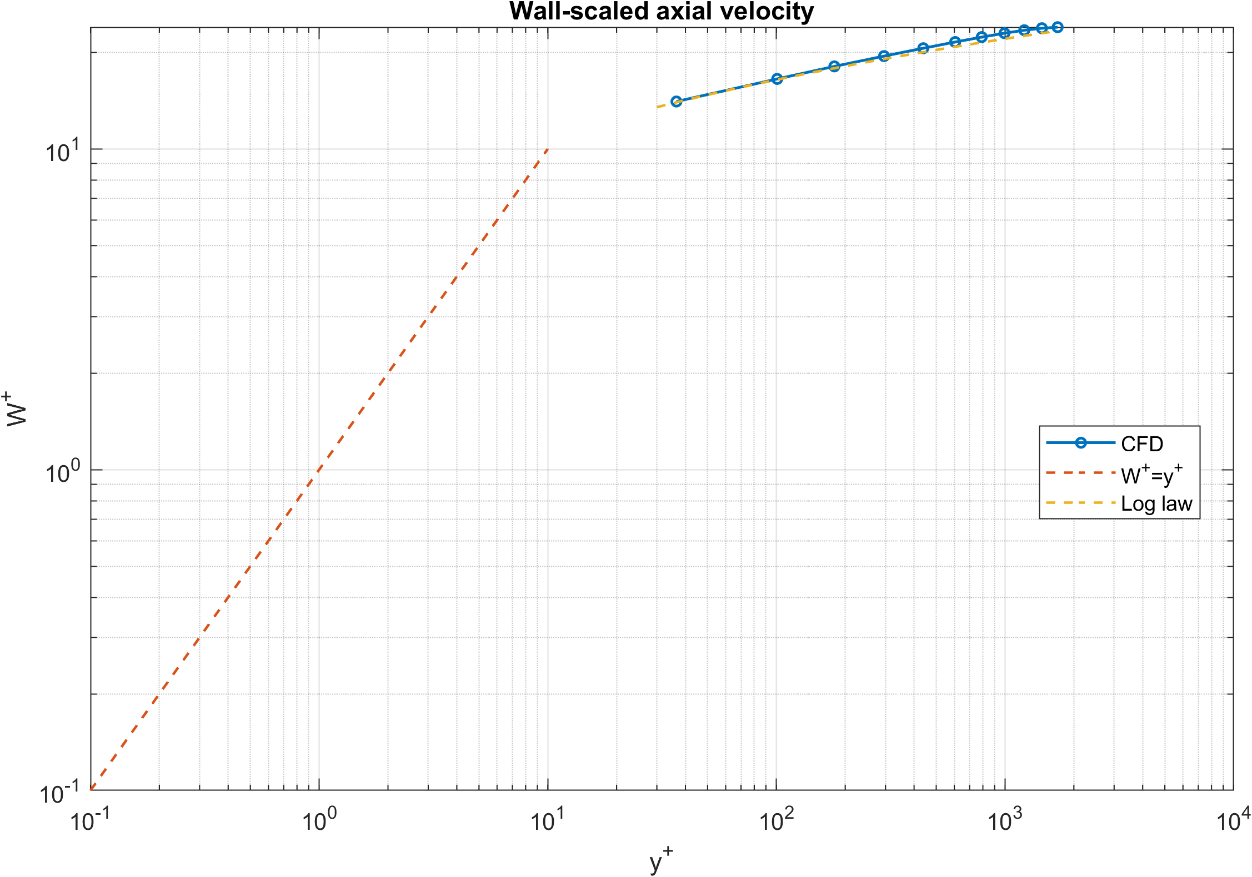
I · INTERNAL FLOW · CFD
14
Inner scaling: the profile crosses the logarithmic range
SCALING
u_{τ} = (τ_{w}/ρ)^{1/2}, y⁺ = y u_{τ}/ν, W⁺ = W/u_{τ} . Compared with viscous and logarithmic laws.
Friction velocity
Maximum plotted y⁺
0.03654 m/s
≈ 1699
OBSERVATION
The computed profile follows the logarithmic law over the resolved range.
SCOPE
Maximum y⁺ is the wall-to-axis distance. The near-wall resolution cannot be reconstructed from the compact exports.

Slide 15
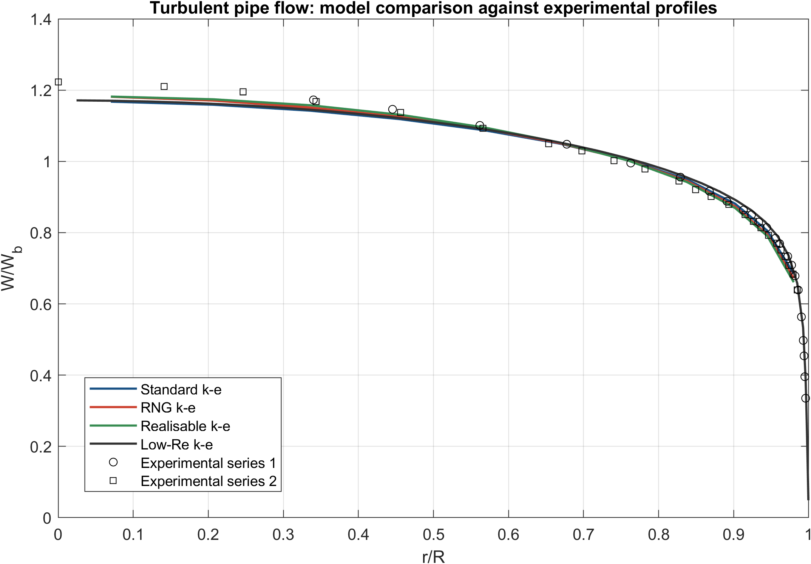
I · INTERNAL FLOW · CFD
15
All four closures reproduce the measured profile shape
METHOD
CFD profiles interpolated to the experimental radial coordinates; normalised RMSE against two measured series at Re_{b} = 75,000.
Model
Profile RMSE
Standard k–ε
0.0158
RNG k–ε
0.0166
Realisable k–ε
0.0195
Low-Re k–ε
0.0214
IMPLICATION
RMSE spans only 0.016–0.021: profile shape alone weakly discriminates between closures. Wall friction is needed.

Slide 16
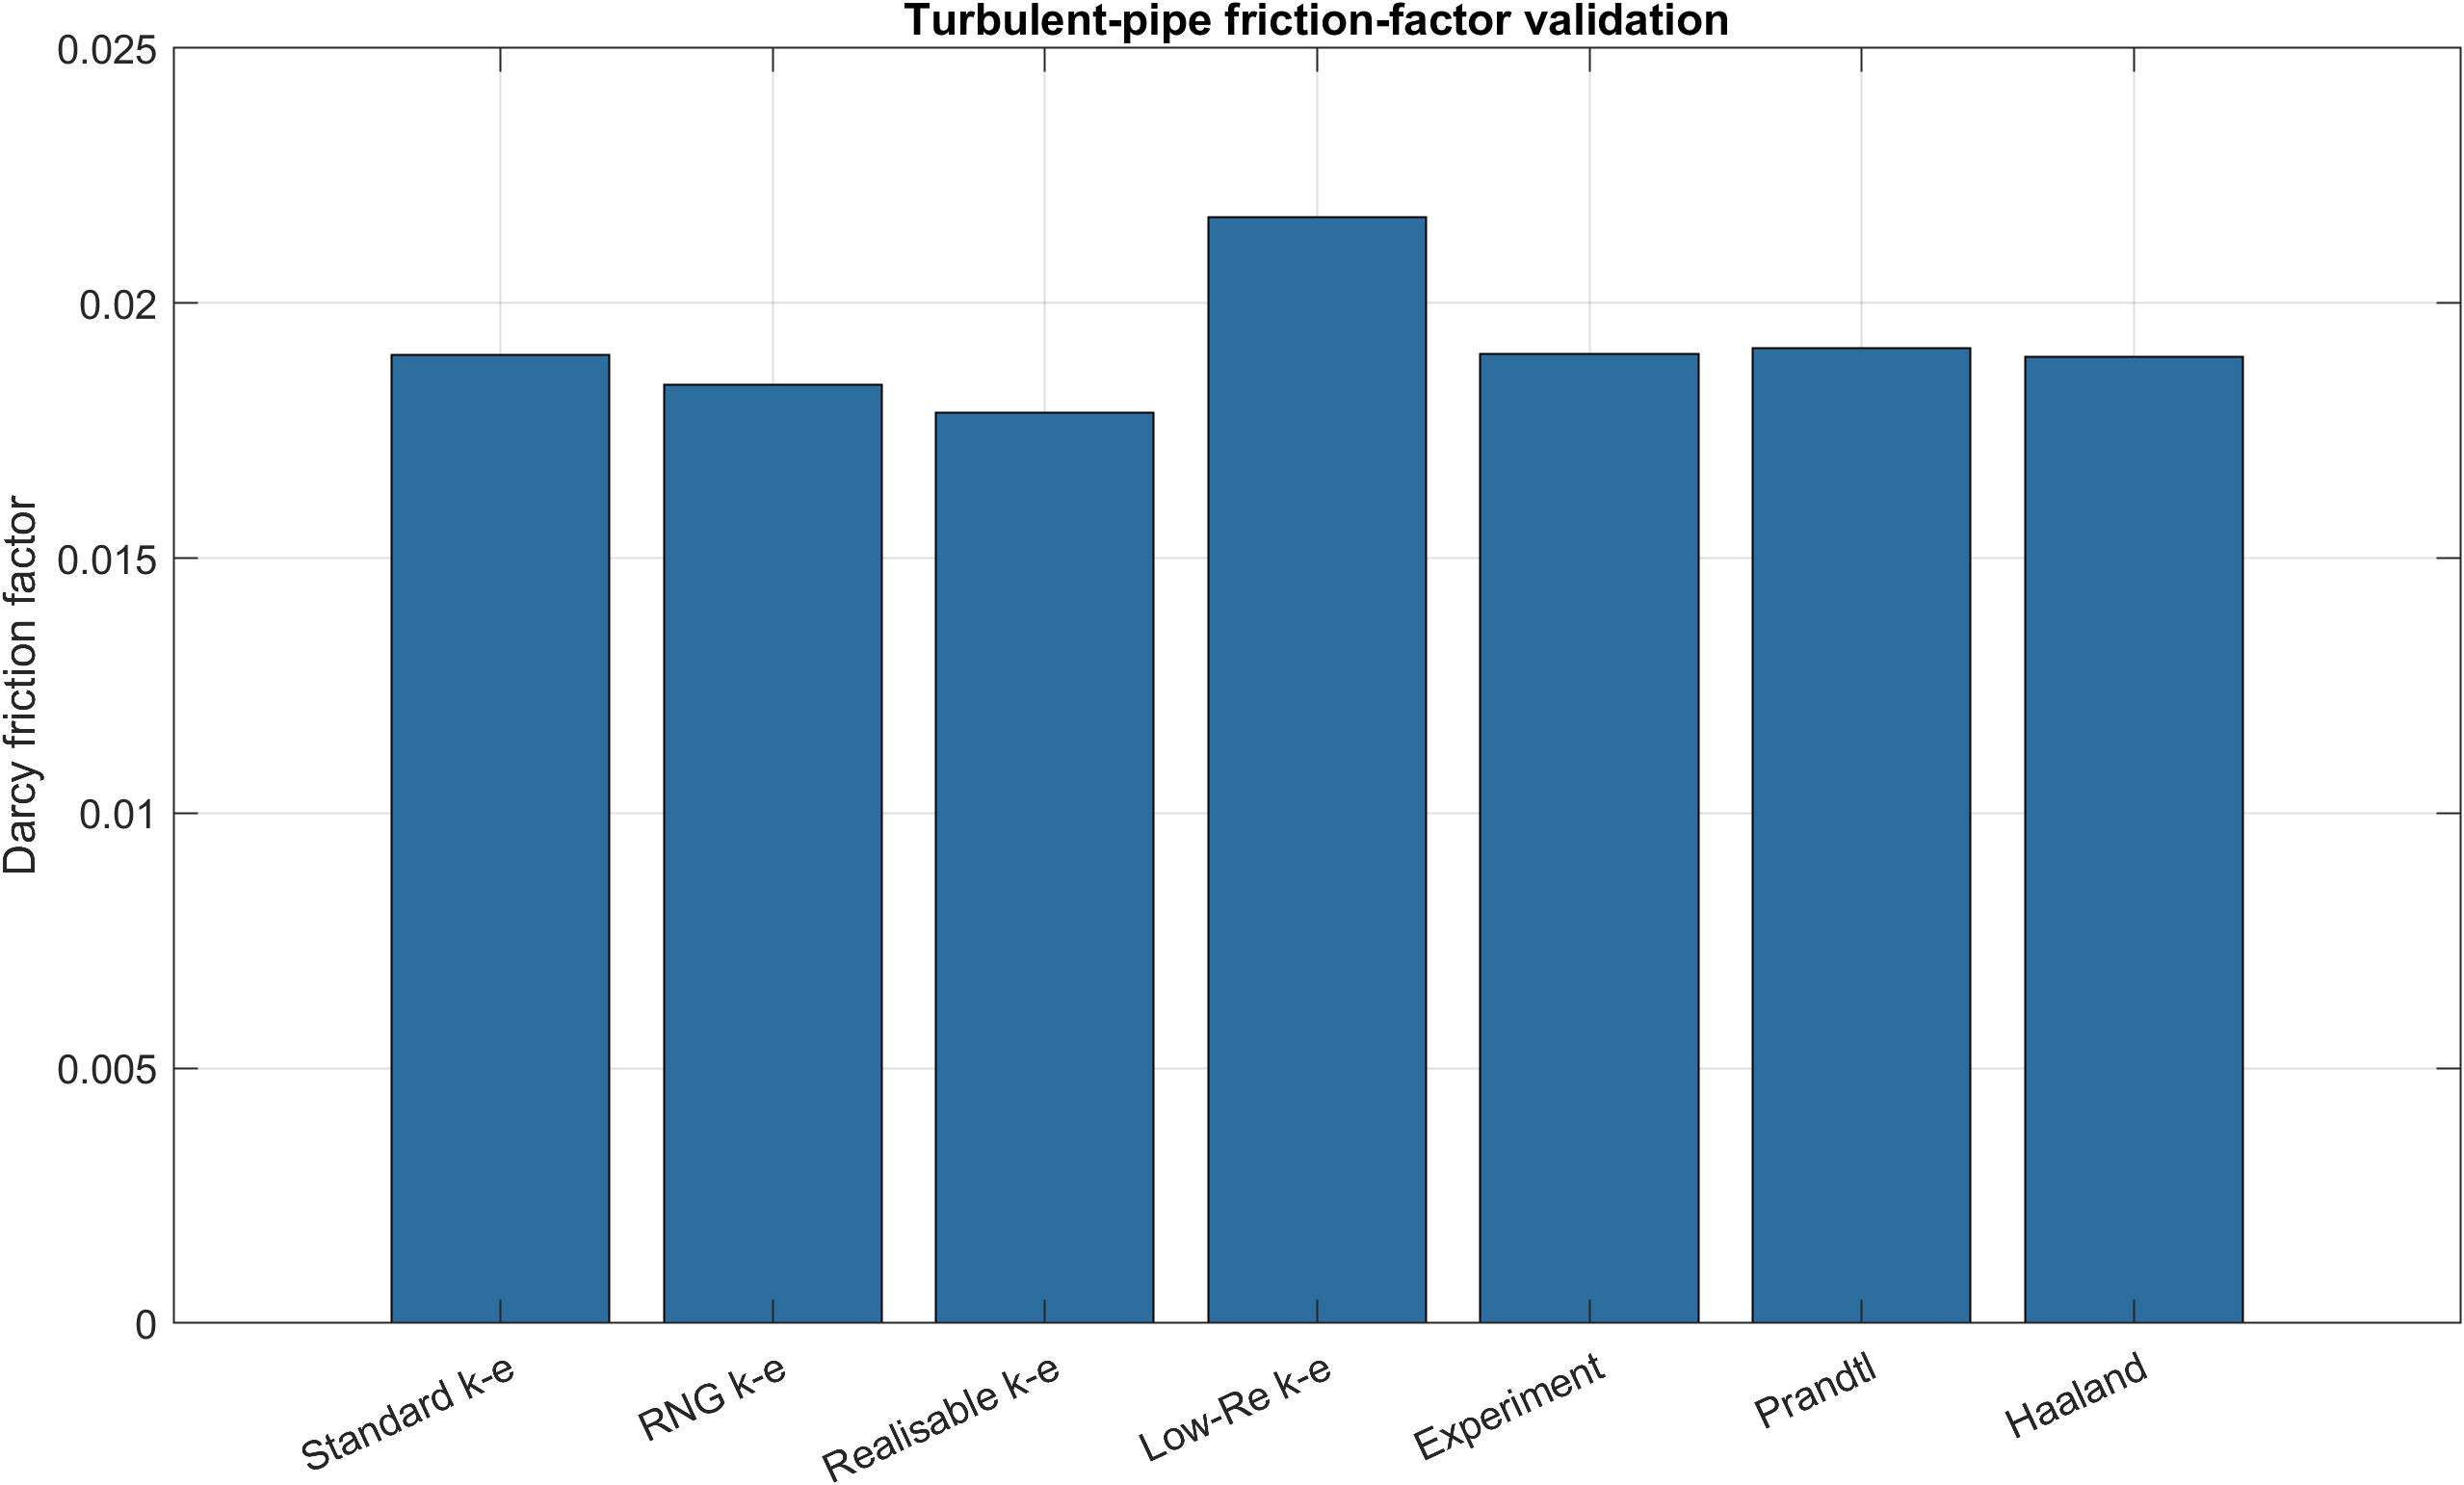
I · INTERNAL FLOW · CFD
16
Wall friction discriminates between the closures
References: experiment 0.0190 · Prandtl 0.01912 · Haaland 0.01895
Model
f
Error vs exp.
Standard k–ε
0.018984
0.082%
RNG k–ε
0.018403
3.14%
Realisable k–ε
0.017853
6.04%
Low-Re k–ε
0.021688
14.15%
INTERPRETATION
The low-Re closure overpredicts wall friction on this grid. Its sensitivity to near-wall resolution requires a dedicated refinement study.
Standard k–ε gives the smallest friction and profile errors for the grids and wall treatments tested.

Slide 17
PART II
Cylinder wake experiment
Calibration of the measurement chain, then the wake through its velocity field, its forces and their uncertainty.
18 Experimental setup
19 Load-cell calibration
20 Calibration stability
21 Mean wake
22 Wake recovery
23 Probe spectrum
24 Vorticity phases
25 Cylinder forces
26 Lift spectrum
27 Uncertainty budget

Slide 18
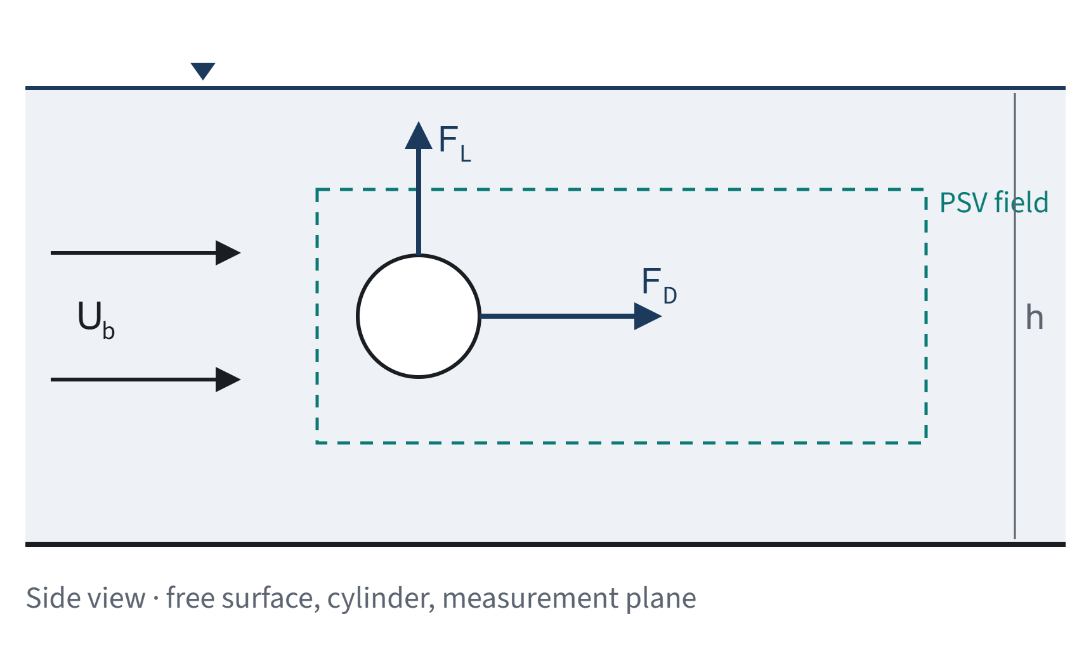
II · CYLINDER WAKE · EXPERIMENT
18
Experimental setup
Circular cylinder, D = 0.06 m, in a 0.50 m wide open channel.
Quantity
PSV
Forces
Flow rate
35 L/s
75 L/s
Water depth
0.42 m
0.45 m
Bulk velocity U_{b}
0.1667 m/s
0.3333 m/s
Sampling rate
50 Hz
200 Hz
Data
1499 fields, 23×30
span 0.185 m
PSV
Particle-shadow velocimetry: pixel displacements converted at 3040 px/m, local velocity field in the cylinder frame.
FORCES
Calibrated load cell: span-integrated drag and lift, buoyancy removed with a still-water record.

Slide 19
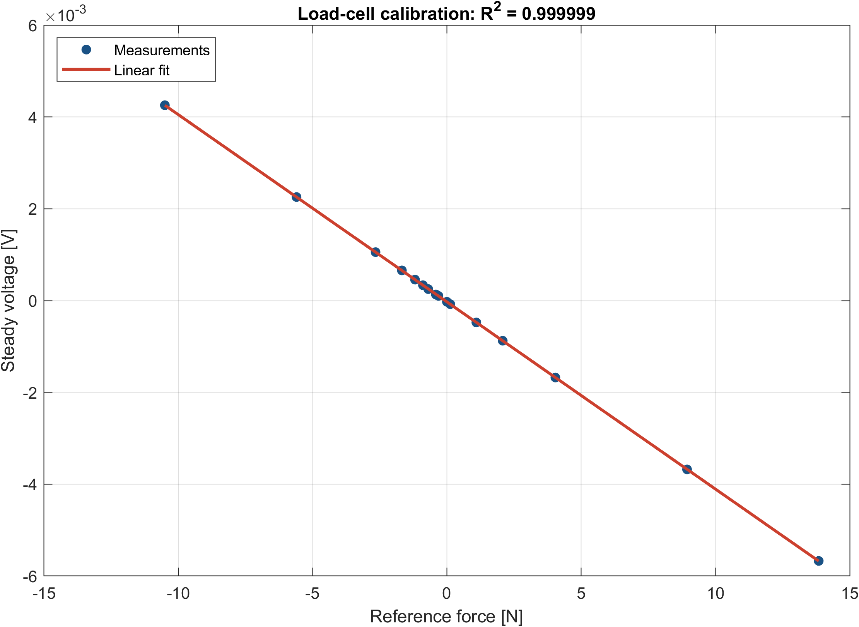
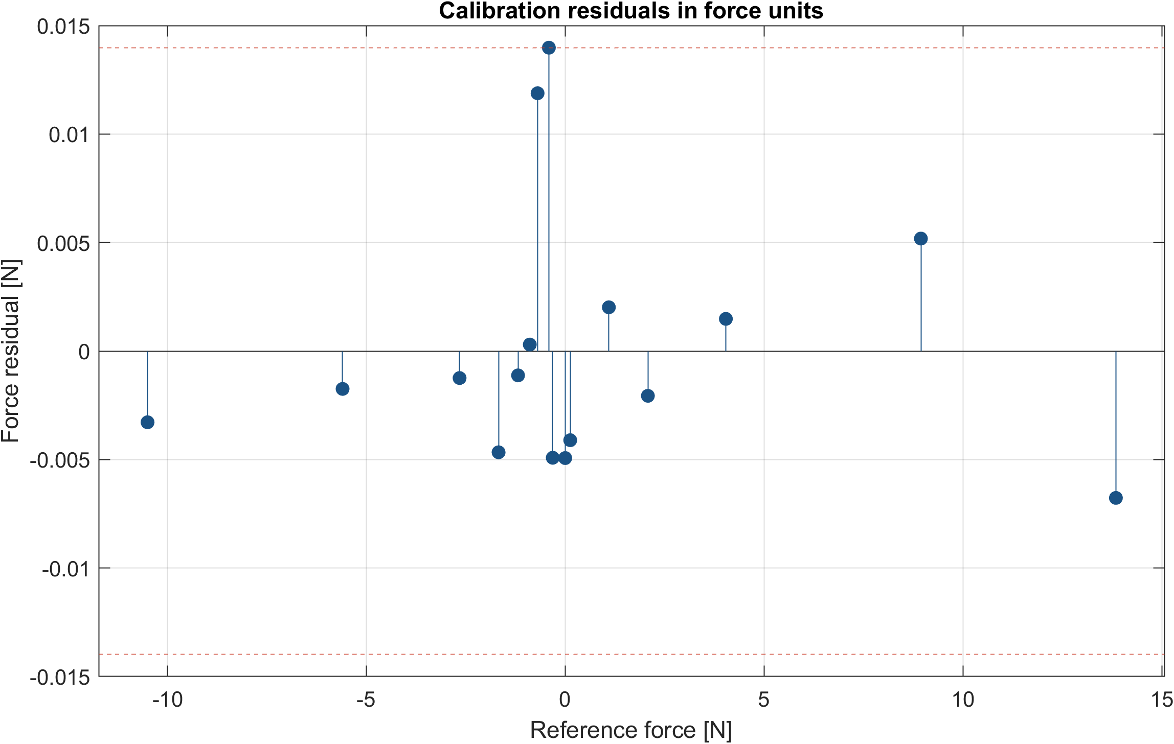
II · CYLINDER WAKE · EXPERIMENT
19
Load cell: linear transfer function over −10.5 to 13.8 N
Sensitivity S
R²
Force RMSE
Max residual
−4.078·10⁻⁴ V/N
0.9999988
0.00572 N
0.01398 N
METHOD
OBSERVATION
IMPLICATION
Sixteen static loads at 100 Hz. Fit V = SF + V₀ using the last 30% of each record.
No sign-dependent slope or visible curvature. Largest residual near −0.41 N.
Small relative to mean drag (0.92 N), but comparable to mean lift (−0.017 N).

Slide 20
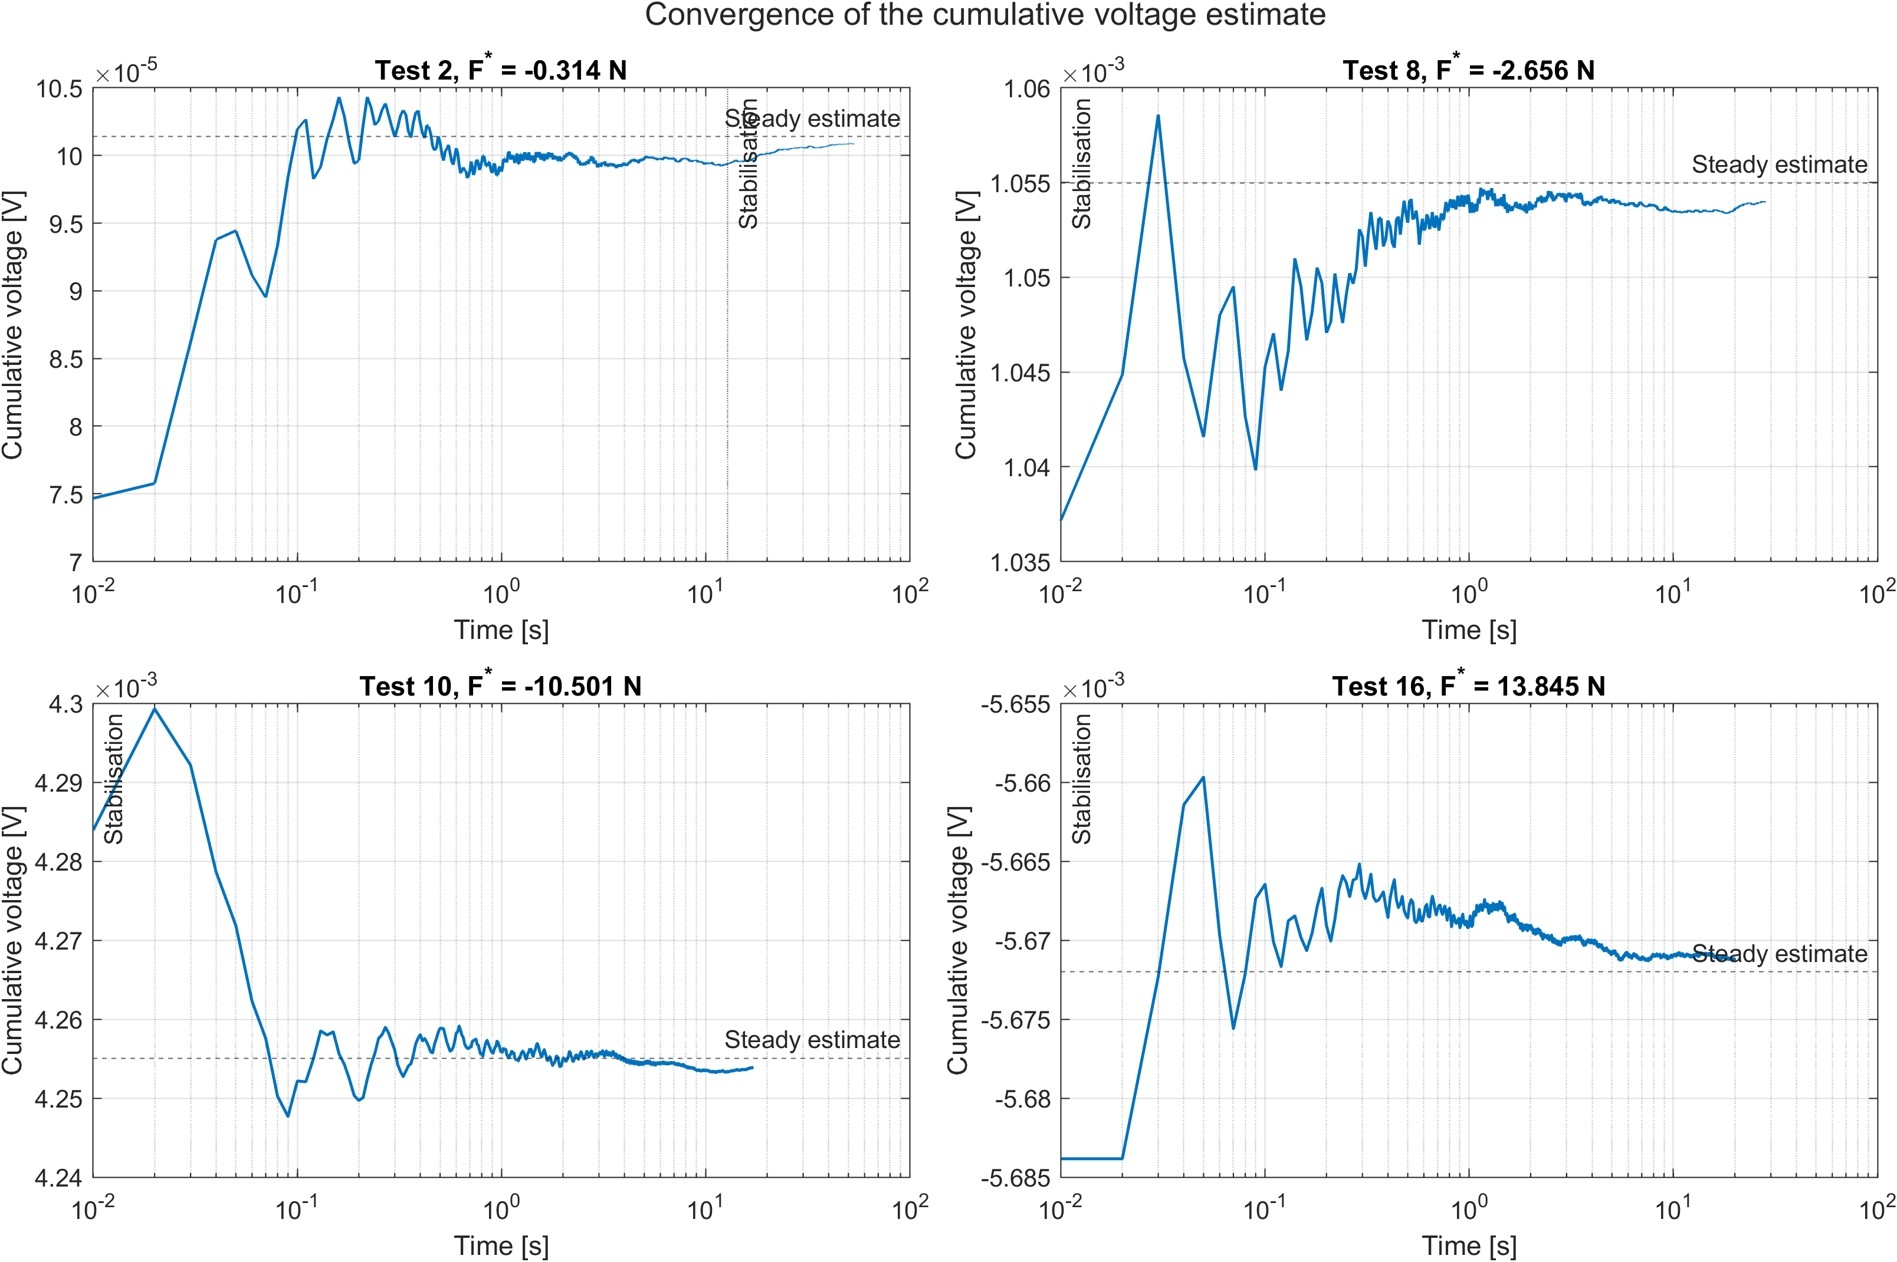
II · CYLINDER WAKE · EXPERIMENT
20
Small loads need long records to settle
CRITERION
Cumulative mean within a 2% band of the final level.
Reference load
Settling time
0 N
25.99 s
|F| ≤ 0.41 N
11.9–21.0 s
|F| ≥ 0.70 N
≤ 0.49 s
OBSERVATION
High loads settle almost immediately; near zero, drift and noise are comparable with the signal.
IMPLICATION
Justifies the last-30% window and sets the practical limit for interpreting mean lift.

Slide 21
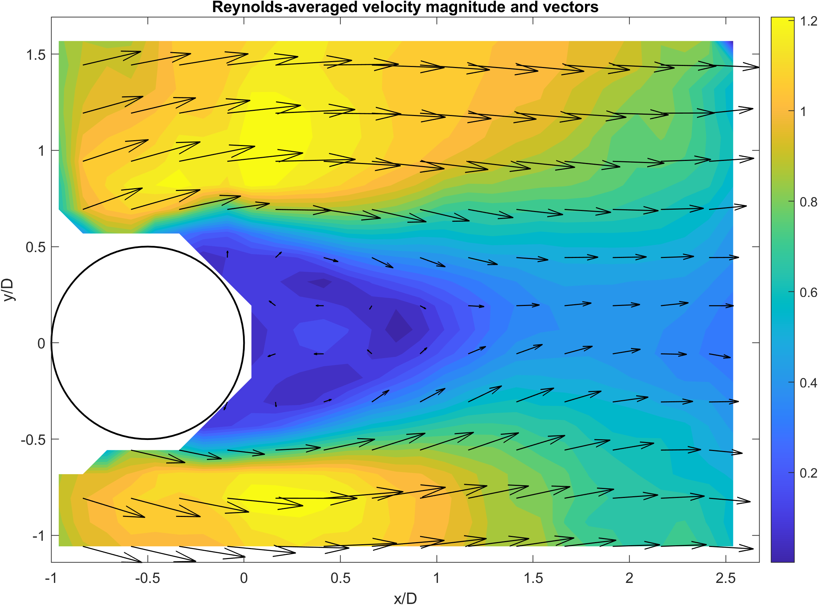
II · CYLINDER WAKE · EXPERIMENT
21
Mean wake: velocity deficit bounded by separated shear layers
Reynolds number
Bulk velocity
Re_{D} = 9980
0.1667 m/s
METHOD
Time average of 1499 PSV fields. Invalid vectors omitted, cylinder interior masked, no spatial interpolation.
OBSERVATION
Streamwise velocity drops behind the cylinder and a deficit forms around the centreline. Vectors show transverse motion from the shear layers.
SCOPE
Boundary regions with few valid vectors are not interpreted.

Slide 22
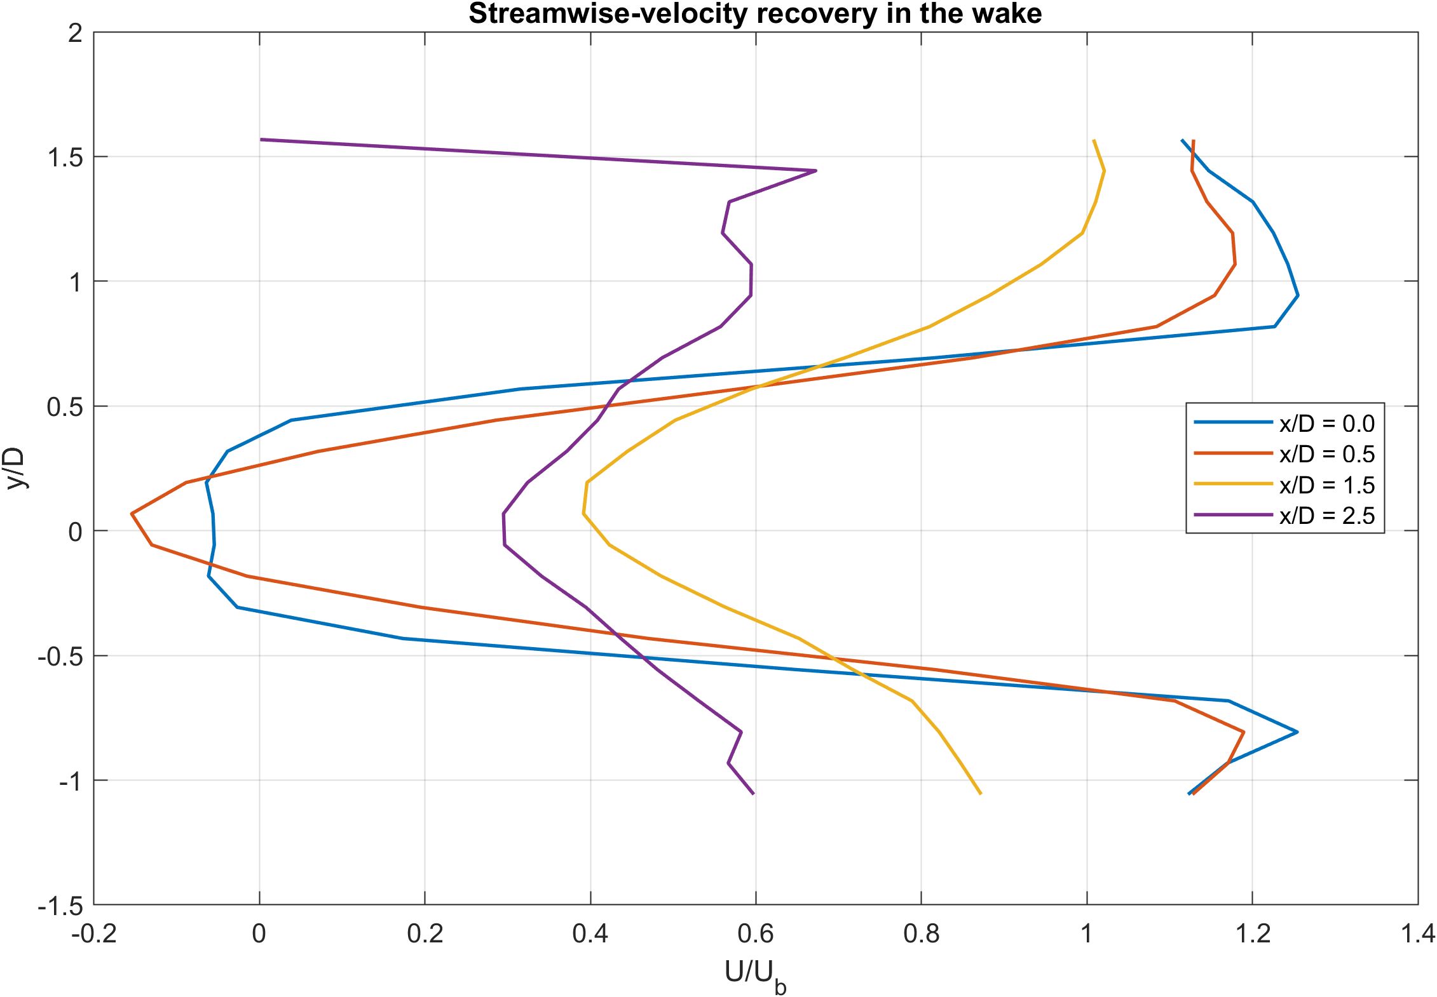
II · CYLINDER WAKE · EXPERIMENT
22
Streamwise recovery of the mean velocity
METHOD
Vertical profiles of mean streamwise velocity at four downstream stations.
OBSERVATION
The strongest deficit and cross-stream variation occur in the near wake. Profiles smooth out downstream as momentum is redistributed.
SCOPE
The field of view is too short to establish a self-similar far-wake regime.

Slide 23
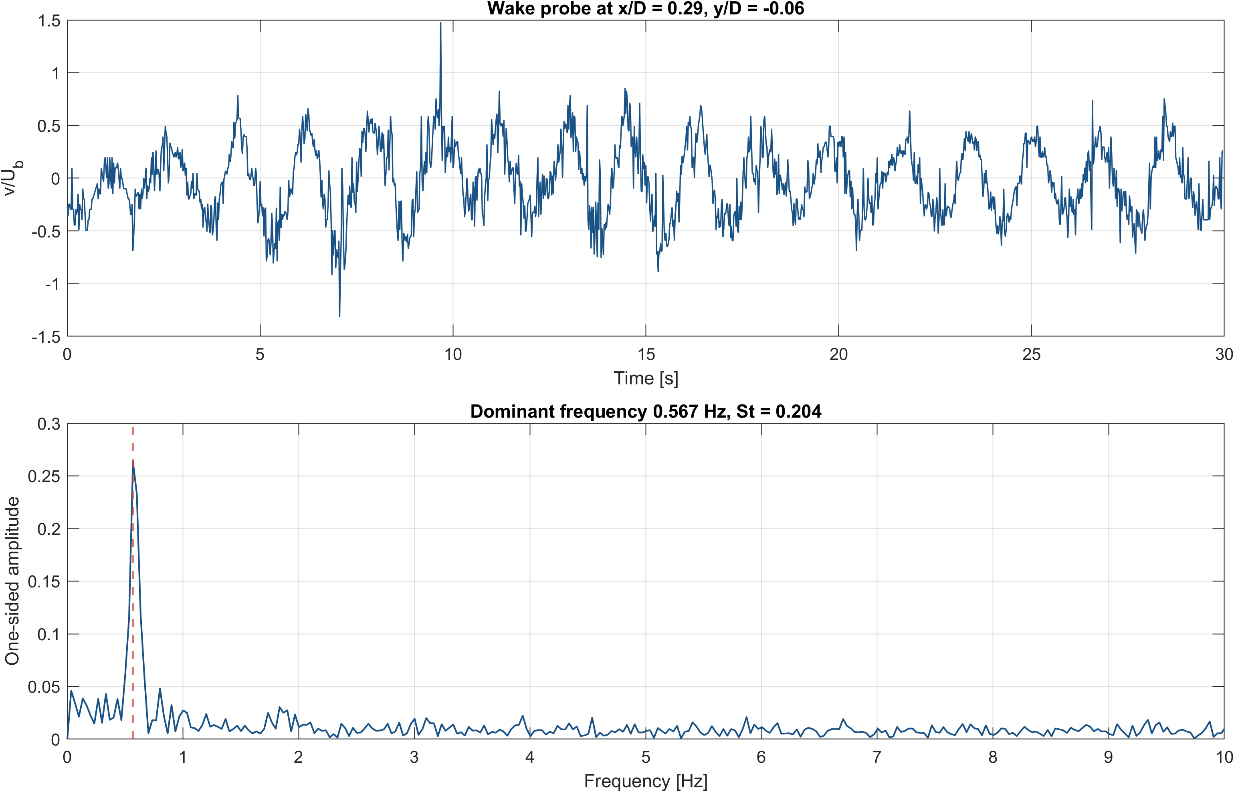
II · CYLINDER WAKE · EXPERIMENT
23
Velocity spectrum: one dominant frequency, St = 0.204
METHOD
Transverse velocity at the valid grid point nearest to
(x/D, y/D) = (0.25, 0), i.e. (0.288, −0.057). Gaps interpolated in time; peak searched in 0.2–10 Hz.
Dominant frequency
St = f_{s}D/U_{b}
0.567 Hz
0.204
OBSERVATION
A single peak well above the broadband level over a 30 s record at 50 Hz.
IMPLICATION
Consistent with periodic shedding behind a circular cylinder at Re_{D} ≈ 10⁴.

Slide 24
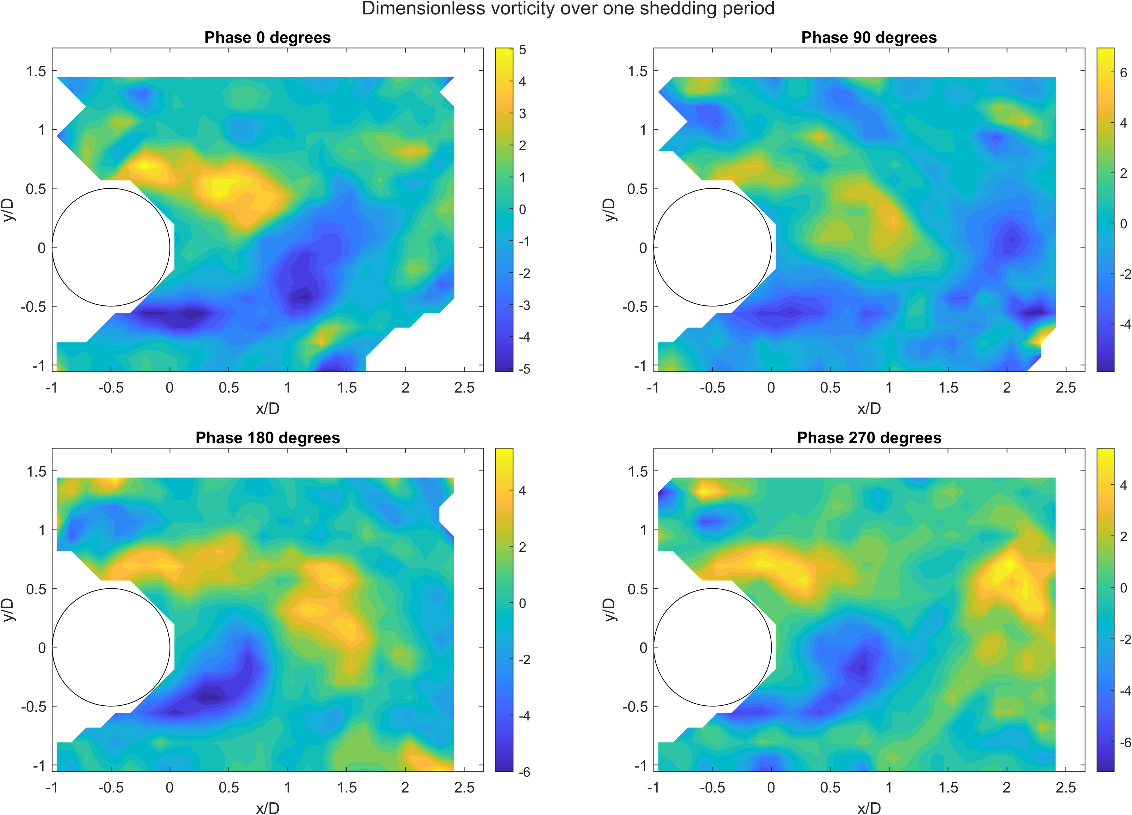
II · CYLINDER WAKE · EXPERIMENT
24
Vorticity phases: alternating vortices convected downstream
METHOD
OBSERVATION
IMPLICATION
Four frames separated by a quarter of the identified period, from a moving-average filtered sequence.
Alternating signed structures form behind the cylinder and are convected through the measurement region.
Spatial counterpart of the spectral peak. Topology only: no ensemble phase average, amplitudes not interpreted.

Slide 25
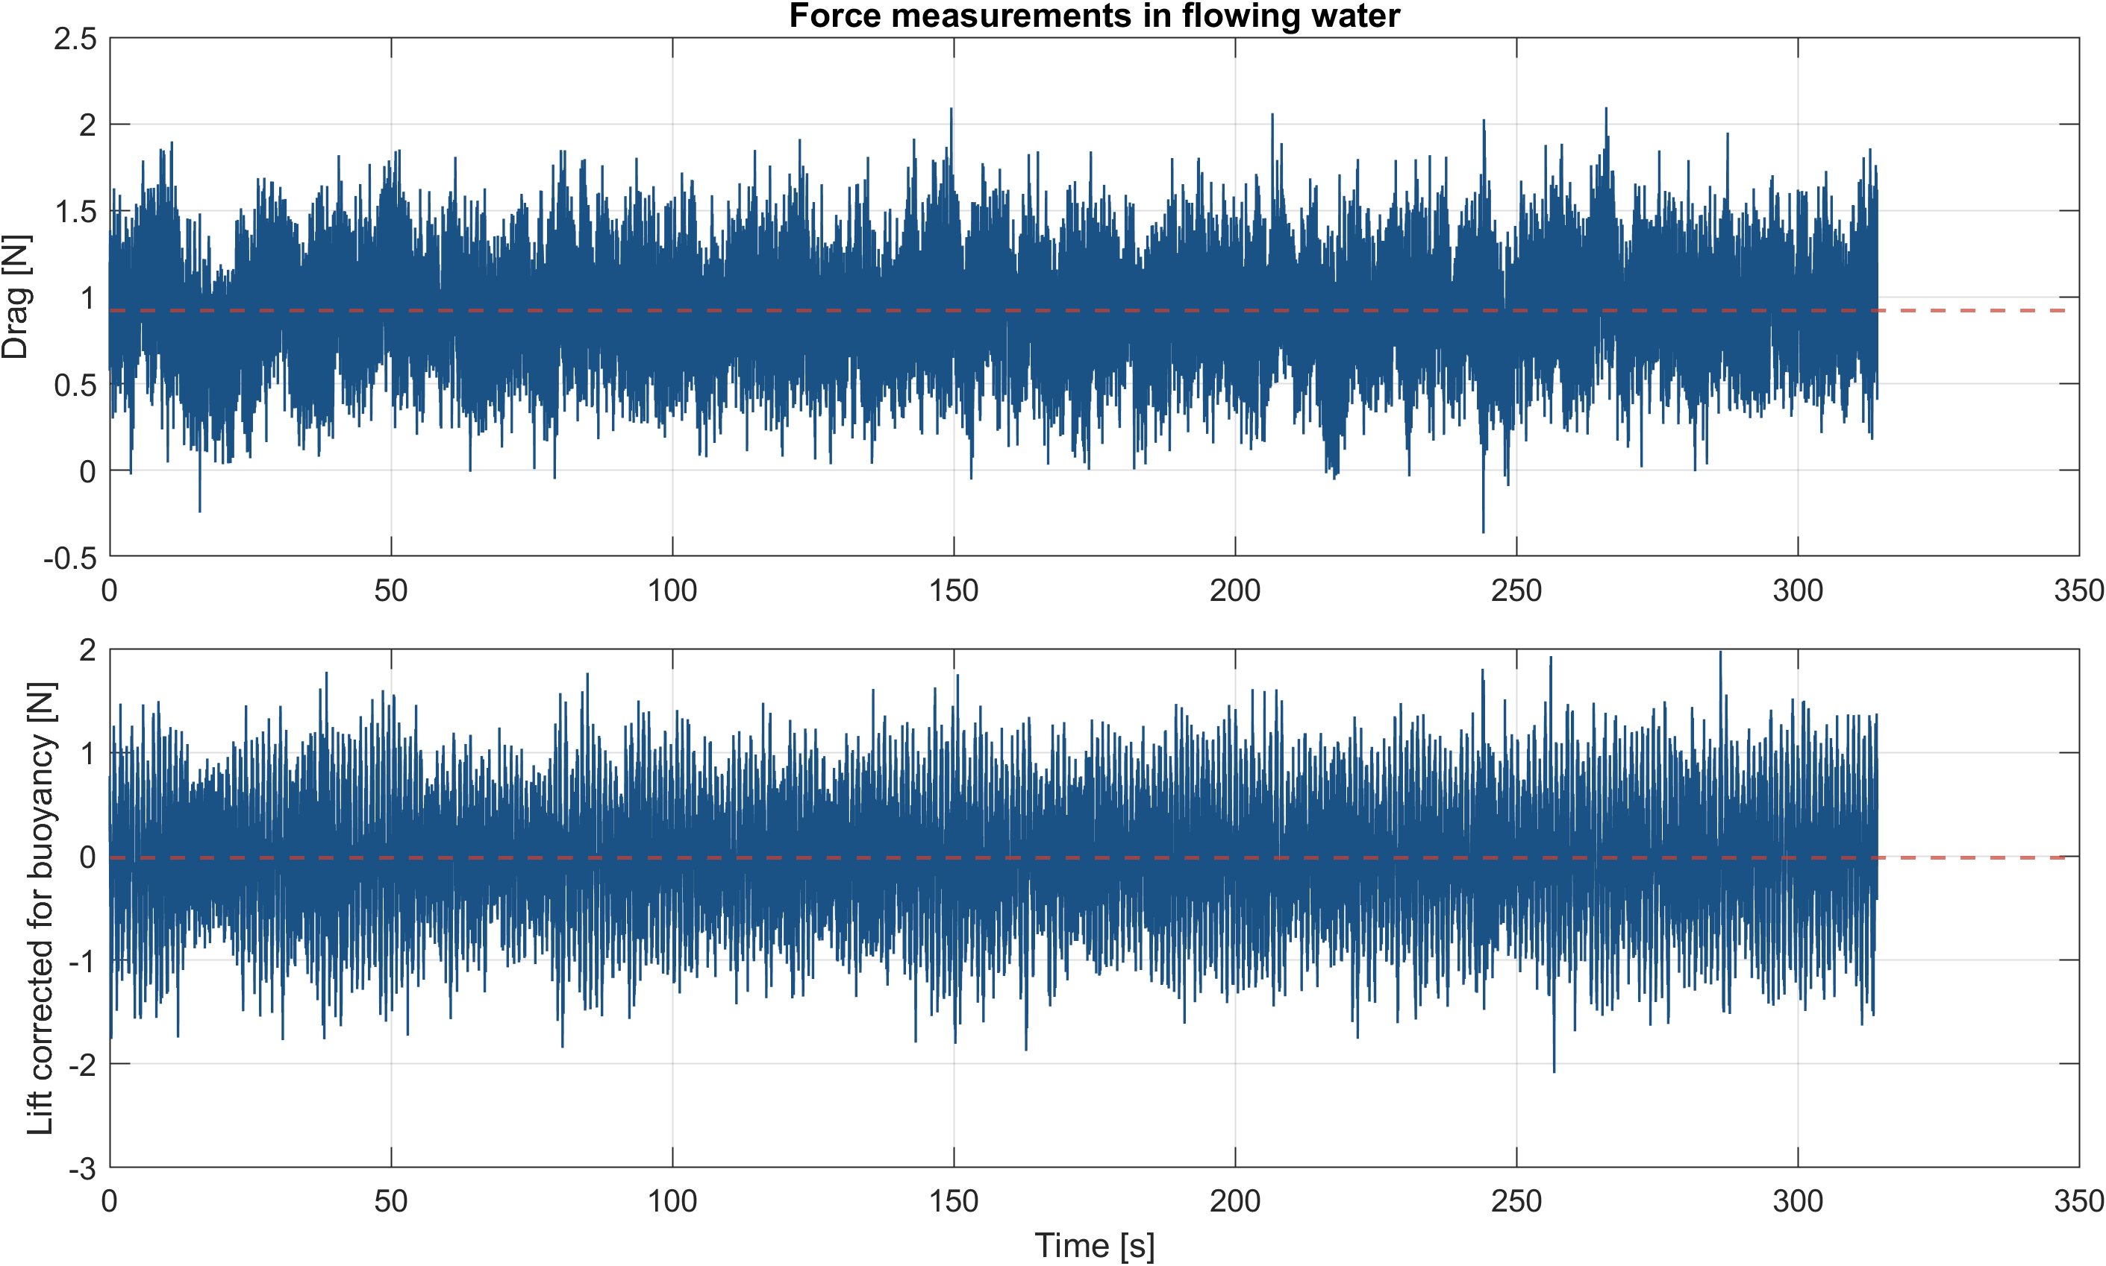
II · CYLINDER WAKE · EXPERIMENT
25
Mean drag coefficient 1.50; mean lift close to zero
METHOD
C = F / (½ρU_{b}²DL), L = 0.185 m. Lift corrected for buoyancy with the still-water record.
Mean drag
Mean lift
0.9223 N
−0.0172 N
C̅_{D}
C̅_{L}
1.4987
−0.0280
OBSERVATION
Drag fluctuates about a positive mean; lift oscillates about zero.
IMPLICATION
A non-zero mean lift alone is not evidence of physical asymmetry.

Slide 26
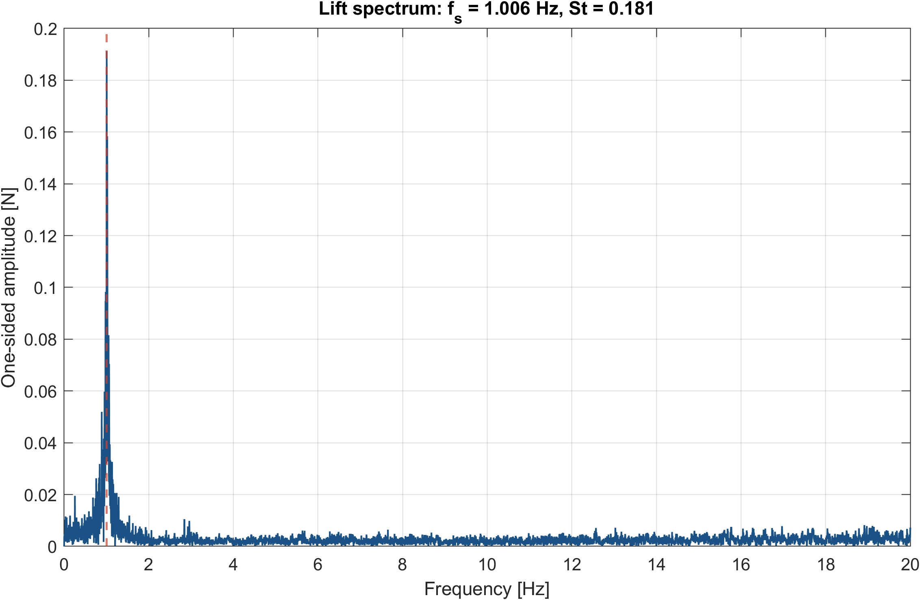
II · CYLINDER WAKE · EXPERIMENT
26
Lift spectrum: shedding at St = 0.181
METHOD
One-sided amplitude spectrum of the corrected lift after mean removal, 200 Hz.
WHY LIFT
Alternating shedding forces the cylinder cross-stream at f_{s} ; drag responds mainly at the mean and at even harmonics.
Shedding frequency
St
1.006 Hz
0.181
IMPLICATION
The narrow peak indicates a coherent periodic component, measured independently of the velocity field.

Slide 27
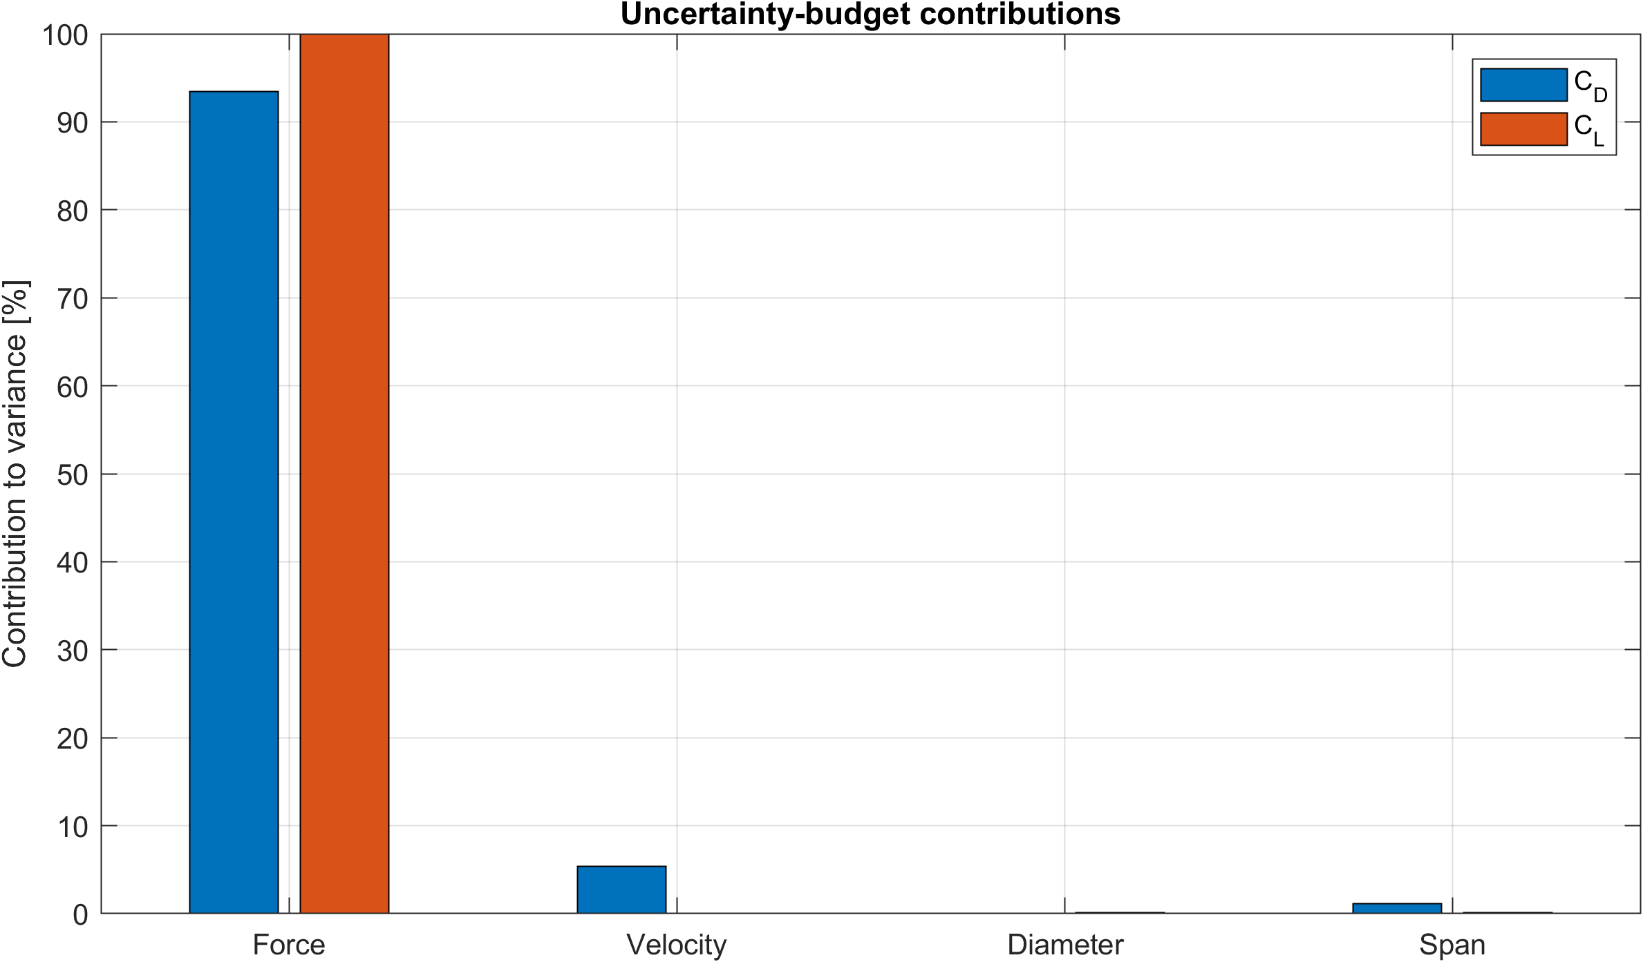
II · CYLINDER WAKE · EXPERIMENT
27
Force measurement dominates the uncertainty budget
METHOD
First-order propagation, root sum of squares of independent contributions (assumptions in appendix A2).
u(C_{D})
u(C_{L})
0.0756 · 5.0%
0.0574
2 mm level mismatch
ΔC_{L} ≈ 0.0229
OBSERVATION
Force measurement dominates both coefficients. Velocity is next for drag, since C ∝ U_{b}⁻².
The mean lift is smaller than its uncertainty: it is compatible with zero.

Slide 28
SYNTHESIS
What the evidence supports
Cross-comparison of independent estimates, conclusions and the range over which they hold.
29 Strouhal comparison
30 Conclusions
31 Range of validity and extensions

Slide 29
SYNTHESIS
29
Two Strouhal estimates, one shedding regime
DIFFERENCES BETWEEN THE ACQUISITIONS
PSV · LOCAL VELOCITY
LOAD CELL · LIFT
1
Bulk velocity doubles between the two acquisitions.
0.204
0.181
2
Water depth changes from 0.42 to 0.45 m.
f_{s} = 0.567 Hz at U_{b} = 0.167 m/s
f_{s} = 1.006 Hz at U_{b} = 0.333 m/s
3
The estimators differ: local transverse velocity against span-integrated force.
|ΔSt| = 0.023, force estimate 11.3% below PSV
Both estimates indicate the same shedding regime, but the tests were conducted under different flow conditions.

Slide 30
SYNTHESIS
30
Conclusions
1
LAMINAR CFD · VERIFIED
2
TURBULENT CFD · VALIDATED
Final refinement changes the observables by less than 1%. Profile error 3.18%, pressure-gradient error 1.24%.
Standard k–ε gives the lowest profile RMSE and f = 0.018984, 0.082% from experiment.
3
MEASUREMENT CHAIN
4
CYLINDER WAKE
Linear load cell, R² = 0.9999988. Near-zero loads settle slowly and bound the interpretation of mean lift.
C̅_{D} = 1.499 ± 0.076, C̅_{L} = −0.028 ± 0.057. Coherent shedding at St = 0.181–0.204.
Each result is stated together with its reference, its error and the conditions under which it holds.

Slide 31
SYNTHESIS
31
Range of validity and extensions
CONDITIONS OF THE RESULTS
EXTENSION · OUTCOME
Grid
Sensitivity quantified pairwise, below 1% on the final refinement in both regimes
Constant-ratio grid triplets
→
GCI and extrapolated solution
First-cell y⁺ control
→
Targeted assessment of the low-Re wall treatment
Closures
Model ranking established for the implemented mesh and wall treatment
Conditional phase averaging
→
Quantitative vortex strength
Wake field
Mean field and shedding frequency quantitative; vorticity phases describe topology
Blockage and free-surface corrections
→
Unbounded-flow force coefficients
Forces
Instrument-chain uncertainty propagated; installation effects bounded by a level-mismatch scenario
Synchronous PSV and force acquisition
→
Direct Strouhal cross-validation at one operating point
Strouhal
Two operating points, compared through nondimensional quantities
The same verification and validation chain extends directly to each case.

Slide 32
APPENDIX
Supporting material
Complete grid-sensitivity metrics and the assumptions behind the uncertainty budget.
A1 Grid metrics
A2 Uncertainty assumptions

Slide 33
APPENDIX
A1
Complete grid-sensitivity metrics
Regime
Refinement
Coarse–medium
Medium–fine
Laminar
Radial
2.359%
0.521%
Axial
0.412%
0.225%
Combined
1.438%
0.925%
Turbulent
Radial
0.842%
0.242%
Axial
0.260%
0.132%
Combined
0.625%
0.366%
Relative L∞ difference between successive grids. Pairwise differences, not an asymptotic GCI.

Slide 34
APPENDIX
A2
Uncertainty assumptions and limitations
PROPAGATED · FIRST ORDER
NOT PROPAGATED
Drag force
0.045 N
Blockage
Each vertical contribution
0.025 N
Free-surface deformation
Depth, channel width
1 mm
End effects
Cylinder diameter
0.05 mm
Alignment
Span
1 mm
Non-simultaneous PSV and force acquisitions
Flow rate
0.5% + meter head

