Slide 1
Verification and Validation
of Canonical Fluid Flows
Numerical analysis of internal flows and experimental characterisation of a circular-cylinder wake
Anton
MSc in Mathematical Engineering
Academic year 2025--2026
Repository draft
Notes:
Opening slide. State the scope: numerical verification and validation in pipe flows, then experimental force and wake analysis around a circular cylinder.

Slide 2
Methodological structure
The common thread is model assessment and measurement traceability
Numerical work
Experimental work
Laminar pipe flow
Analytical verification against Poiseuille flow
Turbulent pipe flow
RANS-model comparison against velocity profiles and friction factor
Load-cell calibration
Transfer function and residual error
Circular cylinder
Mean force coefficients and lift-spectrum peak
The pipe and cylinder cases do not provide a direct numerical--experimental comparison. They share a reproducible validation workflow.
Verification and validation of canonical fluid flows
2
Notes:
Explain the two work packages. Avoid claiming that the pipe CFD validates the cylinder experiment. The relationship is methodological: references, calibration, uncertainty, and reproducible post-processing.

Slide 3
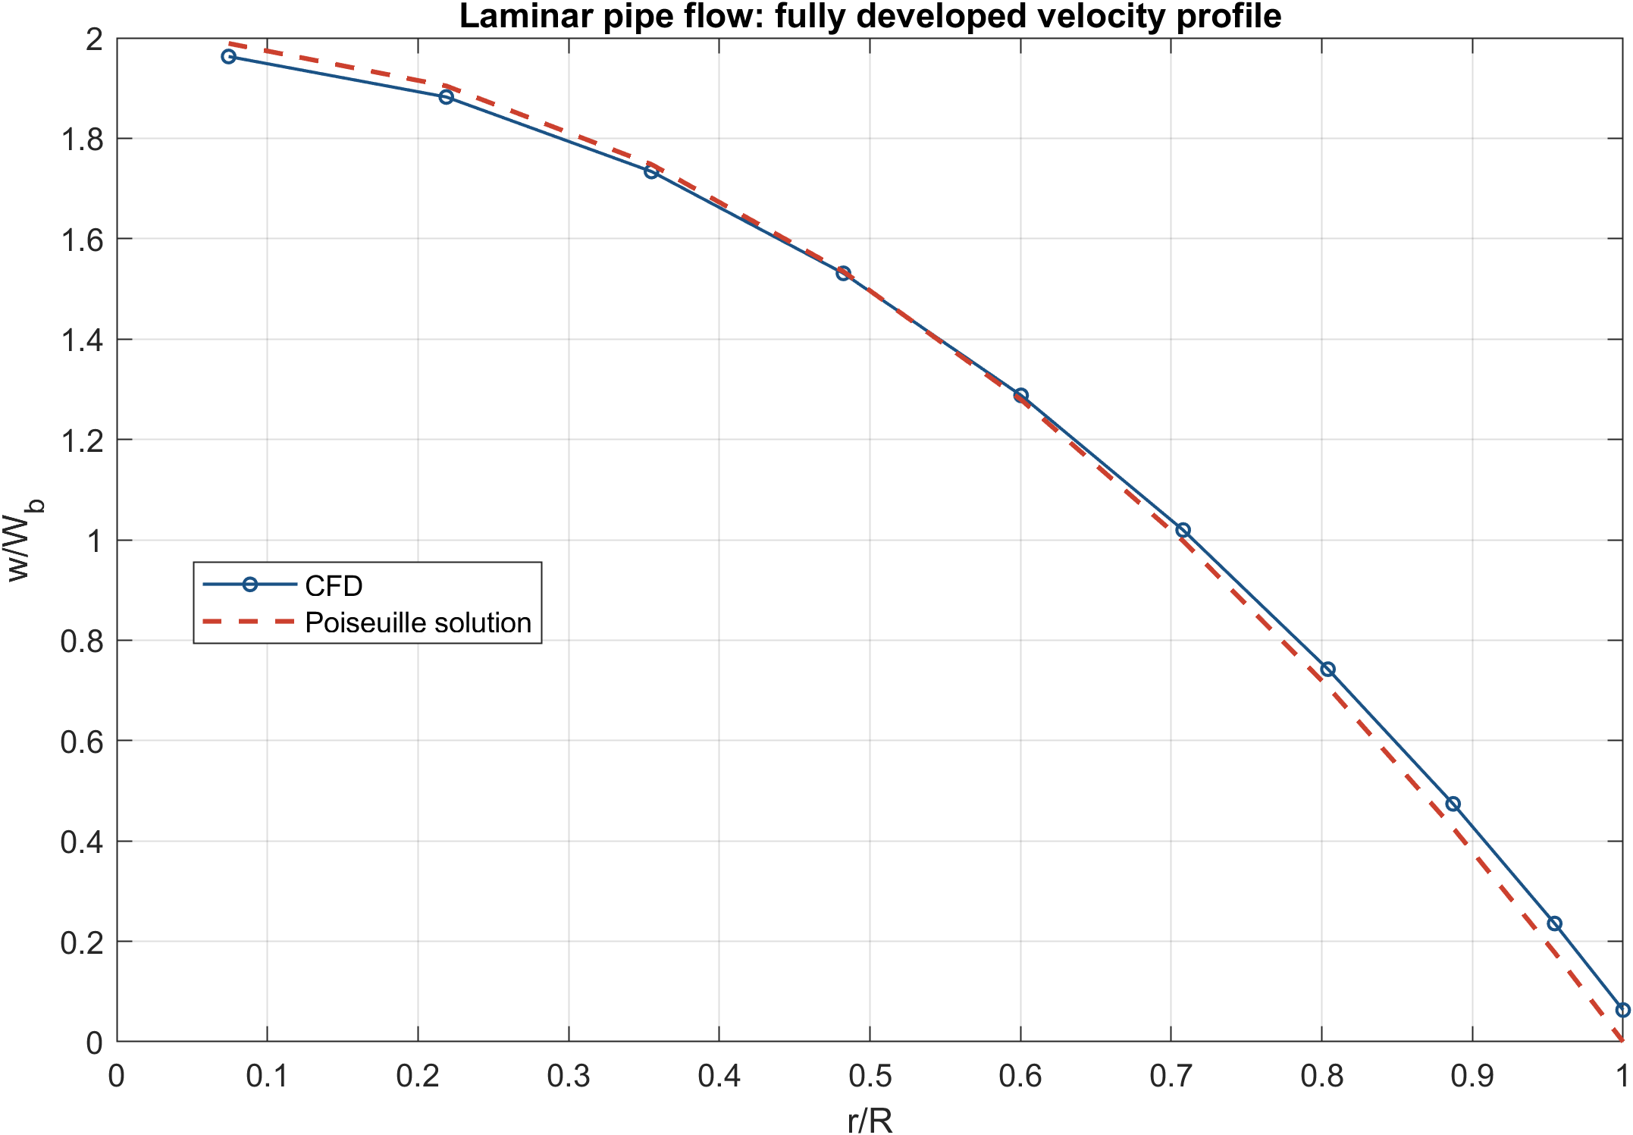
Laminar pipe-flow verification
The fully developed profile provides an analytical benchmark
Reference relation
w/W_b = 2[1 - (r/R)^2]
The extracted profile follows the expected parabolic distribution in the fully developed region.
Numerical bulk velocity
0.4523 m/s
Verification and validation of canonical fluid flows
3
Notes:
Use this case to establish the numerical verification logic. The full profile, rather than only one scalar output, is compared with the Poiseuille solution.

Slide 4
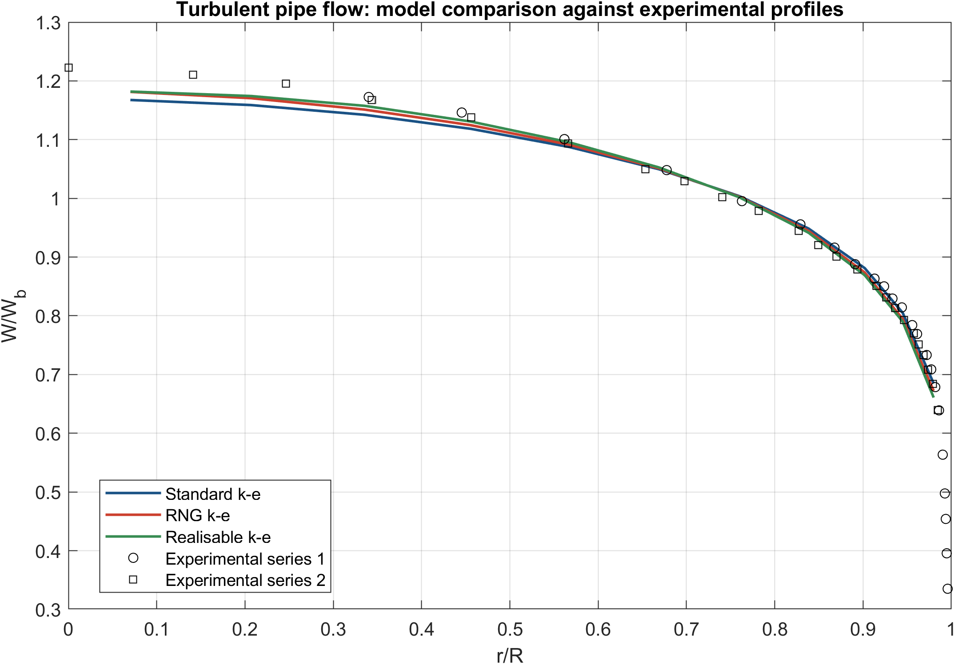
Turbulent pipe-flow validation
Velocity profiles and friction factor discriminate the selected turbulence closures
Re_b = 75,000
Reference friction factor
f = 0.0190
Standard k-e
f = 0.01898
0.082% relative error
RNG and realizable variants deviate by 3.14% and 6.04% in the present configuration.
Verification and validation of canonical fluid flows
4
Notes:
Describe the comparison as configuration-specific. Wall treatment, near-wall resolution, and boundary conditions influence the result. The standard k-e model gives the closest friction-factor estimate here.

Slide 5
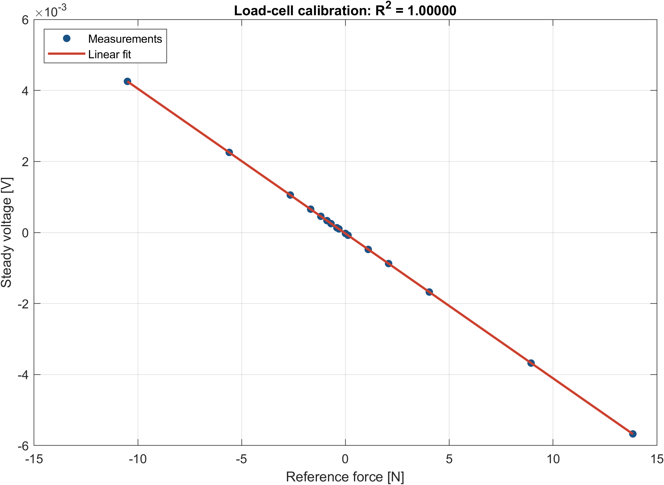
Force-transducer calibration
The force measurement chain is established before interpreting cylinder coefficients
Identified sensitivity
-4.07807 x 10^-4 V/N
Fit quality
R^2 = 0.999999
Force RMSE = 0.00572 N
Steady voltage was evaluated over the final 30% of each acquisition.
Verification and validation of canonical fluid flows
5
Notes:
State that calibration does not only provide a conversion factor. It also gives a quantitative residual error that frames the interpretation of force measurements.

Slide 6
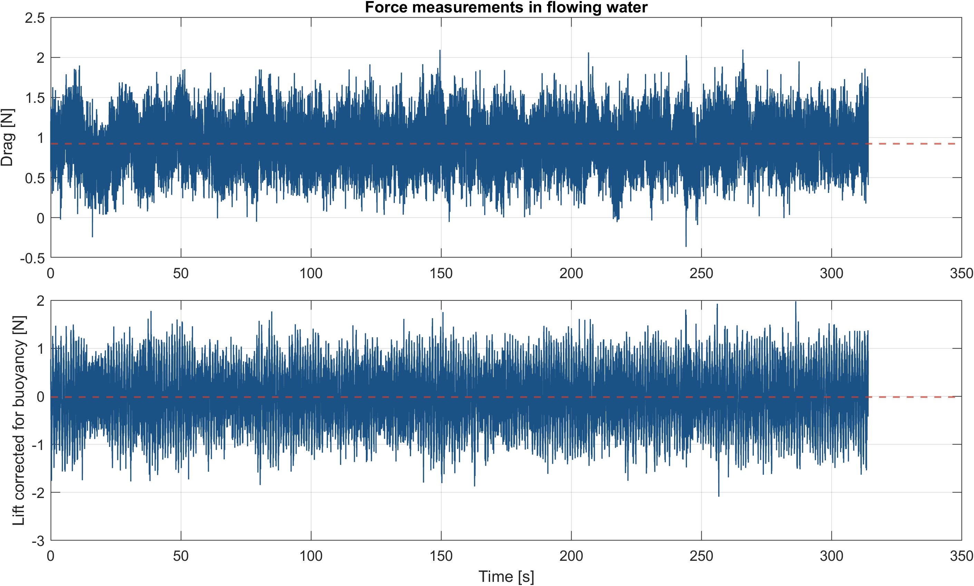
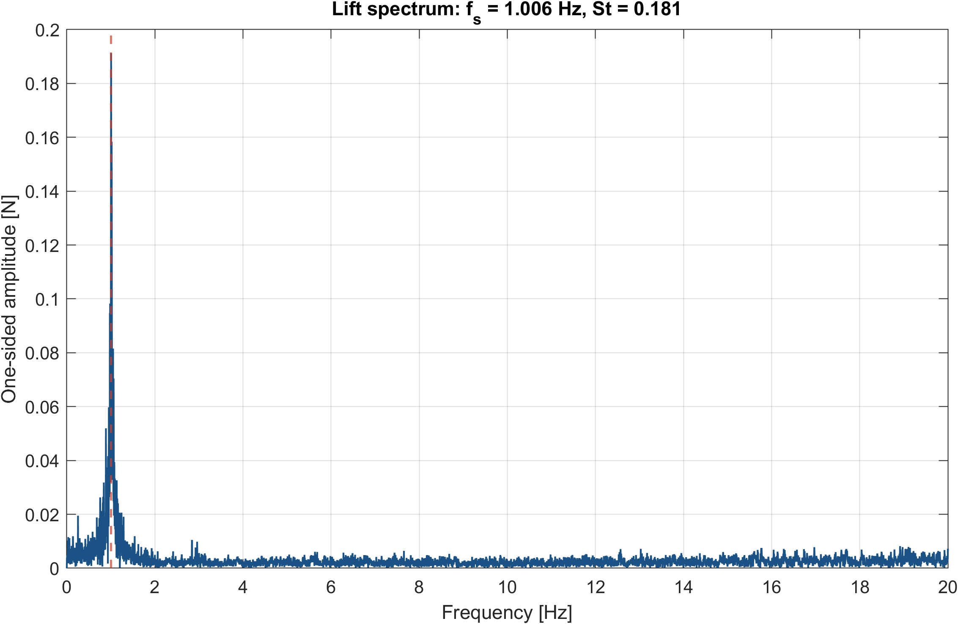
Cylinder forces and unsteady response
Buoyancy correction and spectral analysis identify the mean and periodic components
Mean coefficients: C_D = 1.4987, C_L = -0.0280
Dominant response: f_s = 1.0064 Hz, St = 0.1811
Verification and validation of canonical fluid flows
6
Notes:
The mean lift remains close to zero after buoyancy correction, whereas the time history contains the unsteady wake contribution. The spectral peak gives the dominant shedding frequency.

Slide 7
Conclusions and reproducibility
The repository turns a collection of laboratory analyses into a documented technical workflow
01
Laminar CFD reproduces the fully developed Poiseuille profile.
02
The standard k-e setup gives the closest turbulent friction factor in this comparison.
03
Calibrated force records yield a consistent drag coefficient and shedding frequency.
Reproduction: run('scripts/run_all.m')
Before public release, confirm redistribution rights for the external turbulent-pipe data.
Verification and validation of canonical fluid flows
7
Notes:
Close on the reproducibility statement. Mention the remaining data-rights check and the choice to keep proprietary PHOENICS runtime files outside version control.

