Slide 1
LLM Resource Allocation
PERSONAL PROJECT · SCIENTIFIC COMPUTING
A verified reference and CPU performance study
Antonio Arbizzani Tonelli
linkedin.com/in/antonio-arbizzani-tonelli
Python/Pyomo reference, serial C++20 port and OpenMP campaigns for a published allocation model. Formulation and GH/AGH algorithms: Cheng and Nguyen, arXiv:2604.07472.
github.com/antonio-arbizzani-tonelli/llm-resource-allocation · MIT license · October 2026
Notes:
Opening. The allocator chooses model deployments and routes demand across heterogeneous GPU options while meeting budget, capacity and service-level constraints. This project implements and verifies that allocation software, then measures its CPU runtime. The formulation and the GH/AGH algorithms are by Cheng and Nguyen (arXiv:2604.07472, v2 as the main source, v1 for the explicit operational LP); the implementation, explicit unit conventions, independent validation, C++20 port and measurements are this project's work. All experiments run on CPU with synthetic inputs; GPU capacity and latency are modeled coefficients. Every number in the deck is pinned to public commit 80a9625ab62a3c5c70ede7a9dae97a61158e250a, whose numerical payload matches checkpoint 543ad4e; the last appendix slide lists the sources.

Slide 2
Four measured results, each with its scope
OVERVIEW · RESULTS AT A GLANCE
63/63
Cross-language checks pass: 3,023 final values bitwise identical
48 placement cases (4 frozen) and 15 seeded-shuffle checks · bounded synthetic verification.
120.54×
Python/C++ core-timer ratio of medians, AGH 16×4×4, load 200
95% CI [109.75, 131.22] · complete invocation 99.70× · not a pure language effect.
4.02×
OpenMP throughput, 8 threads vs one thread, fixed 32-case batch
95% CI [3.76, 4.42] · 50.28% efficiency · 30 paired rounds · each solve stays serial.
1.94
Log-log slope of native AGH time: about 3.8× per doubling of queries
95% CI [1.93, 1.96] · 16–384 queries, five input seeds each · GH 1.66 · descriptive, not asymptotic.
Synthetic inputs, CPU only (i7-13620H, WSL) · GPU latencies are model coefficients · sources in Appendix A8.
2 / 21
Notes:
Four headline numbers, each with its denominator and limit. 63/63: retained cross-language suite (benchmarks/portfolio/raw/serial/parity.json: passed, total, sum of cases[*].compared_numeric_values = 3,023 with zero bitwise_difference_count). 120.54x: matched WP1 runtime, AGH 16x4x4 load 200, ratio of medians Python/C++ at the core timer, 95% CI [109.7530, 131.2151], ten paired rounds; complete invocation 99.7005 [93.2556, 107.2592] (benchmarks/matched_runtime_2026-10-14/analysis/analysis.json, rows case=16x4x4_load200_agh). The implementations have different preparation and trace costs, so this is not a language-only speedup. 4.02x: WP2, key 8_cores_close_dynamic_1_False_None against its own one-thread control, 95% CI [3.7636, 4.4243], efficiency 50.28%, 30 paired core rounds (benchmarks/openmp_diagnostics_2026-10-14/analysis/extension.json). 1.94: WP5 query fit for AGH, 1.9402 [1.9254, 1.9600]; GH 1.6615 [1.6402, 1.6798] (benchmarks/instance_scaling_2026-10-14/analysis/analysis.json, fits family=query). "About 3.8x per doubling" is 2 to the power 1.9402 = 3.84, a reading of the fit within the measured range only. All sources at commit 80a9625.

Slide 3

Allocation under service constraints
01 · THE PROBLEM
Choose model deployments and route demand across heterogeneous GPU options while meeting budget, capacity and service-level constraints.
Allocator
Models and GPU options
Workload
Chooses deployments, GPU counts, parallelism and routing.
Demand per query type, forecast or realized.
Heterogeneous options, modeled rather than measured on a cluster.
Budget
Capacity
SLOs
THIS PROJECT
Implements and verifies the allocation software, then measures its CPU runtime.
Formulation and GH/AGH: Cheng and Nguyen, arXiv:2604.07472 v2 (v1 for the operational LP).
3 / 21
Notes:
The allocator decides which models to deploy on which GPU options, with which tensor/pipeline configuration, and how to route each query type, under demand, budget, capacity and service-level constraints. GPU resources are modeled inputs; no GPU cluster was measured. This slide makes no numerical claim. Source: docs/MODEL.md, opening and "Stage 1: choose a deployment", at commit 80a9625; paper v2 https://arxiv.org/abs/2604.07472v2 and v1 https://arxiv.org/abs/2604.07472v1.

Slide 4
The allocation model: two decision stages
02 · MODEL
STAGE 1 · PLANNING
STAGE 2 · OPERATION
Choose deployment and nominal routing
Adapt routing to a supplied scenario
VARIABLE
GPU counts, model placement, TP/PP, routed and unmet fractions.
VARIABLE
Routed and unmet fractions, via the operational LP.
FIXED
Forecast demand and model coefficients.
FIXED
GPU counts, admissions and TP/PP from Stage 1.
Objective · GPU rental C1 + model storage C2 + data storage C3 + delay C4 + unmet demand C5
Constraints · demand balance, admission, compute, memory, storage, latency, error, budget on C1+C2+C3
GPU capacity and latency are model inputs · all runtime experiments execute allocation software on CPU.
4 / 21
Notes:
Stage 1 solves the deterministic problem, either exactly as the P_DM MILP or with the GH/AGH heuristics, and chooses the deployment and nominal routing. Stage 2 keeps the deployment fixed and minimizes C4+C5 under a supplied realized scenario; the explicit operational LP comes from paper v1, Eq. (12a)-(12f). Coherent KV, resident-data and period-cost conventions are documented project choices (docs/UNITS.md, Appendix A1), not conversion factors printed in the paper. Sources: docs/MODEL.md "Stage 1", "Physical units and explicit assumptions" and "Stage 2", commit 80a9625. Formulation: Cheng and Nguyen, arXiv:2604.07472 v2 and v1.

Slide 5

Python and Pyomo as the scientific reference
03 · PYTHON REFERENCE
Inputs
Algorithm or model
Decision record
Independent validator
Validated problem data with explicit units.
GH/AGH in Python, or a Pyomo MILP/LP solved by HiGHS or Gurobi.
Plain domain data; extraction never repairs a decision.
Recomputes constraints and objective; accepts or records failure.
KEPT AS SEPARATE EVIDENCE
SOLVER BOUNDARY
Completion
Constraint feasibility
Pyomo builds the model; the configured backend solves it. A time-limited incumbent is not a proven optimum, and a heuristic has no optimality certificate.
Objective agreement
Solver termination
Roles from docs/ARCHITECTURE.md and src/ · implementation responsibilities, not performance claims.
5 / 21
Notes:
Python implements the reference algorithms and the independent scientific checks. Pyomo builds the Stage-1 P_DM MILP and the Stage-2 LP for a configured solver backend (HiGHS by default in the examples, Gurobi optional with its own license). GH/AGH orchestration is ordinary Python on plain domain records, not Pyomo optimization. Extracted decisions become plain data; normalization never rebalances demand, repairs auxiliary products or adjusts a decision to pass constraints. Completion, constraint feasibility, objective agreement and solver termination are reported separately. Sources at commit 80a9625: docs/ARCHITECTURE.md "From problem data to accepted decisions"; src/llm_resource_allocation/optimization/pyomo_pdm.py, pyomo_stage2.py, pdm_run.py, stage2_run.py; src/llm_resource_allocation/validation/placement.py and stage2.py.

Slide 6
C++20 implements the same Stage-1 heuristics
04 · C++20 PORT
Component | Python reference | C++20 native
GH and AGH (Stage 1) | Reference implementation | Serial port, same decisions
Costs, traces, validation | Independent validator | Native checks; output re-validated in Python
P_DM exact MILP | Pyomo + HiGHS or Gurobi | Future work
Stage-2 operational LP | Pyomo + HiGHS or Gurobi | Future work
Experiment scheduling | Python experiment runners | OpenMP across independent cases
SAME NUMERICAL RULES
SEPARATE RESPONSIBILITIES
Explicit owned state, deterministic ordering, Python's summation order; no fast-math or FP contraction.
Input preparation, algorithms, validation and campaign scheduling live in separate modules.
Source: cpp/README.md and docs/ARCHITECTURE.md · commit 80a9625.
6 / 21
Notes:
The native code covers Stage-1 GH and AGH, their costs, traces and validation, not every Python component. Problem::prepare() validates external input and derives configuration indices; placements own routing, admission, deployment, unmet, configuration, GPU-count and auxiliary-product decisions, and the validator uses them all directly. Stable ties, canonical scans, seeded shuffles, first acceptance and early stopping are part of reproducibility; C++ preserves Python's floating summation conventions and disables floating contraction and fast-math. OpenMP sits only at the experiment-scheduling layer: each worker gets an independent prepared problem, options, seed and result slot, and each solve keeps its serial acceptance and stopping sequence. Native exact optimization and native Stage 2 remain future work. Sources at commit 80a9625: cpp/README.md, cpp/src/gh.cpp, agh.cpp, core.cpp, campaign.cpp; docs/ARCHITECTURE.md "State, ordering, and numerical policy" and "Where parallelism belongs".

Slide 7
Verification before performance comparison
05 · VERIFICATION
63/63
3,023
TWO DISTINCT CHECKS
Python and C++ decisions compared value by value, plus independent recomputation of constraints and objective.
cross-language checks pass: 48 placement cases (4 frozen) and 15 seeded-shuffle checks.
compared final numeric values, with zero bitwise differences.
STATED COVERAGE
WHAT PARITY SHOWS
Historical AGH Python runs at 256×4×4 and 128×8×8 failed with MemoryError: final-decision checks only, no Python time. In the scaling study, full parity covers 20 small points; 70 others have independent final-decision validation.
The port matches the reference. It does not prove the reference matches the paper.
Source: release parity check · bounded synthetic verification · commit 80a9625.
7 / 21
Notes:
Port first, measure second. Source at commit 80a9625: benchmarks/portfolio/raw/serial/parity.json, top-level passed=63 and total=63; summing cases[*].compared_numeric_values over the numeric-comparison cases gives 3,023, with zero bitwise_difference_count. The 15 seeded-shuffle cases belong to the 63 but carry no final-numeric field. docs/VALIDATION.md "Checks performed before publication" explains the checkpoint. These are synthetic checks. The separate October 13 campaign (16 full comparisons, 185,832 bit-identical values) is a different count and is not added to this one (Appendix A7). The two historical AGH Python references that raised MemoryError have no Python timing and no full algorithm parity. In the WP5 scaling study (benchmarks/instance_scaling_2026-10-14/analysis/analysis.json, points[*].verification_mode), full Python parity covers the 20 points at I=16 and 32; the other 70 have independent final-decision validation.

Slide 8
Matched runtime: core and complete invocation
06 · MATCHED RUNTIME
AGH, 16 queries × 4 models × 4 GPU tiers, load 200 · same WSL environment · ten paired rounds per timer.
Core timer · medians: Python 8.425 s, C++ 0.0699 s
TWO SEPARATE TIMERS
120.54×
Core: fresh public solve with traces and validation; excludes startup, parsing and output. Invocation: a Linux subprocess from startup to exit.
CI [109.75, 131.22]
Complete invocation · medians: Python 9.884 s, C++ 0.0991 s
99.70×
NOT A PURE LANGUAGE EFFECT
CI [93.26, 107.26]
Python validates input and builds PdmProblemData inside its timed call; C++ receives a prepared coefficient lattice. Trace costs also differ.
Bars: Python/C++ ratio of medians, common scale. Whiskers: 95% paired-round percentile bootstrap, 10,000 resamples.
Source: WP1 matched-runtime analysis · i7-13620H, WSL · commit 80a9625.
8 / 21
Notes:
Source at commit 80a9625: benchmarks/matched_runtime_2026-10-14/analysis/analysis.json, rows with case="16x4x4_load200_agh", boundary="core" and boundary="invocation" read separately; fields python.median_seconds, cpp.median_seconds and ratio.{ratio_of_medians, ci95_low, ci95_high}. Core: 120.5437, 95% CI [109.7530, 131.2151], medians Python 8.425024 s and C++ 0.069892 s. Invocation: 99.7005 [93.2556, 107.2592], medians 9.883960 s and 0.099137 s. AGH seed 37, beta 0.8. The core timer covers a fresh public solve, traces and internal validation, excluding startup, parsing, projection/output and destruction; same-process warmup excluded. Python validates input and prepares problem data inside the core call; C++ receives a prepared lattice before timing. Invocation is a separate Linux subprocess from startup through exit, with no in-process warmup. The two boundaries are separate paired samples and are never mixed. A median of paired ratios (117.83 core, 102.42 invocation) is a different estimator. Campaign coverage: 480/480 verified worker calls across 12 GH/AGH configurations (status.json); the full per-configuration plots are analysis/core_ratios.png and invocation_ratios.png. The historical 103.93x figure (Windows Python vs WSL C++, different timers) keeps its own scope and is not this result. Conditions: docs/EXTENSION_ENVIRONMENT.md.

Slide 9
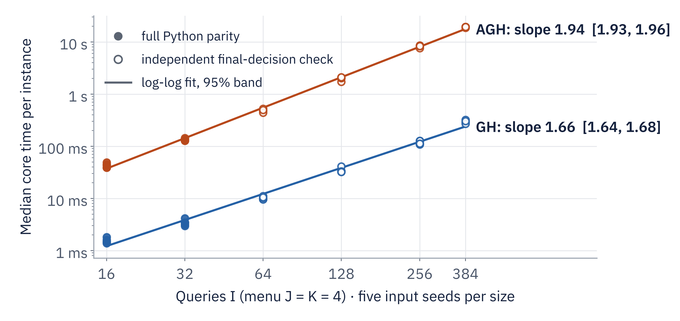
Native scaling across seeded instances
07 · SCALING
GH slope
1.6615
CI [1.6402, 1.6798] · R² 0.9903 · ≈3.2× time per doubling
AGH slope
1.9402
CI [1.9254, 1.9600] · R² 0.9975 · ≈3.8× time per doubling
DESIGN
Six sizes, five input seeds each · median of three core solves per instance.
Filled points: full Python parity (16 and 32 queries). Open points: independent final-decision checks. Fits describe the measured range, not asymptotic complexity.
Source: WP5 instance-scaling analysis · 5 seed clusters, 10,000 draws · commit 80a9625.
9 / 21
Notes:
Source at commit 80a9625: benchmarks/instance_scaling_2026-10-14/analysis/analysis.json, fits where family="query" and method="gh" or "agh", fields fit.{exponent, ci95_exponent_low, ci95_exponent_high, r_squared_log_space, predicted}; per-instance medians in analysis/instance_timings.csv. The chart is redrawn from those two files for legibility (the repository's analysis/query_scaling.png shows the same data, colored by seed). Query levels 16/32/64/128/256/384 at J=K=4; instance seeds 11/23/37/41/53, separate from AGH seed 37. The statistical input is each instance's median of three native core solves; intervals resample five complete seed clusters (10,000 draws, seed 20261014) holding those medians fixed. "Per doubling" is 2 to the power of the fitted slope (2^1.6615 = 3.16, 2^1.9402 = 3.84), a reading of the fit within the measured range only. Core includes native traces and validation and excludes startup, parsing, output and destruction. Coverage: 90/90 method/instance points and 270/270 samples, all independently feasible; full Python parity covers the 20 points at I=16 and 32 only. Not an asymptotic complexity claim, no extrapolation. Larger menus: Appendix A2.

Slide 10
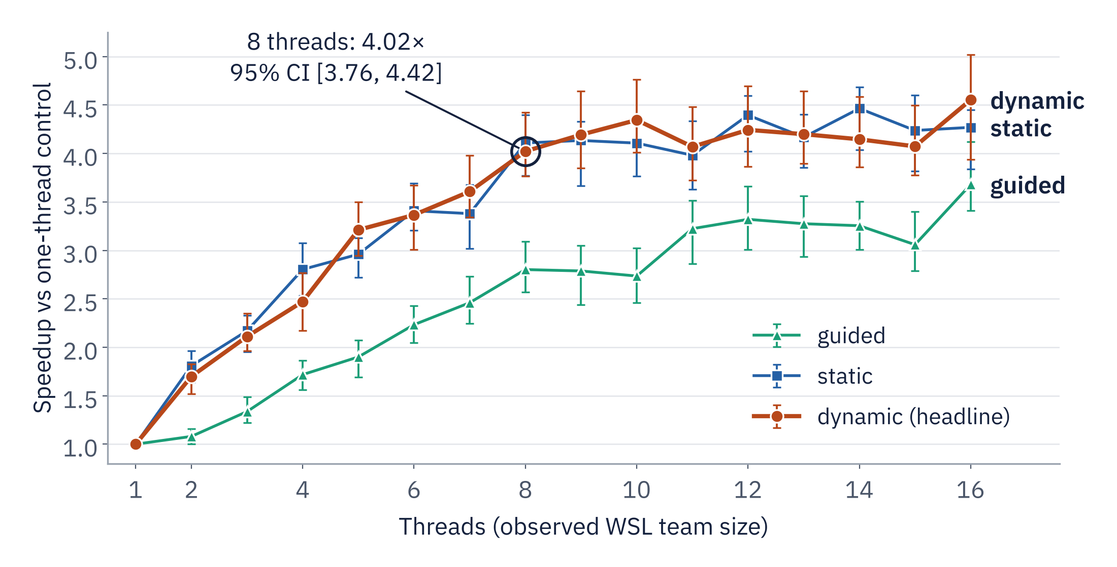
OpenMP runs independent cases concurrently
08 · OPENMP
4.02×
8 threads, dynamic, vs its own one-thread control · 95% CI [3.76, 4.42]
50.28%
efficiency = speedup / 8
WORK UNIT
One independent allocation case per task. Each GH/AGH solve stays serial; this is batch throughput, not a faster single solve or GPU inference.
Fixed mixed batch of 32 GH/AGH cases · cores/close · chunk 1 · unsorted · default allocator · 30 paired core rounds.
Source: WP2 OpenMP analysis · i7-13620H, WSL · commit 80a9625.
10 / 21
Notes:
Source at commit 80a9625: benchmarks/openmp_diagnostics_2026-10-14/analysis/extension.json, settings key "8_cores_close_dynamic_1_False_None", field speedup_vs_same_setting_one_thread.{ratio_of_medians, ci95_low, ci95_high} = 4.0223 [3.7636, 4.4243], valid_rounds=30; one-thread control key "1_cores_close_dynamic_1_False_None" (median 1.008776 s); eight-thread median 0.250794 s. Efficiency is the displayed speedup divided by eight. The chart is redrawn from the same file: keys "T_cores_close_S_1_False_None", with T the thread count from 1 to 16 and S one of static, dynamic or guided, 10,000 paired-round percentile resamples, seed 20261014; it shows the same series as the repository's plots/speedup.png. The core timer includes team creation and barriers and excludes parsing, output and warmup. This confirms a local throughput gain for the stated batch; the settings search is exploratory and a selected minimum is not an optimum. Physical P/E-core, cache, SMT and throttling causes remain unresolved in WSL (next slide). The older 18-round campaign (4.20x core, 2.27x invocation) keeps its own scope and is not combined with these thirty-round figures (Appendix A7). Native scheduling code: cpp/src/campaign.cpp.

Slide 11
Diagnosing the lost efficiency
09 · OPENMP DIAGNOSTICS
6,030/6,030
6.23%
14.13%
4.55×
observations: 201 settings × 30 rounds
wall-idle proxy at 8 threads
Amdahl-equivalent serial fraction (a fit)
16 threads, CI [3.94, 5.02], 28.46% efficiency
Hypothesis | Intervention or measurement | Outcome
Load balance | Schedule, chunk and case-ordering interventions; per-worker wall time | Sorting gain unestablished: 1.0053 [0.959, 1.200] at 16 threads
Memory allocator | MALLOC_ARENA_MAX=1 at 8 threads, same setting | Much slower: median 2.989 s vs 0.251 s
Thread placement | Places and binding levels at dynamic, chunk 1 | One exploratory gain: cores/spread at 4 threads, 1.138 [1.070, 1.264]
Hardware causes | P/E cores, SMT, cache bandwidth, frequency | Unresolved: WSL hides topology; no counters or frequency series
Source: WP2 OpenMP analysis · unadjusted exploratory intervals · commit 80a9625.
11 / 21
Notes:
What explains 50% efficiency? Tested, not resolved. All 201 settings x 30 rotated rounds = 6,030/6,030 observations completed with matching compact projections and zero failures (factor-separable design; the full 585-setting interaction grid was skipped). At the eight-thread baseline the median wall-idle proxy is only 6.2262%, so 50.28% efficiency does not mean half the time idle; the Amdahl-equivalent serial fraction, 14.1272%, is a response-time fit, not measured serial code. Sixteen threads: 4.5536 [3.9406, 5.0207], 28.46% efficiency. Same-team controls divide the control median by the candidate median: sorting at 16 threads 1.0053 [0.9592, 1.1998], interval includes one; MALLOC_ARENA_MAX=1 at eight threads 0.08390 [0.07616, 0.08836] (candidate median 2.989136 s), so the restriction slows the workload; the lone above-one binding interval is cores/spread vs cores/close at four threads, 1.1377 [1.0703, 1.2643], exploratory. Intervals are unadjusted across many dependent comparisons. WSL cannot identify physical P/E cores or offer an SMT intervention; perf counters and frequency/temperature series are unavailable. Sources at commit 80a9625: benchmarks/openmp_diagnostics_2026-10-14/analysis/extension.json, same_team_controls.csv, thread_statistics.csv, decomposition.csv; docs/EXTENSION_REPORT.md "WP2".

Slide 12
What this project demonstrates
10 · SKILLS
Optimization modeling
C++20 engineering
Verification
Pyomo MILP and LP models solved with HiGHS or Gurobi; GH and AGH heuristics; explicit units.
Serial GH/AGH port with deterministic ordering and no fast-math; release and ASan/UBSan checks.
Independent validator; 63/63 cross-language checks with 3,023 values bitwise identical.
Performance measurement
Reproducibility
Honest reporting
Separate timers, paired rounds and bootstrap intervals; OpenMP across independent cases.
Seeded inputs, replay commands and a SHA-256 manifest of 3,572 published files.
Negative and open results kept: allocator slowdown, unestablished sorting gain, rejected incumbents.
Algorithms: Cheng and Nguyen, arXiv:2604.07472 · this project: implementation, verification, measurement.
12 / 21
Notes:
Each card points to evidence shown in the deck. The formulation and the GH/AGH algorithms are by Cheng and Nguyen; this project adds the verified implementation, the independent validator, the C++20 port with bitwise parity, matched runtime measurements, OpenMP diagnostics, the Stage-2 studies and the way limits and failures are reported. The release and ASan/UBSan checks, 63/63 parity cases and 1,131 Python tests with zero skips are the recorded WP8 verification at checkpoint 543ad4e (docs/KEY_NUMBERS.md "Verification scope"), historical results rather than tests rerun for this deck. The manifest count comes from docs/PUBLICATION_REVIEW.md and release-manifest.json; python scripts/prepare_release.py --check verifies it.

Slide 13
What is done, what is measured, what is open
11 · CONTRIBUTION AND LIMITS
IMPLEMENTED
MEASURED
STILL OPEN
Python/Pyomo reference and independent validator
Serial C++20 GH and AGH
OpenMP across independent cases
Opt-in relative Stage-2 objective tolerance
Local CPU runtime on synthetic inputs
Separate core and invocation timers
Paired rounds and bootstrap intervals
Stated verification coverage
Author-data calibration
Native exact and Stage-2 solvers
Memory profiling
A validated MPI implementation
Physical causes of OpenMP efficiency loss
NOT CLAIMED
REPOSITORY · MIT LICENSE · CONTACT
GPU-serving speed, real cloud savings, heuristic optimality or replication of the paper's tables.
github.com/antonio-arbizzani-tonelli/llm-resource-allocation
linkedin.com/in/antonio-arbizzani-tonelli
Original work: Cheng and Nguyen, arXiv:2604.07472 · measurements here are this project's own · CITATION.cff in the repository.
13 / 21
Notes:
Close by connecting each claim to its evidence rather than repeating a headline speedup. Implemented: the Python/Pyomo reference, serial C++20 GH/AGH, independent checks, OpenMP across experimental cases and the opt-in relative Stage-2 objective tolerance (docs/STAGE2_OBJECTIVE_POLICY.md; the default stays absolute 1e-8 USD, relative zero). Measured: local CPU runtime on retained synthetic inputs with explicit timer boundaries and verification coverage. Still open: author-data calibration (the paper's calibration is unavailable), native exact and Stage-2 integration, memory profiling (optional WP7 was skipped), a validated MPI implementation, and the physical causes of OpenMP efficiency loss. Local runtime ratios do not demonstrate GPU-serving acceleration or real cloud savings; heuristic results are not proven optima; the synthetic verification does not complete numerical replication of the paper's tables. Sources at commit 80a9625: docs/ARCHITECTURE.md "Where parallelism belongs"; docs/EXTENSION_REPORT.md "Interpretation and remaining limits"; docs/KEY_NUMBERS.md. The software is MIT-licensed; CITATION.cff asks to cite the software and, separately, Cheng and Nguyen.

Slide 14
An explicit dimensional convention
APPENDIX A1 · UNITS
Quantity | Unit
Arrival rate λ | requests/hour
KV residency | seconds/request
Data residency | hours
Horizon H | hours
Processing delay | seconds/request
Delay penalty | USD/(ms·request)
ONE CONVERSION, SPELLED OUT
KV GB per GPU = β · r · T_res · (λ / 3600) · v / (TP · PP)
λ is in requests per hour and T_res in seconds, so the factor 3600 turns arrivals into average concurrent requests.
The historical printed arithmetic stays available and clearly labeled as LITERAL_PAPER; new instances are COHERENT.
The dimensional reading is a project choice, not a claim about what the paper printed.
14 / 21
Notes:
Hours, seconds, milliseconds, KV concurrency and resident data each have an explicit boundary, converted once at the input boundary. Conversion constants live in a single module. Details are in docs/UNITS.md.

Slide 15
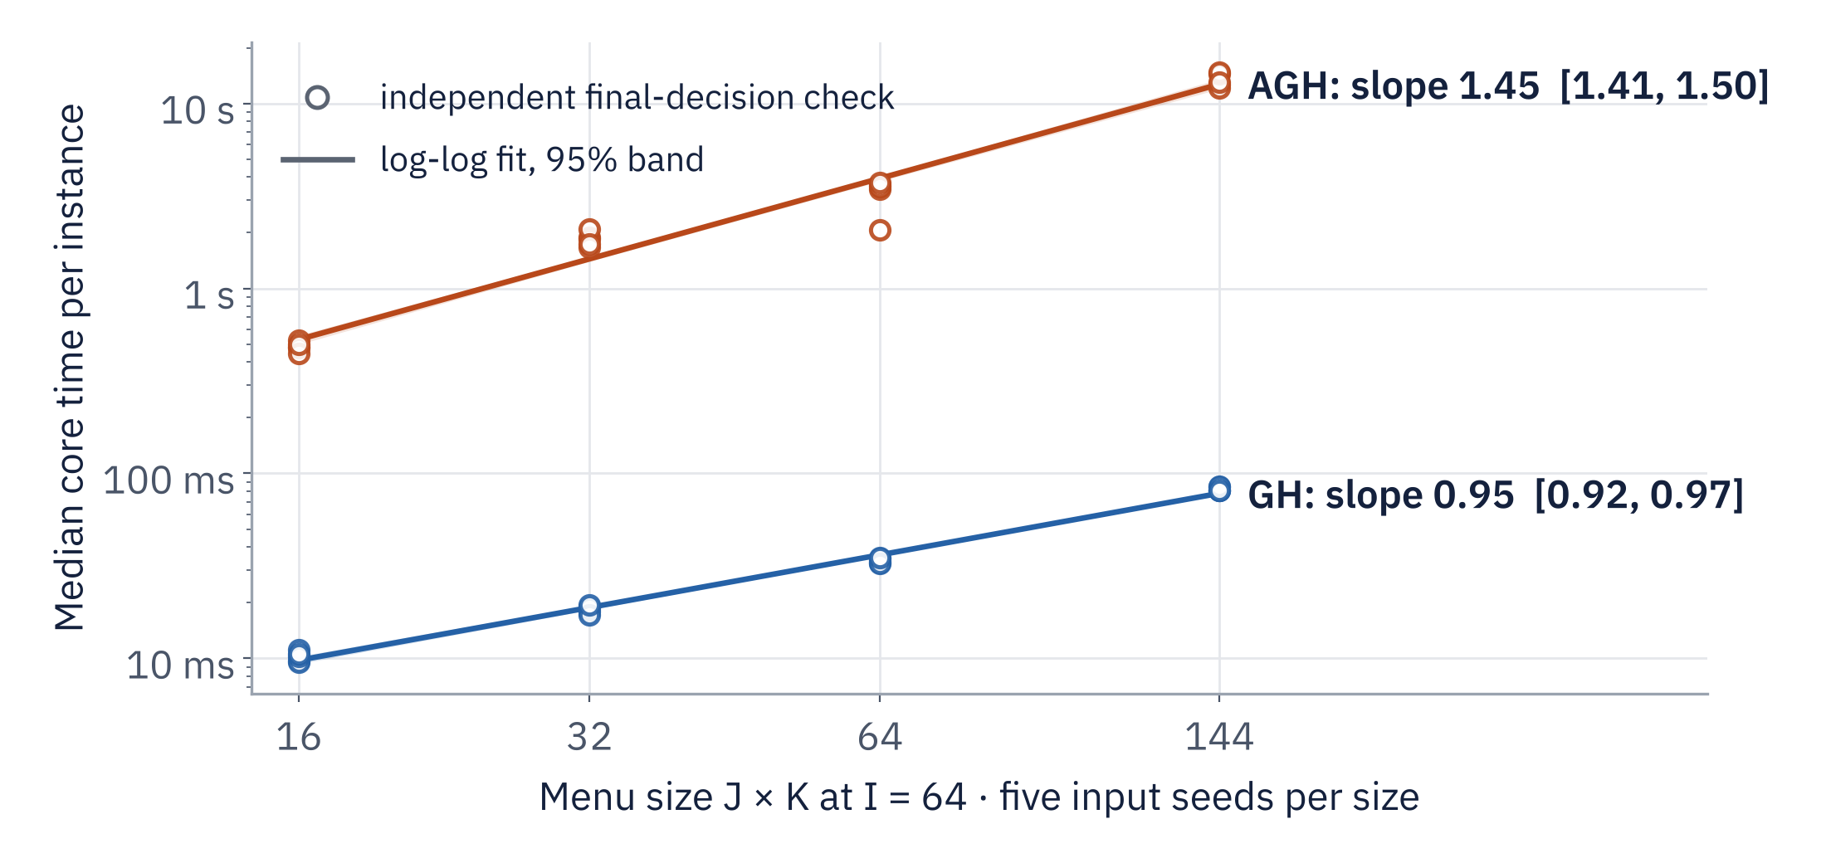
Larger model and GPU-tier menus at 64 queries
APPENDIX A2 · MENU SCALING
GH slope
0.9455
CI [0.9185, 0.9707] · R² 0.9928
AGH slope
1.4461
CI [1.4065, 1.4998] · R² 0.9694
LIMIT
Menu aspect ratios and structural branches confound a single product exponent.
Menus 4×4, 8×4, 8×8 and 12×12 at I = 64 (products 16–144). Every point has an independent final-decision check.
Source: WP5 instance-scaling analysis · descriptive observed-range fits · commit 80a9625.
15 / 21
Notes:
Source at commit 80a9625: benchmarks/instance_scaling_2026-10-14/analysis/analysis.json, fits where family="menu" and method="gh" or "agh"; per-instance medians in analysis/instance_timings.csv; the chart is redrawn from those files (the repository's analysis/menu_scaling.png shows the same data, colored by seed). Menus 4x4, 8x4, 8x8 and 12x12 at I=64, products 16/32/64/144; the 64x4x4 points are shared with the query study and measured once; 20/20 feasible points per method. Intervals resample five complete seed clusters, 10,000 draws, seed 20261014. Five clusters limit precision, and menu aspect ratios and structural branches confound a single product exponent: the fit does not establish a universal exponent for the product of menu dimensions. Descriptive over the measured range, no extrapolation.

Slide 16
More solver time changes the ordering on one input
APPENDIX A3 · SOLVER BUDGETS
10×10×10, LOAD 1 · ACCEPTED MODELED COST, USD
AGH · accepted heuristic
1,150.055
HiGHS 20 s · incumbent
1,274.759
HiGHS 120 s · incumbent
915.549
HiGHS 600 s · incumbent
915.549
18/20
12/12
0.845 → 2.103
measured jobs accepted (20/20 completed) on four fixed inputs, fresh cold solves
MILPs end at the time limit; normalized gaps 0.987–0.99999998: weak bounds, no optimum
median AGH/HiGHS cost: 20 s (4/4 pairs) vs 120 and 600 s (3/4 pairs); cohorts differ
Source: WP6 solver-quality analysis · HiGHS only: Gurobi WSL license unavailable · commit 80a9625.
16 / 21
Notes:
Source at commit 80a9625: benchmarks/solver_quality_2026-10-14/analysis.json, rows 10x10x10_L1_agh, 10x10x10_L1_highs_20, _highs_120 and _highs_600; fields usable_objective_usd, accepted, solver_status, best_bound_usd and normalized_gap; complete table in REPORT.md. AGH 1,150.055 USD; HiGHS 1,274.759 USD at 20 s (bound 11.42, normalized gap 0.991), 915.549 USD at 120 s and 600 s (gaps 0.987-0.988). All HiGHS results are time-limited incumbents with weak bounds and no optimality proof. Cohort: four fixed coherent inputs (10x10x10 at loads 1/200/100,000 and 6x6x10 at 100,000), 20/20 measured jobs, 18/20 accepted; the 10x10x10/load200/120 s and 6x6x10/load100,000/600 s incumbents fail independent constraints. Median AGH/HiGHS cost ratio 0.845329 at 20 s (4/4 pairs) and 2.103171 at 120 and 600 s (3/4 pairs), descriptive intervals from 5,000 accepted-case resamples; ratios below one favor AGH. The longer-limit cohorts exclude different cases, so this is a local ordering change, not a general method ranking. Gurobi was skipped because its WSL license did not cover these cases; the October backend comparison (Gurobi incumbents) is a separate, older evidence set.

Slide 17
Standard policy: 1,850 operational attempts
APPENDIX A4 · STAGE 2, ORIGINAL CAMPAIGN (OCT 13)
OUTCOME OF EACH ATTEMPTED LP
37/40
Scientifically usable
646
Stage-1 sources accepted; all 40 jobs completed
1,000
Solver-infeasible
19.05%
256 of 1,344 frozen-routing failures recovered by adaptation
Objective-only rejection
204
5.86%
Skipped, not attempted
150
summed C4+C5 reduction over 390 usable pairs; no savings for infeasible baselines
A completed run is not an accepted decision. The 150 skipped scenarios follow three rejected Stage-1 sources and lie outside the 1,850 attempts.
Source: original Stage-2 analysis · absolute 1e-8 USD objective agreement · commit 80a9625.
17 / 21
Notes:
October 13 campaign, standard policy. Source at commit 80a9625: benchmarks/stage2_stress_2026-10-13/analysis/analysis.json, top-level completed_jobs, accepted_sources and rejected_source_diagnostics; overall.{attempted_scenarios, stage2_status_counts, frozen_infeasible_scenarios, recovered_scenarios, paired_cost_scenarios, paired_cost_reduction_fraction_of_baseline_sum}. The outcome bars are redrawn from stage2_status_counts on a common scale (the repository's plots/outcomes.png shows the same counts); the dashed bar marks scenarios outside the denominator. Forty completed source jobs, thirty-seven accepted sources, 1,850 operational LP attempts: 646 usable, 1,000 solver-infeasible, 204 objective-only rejections. 150 scenarios were skipped after three rejected Stage-1 sources. Adaptation recovers 256/1,344 frozen-routing failures (19.0476%). Summed C4+C5 falls by 5.857419% over 390 usable frozen/adapted pairs; reduction = (sum frozen - sum adapted) / sum frozen on identical usable scenarios, with no savings assigned to infeasible baselines. The retained policy uses absolute objective agreement 1e-8 USD and relative zero; completed jobs and solver-optimal status do not imply scientific acceptance (docs/STAGE2_RESULTS.md). The method breakdown (GH 85 pairs, AGH 255, P_DM 50) documents coverage, not a ranking.

Slide 18
Same decisions, optional relative tolerance
APPENDIX A5 · RETROSPECTIVE POLICY REPLAY
USABLE ATTEMPTS OUT OF 1,850
204/204
Absolute 1e-8 USD (default)
646
objective-only rejections accepted: 1–3 floating-point spacings apart
850
Opt-in relative 1e-12
1,000
solver-infeasible attempts still rejected
Policy | Recovered | C4+C5 reduction, 95% CI (usable pairs)
Absolute default | 256/1,344 | 5.86% [5.18, 6.12] (390)
Opt-in relative | 344/1,344 | 5.96% [5.75, 6.06] (506)
~2e-6
injected relative objective error is still rejected
Rule |a−b| ≤ max(abs_tol, rel_tol·max(|a|,|b|)). No LP solved, no decision repaired; defaults unchanged. Different cohorts: not a causal policy benefit.
Source: WP3 policy-replay analysis · retrospective, no new solves · commit 80a9625.
18 / 21
Notes:
Retrospective re-evaluation of the same retained October 13 decisions with the optional relative objective tolerance 1e-12. No LP is solved and no decision is repaired. Source at commit 80a9625: benchmarks/stage2_policy_2026-10-14/analysis.json, old_policy and selected_policy (usable, newly_usable, frozen_failures, recovered, paired_scenarios, paired_reduction_fraction, source_cluster_bootstrap.ci95) and mutation_check; rule in docs/STAGE2_OBJECTIVE_POLICY.md. The bars and table are redrawn from those fields (the repository's plots/policy_comparison.png shows the same values). Result: 204/204 objective-only rejections become usable, 850/1,850 usable attempts; all 1,000 infeasible attempts remain rejected; recovery 344/1,344 = 25.5952% vs 256/1,344 = 19.0476%. Paired summed C4+C5 reduction 5.957974%, 95% CI [5.745418%, 6.063490%], over 506 usable pairs in 37 source-grid clusters, vs 5.857419% [5.178352%, 6.117907%] over 390 pairs; the changed cohort prevents reading the difference as a causal policy benefit. An injected relative error of about 2e-6 is rejected; all seven nonzero coefficients from 1e-12 to 1e-6 recover the same 204. The 204 differences were 1-3 floating-point spacings, maximum relative 3.40e-16 (e.g. 76,006,408.80000001 vs 76,006,408.8 USD). Defaults remain absolute 1e-8 USD and relative zero; constraint tolerances and Stage-1 acceptance are unchanged. This establishes acceptance of these observed roundoff cases, not universal solver precision.

Slide 19
New matched solves across four loads
APPENDIX A6 · STAGE 2, NEW CAMPAIGN (OCT 14)
3,246/6,800
136/144
400
40/48
usable LPs; 3,554 solver-infeasible
sources accepted, all 144 complete
planned LPs unattempted: 8 rejected P_DM sources
inputs accepted for all methods: no ranking
Nominal load | Recovered / frozen failures | Usable cost pairs | C4+C5 reduction, 95% CI
200 | 330/1,260 (26.19%) | 540 | 4.95% [4.64, 5.18]
2,000 | 280/1,260 (22.22%) | 540 | 4.92% [4.63, 5.15]
20,000 | 400/1,220 (32.79%) | 530 | 5.16% [4.73, 5.53]
100,000 | 311/1,135 (27.40%) | 315 | 5.43% [4.98, 5.87]
Explicit relative objective tolerance 1e-12, HiGHS, 20 s limits. Reduction = (Σ frozen − Σ adapted) / Σ frozen on identical usable pairs; infeasible baselines get no savings, and lower modeled cost may come with more unmet demand.
Source: WP4 Stage-2 analysis · 12 input clusters per load · conditional synthetic grid · commit 80a9625.
19 / 21
Notes:
Separate October 14 campaign with new solves. Source at commit 80a9625: benchmarks/stage2_robustness_2026-10-14/analysis.json, completed_sources, accepted_sources, attempted_lps, status_counts and by_load keys "200.0", "2000.0", "20000.0", "100000.0" (recovered, frozen_failures, paired_scenarios, paired_reduction_fraction, source_cluster_bootstrap.ci95); source_results.json. Exact values: load 200, 330/1,260 = 26.1905%, 540 pairs, 4.945490% [4.640838%, 5.177031%]; load 2,000, 280/1,260 = 22.2222%, 540 pairs, 4.923512% [4.628603%, 5.146725%]; load 20,000, 400/1,220 = 32.7869%, 530 pairs, 5.156249% [4.726027%, 5.526150%]; load 100,000, 311/1,135 = 27.4009%, 315 pairs, 5.433509% [4.983066%, 5.865710%]. Intervals resample twelve shared-input clusters per load, 10,000 draws. Eight time-limited P_DM incumbents fail the unchanged Stage-1 absolute-only 1e-8 USD objective agreement and skip 400 planned LPs. The accepted three-method intersection is 40/48 input identities (12/12, 12/12, 11/12, 5/12 by load); pooled per-load rows include unmatched accepted inputs and support no method ranking. Historical diagnosis of the original 1,000 infeasible LPs: 940 error-SLO, 120 compute-capacity, 60 overlapping, zero unexplained (historical_infeasibility.json); these are lower-bound certificates, not exclusive causes. Conditional synthetic-grid results, not real-world probabilities or cloud bills.

Slide 20
Earlier results keep their own scope
APPENDIX A7 · EVIDENCE SETS
Evidence set | Headline | Why it stays separate
Release parity suite | 63/63 checks · 3,023 values bitwise | Bounded fixture suite: 48 placement, 15 shuffle
Full comparisons, Oct 13 | 16 comparisons · 185,832 values bitwise | Two AGH MemoryError points: final-decision only
Cross-platform timing, Oct 13 | 103.93× AGH 16×4×4, load 200 | Windows Python vs WSL C++, different timers
OpenMP campaign, Oct 13 | 4.20× core · 2.27× invocation | 18 rounds; not combined with the 30-round study
OpenMP 16-case, Oct 11–12 | 5.16× core, 16 large AGH | Minima of three rounds, different batch
Allocation quality, Oct 11–12 | AGH vs GH rental C1: 9 → 8 USD | C1 −11.1%; total score only 0.087–0.278%
Validator probe, Oct 11–12 | Parallel validator slower than serial | Negative result kept; validation stays serial
Checkpoint 543ad4e | 1,131 Python tests; ASan/UBSan | Development tree; public tree omits one module
Sources: docs/RESULTS.md, PERFORMANCE.md, VALIDATION.md, KEY_NUMBERS.md · commit 80a9625.
20 / 21
Notes:
Each campaign has its own inputs, timers and accepted cohort; favorable values from different sets are never combined. The release suite (benchmarks/portfolio/raw/serial/parity.json) is a bounded fixture check. The October 13 performance campaign's 16 complete Python/C++ comparisons check 185,832 values without a bitwise difference (benchmarks/performance_2026-10-13/analysis/analysis.json, serial[*].verification_mode and compared_numeric_values; docs/PERFORMANCE.md); two AGH Python references raised MemoryError and have final-decision checks only. The cross-platform 103.93x ratio (Python 4.774378 s on Windows vs C++ core 0.045939 s on WSL; docs/RESULTS.md) has different timer boundaries and is superseded for presentation by the matched WP1 study. The October 13 OpenMP campaign (18 rounds, 4.20x core, 2.27x invocation) and the October 11-12 16-case campaign (5.16x core, 64.5% efficiency, minima of three rounds) keep their own scope. October 11-12 allocation quality (docs/RESULTS.md): on eight shared synthetic cases AGH lowers GPU rental C1 from 9 to 8 USD (11.1%) while C2-C5 and service match GH; the nominal total score moves by only 0.087-0.278%. October 11-12 validator probe (benchmarks/portfolio/plots/validation_grain.png): at AGH 32 queries, serial 0.102698 s vs 0.109183, 0.133577, 0.205992 s with 2, 4, 8 threads, so production validation stays serial (docs/ARCHITECTURE.md "Where parallelism belongs"). WP8 recorded 1,131 Python tests with zero skips, native release and ASan/UBSan checks, 63/63 parity cases and 90 OpenMP comparisons at checkpoint 543ad4e (docs/KEY_NUMBERS.md "Verification scope"). The public tree omits the development-document test module (docs/VALIDATION.md); a fresh base install of the public tree on 15 October 2026 ran 1,126 tests with four optional skips (Gurobi, matplotlib), a local check rather than a retained artifact.

Slide 21
Claim-to-source table
APPENDIX A8 · SOURCES
Paths under benchmarks/ at public commit 80a9625ab62a3c5c70ede7a9dae97a61158e250a; its numerical payload matches checkpoint 543ad4e.
Study (slides) | Artifact | Selector
Release parity (7) | portfolio/raw/serial/parity.json | passed, total; Σ compared_numeric_values
WP1 runtime (8) | matched_runtime_2026-10-14/analysis/analysis.json | case 16x4x4_load200_agh; core, invocation
WP5 scaling (9, A2) | instance_scaling_2026-10-14/analysis/analysis.json | fits: family query/menu, method gh/agh
WP2 OpenMP (10, 11) | openmp_diagnostics_2026-10-14/analysis/extension.json | key 8_cores_close_dynamic_1_False_None
WP6 solver (A3) | solver_quality_2026-10-14/analysis.json | rows 10x10x10_L1_agh, _highs_20/120/600
Stage 2, Oct 13 (A4) | stage2_stress_2026-10-13/analysis/analysis.json | overall: status counts, recovery, pairs
WP3 replay (A5) | stage2_policy_2026-10-14/analysis.json | old_policy, selected_policy
WP4 Stage 2 (A6) | stage2_robustness_2026-10-14/analysis.json | sources, status_counts, by_load
Replay commands: docs/KEY_NUMBERS.md · interpretation: EXTENSION_REPORT.md, MODEL.md, ARCHITECTURE.md, VALIDATION.md.
21 / 21
Notes:
Every numerical claim in the deck maps to one retained artifact at public commit 80a9625ab62a3c5c70ede7a9dae97a61158e250a (base URL https://github.com/antonio-arbizzani-tonelli/llm-resource-allocation/blob/80a9625ab62a3c5c70ede7a9dae97a61158e250a/ followed by benchmarks/ and the path). The numerical payload matches extension checkpoint 543ad4e640100a4c2a69febf17fe885bd452861e. Charts redrawn for legibility use only these files: the OpenMP speedup curves (extension.json settings keys), the scaling charts (analysis.json fits plus analysis/instance_timings.csv), and the Stage-2 outcome and policy bars (analysis.json counts). The policy replay also uses mutation_check and docs/STAGE2_OBJECTIVE_POLICY.md; the new Stage-2 campaign also uses source_results.json and historical_infeasibility.json; the OpenMP diagnostics slide also uses same_team_controls.csv, thread_statistics.csv and decomposition.csv. The replay commands in docs/KEY_NUMBERS.md regenerate the analyses from retained evidence without rerunning timed algorithms or solving LPs/MILPs. Formulation and algorithms: Cheng and Nguyen, arXiv:2604.07472 v2 and v1.

