Slide 1
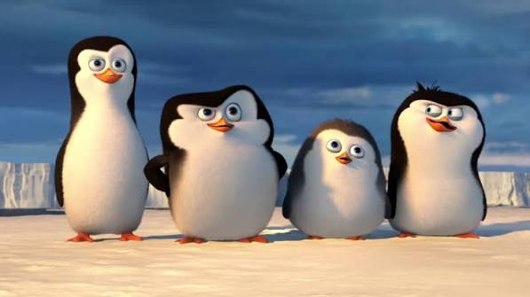
STATISTICAL INFERENCE PROJECT
Penguin Morphometrics
Body mass modelling and species classification
Antonio Arbizzani Tonelli · Simone Biraghi · Samuele Cipriani · Tommaso Frignani
Notes:
Cover image supplied by the project team. Project team names supplied by the user.

Slide 2
CONTEXT
02
Research questions
Morphological measurements support two complementary analyses.
01
02
What explains variation in penguin body mass?
Can measurements separate Adelie and Chinstrap?
ANALYTICAL DESIGN
1
2
3
Body mass model
Species and sex effects
Species classification
Linear regression
Two-way ANOVA
Logistic regression
Penguin Morphometrics · Statistical Inference Project
02
Notes:
Analysis questions based on the project presentation and the accompanying R analysis.

Slide 3
DATA
03
Dataset and variables
RESPONSE
324
Body mass (g)
complete observations
used throughout the analysis
MORPHOLOGICAL MEASUREMENTS
Bill length
Bill depth
Flipper length
mm
mm
mm
CONTEXT VARIABLES
Species · Sex · Island · Clutch completion
Penguin Morphometrics · Statistical Inference Project
03
Notes:
Data source: Horst, Hill and Gorman (2020), palmerpenguins. The project uses a 324-row complete-case CSV snapshot.

Slide 4
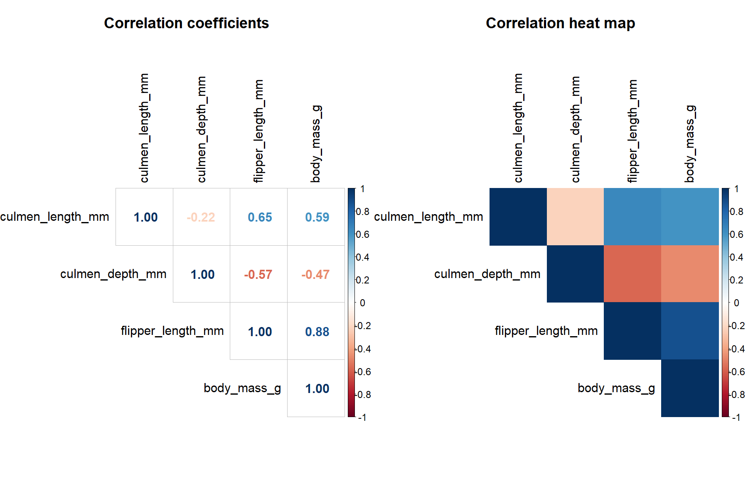
EXPLORATORY ANALYSIS
04
Flipper length has the strongest continuous association with body mass
0.88
Pearson correlation
Flipper length vs body mass
Species and sex account for structure that the pooled correlations cannot show on their own.
Pearson correlations, n = 324
Penguin Morphometrics · Statistical Inference Project
04
Notes:
Data source: Horst, Hill and Gorman (2020), palmerpenguins. Correlations calculated from the 324 complete observations used in this project.

