Slide 1
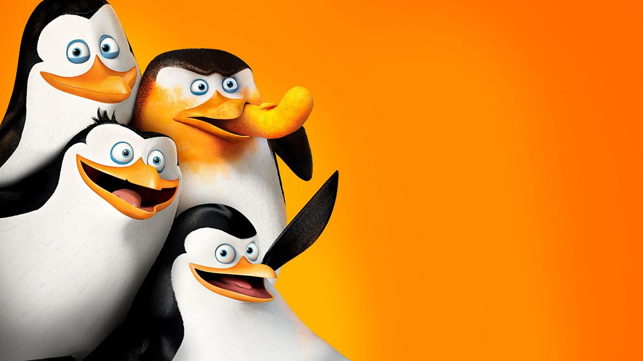
STATISTICAL INFERENCE PROJECT
Penguin morphometrics
Body mass modelling and species classification on 324 complete observations from the Palmer Archipelago.
Linear regression
Two-way ANOVA
Logistic regression
Antonio Arbizzani Tonelli · Simone Biraghi · Samuele Cipriani · Tommaso Frignani

Slide 2
CONTEXT
02
Research questions
The same four morphological measurements support two analyses that answer different questions.
01
02
What explains the variation in body mass?
Can measurements separate Adelie from Chinstrap?
A continuous response measured in grams, with morphological and categorical predictors.
A binary response on the 206 penguins of the two species that overlap in size.
Multiple linear regression
slides 05–11
Logistic regression
slides 16–17
Two-way ANOVA
slides 13–14
Gentoo is excluded: it separates trivially
Penguin Morphometrics · Statistical Inference Project
02

Slide 3
DATA
03
Dataset and variables
324
COMPOSITION OF THE SAMPLE
Species
324 penguins
Adelie 139
Chinstrap 67
Gentoo 118
complete observations, one row per penguin, after dropping every record with a missing field
Island
324 penguins
Biscoe 162
Dream 119
43
RESPONSE
Sex
324 penguins
Body mass (g)
Female 163
Male 161
MEASURED IN MILLIMETRES
Clutch completion
324 penguins
Bill length · Bill depth · Flipper length
Completed 290
34
CATEGORICAL
Mean body mass is 3703 g for Adelie, 3730 g for Chinstrap and 5091 g for Gentoo. Adelie and Chinstrap are almost indistinguishable on mass alone, which is exactly why the classifier uses shape instead.
Species · Sex · Island · Clutch completion
Penguin Morphometrics · Statistical Inference Project
03

Slide 4
PART ONE
Modelling body mass
From the strongest univariate association to a multivariable model, its diagnostics, its simplification and its out-of-sample error.
05 Correlation
06 Specification
07 Fit
08 Diagnostics
09 Selection
10 Intervals
11 Validation

Slide 5
EXPLORATORY ANALYSIS
05
Flipper length carries most of the univariate signal
0.88
Pearson correlation between flipper length and body mass, n = 324
The negative bill-depth correlation is a between-species effect, not a biological rule: Gentoo are the heaviest birds and also the shallowest-billed. Pooled correlations therefore cannot be read as within-species relationships.
Adelie
Chinstrap
Gentoo
Penguin Morphometrics · Statistical Inference Project
05

Slide 6
LINEAR MODEL
06
Multivariable body-mass model
Categorical contrasts in grams, with 95% intervals
body mass ~ species + island + clutch completion + bill length + bill depth + flipper length + sex
REFERENCE LEVELS
Adelie · Biscoe · clutch not completed · female
CONTINUOUS SLOPES, GRAMS PER MM
Flipper length
+16.0 [10.1, 21.8]
Bill depth
+69.3 [30.3, 108.3]
Bill length
+18.9 [4.9, 32.9]
Penguin Morphometrics · Statistical Inference Project
06

Slide 7
LINEAR MODEL
07
Nine predictors explain 88% of the variation, and typical error is a quarter of a kilogram
0.876
285 g
255.3
adjusted R², from R² = 0.880 on 9 and 314 degrees of freedom
residual standard error, about 7% of the mean body mass
F statistic on 9 and 314 df, p < 2.2 × 10⁻¹⁶
WHAT THE COEFFICIENTS SAY
WHAT THEY DO NOT SAY
A Gentoo weighs 998 g more than an Adelie of the same size and sex, and a male weighs 387 g more than a female of the same species. Both contrasts hold the morphology fixed.
After adjustment, the island contrasts are small and imprecise: Dream −15 g (p = 0.80) and Torgersen −32 g (p = 0.61). Clutch completion is borderline at +101 g (p = 0.058).
Each millimetre of flipper adds 16.0 g , and the bill measurements add 18.9 g and 69.3 g per mm — bill depth with the opposite sign to its pooled correlation.
The design is observational, so these are associations within the sample. Nothing here licenses a causal reading of flipper length on mass.
Penguin Morphometrics · Statistical Inference Project
07

Slide 8
LINEAR MODEL
08
The assumptions hold well enough to keep the model as it is
No curvature and no fan shape in the residuals; the tails of the Q-Q plot are slightly heavy, which is what we expect with 324 observations and no transformation.
Residuals versus fitted values
Normal Q-Q plot of residuals
29 observations are flagged by at least one criterion: 11 high leverage, 14 with a standardised residual beyond ±2, 18 above the 4/(n − p) cut for Cook's distance. The largest Cook's distance is 0.037, far from 1, so no single bird drives the fit.
08

Slide 9
MODEL SELECTION
09
Dropping island and clutch completion costs nothing
Backward elimination with penalty k = log n removes the two blocks that the coefficient plot already showed as flat.
MODEL
TERMS
BIC
AIC
ADJ. R²
Full model
7
4634.8
4593.2
0.8763
BIC-selected model
5
4621.8
4591.5
0.8759
RETAINED
REMOVED
species + bill length + bill depth + flipper length + sex
island + clutch completion
Adjusted R² moves by 0.0004 and the residual standard error by half a gram, from 284.6 g to 285.1 g. The simplification is a statement about parsimony; it is not evidence that island has no effect, only that it adds nothing beyond species.
Penguin Morphometrics · Statistical Inference Project
09

Slide 10
UNCERTAINTY
10
Predicting the average penguin is 18 times more precise than predicting one penguin
Confidence band
± 43 g
for the mean body mass at the centre of the flipper range
Prediction band
± 770 g
for a single new penguin at the same flipper length
Slope
50.9 g/mm
95% interval
[47.8, 53.9]
R²
0.769
Residual s.e.
389 g
Penguin Morphometrics · Statistical Inference Project
10

Slide 11
VALIDATION
11
Added curvature buys 16 grams of accuracy, so we keep the straight line
Out-of-sample error for polynomials in flipper length. Cross-validated error falls from degree 1 to degree 4 and then breaks down.
Degree 1, LOOCV
Degree 4, LOOCV
390 g
374 g
A 4% gain in root mean squared error, against coefficients we could no longer interpret. Beyond degree 4 the raw polynomial design is ill-conditioned and the two estimates disagree by more than the gain itself.
Curvature is not what limits this model: adding species and sex is worth far more (appendix A3).
Training
LOOCV
10-fold CV
Penguin Morphometrics · Statistical Inference Project
11

Slide 12
PART TWO
Species and sex
A two-way ANOVA on body mass, and what a significant interaction term actually means for the size difference between males and females.
13 Two-way ANOVA
14 Interaction

Slide 13
TWO-WAY ANOVA
13
Species and sex both matter, and they do not act independently
Mean body mass by species and sex, with 95% intervals
SOURCE
DF
F
P
Species
2
752.3
<2e−16
Sex
1
388.1
<2e−16
Species × sex
2
8.94
0.000166
Residuals
318
—
—
Sequential sums of squares with species entered first. Residual mean square 94 919 g², i.e. a within-group standard deviation of about 308 g.
Penguin Morphometrics · Statistical Inference Project
13

Slide 14
TWO-WAY ANOVA
14
Chinstrap sexual dimorphism is half that of Gentoo
The interaction is not about whether males are heavier — they always are — but about how much heavier, which changes with species.
MALE MINUS FEMALE, TUKEY 95% INTERVALS
Adelie
+687 g
[537, 837]
20.4% of female mass
Chinstrap
+411 g
[196, 627]
11.7% of female mass
Gentoo
+809 g
[646, 972]
17.3% of female mass
All three gaps exclude zero, so dimorphism is real in every species. What the interaction adds is that the Chinstrap gap is materially smaller — the reason the three lines are not parallel.
Penguin Morphometrics · Statistical Inference Project
14

Slide 15
PART THREE
Telling Adelie from Chinstrap
Two measurements, one decision boundary, and an evaluation that we deliberately do not oversell.
16 Logistic model
17 Performance

Slide 16
LOGISTIC REGRESSION
16
Bill length separates the two species; flipper length corrects for body size
logit P(Chinstrap) = −19.59 + 1.223 · bill length − 0.178 · flipper length
Odds ratio, bill length
3.40 ×
95% interval
[2.19, 5.27]
Odds ratio, flipper
0.84 ×
95% interval
[0.73, 0.97]
One extra millimetre of bill multiplies the odds of being a Chinstrap by 3.4 at fixed flipper length. Adding flipper length to the bill-only model is worth a likelihood-ratio χ² of 7.11 on 1 df (p = 0.008).
Adelie (139)
Chinstrap (67)
P(Chinstrap) = 0.5
Penguin Morphometrics · Statistical Inference Project
16

Slide 17
LOGISTIC REGRESSION
17
Eight birds out of 206 fall on the wrong side of the line
All figures below are in-sample: the classifier was scored on the same observations used to estimate it.
CONFUSION MATRIX, THRESHOLD 0.5
ROC CURVE
Predicted Adelie
Predicted Chinstrap
Observed Adelie
135
4
Observed Chinstrap
4
63
96.1%
94.0%
97.1%
accuracy
sensitivity
specificity
An AUC of 0.993 says the two species are almost linearly separable in this plane. It does not say the classifier would hold on penguins measured by another team, on another island, in another season.
Penguin Morphometrics · Statistical Inference Project
17

Slide 18
INTERPRETATION
18
What these results cannot establish
01
02
The design is observational
Complete cases only
No measurement was assigned, so the coefficients are conditional means, not effects. We can say heavier birds have longer flippers; we cannot say a longer flipper makes a bird heavier.
We dropped 20 of 344 records with a missing field. If those measurements failed for a reason connected to the bird's condition, our sample is mildly selected and the means are biased.
03
04
The results are model-dependent
The classifier is not validated
Bill depth changes sign between the pooled correlation and the fitted model. Any single coefficient has to be quoted together with the set of variables it was conditioned on.
96.1% and AUC 0.993 are in-sample. The size of the optimism is unknown here. An external estimate would require nested resampling or an independent test set.
Penguin Morphometrics · Statistical Inference Project
18

Slide 19
CONCLUSIONS
19
Three answers
16.0 g
Flipper length is the strongest continuous predictor of body mass, and the multivariable model accounts for 88% of the adjusted variation with a residual standard error of 285 g. BIC removes island and clutch completion after accounting for species and morphology.
per millimetre of flipper, species and sex held fixed
p = 1.7e−4
Species and sex both shift body mass, and their interaction is significant: the male–female gap runs from 411 g in Chinstrap to 809 g in Gentoo. A single additive dimorphism constant would misdescribe the data.
species × sex interaction
96.1%
Bill length and flipper length separate Adelie from Chinstrap almost linearly within this sample. The honest next step is not a bigger model but an independent test set.
in-sample accuracy, AUC 0.993
Horst, A. M., Hill, A. P. and Gorman, K. B. (2020). palmerpenguins: Palmer Archipelago (Antarctica) penguin data . R package. Analysis in R 4.1: scripts 01–04, 324 complete observations.
19

Slide 20
BACKUP
Appendix
Full regression table, influence diagnostics, the value of each added predictor, and the goodness-of-fit checks for the classifier.
A1 Coefficients
A2 Influence
A3 Predictor value
A4 Classifier checks

Slide 21
APPENDIX
A1
Full linear model, complete coefficient table
TERM
ESTIMATE
STD. ERROR
95% INTERVAL
P VALUE
Intercept
−1603.5
579.2
[-2739, -468]
0.006
Chinstrap vs Adelie
−243.2
89.0
[-418, -69]
0.007
Gentoo vs Adelie
997.7
138.7
[726, 1270]
4.7e−12
Dream vs Biscoe
−14.9
58.7
[-130, 100]
0.800
Torgersen vs Biscoe
−32.0
62.4
[-154, 90]
0.609
Clutch completed
101.1
53.2
[-3, 205]
0.058
Bill length (mm)
18.9
7.1
[5, 33]
0.008
Bill depth (mm)
69.3
19.9
[30, 108]
5.6e−4
Flipper length (mm)
16.0
3.0
[10, 22]
2.1e−7
Male vs female
387.1
48.2
[293, 482]
2.0e−14
Reference levels: Adelie, Biscoe, clutch not completed, female. Residual standard error 284.6 g on 314 degrees of freedom; R² = 0.880, adjusted R² = 0.876; F(9, 314) = 255.3.
Penguin Morphometrics · Statistical Inference Project
A1

Slide 22
APPENDIX
A2
Influence diagnostics for the full model
Bubble area is proportional to Cook's distance
High leverage, > 2p/n
11
|standardised residual| > 2
14
Cook's D > 4/(n − p)
18
Flagged by any criterion
29
Largest Cook's D
0.037
The 4/(n − p) rule is deliberately sensitive; with 324 observations the cut-off sits at 0.013. Judged on the conventional threshold of 1, no observation is influential, so we refit nothing and delete nothing.
Penguin Morphometrics · Statistical Inference Project
A2

Slide 23
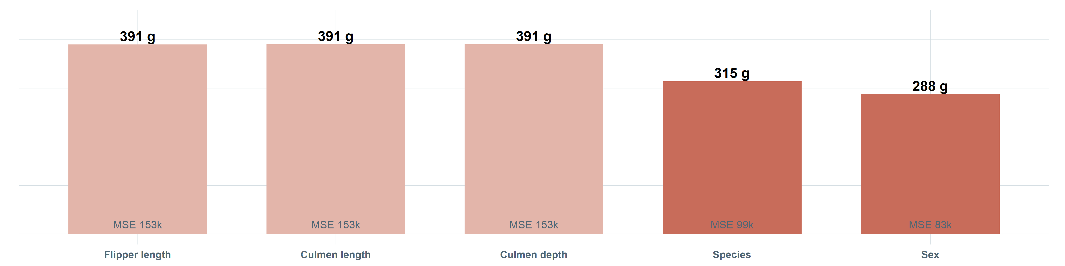
APPENDIX
A3
Species and sex drive the main reduction in prediction error
Ten-fold cross-validated root mean squared error for progressively larger models.
Adding the two bill measurements to a flipper-only model does not reduce cross-validated error. In this sequence, species lowers RMSE from 391 to 315 g, and sex lowers it further to 288 g. This complements the BIC comparison, but answers a different out-of-sample question.
Penguin Morphometrics · Statistical Inference Project
A3

Slide 24
APPENDIX
A4
Classifier: fit, comparison and goodness of fit
DEVIANCE, N = 206
WHY NOT THE FULL LOGISTIC MODEL
Null deviance, 205 df
259.9
With island, clutch completion, all four measurements and sex, the fit runs into quasi-complete separation: Chinstrap are observed on Dream only, so the island coefficient diverges and its standard error explodes. The likelihood keeps increasing without a finite maximum.
Bill length only, 204 df
50.0
Bill + flipper, 203 df
42.9
Likelihood-ratio χ², 1 df
7.11 (p = 0.008)
We keep the two-variable model because it converges, it can be plotted, and its coefficients can be read as odds ratios.
GOODNESS OF FIT
Hosmer–Lemeshow χ², 8 df
2.19
p value
0.975
The Hosmer–Lemeshow test does not reject the calibration of the bivariate model, but with 8 misclassified birds out of 206 the test has very little power here. We report it for completeness, not as evidence of good calibration.
Penguin Morphometrics · Statistical Inference Project
A4

