Slide 1
Flyway
Db migration tool

Slide 2
What is Flyway?
Flyway is an open-source tool for vesion control and database migration that enables incremental and evolutionay changes to the database schema
It ensures safe and consistent application of database changes across development, testing and production

Slide 3
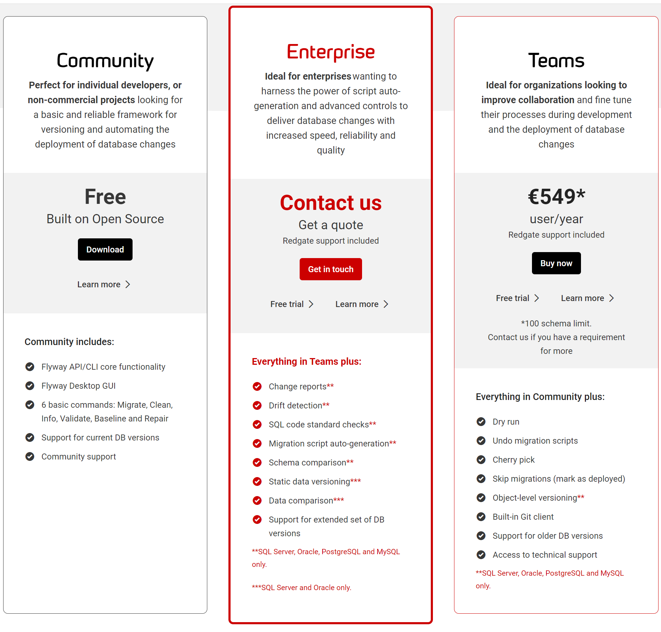
Installing Flyway
Download - Flyway features and editions (red-gate.com)
Supported Databases - Flyway - Product Documentation (red-gate.com)
Aurora MySQL | H2 | SAP HANA (Including SAP HANA Cloud)
Aurora PostgreSQL | HSQLDB | SingleStoreDB
Azure Synapse | Ignite | Snowflake
Cassandra Database | Informix | SQLite
Clickhouse Database | MariaDB | SQL Server Database
CockroachDB | MongoDB | Sybase ASE
DB2 | MySQL | TestContainers
Derby | Oracle Database | TiDB (Titanium DB)
Firebird | Percona XtraDB Cluster | TimescaleDB
Google BigQuery | PostgreSQL Database | YugabyteDB
Google Cloud Spanner | Redshift

Slide 4
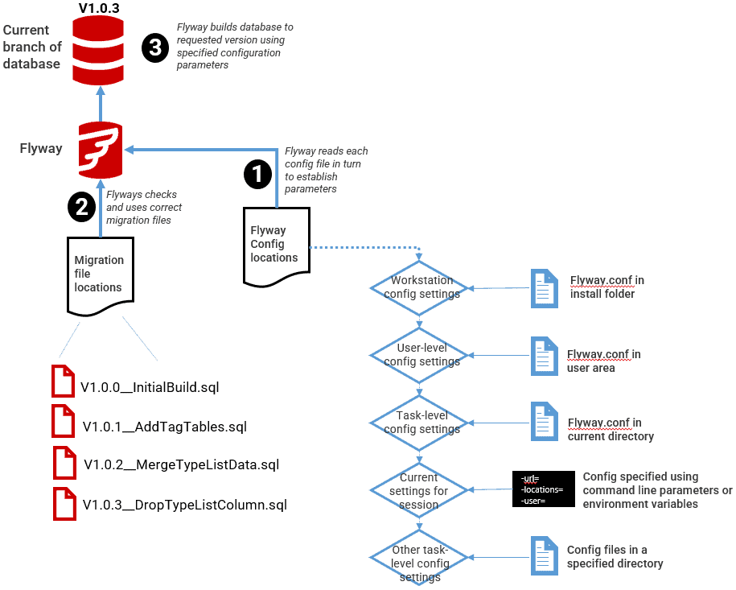
flyway.conf A Programmer's Guide to Flyway Configuration | Redgate (red-gate.com)
# Intiatize Flyway on DB is it does not exists
flyway.baselineOnMigrate=true
#flyway.user=
#flyway.password=
flyway.url=jdbc:sqlserver://<Server>:>Port>;databaseName=<DBName>;integratedSecurity=true;trustServerCertificate=true
flyway.locations=filesystem:./migrations,./sprint-*,filesystem:./migrations-undo

Slide 5
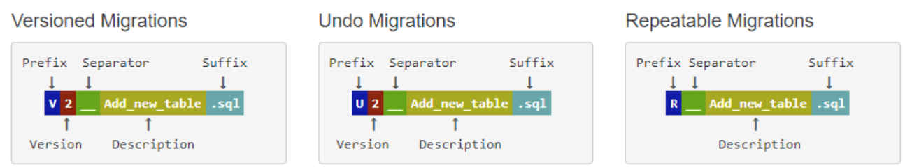
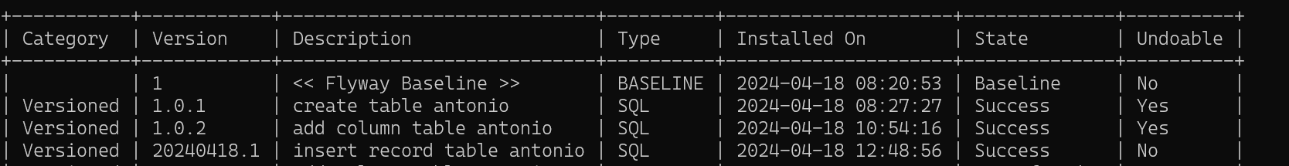
File Structure
Migrations scripts
“V1__migrationName.sql” <- Migration script delimited by double underscore
“R__name_for_repitable_object.sql”
“U1__undoMigrationName_for_version_1.sql”

Slide 6
Basic Flyway Commands > flyway [options] command
Migrate: Applies all pending migrations
Clean: Removes all objects from the configured shemas(caution)
Info: Provides detailed information about the state of migrations
Validate: Checks that the migrations applied in database match those available locally
Undo [Flyway Teams]: undoes the most recently applied migration
Baseline: Baselines an existing database, excluding all migrations up to and including baselineVersion
Repair: Repairs the schema history table
> flyway -target="1.0.5" -ignoreMigrationPatterns='*:ignored' -outOfOrder=true migrate

Slide 7
Resources
https://www.github.com/flyway/flywaydb.org
Blog - Flyway (flywaydb.org)

