Slide 1
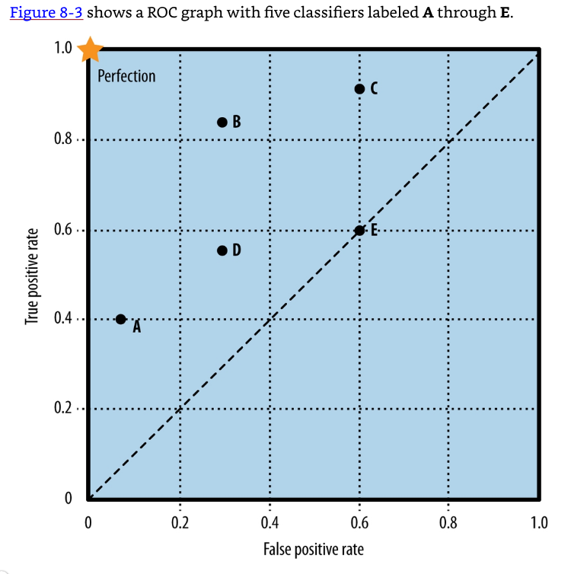
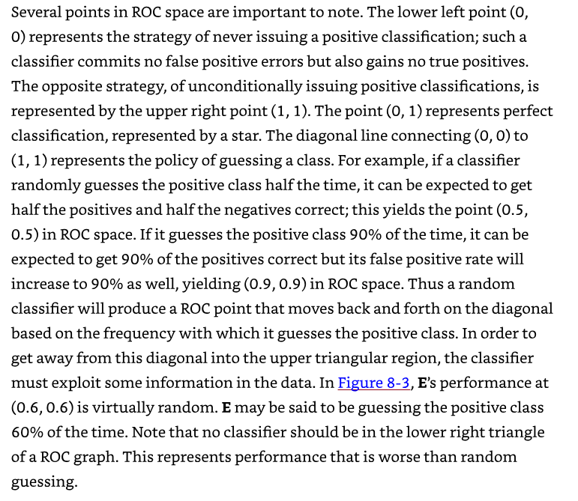

Slide 2
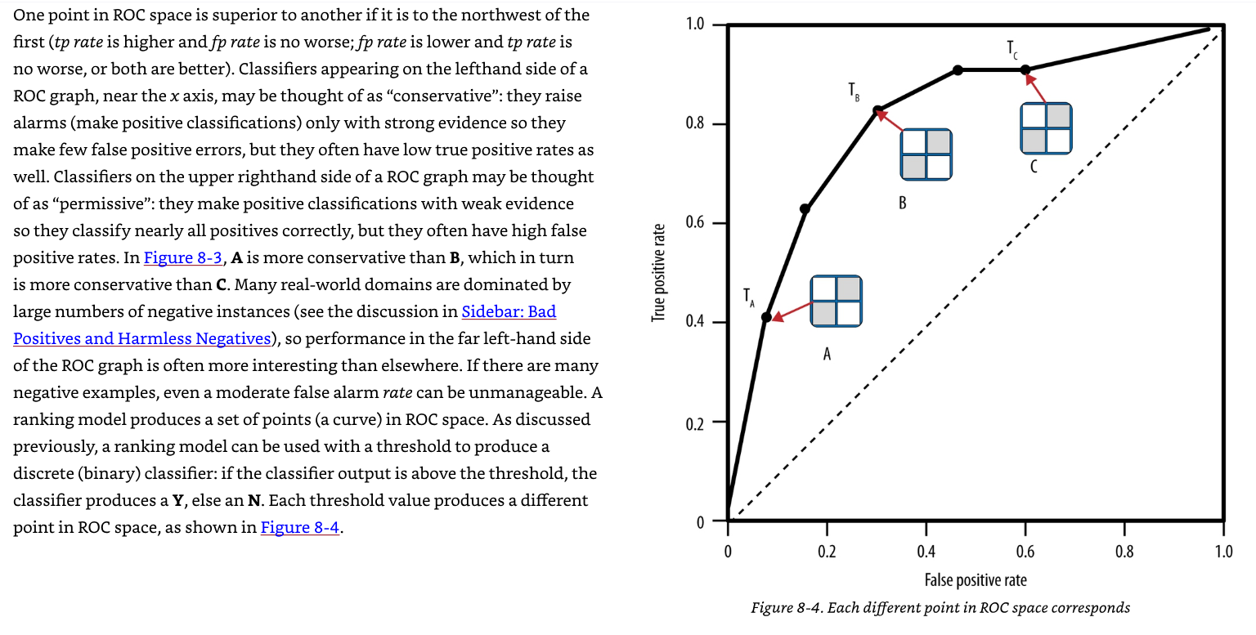

Slide 3
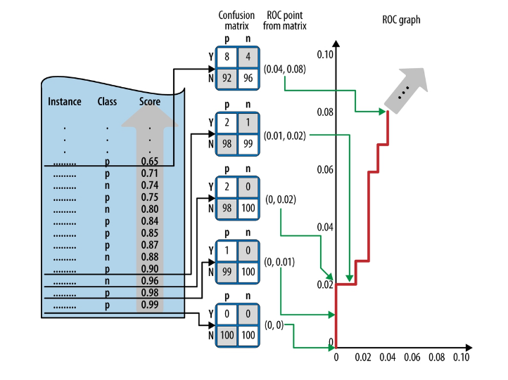
Figure 8-5. An illustration of how a ROC “curve” (really, a stepwise graph) is constructed from a test set. The example set, at left, consists of 100 positives and 100 negatives. The model assigns a score to each instance and the instances are ordered decreasing from bottom to top. To construct the curve, start at the bottom with an initial confusion matrix where everything is classified as N. Moving upward, every instance moves a count of 1 from the N row to the Y row, resulting in a new confusion matrix. Each confusion matrix maps to a (fp rate, tp rate) pair in ROC space.

