Slide 1
DATA SCIENCE
WITH EXCEL
X
Retail Banking EDA
X
fx
=CORREL(Table1[Income],Table1[Balance])
ID
Age
Income
Balance
C1001
42
65k
12.5k
C1002
35
54k
8.2k
Exploratory Data Analysis for Banking Analysts
C1003
61
92k
45.5k
C1004
29
3.2k
From raw tables to reliable insight — using the tools already available in Excel.
C1005
47
71k
165k
Correlation
STRUCTURED DATA
EDA
STATISTICS
DATA QUALITY
Banking context · Excel-first examples · Practical formulas and charts
Training deck

Slide 2
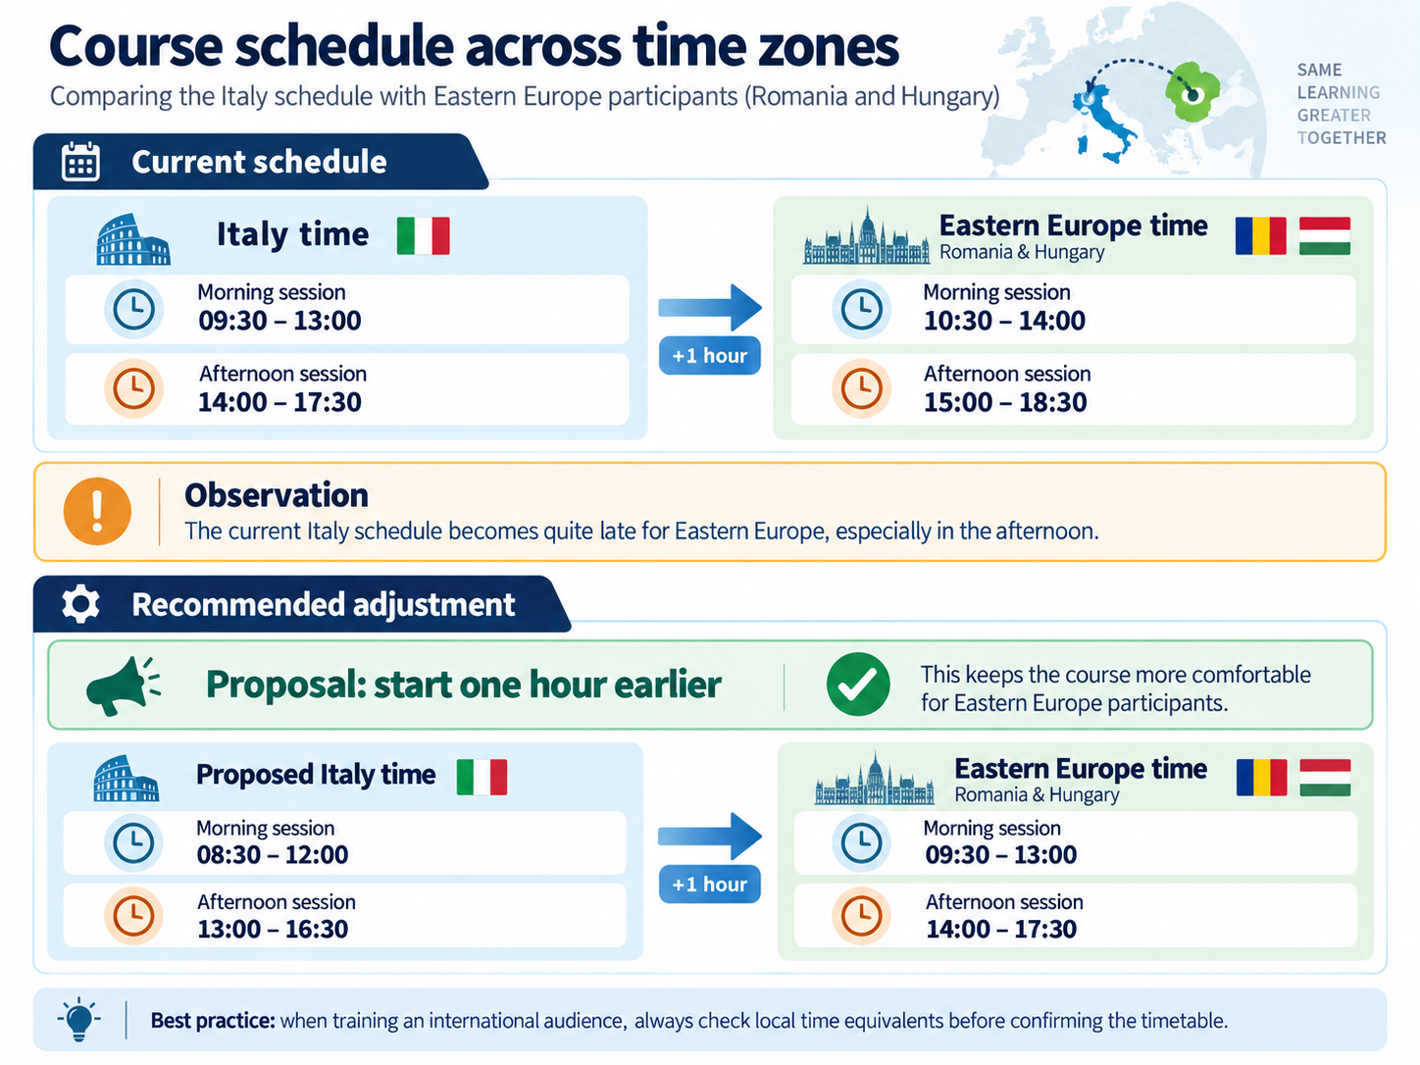

Slide 3



✣
ChatGPT
The first draft of this set of slides was generated using AI tools under the direction of Antonio Piemontese and in accordance with his general and specific instructions and guidelines. The material was subsequently reviewed, revised, and further refined through additional interactions with AI tools, based on Antonio Piemontese’s feedback and specific requests for changes.
Throughout the process, Antonio Piemontese retained responsibility for the overall direction, content, review, and final approval of the material.
This declaration is provided in accordance with the transparency requirements of the European Union’s AI Act.
3

Slide 4
COURSE OVERVIEW
Course map: what we will build together
A conceptual framework for data analysis, anchored in Excel and banking examples.
0
Preliminaries
TechnicalRequirements, Language, Anatomy of Excel
1
Foundations
Data Science, analytics, banking context
2
Data
Structured tables and data types
3
EDA
Profiling, summaries, pivots, visual exploration
4
Probability & statistics
Random variables, distributions, uncertainty
5
Relationships
Correlation and correlation matrices
6
Visualisation
Plots that reveal structure and problems
7
Data issues
Outliers, missing values, patterns, quality
Goal: make the analysis explainable, auditable and reproducible — not just “get a chart”.
Data Science with Excel · Banking Analysts

Slide 5
00 · PRELIMINARIES
Technical requirements: Excel version matters
Minimum setup to run every example in this training deck.
Microsoft Excel 2021 or later — minimum for full compatibility.
Dynamic-array functions are used in examples: SORT and UNIQUE.
1
6
Recommended: Microsoft Excel 2024 or Microsoft 365.
Excel Tables (Ctrl+T) are used throughout the EDA workflow.
2
7
Enable the Analysis ToolPak (Data → Data Analysis).
No Python, R, Power BI or other Data Science software required.
3
8
Windows 10 or Windows 11 recommended for the classroom setup.
No VBA or macros required.
4
9
PowerPoint 2016+ or a compatible presentation viewer.
No Internet connection required for the exercises.
5
10
KEY REQUIREMENT Full compatibility requires Excel 2021 or later • Recommended: Excel 2024 / Microsoft 365
Data Science with Excel · Banking Analysts

Slide 6
00 · PRELIMINARIES
How to change the language in Excel
Display language controls menus and tabs; authoring language affects editing and localized function names.
1 Open Options
What changes?
File → Options → Language (with possible download for the new language)
Ribbon
Home ↔ Home
Data ↔ Dati
2 Choose the language
Menus
File ↔ File
Options ↔ Opzioni
Office display language
Office authoring languages
Functions
SUM ↔ SOMMA
AVERAGE ↔ MEDIA
Changes Ribbon tabs, menus, commands and dialog boxes.
Controls proofing/editing language and can affect localized function names.
Separators
Comma / semicolon and decimal conventions may depend on regional settings.
Select the desired language → Set as Preferred / Default → restart Excel if requested.
If the language is not installed, Excel may offer Add a Language / install the Office language pack.
6

Slide 7
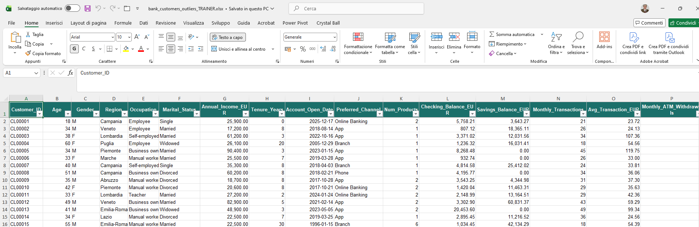
00 · PRELIMINARIES
Anatomy of the Excel interface (2024)
The main components you will use when exploring and analysing tabular data
1
2
3
4
5
6
7
8
10
11
9
12
1
Quick Access Toolbar
4
Ribbon tabs
7
Formula Bar
10
Active cell
Frequently used commands such as Save, Undo and Redo.
Home, Insert, Formulas, Data, Review, View, etc.
View, enter and edit values or formulas for the active cell.
The currently selected cell; its reference appears in the Name Box.
2
Title bar
5
Ribbon
8
Column headings
11
Table header & filters
Shows the workbook name and the Excel application window.
Context-sensitive command area organised into groups.
Letters identify columns; click to select an entire column.
Field names plus sorting/filter controls in an Excel Table.
3
Search box
6
Name Box
9
Row headings
12
Worksheet grid
Find commands, help topics and Excel features quickly.
Shows the active cell reference; can also jump to a cell/range.
Numbers identify rows; click to select an entire row.
The cell area where tabular data, formulas and results live.
Also important (not visible in this screenshot): sheet tabs, horizontal/vertical scroll bars, the status bar and zoom controls.

Slide 8
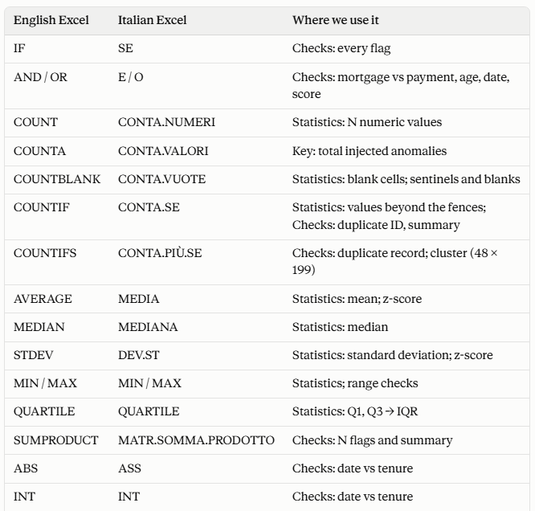
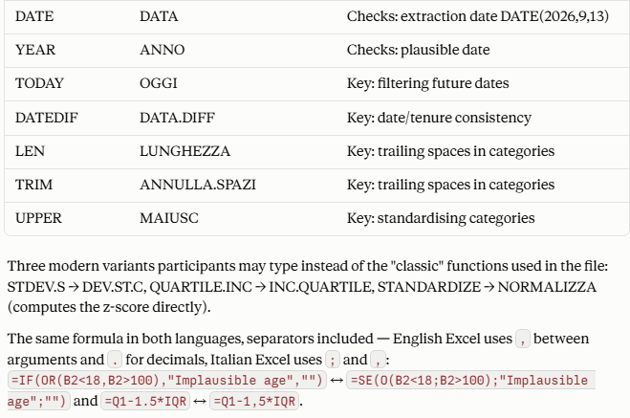
00 · PRELIMINARIES
ExcelFormulasIn Italian and English
The main matchings

Slide 9
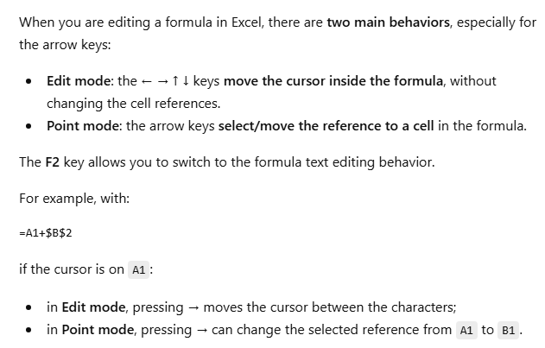
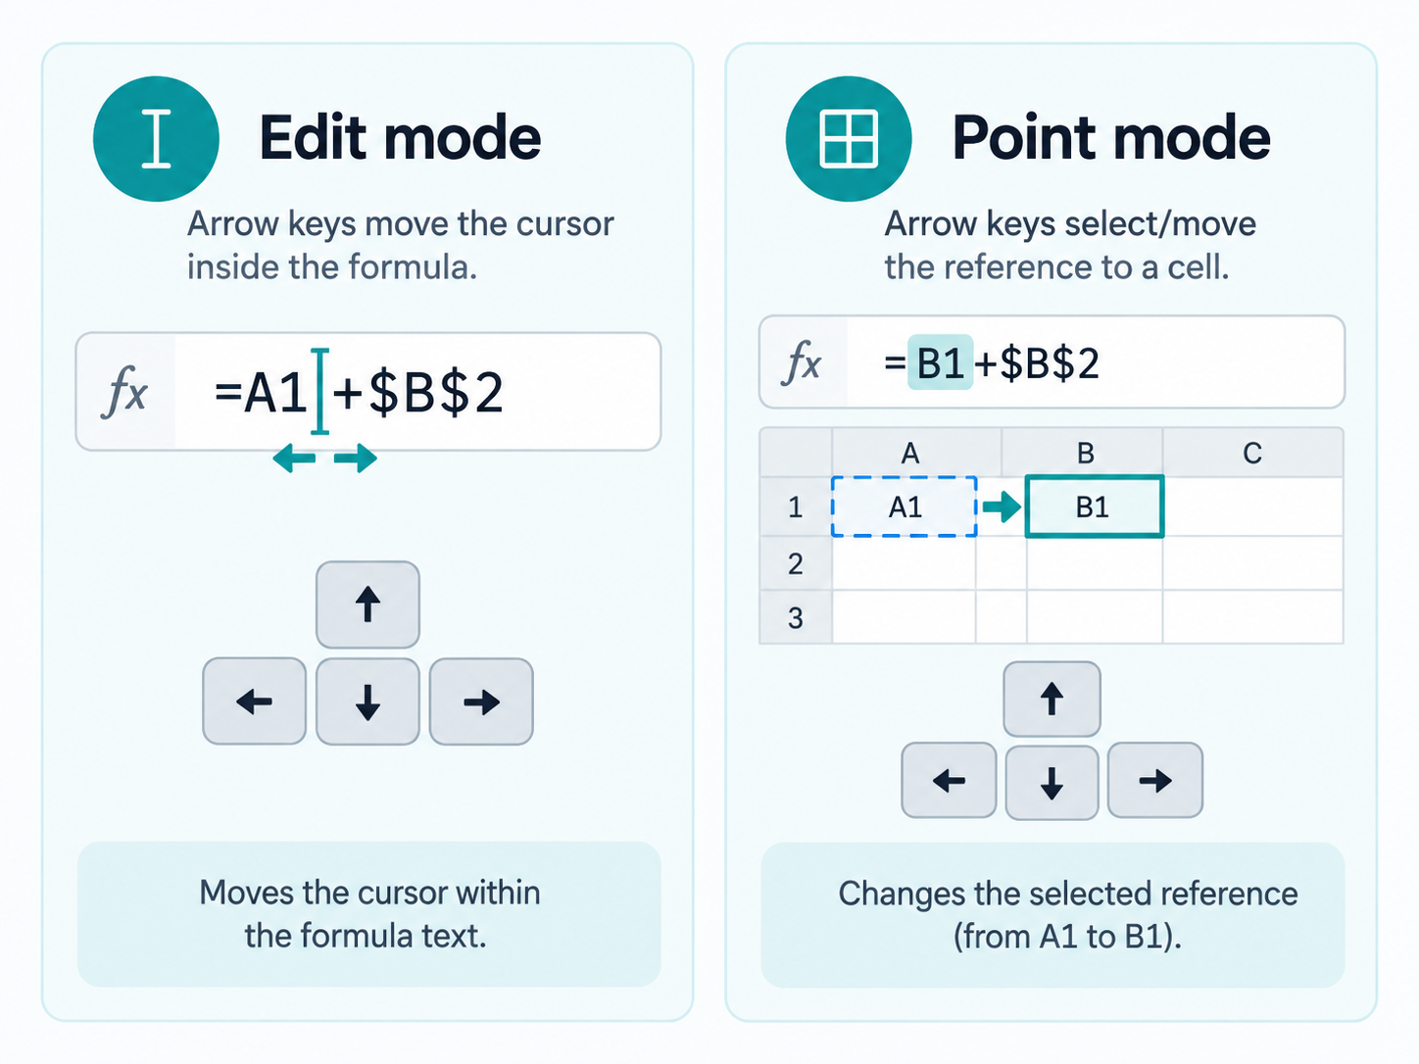
00 · PRELIMINARIES
Two main behaviours when editing a formula
Especially regarding the arrow keys

Slide 10
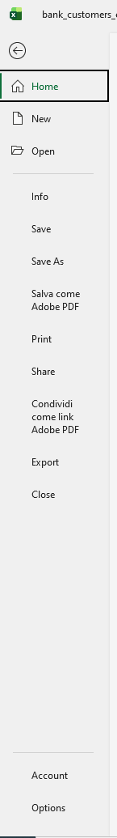
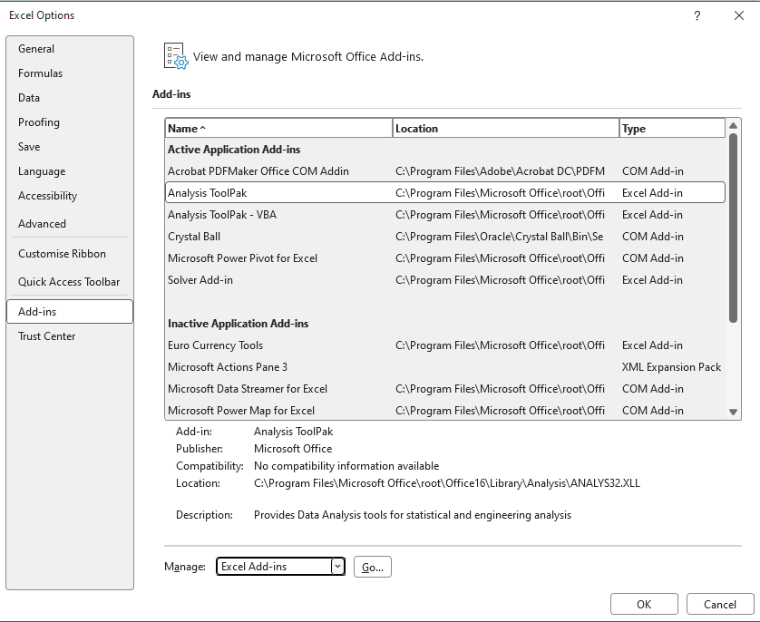

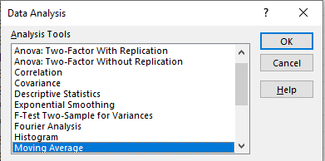
00 · PRELIMINARIES
Analysis tool –a key piece of functionality
What it is
How to get it

Slide 11
01 · FOUNDATIONS
Data Science in one slide
Data Science combines business questions, data, statistical reasoning and computational tools to support decisions.
Business question
Collect / access data
Explore & clean
Model / quantify
Communicate
Decide & monitor
What matters most
Where Excel fits
Where Excel stops
A model or dashboard is useful only if it answers a relevant question with trustworthy data.
Excel is excellent for inspection, quick EDA, small-to-medium datasets, validation and communication.
Very large datasets, heavy automation and advanced modelling often need SQL, Python, R or cloud platforms.
Question → Data → Evidence → Decision
Data Science with Excel · Banking Analysts

Slide 12
01 · FOUNDATIONS
Why Excel still matters for bank analysts
Excel is not “less scientific”; it is a practical analysis surface when used with disciplined methods.
Fast inspection
Business proximity
Transparent logic
Open a table and immediately inspect values, types, gaps and extremes.
Analysts, risk teams and finance users already exchange workbooks.
Formulas, filters and PivotTables make many transformations visible.
Excellent EDA
Audit support
Bridge tool
Descriptive statistics, histograms, scatter plots, box plots and correlations.
Checks, reconciliation and exception lists can be made explicit.
Useful before/after SQL, Python or modelling pipelines.
The key limitation to Data Science is not the tool: it is uncontrolled data handling, hidden assumptions and poor reproducibility.
Data Science with Excel · Banking Analysts

Slide 13
01 · FOUNDATIONS
Data Science, statistics, BI and Machine Learning
They overlap, but they answer different kinds of questions.
Business Intelligence
Statistics
Machine Learning
Data Science
What happened?
What can we infer?
What can we predict?
How do we turn data into decisions?
Reports, KPIs, dashboards, aggregation
Variation, uncertainty, estimation, testing
Prediction, classification, clustering
End-to-end problem framing, data, analysis, modelling, communication
Excel can support all four — but EDA and descriptive statistics are where it is especially strong.
Data Science with Excel · Banking Analysts

Slide 14
01 · FOUNDATIONS
Banking examples: questions before tools
Start with the decision or risk question, then choose the analysis.
Domain
Business question
Excel-first EDA
Retail customers
Which segments show declining balances?
PivotTable + line chart
Credit risk
Which variables move with arrears (ie, payments that are overdue or unpaid when due) or default?
Correlation + distributions
Operations
Where are processing times unusually high?
Histogram + outlier analysis
Fraud monitoring
Which transactions are atypical?
Patterns + anomaly flags
Data governance
Where is information incomplete or inconsistent?
Missingness + quality checks
Data Science with Excel · Banking Analysts

Slide 15
01 · FOUNDATIONS
The data landscape in a bank
Most analysis starts from structured operational data — but meaning comes from context.
Core banking
accounts · balances · products
X
Analysis-ready extract
fx
=ROWS(Table1)
CustomerID
Date
Balance
Segment
Default
Payments
transactions · merchants · channels
C1001
2026-08-31
12,500
Affluent
No
CRM
customers · campaigns · interactions
C1002
2026-08-31
8,200
Mass
No
ETL processing
C1003
2026-08-31
45,500
Affluent
No
Risk systems
exposure · ratings · arrears
C1004
2026-08-31
3,200
Mass
No
External data
rates · macro · geography
C1005
2026-08-31
165,000
Affluent
Yes
Source, operational data
C1006
2026-08-31
9,700
Mass
No
A structured table ready to be analysed
Data Science with Excel · Banking Analysts

Slide 16
02 · DATA & TYPES
Structured vs semi-structured vs unstructured data
Data Science works with many kinds of data. Excel is strongest with structured data, but analysts often receive all three forms.
STRUCTURED DATA
SEMI-STRUCTURED DATA
UNSTRUCTURED DATA
Clear rows, columns and fields
Some organisation, but not fully tabular
No fixed table structure
Examples: Excel tables, CSV files, relational databases, banking transaction tables
Typical fields: Customer_ID, Region, Balance, Date, Product_Count
Excel fit: excellent
Examples: JSON, XML, logs, email headers, API responses
Has labels or tags, but the shape may vary from record to record
Excel fit: possible after transformation or flattening
Examples: PDFs, emails, contracts, images, audio, call recordings
Meaning exists, but structure is implicit rather than explicit
Excel fit: weak unless data is first extracted or summarised
Recognition: every row represents the same type of entity, and every column has a stable meaning.
Recognition: records contain keys or tags, but not every record must contain the same fields.
Recognition: humans can understand the content, but software must work harder to extract variables.
Excel takeaway: structured data is the natural starting point for EDA in Excel; semi-structured and unstructured data usually need preparation before they can be analysed as tables.
Data Science with Excel
16

Slide 17
02 · DATA & TYPES
Structured data: the backbone of everyday Data Science
Structured data has an explicit schema: rows are observations, columns are variables, cells are values.
X
Table1 · Customer snapshot
Rows = observations
fx
=AVERAGE(Table1[Balance])
One customer, account, loan, transaction or time period per row.
CustomerID
Age
Income
Balance
Segment
C1001
42
65,000
12,500
Affluent
Columns = variables
C1002
35
54,000
8,200
Mass
Age, balance, product, segment, status, date, risk score…
C1003
61
92,000
45,500
Affluent
Schema = meaning
C1004
29
—
3,200
Mass
Names, types, units, valid ranges, keys and business definitions.
C1005
47
71,000
165,000
Affluent
This in Data Science is TIDY DATA
Data Science with Excel · Banking Analysts

Slide 18
02 · DATA & TYPES
Anatomy of a table
Understanding the grain of the table prevents many analytical mistakes.
X
Monthly customer snapshot
Primary key / identifier
fx
=COUNTIFS(Table1[CustomerID],"C1001")
CustomerID + Month uniquely identifies each row.
CustomerID
Month
Balance
Products
C1001
Jan
11,800
3
Grain
C1001
Feb
12,100
3
One row = one customer in one month.
C1001
Mar
12,500
3
C1002
Jan
8,700
2
Risk of wrong grain
Averaging balances at the wrong level can double-count customers.
C1002
Feb
8,450
2
C1002
Mar
8,200
2
Data Science with Excel · Banking Analysts

Slide 19
02 · DATA & TYPES
Observation, variable, value: three simple words, three different roles
A table becomes easier to reason about when these terms are explicit.
1
2
3
OBSERVATION
VARIABLE
VALUE
A unit being analysed
Example: Customer C1003
A measured attribute
Example: AnnualIncome
A concrete measurement
Example: €92,000
In Excel: rows usually represent observations, columns variables, and cells values.
Data Science with Excel · Banking Analysts

Slide 20
02 · DATA & TYPES
What makes tabular data analysis-ready?
A clean table is a model of the business process, not merely a rectangular range.
✓
One row, one observation
✓
One column, one variable
No merged cells; no subtotals inside the data area.
Do not mix currency, text and comments in the same field.
✓
Consistent units
✓
Stable categories
EUR vs thousands of EUR must be explicit.
“Retail”, “RETAIL”, “retail” should not be three categories.
✓
Explicit missing values
✓
Traceable definitions
Blank ≠ zero ≠ not applicable.
Every field has a business meaning and owner.
Tip: convert ranges to an Excel Table (Ctrl+T) before serious EDA.
Data Science with Excel · Banking Analysts

Slide 21
02 · DATA & TYPES
Why convert a range to an Excel Table?
Before starting EDA, turn a normal cell range into a formal Excel Table (Ctrl+T).
NORMAL RANGE
EXCEL TABLE
Example: A1:F1000
A structured object designed for analysis
ID
Age
Income
Bal.
Seg.
Stable headers
Column names remain explicit and usable.
C01
42
65k
12.5k
A
C02
35
54k
8.2k
M
Built-in filters
Sort and filter every column immediately.
C03
61
92k
45.5k
A
Automatic expansion
New rows and formulas are included automatically.
C04
29
—
3.2k
M
Ctrl+T
Structured references
Use readable formulas such as Table1[Balance].
Typical formula:
=AVERAGE(D2:D1000)
=AVERAGE(Table1[Balance])
For EDA, an Excel Table makes the analysis more robust, readable and less error-prone.
21

Slide 22
02 · DATA & TYPES
How to convert an Excel Table back to a range
The data are preserved; only the Table structure is removed.
1
Select the Table
Click any cell inside the Excel Table.
What changes?
Excel Table
Data remain
2
Open Table Design
The Table Design tab appears on the Ribbon.
Values and formulas are preserved.
Formatting
Normal range
Table formatting usually remains.
3
Convert to Range
Choose Table Design → Convert to Range.
Table features
4
Confirm
When Excel asks for confirmation, click Yes.
Automatic expansion and structured Table behavior are removed.
Range → Ctrl+T → Excel Table → Table Design > Convert to Range → Range
22

Slide 23
02 · DATA & TYPES
Data types: meaning comes before formatting
The type determines which operations are meaningful — and which are nonsense.
Numeric
Categorical
Boolean / binary
Measured quantities
Balance, age, income, interest rate
Labels / groups
Segment, product type, branch
Two states
Default yes/no, active/inactive
Date / time
Text
Identifier
Time coordinates
Transaction date, month-end
Free-form strings
Comments, descriptions, notes
Keys, not quantities
CustomerID, IBAN, account number
A CustomerID that contains digits is still an identifier, not a numeric measurement.
Data Science with Excel · Banking Analysts

Slide 24
02 · DATA & TYPES
Numeric data: discrete and continuous
Both are numeric, but the measurement scale and distribution may differ.
Discrete numeric variables
Continuous numeric variables
Countable values, often integers.
Examples: number of products, missed payments, complaints.
Measurements on a scale.
Examples: balance, income, amount, duration, interest rate.
Discrete: Products per customer
Continuous: Account balance
=AVERAGE(Table1[Balance]) =MEDIAN(Table1[Balance]) =STDEV.S(Table1[Balance])
Data Science with Excel · Banking Analysts

Slide 25
02 · DATA & TYPES
Categorical data: nominal, ordinal and binary
Categories can be labels, ordered levels or two-state flags.
Nominal
Ordinal
Binary
No intrinsic order
Region: North / South
Product: Card / Mortgage / Loan
Meaningful order
Risk grade: Low / Medium / High
Satisfaction: 1…5
Exactly two states
Default: Yes / No
Active: 1 / 0
Excel implications
Use Data Validation lists to control allowed categories.
Use PivotTables to compare counts, averages and rates across groups.
Do not average arbitrary codes (e.g., Region 1, 2, 3).
Data Science with Excel · Banking Analysts

Slide 26
02 · DATA & TYPES
Data types: qualitative and quantitative
A practical taxonomy for structured (tabular) data — with examples and software mappings.
VARIABLES IN TABULAR DATA
QUALITATIVE DATA
Values are labels or classes. The set of possible values is often finite and relatively small. Numeric operations such as sums or divisions are not meaningful.
QUANTITATIVE DATA
aka categorical
aka numeric
Values represent quantities. Arithmetic and distances are meaningful. The theoretical set of possible values may be very large or infinite.
NOMINAL
ORDINAL
DISCRETE
CONTINUOUS
Unordered categories
Ordered categories
Counts
Measurements
No intrinsic ranking between values.
Values have an order, but gaps are not numeric distances.
Typically integer-valued observations.
Can take any value within an interval, conceptually.
Examples: ZIP code, eye color, region, product type
Examples: rating, risk class, customer tier
Examples: # children, # transactions, # defects
Examples: temperature, height, balance, interest rate
Software mapping in Excel
See the next slide
Important:
A numeric-looking code is not necessarily numeric data. ZIP code and Customer_ID are identifiers.
Key idea: data type is about meaning and valid operations — not only about how a value is formatted in Excel.
Data Science with Excel · Banking Analysts
26

Slide 27
02 · DATA & TYPES
Statistical Data Types vs Excel Data Types
Excel stores values using technical cell types. The analyst assigns the statistical meaning.
Statistical data type
Meaning
Typical Excel storage
Example
KEY IDEA
Excel data type ≠ statistical data type
Nominal categorical
Labels with no inherent order
Text
Region = "Lombardy"
Ordinal categorical
Categories with a meaningful order
Text or coded Number
Low / Medium / High
Discrete numeric
Counts; integer-valued measurements
Number (integer value)
Num_Products = 4
EXAMPLE 1 — ORDINAL CODES
1 = Low 2 = Medium 3 = High
Continuous numeric
Measurements on a continuous scale
Number (decimal value)
Balance = 5,823.47
Excel sees numbers; the analyst sees ordered categories. An average may be mathematically possible but analytically questionable.
Binary / Boolean
Two possible states
TRUE/FALSE or 0/1
Defaulted = FALSE
Date / Time
Temporal values
Date/Time*
13/09/2026
EXAMPLE 2 — IDENTIFIERS
Identifier
A code, not a quantity
Usually Text
Customer_ID = "CL00015"
ZIP = 10121 Account = 000173
They look numeric, but they are labels. Store them as Text when leading zeros or code semantics matter.
Missing value
Unknown / not recorded
Blank cell
empty cell
* Excel stores dates/times internally as serial numbers, but formats them as dates/times.
Analyst rule: determine the variable’s meaning first; only then decide the Excel representation and the valid operations.

Slide 28
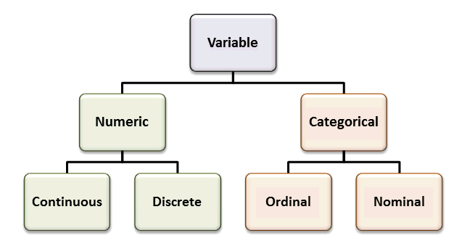
02 · DATA & TYPES
Numerical vs Categorical Data Tyypes
Not every column that looks like a number should be treated as a number.
28

Slide 29
02 · DATA & TYPES
Dates, text and identifiers need special care
Not every column that looks like a number should be treated as a number.
Example
Semantic type
Appropriate analysis
2026-08-31
Date
Sort, group by month/quarter, compute intervals
C100245
Identifier
Join / lookup key — never average it
0012345678
Identifier stored as text
Leading zeros matter
“Mortgage renewal”
Text
Search, classify, count terms
12.5%
Numeric rate
Store as 0.125; display as percentage
Formatting changes appearance; it does not automatically correct the underlying data type.
Data Science with Excel · Banking Analysts

Slide 30
02 · DATA & TYPES
Common data type problems in Excel
Many “analysis errors” are actually type errors.
X
Type issues hiding in plain sight
Symptoms
fx
=ISTEXT(C4)
Sort order looks wrong · SUM ignores values · dates do not group.
CustomerID
Date
Income
Rate
Balance
Checks
00125
31/08/26
65,000
4.25%
12,500
ISTEXT · ISNUMBER · DATEVALUE · VALUE · NUMBERVALUE.
00126
08/31/26
54.000
0,0425
8,200
Prevention
Define schema, use Tables, validation, Power Query types and controlled imports.
00127
text
92,000
4.10%
—
00128
31/08/26
71k
4.35%
165,000
=ISNUMBER(C2) =ISTEXT(C2) =DATEVALUE(B2) =NUMBERVALUE(C2)
Data Science with Excel · Banking Analysts

Slide 31
03 · EXPLORATORY DATA ANALYSIS
Exploratory Data Analysis (EDA): learn the data before modelling it
EDA is a disciplined conversation with the dataset: structure → distributions → relationships → problems → hypotheses.
STRUCTURE
DISTRIBUTIONS
RELATIONSHIPS
DATA ISSUES
PATTERNS
rows · columns · types · grain
centre · spread · shape
correlation · groups · trends
missing · outliers · inconsistencies
segments · seasonality · anomalies
EDA output is not just charts
It is a set of findings: what the data represents, what looks suspicious, what relationships exist, and what should be investigated next.
EDA = ask → inspect → visualise → quantify → question → repeat
Data Science with Excel · Banking Analysts

Slide 32
03 · EXPLORATORY DATA ANALYSIS
EDA in practice: one graphical example for each of the five lenses
Each lens asks a different question: how the table is organised, how values are distributed, how variables move together, where the problems are, and what broader regularities emerge.
STRUCTURE
DISTRIBUTIONS
RELATIONSHIPS
DATA ISSUES
PATTERNS
A table with fields and records
Histogram of a numeric variable
Scatter plot between two variables
Missing values and outliers
Trend / seasonality / anomaly
ID
Age
Region
Balance
Age
Income
Score
C001
32
North
5,240
34
28,000
71
C002
41
West
8,120
41
missing
69
C003
29
South
3,410
39
31,500
70
C004
55
East
9,780
999,999
36
72
Example question:
Do we have one row per customer, clear column names and meaningful data types?
Example question:
How are transaction amounts distributed? Is the shape symmetric, skewed or multi-modal?
Example question:
Do income and account balance move together? A scatter plot reveals direction and strength.
Example question:
Where are the blanks, errors or extreme values that could distort averages, correlations and charts?
Example question:
Is there a repeated monthly pattern, an upward trend or a point that breaks the usual behaviour?
EDA = structure + distributions + relationships + data issues + patterns
32

Slide 33



03 · EXPLORATORY DATA ANALYSIS
What is a “pattern”?
Pattern recognition means finding recurring structures inside data that may initially look random.
Look at this set of numbers and letters:
Patterns are repeated structures
• knsxoi543y77778efh8rfv097777d
• j39e8389f7777lmjbh8ihrz7777
• knsxoi543y77778efh8rfv097777
• 39e8389f7777lmjbh8ihrz>7777
Do you notice anything unusual?
The same idea applies to data: repeated forms, relationships, sequences or behaviours can be discovered and described.
Exactly. After every 10 apparently random letters and numbers, the digit “7” is repeated four times — the pattern “7777”. Your brain has recognised a regular structure inside data that initially looks random. This process is called pattern recognition.
Pattern recognition = identifying recurring models, structures or regularities within raw data.
Data Science with Excel
1

Slide 34
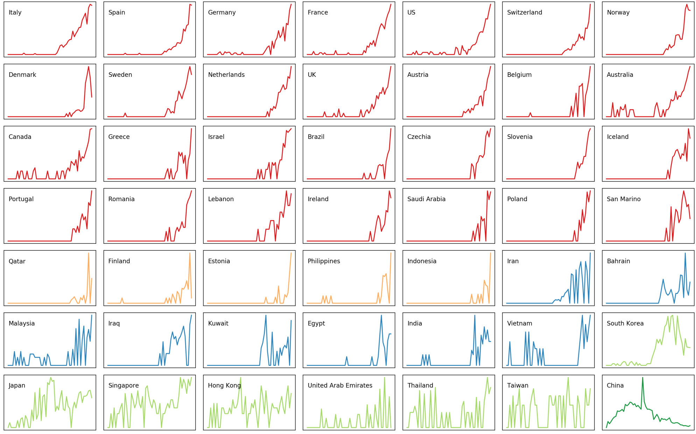
03 · EXPLORATORY DATA ANALYSIS
Patterns
Patterns in Covid-19 growth
34

Slide 35
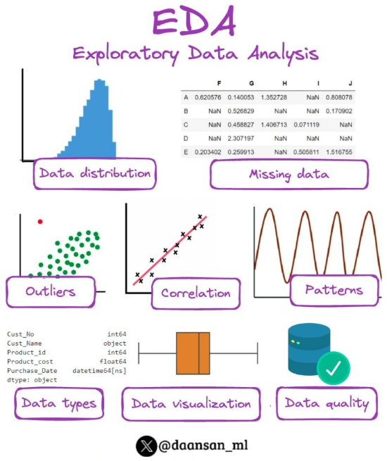
03 · EXPLORATORY DATA ANALYSIS

Slide 36
03 · EXPLORATORY DATA ANALYSIS
A practical EDA workflow in Excel
Use a repeatable sequence so important checks are not skipped.
1. Import / Table
2. Check types
3. Profile columns
4. Summarise
5. Plot
6. Investigate issues
Import / Table
Check types
Profile columns
Convert the range to an Excel Table; preserve raw data.
Dates, numbers, categories, IDs, units.
Row counts, unique values, missing values, valid ranges.
Summarise
Plot
Investigate
Mean, median, standard deviation, percentiles, category counts.
Histogram, box plot, scatter, line and bar charts.
Outliers, gaps, strange patterns, data-quality exceptions.
Best practice: keep “raw”, “clean”, “analysis” and “output” areas separate.
Data Science with Excel · Banking Analysts

Slide 37
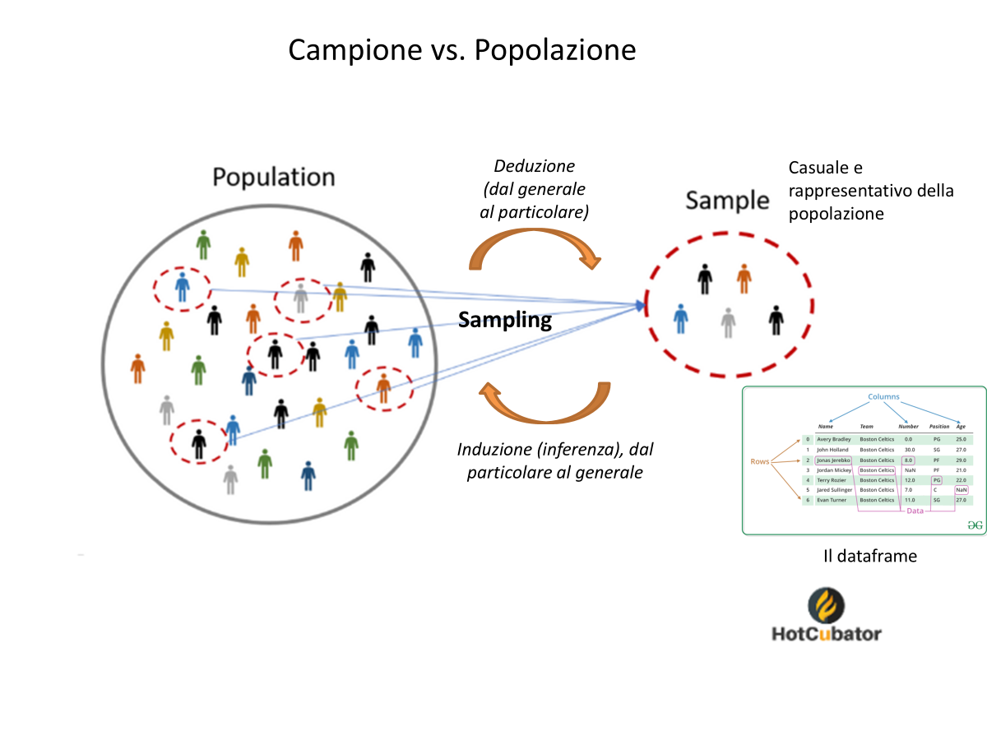
03 · EXPLORATORY DATA ANALYSIS
Sample vs. Population
Deduction
(from the general
to the particular)
Random and
representative of the
population
Induction (inference):
from the particular to the general
The dataframe
Sampling selects observations from the population; statistical inference uses the sample to learn about the population.
37
Notes:
Translated and adapted from the user-provided slide.

Slide 38
02 · DATA FOUNDATIONS
Building a dataset in Excel: two starting points
A dataset can be created directly in Excel or imported from an external source. In both cases, the goal is a clean, structured, analysis-ready table.
1 BUILD THE DATASET NATIVELY IN EXCEL
2 IMPORT THE DATASET FROM OUTSIDE EXCEL
Typical sources
• Manual data entry
• Copy / paste from controlled sources
• Form-based or operational data entry
OR
Typical external sources
• CSV / TXT files
• Other Excel workbooks
• Databases
• Web / API sources via Power Query
Customer_ID
Age
Region
Balance
CL001
34
North
5,240
CSV / DB
Data →
Get Data
Review import
settings
CL002
41
West
8,120
CL003
29
South
3,410
Check before loading
• Delimiter and text encoding
• Locale (decimal and date conventions)
• Inferred data types
• Missing values and unexpected columns
Good practice
• One row = one observation
• One column = one variable
• Use clear headers and consistent data types
• Convert the range to an Excel Table (Ctrl+T)
ANALYSIS-READY
EXCEL TABLE
Key point: regardless of the starting point, verify structure, data types, missing values and business meaning before starting EDA.
Data Science with Excel
1

Slide 39

03 · EXPLORATORY DATA ANALYSIS
CSV files: simple tabular data in plain text
CSV stands for Comma-Separated Values: a lightweight format for storing and exchanging structured data.
customers.csv
Plain text
No formulas, charts, formatting or multiple worksheets — only values.
Customer_ID,Age,Income,Balance,Default
CL0001,42,65000,12500,No
CL0002,35,54000,8200,No
CL0003,61,92000,45500,No
CL0004,29,45000,3200,Yes
Tabular structure
Rows represent observations; fields represent variables.
Delimiter matters
Each line is a row. Separators divide fields into columns. The first row usually contains column names.
Despite the name, CSV files may use commas, semicolons or other delimiters depending on locale and source.
CSV is a data format, not a spreadsheet workbook.
39

Slide 40
03 · EXPLORATORY DATA ANALYSIS
Why CSV is useful in Data Science
CSV is widely used as a simple interchange format between analytical tools, databases and programming environments.
Portable
Transparent
Easy to exchange
Readable by Excel, Python, R, SQL tools, BI platforms and many other applications.
The content can be inspected with a text editor: there is little hidden structure.
Useful for exporting datasets from systems and moving tabular data between tools.
Automation-friendly
Lightweight
Good for datasets
Straightforward to read and write in scripts and data pipelines.
No workbook features are stored, so the format focuses on the data itself.
A natural representation for rows × columns used in EDA and Machine Learning.
Typical Data Science flow: source system → CSV → Excel / Python / R → analysis
CSV
40

Slide 41
03 · EXPLORATORY DATA ANALYSIS
CSV ↔ Excel: how to convert in both directions
Import a CSV when you want to analyse it in Excel; export to CSV when you need a simple, portable data file.
CSV → Excel
Excel → CSV
1. In Excel, choose Data → From Text/CSV.
2. Select the .csv file.
3. Check delimiter, encoding and the previewed columns.
4. Choose Load to bring the data into Excel.
5. Save as .xlsx if you want to preserve Excel features.
1. Keep the worksheet you want to export active.
2. Choose File → Save As.
3. Select CSV UTF-8 (Comma delimited) (*.csv) when appropriate.
4. Save the file and confirm Excel’s warnings.
5. Re-open or inspect the CSV if delimiter/encoding is critical.
Important: CSV stores one flat table only — formulas, formatting, charts, PivotTables and additional worksheets are not preserved.
41

Slide 42
03 · EXPLORATORY DATA ANALYSIS
CSV files across locales: when commas stop being simple
A CSV file is plain text. The delimiter, decimal symbol, dates and encoding may be interpreted differently by Excel depending on regional settings.
KEY IDEA
Never assume that “CSV” means the same parsing rules on every computer. Import settings must be explicit.
1 What can change with locale?
2 Example: the same data, different conventions
3 Safe Excel import workflow
Field delimiter
Comma (,), semicolon (;), tab, etc.
Source CSV created in an English/US environment
1
Data → From Text/CSV
Customer_ID,Income,Rate,Region
C001,25900.50,3.75,Turin
C002,17200.00,4.10,Milan
Do not rely on double-click when locale is uncertain.
Decimal symbol
3.75 in EN/US vs 3,75 in many EU locales
2
Set delimiter explicitly
Choose comma, semicolon, tab, etc.
Thousands separator
25,900.50 vs 25.900,50
Check File Origin / UTF-8
3
Preserve accented characters and symbols.
03/04/2026 can mean Mar 4 or Apr 3
Double-click / automatic opening
Explicit import settings
Date interpretation
Set locale for numbers & dates
4
POSSIBLE RESULT
SAFE RESULT
Especially decimal comma/dot and date order.
Text encoding
UTF-8 avoids many accented-character problems
• all fields in one column
• decimal values split incorrectly
• numbers stored as text
• dates silently reinterpreted
• delimiter set explicitly
• decimal locale set correctly
• columns typed as expected
• row/column counts validated
Validate before analysis
5
Check column count, data types, totals and sample rows.
For shared workflows: document the delimiter, encoding and locale.

Slide 43
03 · EXPLORATORY DATA ANALYSIS
CSV import in Excel: data type inference
Why the same CSV file can be interpreted differently across tools, locales and workflows
WHAT EXCEL DOES
CSV file
(raw text values)
Excel import engine
scans sample values
Excel infers
column data types
Worksheet result
(numbers, dates, text)
Typical inference examples
Why this matters
CSV values
Inferred as
Possible issue
The same column may be imported as text, number or date.
Wrong inference can distort sorting, filtering, formulas and charts.
IDs, ZIP codes and account numbers can be damaged by numeric conversion.
Cross-language imports may change decimal separators and date interpretation.
"00123"
Number
Leading zeros lost
"13/09/2026"
Date
Locale ambiguity
"1,234"
Number/Text
Decimal vs thousands
"TRUE"
Logical/Text
Depends on parser
Safer Excel workflow
Use Data → From Text/CSV instead of double-clicking the file.
Review delimiter, file origin / encoding, locale, and detected data type.
Force Text for identifiers; verify dates, decimals and missing-value markers.
"NA" / blank
Missing/Text
May not mean the same thing
"CL00015"
Text
Usually OK
Key idea: a CSV file stores text separated by delimiters; data types are reconstructed during import.
Takeaway: CSV files do not carry rich type metadata. Excel infers types during import, so analysts must review the import settings before trusting the data.
43
Data Science with Excel

Slide 44
03 · EXPLORATORY DATA ANALYSIS
First look: create a dataset profile
Before any deep analysis, answer a small set of basic questions.
X
Column profile
fx
=COUNTBLANK(Table1[Income])
How many rows?
Field
Type
Missing
Unique
Min
Max
ROWS, COUNTA or Table totals.
Age
Numeric
0
41
18
86
How many unique values?
UNIQUE + ROWS (modern Excel) or PivotTable.
Income
Numeric
37
1,204
12k
420k
Segment
Category
0
4
—
—
What is missing?
COUNTBLANK, ISBLANK, filters and conditional formatting.
Balance
Numeric
4
8,951
-1.2k
650k
Default
Binary
0
2
0
1
=ROWS(Table1) =COUNTA(Table1[CustomerID]) =COUNTBLANK(Table1[Income])
Data Science with Excel · Banking Analysts

Slide 45
03 · EXPLORATORY DATA ANALYSIS
Descriptive statistics: centre, spread and shape
Summary statistics compress a distribution into a few interpretable numbers.
Mean
Median
Std. deviation
Average level
Middle value
Typical spread
=AVERAGE(range)
=MEDIAN(range)
=STDEV.S(range)
Min / Max
Quartiles
Important
Observed range
25th / 50th / 75th percentiles
Mean and standard deviation can be heavily affected by outliers. Always compare with median and quartiles.
=MIN(range) / =MAX(range)
=QUARTILE.INC(range,k)
The “Descriptive Statistics” option in Excel Analysis ToolPak can generate a compact summary table.
Data Science with Excel · Banking Analysts

Slide 46
03 · EXPLORATORY DATA ANALYSIS
PivotTables: fast multivariate EDA without writing formulas
PivotTables help answer “how does a metric differ across groups?”
X
PivotTable output
fx
Average of Balance / Count of CustomerID
Segment
Region
Customers
Avg Balance
Default %
Affluent
North
1,240
46,200
0.8%
Affluent
South
980
42,900
1.1%
Aff N
Aff S
Mass N
Mass S
Mass
North
4,650
8,400
2.9%
Average balance by segment & region
Mass
South
4,210
7,950
3.4%
PivotTables are a bridge between raw tables and clear business questions.
Data Science with Excel · Banking Analysts

Slide 47
03 · EXPLORATORY DATA ANALYSIS
Sorting, filtering and conditional formatting are EDA tools
Simple spreadsheet operations often reveal data issues faster than complex methods.
X
Filter & inspect
Sort
fx
=SORT(Table1[Balance],,-1)
Find top/bottom values and suspicious extremes.
Customer
Income
Balance
DaysPastDue
C1001
65,000
12,500
0
Filter
Inspect one segment, branch, category or exception at a time.
C1002
54,000
8,200
0
C1003
92,000
45,500
12
Conditional formatting
Highlight blanks, duplicates, thresholds and unusual values.
C1004
3,200
0
C1005
71,000
165,000
97
Freeze panes / Table headers
Keep context while scanning many rows.
C1006
58,000
9,700
0
Tip: “show me the 20 largest values” is often a very good EDA question.
Data Science with Excel · Banking Analysts

Slide 48
04 · PROBABILITY & STATISTICS
Random variables: a bridge from data to probability
A random variable represents a quantity whose observed value depends on an uncertain outcome.
Experiment / process
Random variable X
Observed value
A customer may or may not default within 12 months.
X = 1 if default occurs
X = 0 otherwise
For one customer: X = 0
Other examples
Transaction amount · number of late payments · account balance next month · time until loan closure · daily loss.
Random does not mean “without structure”. It means the exact outcome is uncertain before observation.
Data Science with Excel · Banking Analysts

Slide 49
04 · PROBABILITY & STATISTICS
Probability distributions: the “shape” of uncertainty
A distribution describes which values a random variable can take and how likely they are.
Continuous distribution
Discrete distribution
Binary distribution
Distributions help us reason about typical values, variability and tail risk.
The empirical distribution comes from observed data; a theoretical distribution is a model.
EDA asks whether the observed shape is symmetric, skewed, multi-modal, heavy-tailed or irregular.
Data Science with Excel · Banking Analysts

Slide 50
04 · PROBABILITY & STATISTICS
The Normal distribution: useful model, not universal law
Many measurement errors and aggregate quantities are approximately bell-shaped — but financial data often has skew and heavy tails.
Parameters
Mean μ controls location; standard deviation σ controls spread.
EDA question
Does the histogram look roughly symmetric and bell-shaped?
μ − 2σ
μ
μ + 2σ
Banking caution
Losses, balances and transaction amounts are often skewed and may have heavy tails.
Excel examples: =NORM.DIST(x, mean, stdev, FALSE) | =NORM.INV(p, mean, stdev)
Data Science with Excel · Banking Analysts

Slide 51
04 · PROBABILITY & STATISTICS
Bernoulli and Binomial: natural distributions for “event / no event”
Binary outcomes appear everywhere in banking: default, fraud flag, churn, approval, response.
Bernoulli random variable
Binomial random variable
One trial with two outcomes.
X = 1 with probability p
X = 0 with probability 1 − p
Counts how many “successes” occur in n comparable Bernoulli trials.
Example: number of defaults among 100 similar loans.
Bernoulli: one customer
Binomial: count across many customers
Data Science with Excel · Banking Analysts

Slide 52
04 · PROBABILITY & STATISTICS
Probability vs statistics: opposite directions of reasoning
Probability starts from a model; statistics starts from data.
Probability
Statistics
MODEL / assumptions
OBSERVED DATA
Possible data / outcomes
Model / parameters / inference
EDA sits mainly on the statistics side: use observed data to learn what is plausible, typical and suspicious.
Data Science with Excel · Banking Analysts

Slide 53
04 · PROBABILITY & STATISTICS
Sampling and uncertainty: a sample is not the population
Any estimate from a sample varies from sample to sample. Statistical thinking quantifies that uncertainty.
Population
Sample
Estimate
Sample mean
Sample default rate
Sample correlation
… each has uncertainty.
Larger, representative samples usually reduce uncertainty.
Biased samples can be precise but wrong.
Always ask: “how was this data selected?”
Data Science with Excel · Banking Analysts

Slide 54
05 · CORRELATION
Correlation: how two numeric variables move together
Correlation quantifies the strength and direction of a linear relationship.
Positive correlation
Negative correlation
Little linear correlation
r > 0
r < 0
r ≈ 0
High values of X tend to occur with high values of Y.
High values of X tend to occur with low values of Y.
No strong linear relationship — but nonlinear structure may still exist.
Data Science with Excel · Banking Analysts

Slide 55
05 · CORRELATION
The Pearson correlation coefficient
Pearson r is bounded between −1 and +1 and measures linear association.
−1
−0.5
0
+0.5
+1
Perfect negative
Moderate negative
No linear relationship
Moderate positive
Perfect positive
Scale-free
Linear
Sensitive to outliers
Changing EUR to thousands of EUR does not change r.
r can miss curves, thresholds and other nonlinear patterns.
One extreme point can dramatically change the result.
Interpret the coefficient together with a scatter plot.
Data Science with Excel · Banking Analysts

Slide 56
05 · CORRELATION
Correlation in Excel: CORREL + scatter plot
A number is useful; a number plus a plot is much safer.
X
Income vs Balance
Income vs Balance
fx
=CORREL(Table1[Income],Table1[Balance])
Customer
Income
Balance
C1001
65,000
12,500
C1002
54,000
8,200
C1003
92,000
45,500
C1004
45,000
3,200
C1005
71,000
40,000
=CORREL(Table1[Income], Table1[Balance])
C1006
58,000
9,700
Always check units, missing rows and outliers before interpreting r.
Data Science with Excel · Banking Analysts

Slide 57
05 · CORRELATION
Correlation matrix: many pairwise relationships at once
A correlation matrix is a compact map of linear associations among numeric variables.
Age
Income
Balance
Products
Arrears
Age
What to look for
1.00
0.28
0.21
0.15
0.05
Large absolute values |r| reveal strong linear association.
Income
0.28
1.00
0.63
0.36
-0.18
Diagonal
Balance
0.21
0.63
1.00
0.42
-0.31
A variable is perfectly correlated with itself: r = 1.
Products
0.15
0.36
0.42
1.00
-0.12
Symmetry
corr(X,Y) = corr(Y,X), so the matrix mirrors across the diagonal.
Arrears
0.05
-0.18
-0.31
-0.12
1.00
Excel: Data Analysis → Correlation or multiple =CORREL(...) formulas
Data Science with Excel · Banking Analysts

Slide 58
05 · CORRELATION
Correlation is not causation
A strong relationship can be real and useful without proving that X causes Y.
Common cause
Reverse direction
Spurious relationship
A third variable drives both X and Y.
Example: season affects both heating usage and energy bills.
Y may influence X rather than X influencing Y.
Correlation alone cannot determine direction.
With many variables, some correlations appear by chance.
Strong r
Need additional evidence
Does X cause Y?
Domain knowledge · time ordering · experiments · causal designs.
Not answered by correlation alone
Data Science with Excel · Banking Analysts

Slide 59
06 · VISUALISATION
Choose the plot that matches the question
Visualisation is part of reasoning, not decoration.
Distribution of one numeric variable
Histogram / Box plot
Relationship between two numeric variables
Scatter plot
Metric over time
Line chart
Compare categories
Bar / Column chart
Missingness / quality exceptions
Conditional formatting / table
Avoid charts that hide the data structure. Pie charts, 3D effects and decorative clutter are often poor analytical choices.
Data Science with Excel · Banking Analysts

Slide 60
06 · VISUALISATION
Histogram: see the distribution, not only the average
A histogram groups numeric observations into bins and shows how frequently values occur.
Reveals
Skewness · multiple modes · gaps · tails · unusual peaks.
Frequency
Excel
Insert → Statistical Chart → Histogram, or Data Analysis → Histogram.
Watch the bins
Balance bins →
Too few bins hide structure; too many bins create noise.
Question: “What does the distribution of customer balances look like?”
Data Science with Excel · Banking Analysts

Slide 61
06 · VISUALISATION
Box plot: compact view of centre, spread and outliers
The box spans Q1 to Q3, the line is the median, whiskers show the non-outlier range, and points may mark outliers.
Min
Q1
Median
Q3
Max
Outlier
Strength
Robust centre
Excel
Very fast comparison across customer segments, products or branches.
Median and quartiles are less sensitive to extreme values than the mean.
Insert → Statistical Chart → Box & Whisker.
Data Science with Excel · Banking Analysts

Slide 62
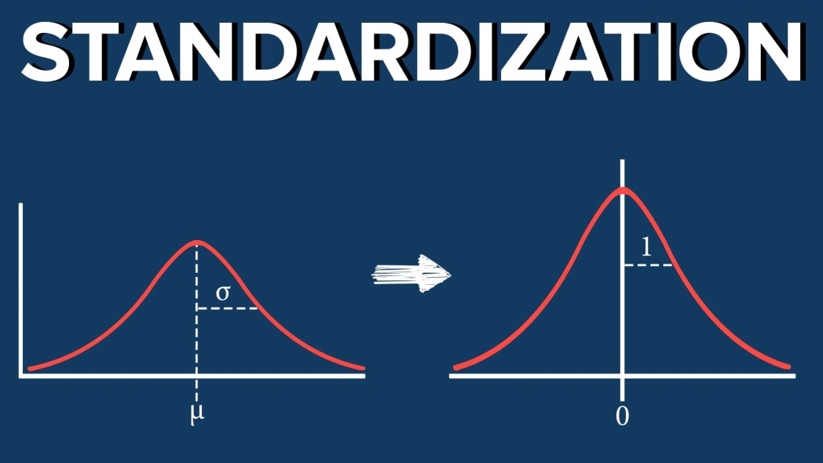
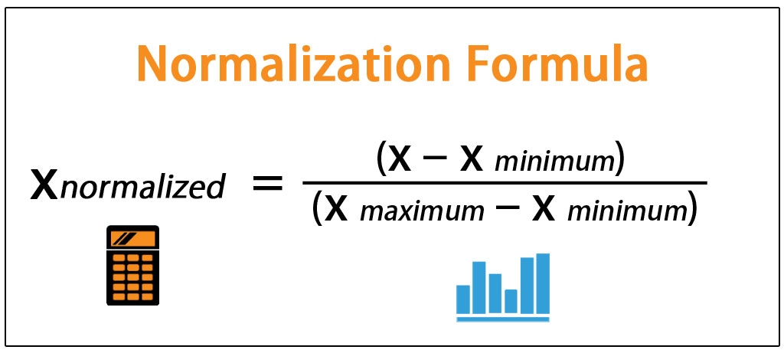
06 · VISUALISATION
Box plots: required to compare unevenly distributed data
Two typical useful techniques to compare unevenly distributed data by boxplots → this way, we can then appreciate differences
62

Slide 63
06 · VISUALISATION
Standardising a numeric column in Excel (Z-score)
Standardisation expresses each value as a number of standard deviations from the mean.
CONCEPT
EXCEL FORMULA
EXAMPLE
Z-score formula
For values in A2:A101
Annual income (k€)
z = (x − μ) / σ
=(A2-AVERAGE($A$2:$A$101))
/STDEV.S($A$2:$A$101)
Original
Z-score
20
−1.26
Interpretation
40
−0.63
z = 0 → value is at the mean
z = +1 → one standard deviation above
z = −1 → one standard deviation below
Copy the formula down the column.
60
0.00
80
+0.63
100
+1.26
When standardisation is useful
Important
• Variables have very different units or scales
• Distance-based methods are used (e.g. k-NN, k-means)
• You want a common scale centred around zero
Standardisation does not force values into a fixed range. Values below −3 or above +3 are possible and may highlight unusual observations.
Takeaway: standardisation changes the scale, not the relative ordering of the observations.
63

Slide 64
06 · VISUALISATION
Normalising a numeric column in Excel (Min–Max)
Min–Max normalisation rescales a variable to a fixed interval, most commonly 0 to 1.
CONCEPT
EXCEL FORMULA
EXAMPLE
Min–Max formula
For values in A2:A101
Customer score
=(A2-MIN($A$2:$A$101))
/(MAX($A$2:$A$101)-MIN($A$2:$A$101))
Original
0–1 scaled
(x − min) / (max − min)
20
0.00
40
0.25
Result
60
0.50
minimum → 0
maximum → 1
all other values → proportionally between 0 and 1
For a 0–100 scale, multiply the result by 100.
80
0.75
100
1.00
How to read the new scale
Watch out for outliers
Min–Max normalisation is highly sensitive to extreme minimum or maximum values. One outlier can compress most observations into a very narrow part of the 0–1 interval.
0
0.25
0.50
0.75
1
minimum
maximum
Takeaway: normalisation maps values to a chosen range; standardisation centres and scales them around the mean.
64

Slide 65
06 · VISUALISATION
Scatter plot: the essential chart for relationships
Every point is one observation positioned by two numeric variables.
Income vs Balance
Look for
Direction · strength · curvature · groups · isolated points.
Add meaning
Colour points by segment or branch; use labels only for key exceptions.
Excel
Insert → Scatter. Add a trendline only when it supports the question.
Pair with =CORREL(...) — never interpret the coefficient without seeing the points.
Data Science with Excel · Banking Analysts

Slide 66
06 · VISUALISATION
Line chart: patterns across time
Use line charts when order matters — especially for time series.
Best for
Trend · seasonality · regime shifts · before/after comparisons.
Banking example
Monthly deposits, delinquency rate, call volume or transaction counts.
Caution
Do not connect unordered categories with a line.
Month →
Excel: put a real date in the X-axis whenever possible.
Data Science with Excel · Banking Analysts

Slide 67
06 · VISUALISATION
Bar and column charts: compare categories clearly
The baseline should normally start at zero because bar length encodes magnitude.
Use for
Counts, averages, totals and rates by category.
Good practice
Sort bars when ranking matters; keep category labels readable.
Avoid
3D bars, too many categories and truncated baselines.
Affluent
Mass
SME
Private
Question: “Which customer segment has the highest average balance?”
Data Science with Excel · Banking Analysts

Slide 68
07 · OUTLIERS & MISSING DATA
Outliers: extreme observations that deserve investigation
An outlier may be an error, a rare valid case, a new regime — or the most interesting observation in the dataset.
Mostly regular pattern
Data error
Extra zero, wrong sign, wrong unit, duplicate record.
Valid rare case
Very wealthy customer, large transaction, unusual product.
Process change
outlier
System migration, policy change, new branch behaviour.
Interesting signal
Potential fraud, stress event or operational exception.
Never delete an outlier just because it is inconvenient.
Data Science with Excel · Banking Analysts

Slide 69
07 · OUTLIERS & MISSING DATA
Detecting outliers with the IQR rule
The interquartile range is robust and works well as a first-pass rule.
Q1: =QUARTILE.INC(range,1)
Q3: =QUARTILE.INC(range,3)
IQR: =Q3-Q1
IQR rule
Lower = Q1-1.5*IQR
Q1 = 25th percentile
Q3 = 75th percentile
IQR = Q3 − Q1
Flag values below Q1 − 1.5×IQR or above Q3 + 1.5×IQR.
Upper = Q3+1.5*IQR
A statistical flag is a prompt to investigate, not a business verdict.
Data Science with Excel · Banking Analysts

Slide 70
07 · OUTLIERS & MISSING DATA
Detecting outliers with z-scores
A z-score expresses how many standard deviations an observation lies from the mean.
Formula
z = (x − mean) / standard deviation
=(B2-AVERAGE($B$2:$B$101))/STDEV.S($B$2:$B$101)
Caution
≈ −3σ
≈ +3σ
z-scores are sensitive to outliers and assume the mean/std are meaningful for the distribution.
For strongly skewed banking data, the IQR rule is often safer as a first screen.
Data Science with Excel · Banking Analysts

Slide 71
07 · OUTLIERS & MISSING DATA
Handling outliers: preserve information and business meaning
The right treatment depends on why the value is extreme.
Validate
Correct
Keep
Check source system, unit, sign, duplicate and business event.
Fix confirmed errors using traceable rules.
Valid extreme cases may be essential to risk analysis.
Transform
Cap / Winsorise
Segment / model separately
Log scale can reduce skew for positive amounts.
Limit extreme influence when methodologically justified.
Different populations may need different treatment.
Document every exclusion or transformation — especially in regulated analytical processes.
Data Science with Excel · Banking Analysts

Slide 72
07 · OUTLIERS & MISSING DATA
Missing values: “unknown” is a data state, not a number
Missingness can distort summaries and models — and may itself contain information.
X
Missing values
MCAR
fx
=COUNTBLANK(Table1[Income])
Missing Completely At Random — unrelated to observed or unobserved data.
Customer
Income
Balance
RiskGrade
C1001
65,000
12,500
A
MAR
Missing At Random conditional on observed information.
C1002
54,000
8,200
B
C1003
45,500
A
MNAR
Missing Not At Random — missingness depends on the missing value or process.
C1004
45,000
C
C1005
165,000
Do not silently replace missing values with zero unless zero is the correct business meaning.
Data Science with Excel · Banking Analysts

Slide 73
07 · OUTLIERS & MISSING DATA
Detecting missing values in Excel
Combine formulas, filters and visual highlighting.
X
Exception list
=COUNTBLANK(Table1[Income])
fx
=IF(ISBLANK(B4),"Missing","OK")
Customer
Income
Balance
MissingFlag
=ISBLANK(C2)
C1001
65,000
12,500
OK
=COUNTIF(C2:C1000,"")
C1002
54,000
8,200
OK
=IF(ISBLANK(C2),"Missing","OK")
C1003
45,500
Missing
C1004
45,000
Missing
Be aware: a formula that returns "" may look blank but is not always the same as a truly empty cell.
C1005
165,000
Missing
Data Science with Excel · Banking Analysts

Slide 74
07 · OUTLIERS & MISSING DATA
Handling missing data: choose a strategy, do not hide the problem
Treatment depends on volume, mechanism, business meaning and downstream use.
Leave missing
Best when “unknown” is meaningful and downstream tools can handle it.
Exclude rows
Reasonable only when missingness is limited and exclusion does not bias the sample.
Impute simple values
Median for skewed numeric data; mode for categories — document the rule.
Create missing indicator
A separate flag can capture information in the fact that a value is missing.
Impute with a model
Useful for complex data, but adds assumptions and validation requirements.
Example simple rule: =IF(ISBLANK(C2), MEDIAN($C$2:$C$1000), C2)
Data Science with Excel · Banking Analysts

Slide 75
08 · PATTERNS & QUALITY
Patterns in data: what EDA is trying to discover
A pattern is a repeatable structure in the data that helps explain, predict or segment observations.
Trend
Seasonality
Clusters
Association
Anomaly
Patterns are hypotheses until validated — they may reflect sampling, missingness or data quality problems.
In banking, patterns often differ across segments, products, branches and time periods.
A useful EDA habit: ask “what would make this pattern disappear?”
Pattern ≠ proof. It is a structured clue that guides the next question.
Data Science with Excel · Banking Analysts

Slide 76
08 · PATTERNS & QUALITY
Data quality: six dimensions to check before trusting analysis
Quality is fitness for use: “good data” depends on the analytical purpose.
Accuracy
Does the value reflect reality?
Timeliness
Completeness
DATA
QUALITY
Is the data current enough?
Are required values present?
Uniqueness
Consistency
Are duplicates controlled?
Do systems / fields agree?
Validity
Does the value obey rules and domains?
The same dataset can be “good enough” for one purpose and unacceptable for another.
Data Science with Excel · Banking Analysts

Slide 77
08 · PATTERNS & QUALITY
How data quality changes the analysis
Poor quality can create fake signals, hide real ones and bias decisions.
X
Dirty data → distorted evidence
Wrong descriptive statistics
fx
=COUNTBLANK(Table1[Income])
Mean, rate, dispersion and counts become misleading.
Issue
Example
Analytical effect
Missing
Income absent for some segments
Biased averages
Wrong relationships
Spurious or suppressed correlations and segment differences.
Wrong type
Amounts imported as text
Rows silently excluded
Duplicate
Customer repeated twice
Inflated counts / balances
Wrong decisions
Mis-prioritised customers, risk, operations or controls.
Outlier error
Balance ×1000
Mean & correlation distorted
Stale data
Old risk grade
Wrong segmentation
Data quality is part of the model — not a preprocessing footnote.
Data Science with Excel · Banking Analysts

Slide 78
09 · TAKEAWAYS
Excel EDA checklist: from raw table to trustworthy insight
A compact workflow to use after the course.
Define the question and the unit of analysis.
Visualise distributions, relationships and time patterns.
1
6
Convert the data to an Excel Table and preserve the raw extract.
Investigate outliers and missing values before changing them.
2
7
Check types, units, keys and valid categories.
Use correlation with scatter plots — not as proof of causality.
3
8
Profile rows, unique values, ranges and missingness.
Assess data quality and document every transformation.
4
9
Summarise numeric and categorical variables.
Communicate findings, limitations and next questions.
5
10
Good Data Science in Excel = clear question + clean structure + statistical thinking + visual evidence + data quality discipline
Data Science with Excel · Banking Analysts

