Slide 1
CS-499 – Code Review
By Antonio Diaz-Leyva

Slide 2
Software Design and Engineering
CS-465: Travlr Getaways

Slide 3
Overview: Travlr Getaways
app_server: Express + Handlebars. Renders the home page and the trip listing
app_api: Express + Mongoose. Seven routes, Passport login, and JWT
app_admin: Angular single-page app for adding, editing, and deleting trips.
travlr: MongoDB database
  trips
  users
The customer site and admin app calls the API over HTTP which is the only path to the data.

Slide 4
Starter Code Layout
adiazleyva_travlr/
  apps.js bin/www
  app_server/ customer pages
  app_api/ REST API
  app_admin/ Angular SPA
  data/ trips.json
  public/ template and CSS
Walkthrough:
bin/www -> app.js -> routes -> travel.js -> travel.hbs

Slide 5
REST API
Method | Path | Auth | Handler
GET | /api/trips | Public | tripsList
GET | /api/trips/:tripCode | Public | tripsFindByCode
POST | /api/trips | JWT | tripsAddTrips
PUT | /api/trips/:tripCode | JWT | tripsUpdateTrip
DELETE | /api/trips/:tripCode | JWT | tripsDeleteTrip
POST | /api/login | Public | Login
GET | /api/register | Public | Register

Slide 6
Angular Admin
app.routes.ts
  Four routes: list, add, edit, login
Components
  TripListing, TripCard, AddTrip, EditTrip, and Navbar
Services
  TripData calls the API. Auth keeps token in browser storage
jwt-interceptors.ts
  Adds Bearer token to API calls while user is logged in

Slide 7
Enhancement – Conversion to Astro
One project instead of three
Layout
src/
  layouts/ BaseLayout.astro
  components/ Header, Footer, TripCard
  pages/ index, travel, api/
  lib/ db, trips, nav
  models/ Trip.js Trip.ts
public/ css, images
data/ trips.json
src/lib: shared logic, one connection, one trip query, one nav list
public: CSS and images stay put

Slide 8
Enhancement - Layout and Components
Before - Handlebars
After - Astro
header.hbs and footer.hbs each held a copy of the linked list
Travel was hardcoded as the selected page
nav.ts holds one link list for both components
isCurrent() highlights the page from the URL
BaseLayout wraps every page through a slot

Slide 9
Enhancement - Data Layer and Trip Page
db.ts: opens MongoDB once and reuses the connection
trips.ts getTrips() and getTripsByCode() return plain objects, so pages and API can share one query
Trip.ts: same eight fields as before with the required rules on start and resort enforced
travel.astro: calls getTrips() directly, renders live, and shows empty and error messages.

Slide 10
Data Structures and Algorithms
CS-370: Pirate Pathfinding Agent

Slide 11
Overview: AI Pathfinder
8x8 Maze of open cells and walls. Our pathfinder can move left, right, up, or down.
100% Win Rate reached at epoch 532
Deep Q-learning with a small neural network scores each move. The pirate learns from its own experience
TreasureMaze and GameExperience handle the maze and replay memory

Slide 12
Each epoch plays one game
Start: A random open cell
Move: Explore at rate epsilon, else take the best-scoring move
Remember: Store the move and its reward in replay
Learn: Train on a random batch of 32 after every move
Every 50 epochs the network gets copied into the target network and supplies the future value estimate.

Slide 13
Enhancement – Structure with OOP
Global models, optimizer, and epsilon
  train_step and qtrain read shared globals, so the model passed into qtrain is not what gets updated unless it’s the same object
Settings hard-coded in cells
  The maze, hyperparameters, and start cell live in code, every experiment means editing cells and re-running them in order
Results never leave the notebook
  The trained model is not saved, so every run retrains from scratch

Slide 14
Enhancement – Notebook to Classes
Class | Replaces | Job
TrainingConfig | settings, hard-coded maze | Holds every setting, validated
DQNAgent | build_model, train_step | Network, optimizer, epsilon, save/load
Trainer | qtrain | Epoch loop, logging, stopping rule
Evaluator | play_game, completion_check | Plays game, returns data not True/False
MazeRenderer | show | Text board or saved image
TreasureHuntCLI | manual notebook cells | Parses options, runs the three commands

Slide 15
Enhancement - One entry point, three commands
train
  Reads options, loads/validates maze, builds agent, runs epochs, save and print model results
evaluate
  load saved model, validate size and maze size, play game from open cell, report any failures
play
  loads saved model, play one game, print results and path

Slide 16
Databases
CS-410: SNHU Investments

Slide 17
Overview: SNHU Investments
Small console app
5 clients held in global variables
1 shared password
3 menu options: display, change, exit
User logs in then loops through a menu to view the client list or change a client’s service. Everything resets on program exit.

Slide 18
Starter Code Flow
Greeting
Login
Menu Loop
  Display Info
  Change Customer Choice
Exit

Slide 19
Inside the Starter File
Function | Role
main() | greeting, login loop, menu loop
CheckUserPermissionAccess() | asks for credentials, compares hashes
GetMaskedPassword() | hides typed characters
HashPassword() | std::hash of password text
GetValidatedMenuChoice() | re-prompts until integer is entered
DisplayInfo() | prints the five clients
ChangeCustomerChoice() | if / else chain updates num1…num 5
Global Data
  name1 – name 5
    ex. “John Doe”
  num1 – num 5
    ex 1 or 2 (for service choice)
  storedPasswordHash
    hash of 123

Slide 20
Enhancements – Database Design
clients
  client_id, name, address, ZIP, phone, status, create_date, updated_at, service
users
  user_id, username, salt, password_hash
accounts
  account_id, client_id, amount, service
orders
  order_id, client_id, order_date, status, total_amount

Slide 21
Enhancement – CRUD and Reporting
Display: Lists every client with its service
Add: Checks name, address, state, ZIP, phone, and service. Inserts row.
Change: Looks up client, shows current service, then updates row
Delete: Asks for Y to confirm, then removes the client, accounts, and orders together.
Report: Filters by service, part of a name, or all clients, with a row count

Slide 22
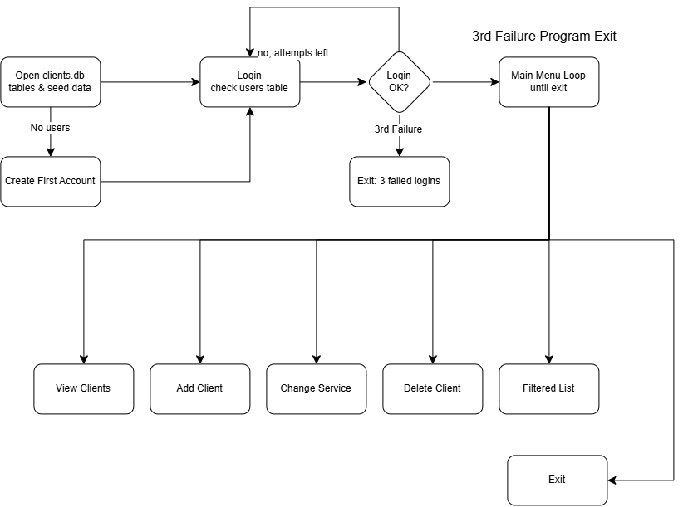
Enhancements – New Program Flow

Slide 23
Thank You

