Slide 1

UNIVERSIDAD CENTRAL DE VENEZUELA FACULTAD DE CIENCIAS
ESCUELA DE COMPUTACION
APLICACIONES CON TECNOLOGÍA INTERNET 2014-1
PROFESOR: ANTONIO LEAL
Diego Lamas
Isaac Herrera

Slide 2
Agenda
W3C - Introduccion
HTML5
Novedades:
Web semántica
<input>
<canvas>
SVG
audio/video
Geolocalización
Almacenamiento web
BD locales
Novedades DOM
APIs
ACID3
CONCLUSIONES

Slide 3

Consorcio W3C
World Wide Web Consortium (1994)
Tim Berners-Lee (URL, HTTP y HTML)
Proyecto HTML (1990-1995 y 1997)
XML y DOM (1998 - 2004)
Inicia HTML5 (2006 - 2007)
HTML y XHTML (text/html MIME y application/xhtml + xml MIME XML)
Estándares globales mantenidos por consorcio W3C

Slide 4

LENGUAJE DE MARCACIÓN DE HIPERTEXTO (Lenguaje interpretado)
ESTRUCTURA
Elementos y texto (etiquetas)
Atributos
<!DOCTYPE html>
<html>
<head>
<title>Sample page</title>
</head>
<body>
<h1>Sample page</h1>
<p>This is a <a href="demo.html">simple</a> sample.</p>
<!-- this is a comment →
</body>
</html>
EDITORES DE TEXTO
Adobe Dreamweaver (Privado)
BlueGriffon (OpenSource)

Slide 5
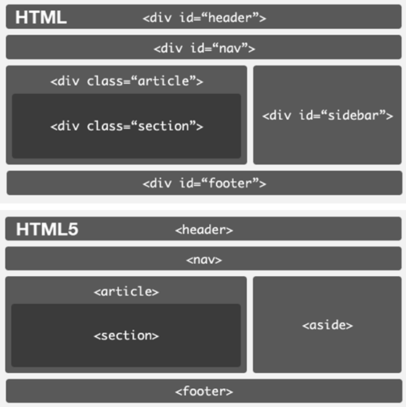
Web Semántica

Slide 6
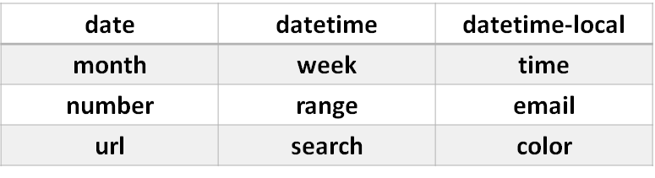
<input>
Nuevos Tipos de Datos

Slide 7
<canvas>
<html>
<body>
<canvas id="myCanvas" width="200" height="100" style="border:1px solid #d3d3d3;">
</canvas>
<script>
var c = document.getElementById("myCanvas");
var ctx = c.getContext("2d");
ctx.beginPath();
ctx.arc(95,50,40,0,2*Math.PI);
ctx.stroke();
</script>
</body>
</html>
Canvas
Elemento

Slide 8
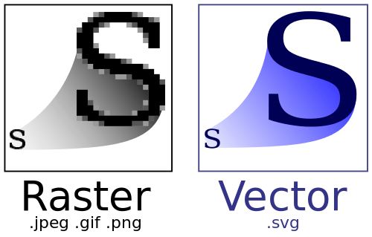
SVG
<svg height="100" width="100">
<circle cx="50" cy="50" r="40" stroke="black" stroke-width="3" fill="red" />
</svg>

Slide 9

Audio y Video

Slide 10
Audio
<audio controls>
<source src="horse.ogg" type="audio/ogg">
<source src="horse.mp3" type="audio/mpeg">
Your browser does not support the audio element.
</audio>
Attribute | Value | Description
autoplay | autoplay | Specifies that the audio will start playing as soon as it is ready
controls | controls | Specifies that audio controls should be displayed (such as a play/pause button etc)
loop | loop | Specifies that the audio will start over again, every time it is finished
muted | muted | Specifies that the audio output should be muted
preload | auto metadata none | Specifies if and how the author thinks the audio should be loaded when the page loads
src | URL | Specifies the URL of the audio file

Slide 11
Video
<video width="320" height="240" controls>
<source src="movie.mp4" type="video/mp4">
<source src="movie.ogg" type="video/ogg">
</video>
Attribute | Value | Description
autoplay | autoplay | Specifies that the video will start playing as soon as it is ready
controls | controls | Specifies that video controls should be displayed (such as a play/pause button etc).
height | pixels | Sets the height of the video player
loop | loop | Specifies that the video will start over again, every time it is finished
muted | muted | Specifies that the audio output of the video should be muted
poster | URL | Specifies an image to be shown while the video is downloading, or until the user hits the play button
preload | auto metadata none | Specifies if and how the author thinks the video should be loaded when the page loads
src | URL | Specifies the URL of the video file
width | pixels | Sets the width of the video player

Slide 12

Geolocalización

Slide 13
Geolocalización
Property | Description
coords.latitude | The latitude as a decimal number
coords.longitude | The longitude as a decimal number
coords.accuracy | The accuracy of position
coords.altitude | The altitude in meters above the mean sea level
coords.altitudeAccuracy | The altitude accuracy of position
coords.heading | The heading as degrees clockwise from North
coords.speed | The speed in meters per second
timestamp | The date/time of the response

Slide 14

Almacenamiento Web
Local
Sesión
if(typeof(Storage) !== "undefined") {
// Code for localStorage/sessionStorage.
} else {
// Sorry! No Web Storage support..
}

Slide 15

BD Locales
•HTML5 nos introduce la posibilidad de disponer de un base de datos local (basadas en SQLite) almacenada en el navegador del usuario.
•Mediante Web SQL Database, la W3C ofrece una API estándar destinada a manipular bases de datos en el lado del cliente mediante peticiones SQL

Slide 16
BD Locales
Las dos funciones más usadas:
• transaction: crearemos una transacción que se ejecutará contra la base de datos de forma atómica
• executeSql: como su nombre indica ejecutaremos las propias sentencias sql.

Slide 17
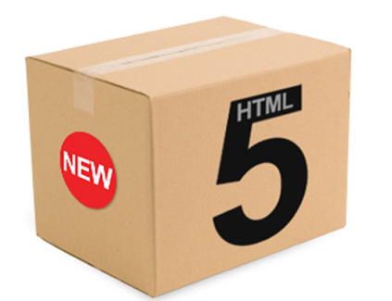
NOVEDADES DOM
getElementsByClassName()
classList
innerHTML
activeElement / hasFocus
getSelection()
designMode
execCommand()

Slide 18

NUEVAS APIs
Drag & Drop
Trabajo Off-Line (cloud)
WebSockets
WebWorkers

Slide 19

ACID3
PRUEBA DE ESTANDARES (DOM y JavaScript)
http://acid3.acidtests.org/
DESARROLLADO POR IAN HICKSON (2007 - 2008)
THE WEB STANDARDS PROJECT (1998)
Reducción de coste y complejidad
Aumento de la accesibilidad

Slide 20
Sitios de Interes
http://www.w3schools.com/
http://html5accessibility.com/
http://html5demos.com/
https://developer.mozilla.org/en-US/docs/Web/HTML/Element
http://html5test.com/
http://flashvhtml.com/
http://ie.microsoft.com/testdrive/performance/fishbowl/

