Slide 1
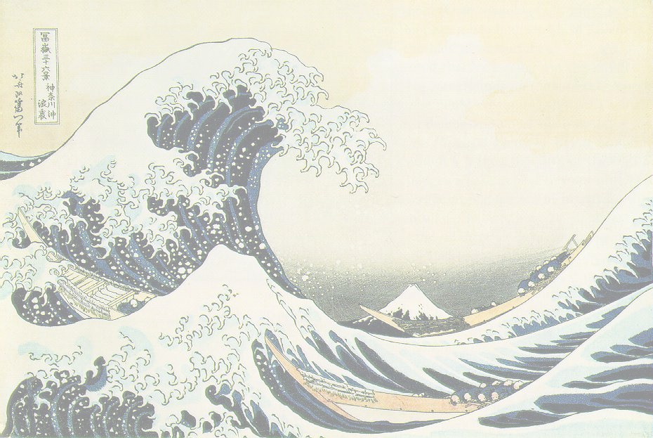
Neural Network and Deep Learning
MNIST classification
Antonio Petrillo
N9700496

Slide 2
History of MNIST
Images representing digits from 0 to 9 (labeled)
Introduced by Yann Le Cun
Not too hard:
  Doesn’t require to much computational power
  Easy to understand
  Although my laptop suffered quite a bit
Not too simple:
  A Network is required

Slide 3
Machine Learning
Predict the Result
Observe the Error
Update the Parameters
Repeat (a reasonable amount of times)

Slide 4
Deep Learning
Limits of Shallow Networks:
A difficult hyperplane
Tend to overfit
Exponential more neurons are required
Why Deep Networks?
Each Layer learn some aspects of the problem
An Exponential number of combinations
Hence less neurons are needed

Slide 5
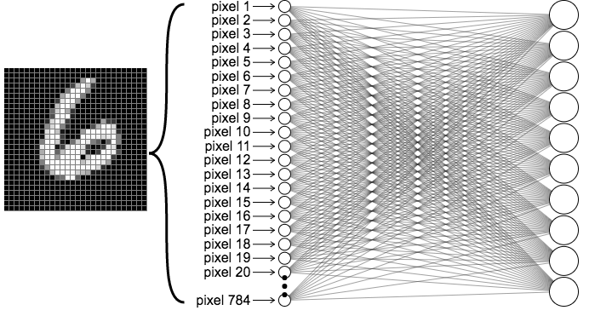
Input data
28x28 pixel
Greyscale (0-255 possible values)
Flatten to 784 array

Slide 6
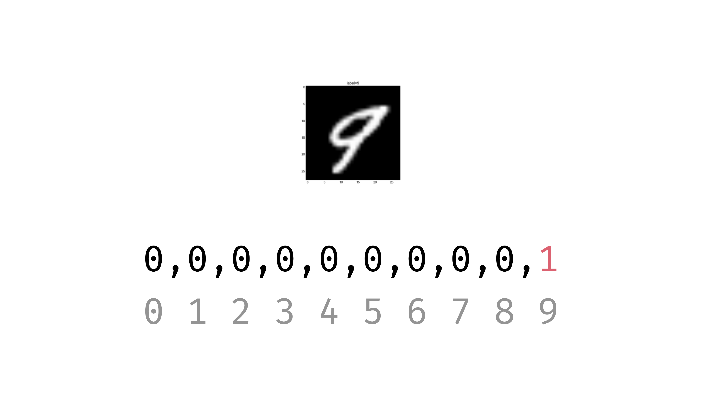
Output format
Ten possible values
One for each class (One-hot encoding)

Slide 7
Grid search VS Random search
(Theory)
Grid Pros:
Guarantees Optimal
Easy to implement
Reproducible
Random Pros:
More efficient
May find unexpectedly good combinations
Grid Cons:
Ridiculously expensive
Can’t use large dataset
Random Cons:
More efficient
Require a search space large enough

Slide 8
Grid search VS Random search
(Practice)

Slide 9
Grid search VS Random search
(Practice)

Slide 10
Resilient Backpropagation
(Rprop)
Adaptive Weights Update, based on:
  Sign of the gradient
  η⁺, η⁻ regulate the weights update
Faster Convergence
Designed for Batch Update
For mini batch see:
  ADAM, the widest in use
  RMSProp, a valid alternative to ADAM in some contexts

Slide 11
Rectified Linear Unit
(ReLU)
Formulae: ReLU(x) = max(0, x)
Simple to Compute
Mitigate vanishing gradient
  Not a real problem in this toy network example
Doesn’t work well if the weights become negative
  See Leaky Relu in that case

Slide 12
Cross Entropy
Binary: t·log(ŷ) + (1-t)·log(1-ŷ)
Multiclass: Σ^{C}c=1 tc·log(ŷc)
Small values for correct classification
Big values for incorrect classification
Supported by mathematical model
Entropy in Information Theory:
  Minimize Uncertainty
  Self Information

Slide 13
Early Stopping
Stop the learning process if the network doesn’t improve for many consecutive epochs
Regulate by the Patience parameter
Easy to implement

Slide 14
Grazie per l’attenzione

