Slide 1

Métodos Estatísticos em Saúde
Aquisição de conhecimentos em conceitos, modelos e técnicas mais comuns na análise estatística em Ciências da Saúde
Programa Doutoral em Ciências Cardiovasculares (PDCCV) 2021 ● 2022
Faculdade de Medicina Universidade do Porto
António Barros asbarros@med.up.pt unic.med.up.pt | Course Schedule details 11-19 November, 16.30-18.30 | Contacting me E-mail is the best way to contact me. I will try to answer within 24 hrs. Otherwise, Office at Level 6 (Physiology)

Slide 2
Syllabus
Schedule
1. Common, free, software for statistical data analysis (R, JASP, JAMOVI);
Install, project creation, reproducible reports;
Data management best practices
2. Data types – (association, correlation etc.). Data description
3. Common hypothesis tests; Considerations about p-values, effects sizes, confidence interval
Lab-practice
4. Simple and multiple regression; Lab-practice
5. Logistic regression; Lab-practice
6. Survival analysis and Cox regression; Lab-practice
7. Exam (1 hrs)

Slide 3
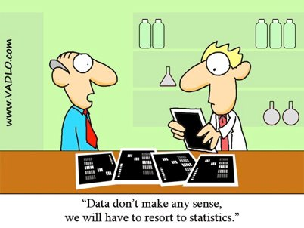
Statistics
Statistics is the branch of scientific method which deals with the data obtained counting or measuring the properties of populations of natural phenomena. In this definition “natural phenomena” includes all the happenings of the external world, whether human or not”¹

Slide 4
Useful links
Software links:
1\ R Programming Language (Windows, or macOS): https://www.r-project.org/
2\ RStudio: https://www.rstudio.com/products/rstudio/ (RStudio Desktop)
3\ JASP : https://jasp-stats.org/
4\ JAMOVI: https://www.jamovi.org/
5\ Slides & Extra: https://antoniobarros.github.io/fmup_mes/

Slide 5
Statistical analysis allows us to put limits on our uncertainty, but not to prove anything. (Altman, 1991)

Slide 6
Why statistics
1\ We collect data on a sample from a much larger group called population
2\ Statistics allow us to use the sample to make inferences about the population
3\ Sample variation (due to chance alone, different samples of the same population give different results)
Population
Statistics
Sample
adapted. Kirkwood & Sterne, Medical Statistics

Slide 7
Types of variables
Numerical variables, either continuous or discrete
Categorical variables (non-numerical, type of drug, city, etc.)
Binary variables (aka dichotomous); survive or death, female or male, etc.
Ordered categorical variables; although non-numerical, have a natural ordering
Derived variables – computed or categorized from recorded variables (many times, related to categorization(*) of continuous variable, e.g., BMI
Transformed variables – log, sqrt etc.
(*) why should we avoid/minimize the temptation?

Slide 8
Data management

Slide 9
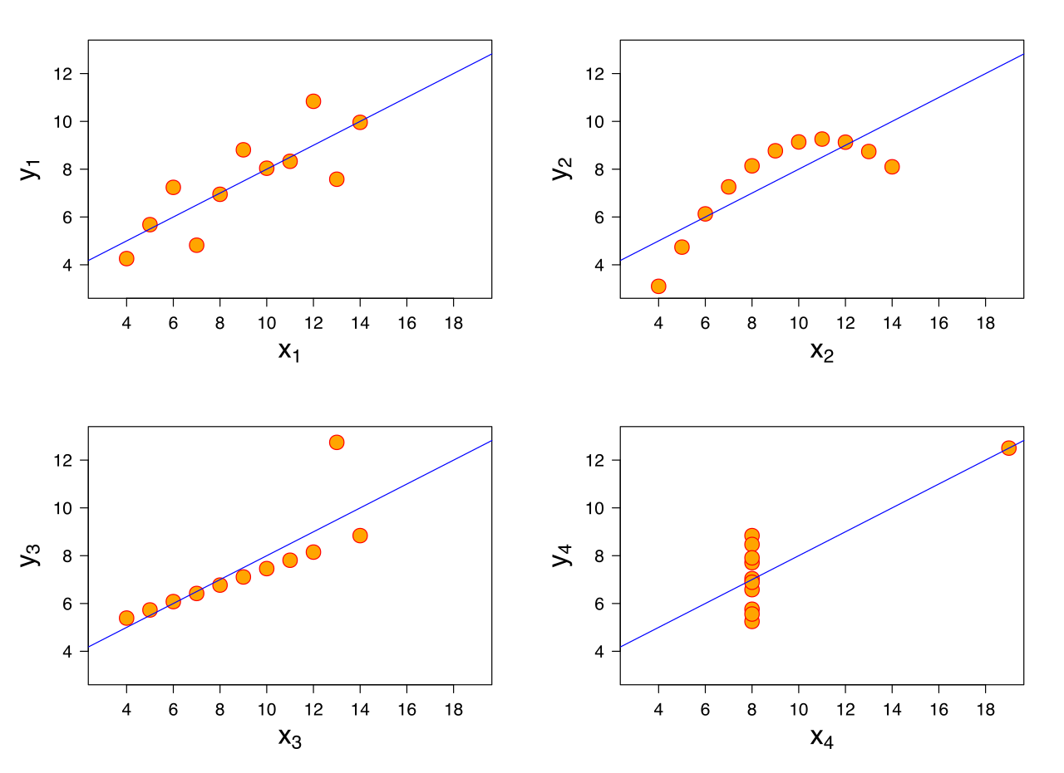
Anscombe’s quartet(*) – Never trust summary data
To illustrate the importance of looking at a set of data graphically, above-all.
 | I |  | II |  | III |  | IV
 | x | y | x | y | x | y | x | y
 | 10 | 8.04 | 10 | 9.14 | 10 | 7.46 | 8 | 6.58
 | 8 | 6.95 | 8 | 8.14 | 8 | 6.77 | 8 | 5.76
 | 13 | 7.58 | 13 | 8.74 | 13 | 12.74 | 8 | 7.71
 | 9 | 8.81 | 9 | 8.77 | 9 | 7.11 | 8 | 8.84
 | 11 | 8.33 | 11 | 9.26 | 11 | 7.81 | 8 | 8.47
 | 14 | 9.96 | 14 | 8.1 | 14 | 8.84 | 8 | 7.04
 | 6 | 7.24 | 6 | 6.13 | 6 | 6.08 | 8 | 5.25
 | 4 | 4.26 | 4 | 3.1 | 4 | 5.39 | 19 | 12.5
 | 12 | 10.84 | 12 | 9.13 | 12 | 8.15 | 8 | 5.56
 | 7 | 4.82 | 7 | 7.26 | 7 | 6.42 | 8 | 7.91
 | 5 | 5.68 | 5 | 4.74 | 5 | 5.73 | 8 | 6.89
figures of merit
average | 9.0 | 7.5 | 9.0 | 7.5 | 9.0 | 7.5 | 9.0 | 7.5
standard deviation | 3.32 | 2.03 | 3.32 | 2.03 | 3.32 | 2.03 | 3.32 | 2.03
correlation | 0.82 |  | 0.82 |  | 0.82 |  | 0.82
(*) https://en.wikipedia.org/wiki/Anscombe%27s_quartet

Slide 10
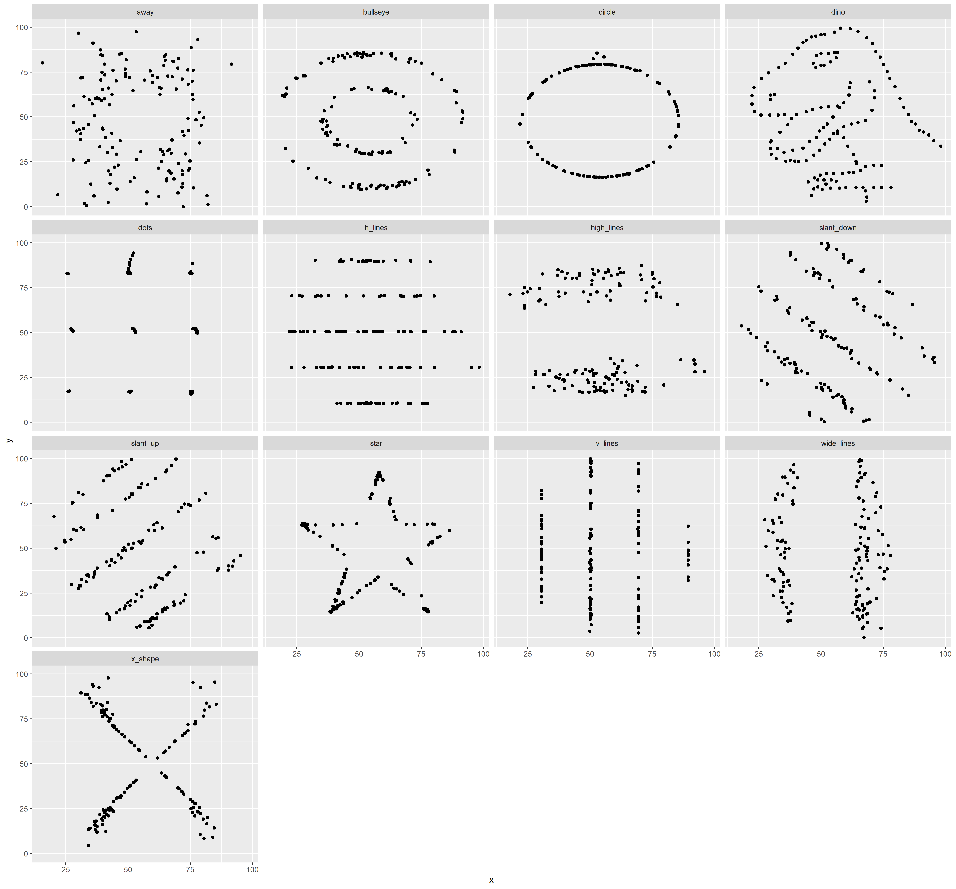
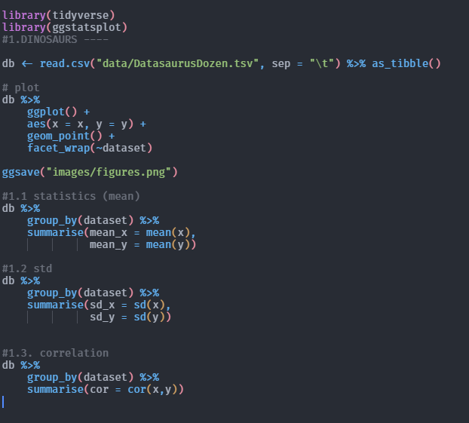
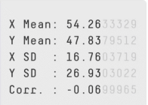
R demo about the datasauRus set
Same summary statistics, different data structure. Wildly different data sets can give similar results

Slide 11
Normal distribution & other tales
Random variable: A set of possible values from a random experiment (c.f. Why Statistics slide)
Normal distribution (Gaussian) – the fundamental probability distribution of statistics (1)
Central Limit Theorem (CLT) – any series of independent, identically distribution random variables, their sum tends to follow a normal distribution (as the number of variables increase).
(1) in a way, this can be loosely related to sampling binominal distribution – the binomial variable may be regarded as the sum of n independent, identicality distributed random variable (each being the result of one trial taking value 1 with probability p.
Notes:
Mencionar o significado de “Normal”

Slide 12
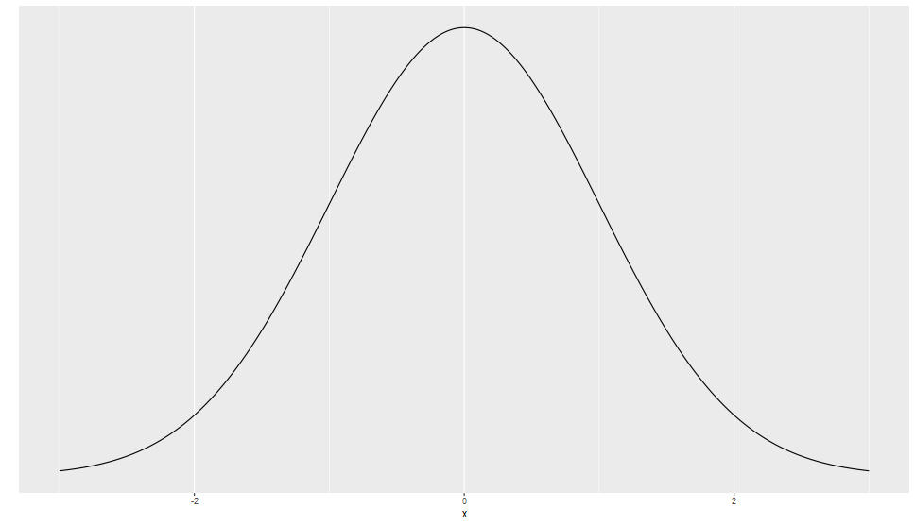
Normal distribution & other tales
μ
the true population mean (this is unknown, and we will try to estimate it)
sampling data to estimate a population parameter
A point estimate
An interval estimate
normal distribution (mean = 0, standard deviation = 1)
we take a sample from the population to estimate the population mean

Slide 13
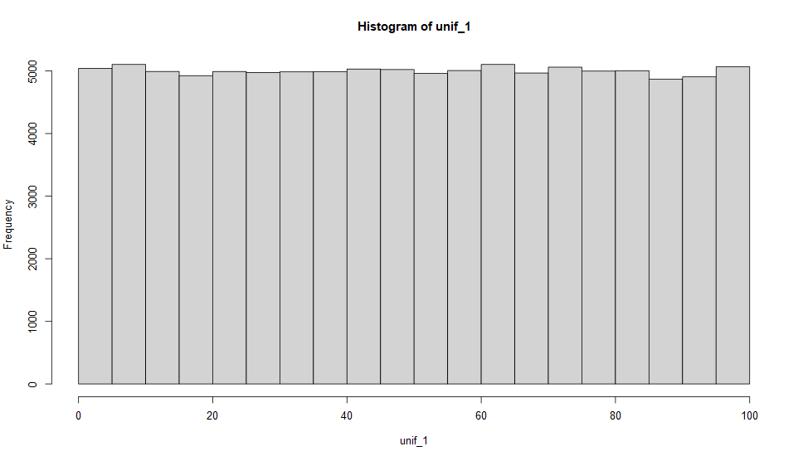
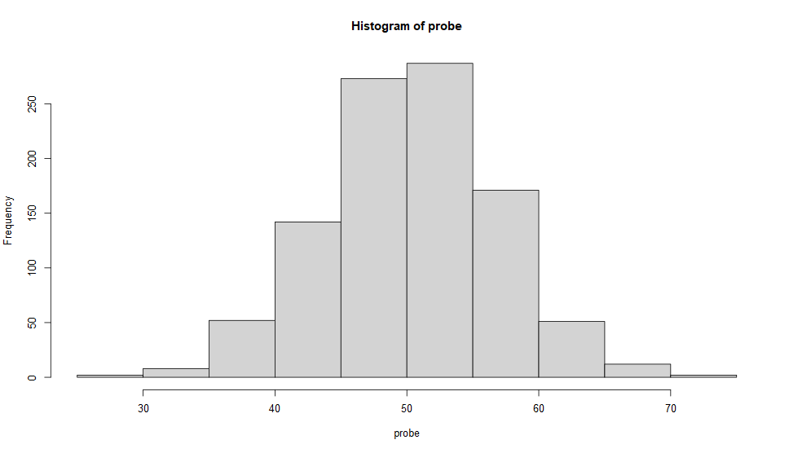
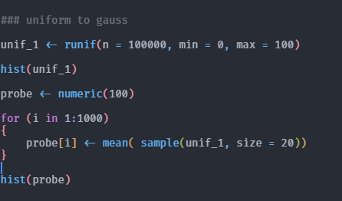
Central Limit Theorem
Central Limit Theorem (CLT) – any series of independent, identically distribution random variables, their sum tends to follow a normal distribution (as the number of variables increase).
Notes:
Mencionar o significado de “Normal”

Slide 14
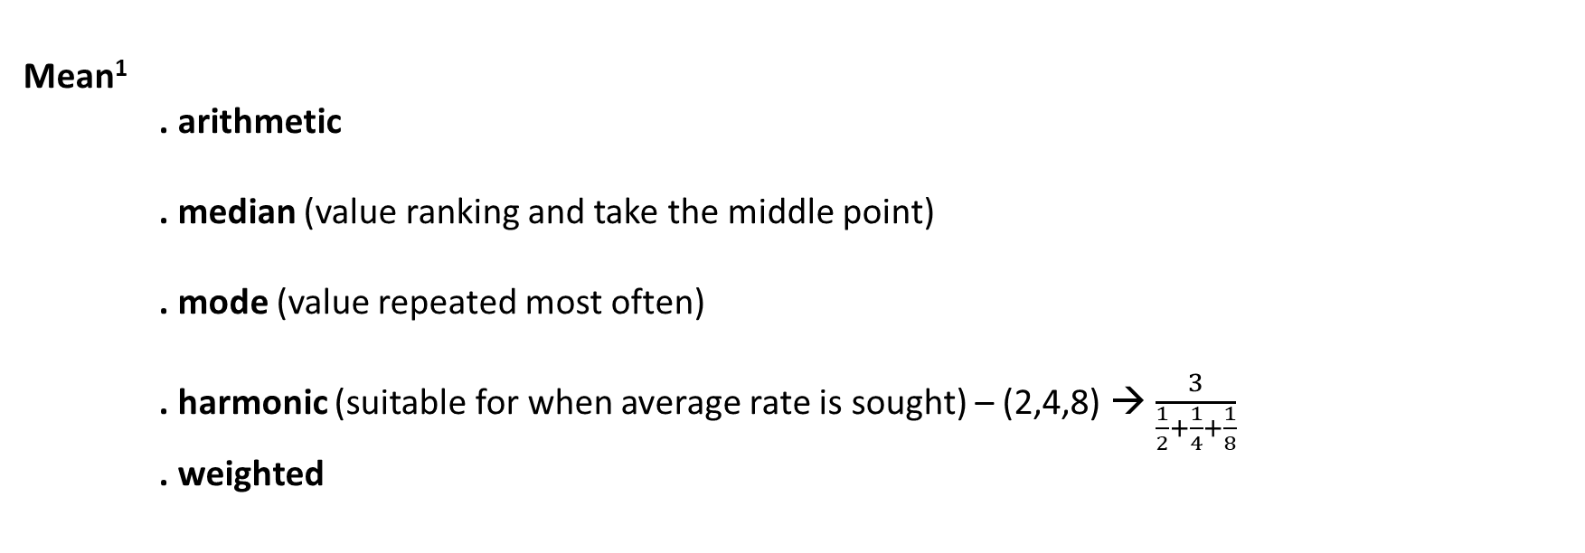
Figures of merit
Mean¹
. arithmetic
. median (value ranking and take the middle point)
. mode (value repeated most often)
. harmonic (suitable for when average rate is sought) – (2,4,8) → $\frac{3}{\frac{1}{2}+\frac{1}{4}+\frac{1}{8}}$
. weighted

Slide 15
Figures of merit
Variation/Variability/Dispersion/Spread
. range (difference between the highest and the lowest value)
. interquartile range IQR (Q3 – Q1) – provide information on 50% of the values (middle 50%)
. variance (average of the squares of the distances of each data value to the mean)
. MAD¹ (mean absolute deviation) – averaged (unsquared) distance of the points from the mean
. standard deviation (square root of variance)
¹useful to avoid emphasizing the effects of outliers

Slide 16
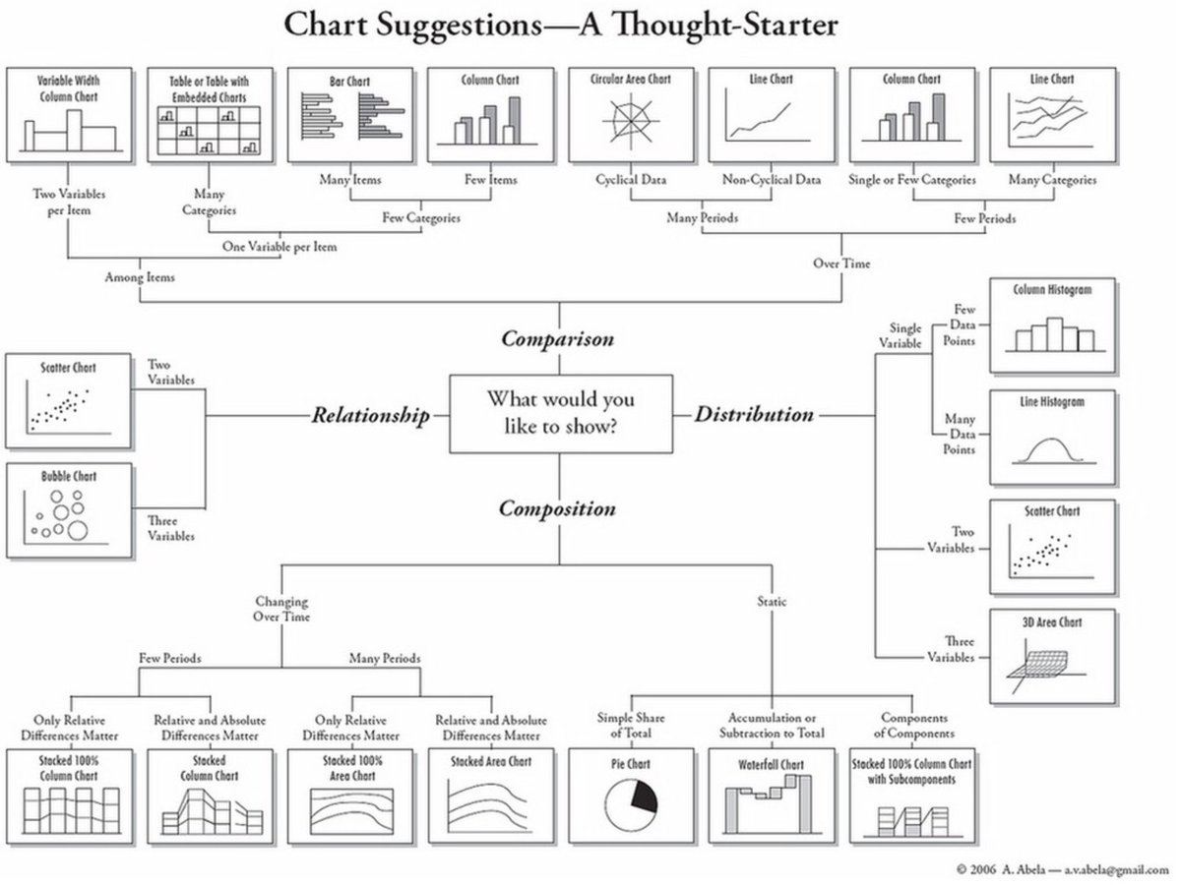
Visualization
Graphical presentation of data,
are essential before any inferential statistical analyses are done

Slide 17
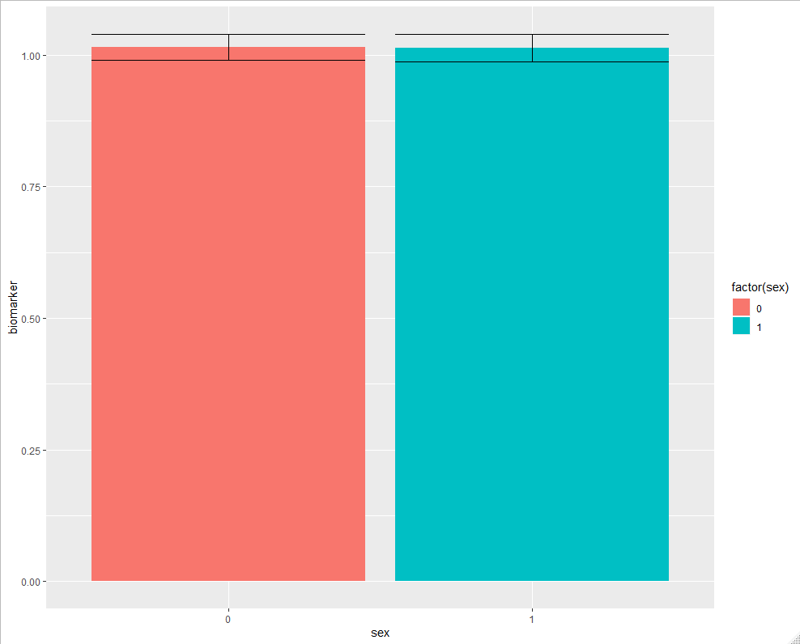
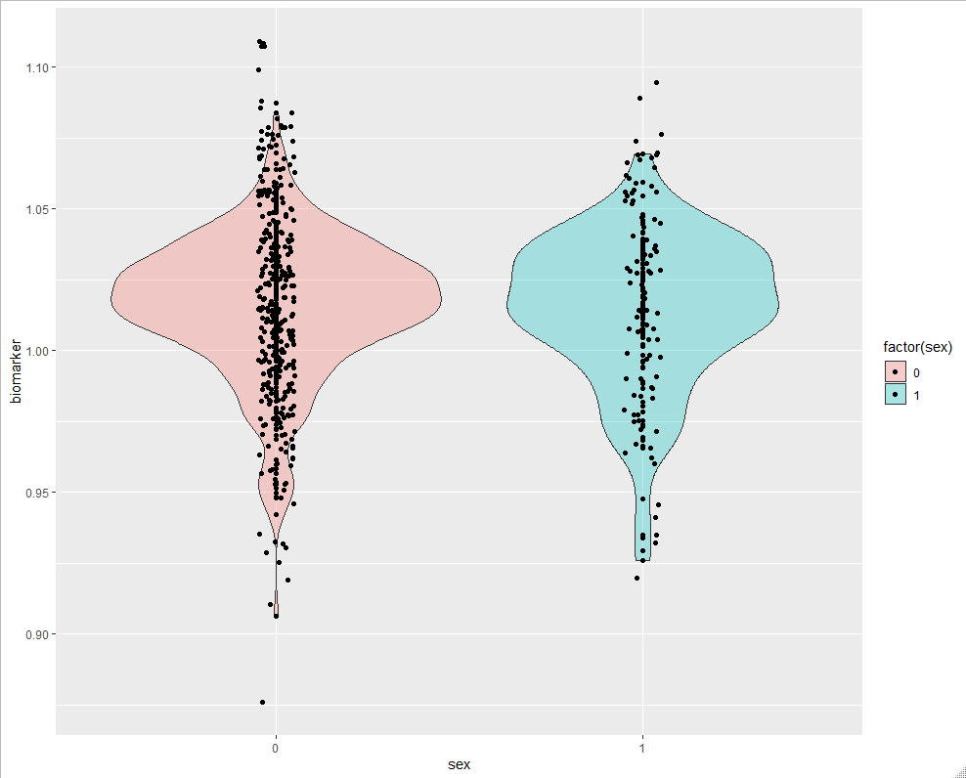
Visualization
Same data – different insights

Slide 18
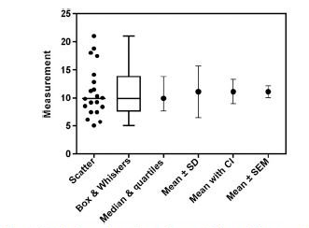
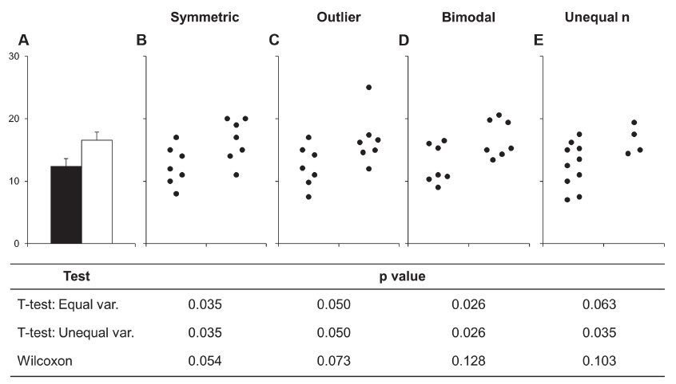
Visualization
Same data – different insights

Slide 19
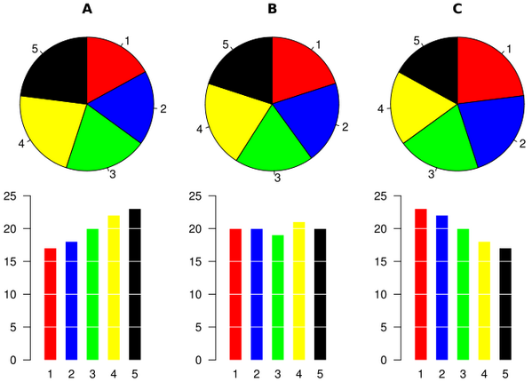
Visualization
Data visualization | a word of caution

Slide 20
Parametric vs Non-Parametric distributions
Normality tests
. Kolmogorov – Smirnov test (n > 50)
. Shapiro-Wilk test (n < 50)
. Q-Q (quantile-quantile) plots
. Histogram inspection

Slide 21
Inference I: Point Estimate & Confidence interval
Estimate of the mean of a random variable of interest from a population
(point estimate – sample mean)
The is no reason to suppose that the population mean is exactly equal to the point estimate
(sample mean)
The amount by which it is likely to differ can be found from the standard error (SE)
We try to find limits which are likely to include the population mean and report that the we estimate the population mean lies somewhere in the interval between limits (interval estimate)
A confidence interval only estimate errors caused by sampling.

Slide 22
Inference II: Testing hypothesis
Hypothesis testing is one method of inferential statistics
It answers a question about a Population based on analysis of data from a Sample
The question usually asks whether there is a statistically significance difference, change, or effect.
The question is converted to a negative statement called Null Hypothesis (H0)
There two possible outcomes: Reject the H0, or fail to reject the H0
A significance test enable the measure of the strength of the evidence
Type I error : deciding against the true null hypothesis
Type II error: if we DO NOT reject a null hypothesis, which in fact is false.

Slide 23
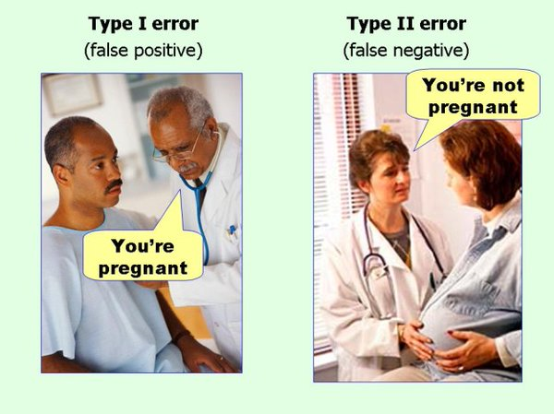
Inference II: Testing hypothesis
Type I error : deciding against the true null hypothesis
Type II error: if we DO NOT reject a null hypothesis, which in fact is false
Significant is different from real and from important

Slide 24
Inference II: Testing hypothesis
Important
A result may be significant, may well be real but not important (e.g. clinically)
A difference NOT statistically significant, could be real. Probably, we have a small sample to show that a difference exists and probably still important
NOT SIGNIFICANT DOES NOT IMPLY THAT THERE IS NO EFFECT; JUST THAT WE HAVE NOT ESTABLISHED THE EXISTENCE OF ONE.

Slide 25
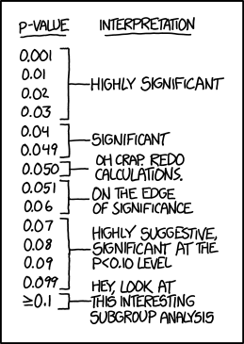
Inference II: Testing hypothesis
P-value: The probability of getting a result (t or Χ² statistics) as or more extreme than the observed statistic had H₀ been true.
An α-level test would reject H₀ if P≤α.
However, the P-value should be reported instead of choosing an arbitrary value of α.
Confidence intervals should be used in tandem with P-values.

Slide 26
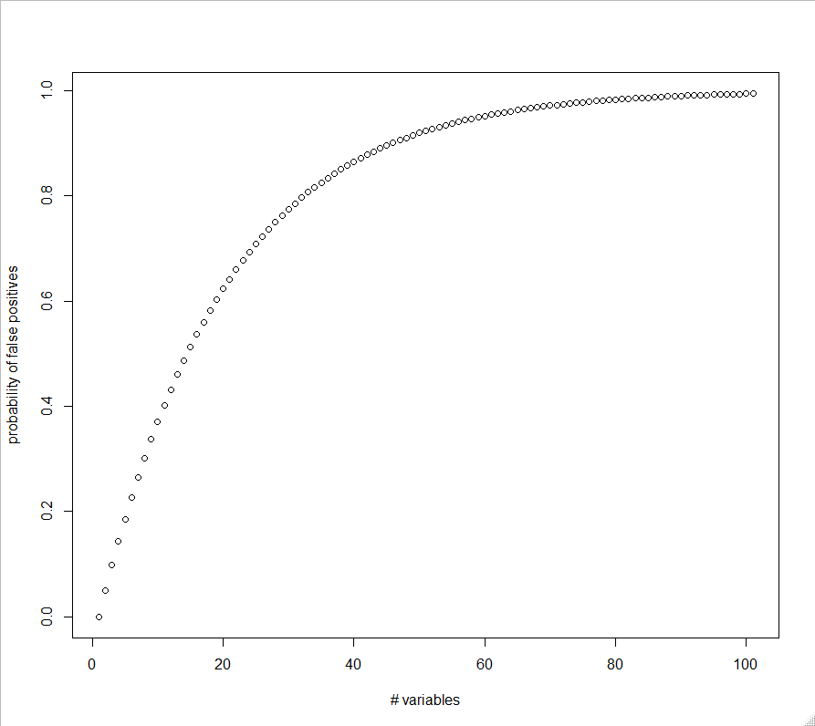
Inference II: Testing hypothesis
Multiple comparisons occurs when one considers a set of statistical inferences simultaneously – should be addressed
- Type I risk increase =
1- (1-p.value)^{m}
m = number of variables tested
IF m = 1 : 0.05
IF m = 100 : 0.994 …
FDR correction (false discovery rate)
p-value adjustment or estimate of FDR (Bonferroni,
q-value, etc.)

Slide 27
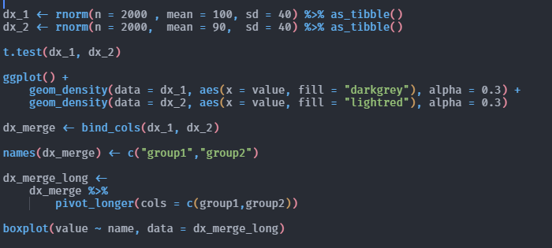
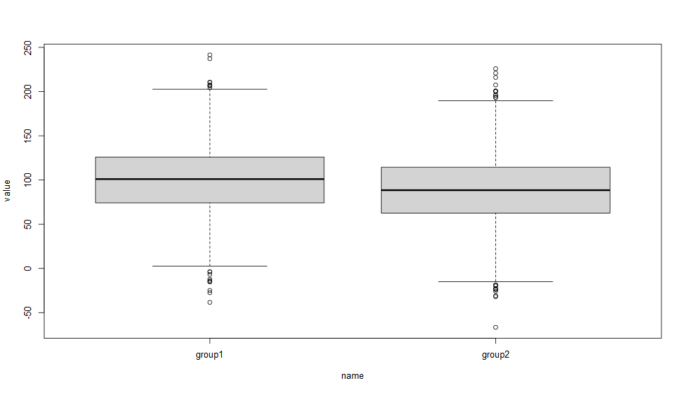
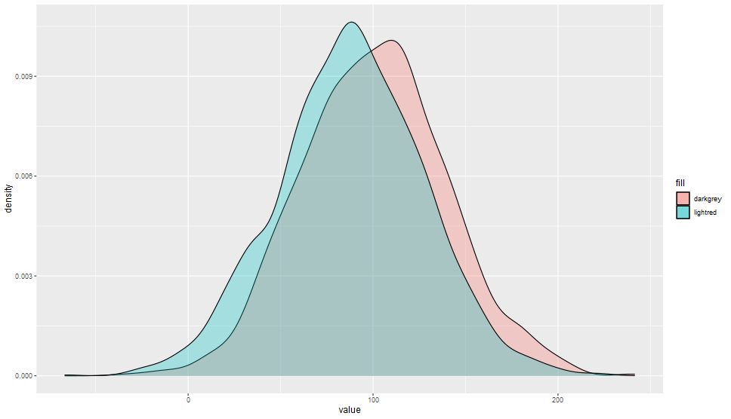
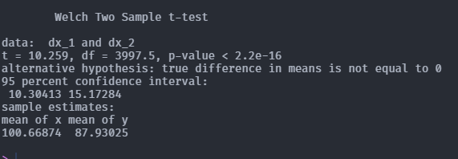
Inference II: Testing hypothesis

Slide 28
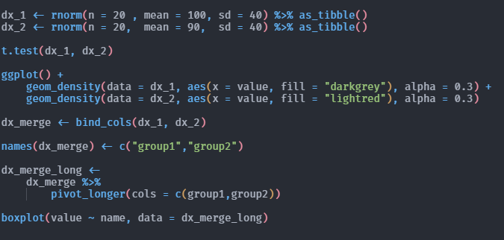
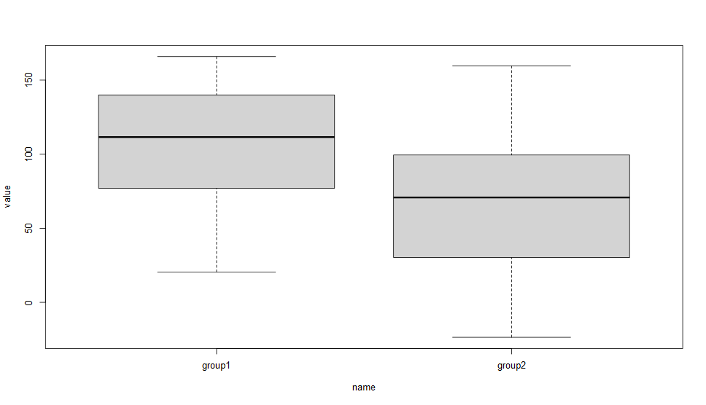
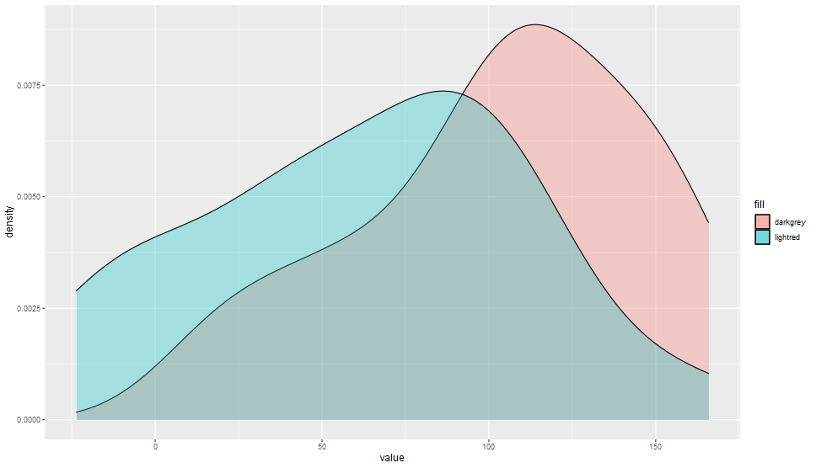
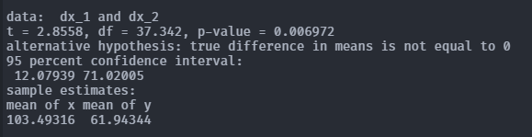
Inference II: Testing hypothesis

Slide 29
Guide to select tests – a cautionary tale
Group or relationship?
Group
One group
Two groups
Relationship
Causal relationships?
More groups
One-Sample t-Test
One-Sample Wilcoxon Test
χ2-test
Independent samples
Dependent samples
Two-Sample- t-Test independent samples
Two-sample-t-Test dependent samples
Wilcoxon Rank-sum Test
χ2-Test
ANOVA
Kruskal-Wallis-Test
χ2-Test
Wilcoxon Signed-rank test
McNemar χ2-Test
No
Bravais-Pearson
Yes
Regression
Spearman
Ordinal regression
χ2-Independent-Test
Logistic Regression
metric and normally distributed
ordinal or metric and non-normally distributed
nominal

