Slide 1
A text mining case study on document clustering and topic extraction

Slide 2
Bag of Words
Representation of a corpus of documents in two files
vocabulary
Document-word-frequencies
Aardvark
Abacus
…
…
…
…
…
…
…
Zucchini
Doc Idx
Word Idx
Count
1 126 3
1 133 6
…
…
…
…
…
…
…

Slide 3
DTM: Document-Term Matrix
Sparse matrix: most values are 0
 | aah | aaheed | aaron | abacus | ... | zucchini
Document 1 | 0 | 0 | 0 | 0 | ... | 0
Document 2 | 0 | 0 | 0 | 1 |  | 1
...
Document n | 0 | 0 | 0 | 2 | ... | 0

Slide 4
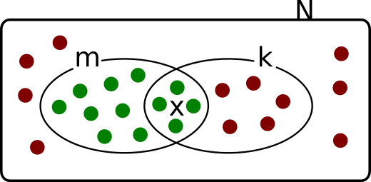
Term Enrichment Analysis and Hypergeometric
Distribution for significant Topic Extraction
The hypergeometric test can be applied to associate a group of documents to a particular term or set of terms
N = Total number of terms in corpus
m = counts of one particular term in corpus
k = terms in one particular group of documents (one cluster from K-Means)
x = counts of one particular term in cluster
What is the probability that the term has been observed x times in the cluster?
Summed over times a term is searched (draws). Substract from one to give positive probability

Slide 5
Weighting of the DTM
Absolute frequencies (counts) introduce a bias:
Larger documents will have larger values
TF-IDF : Term Frequency Inverse Document Frequency
Improves clustering and predictive performance by accounting for:
    Relative frequency of term across corpus
    Length of document
N: Number of documents in corpus
df_{t}: Number of documents containing term t
Downweight terms appearing in many documents
multiplying the original DTM frequency by idf

Slide 6
SVD: Singular Value Decomposition
Dimensionality reduction:
DTM → Dense matrix with many fewer columns
The new (orthogonal) columns are linear combinations of columns in original DTM
Preserve as much as the variance structure of original DTM as possible
U: Dense d by s (d: num documents, s: num reduced dimensions)
Dim-reduced representation of documents
D: Diagonal matrix with nonnegative entries
V: Dense w by s (w: num terms)
Dim-reduced representation of terms

Slide 7
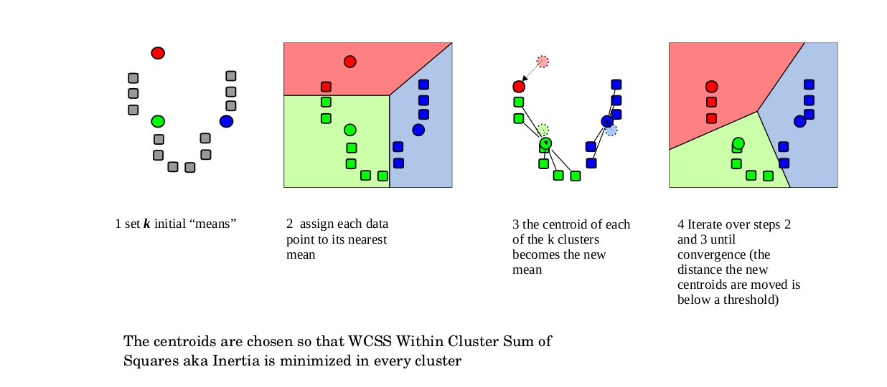
The K-Means clustering algorithm

Slide 8
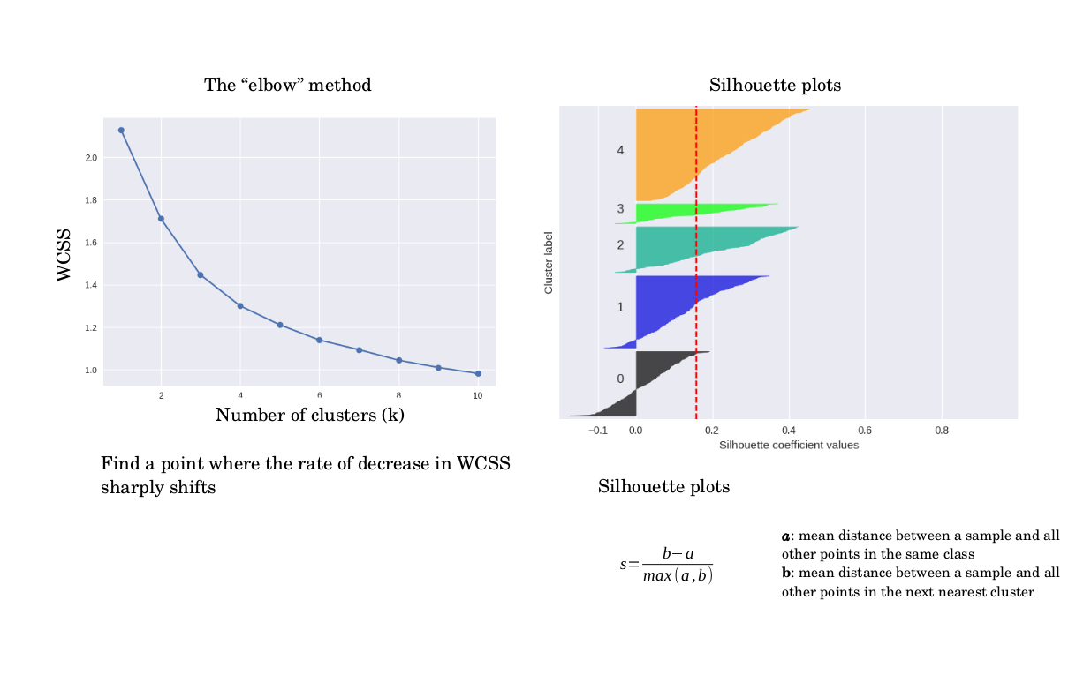
Finding an optimal number of clusters for K-Means

Slide 9
KOS Blog entries
A group blog and internet forum focused on liberal American politics
orig source: dailykos.com
D = 3430
W = 6906
N = 353160

Slide 10
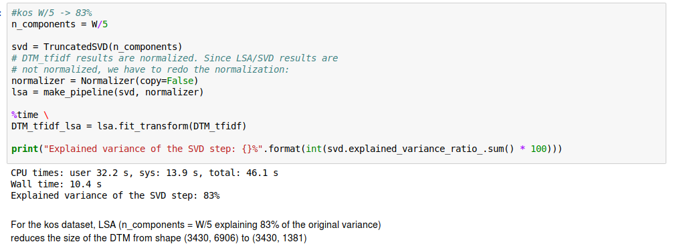
KOS dataset
SVD/LSA
U: Dense d by s (d: num documents, s: num reduced dimensions)
Dim-reduced representation of documents
D: Diagonal matrix with nonnegative entries
V: Dense w by s (w: num terms)
Dim-reduced representation of terms

Slide 11
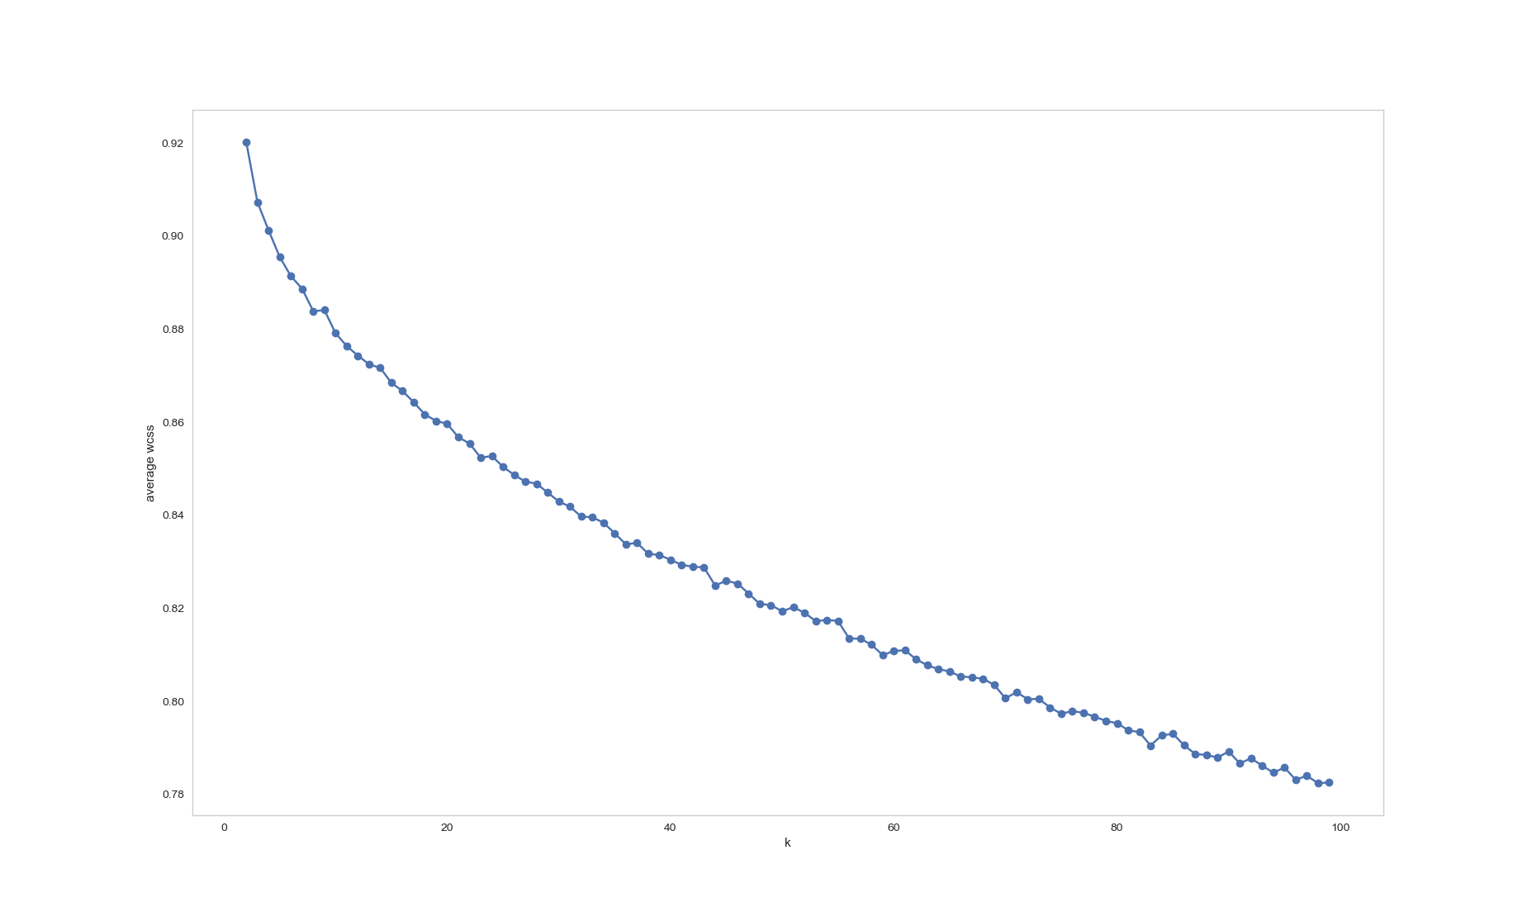
KOS dataset
Estimate k for KMeans
range(k) = [2,100]
8
23
‘Elbow’ method does not reveal an optimal k.
Clusters might not show a real good separation
Topic inter-relation

Slide 12
KOS dataset
K-Means k= 8
Cluster 0 | iraq | war | bush | iraqi | military
Cluster 1 | dean | clark | edwards | kerry | lieberman
Cluster 2 | party | nader | democratic | ballot | state
Cluster 3 | bush | administration | president | kerry | general
Cluster 4 | november | account | electoral | turnout | governor
Cluster 5 | kerry | bush | poll | percent | voters
Cluster 6 | november | voting | account | electoral | governor
Cluster 7 | house | senate | race | elections | district
Choose smaller values for k for
Broadly/loosely defined topics

Slide 13
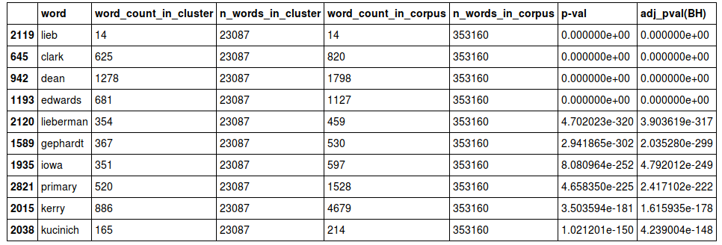
KOS dataset
K-Means Cluster 1
x
k
m
N
What is the probability to observe exactly x marked elements in the sample?
Summed over times a term is searched (draws). Substract from one to give positive probability

Slide 14
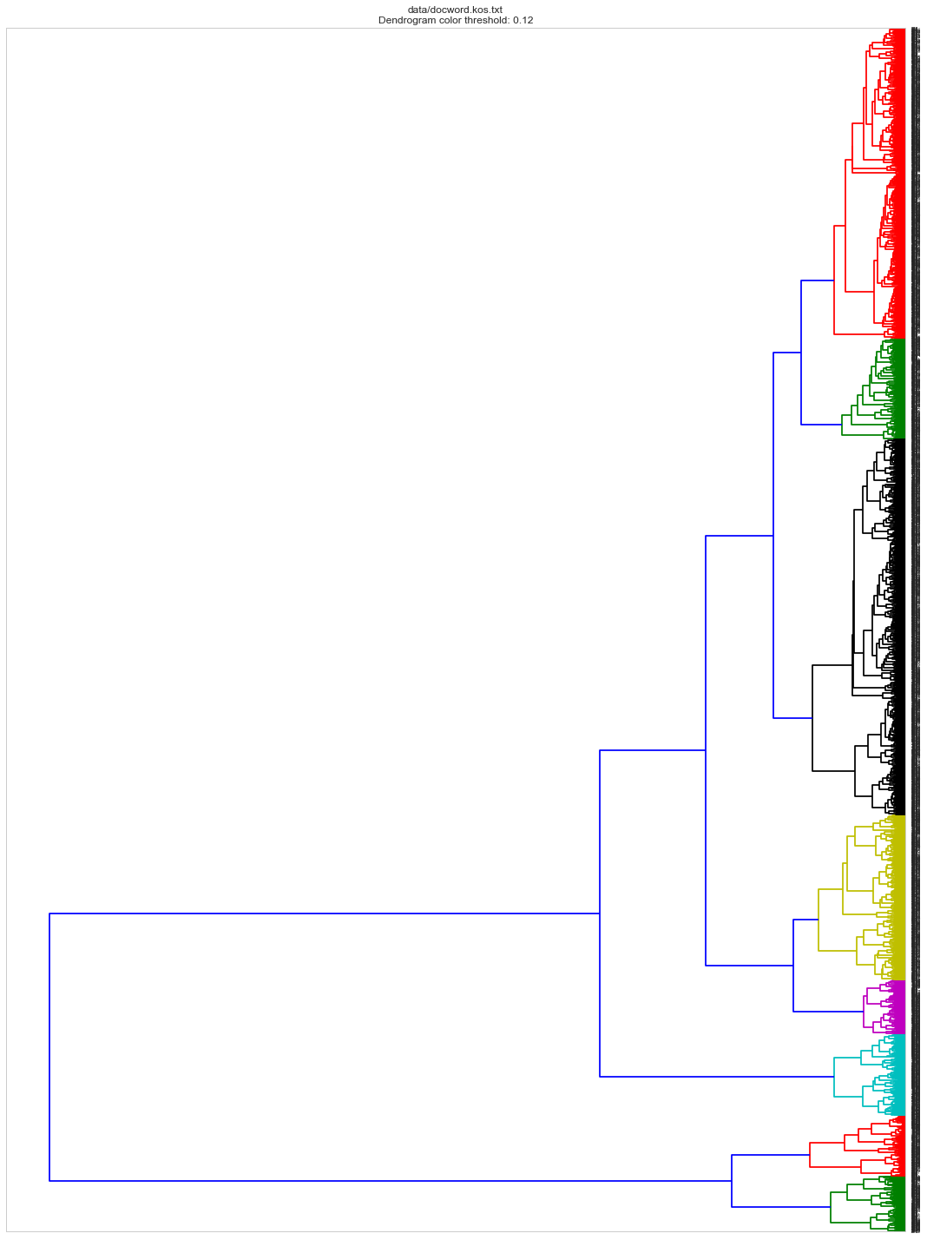
KOS dataset
Hierarchical clustering
‘ward’

Slide 15
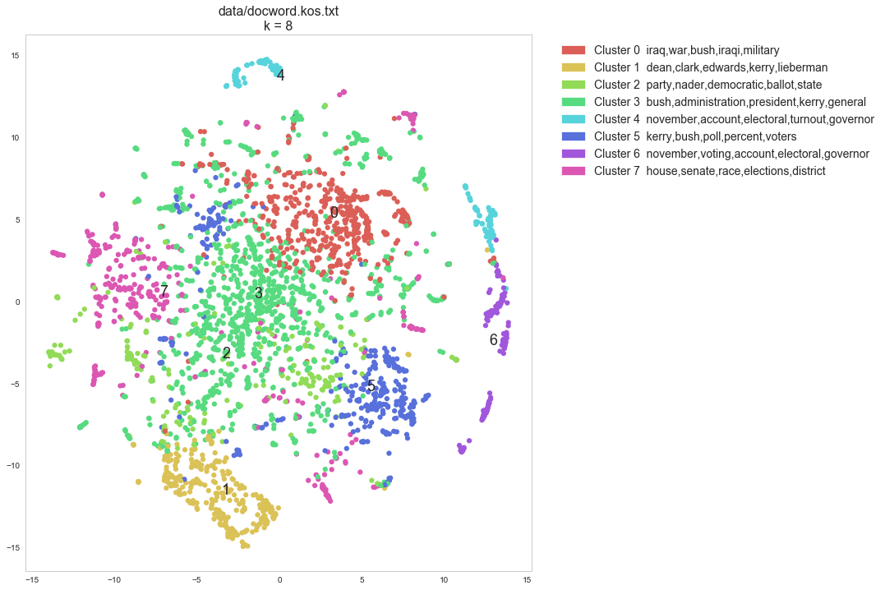
KOS dataset
TSNE
t-distributed Stochastic Neighbor Embedding.
From Sklearn:
t-SNE is a tool to visualize high-dimensional data.
It converts similarities between data points
to joint probabilities and tries to minimize
the Kullback-Leibler divergence between the
joint probabilities of the low-dimensional embedding and the high-dimensional data.
t-SNE has a cost function that is not convex, i.e. with different initializations we can get different results

Slide 16
KOS dataset
Estimate k for KMeans
range(k) = [2,100]
8
23

Slide 17
KOS dataset
K-Means k= 23
Cluster 0 | jobs | tax | bush | cuts | billion
Cluster 1 | kerry | bush | campaign | john | general
Cluster 2 | bush | administration | white | president | intelligence
Cluster 3 | dean | iowa | clark | primary | kerry
Cluster 4 | time | meteor | blades | bush | convention
Cluster 5 | marriage | amendment | gay | adviser | sens
Cluster 6 | gotv | server | election | database | general
Cluster 7 | donors | specter | toomey | hoeffel | campaign
Cluster 8 | november | account | electoral | turnout | governor
Cluster 9 | district | candidates | house | dozen | races
Cluster 10 | iraq | war | bush | president | bushs
Cluster 11 | dean | edwards | clark | lieberman | kerry
Cluster 12 | obama | senate | keyes | salazar | illinois
Cluster 13 | kerry | bush | poll | percent | voters
Cluster 14 | senate | race | seat | herseth | house
Cluster 15 | party | nader | ballot | republican | signatures
Cluster 16 | cheney | vice | president | dick | bush
Cluster 17 | november | voting | account | electoral | governor
Cluster 18 | fox | news | radio | media | sinclair
Cluster 19 | iraq | iraqi | military | war | baghdad
Cluster 20 | million | raised | money | bush | kerry
Cluster 21 | delay | ethics | committee | house | morrison
Cluster 22 | carson | coburn | oklahoma | senate | brad
Choose larger values for k for
more granular topics

Slide 18
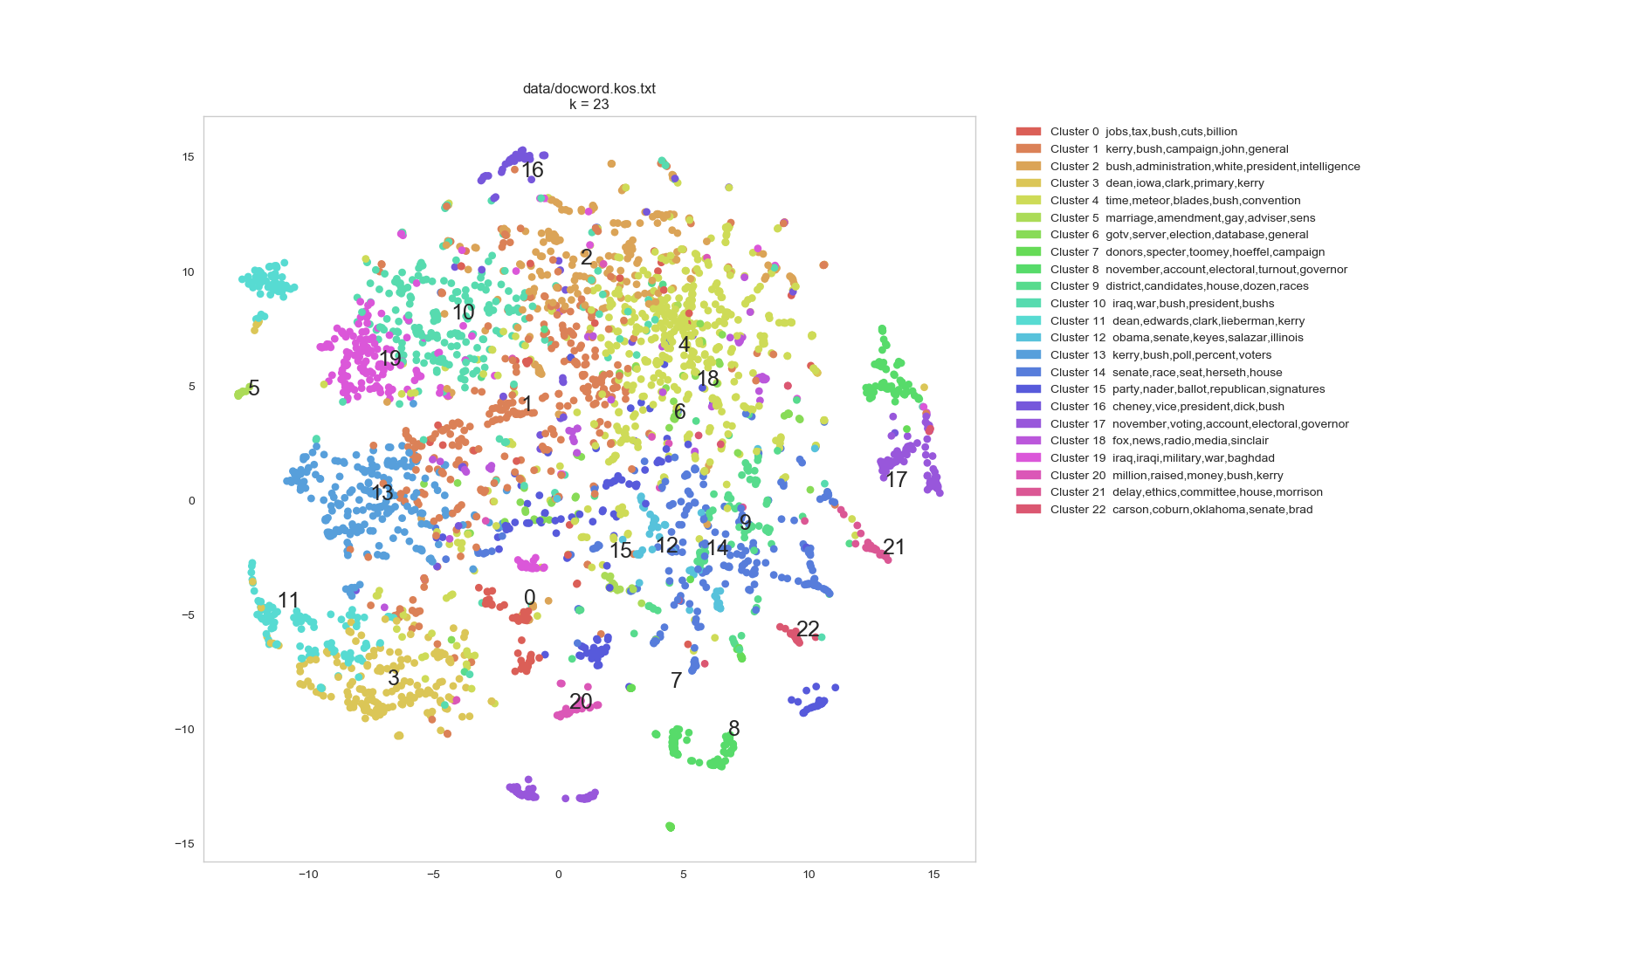
KOS dataset
TSNE

Slide 19
NIPS full papers
Neural Information Processing Systems Conference
orig source: books.nips.cc
D = 1500
W = 12419
N = 1900000 (approx)

Slide 20
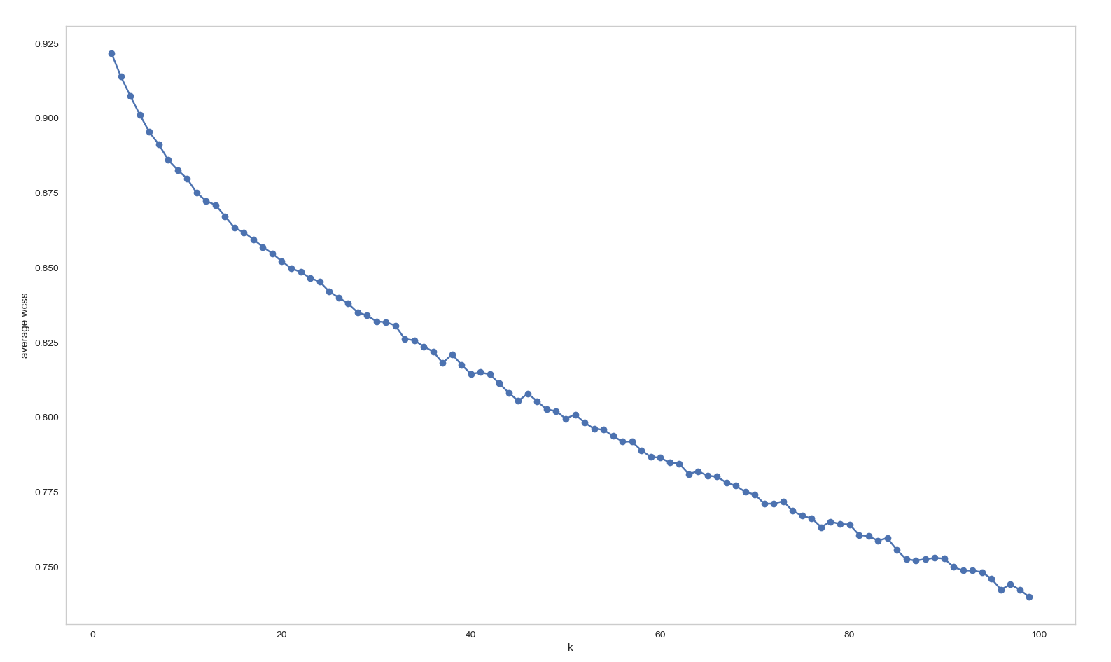
NIPS dataset
Estimate k for KMeans
range(k) = [2,100]

Slide 21
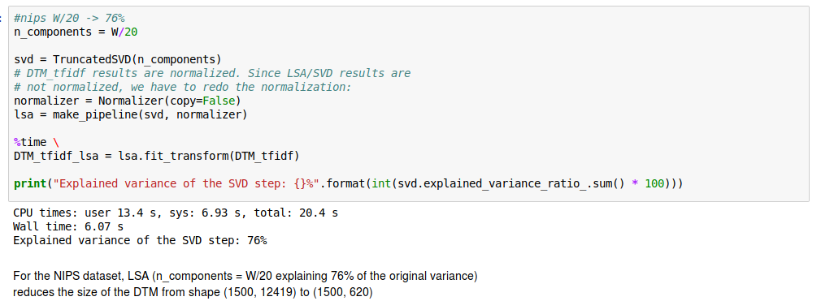
NIPS dataset
SVD/LSA
U: Dense d by s (d: num documents, s: num reduced dimensions)
Dim-reduced representation of documents
D: Diagonal matrix with nonnegative entries
V: Dense w by s (w: num terms)
Dim-reduced representation of terms

Slide 22
NIPS dataset
K-Means k=15
Cluster 0 | ica | blind | separation | signal | sources
Cluster 1 | learning | error | function | network | weight
Cluster 2 | network | attractor | memory | neuron | dynamic
Cluster 3 | network | algorithm | data | model | learning
Cluster 4 | model | data | gaussian | likelihood | bayesian
Cluster 5 | cell | orientation | visual | cortical | model
Cluster 6 | chip | circuit | analog | voltage | vlsi
Cluster 7 | neuron | spike | firing | cell | synaptic
Cluster 8 | kernel | svm | vector | function | support
Cluster 9 | policy | action | learning | mdp | algorithm
Cluster 10 | movement | eye | motor | model | head
Cluster 11 | network | unit | hidden | input | weight
Cluster 12 | image | object | images | model | network
Cluster 13 | controller | control | learning | action | robot
Cluster 14 | speech | word | recognition | hmm | speaker

Slide 23
NIPS dataset
K-Means Cluster 0
x
k
m
N
word | word_count_in_cluster | n_words_in_cluster | word_count_in_corpus | n_words_in_corpus | p-val | adj_pval(BH)
demixing | 30 | 22289 | 30 | 746316 | 0.00E+00 | 0.00E+00
ica | 341 | 22289 | 422 | 746316 | 0.00E+00 | 0.00E+00
blind | 288 | 22289 | 355 | 746316 | 0.00E+00 | 0.00E+00
endmember | 29 | 22289 | 29 | 746316 | 0.00E+00 | 0.00E+00
separation | 361 | 22289 | 592 | 746316 | 0.00E+00 | 0.00E+00
equipartition | 23 | 22289 | 23 | 746316 | 0.00E+00 | 0.00E+00
sources | 327 | 22289 | 642 | 746316 | 0.00E+00 | 0.00E+00
signal | 703 | 22289 | 4261 | 746316 | 1.09E-296 | 8.02E-295
sound | 311 | 22289 | 653 | 746316 | 5.05E-287 | 3.30E-285
source | 359 | 22289 | 1024 | 746316 | 1.06E-272 | 6.22E-271
eeg | 223 | 22289 | 328 | 746316 | 1.86E-256 | 9.92E-255
component | 523 | 22289 | 3311 | 746316 | 7.45E-212 | 3.65E-210
independent | 374 | 22289 | 1966 | 746316 | 5.19E-180 | 2.35E-178
artifact | 135 | 22289 | 176 | 746316 | 5.63E-169 | 2.37E-167
mixing | 144 | 22289 | 256 | 746316 | 1.10E-148 | 4.31E-147
auditory | 191 | 22289 | 651 | 746316 | 8.57E-130 | 3.15E-128
jutten | 71 | 22289 | 74 | 746316 | 3.71E-107 | 1.28E-105
localization | 115 | 22289 | 266 | 746316 | 7.34E-102 | 2.40E-100
spectral | 132 | 22289 | 438 | 746316 | 2.94E-92 | 9.09E-91
deconvolution | 64 | 22289 | 74 | 746316 | 5.94E-89 | 1.75E-87

Slide 24
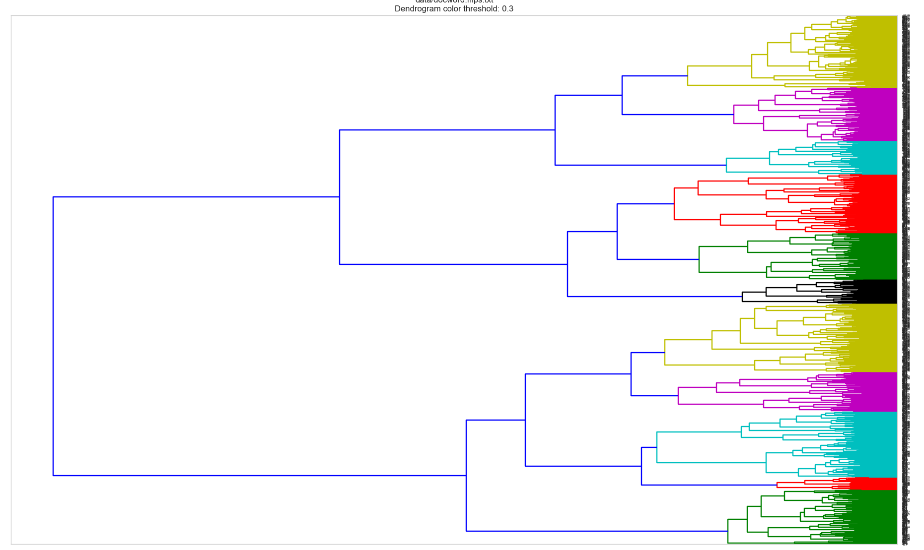
NIPS dataset

Slide 25
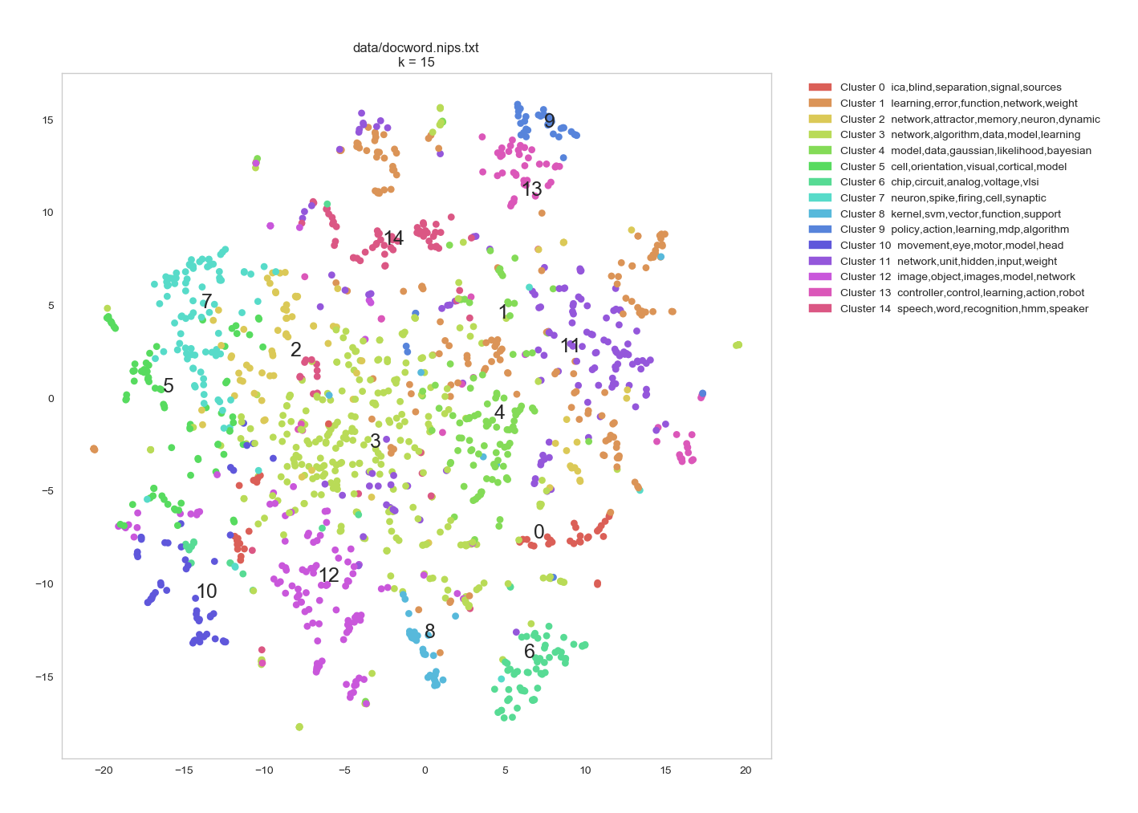
NIPS dataset
TSNE
NIPS

Slide 26
Enron emails
Collection of emails made public by the Federal
Energy Regulatory Commission of the United States
orig source: www.cs.cmu.edu/~enron
D = 39861
W = 28102
N = 6400000 (approx)

Slide 27
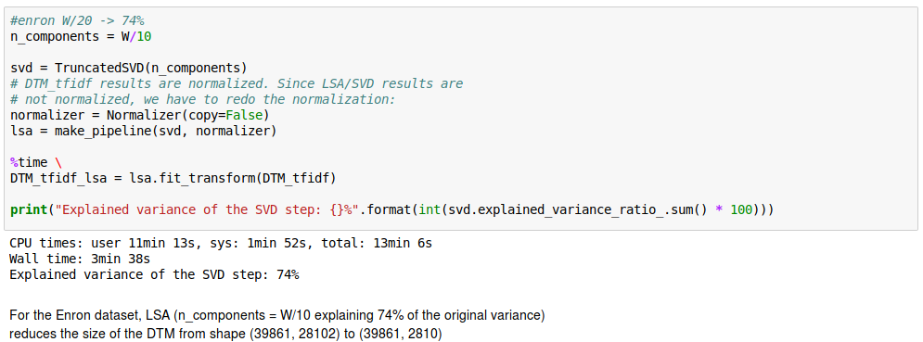
Enron emails
SVD/LSA

Slide 28
Enron emails
K-Means k= 10
Cluster 0 | game | texas | longhorn | yard | fantasy
Cluster 1 | click | online | market | free | link
Cluster 2 | meeting | attend | agenda | discuss | scheduled
Cluster 3 | request | resource | status | approval | report
Cluster 4 | hourahead | final | variances | detected | schedulingiso
Cluster 5 | ferc | customer | california | bill | market
Cluster 6 | attached | report | review | gas | deal
Cluster 7 | corp | contract | estoppel | enforceable | binding
Cluster 8 | power | california | electricity | energy | company
Cluster 9 | think | going | ill | office | hope

Slide 29

NYTimes articles
PubMed Abstracts
orig source: ldc.upenn.edu
D = 300,000
W = 102,660
N = 100,000,000 (approx)
orig source: www.pubmed.gov
D = 8,200,000
W = 141,043
N = 730,000,000 (approx)
Very large datasets → Huge Document-Term Matrices
np.savez('DTM_kos', data=DTM.data, indices=DTM.indices, indptr= DTM.indptr, shape=DTM.shape)

Slide 30
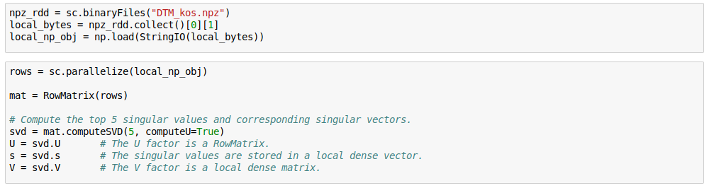
Approach
(Just started doing this)
Save DTM matrix to binary format
Load DTM from binary file
Use pyspark.mllib.linalg.distributed and its computeSVD function

