Slide 1
IFTE0007 Decentralised Finance and Blockchain | Group coursework | AI agent market forecasting
An AI agent forecasts the S&P 500 close
for Fri 20 Nov 2026, scored on the S&P Dow Jones Indices official close
Point forecast, index points
7,637.84
80% interval 7,406 to 7,817
Only the point forecast is scored
Last official close
Information cutoff
Target close
Thu 12 Nov
13 Nov, 12:00 UTC
Fri 20 Nov
7,592.40
07:00 NY; futures +0.25%
h = 6 trading sessions
Layla Ahmed | Antonio Herrera Despradel | Jayen Rughani | Mohamed Derbala
Notes:
[Layla Ahmed - 0:50] One number: the S&P 500 official close on Fri 20 Nov, scored against S&P Dow Jones Indices, from information available at Fri 13 Nov 12:00 UTC (07:00 New York). Forecast 7,637.84, 80% interval 7,406 to 7,817. Three clocks: the last official close (Thu 12 Nov, 7,592.40), the cutoff, where we read the overnight futures move (+0.25%), and the target 6 trading sessions later. Nothing after the cutoff can enter: a leak test corrupted 29 later values and the inputs did not change. Hand over to Antonio Herrera Despradel.

Slide 2
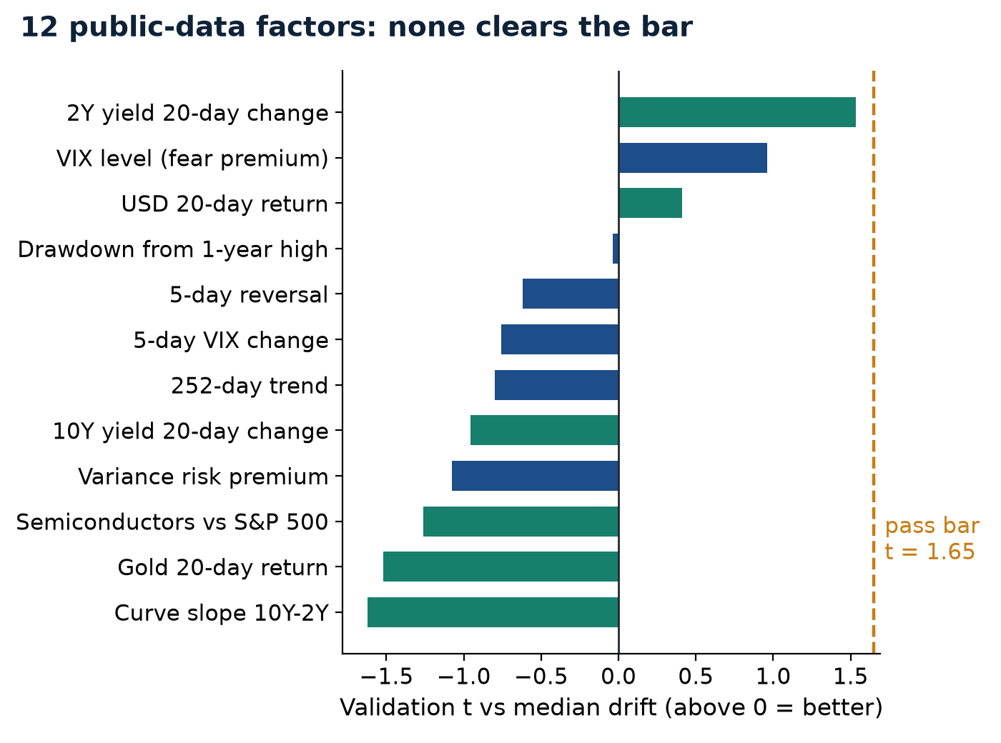
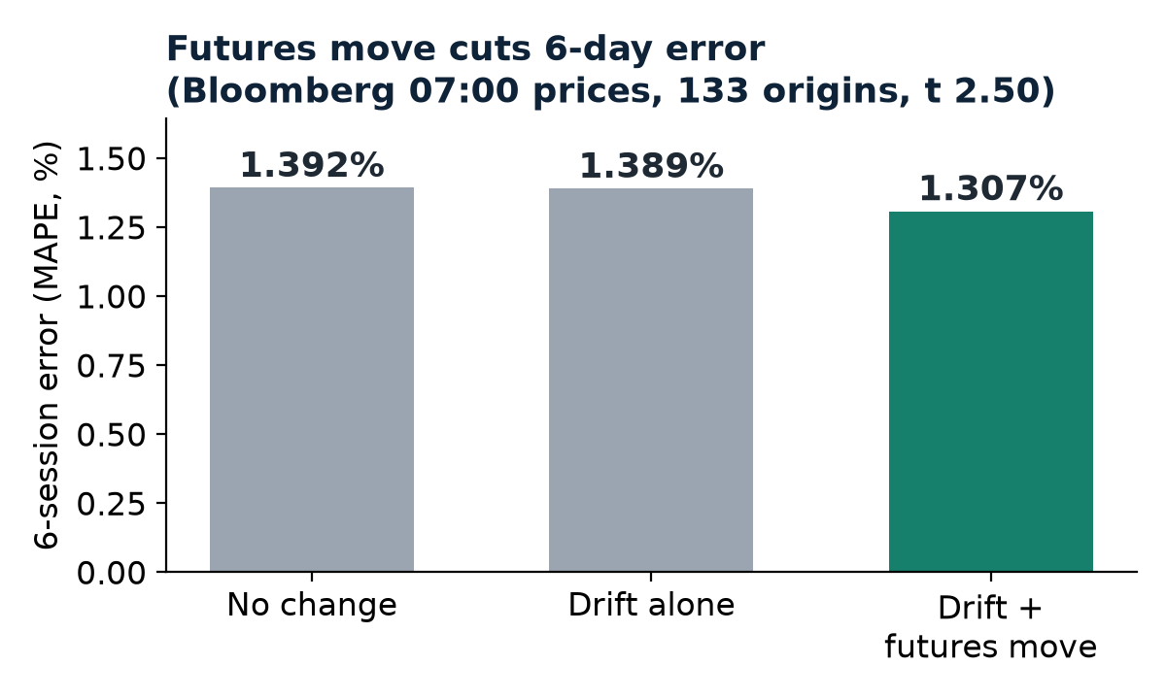
Drift is the anchor; futures add the news
0 of 16 factors pass
Best: 2Y yield 20-day change, t 1.53: wrong sign; no 2000-12 history, so below the 2.33 bar. Drift vs no change: t 0.53, a weak edge.
Group checks agree: 30 pre-registered tests, 1.72M-combination search.
Screen: weekly origins 2018-2026, validation to 2021, then 243 untouched test weeks.
Notes:
[Antonio Herrera Despradel - 1:40] What predicts a six-session S&P move? We tested 16 factors with economic signs fixed in advance: yields, the dollar, gold, semiconductors, surprises, inflation, trend, reversal and VIX. Each had to beat median drift out of sample, with its sign fixed in advance and a Diebold-Mariano t of at least 1.65 with support from 2000-2012 history, or 2.33 without it. None passed: the best, 2Y yield 20-day change (t 1.53), failed: fitted sign opposite to the one fixed in advance; no 2000-12 history, so below the 2.33 bar. The group's 30 pre-registered tests and the 1.72-million-combination search agree. Drift itself is only a weak edge over 'no change' (t 0.53). The one input that adds information is the overnight futures move: in my pre-registered test on Bloomberg 07:00 prices it cut six-day error from 1.389% to 1.307% (133 origins, t 2.50; Thursdays t 3.49), and Jayen's 930-origin test shows it carries through almost one for one (slope 0.92). Hand over to Jayen Rughani.

Slide 3
Forecast = drift + overnight futures move
7,592.40
× exp(
+0.40%
+
+0.20%
) =
7,637.84
last close (Thu 12 Nov)
median 6-session drift
overnight futures move
forecast
Futures: ES 7,616.25 at the 16:00 close to 7,635.50 at the cutoff = +0.25%, less the average overnight drift (+0.06%) = +0.20%. No hand adjustment.
D Median drift
Sensitivity of the forecast
Why: investors are paid to bear equity risk; negative skew puts the median above zero.
No drift (unchanged centre)
7,607
-31
Fails: prolonged bear markets (2000-02, 2008).
Median since 2000
7,637
-1
Fixed +0.25% per 6 sessions
7,626
-11
N Overnight futures move
Futures read 1 hour earlier
7,632
-6
Why: futures trade nearly 24h and price overnight news; arbitrage ties the cash open to them.
No futures nowcast
7,623
-15
Fails: contract roll, thin overnight trading, reversal at the open.
80% interval: historical errors scaled by today's VIX.
Notes:
[Jayen Rughani - 1:30] The calculation: 7,592.40 x exp(+0.40% + +0.20%) = 7,637.84. Drift: the median 6-session return since 1990, the equity risk premium; it fails in prolonged bear markets. Futures: E-mini futures trade nearly 24 hours, so they price overnight news; the move from 7,616.25 to 7,635.50 (+0.25%), less the average overnight drift, gives +0.20%. It fails on a contract roll, thin overnight trading or a reversal at the open. Sensitivity: the drift choice barely matters; dropping the nowcast moves the forecast to 7,623. The 80% interval scales the historical error distribution by today's VIX. No hand adjustment. Hand over to Layla Ahmed.

Slide 4
The agent: who did what, and the proof it ran
1 Goal
2 Data
3 Tools
4 Decisions
5 Checks
6 Approval
HUMAN
AGENT
AGENT
AGENT
AGENT + HUMAN
HUMAN
Group sets the target, cutoff, data boundary and permitted tools.
▶
Fetches dated raw files; logs URL, time, SHA-256; drops anything after the cutoff.
▶
Python: 16-factor screen, median regression, 447 chronological backtests.
▶
Applies pre-registered rules; logs every choice and correction.
▶
Second code path, leak test; humans check the S&P DJI close.
▶
Members re-run, read the trace, sign the record. No trading.
>> run_model.py --snapshot data/raw_final --cutoff 2026-11-13T12:
cutoff 2026-11-13 12:00:00+00:00 last close 2026-11-12 = 7592.40
RULE WOULD SELECT: none | FACTOR ENTRY: off (frozen)
"forecast_final": 7637.84,
>> independent_check.py --snapshot data/raw_final --tag final
"PASS_ALL": true
From agent_log.md
Correction: 3 faulty Yahoo prices replaced after a Yahoo / Cboe / workbook check.
Decision: model frozen after group review; the screen is reported, never acted on.
Demo (90 s): replay of the agent's /check on the final record (agent/demo_runs/); live on slide 6.
Notes:
[Layla Ahmed - 1:50] AGENT DEMO (about 90 seconds): in `python code/demo_ui.py` (unzipped copy of the package), Replay the agent's saved /check on the final record (agent/demo_runs/; run it live only if time allows). The agent writes its own plan, chooses its tools (record, recompute, check), reads each result and recommends: point at its Plan line, one tool call and its Found, Decision and Recommendation lines. Then the transcript on this slide is the pipeline it checked: `python code/run_all.py --final` on the frozen inputs. Walk the flow: the group set the goal and boundary; the agent fetched the data with fingerprints and applied the cutoff filter; it called Python to screen factors, fit the median regression and run the backtests; it applied rules fixed in advance and logged every decision; a second code path and a leak test checked it; we approve and sign. Point at the transcript: the command, the frozen-model line and PASS_ALL. Two logged corrections: three faulty Yahoo prices replaced after a three-source check, and the model frozen after group review. Hand over to Mohamed Derbala.

Slide 5
What could invalidate it, and what we claim
Rehearsal outcome
Adverse scenario
Counterargument
3.9%
-4.1%
'Use the news': we tested its measurable parts and none beat drift; the rest is priced in futures. Momentum + RSI (ML) was worse than drift over 22 years. The group's 30 pre-registered tests and 1.72M-combination search agree.
Cutoff Fri 30 Oct, target Fri 6 Nov: 7,663 vs realised 7,377; no change missed by 4.7%. Reported, not retuned.
Chip rout (index -4%, VIX 30): level 7,324. The interval's lower end is -3.0%.
Context and watch list
VIX 18.7; 11/10: October CPI +0.4% (0.3% expected)
- failed independent check or leak test
- futures roll or thin overnight trading
- last close not matching S&P DJI
- Nvidia results 17 Nov, FOMC minutes 18 Nov
We claim
A well-centred, reproducible forecast with honest evidence.
Not foresight: no factor beat drift. Humans sign; the agent never trades.
Questions
Notes:
[Mohamed Derbala - 1:10] What could invalidate it. Rehearsal (cutoff Fri 30 Oct, target Fri 6 Nov): forecast 7,663.45 against a realised 7,376.86, error 3.88% against 4.66% for unchanged, in a week with a 4.4% one-day fall: a tail event no factor anticipated. History: the worst test error was 14.6% on 20 Feb 2020, a shock that no change missed just as badly. Adverse scenario: a further chip rout (index -4%, VIX 30) puts the level at 7,324, 4.1% below the forecast; the interval's lower end is 3.0% below. Counterargument: 'an analyst would use the news'. We tested its measurable parts and none beat drift; the rest is already in the futures price. My momentum + RSI machine-learning model was also worse than drift over 22 years. Watch list: a failed independent check, a futures roll, the last close against S&P DJI, Nvidia on 17 Nov, FOMC minutes on 18 Nov. We claim a well-centred, reproducible forecast with honest evidence, not foresight. Questions: everyone answers on their own part (see the speaker script). At the start of the questions, Jayen Rughani opens slide 6 and runs the agent live (about 1 to 2 minutes).

Slide 6
Live in Q&A: our agent re-checks the forecast
Claude Code plans its own check on the frozen inputs and recommends; we decide.
1 Its own check
about 30 s
2 Hidden fault
about 40 s
3 Your question
about 30 s
/check: the agent writes a plan, picks its tools (record, recompute, check...), reads each result and recommends submit or not.
The page plants one error in a copy of the record: forecast, last close or cutoff. Nobody knows which. Does the agent catch it? Saved tests (preview and final data): 4 of 4 caught.
Ask anything about the forecast. The agent chooses its own tools and what-if values, then answers.
Live vs fixed
Live: its plan, which tools it calls, the what-if values, every number (Python, run now), its words and its verdict.
Fixed: the frozen data, the tools' code, the goal and the brief's rules.
Boundary and backup
No internet; reads files and runs code/demo_tools.py only; cannot write files or change the record. A member signs.
Backup: Replay a saved run (agent/demo_runs/).
python code/demo_ui.py
Notes:
[Jayen Rughani - Q&A, about 1 to 2 minutes] LIVE AGENT DEMO, in addition to the recorded run on slide 4. Start `python code/demo_ui.py` in an unzipped copy of the package before the talk and open http://127.0.0.1:8765. 1) Press Run /check: the agent writes its own plan, chooses its tools (typically a recalculation and the independent check), reads each result and recommends; point at its Plan line, a tool call and its Found and Decision lines (about 30 seconds). 2) Press Fault drill: the page plants one error in a temporary copy of the record (forecast, last close or cutoff, at random); nobody knows which. Ask the room to watch whether the agent catches it; the page reveals the error at the end (about 40 seconds). 3) If time allows, type a question from the audience into Ask: the agent picks its own tools and what-if values (about 30 seconds). Say what is live and what is fixed: the data, the tools' code and the rules are fixed; the plan, the tool choices, the numbers it computes, its words and its verdict happen live. Saved tests (preview and final data): 4 of 4 caught. If the connection fails, switch to Replay and play a saved run: the brief allows a recorded walkthrough. The agent cannot write files or change the record; a member signs.

