Slide 1
libShowRec
Manual
V0.1
As of 08.11.2010
frank.meisel@lhep.unibe.ch

Slide 2
Description
LibShowRec is NOT libShower.
It is intended as better replacement with more functionalities and simpler usage.
It is NOT yet ready for „production“ use.
Transition phase libShower-> libShowRec is in progress
Hint: everything with „Shower“ in name: libShower
Hint: everything with „Show“ in name: libShowRec
Hint: VERSION.log.txt gives info about current activities

Slide 3
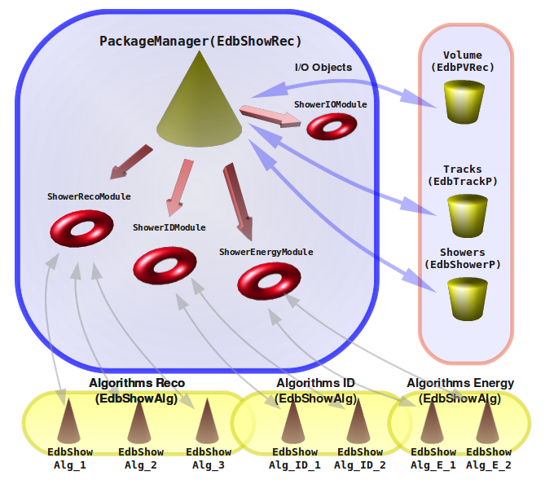

Slide 4
Settings: Now can be set in default.par

Slide 5
Important (new) Classes
EdbShowRec
EdbShowerP
EdbShowAlg
EdbShowAlgE_Simple
EdbShowAlgID_Simple
EdbShowPVRQuality
MAIN CLASS
Shower Object
Reco Algo Objects
Energy Algo Object
ID Algo Object
IO: BG Cleaning Object
EdbShowAlg SubAlgorithms:
      EdbShowAlg_OI,
      EdbShowAlg_NN,
      EdbShowAlg_GS,
      EdbShowAlgClean...

Slide 6
Object description: EdbTrackP
A track in fedra
  One Segment Per Plate
  N(), Npl(), N0, Theta(), XYZ, P()
EdbTrackP
EdbSegP
EdbSegP
Hole
EdbSegP
EdbSegP

Slide 7
Object description: EdbShowerP
A shower in fedra
  Can have More than One Segment Per Plate
  N(), Npl(), N0, Theta(), XYZ, P()
  Plus Additional information: long&trans Profile!
EdbSegP
Shower
Represented as
EdbShowerP
EdbSegP
EdbSegP
EdbSegP
EdbSegP
EdbSegP
EdbSegP
Hole
EdbSegP
EdbSegP
EdbSegP
EdbSegP
EdbSegP

Slide 8
Object description: EdbShowerP
Using EdbTrackP as object class for Shower is ok, but we lose physical information.
Compensated by introducing: EdbShowerP
Conversion EdbTrackP ↔ EdbShowerP , in progress...
EdbShowerP has all info like EdbTrackP
  EdbShowerP->PrintNice() gives info.
  EdbShowerP->PrintAll() gives info.

Slide 9
Shower Energy Measurement
The Shower Energy is measured using:
    Basic Properties of the Shower
    Conditions from Brick Scanning
Shower Properties
  Shape
  Density
  Angle
Scan Conditions
  Reco Efficiency
  BG Level

Slide 10
Block diagram: energy
EdbSegP
EdbSegP
Shower
Represented as
EdbShowerP
EdbSegP
EdbSegP
EdbSegP
EdbSegP
EdbSegP
Hole
EdbSegP
EdbSegP
EdbSegP
EdbSegP
EdbSegP
Shower
Characteristics
Energy class
instance
E= 4.2 +- 1.8 +- 0.5 GeV
Scan cond. Info
==Shower->P()

Slide 11
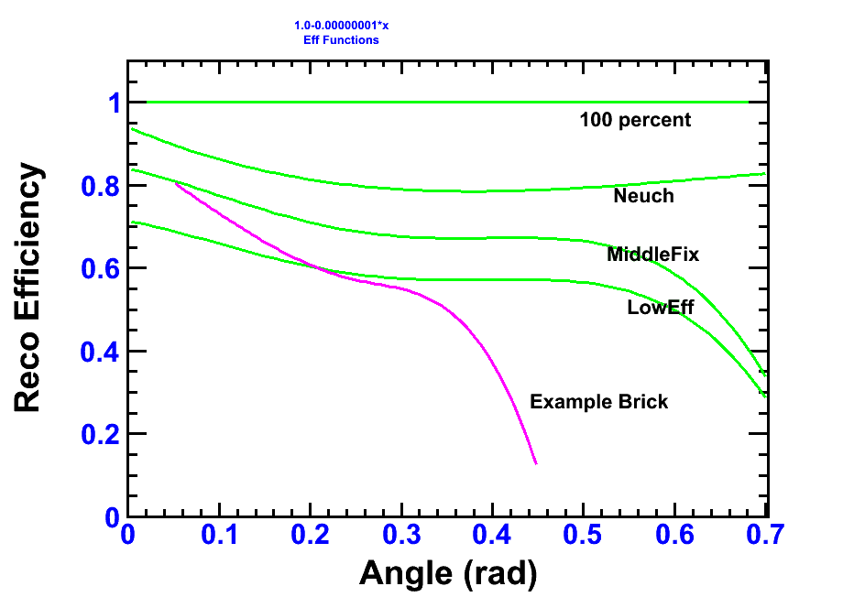
Implemented ScanEfficiencies
Example Brick: Bern 144320, Mic4

Slide 12
 | DEPENDS ON ENERGY ?? | DEPENDS ON NPLATES ?? | E/G IMPACT ?? | PRIORITY | Sample Resolution/E gamma @ 1GeV@20Pl | Sample Resolution/E Electron @ 4GeV@20Pl
FROM THE SCANNING METHOD
EFFICIENCY MISMATCH | YES | YES | NO | HIGH | 0.12 | 0.16
BG LEVEL | YES | YES | YES | HIGH | ? | ?
NPL, Before,After match | YES | YES | NO | MIDDLE | 0.026 | 0.081
DISALIGNMENT | YES | YES | NO | LOW
FROM THE RECO METHOD
E/G MISMATCH | YES | YES | NO | LOW | 0.04 | 0.03
RECO ALG | ? | ? | ? | LOW | ? | ?
FROM THE Multivariate METHOD
N TRAININGS CYLCES | ? | ? | NO | LOW | - | -
N TRAININGS EVENTS | ? | ? | NO | LOW | - | -
TYPE TRAININGS FILE | YES | ? | ? | MIDDLE | - | -
FROM THE MONTE CARLO METHOD
QUALITY CUT | - | - | - | LOW | ? | ?
SHOWER PARAMETRISATION | - | - | - | MIDDLE | ? | ?
ESTIMATED SUM SYST. (+linear, i.e. Overestimated a bit) |  |  |  |  | <0.33 | <0.4
STATISTICAL |  |  |  |  | 0.48 | 0.38

Slide 13
Shower ID
Problem:
  One single Shower can originate from either photons, electrons or (charged) pions
Solution:
  Shower ID class, which does a differentiation!
Technicalities:
  The ID class determines Shower from its originating particle

Slide 14
Shower ID
Instead of assigning the ANN one number for
    Gamma, Electron, Pion(+-)
We do decions based on „X vs Y“, i.e.
    Gamma vs Electron
    Electron vs Pion
Because the ANN is better in discriminating two-by-two variable discrimination.
In continuation with former implementations, we save these results in eProb1,eProb90_X_vs_Y
Eprob1: bg rejection at 1%
Eprob90: signal efficiency 90%

Slide 15
Shower ID
Two type of variables:
  ShID: 0(G),1(E),2(P)
  SPId: 0,1,2
  So we can assign a unique
  ID for each combination:
  Example:
    gamma_vs_e: ShID=0,SPID=1
    e_vs_pi: ShID=1,SPID=2
  Always put 1 if it belongs to 1 st
  Always put 0 if it belongs to 2 nd type.
G
P
E

Slide 16
Block diagram: ID
EdbSegP
EdbSegP
Shower
Represented as
EdbTrackP
EdbSegP
EdbSegP
EdbSegP
EdbSegP
EdbSegP
Hole
EdbSegP
EdbSegP
EdbSegP
EdbSegP
EdbSegP
Shower
Characteristics
ID class
instance
Gamma
Electron
Pion
Vertex Info
==Track->Flag()

Slide 17
More here...

