Slide 1
ID Systematics
Manual & Plots
frank.meisel@lhep.unibe.ch

Slide 2
ID Systematics...
FWM
In analogy to the Energy estimation, one can try to determine if there are similar effects for the electron/gamma separation.
It should be easier, since the ID output is continous (0..1), but the final decision is binary (either Type A or B).
So the Question is:
    How „stable“ is the ID algorithm w.r.t. to variations in the environment (whatever that is) ?

Slide 3
Procedure:
For the ID algo, we are using the same input variables as for the energy
We have different seperation modes:
  Electron - Pion
  Electron – Gamma
  Gamma – Pion

Slide 4
Procedure:
And we test all it for
  Different number of plates reconstructed and
  Different scanning efficiencies
  Different trainingsfiles
  Different cut modes
  Different shape recognition modifiers
But we wont go into more details as for the BG systematics, the information gain is limited.

Slide 5
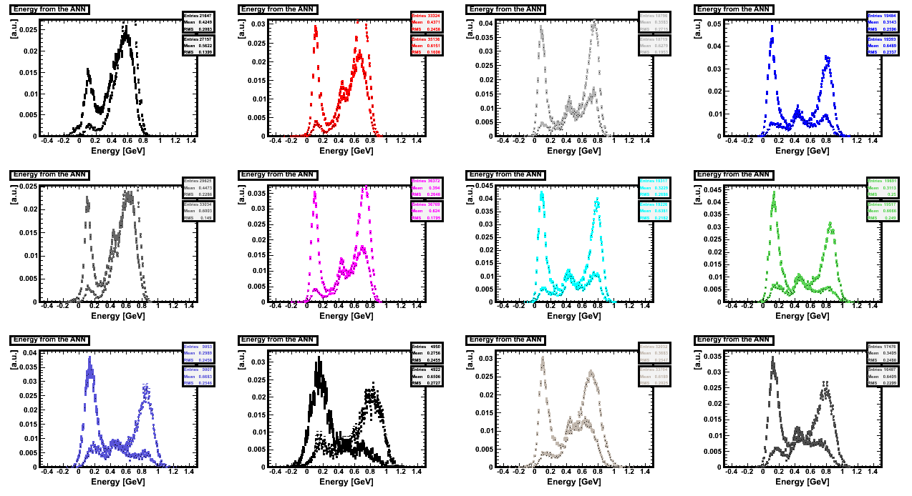
Exampleplots … distributions

Slide 6
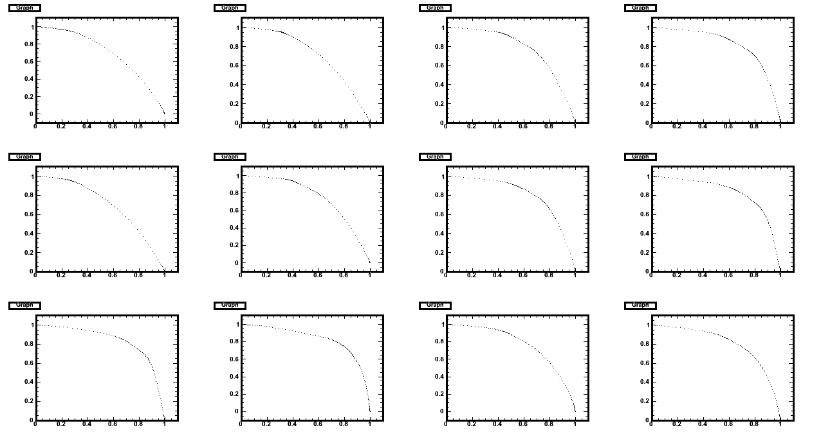
Exampleplots ...eff`s and cont`s

Slide 7
Cutvalues
Now it is shown the distribution
Of the best dmin_cut to point (1/1) (which means perfect separation)
For different shower shape analysis
And also for the different energies
  The negative point for the energy values is a sample of continuous energy distribution.

Slide 8
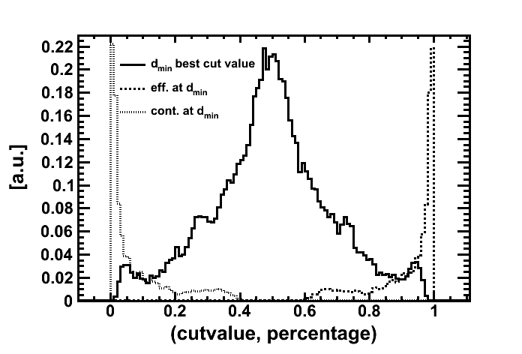
All Energies, All Shapes, All Plates
Note the shift to better values here!

Slide 9
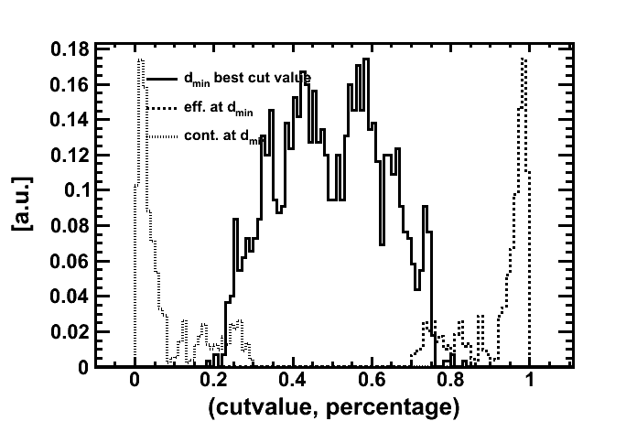
All Energies, All Shapes, All Plates
All Energies, All Shapes, All Plates
Continous Energies,, All Plates, ShapeOnly
Note the shift to better values here!

Slide 10
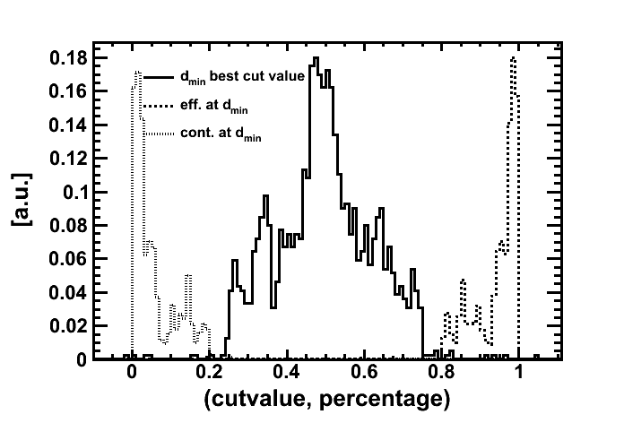
All Energies, All Shapes, All Plates
All Energies, All Shapes, All Plates
Continous Energies,, All Plates, AndVtxIp
Note the shift to better values here!

Slide 11
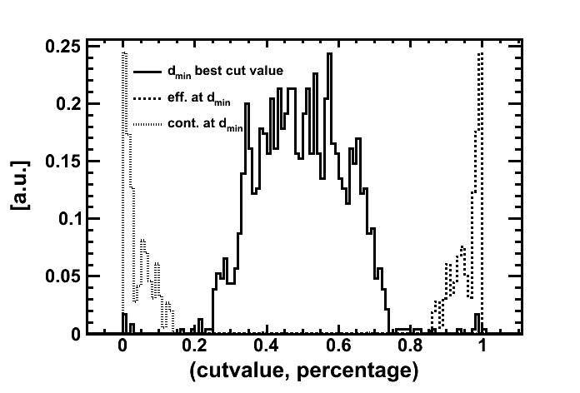
All Energies, All Shapes, All Plates
All Energies, All Shapes, All Plates
Continous Energies,, All Plates, AndDeltaZ
Note the shift to better values here!

Slide 12
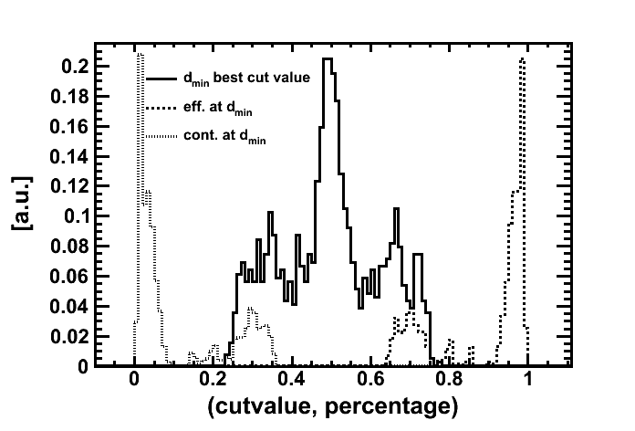
All Energies, All Shapes, All Plates
All Energies, All Shapes, All Plates
Continous Energies,, All Plates, ShapeWo1
Without first two plates, result is ok,
But not as good anymore as before.

Slide 13
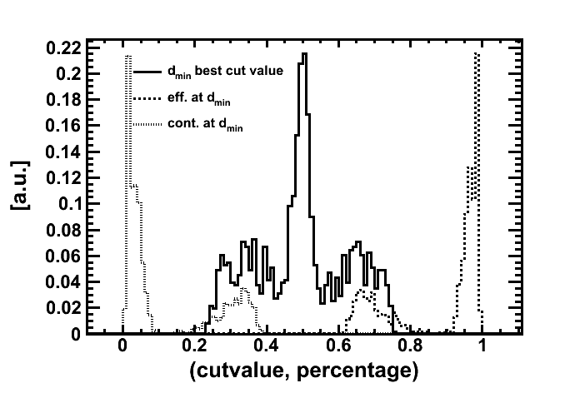
All Energies, All Shapes, All Plates
All Energies, All Shapes, All Plates
Continous Energies,, All Plates, ShapeWo12
Without first two plates, result is ok,
But not as good anymore as before.

Slide 14
Dependency
Dependency on Single Energies
Dependency on the Number of Plates Reconstructed

Slide 15
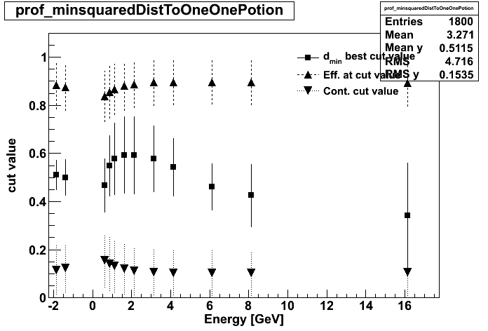
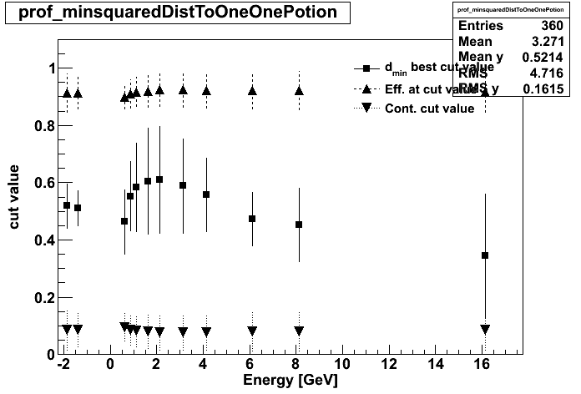
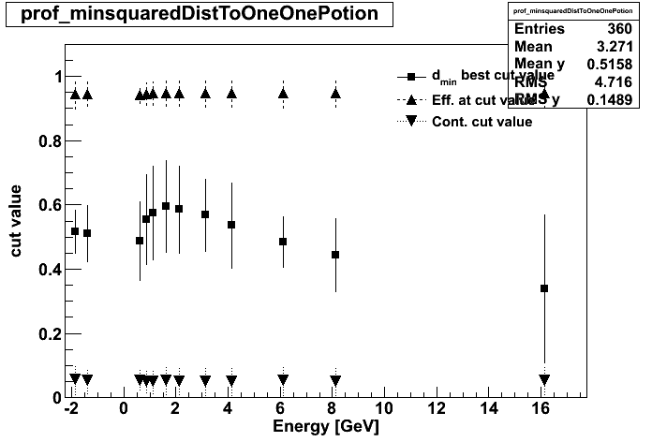
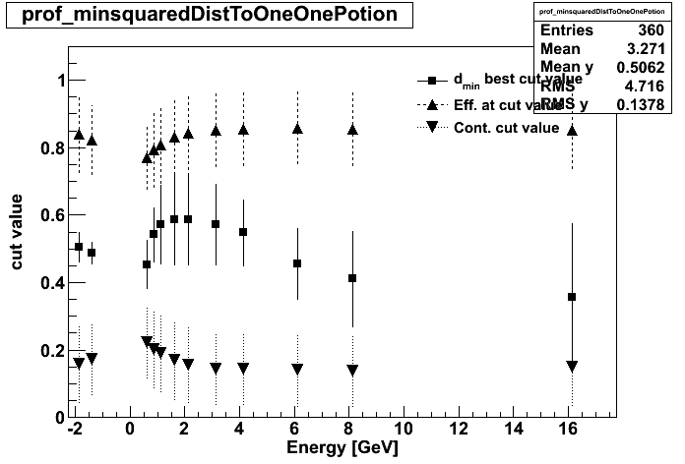
Shower Shape Only
Shower Shape + VtxIP
Nota bene: the errors on the profile plots
are the sigma of the corresponding distribution,
and not the error on the mean.
Shower Shape + VtxIP + VtxDZ
Shower Shape without plate 1&2
(double BT effect)

Slide 16
Npl=10

Slide 17
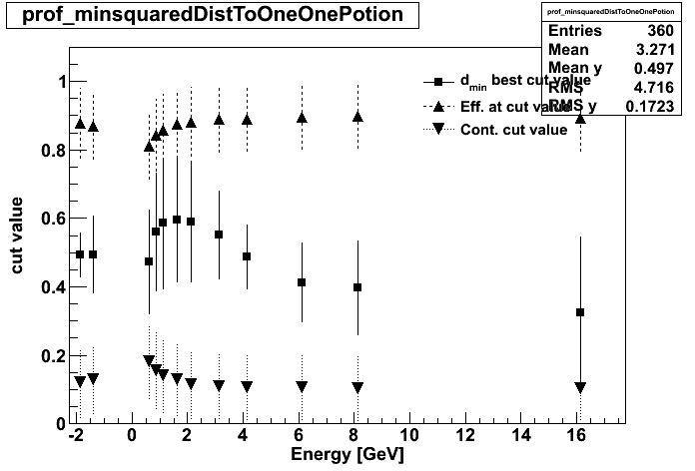
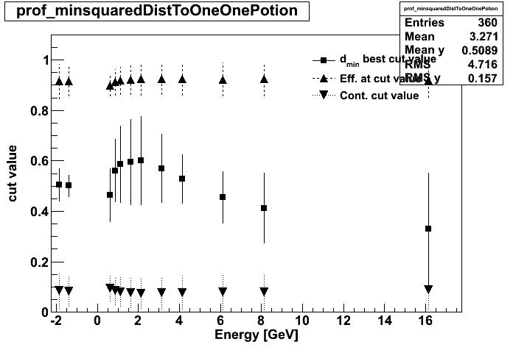

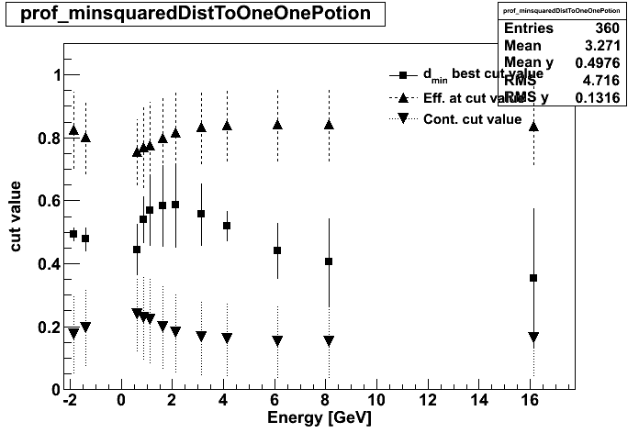
Npl=14

Slide 18

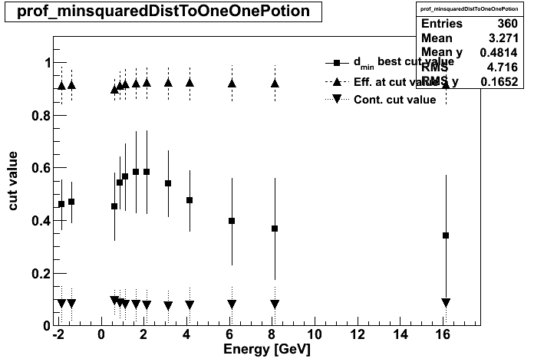

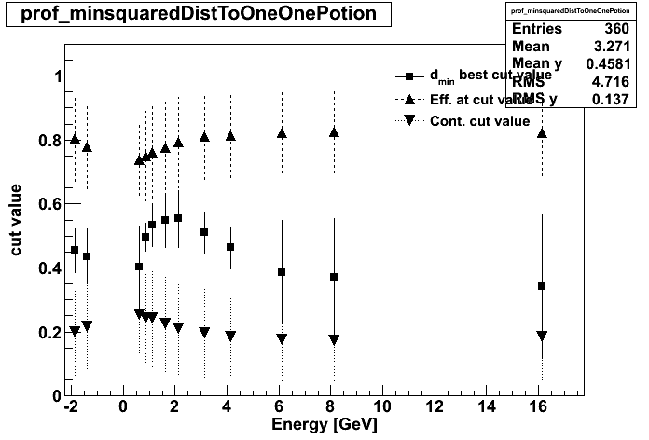
Npl=18

Slide 19




Npl=23

Slide 20




Npl=26

Slide 21
Now separated ID plots for:
Gamma-Electron
Electron-Pion
Pion-Gamma
N.B.: dmin cutvalues for separation on e_g, pi_e, g_pi are obtained
by substituting dmin: dmin(e_g) = 1 - dmin(g_e)

Slide 22
Now
gamma_electron

Slide 23
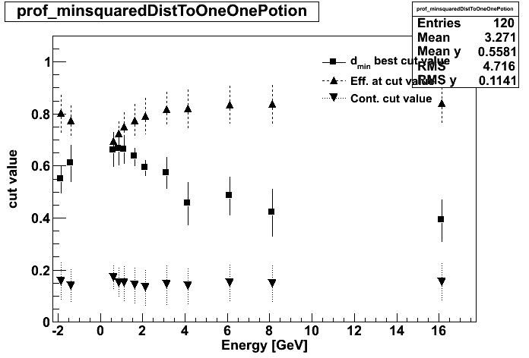
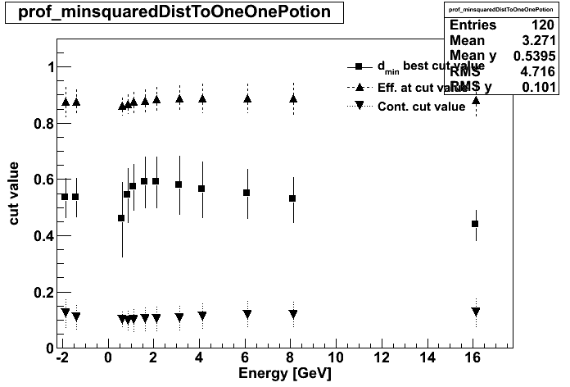
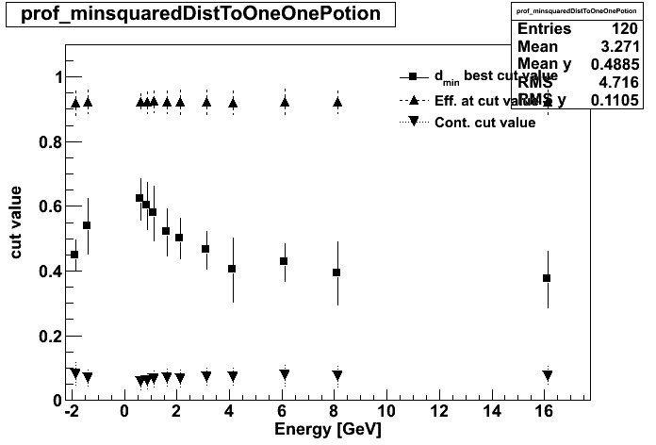

Npl=10
gamma_vs_electron

Slide 24

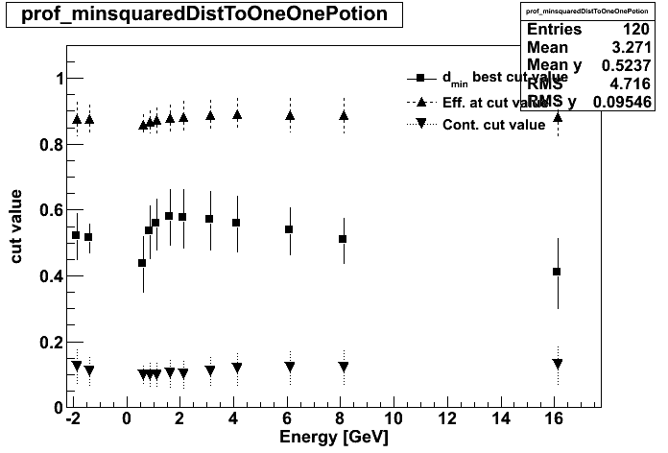
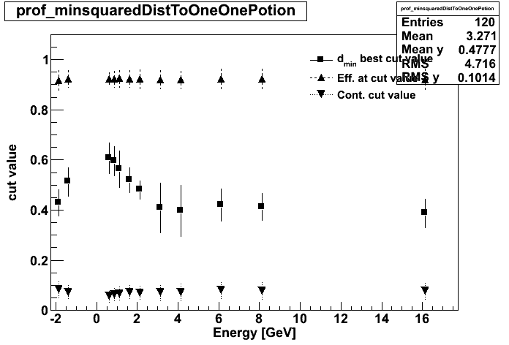

Npl=14
gamma_vs_electron

Slide 25


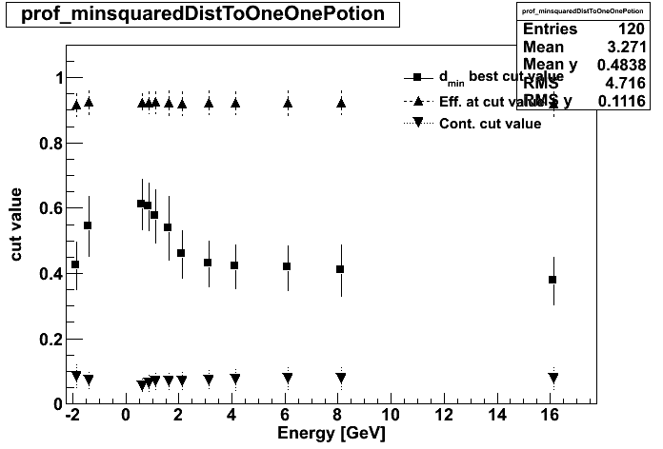

Npl=18
gamma_vs_electron

Slide 26
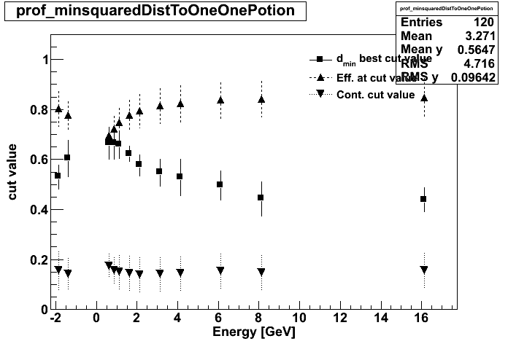
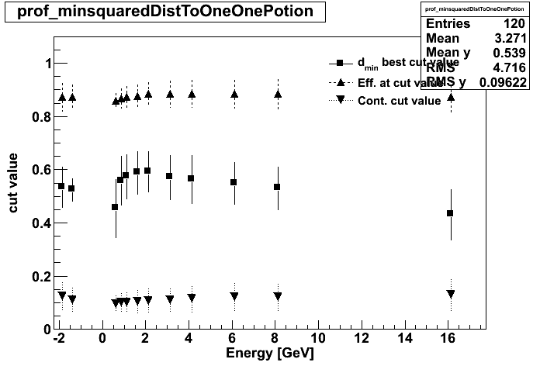

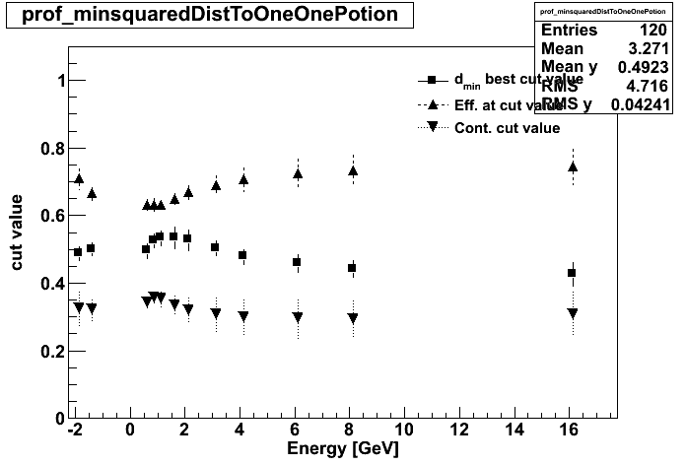
Npl=23
gamma_vs_electron

Slide 27


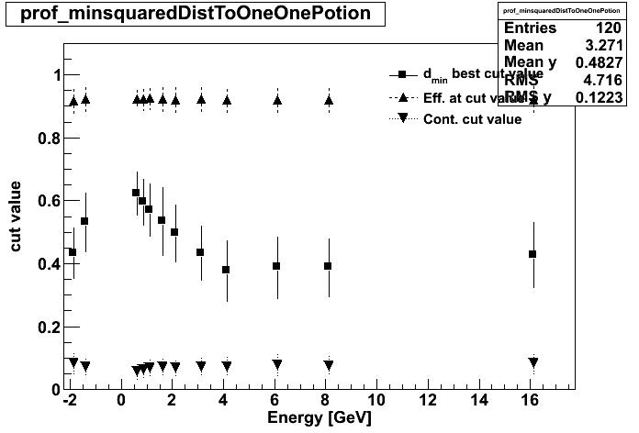

Npl=26
gamma_vs_electron

Slide 28




Npl=29
gamma_vs_electron

Slide 29
Now
electron_pion

Slide 30
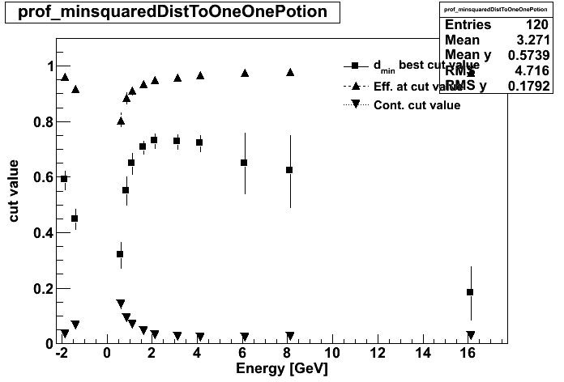
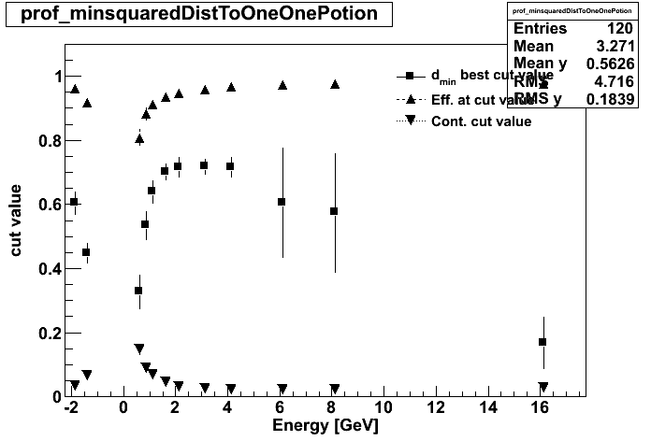


Npl=10
electron_vs_pion

Slide 31
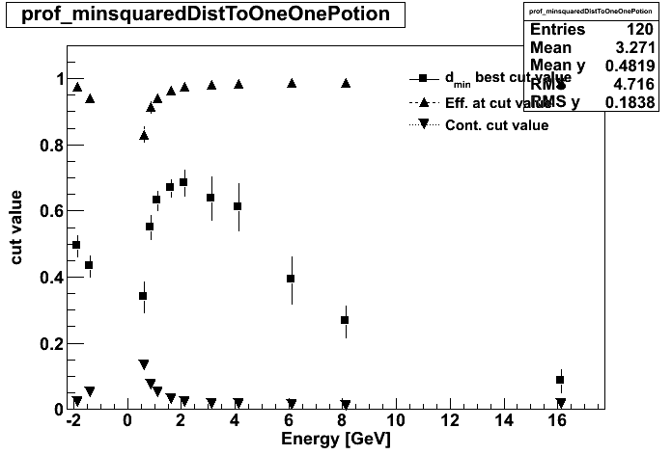



Npl=14
electron_vs_pion

Slide 32
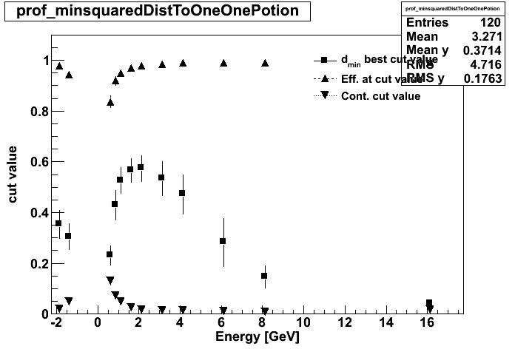
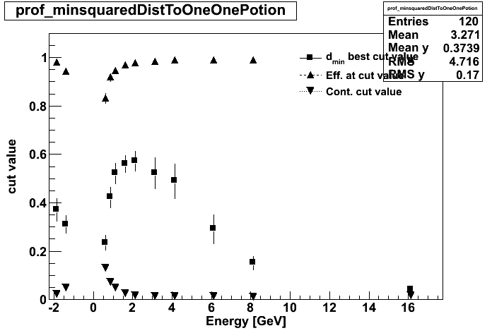
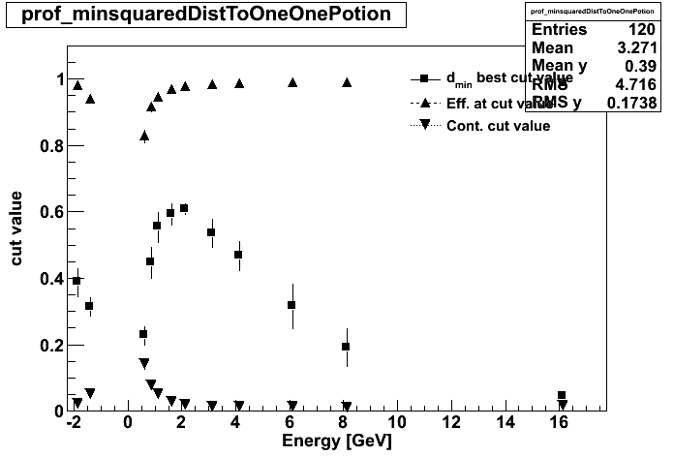

Npl=18
electron_vs_pion

Slide 33




Npl=23
electron_vs_pion

Slide 34




Npl=26
electron_vs_pion

Slide 35




Npl=29
electron_vs_pion

Slide 36
Now
pi_gamma

Slide 37
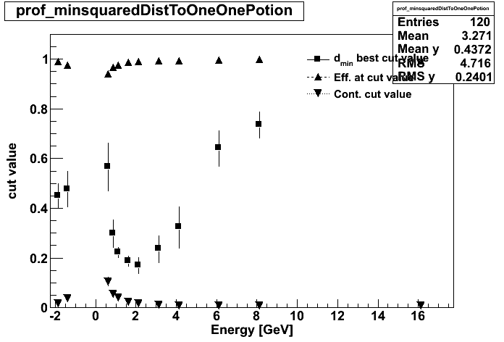
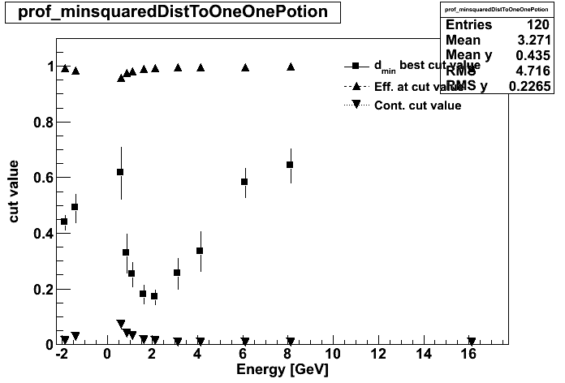
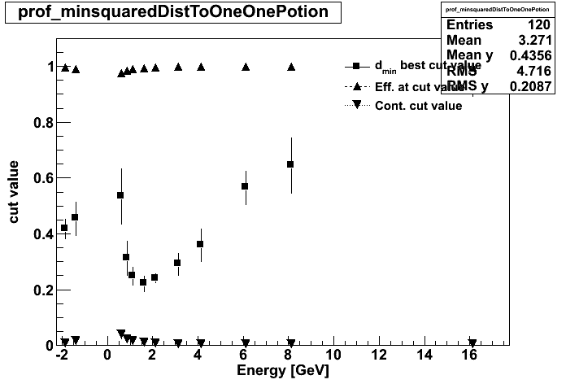
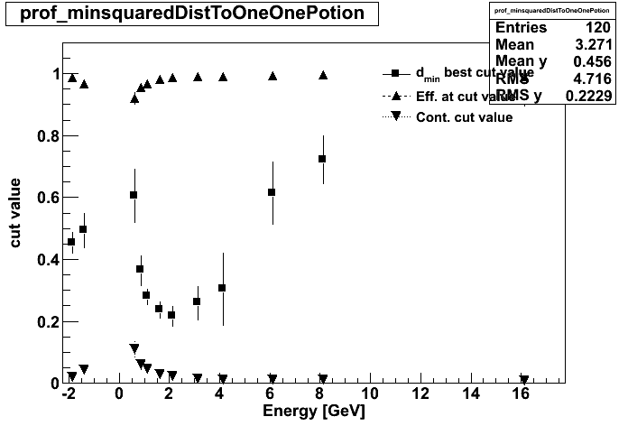
Npl=10
pion_vs_gamma

Slide 38
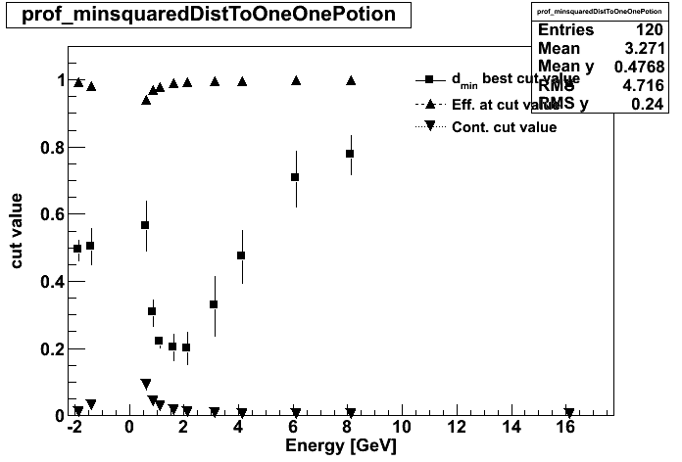

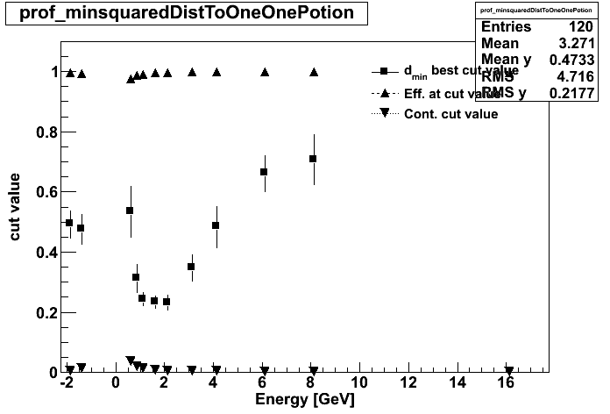
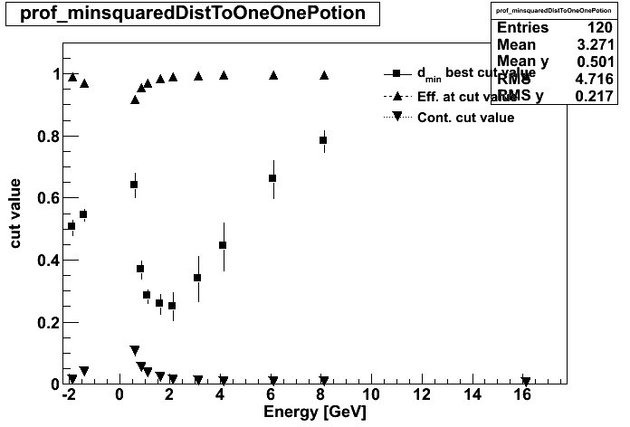
Npl=14
pion_vs_gamma

Slide 39
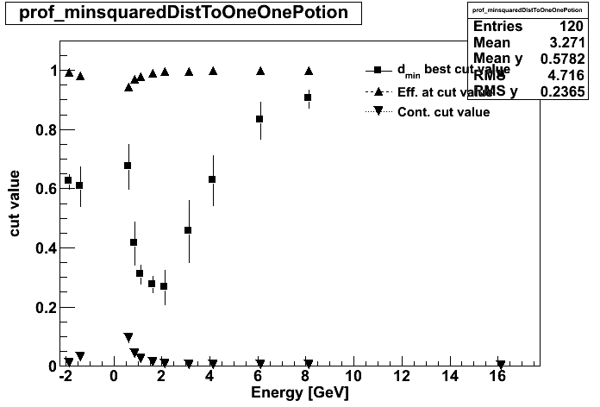
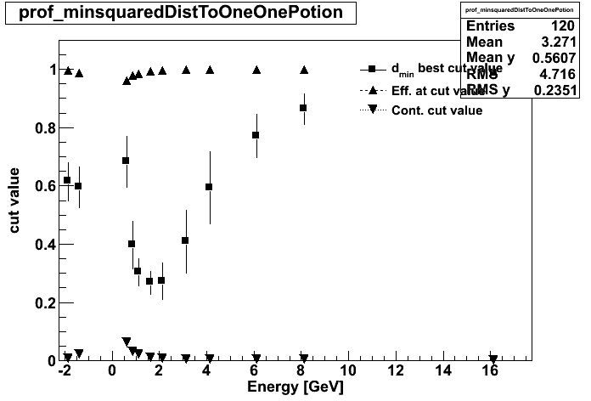
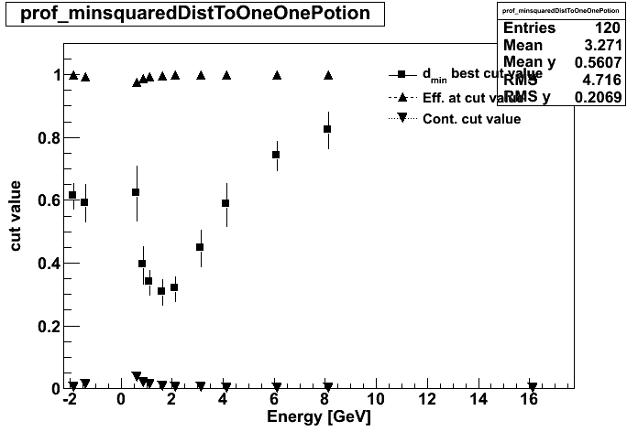
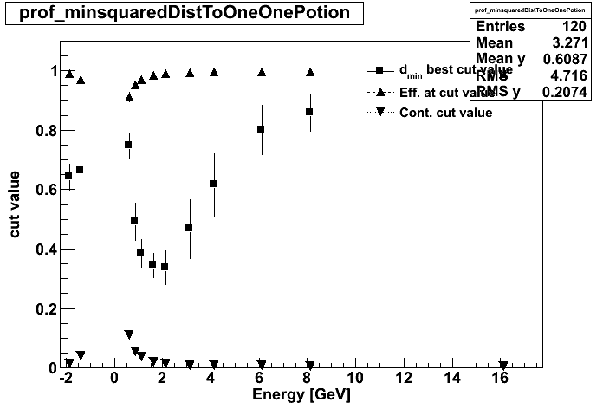
Npl=18
pion_vs_gamma

Slide 40




Npl=23
pion_vs_gamma

Slide 41
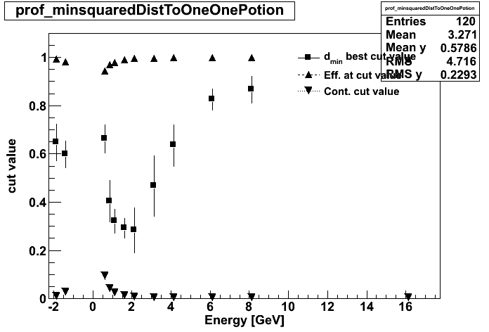
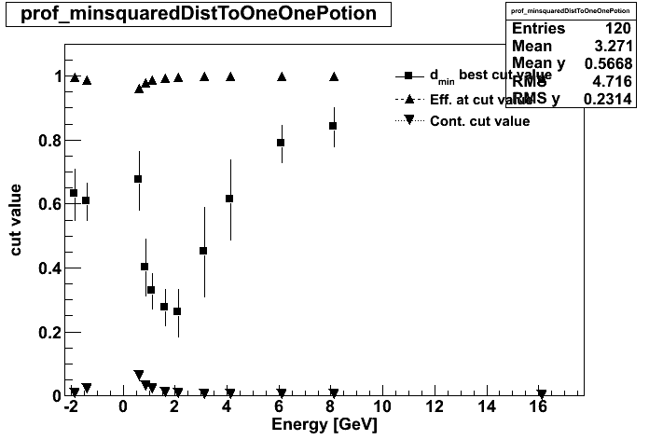
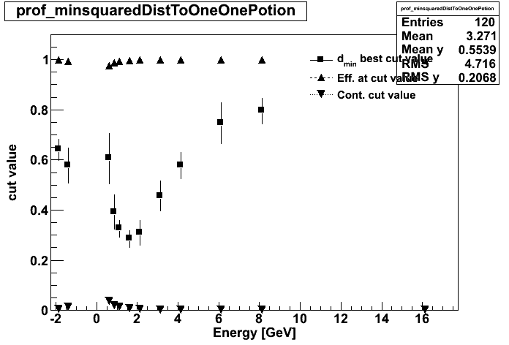

Npl=26
pion_vs_gamma

Slide 42


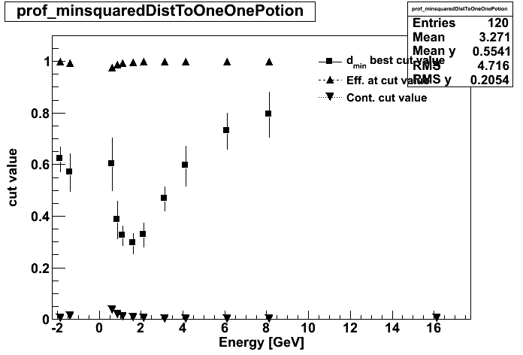

Npl=29
pion_vs_gamma

Slide 43
…
Now we run the ID estimations with these adapted cutvalues.
See if its better ….
The d_min cut is almost independent on number of plates for e_gamma. But strongly dependendt for electron_pi and gamma_pion
It changes for the type of separation one uses
It changes for the energy
Cut depending on separation method is easy to implement.
An energy dependent cut is a priory not possible, just in a second run, after the energy estimation

Slide 44
Used cuts in the routines:
Now we run the ID estimations with these adapted cutvalues.
See if its better ….

Slide 45
Summary
The best min_dist cut is very well suited for general purpose ID tagging. It delivers both high efficiency and low contamination.
Nevertheless, it does not seem to be a constant fixed value, especially around 2-4GeV, so it cannot be hardcoded in.
But one could implement a double routing of
  ID-Energy-ID-Energy estimations.
In this case (not complicated to code into libShowRec) results can be improved.

Slide 46
Nota bene.
These (MC)-results (with many plots and many seperate listings), will also be put into the Internal Note of the energy note.

