Slide 1
libShower
Manual
V0.1
frank.meisel@lhep.unibe.ch

Slide 2
Description
This manual is intended to make the user familiar on the way showers are dealt with.
The user should not bother about details.
To increase the performance, the user may give additional information on the date to obtain a better result.

Slide 3
Overview
Shower for Event classification.
Shower characteristics
Shower implementation in FEDRA

Slide 4
Object description
A track in fedra
  One Segment Per Plate
  N(), Npl(), N0, Theta(), XYZ, P()
EdbTrackP
EdbSegP
EdbSegP
Hole
EdbSegP
EdbSegP

Slide 5
Object description
A shower in fedra
  Can have More than One Segment Per Plate
  N(), Npl(), N0, Theta(), XYZ, P()
  Plus additional information: longitudinal&transversal Profile!
EdbSegP
Shower
Represented as
EdbTrackP
EdbSegP
EdbSegP
EdbSegP
EdbSegP
EdbSegP
EdbSegP
Hole
EdbSegP
EdbSegP
EdbSegP
EdbSegP
EdbSegP

Slide 6
Object description
Using EdbTrackP as object class for Shower is ok, but we lose physical information.
Compensated by infos in EdbShowerAlgE...
    May be put later in a extra EdbShowerP class...
Up to now: how is a shower represented/stored?
We have Shower.root which uses a TTree to store the variables. Technically equivalent to do storage like EdbTrackP, but it requires complex I/O conversions to get from
    TTree entry ↔ EdbTrackP
Due to backward compabilities we have to use this way.
This is a pain in the back... :-)

Slide 7
What is to be done for showers?
In case we have scanback done, vertex found, scanforth done (hadr. re-interaction), we need for the full description of the event some other information: showers?
Why are showers for the event classification important?
Electrons: nu_e from beam; tau->e;
Photons: present in almost any event, mainly through the decay of:
Pi0: Find two photons, match them in case of more

Slide 8
Finding showers
Showers are either attached to vertex directly or indirectly:
  Electrons: start to shower direct from the vertex without flight length; IP to vertex rather small; DeltaZ to vertex very small.
  Photons: fly – then showering happens; therefore IP to vertex bigger than attached tracks; DeltaZ to vertex can be large (mean flight length ca10plates).
Finding a electron shower can be easier than photon shower (directly attached track or BT)

Slide 9
Properties of Showers
We need to be sure of the following things.
We have to find the shower (start)
We have to reconstruct (collect all the tracks) it having as much of it reconstructed as possibles (lowest loss as possible).
After shower(s) found and reconstructed we need the main properties:
    Energy
    ID
    1ry-2ry vtx attachment

Slide 10
Properties of the Shower.root file. a) basic quantities
Name in Shower.root
Description
Analogy in EdbTrackP
number_eventb/I
MC event number
->MCEvt()
sizeb
nfilmb[]
lengthfilmb
x,y,z -b[]
tx,ty -b[]
plateb -b[]
Number of Basetracks
Plate ID of BT[i]
Number of Plates Crossed
X,Y,Z Coordinates of BT[i]
TX,TY Coordinates of BT[i]
??(to be looked up)
N()
??(to be looked up)
Npl()
->X(),Y(),Z()
->TX(),TY()
??(to be looked up)
Numbereventb[]
showerID/I
isizeb/I
ntrace1simu[sizeb]/I
ntrace2simu[sizeb]/I
ntrace3simu[sizeb]/I
Ntrace4simu[sizeb]/I
chi2btkb[sizeb]/F
Numbereventb[]
showerID/I
isizeb/I
ntrace1simu[sizeb]/I
ntrace2simu[sizeb]/I
ntrace3simu[sizeb]/I
Ntrace4simu[sizeb]/I
chi2btkb[sizeb]/F
Numbereventb[]
showerID/I
isizeb/I
ntrace1simu[sizeb]/I
ntrace2simu[sizeb]/I
ntrace3simu[sizeb]/I
Ntrace4simu[sizeb]/I
chi2btkb[sizeb]/F

Slide 11
Properties of the Shower.root file. b) derived quantities
Name in Shower.root
Description
Analogy in EdbTrackP
number_eventb/I
number_eventb/I
number_eventb/I
sizeb
nfilmb[]
lengthfilmb
x,y,z -b[]
tx,ty -b[]
plateb -b[]
sizeb
nfilmb[]
lengthfilmb
x,y,z -b[]
tx,ty -b[]
plateb -b[]
sizeb
nfilmb[]
lengthfilmb
x,y,z -b[]
tx,ty -b[]
plateb -b[]
Numbereventb[]
showerID/I
isizeb/I
ntrace1simu[sizeb]/I
ntrace2simu[sizeb]/I
ntrace3simu[sizeb]/I
Ntrace4simu[sizeb]/I
chi2btkb[sizeb]/F
Numbereventb[]
showerID/I
isizeb/I
ntrace1simu[sizeb]/I
ntrace2simu[sizeb]/I
ntrace3simu[sizeb]/I
Ntrace4simu[sizeb]/I
chi2btkb[sizeb]/F
Numbereventb[]
showerID/I
isizeb/I
ntrace1simu[sizeb]/I
ntrace2simu[sizeb]/I
ntrace3simu[sizeb]/I
Ntrace4simu[sizeb]/I
chi2btkb[sizeb]/F

Slide 12
Reconstruction: Mode A
ShowerInstance = new EdbShowerRec();
ShowerInstance-> SetInBTArray(TObjArray* InBTArray);
ShowerInstance-> SetEdbPVRec(EdbPVRec* Ali);
ShowerInstance-> Execute();
ShowerInstance-> GetRecoShowerArray();
Choose Initiator Basetracks:
Set the PVR object on which the reconstruction shall operate:
Start Reconstruction
Retrieve Reconstructed Shower Array

Slide 13
Reconstruction: Mode B
Frederics Algo Implementation
To be filled and explained...:
void recdown(int num, int MAXPLATE, int DATA, int Ncand, double* x0, double* y0, double* z0, double* tx0, double* ty0, double* chi20, int* W0, double* P0, int* Flag0, int* plate0, int* id0, int* TRid, double* Esim, int piece2, int piece2par)

Slide 14
Shower Energy Measurement
The Shower Energy is measured using:
    Basic Properties of the Shower
    Conditions from Brick Scanning
Shower Properties
  Shape
  Density
  Angle
Scan Conditions
  Reco Efficiency
  BG Level

Slide 15
Block diagram: energy
EdbSegP
EdbSegP
Shower
Represented as
EdbTrackP
EdbSegP
EdbSegP
EdbSegP
EdbSegP
EdbSegP
Hole
EdbSegP
EdbSegP
EdbSegP
EdbSegP
EdbSegP
Shower
Characteristics
Energy class
instance
E= 4.2 +- 1.8 +- 0.5 GeV
Scan cond. Info
==Track->P()

Slide 16
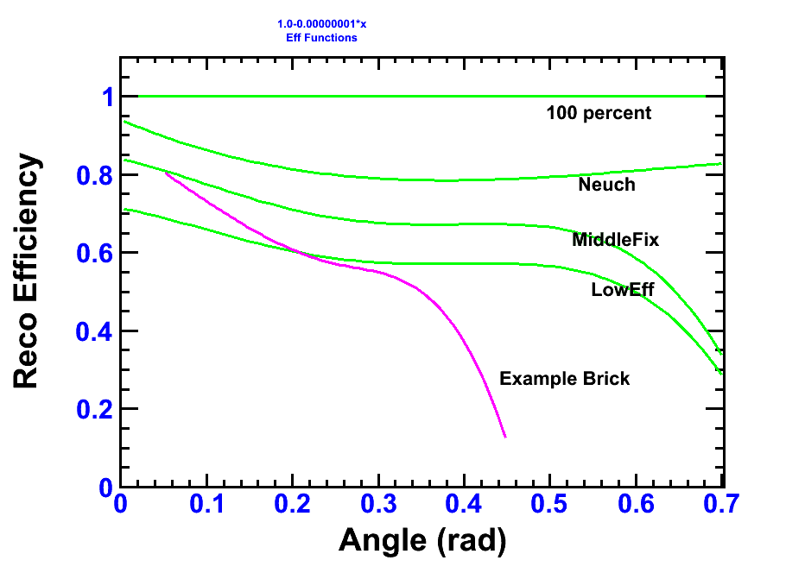
Implemented ScanEfficiencies
Example Brick: Bern 144320, Mic4

Slide 17
Energy: Technical
Get Reconstructed Shower Array
Start Energy Estimation
Retrieve Reconstructed Shower Array, with P() filled.
// Instantate ShowerAlgorithmEnergy Class
EdbShowerAlgESimple* ShowerAlgEnergyInstance = new EdbShowerAlgESimple();
// Run Shower Energy Algorithm on all shower/tracks
ShowerAlgEnergyInstance->DoRun(RecoShowerArray);
// All tracks contain now in P() the estimated energy.

Slide 18
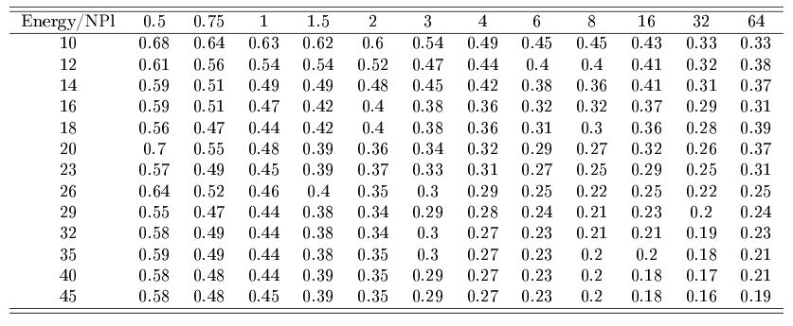
Energy: stat. Results: sigma(E)/E gamma

Slide 19
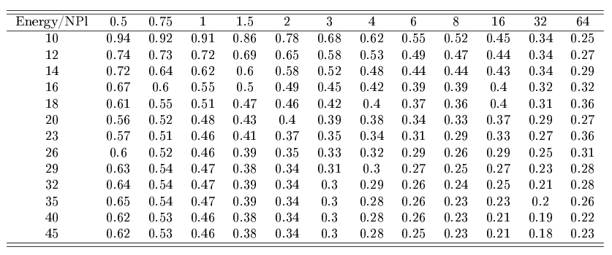
Energy: stat. Results: sigma(E)/E ele

Slide 20
Interpolation
Interpolate energy statistic uncertanties with ROOT Tspline3 class (between energies)
(No interpolation done between plate binnings.)

Slide 21
More here : SYSTEMATICS
Calculating energy gives you stat. AND sys. On the screen. Saved is then the quadratic sum.
  (Attention: at the moment (svn1056) in fedra there is no additional variable to store momentum/energy error of a track/shower. Uncertainty is now only written in shower.root file.)
Different sources have been investigated.
See the following table for an overview.
  (Details will be written up in the thesis, also many plots and tables; explanations will follow here)

Slide 22
 | DEPENDS ON ENERGY ?? | DEPENDS ON NPLATES ?? | E/G IMPACT ?? | PRIORITY | Sample Resolution/E gamma @ 1GeV@20Pl | Sample Resolution/E Electron @ 4GeV@20Pl
FROM THE SCANNING METHOD
EFFICIENCY MISMATCH | YES | YES | NO | HIGH | 0.12 | 0.16
BG LEVEL | YES | YES | YES | HIGH | ? | ?
NPL, Before,After match | YES | YES | NO | MIDDLE | 0.026 | 0.081
DISALIGNMENT | YES | YES | NO | (SKIP) | - | -
FROM THE RECO METHOD
E/G MISMATCH | YES | YES | NO | LOW | 0.04 | 0.03
Shower Alg
FROM THE Multivariate METHOD
N TRAININGS CYLCES | YES | YES | NO | LOW | - | -
N TRAININGS EVENTS | YES | YES | NO | LOW | - | -
TYPE TRAININGS FILE | YES | YES | NO | MIDDLE | - | -
Cycles&Events(File fixed) | YES | YES | NO | LOW | 0.012 | 0.0068
FROM THE MONTE CARLO METHOD
QUALITY CUT | - | - | - | LOW | ? | ?
SHOWER PARAMETRISATION | - | - | - | (SKIP) | - | -
ESTIMATED SUM SYST. (+linear, i.e. Overestimated a bit) |  |  |  |  | <0.33 | <0.4
STATISTICAL |  |  |  |  | 0.48 | 0.38

Slide 23
E: Systematics
Show uncertainties from different sources.
Electrons left, Photons right.
(Tables with full valueset will be put later)
Take Care of different Y-axis scaling!

Slide 24
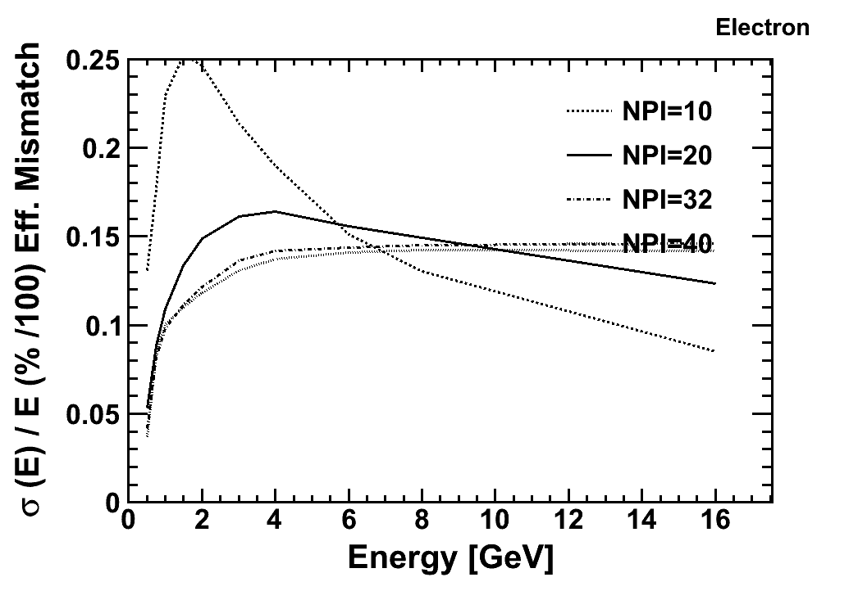
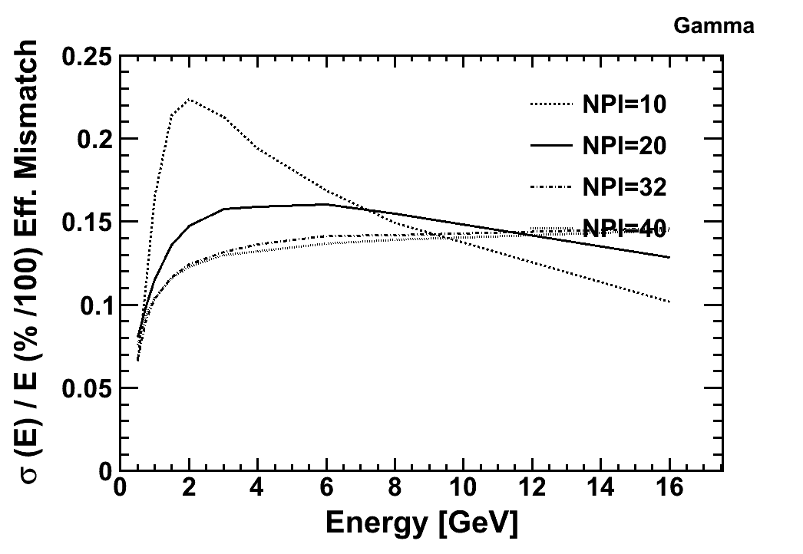
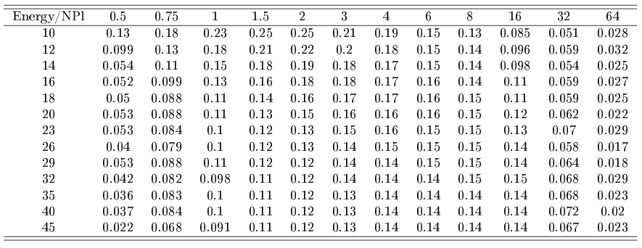
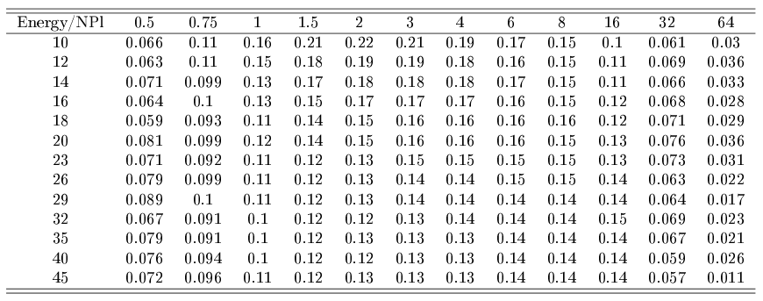
E: Systematics: Eff mismatch

Slide 25
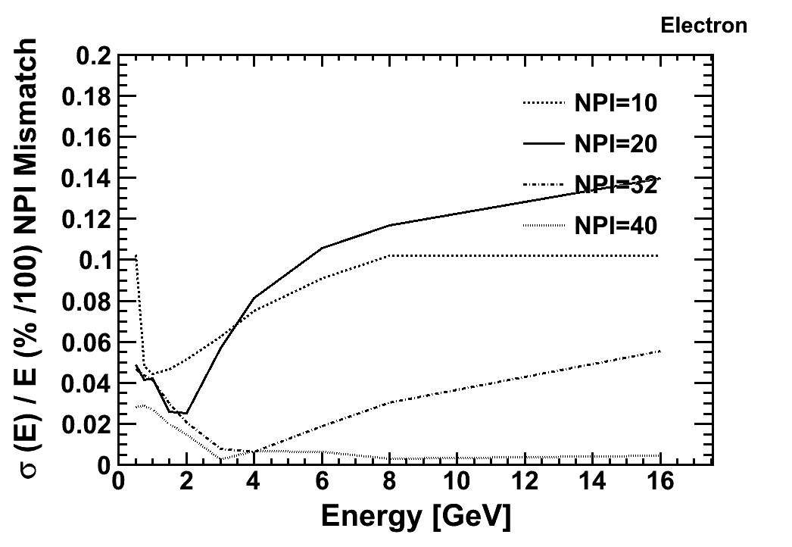
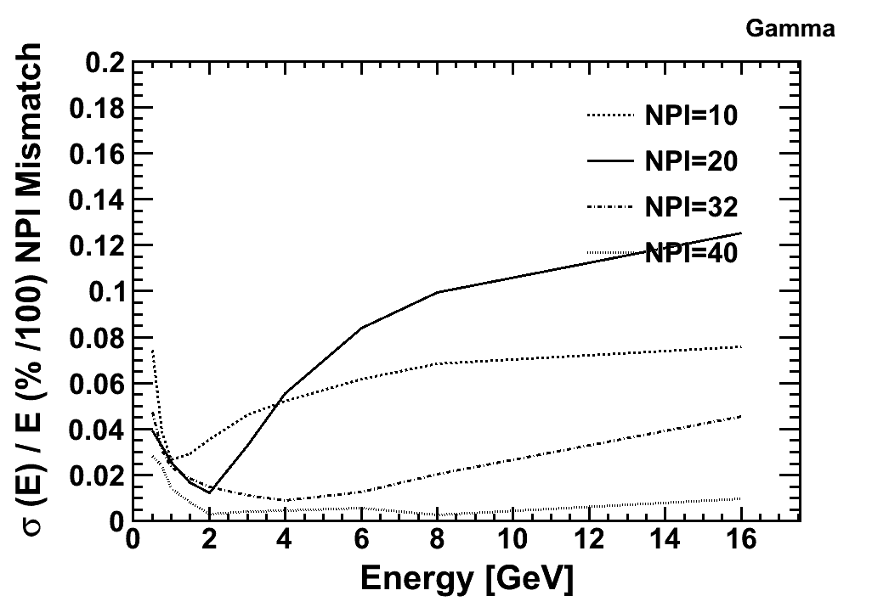
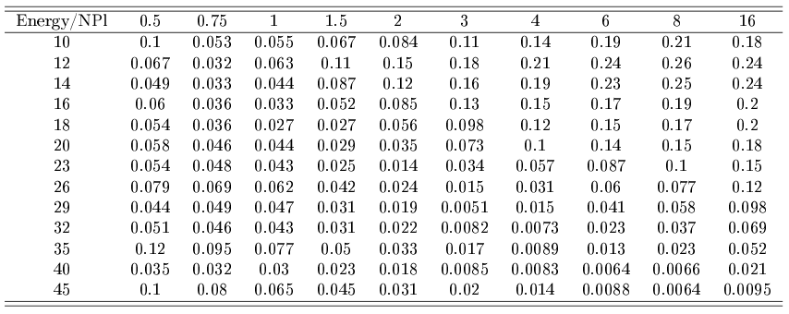
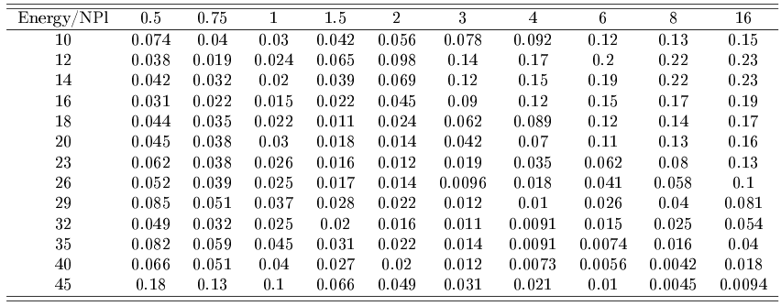
E: Systematics: NPL mismatch

Slide 26
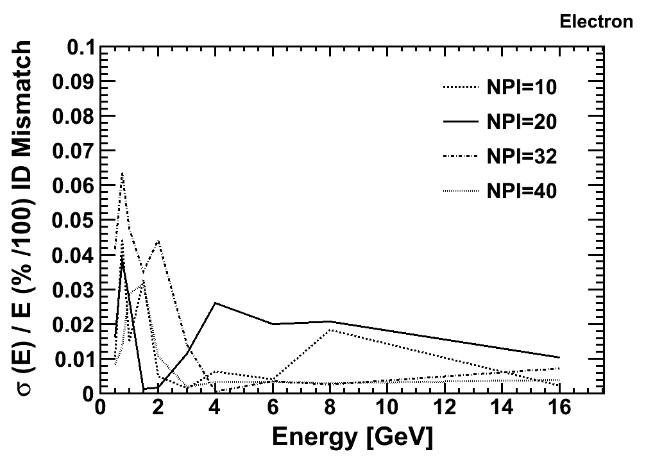
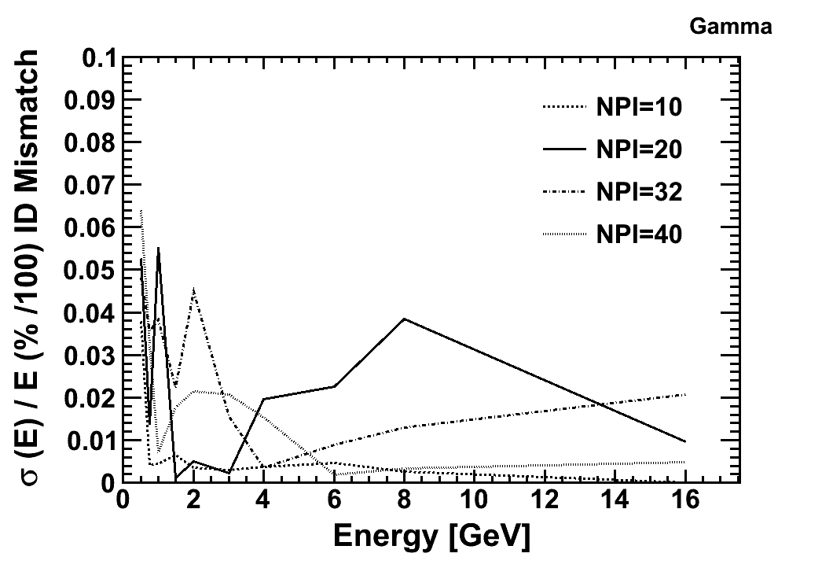
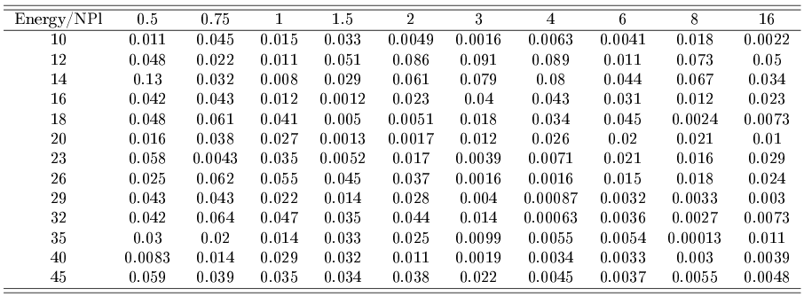
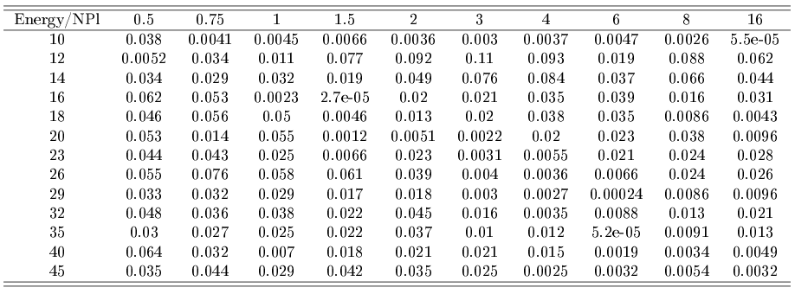
E: Systematics: ID mismatch

Slide 27
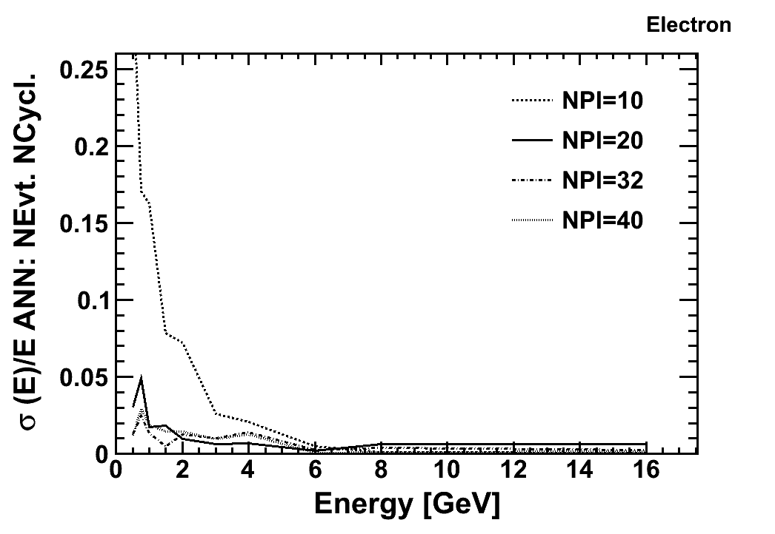
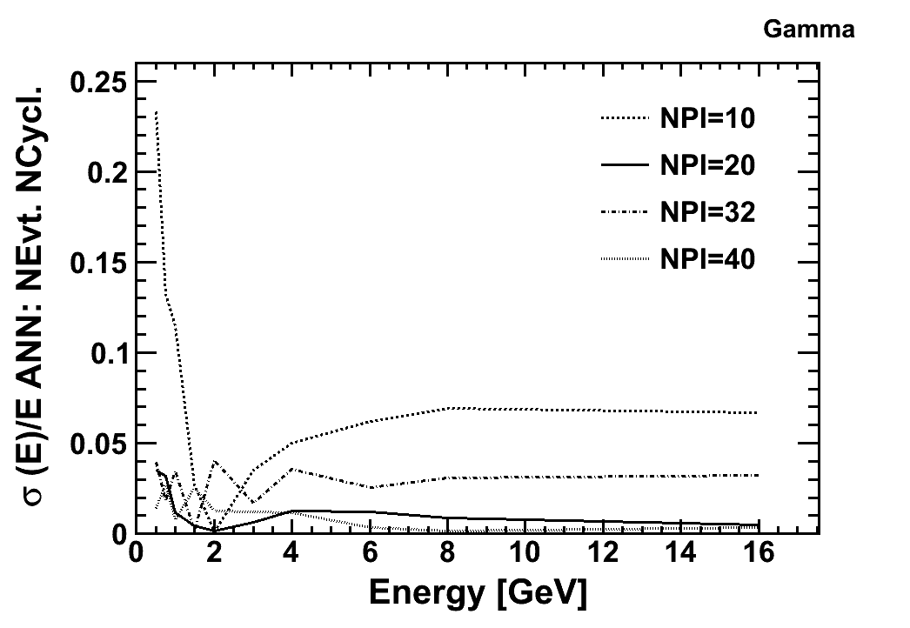
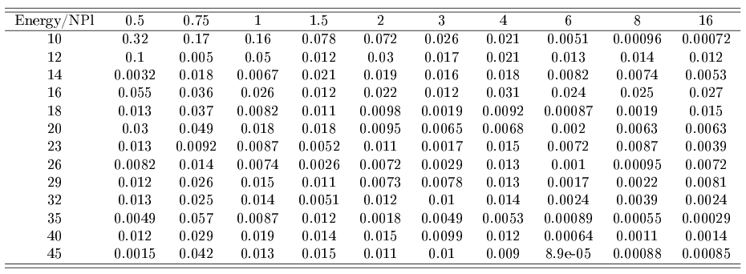
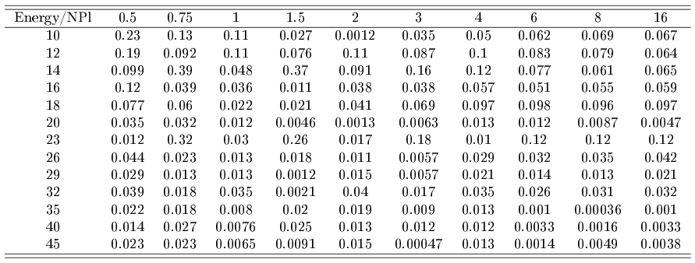
E: Systematics: ANN uncertainty

Slide 28
E: Systematics: Addition
As we know, systematic sources are neither totally independent nor totally dependent...
But to derive an analytical form for the covariance elements is even more impossible in experimental cases (no analytical function to describe the dependencies)
To calculate ALL variations by means of MC estimates would require tooo much computing power.
So tradeoff here: take the sources listed in table and add them
  Quadratically: sigma^sys_tot= QSUM(sigma^sys_i)
  Linear: sigma^sys_tot= LSUM(sigma^sys_i)
„True“ error will be in between....
The more systematic sources considered, the larger the error we get.
We think that the most important we have investigated...

Slide 29
Shower ID
Problem:
  One single Shower can originate from either photons, electrons or (charged) pions
Solution:
  Shower ID class, which does a differentiation!
Technicalities:
  The ID class determines Shower from its originating particle

Slide 30
Shower ID
Instead of assigning the ANN one number for
    Gamma, Electron, Pion(+-)
We do decions based on „X vs Y“, i.e.
    Gamma vs Electron
    Electron vs Pion
Because the ANN is better in discriminating two-by-two variable discrimination.
In continuation with former implementations, we save these results in eProb1,eProb90_X_vs_Y
Eprob1: bg rejection at 1%
Eprob90: signal efficiency 90%

Slide 31
Shower ID
Two type of variables:
  SHID: 0(G),1(E),2(P)
  SPID: 0,1,2
  So we can assign a unique
  ID for each combination:
  Example:
    gamma_vs_e: SHID=0,SPID=1
    e_vs_pi: SHID=1,SPID=2
  Always put 0 if it belongs to Type 0 (SHID)
  Always put 1 if it belongs to Type 1 (SPID)
G
P
E

Slide 32
Block diagram: ID
EdbSegP
EdbSegP
Shower
Represented as
EdbTrackP
EdbSegP
EdbSegP
EdbSegP
EdbSegP
EdbSegP
Hole
EdbSegP
EdbSegP
EdbSegP
EdbSegP
EdbSegP
Shower
Characteristics
ID class
instance
Gamma
Electron
Pion
Vertex Info
==Track->Flag()

Slide 33
More here...

Slide 34
The Cleaning of High BG level...
We try to keep a constant BT density level of not more than 40BT/mm2
To get this, we have the EdbPVRec patterns object, which we use for checks:
We calculate BT density plate by plate and can adapt the Quality Cut plate by plate accordingly.

Slide 35
EdbPVRQuality
This class does BG cleaning... How it works:
EdbPVRQuality* Qualityobject = new EdbPVRQuality(gAli);
    gAli is the filled EdbPVRec object. Usually this implicates the data coming from cp.root files.
    LinkedTracks.root EdbPVRec object usually is already very „clean“, i.e. that linked tracks are often „good“ (physically) objects.
Qualityobject->Print();
Qualityobject->Help();

