Slide 1
libShowRec
Manual
V0.1
frank.meisel@lhep.unibe.ch

Slide 2
Description
This manual is intended to make the user familiar on the way showers are dealt with
The user should not bother about details of programming
To increase the performance, the user may give additional information on the date to obtain a better result

Slide 3
Overview
Shower for Event classification.
Shower characteristics
Shower implementation in FEDRA

Slide 4
EdbShowRec
PackageManager(EdbShowRec)
I/O Objects
Volume
(EdbPVRec)
ShowerIOModule
Tracks
(EdbTrackP)
ShowerRecoModule
ShowerIDModule
ShowerEnergyModule
Showers
(EdbShowerP)
Algorithms Reco (EdbShowAlg)
Algorithms Reco (EdbShowAlg)
Algorithms ID (EdbShowAlg)
Algorithms Energy (EdbShowAlg)
EdbShow
Alg_1
EdbShow
Alg_2
EdbShow
Alg_3
EdbShow
Alg_ID_1
EdbShow
Alg_ID_2
EdbShow
Alg_E_1
EdbShow
Alg_E_2

Slide 5
Object description
A track in fedra
      One Segment Per Plate
      N(), Npl(), N0, Theta(), XYZ, P()
EdbTrackP
EdbSegP
EdbSegP
Hole
EdbSegP
EdbSegP

Slide 6
Object description
A shower in fedra
      Can have More than One Segment Per Plate
      N(), Npl(), N0, Theta(), XYZ, P()
      Plus additional information: longitudinal&transversal Profile!
EdbSegP
Hole
EdbShowerP
EdbSegP
EdbSegP
EdbSegP
EdbSegP
Hole
EdbSegP
EdbSegP
EdbSegP
EdbSegP
EdbSegP
EdbSegP
EdbSegP
EdbSegP
EdbSegP
Hole

Slide 7
Schematic comparison:
EdbTrackP
EdbSegP
EdbSegP
Hole
EdbSegP
EdbSegP
EdbSegP
Hole
EdbShowerP
EdbSegP
EdbSegP
EdbSegP
EdbSegP
Hole
EdbSegP
EdbSegP
EdbSegP
EdbSegP
EdbSegP
EdbSegP
EdbSegP
EdbSegP
EdbSegP

Slide 8
Object description
Using EdbTrackP as object class for Shower is ok, but we lose physical information.
Compensated by infos in EdbShowerAlgE...
    May be put later in a extra EdbShowerP class...
Up to now: how is a shower represented/stored?
We have Shower.root which uses a TTree to store the variables. Technically equivalent to do storage like EdbTrackP, but it requires complex I/O conversions to get from
    TTree entry ↔ EdbTrackP
Due to backward compabilities we have to use this way.
This is a pain in the back... :-)

Slide 9
What is to be done for showers?
In case we have scanback done, vertex found, scanforth done (hadr. re-interaction), we need for the full description of the event some other information: showers?
Why are showers for the event classification important?
Electrons: nu_e from beam; tau->e;
Photons: present in almost any event, mainly through the decay of:
Pi0: Find two photons, match them in case of more

Slide 10
Finding showers
Showers are either attached to vertex directly or indirectly:
  Electrons: start to shower direct from the vertex without flight length; IP to vertex rather small; DeltaZ to vertex very small.
  Photons: fly – then showering happens; therefore IP to vertex bigger than attached tracks; DeltaZ to vertex can be large (mean flight length ca10plates).
Finding a electron shower can be easier than photon shower (directly attached track or BT)

Slide 11
Properties of Showers
We need to be sure of the following things.
We have to find the shower (start)
We have to reconstruct (collect all the tracks) it having as much of it reconstructed as possibles (lowest loss as possible).
After shower(s) found and reconstructed we need the main properties:
    Energy
    ID
    1ry-2ry vtx attachment

Slide 12
Properties of the Shower.root file. a) basic quantities
Name in Shower.root
Description
Analogy in EdbTrackP
number_eventb/I
MC event number
->MCEvt()
sizeb
nfilmb[]
lengthfilmb
x,y,z -b[]
tx,ty -b[]
plateb -b[]
Number of Basetracks
Plate ID of BT[i]
Number of Plates Crossed
X,Y,Z Coordinates of BT[i]
TX,TY Coordinates of BT[i]
??(to be looked up)
N()
??(to be looked up)
Npl()
->X(),Y(),Z()
->TX(),TY()
??(to be looked up)
Numbereventb[]
showerID/I
isizeb/I
ntrace1simu[sizeb]/I
ntrace2simu[sizeb]/I
ntrace3simu[sizeb]/I
Ntrace4simu[sizeb]/I
chi2btkb[sizeb]/F
Numbereventb[]
showerID/I
isizeb/I
ntrace1simu[sizeb]/I
ntrace2simu[sizeb]/I
ntrace3simu[sizeb]/I
Ntrace4simu[sizeb]/I
chi2btkb[sizeb]/F
Numbereventb[]
showerID/I
isizeb/I
ntrace1simu[sizeb]/I
ntrace2simu[sizeb]/I
ntrace3simu[sizeb]/I
Ntrace4simu[sizeb]/I
chi2btkb[sizeb]/F

Slide 13
Properties of the Shower.root file. b) derived quantities
Name in Shower.root
Description
Analogy in EdbTrackP
number_eventb/I
number_eventb/I
number_eventb/I
sizeb
nfilmb[]
lengthfilmb
x,y,z -b[]
tx,ty -b[]
plateb -b[]
sizeb
nfilmb[]
lengthfilmb
x,y,z -b[]
tx,ty -b[]
plateb -b[]
sizeb
nfilmb[]
lengthfilmb
x,y,z -b[]
tx,ty -b[]
plateb -b[]
Numbereventb[]
showerID/I
isizeb/I
ntrace1simu[sizeb]/I
ntrace2simu[sizeb]/I
ntrace3simu[sizeb]/I
Ntrace4simu[sizeb]/I
chi2btkb[sizeb]/F
Numbereventb[]
showerID/I
isizeb/I
ntrace1simu[sizeb]/I
ntrace2simu[sizeb]/I
ntrace3simu[sizeb]/I
Ntrace4simu[sizeb]/I
chi2btkb[sizeb]/F
Numbereventb[]
showerID/I
isizeb/I
ntrace1simu[sizeb]/I
ntrace2simu[sizeb]/I
ntrace3simu[sizeb]/I
Ntrace4simu[sizeb]/I
chi2btkb[sizeb]/F

Slide 14
Reconstruction: Mode A
ShowerInstance = new EdbShowerRec();
ShowerInstance-> SetInBTArray(TObjArray* InBTArray);
ShowerInstance-> SetEdbPVRec(EdbPVRec* Ali);
ShowerInstance-> Execute();
ShowerInstance-> GetRecoShowerArray();
Choose Initiator Basetracks:
Set the PVR object on which the reconstruction shall operate:
Start Reconstruction
Retrieve Reconstructed Shower Array

Slide 15
Reconstruction: Mode B
Frederics Algo Implementation
To be filled and explained...:
void recdown(int num, int MAXPLATE, int DATA, int Ncand, double* x0, double* y0, double* z0, double* tx0, double* ty0, double* chi20, int* W0, double* P0, int* Flag0, int* plate0, int* id0, int* TRid, double* Esim, int piece2, int piece2par)

Slide 16
Shower Reconstruction Algorithms
There have been tested several algorithms to find out optimal shower reconstruction.
Some are similar to each other, some are different.
They can be grouped into two types:
    Local Basetrack Cut Algorithms (CT, CA, OI, RC, BW)
    Global Basetrack Cut Algorithms (CL, TC, GS)
Pseudocodes of all algorithms can be found in thesis, code for OI and GS algo are given in next two slides:

Slide 17
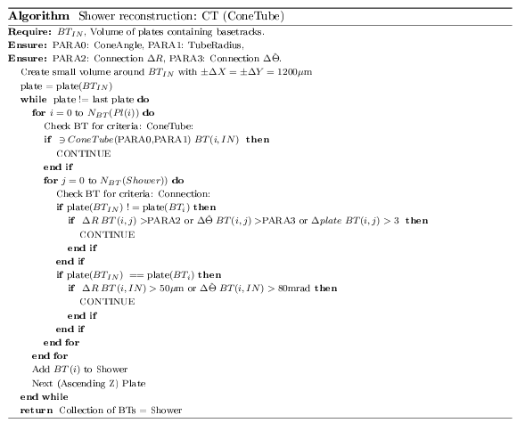
Shower Reco Alg: OI

Slide 18
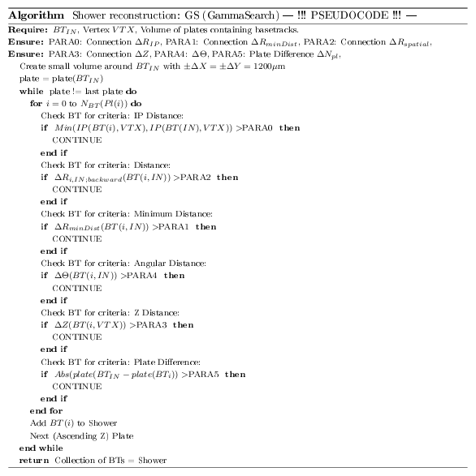

Slide 19
Results for Shower Reco Algs:
OI
GS

Slide 20
Shower Energy Measurement
See extra file...

Slide 21
Shower ID
Problem:
  One single Shower can originate from either photons, electrons or (charged) pions
Solution:
  Shower ID class, which does a differentiation!
Technicalities:
  The ID class determines Shower from its originating particle

Slide 22
Shower ID
Instead of assigning the ANN one number for
    Gamma, Electron, Pion(+-)
We do decions based on „X vs Y“, i.e.
    Gamma vs Electron
    Electron vs Pion
Because the ANN is better in discriminating two-by-two variable discrimination.
In continuation with former implementations, we save these results in eProb1,eProb90_X_vs_Y
Eprob1: bg rejection at 1%
Eprob90: signal efficiency 90%

Slide 23
Shower ID
Two type of variables:
  SHID: 0(G),1(E),2(P)
  SPID: 0,1,2
  So we can assign a unique
  ID for each combination:
  Example:
    gamma_vs_e: SHID=0,SPID=1
    e_vs_pi: SHID=1,SPID=2
  Always put 0 if it belongs to Type 0 (SHID)
  Always put 1 if it belongs to Type 1 (SPID)
G
P
E

Slide 24
Block diagram: ID
EdbSegP
EdbSegP
Shower
Represented as
EdbTrackP
EdbSegP
EdbSegP
EdbSegP
EdbSegP
EdbSegP
Hole
EdbSegP
EdbSegP
EdbSegP
EdbSegP
EdbSegP
Shower
Characteristics
ID class
instance
Gamma
Electron
Pion
Vertex Info
==Track->Flag()

Slide 25
More here...

Slide 26
The Cleaning of High BG level...
We try to keep a constant BT density level of not more than 40BT/mm2
To get this, we have the EdbPVRec patterns object, which we use for checks:
We calculate BT density plate by plate and can adapt the Quality Cut plate by plate accordingly.

Slide 27
EdbPVRQuality
This class does BG cleaning... How it works:
EdbPVRQuality* Qualityobject = new EdbPVRQuality(gAli);
    gAli is the filled EdbPVRec object. Usually this implicates the data coming from cp.root files.
    LinkedTracks.root EdbPVRec object usually is already very „clean“, i.e. that linked tracks are often „good“ (physically) objects.
Qualityobject->Print();
Qualityobject->Help();

Slide 28
EdbPVRQuality Remove FakeDoublets.
From Scanning we know that by view overlap of the microscope there is fake double Bts:
  One BT scanned in two views appears (due to Sysal bending correction function) as two slightly shifted different Bts!
  This we dont want, since several reasons. One of them is for the GammaPairSearch: The pair algo might take these as a e+e—Pair.
Those duplicated tracks show a distinct behaviour in the dR-dT plane.
Plot: photon pairs and instrumental BG doublets in ther dR-dT plane
EdbPVRQuality* Qualityobject = new EdbPVRQuality(gAli);
Qualityobject->Remove_DoubleBT();
Returns a new EdbPVRec Object, where these doublets are eliminated.

Slide 29
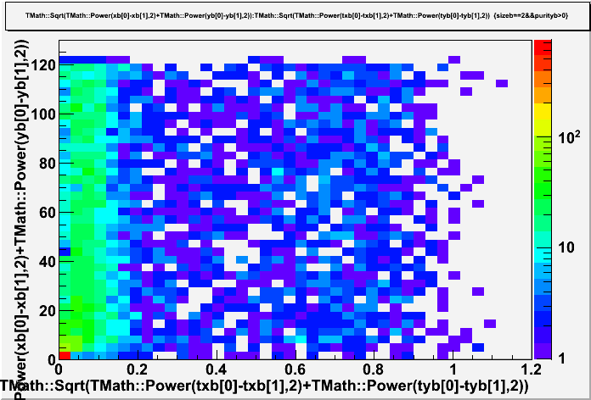

Slide 30
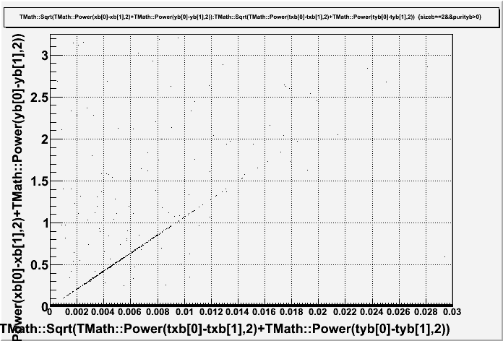
Zoom on very small
dR-dT difference values:
What are these line parings???
Still unknown...

Slide 31
InBT - Execution order
EdbShowerRec
EdbPVRec
Check: plates,
Track..
OK?
In general:
Look:
In Object ???
NO
YES
Check: linked_tracks
in PVR-object?
eTracks
Use eAli
Check: linked_tracks
in PVR/object/file?
NO
STOP
In File ???
NO
YES
Use eTracks
Check: vertices in
PVR-object/file?
eVertices
NO
NO
YES
STOP
Use eVertices
Use: eAli as source
Use: eTrack, eVertices to fill InBT
---------------------------------------------
START RECO
Optimal Case.

Slide 32
BG - Execution order
EdbShowerRec
EdbPVRec
Check: Global
Basetrack
Density
OK?
YES
YES
Check: linked_tracks
in PVR-object?
eTracks
Use eAli
Check: linked_tracks
in PVR-object/file?
For passing sub-
straction.
NO
YES
Use eTracks
Check: vertices in
PVR-object?
eVertices
NO
YES
Use eVertices
Optimal Case.
Use: Constant QualityCut
Use: Passing Track Substraction, Double BT substraction.
-------------------------------------------------------------
SET NEW EdbPVRec FOR RECONSTRUCTION

Slide 33
Scanned Volume
(EdbPVRec)
NO
Exit shower
reconstruction
EdbShowerRec
YES
Tracks
(eTracks)
NO
Use all segments of
the volume
YES
Vertices
(eVertices)
NO
Use first segment
of the tracks
NO
YES
YES
How the Initiator Basetracks are selected.
Default Configuration.
YES
Use segments with
IP<250 μm to vertex

Slide 34
Global basetrack
density ok?
YES
Do nothing. Use
unchanged volume.
Scanned Volume
(EdbPVRec)
NO
Linked tracks
exist?
YES
Add passing track
substraction.
NO
Execute constant
density method.
Execute constant
quality method.
Cleaned Volume
(EdbPVRec)
How the background cleaning is done.
Default Configuration.

