Slide 1
libShower Energy systematics
Manual
V0.1
frank.meisel@lhep.unibe.ch

Slide 2
Shower Energy Measurement
The Shower Energy is measured using:
    Basic Properties of the Shower
    Conditions from Brick Scanning
Shower Properties
  Shape
  Density
  Angle
Scan Conditions
  Reco Efficiency
  BG Level

Slide 3
Block diagram: energy
EdbSegP
EdbSegP
Shower
Represented as
EdbTrackP
EdbSegP
EdbSegP
EdbSegP
EdbSegP
EdbSegP
Hole
EdbSegP
EdbSegP
EdbSegP
EdbSegP
EdbSegP
Shower
Characteristics
Energy class
instance
E= 4.2 +- 1.8 +- 0.5 GeV
Scan cond. Info
==Track->P()

Slide 4
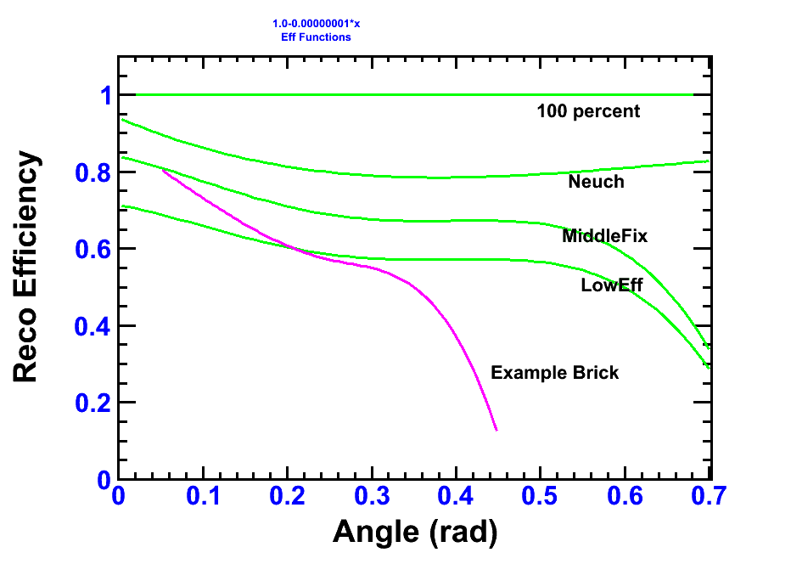
Implemented ScanEfficiencies
Example Brick: Bern 144320, Mic4

Slide 5
Energy: Technical
Get Reconstructed Shower Array
Start Energy Estimation
Retrieve Reconstructed Shower Array, with P() filled.
// Instantate ShowerAlgorithmEnergy Class
EdbShowerAlgESimple* ShowerAlgEnergyInstance = new EdbShowerAlgESimple();
// Run Shower Energy Algorithm on all shower/tracks
ShowerAlgEnergyInstance->DoRun(RecoShowerArray);
// All tracks contain now in P() the estimated energy.

Slide 6
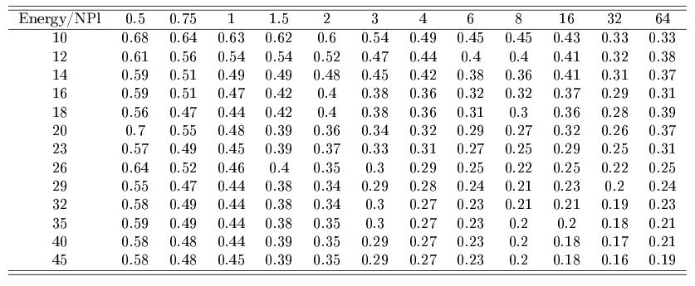
Energy: stat. Results: sigma(E)/E gamma

Slide 7
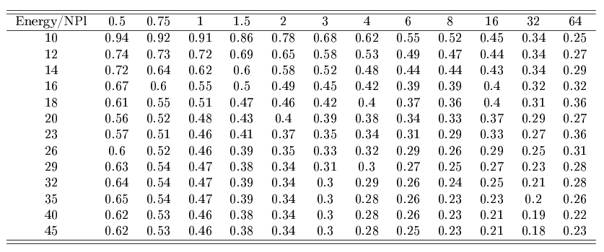
Energy: stat. Results: sigma(E)/E ele

Slide 8
Interpolation
Interpolate energy statistic uncertanties with ROOT Tspline3 class (between energies)
(No interpolation done between plate binnings.)

Slide 9
More here : SYSTEMATICS
Calculating energy gives you stat. AND sys. On the screen. Saved is then the quadratic sum.
  (Attention: at the moment (svn1056) in fedra there is no additional variable to store momentum/energy error of a track/shower. Uncertainty is now only written in shower.root file.)
Different sources have been investigated.
See the following table for an overview.
  (Details will be written up in the thesis, also many plots and tables; explanations will follow here)

Slide 10
 | DEPENDS ON ENERGY ?? | DEPENDS ON NPLATES ?? | E/G IMPACT ?? | PRIORITY | Sample Resolution/E gamma @ 1GeV@20Pl | Sample Resolution/E Electron @ 4GeV@20Pl
FROM THE SCANNING METHOD
EFFICIENCY MISMATCH | YES | YES | NO | HIGH | 0.12 | 0.16
BG LEVEL | YES | YES | YES | HIGH | ? | ?
NPL, Before,After match | YES | YES | NO | MIDDLE | 0.026 | 0.081
DISALIGNMENT | YES | YES | NO | (SKIP) | - | -
FROM THE RECO METHOD
E/G MISMATCH | YES | YES | NO | LOW | 0.04 | 0.03
Shower Alg
FROM THE Multivariate METHOD
N TRAININGS CYLCES | YES | YES | NO | LOW | - | -
N TRAININGS EVENTS | YES | YES | NO | LOW | - | -
TYPE TRAININGS FILE | YES | YES | NO | MIDDLE | - | -
Cycles&Events(File fixed) | YES | YES | NO | LOW | 0.012 | 0.0068
FROM THE MONTE CARLO METHOD
QUALITY CUT | - | - | - | LOW | ? | ?
SHOWER PARAMETRISATION | - | - | - | (SKIP) | - | -
ESTIMATED SUM SYST. (+linear, i.e. Overestimated a bit) |  |  |  |  | <0.33 | <0.4
STATISTICAL |  |  |  |  | 0.48 | 0.38

Slide 11
E: Systematics
Show uncertainties from different sources.
Electrons left, Photons right.
(Tables with full valueset will be put later)
Take Care of different Y-axis scaling!

Slide 12
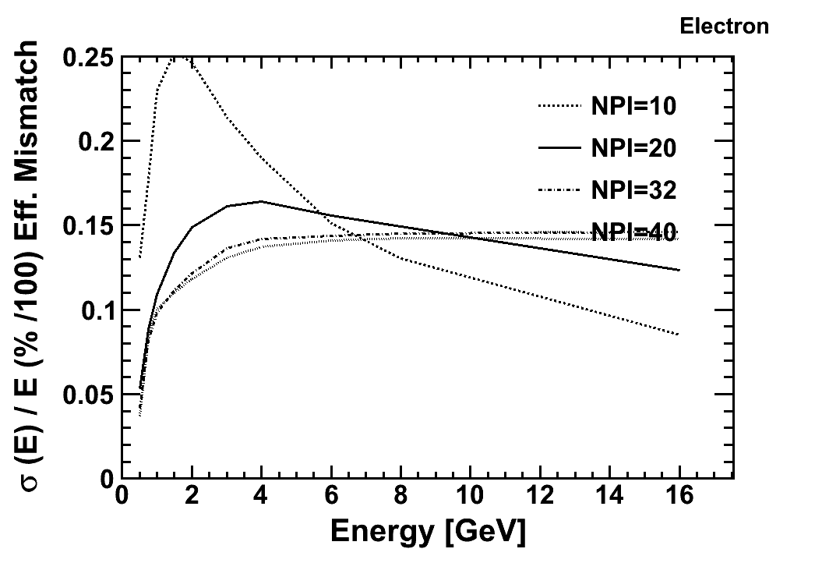
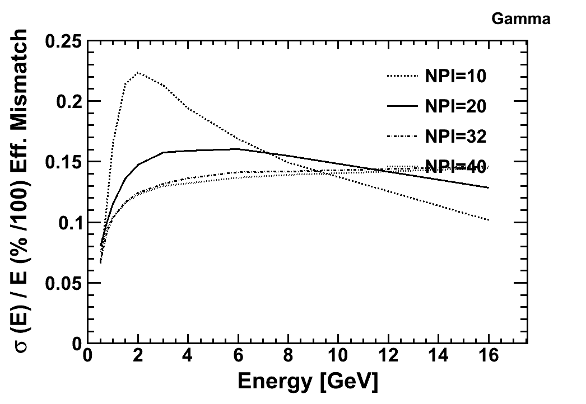
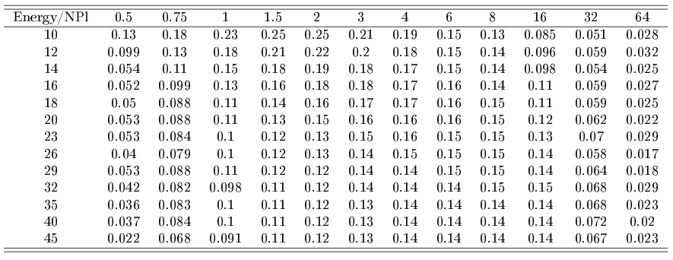
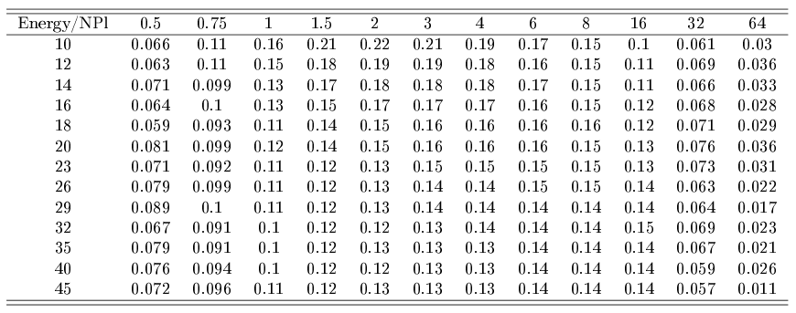
E: Systematics: Eff mismatch

Slide 13
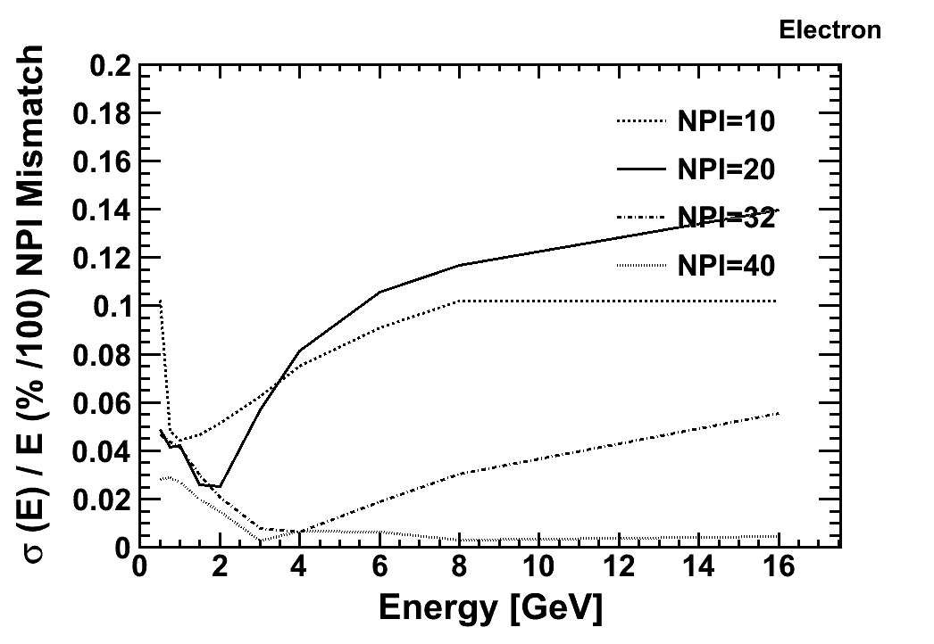
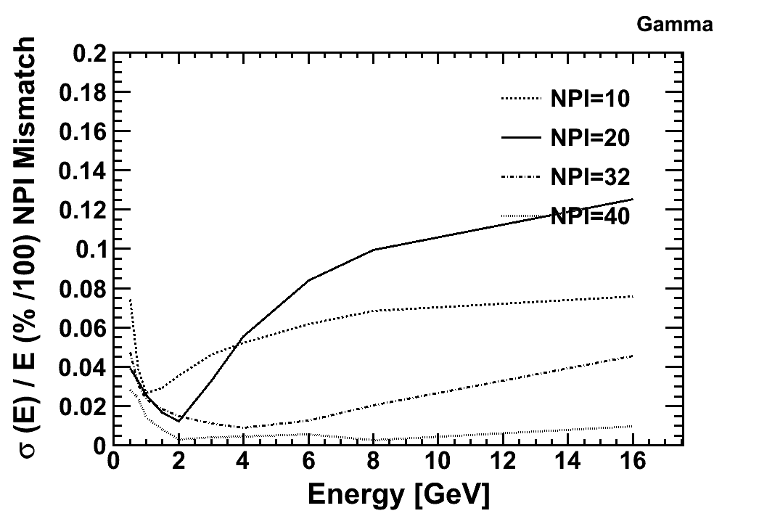
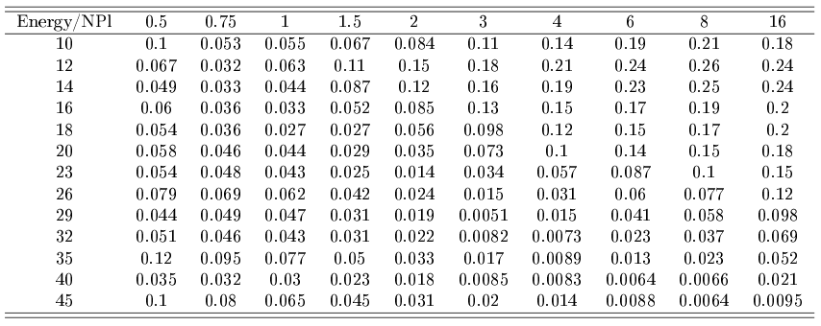
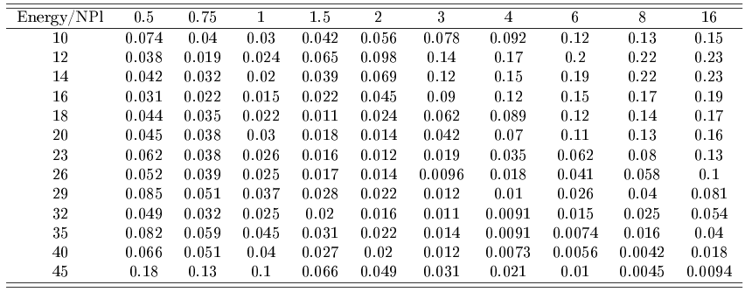
E: Systematics: NPL mismatch

Slide 14
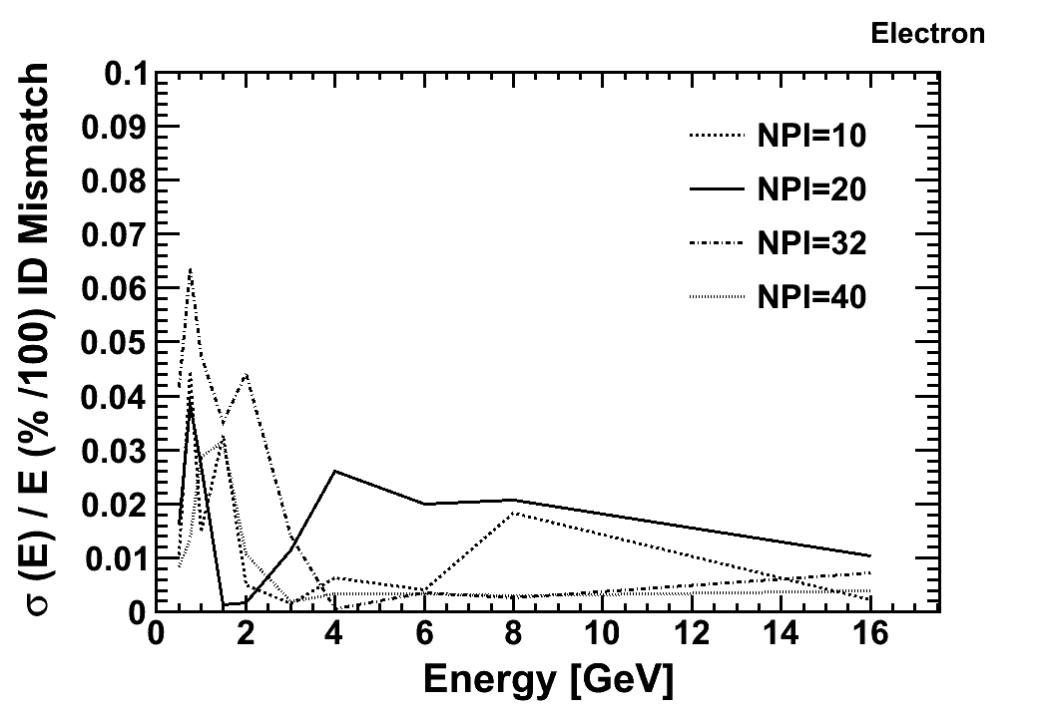
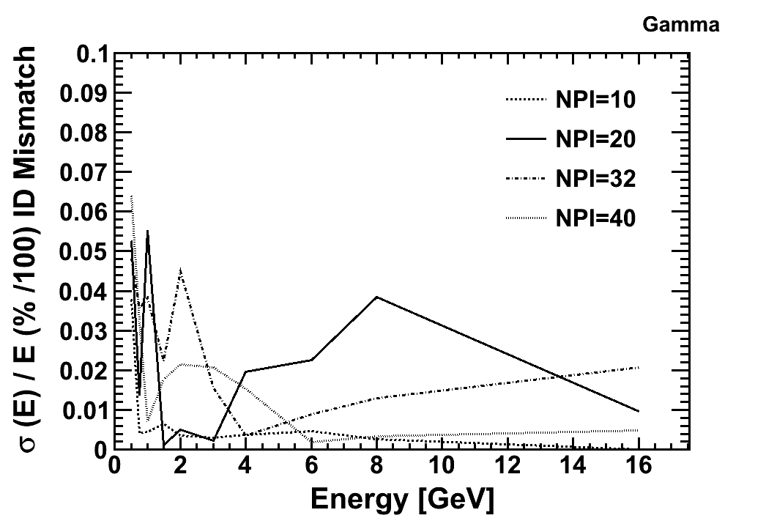
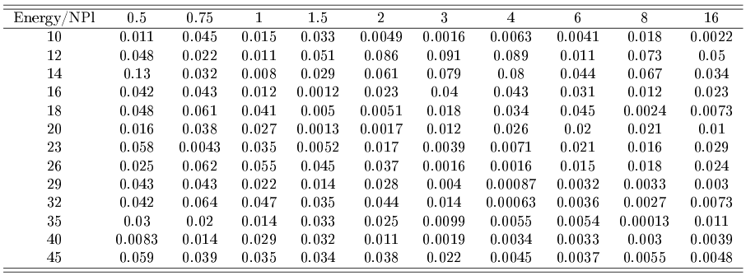
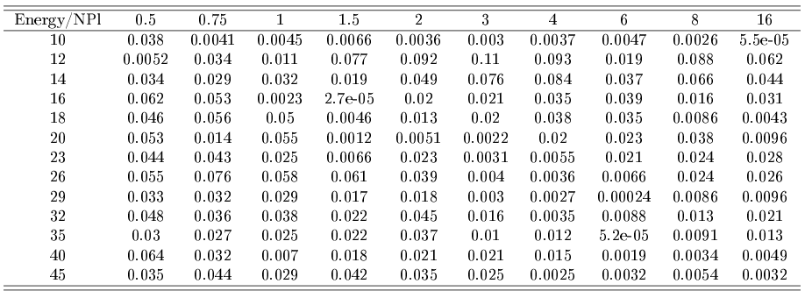
E: Systematics: ID mismatch

Slide 15
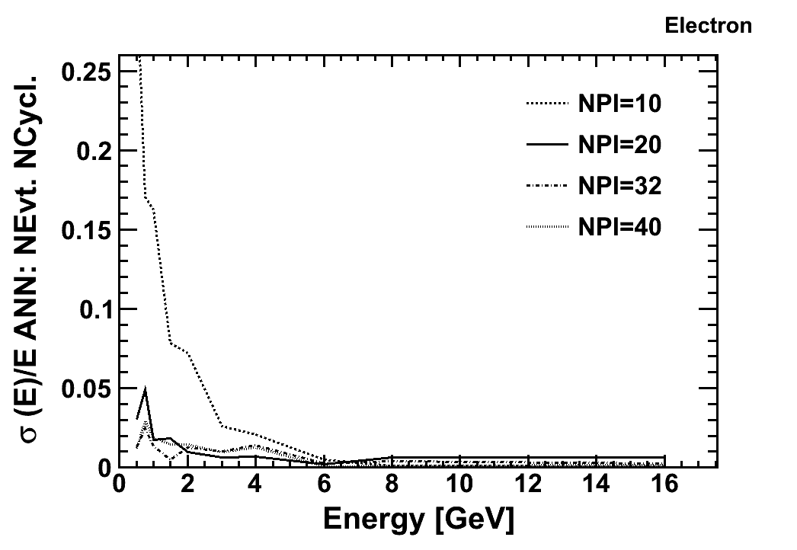
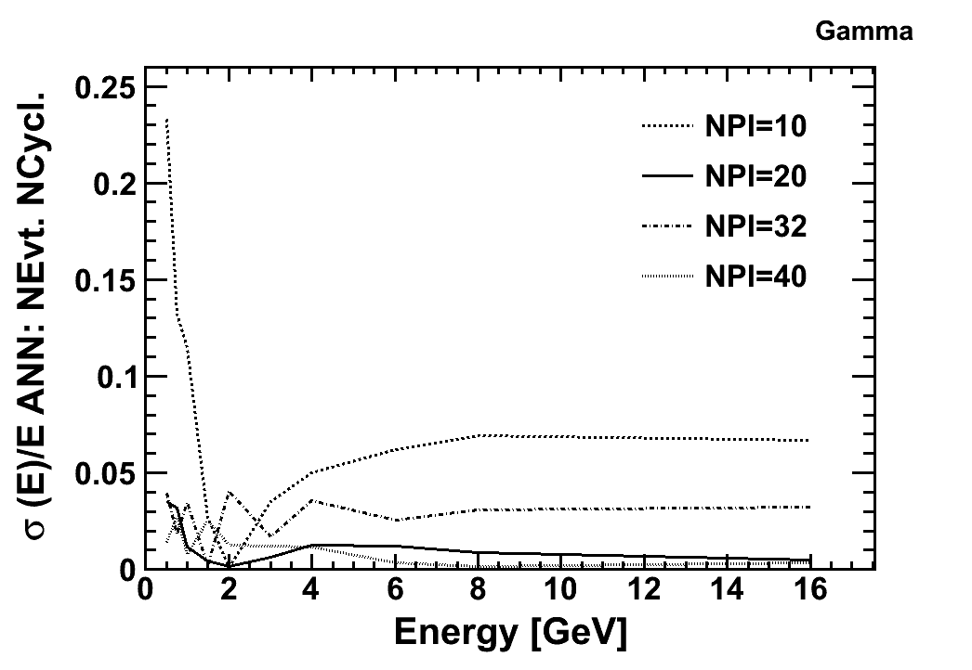
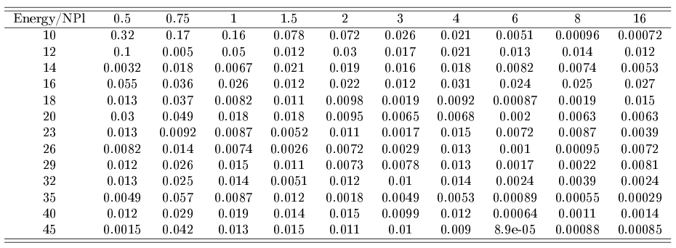
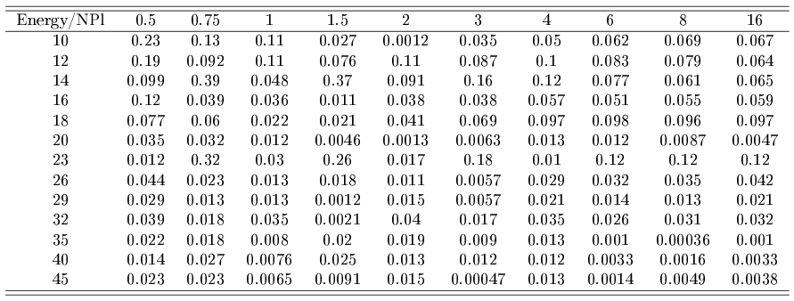
E: Systematics: ANN uncertainty

Slide 16
E: Systematics: Addition
As we know, systematic sources are neither totally independent nor totally dependent...
But to derive an analytical form for the covariance elements is even more impossible in experimental cases (no analytical function to describe the dependencies)
To calculate ALL variations by means of MC estimates would require tooo much computing power.
So tradeoff here: take the sources listed in table and add them
  Quadratically: sigma^sys_tot= QSUM(sigma^sys_i)
  Linear: sigma^sys_tot= LSUM(sigma^sys_i)
„True“ error will be in between....
The more systematic sources considered, the larger the error we get.
We think that the most important we have investigated...

